Slide 1

On-going projects and futur Challenges in the Magnet Section at the Paul Scherrer Institute- an overview
23
International Magnetic Measurement Workshop
6-11 October 2024, Bad Zurzach
Stéphane Sanfilippo Paul Scherrer Institute
Notes:
The aim of this talk is to provide you with an overview of the ongoing projects and future challenges in the PSI magnet section.

Slide 2
Key points discussed
Update of magnet activities and of infrastructure
Magnet measurements for the upgrade of the Swiss Light Source (SLS2.0)- results and lessons learned
High Field Superconducting Magnet activities-an overview
Next challenges:
Magnets for the High Intensity Muon Beam Project (HIMB)
Superconducting Magnets for low consumption in the High Intensity Proton Accelerator
Notes:
2

Slide 3
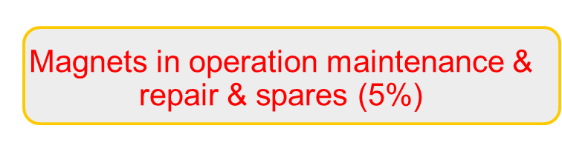
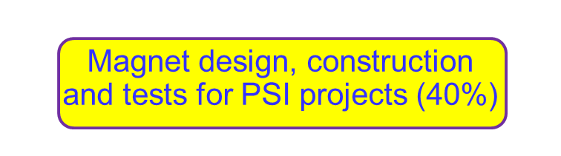

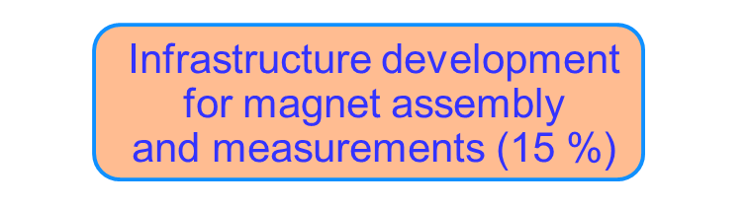
Magnet section mission
R&D on magnet technologies
for Room Temperature and Superconducting Magnets (60%)
  Magnetic design
  CAD design
  Procurement
  Assembly (PM &SC magnets)
  Tests @ 4.2 K and 10 K
  Magnetic measurements
  Maintenance &Repair
  Spare
Page 3

Slide 4
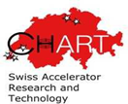
Current activities and projects
Maintenance & repair& replacement of
magnets in operation
High intensity proton accelerator main line
SINQ & muons beam lines
PROSCAN lines + Gantries
Free Electron Laser lines (2)
Magnet procurement for on-going strategic projects
Upgrade of the Swiss Light Source (SLS2.0)
MuH2 and MuH3 High Intensity Muon Beam lines (HIMB-IMPACT)
R&D on superconducting magnets
14T Nb₃Sn and 20 T hybrid magnets for the FCC*
Combined function HTS Short Straight Sections for the FCee injector*
HTS coils for future muon collider magnets*
HTS coils for compact stellarators*
HTS solenoids for FCCee injector studies at PSI*
Advance cyrogenics and LTS/HTS magnets for energy saving program in PSI large research facilities
Fast ramping & low loss magnets for PSI proton
therapy treatment
R&D Measurement techniques
Power tests –SC magnets
Field strength
Field mapping
Multipoles
Magnetic axis
Magnetisation PM magnets
* CHART Program
Growing activities in Superconducting Magnet Technologies
Page 4

Slide 5
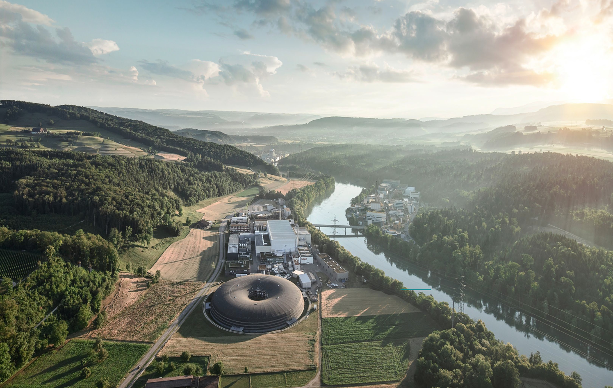
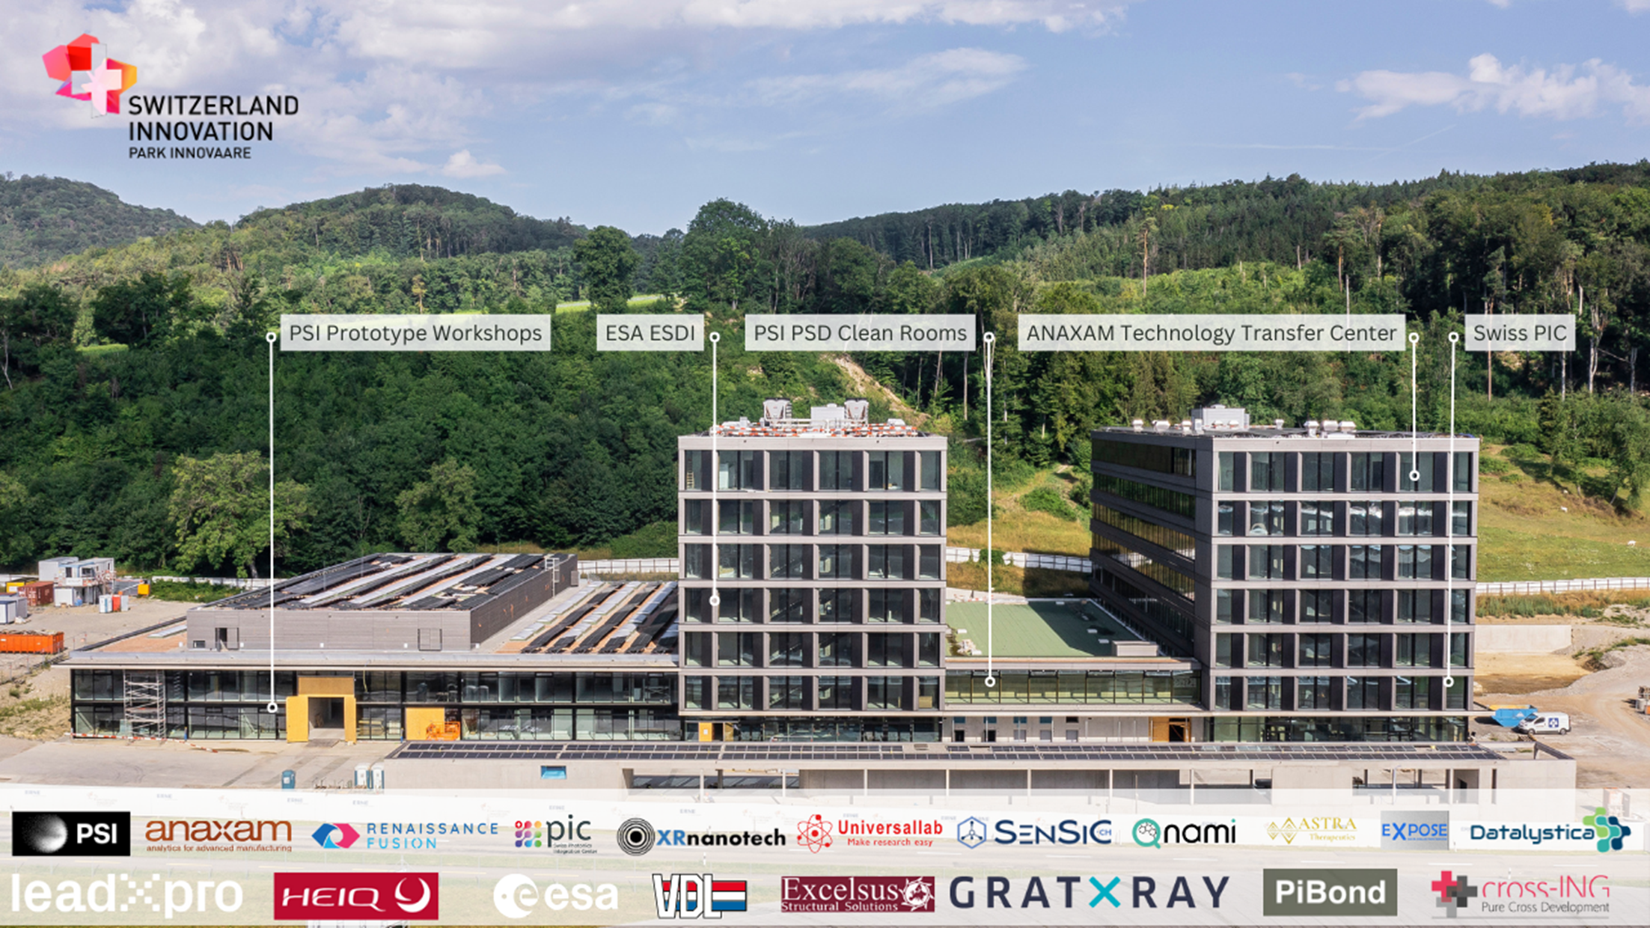



PARK innovAARE –Innovation Park at PSI
gegier@parkinnovaare.ch
23,000 square meters of ground surface
Chemistry, Physics, and Biology Laboratories
Mechanical Workshops
20 companies already installed
Magnet section collaboration with and Proxima Fusion
Notes:
5

Slide 6
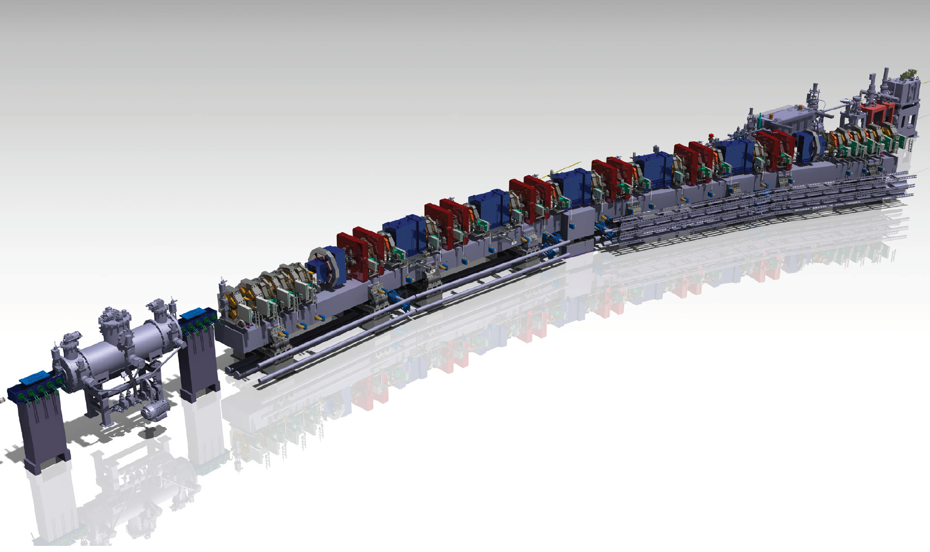
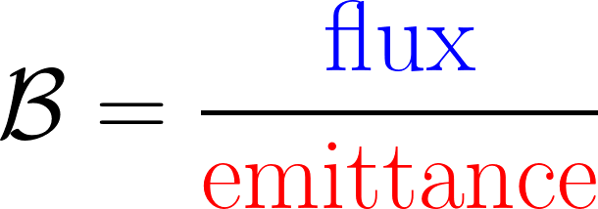
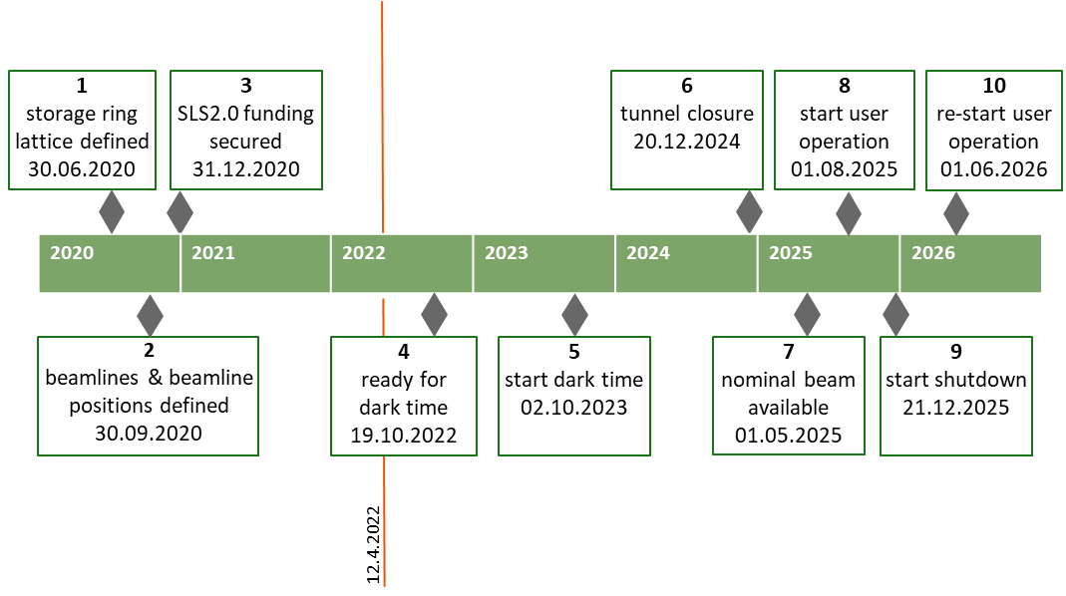
Focus on a strategic PSI project:
The upgrade of the Synchrotron Light Source - SLS2.0 https://www.psi.ch/fr/media/sls-20
x 35
Brilliance
SLS 2.0: ε_{x} = 157 pm.rad
First light: 2025
Phase 1
Phase 2
First beam in 2025

Slide 7
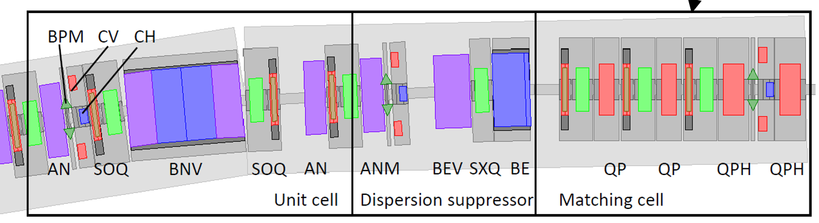
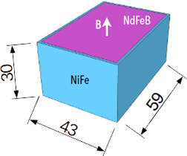
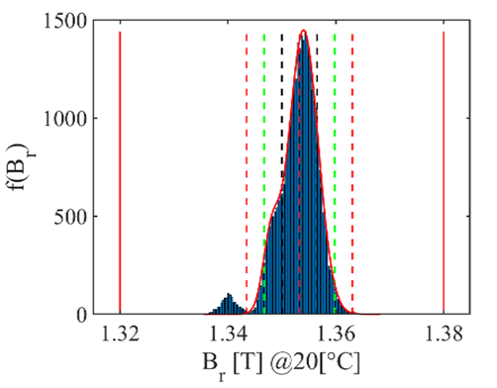
Magnets for the SLS upgrade - last reminder
34 000 NdFeB blocks
16.6 tons
Permanent Magnets
BN 56 Dipole
BS 4 Dipole
VB 96 Quad
VBX 24 Quad
Triplet 60
AN 120 Quad
ANM 24 Quad
BE 24 Dipole
VE 24 Quad
Total : 372
Electromagnets
QP 55 Quad
QPH 53 Quad
SXQ 24 6-Poles
SX 264 6-Poles
OC 264 8-poles
SOQ 264
CHV 112 Steering
Total: 780
1152 (phase 1)+ two 5 T superconducting superbends (phase 2)

Slide 8
SLS2.0 magnets : the production path
In House
Supplier
In House
Electromagnets
Design + CAD
specifications
Magnets manufactured by the supplier
Reception tests & Prototypes &
& 100 % magnetic qualifications at PSI
Permanent Magnets (NdFeB)
few % cross check
(Helmholtz)
Specifications for
NdFeB blocks produced and measured by the supplier
Prototypes & 100 % magnet assembly at PSI
Design + CAD+ specifications
Iron yoke, thermal shunts manufactured by suppliers
100 % Magnetic qualifications at PSI
5 T superbends
Design + specifications
Magnets manufactured by the supplier
Power tests at 4.2 K and magnetic tests at PSI
100 % of Permanent Magnets assembly in house
100 % of magnets magnetically measured at PSI

Slide 9
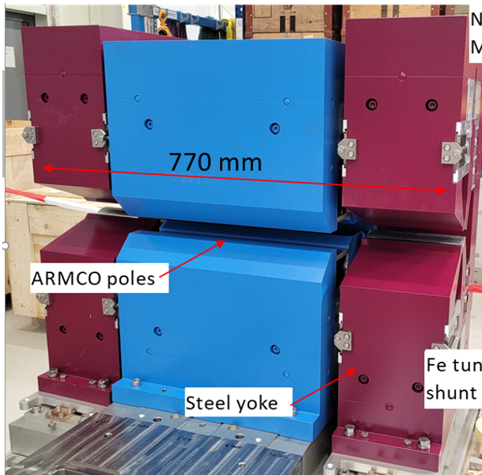
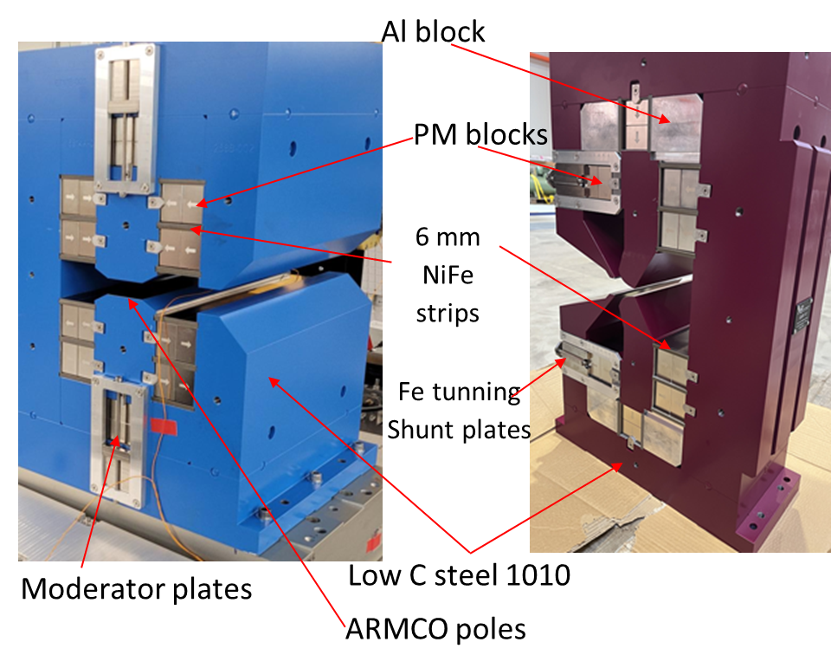
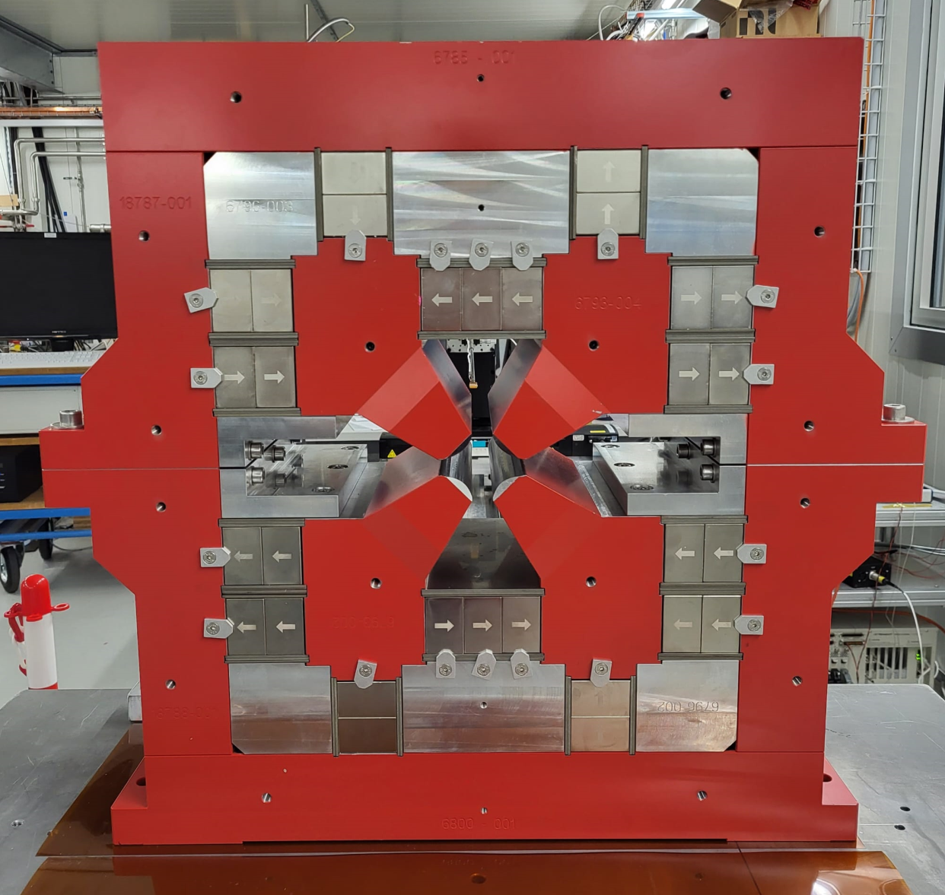
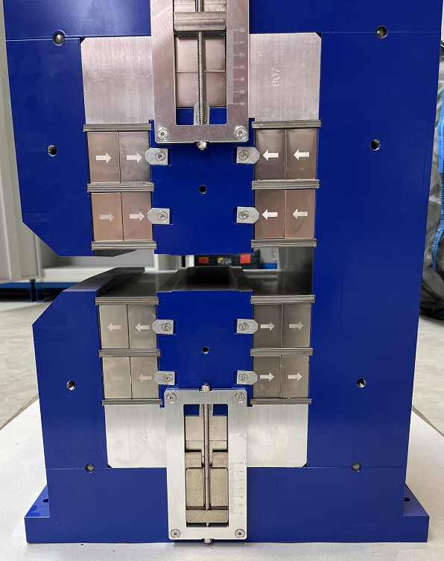
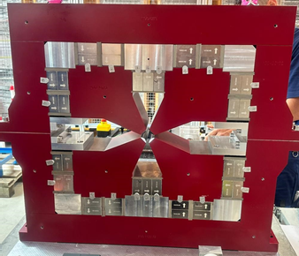
SLS2.0 permanent magnets- last (individual) pictures
Dipole BN (56)
1.35 T; L=405 mm; G=22 mm
VB (120)
0.84 T
40.6 T/m
Triplet VB/BN/VB (60) , 0.861 Tm
Quadrupole AN(M) (148)
72.5-78 T/m ; Ø=22 mm
Quadrupole VE (24)
45.8 T/m; Ø=22 mm
2.1 T Superbend (4)
Gap =14 mm; L=405 mm

Slide 10
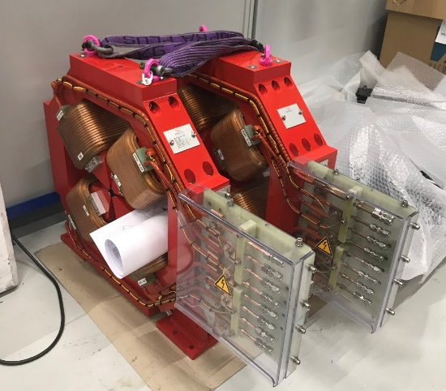
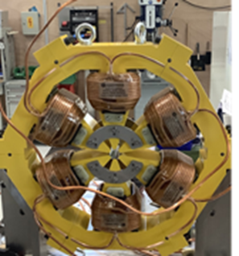
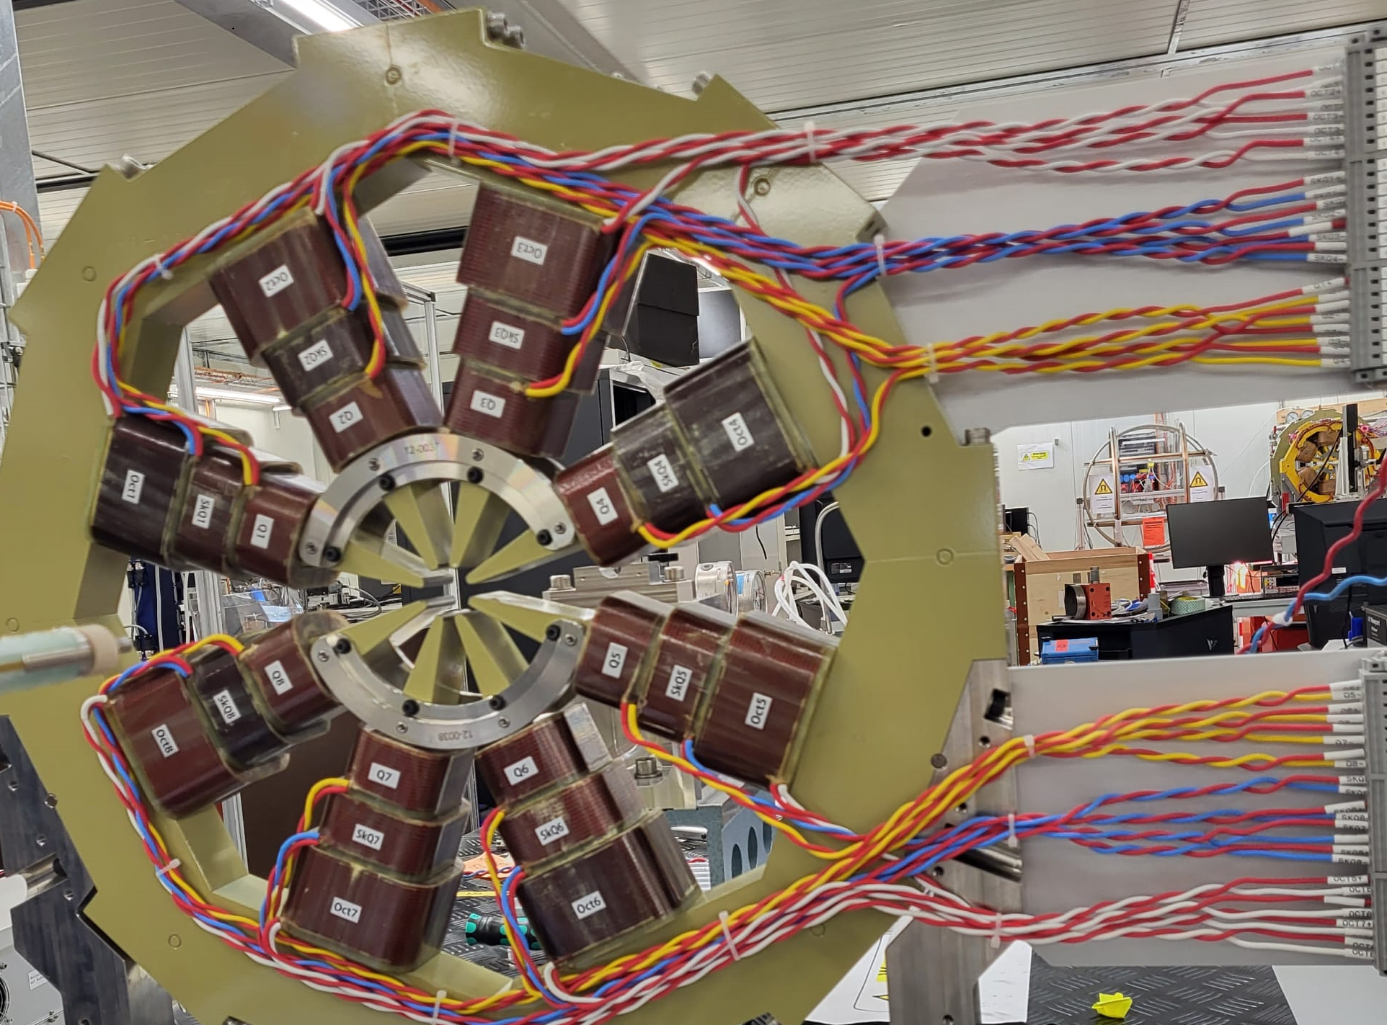
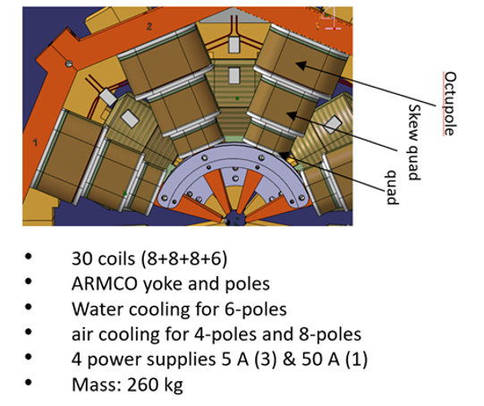
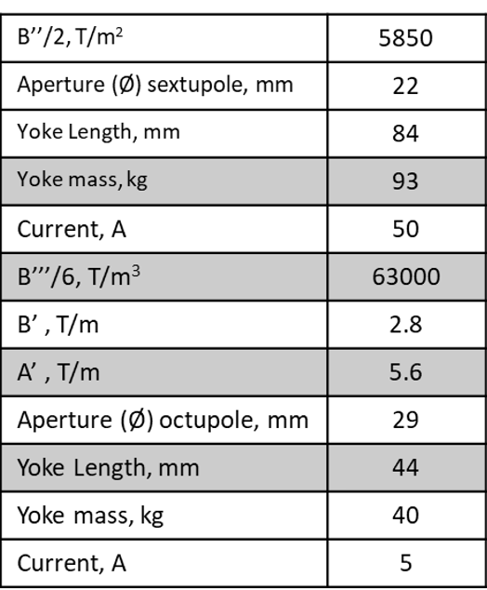
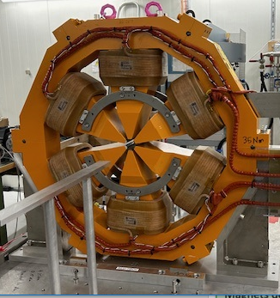
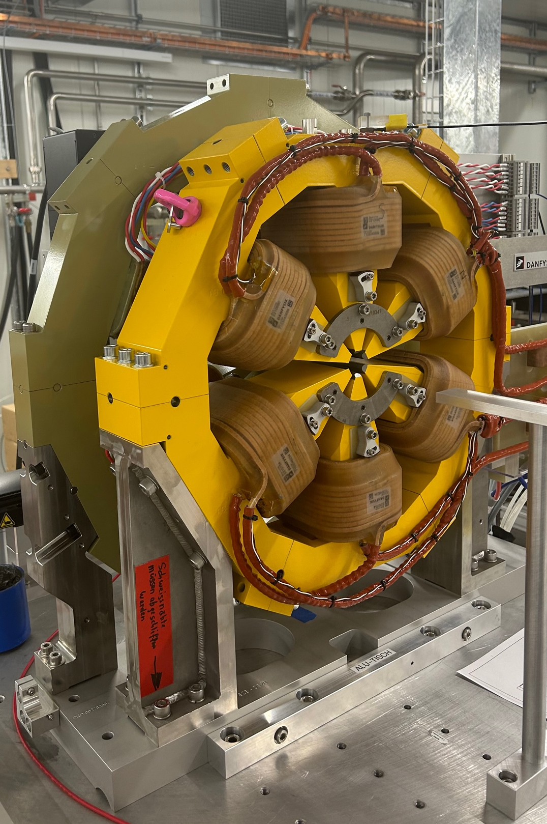
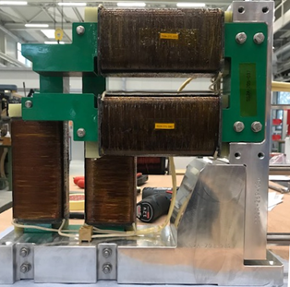
SLS2.0 electromagnets last (individual) pictures
Quadrupoles (110)
93T/m-98 T/m
Ø=21 mm
Sextupoles (288-6 types)
5093T/m²-5840 T/m²
Ø=22 mm
Combined functions
Octupoles (264-2 types)
24 coils
ARMCO yokes and poles
Air cooling
3 power supplies (5 A)
Steerers CH/V
44 mT; 31.4 mT
Sextupoles SXQ (24)
SOQ (264)

Slide 11
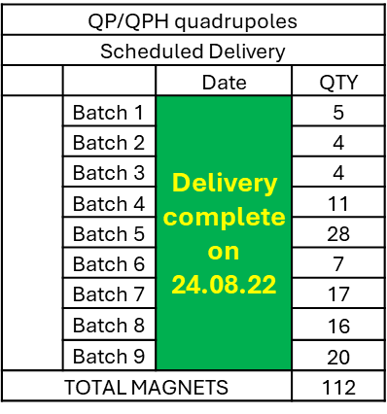
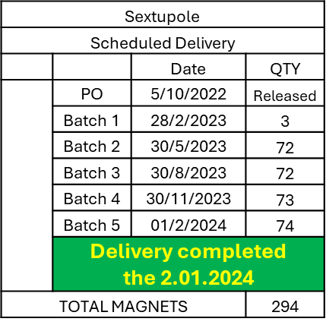
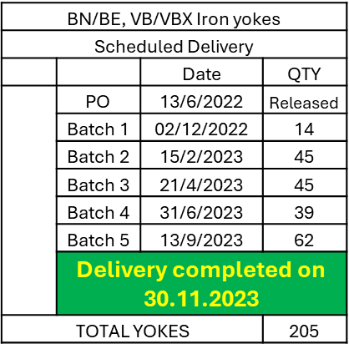
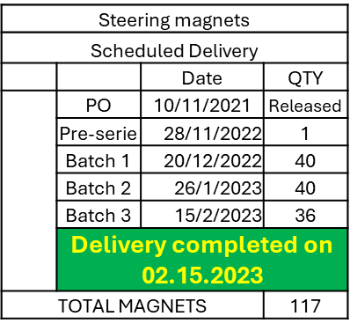
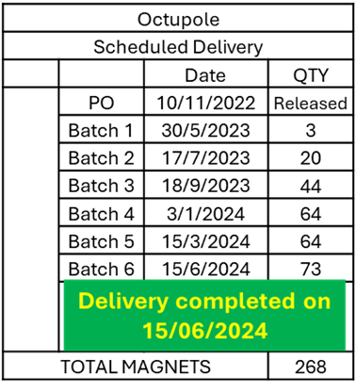
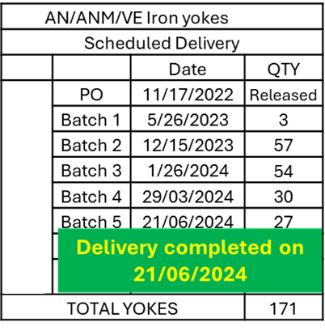



SLS2.0 Magnet & Yoke deliveries and spares
NdFeB blocks (34000)
10000 | 15/9/22
10000 | 15/11/22
14000 | 15/01/23
Completed 15/01/23
Assembled magnet and yokes were delivered on time !
A diligent follow-up of the 7 WTOs

Slide 12

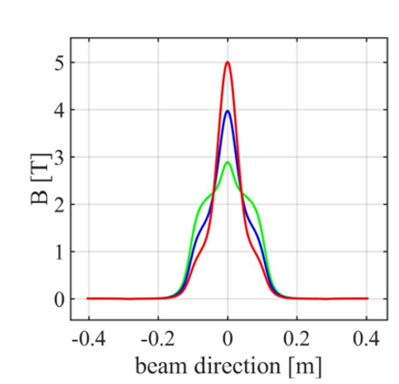
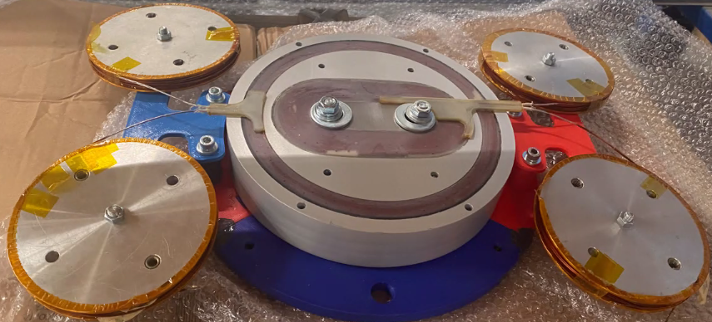
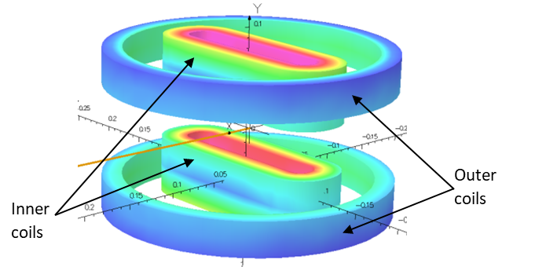
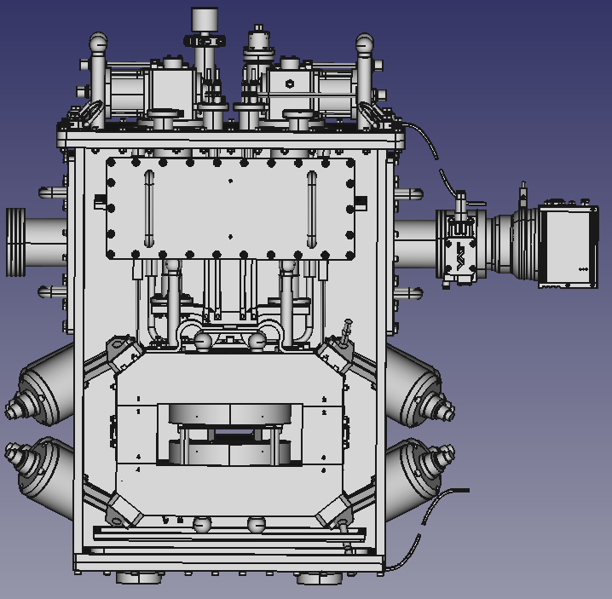
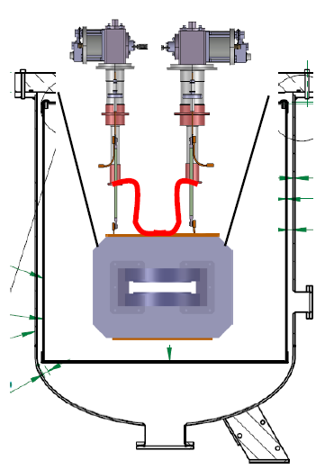
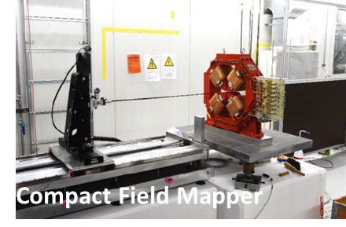
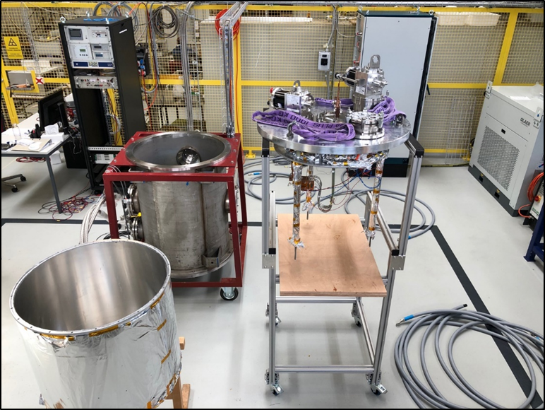
Phase 2: 5T NbTi Superconducting superbend
5T
4T
3T
March 2024
Construction
Drawings ready;
1st coils impregnated
September 2024
Design
2 super VBS
October 2024
Cold mass
Test at Manufacturer
January 2025
1st superbend
At PSI
May 2025
2nd superbend
At PSI
Q1 2026
Superbends
Installation
Dec. 2024 – Jan. 2025
Preparation of the compact fiend map
Feb. 2025
Measurement of the
SCA
Jun. - July 2025
Measurement of SCB
Installation of SCB 1&2 planed in 2026

Slide 13
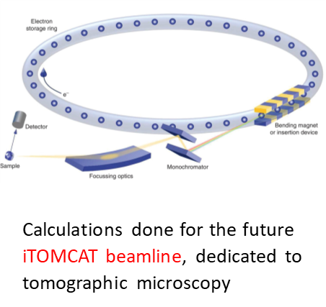
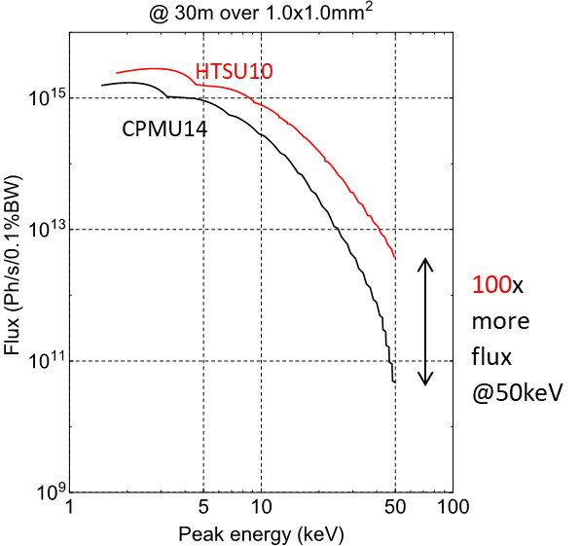
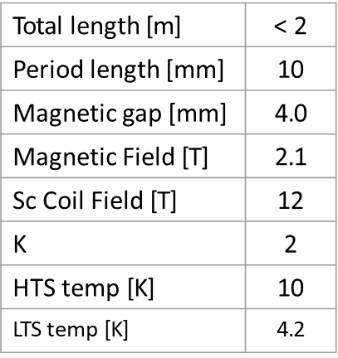
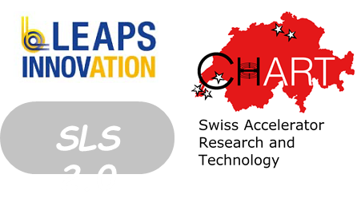

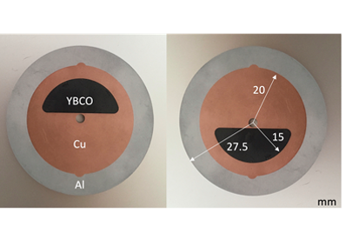
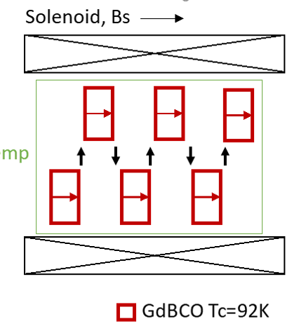
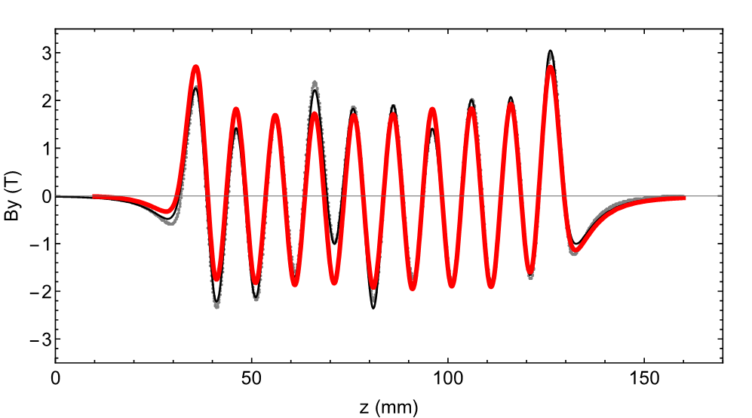
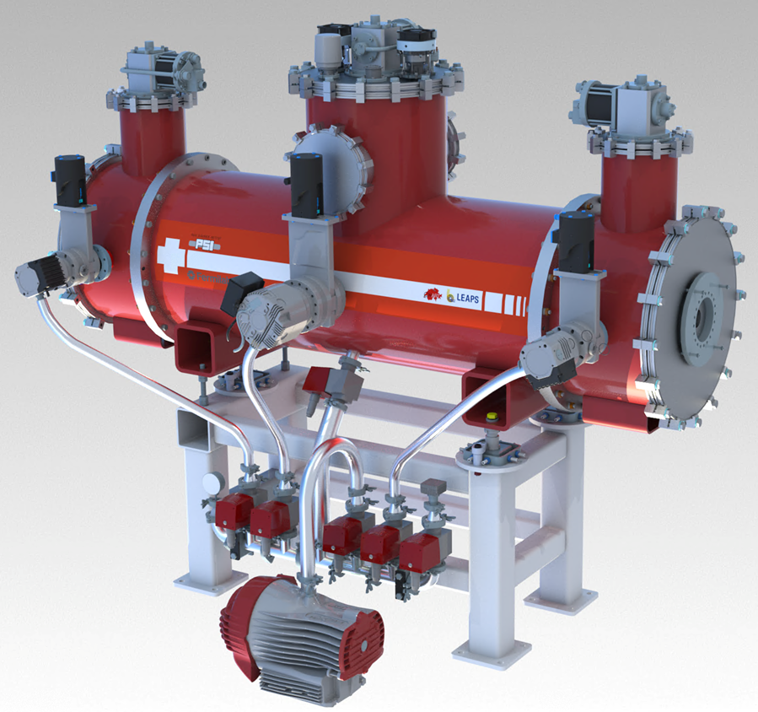
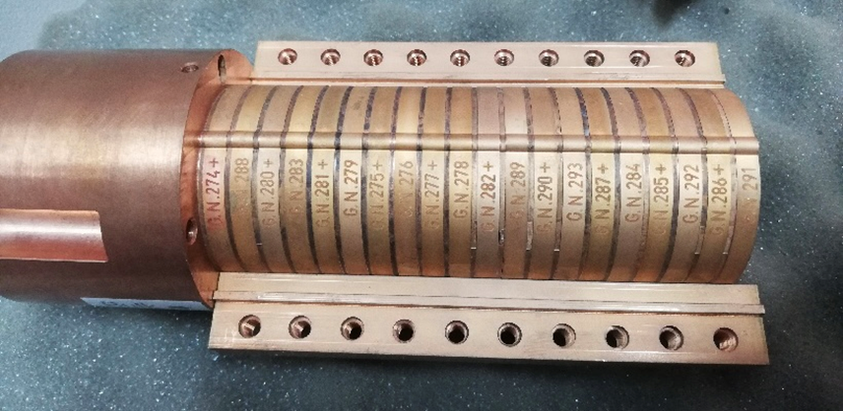
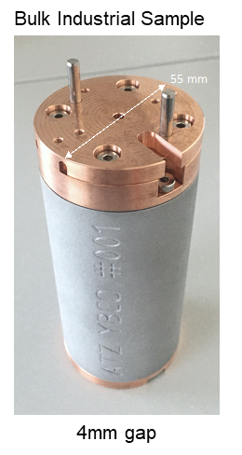
Phase 2 : HTS Bulk Undulator (2026)
Marco Calvi with the Insertion Device Group
Contribution from A. Arsenault
Bulk HTS sample : Cambridge
Ø : 30 mm; Thickness : 4 mm
10 mm period, 4 mm gap, 2 T
Tmag~10 K
Nb₃Sn solenoid (10T): Fermilab
B (z) for a prototype
(FC @ 10T to 0)

Slide 14
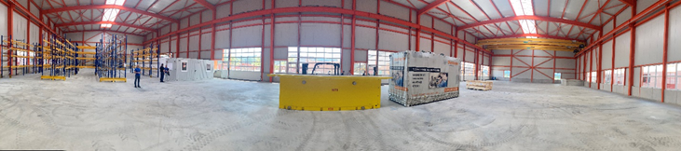
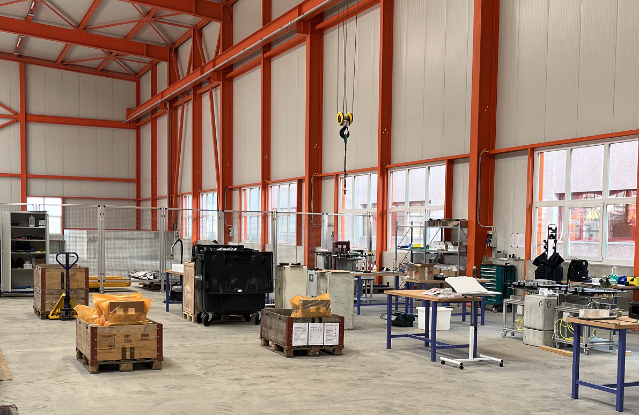



SLS2.0 Permanent Magnets Assembly in PSI
Challenge: Assembly of the 372 Permanent Magnets by PSI staff !
Magnet Section working place
ELMA SLS2.0 Assembly facility
Reception & Storage
PM blocks and measured magnets
PM assembly
two semi-automatic machine
All the magnets are assembled
Up to 4 magnets / day

Slide 15





















Infrastructure for SLS2.0 magnets:
Magnetic Measurement Lab
Field Mapper
Field Mapper
Vibrating Wires
Vibrating Wires
Moving Wires
Moving Wires
Rot. Coils
Seven magnetic measurement benches are operational
since september 2023
Assembly & Measurement
& Support teams for SLS2.0 in 2024 ~ 22 people

Slide 16



Test stand for superconducting magnets cooled with cryocoolers
Projects : SLS2.0 Superbends & HTS; PhP; P^3, HTS4…..
michal.duda@psi.ch
1: Cryostat
Thermal radiation shield
Vacuum pumps
3 Cryocoolers (RDK-415D/418D and RDK-500B)
2: Test setup for superconducting HTS and LTS coils
RRR, T_{C} and th. cond. test
NI HTS coils test (18.2 T)
3: Electronic rack
vacuum control/monitoring
temperature control/monitoring (16 Cernox/ Pt1000 sensors, PID controller)
voltage signals recording (2 nanovolt/64 high precision/64 fast sampling channels )
quench detection system (CERN uQDS with PSI modification)
4: Test setup for cryogenic pulsating heat pipes (PHP)
10 and 20 tube neon PHP (with VDL ETG)
5: 2 kA $±$ 10V power converter
6: Quench protection
mechanical switch (~4 ms ) with varistor

Slide 17
SLS2.0 Magnet qualification
Challenge : 100 % of magnets are measured at PSI
7 measuring test benches operational since September 2023
Systems ( X benches) | Electro magnets | Permanent Magnets | 3-5T superbend
Rotating coils (2) | Field Strength Multipoles | Field Strength Multipoles Magnetic axis
Moving Wires (2) | Magnetic axis (reference magnet) | Triplet: Field Strength alignment
Vibrating Wires (2) | Magnetic Axis (SOQ)
3D Field Mapper | Field Strength & Maps (cross talk) | Field Strength & Maps ( BE & cross talk) | Field Strength Maps
Accuracy (wire) : 1-2 units
Reproduciblity : 1 unit
Axis : < 30 micrometers
Integrated Field Strength | Moving Wire | Rotating Coil | Compact Field Mapper
Uncertainty vs ref. (units) | Reference | <5 units | ~10 units
Reliable and accurate measurement systems

Slide 18



Cumulative magnet measurements
No sleep till October 2024 but……We made it !
All magnets delivered
except last triplets
70 magnets / month
7 benches
From September 2023 : all the 7 magnetic measurement benches operational
………Measurements completed end of October 2024 (6 triplets to be measured)

Slide 19









Magnetic measurements results (phase 1)
Sextupoles &Octupoles axis measurement
with vibrating wires:
Contribution M. Aiba
Field Quality and Field Integral tuning
with Rotating Coils:
Contribution C. Zoller
Triplet measurements and alignment
with Moving Wires
Contribution G. Montenero
Magnetic coupling studies with Hall mapper
Contribution R. Riccioli

Slide 20


SLS upgrade-the progress
03.10.2023
28.11.2023
07.03.2024
September 2024
Dark time start
End of dismantling
Installation Start
Arcs
Visit of the SLS2.0 storage ring on Wednesday
Courtesy Romain Ganter

Slide 21
SLS2.0 with permanent magnets:
Lessons learned
Characterize all the material used for the fabrication : permeability, hysteresis, also at various temperatures→ minimize discrepancies calculated vs. measured values (specialized companies? Lab consortium?)
Include in the magnet design phase and the measurement time plan the magnetic coupling measurements of most sensitive sub-sets of machine magnets assemblies
Perform the commissioning of all the test benches with pre-series magnets and not during the series
Do not under-estimate the number of test benches: the magnetic measurement equipment and the delivery plan are coupled with the installation plan in the machine and the complexity of the measurements (upgrade from 5 → 7 benches in 2022)
Include the impact of neighboring magnetic components in the field integral tunning
Careful follow up of the logistics (assembly pieces, thermal shunts, moderator plates…) and the safety issues

Slide 22














R&D on very high field magnet technologies - CHART
mike.seidel@psi.ch
“CHART, the Swiss Center for Accelerator Research and Technology, was founded to support the future oriented accelerator project Future Circular Collider (FCC) at CERN and the development of advanced accelerator concepts in Switzerland beyond the existing technology. […] The high field magnet R&D has strong synergies with PSI projects […]”
[Application for support of the Swiss Accelerator Research and Technology Initiative, 2018]
Funded in 2016 as umbrella organization for accelerator research in switzerland
support FCC and develop future accelerator technologies
co-funded by CERN, PSI, ETHZ, EPFL and University of Geneva
Support of the State Secretariat
for Education and the ETH Board
Home Institut : PSI
PSI : High field magnet technology and demonstrator design and construction
http://chart.ch

Slide 23





CHART activities at PSI
bernhard.auchmann@psi.ch
Technologies & demonstrators of High Field Magnets
Magnet design
R&D in LTS and HTS materials (key technologies)
Coil winding and magnet assembly
Infrastructure for LTS and HTS magnet assembly and test
Synergies with technological development for Large Research Facilities at PSI
B. Auchmann
https://chart.ch/psi/

Slide 24







Achievements since 2018 : MagDev Laboratory
Visit on Wednesday
3: Thermal Treatment
Argon-furnace (2-m-long coils)
Research tubular furnace
    1-m-long, 14 cm diam.
    Quartz tube, vacuum or gas
    atmosphere up to 1100ºC
HTS
4: Chemistery workplace
Spray-coating equipment.
Ultrasonic cleaning
Diamond wire saw.
Polishing equipment.
Optical microscope
5: Impregnation tools
Vacuum-impregnation vessel for 1-m-long coils, vertical impregnation.
Autoclave for 2-m-long coils, horizontal impregnation.
250ºC, 10 bar.
Mixing, degassing set-up
Box oven for wax crystallization / epoxy curing
LTS
1: Magn. & Mech & CAD
Design (7 mobile desks)
6: Assembly tables
Loading, welding
Instrumentation
3D scanning metrology
2: HTS & LTS coil
manufacturing workplace
2 winding machines

Slide 25










Selected achievements
since 2018 (2)
LTS Powered Samples BOX:
BOnding eXperiment (2019-2022)
Sextupole demonstrator, cosine-theta type with HTS coils
for energy-efficient FCC-ee
And many mores at :
https://chart.ch/chart-projects/ ….

Slide 26




Next challenges
(2025-2030)
SMILE
Proposal
End of 2024
Project IMPACT
SMILE : Superconducting Magnets
Improving Large research facility Efficiency

Slide 27



HIPA Upgrade : magnets for the IMPACT Project
https://www.dora.lib4ri.ch/psi/islandora/object/psi%3A41209
IMPACT = Isotope and Muon Production using Advanced-Cyclotron and Target Technologies
SINQ
TgE
MuH3
TgH
UCN
RING
MuH2
TATTOOS
HIMB : High Intensity Muon Beam Line ( flux X 100)-2 lines (2027)
TATTOOS: Radionucleïde for cancer therapy and diagnostics
(^{149/152} Tb,¹⁶⁵ Er, ¹⁷⁵Yb,…..)- 2029
~ 100 people from 5 PSI divisions are involved
9 subprojects and 35 working groups

Slide 28


HIMB magnets status overview
"Magnet designs for the High-Intensity Muon Beams Project (HIMB) at PSI's Accelerator Complex HIPA"
R. Riccioli et al., IEEE Transactions on Applied Superconductivity (2024)
Magnet caracteristics
Large aperture solenoids (diameter~0.5 m)
Resistive magnets-first option
Radiation hard conductors
Field quality specs (0.1 % of uncertainty)
Magnetic axis measurements?

Slide 29





Superconducting magnets in PSI large Research Facilities: context
The PSI
SLS2.0 2.4->2.7 GeV (2025)
IMPACT- HIMB (2027)
5 large-scale research facilities: the Swiss Spallation Neutron Source (SINQ), the Swiss Synchrotron Light Source (SLS), the Swiss Muon Source (SμS), the X-ray Free Electron Laser (SwissFEL) and Proton Therapy center with 2 upgrades (SLS2.0 and HIMB)-1384 Magnets

Slide 30



Approach for an energy transition of PSI magnets
Low field, high density of magnets & low radiation (Light sources) → permanent magnets
Moderate/high fields & high consumption magnets in highly radiative environment (proton accelerator) → cryogen free superconducting magnets
Normal condutors
Omitting resistive loss
LTS
Lowering cooling cost
Higher magnetic fields
From Samira Fatehi, KIT, Germany
HTS
Aspects to consider :
Economical study (capital cost, power consumption,CO₂…)
Operating conditions (Field and Thermal budget -incl. beam deposited energy)
Radiation damages on superconductor and insulation

Slide 31




Power consumption management for the upgrades
SLS 2.0 and High Intensity Proton Accelerator
Power economy SLS2.0 vs. original SLS (2019-2024)
More radiated X ray power for users (2.4 GeV→2.7 GeV)
Less electricity consumption:
30 % of electricity reduction (24 W→17 kW)
Key Savings: Electromagnets → Permanent magnets
Klystrons → Solid state amplifiers
standard pumps → modern pumps for cooling
372 permanent magnets (one third)
reduction of 60 % of the magnet consumption
High Intensity Proton Accelerator (SMILE project 2025-?)
Required for the proton beam : 7.8 MW
350 resistive magnets in operation: 34 % power consumption (2.6 MW)
On going upgrade → increase power consumption
Magnets in operation (future replacement):
Study : High power consumption dipole in Operation AHO →Cryogen-free SC one collaboration with LASA Milano

Slide 32
SMILE : Superconducting Magnets
Improving Large research facility Efficiency
Implement cost-efficient and sustainable superconducting magnets in PSI's large-scale facilities: High-Intensity Proton Accelerator and PROSCAN (proton therapy)
Work-packages (numerical & experimental aspects & technology development)
DC Magnet design & construction (including radiation impact on HTS conductor)
AC Magnet design and production using selected low loss superconductors
Advance cryogenics study and implementation (Pulsating heat Pipes, efficient cyrocoolers…)
Possible external partners (Institutions and companies)
University Alma Matter Bologna- AC losses numerical studies
CERN (cryostats for AC losses conductor studies)
Politechnico di Torino- radiation effects calculation and experimental tests
LASA UNI Milano – Magnet design
University of Aix Marseille – numerical calculation on PhP mechanisms
VDL company- Pulsating heat Pipes development
  Program in preparation (not approved yet) – submitted to the PSI direction at the end of 2024
Notes:
Few words about the program SMILE Superconducting Magnets Improving Large research facility Efficiency
The aim is Implement cost-efficient and sustainable superconducting magnets in PSI's large-scale facilities: High-Intensity Proton Accelerator and PROSCAN (proton therapy)
Several directions are considered in parallel
DC Magnet design & construction (including radiation impact on HTS conductor)
AC Magnet design and production using selected low loss superconductors
Advance cryogenics study and implementation
Possible partners were already identified:
University Alma Matter Bologna- AC losses numerical studies
Politechnico di Torino- radiation effects calculation and experimental tests
LASA UNI Milano – Magnet design
University of Aix Marseille – numerical calculation on PhP mechanisms
VDL company- Pulsating heat Pipes development
This program with the soles of wind is not approved yet. It will be submitted to the PSI direction end of this years

Slide 33
Summary
The production and measurement of a massive number of magnets for the SLS upgrade Phase 1 were successful, and the magnet production for Phase 2 is currently ongoing.
A tremendous effort was made to develop the infrastructure and parallelize magnetic measurements to comply with the specifications and meet the tight schedule.
This project required meticulous planning and coordination, and a number of valuable lessons were drawn from this extraordinary scientific and human experience.
As we move forward, the development of technologies for the design, assembly, and testing of superconducting magnets is becoming an increasingly significant part of our activities.
Future challenges we are focusing on include the development of high-field, compact, low-consumption, and sustainable magnets.
Bright prospects are on the horizon, particularly through our collaboration with our partners at Park Innovaare.

Slide 34





Join the magnet section
18 T@10 K with 4 NI HTS coils
Training of the team
for rotating coils
Celebrating the Nb₃S_{n} Subscale
Successful measurement of
Sextupoles Octupoles axis
Installation of a triplet
Dedication, Setbacks, Unexpected Turns, Achievements, and…. Challenges
Thank you for your attention

Slide 35
Additional slides

Slide 36







5 T superbends- phase 2 (2026)
2 superconducting dipoles to provide hard X-rays
at two beam lines
Operating fields between 3 T and 5 T
2 pairs of Nb-Ti coils (racetrack, solenoid)
Close yoke with soldered vacuum chamber
SC test coils in Fall 2024
Magnet delivery (Jan-June 2025)
Power and Magnetic tests (Hall Mapper) in 2025
Notes:
This slide describe the mechanical structure :
Cold Mass Components
Ferromagnetic Core Parts: The core structural elements that contribute to the magnetic field configuration.
Four Superconducting Coils: Made of Nb-Ti, arranged in a pancake geometry to produce the required magnetic field.
Reservoir of Liquefied Helium: Mounted on top of the magnetic core assembly to maintain the superconducting state of the coils.
Support Structure
Suspension Straps:
Material: Made of reinforced glass-fiber composites or similar materials, offering high mechanical strength and reduced thermal conductivity.
Placement: Eight suspension straps are used to suspend the full weight of the cold mass inside the mechanical frame of the cryostat.
Intermediate Thermal Connection: The straps are thermally connected to the heat shield at approximately 60 K to reduce heat flow to the 4.5 K level.
Diagonal Placement: Ensures mechanical strength for positioning the cold mass and allows for longer straps with lower thermal conductivity. The diagonal placement also enables precise adjustment of the magnetic core assembly relative to the cryostat.
Cooling System
Cryocoolers:
Type: Two SUMITOMO cryocoolers (RDK-415D).
Stages:
First Stage: Provides 45 W cooling power at 50 K.
Second Stage: Provides 1.5 W cooling power at 4.2 K.
Installation: Cryocoolers are inserted into flanges on top of the cryostat and are mechanically fixed.
Connections: The first stage of both cryocoolers is connected to the top of the thermal shield via flexible copper braids.
Cooling Requirements: Necessary for cooling the intermediate temperature section of the current leads and the radiation shield.
Additional Details
Maintenance: The cryocoolers have a specified maintenance interval of 10,000 hours.
Power Consumption: Between 6.5 and 9.2 k

Slide 37



Phase 2: 5 T superconducting superbend
ciro.calzolaio@psi.ch
Conduction cooled concept (2 cryocoolers)
2 pairs NbTi coils (racetrack, solenoidal)
Two 200 A power supplies to adjust current (field)
T_{op}~4.5 K
2 HTS -110 current leads (500 A@64K)
ARMCO yoke (close geometry)
Beam pipe included in the magnet assembly
5T
4T
3T
 | Main magnet components
1 | 2 cryocolers RDK-415D
2 | Thermal connections
3 | Current leads (Cu+HTS)
4 | Suspension straps
5 | Armco Yoke
6 | Vacuum chamber
7 | Pair of NbTi coils inside the Al precompression ring
3
1
2
7
4
5
6
Cold mass
Cryogenic power tests and magnetic measurements @ PSI in a dedicated test stand
Notes:
Finally the design of the SC superbend with operating field at 4 and 5 T in the middle of the beam path direction.
It is composed of two NbTi racetrack coils per pole surrounde by a pre compression ring and inserted in a close ARMCO yoke .
Two power supplies are used to adjeust the field integral between the two coils.
The cooling at 4.2 K is provide by two cryocoolers

Slide 38

Example : Impact of the vacuum pump
PM Quadrupole
Vacuum pump
(ferrite magnets)
Reduction of 0.3 % of the Field Integral
Vertical shift of the magnetic axis position by 60 micrometers

Slide 39

Practical example: High Intensity Muon Beam project:
Estimated Magnet Consumption (MuH2&3)
Location | Magnet | Number of magnets | Power per magnet | Total power
MuH2 | Capture Solenoid | 1 | 142.5 kW | 142.5 kW
 | Dipole | 1 | 3.2 kW | 3.2 kW
 | Transport Solenoid (A-B) | 3 | 37.5 kW | 112.5 kW
 | Dipole | 1 | 2.4 kW | 2.4 kW
 | Transport Solenoid (C) | 6 | 17.9 kW | 107.4 kW
 | Separator | 2 | 0.45 kW | 0.91 kW
MuH3 | Capture Solenoid | 1 | 142.5 kW | 142.5 kW
 | Dipole | 1 | 2.3 kW | 2.3 kW
 | Transport Solenoid (A-B) | 2 | 35.5 kW | 71 kW
 | Dipole | 2 | 3.1 kW | 6.2 kW
 | Transport Solenoid (C) | 2 | 15.4 kW | 30.8 kW
General | Other magnets | 2 | 5 kW | 10 kW
 | Cable resistance | 3%
TOTAL |  |  |  | 632 kW
Power consumption goes from 120 kW to 632 kW of the new lines
1) Capture solenoid : Superconducting HTS tentative not successful because of lack of space for thick radiation shields
2) Second choice: transport solenoids (13 in the two lines positions A,B,C)
Study for a NbTi (and HTS) superconducting option
Notes:
This slide presents an estimate of the power consumption of magnets used in the High Intensity Muon Beam (HIMB) project, specifically focusing on the MuH2 and MuH3 beamlines.
It provides a breakdown of the different types of magnets, their quantity, individual power consumption, and total power consumption for each beamline.
Magnet Types:
Capture Solenoid: These are the highest power-consuming magnets, with each solenoid in MuH2 and MuH3 consuming 142.5 kW.
r.h. Dipole and Solenoid: These refer to radiation-hard dipoles and solenoids. In MuH2, the r.h. Solenoid consumes 37.5 kW per unit, while in MuH3, it consumes 35.5 kW per unit.
Normal Dipole and Solenoid: These are standard magnets with lower power consumption. For instance, the normal solenoids in MuH2 consume 17.9 kW each, totaling 125.3 kW for seven units, while those in MuH3 consume 15.4 kW each.
Separator and Other Magnets: These components contribute a smaller amount to the overall power consumption.
Total Power Consumption:For MuH2, the total estimated power consumption is 312.9 kW.For MuH3, it totals 263.9 kW.When combined with other magnets and cable resistance, the total power consumption for both beamlines is estimated at 661 kW.
n attempt to use superconducting HTS coils for the capture solenoid was not successful due to space constraints.
The second-choice transport solenoids, highlighted in yellow, account for a significant portion of the total power consumption

Slide 40





HIMB Transport solenoids- NbTi option study
Problematics in PSI facilities :
Energy deposited by beam (T-margin)
Radiation damage on insulation and superconducting coils (>20 years)
Energy savings (Capital cost vs electricity savings)
Sustainability (CO₂ emission reduction)
Decision for a potential implementation by the direction end of 2024
Notes:
The first results using NbTi

