Slide 1
Update muX meeting 17/11
Michael Heines

Slide 2
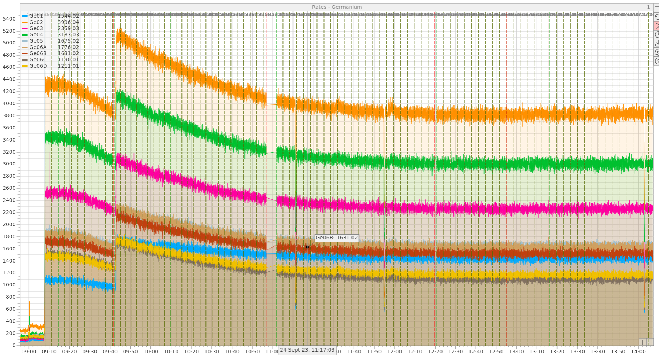
Losing radium?

Slide 3
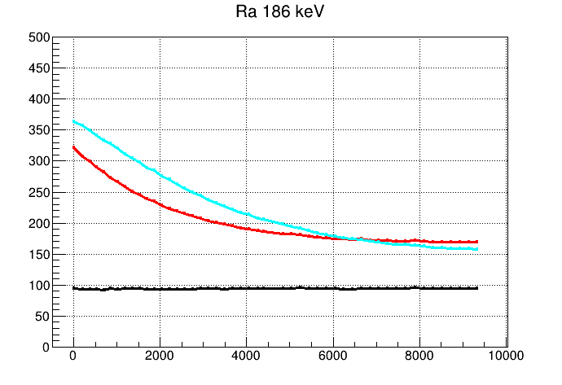
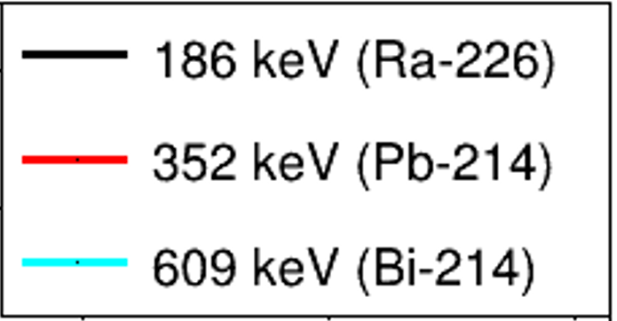
Losing radium?
²²⁶Ra
1600y
²²²Rn
3.8d
²¹⁸Po
3.1m
²¹⁴Po
160µs
²¹⁴Bi
20m
²¹⁴Pb
27m
²¹⁰Pb
22y

Slide 4
Losing radon
²²⁶Ra

Slide 5
Losing radon
²²⁶Ra

Slide 6
Losing radon
²²²Rn
²²⁶Ra

Slide 7
Losing radon
²²²Rn
²²⁶Ra

Slide 8
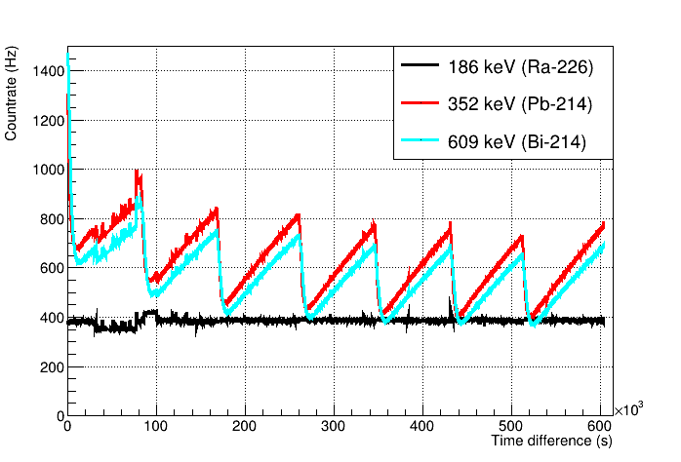
Losing radon
²²⁶Ra
1600y
²²²Rn
3.8d
²¹⁸Po
3.1m
²¹⁴Po
160µs
²¹⁴Bi
20m
²¹⁴Pb
27m
²¹⁰Pb
22y

Slide 9
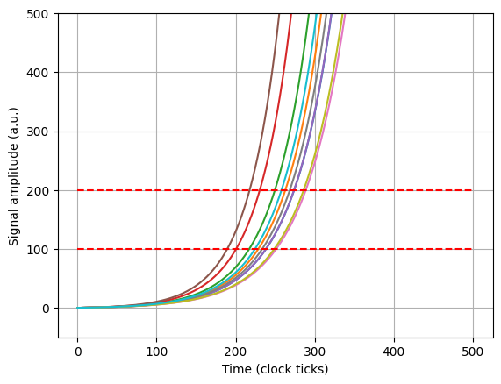
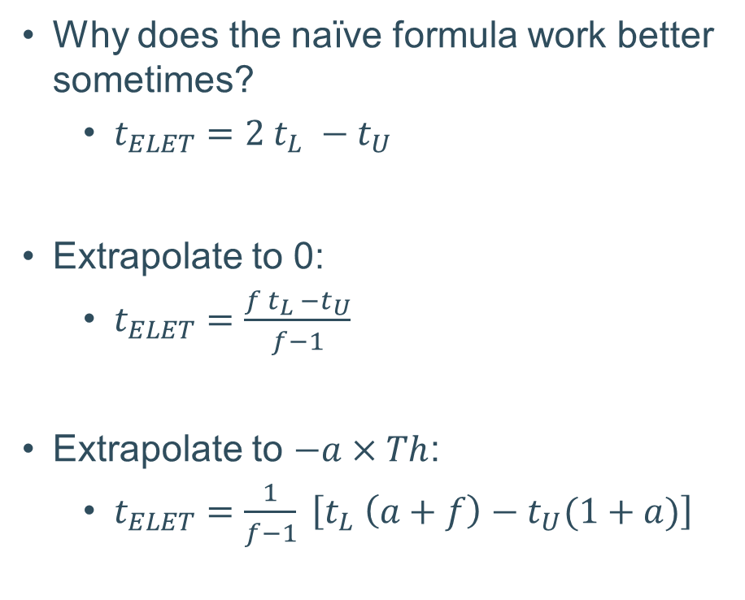

ELET improvement
$$pulse=e^{\frac{t}{τ}} −1$$
Why does the naïve formula work better sometimes?
  $t_{ELET}=2 t_{L} −t_{U}$
Extrapolate to 0:
  $t_{ELET}=\frac{f t_{L} −t_{U}}{f−1}$
Extrapolate to $−a×Th$:
  $t_{ELET}=\frac{1}{f−1} \left[t_{L} \left(a+f\right)−t_{U}(1+a)\right]$

Slide 10
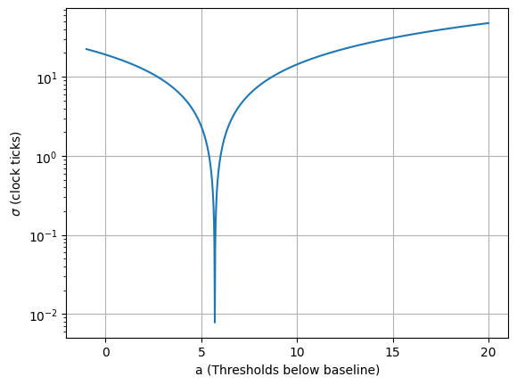
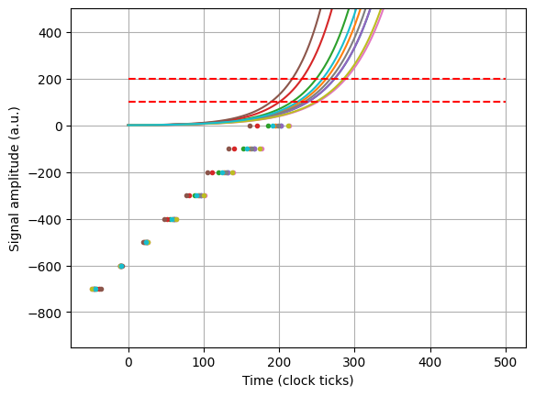
ELET improvement
Concept seems to work well on basic simulation, to be tested on real data!

