Slide 1
Update muX meeting 12/01
Marie Deseyn

Slide 2
Fit with proper lineshape

Slide 3
Fit with proper lineshape
Realized that Roofit somehow is extremely slow on (only) my laptop → do it now on the KU Leuven cluster

Slide 4
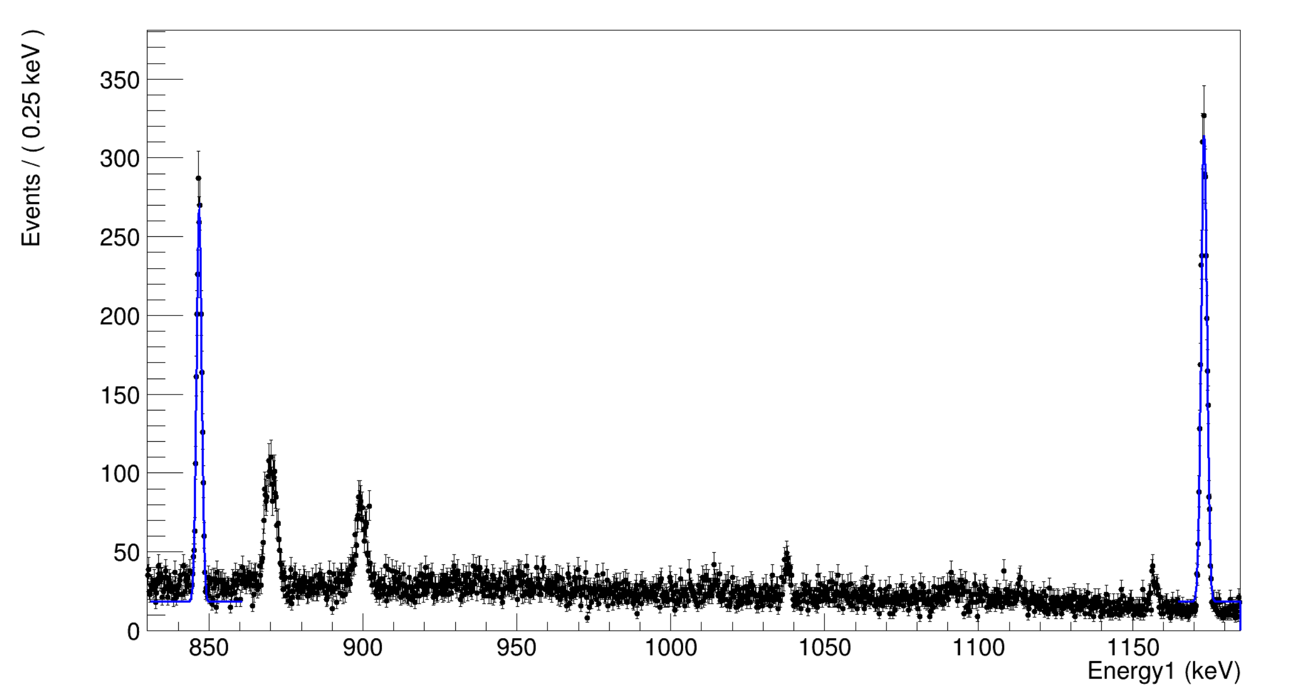
Fit with proper lineshape
Fit two peaks in the silver spectrum with sigma = a*E+b where a and b are simultaneously fitted for the two peaks

Slide 5
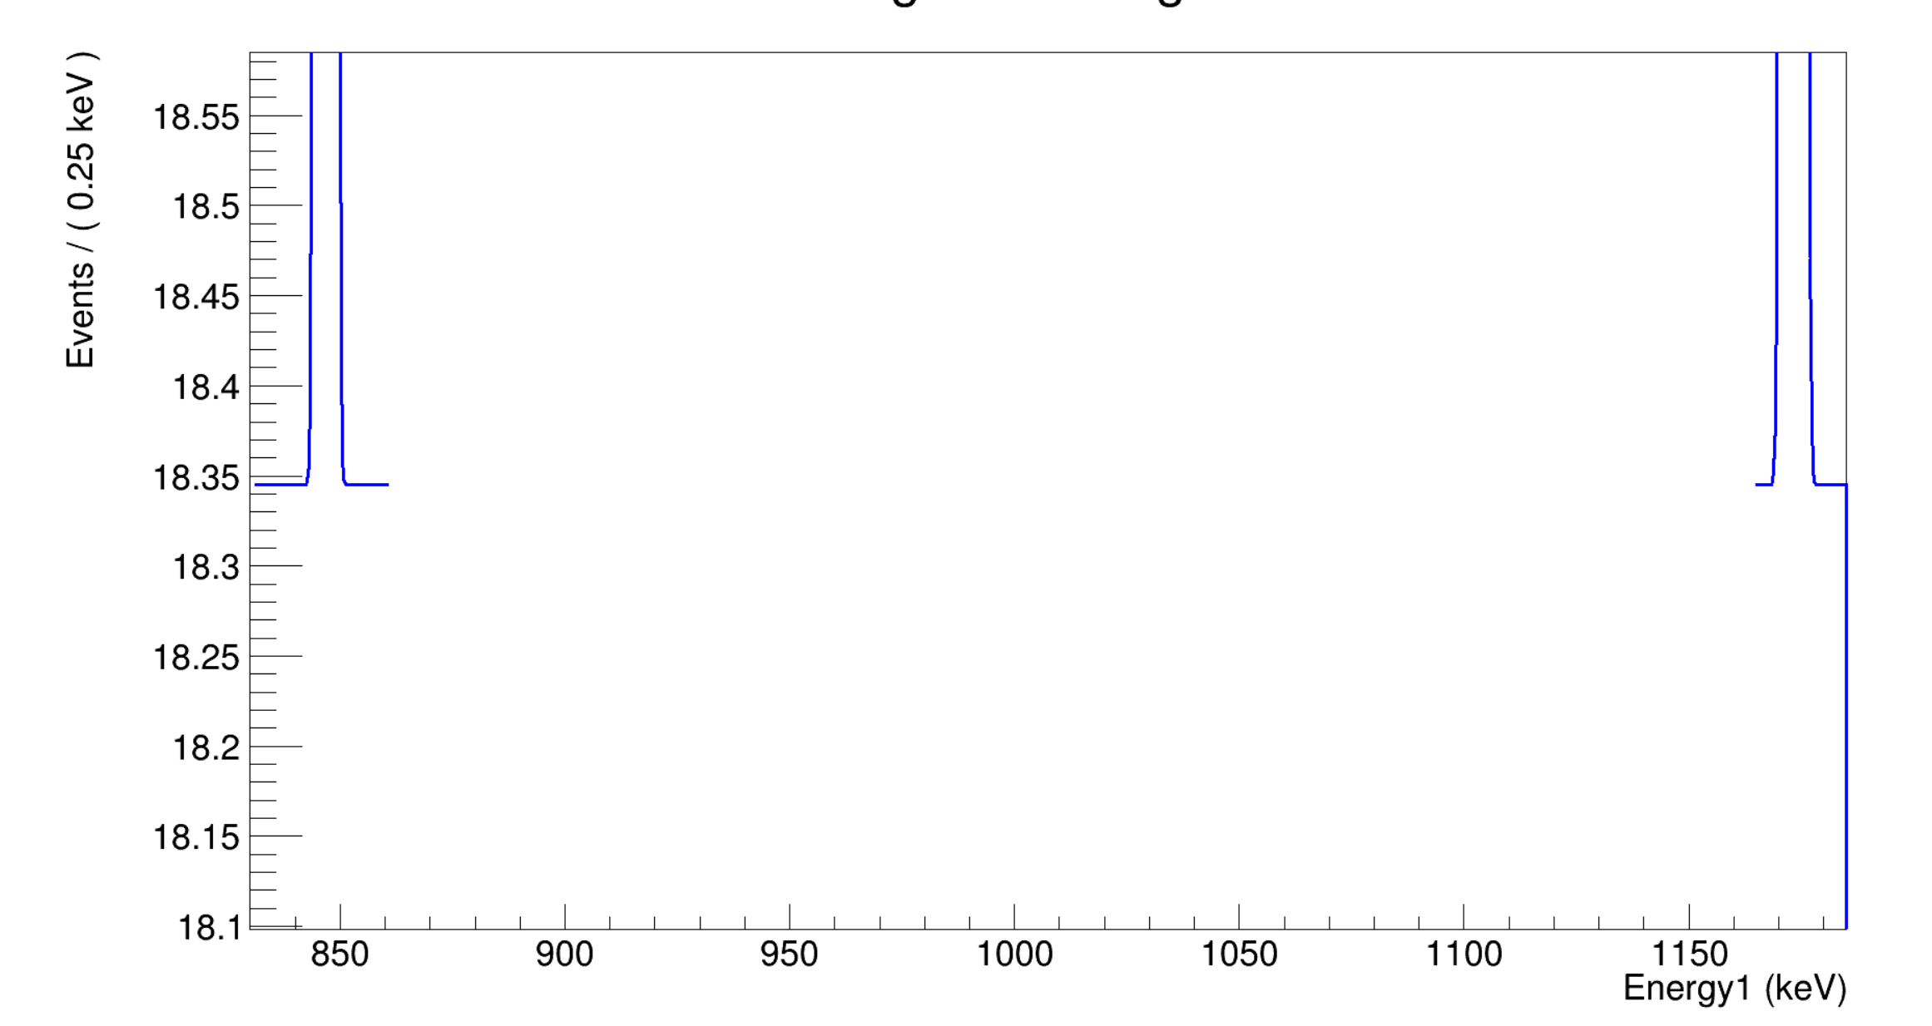
Fit with proper lineshape
Fit two peaks in the silver spectrum with sigma = a*E+b where a and b are simultaneously fitted for the two peaks
BUT background of two peaks is the same
(since we fit the total function, gaussian goes to zero far from centroid but constant background does not)

Slide 6
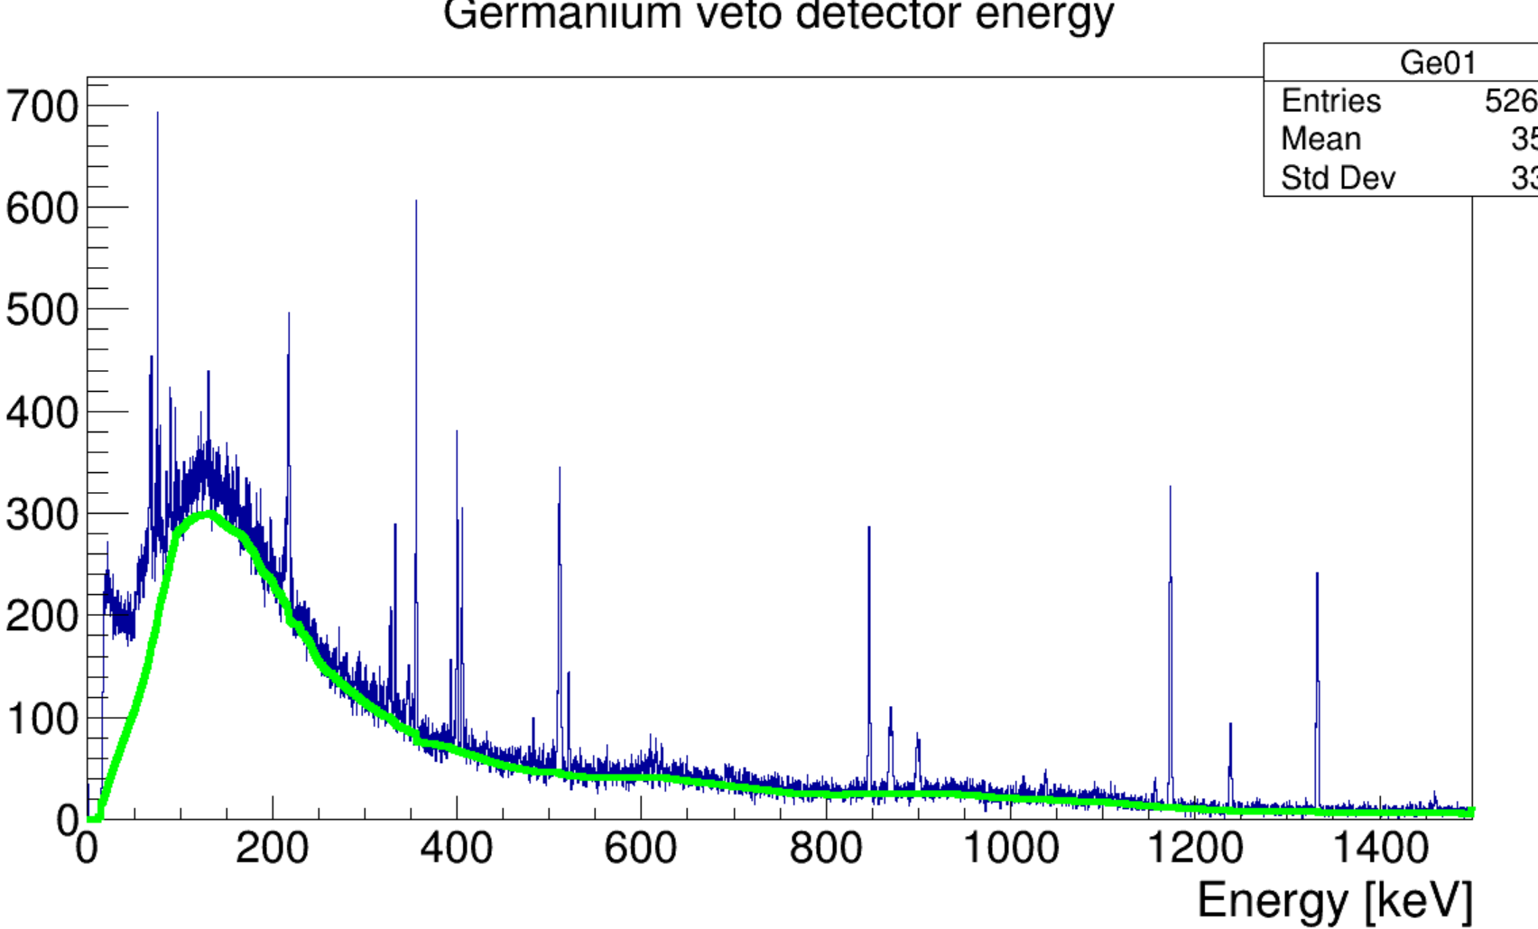
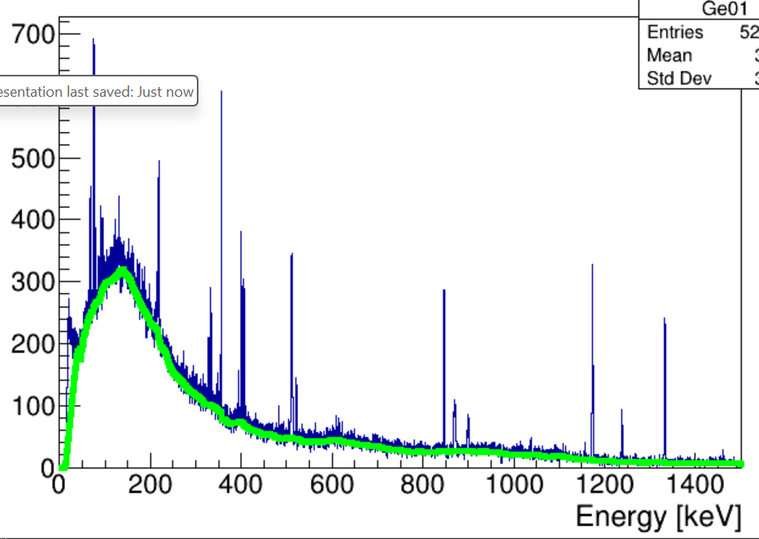
Fit with proper lineshape
Use TSpectrum to estimate full background: Background(spectrum, numberIterations,"Compton");
numberIterations = 40
numberIterations = 20

Slide 7
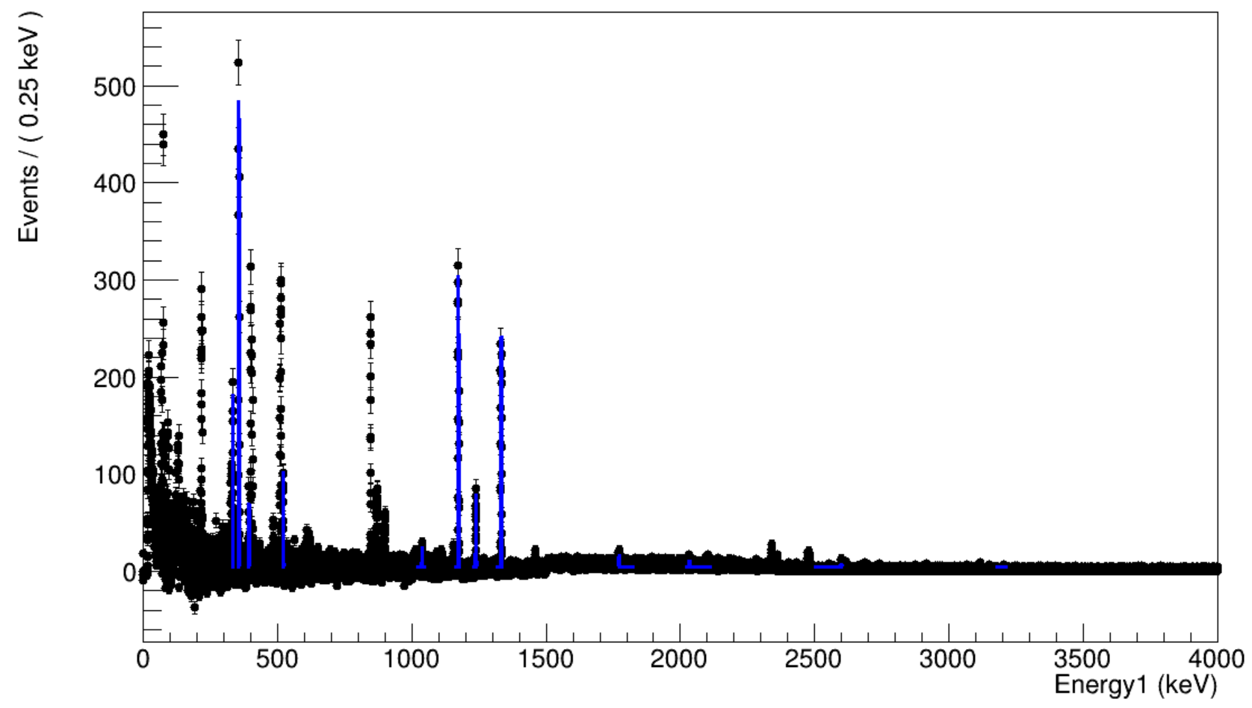
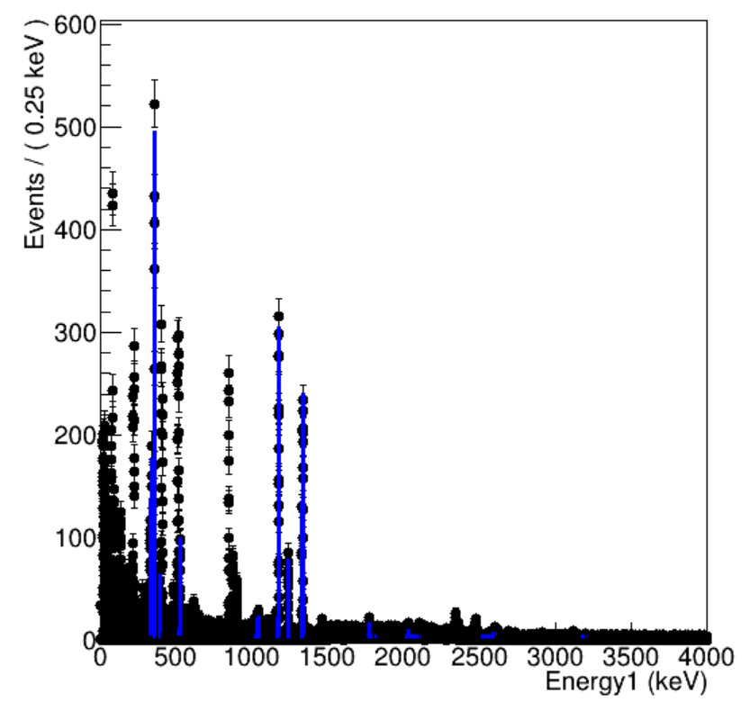
Fit with proper lineshape
And fit background subtracted spectrum (only using 3 runs):
numberIterations = 20
numberIterations = 40

Slide 8
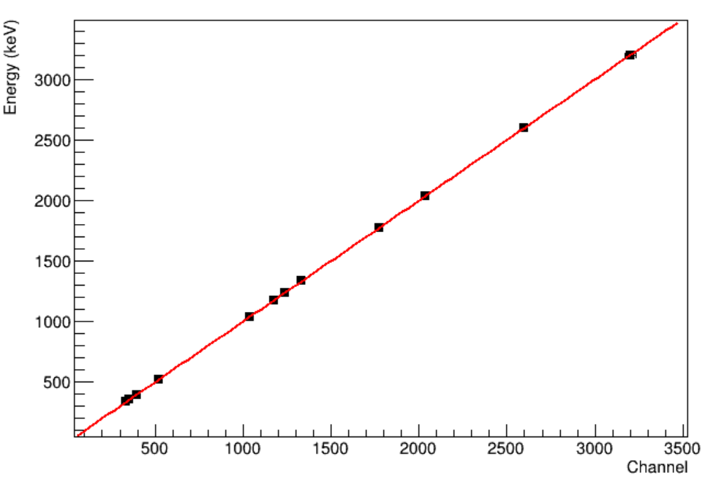
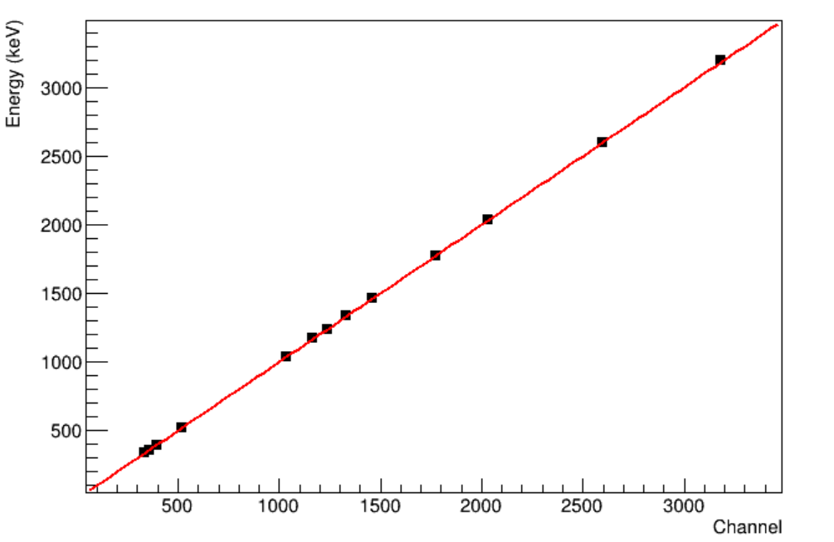
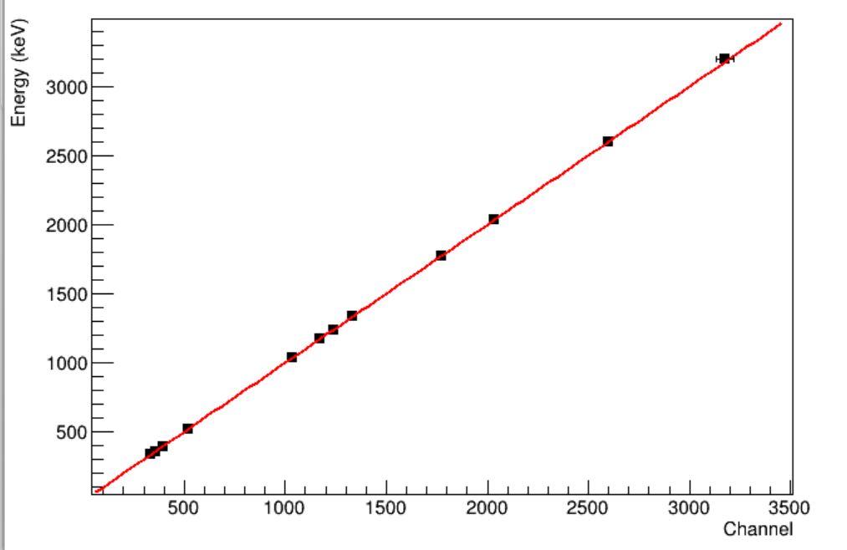
Fit with proper lineshape
And fit background subtracted spectrum (only using 3 runs):
numberIterations = 40
numberIterations = 20

Slide 9
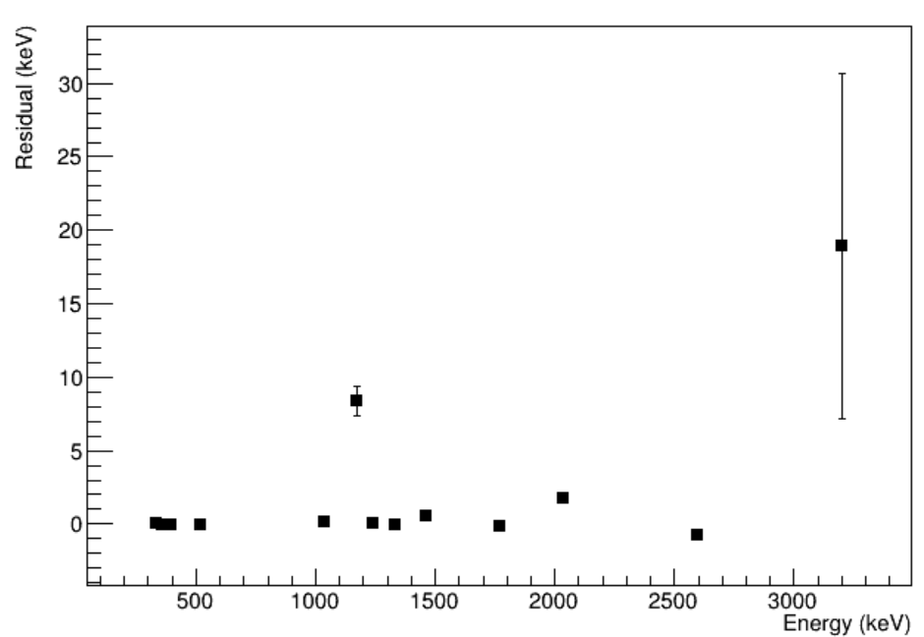
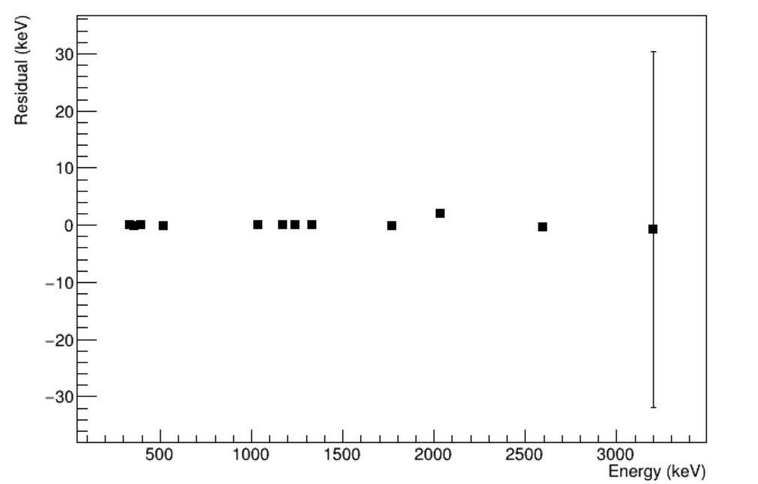
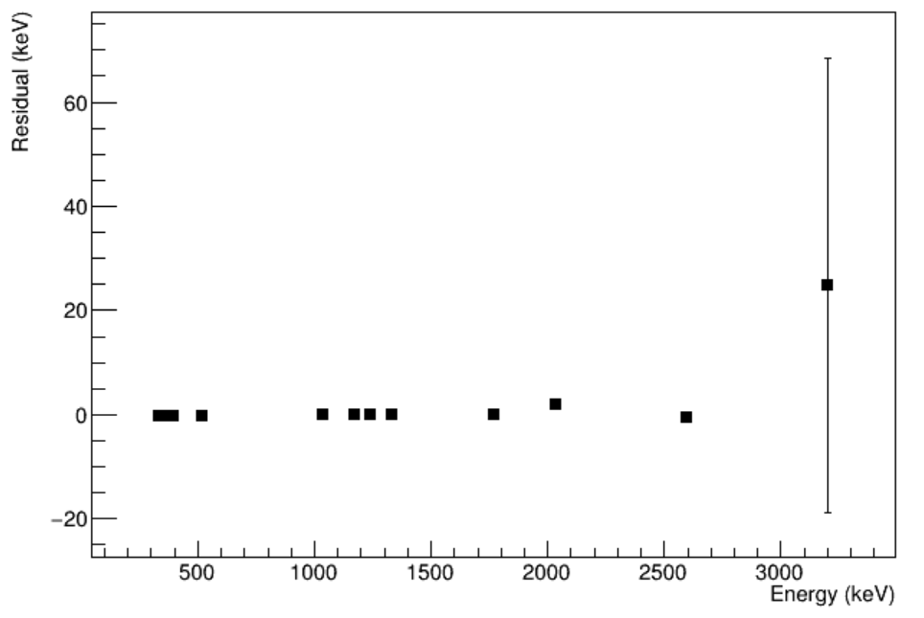
Fit with proper lineshape
And fit background subtracted spectrum (only using 3 runs):
numberIterations = 40
numberIterations = 20

Slide 10
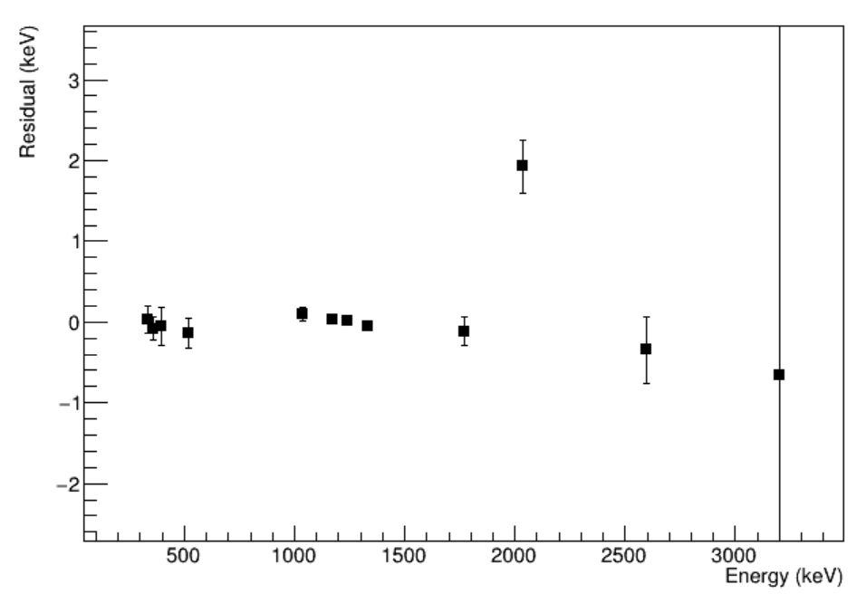
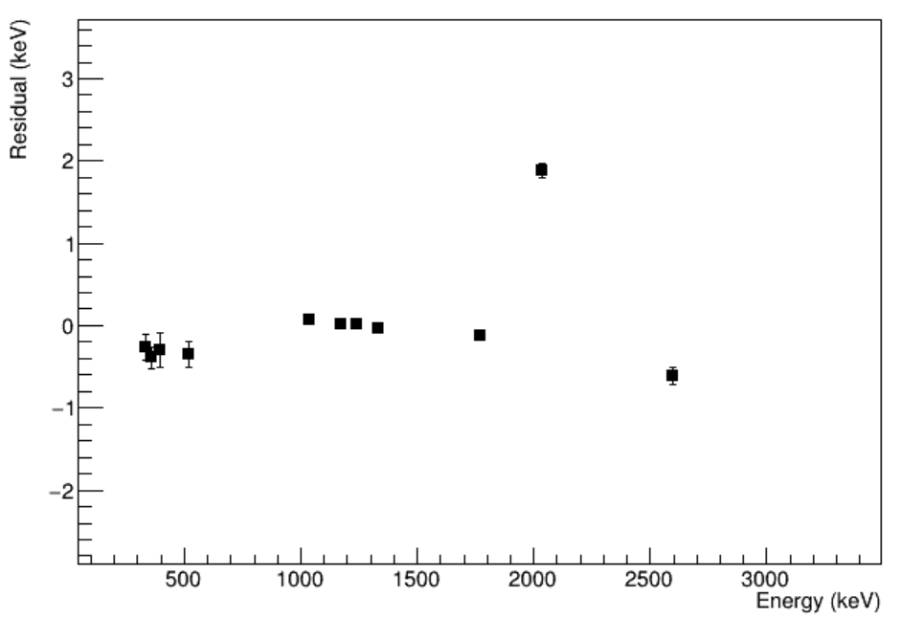
Fit with proper lineshape
And fit background subtracted spectrum (only using 3 runs):
numberIterations = 40
numberIterations = 20

Slide 12
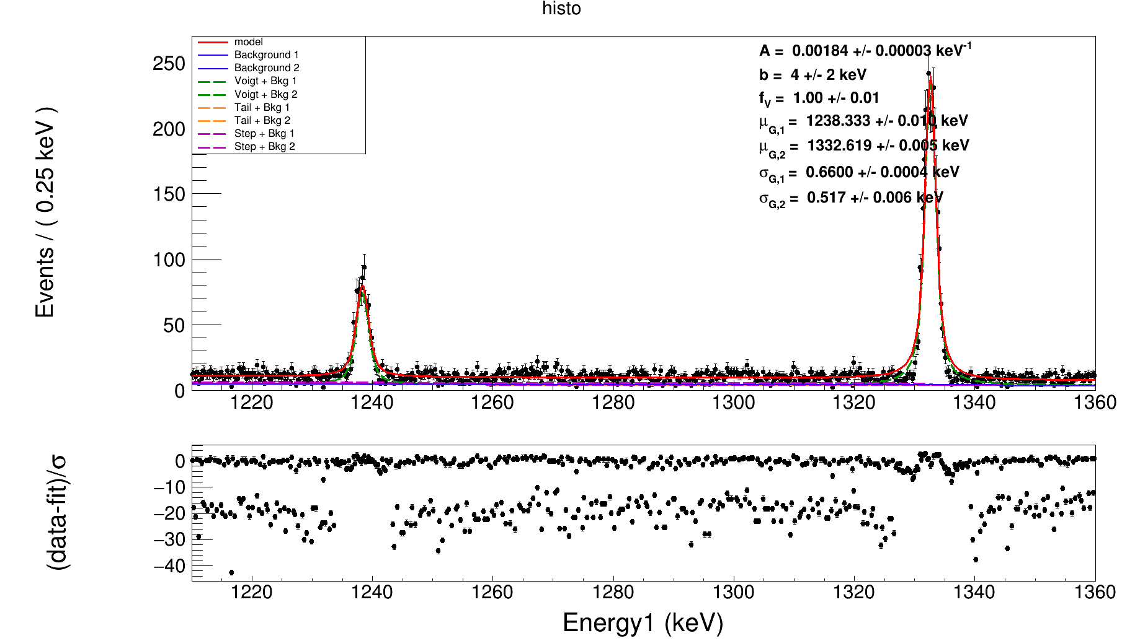
Simultaneous fit
Shared A, b and f_v
Fit over whole range instead of two peaks seperately

Slide 13
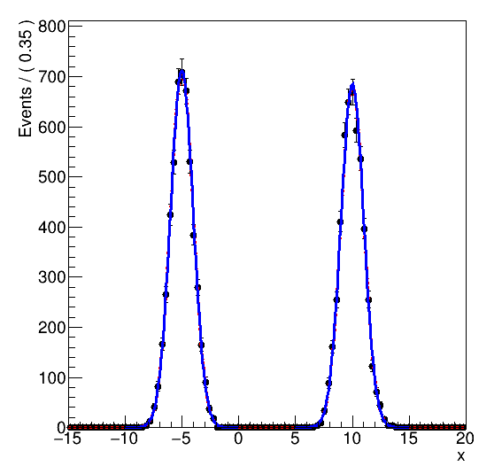
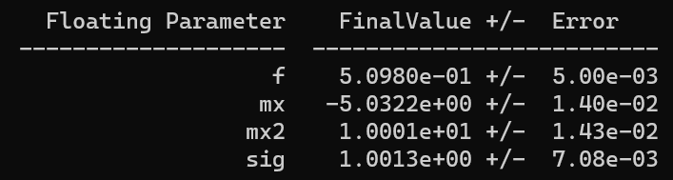
Simultaneous fit over separate ranges
Made it work in simple case of 2 gaussians near each other sharing the sigma

Slide 14
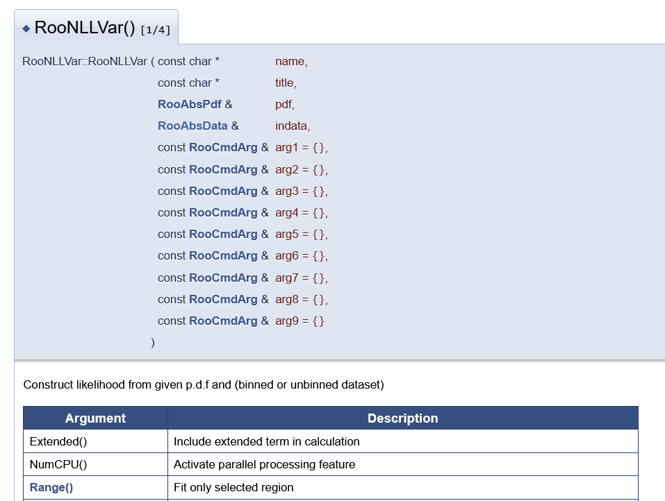
Simultaneous fit over separate ranges

Slide 15
Simultaneous fit over separate ranges for silver data – PROBLEMS
Takes very long time (even if I fit one peak where the range I put is equal to the range of the E param or thus the range of the ‘normal’ fit)

Slide 16
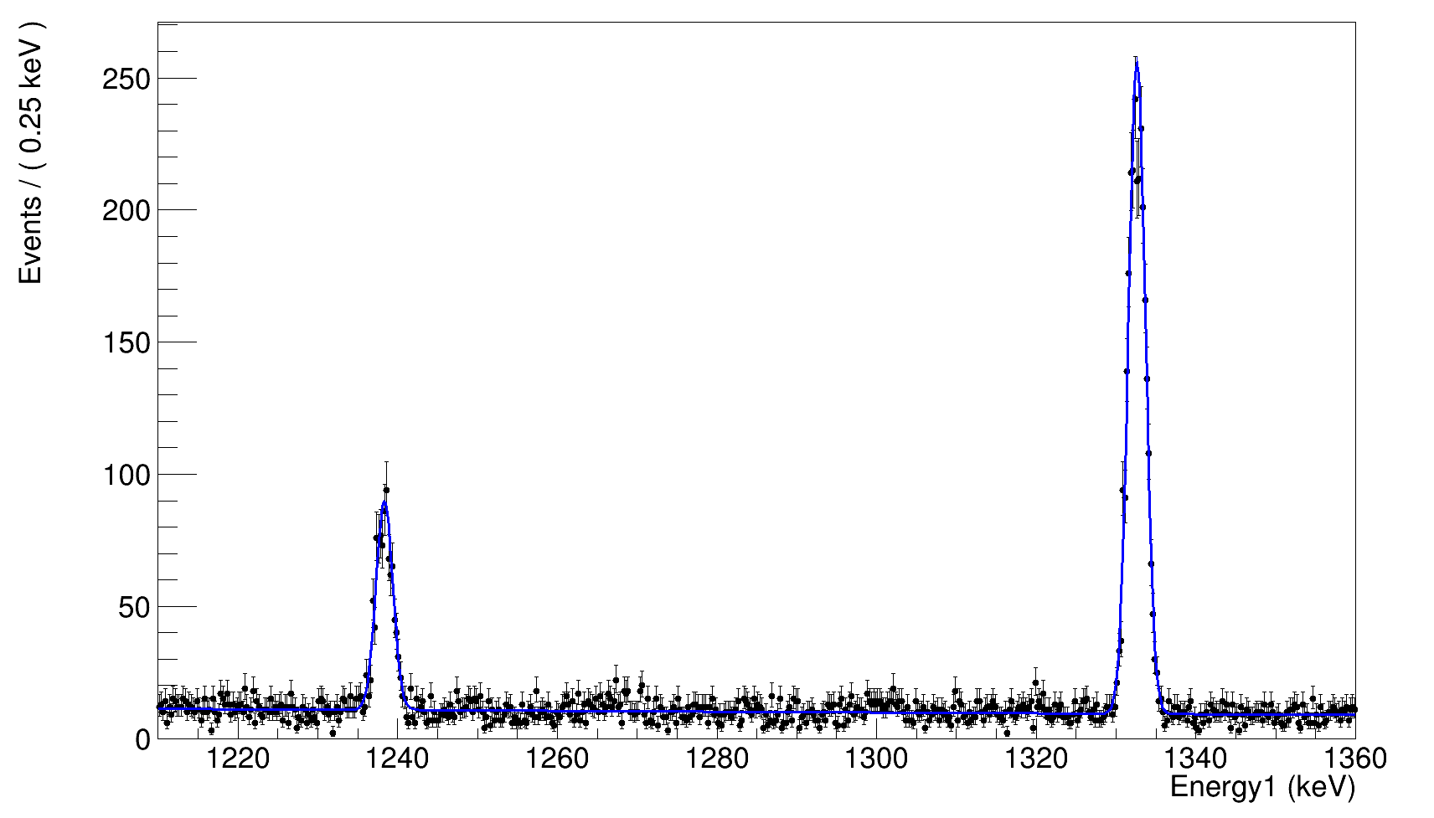
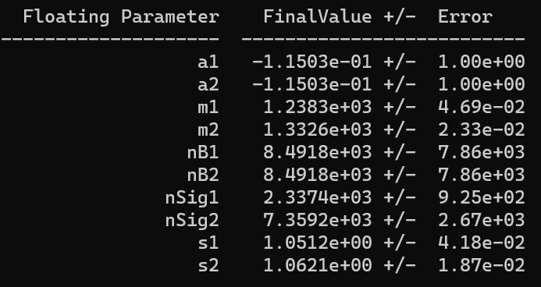
Simultaneous fit over separate ranges for silver data
Fit with two gaussians and Chebyshev polynomial background in 2 ranges:
Takes about 1.5 min

Slide 17
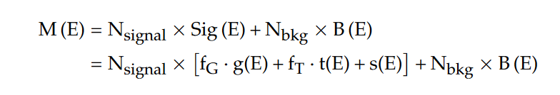
Simultaneous fit over separate ranges for silver data
Add with t(E):
Very slow > 30 min

Slide 18
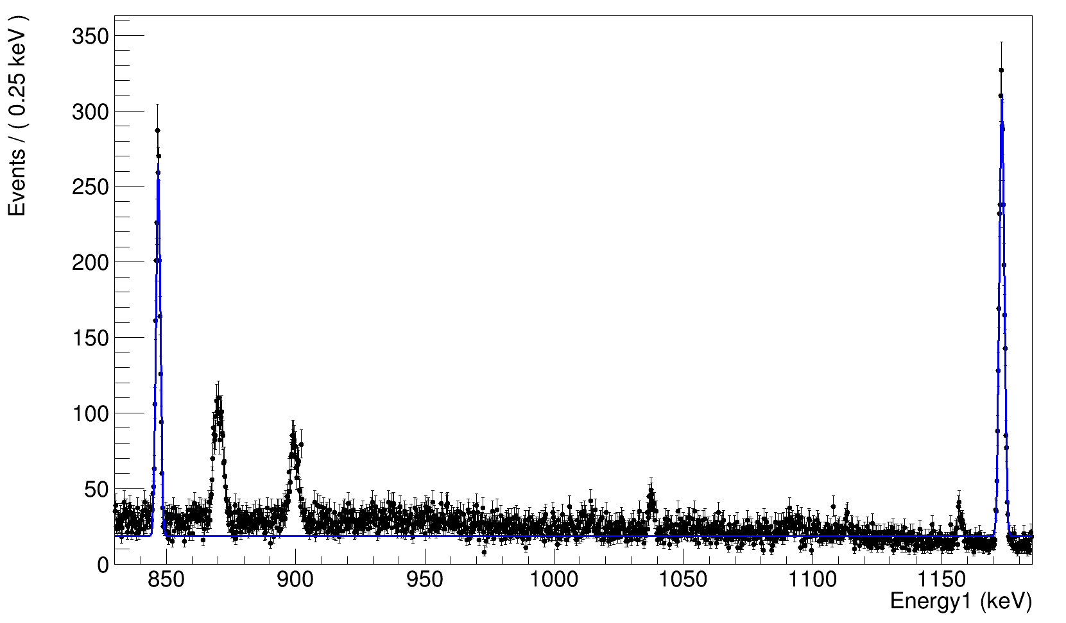
Simultaneous fit over separate ranges for silver data
Fit with two gaussians where sigma = a*E+b with a and b = for both peaks

Slide 19
Simultaneous fit over separate ranges for silver data
Fit with two gaussians where sigma = a*E+b with a and b = for both peaks
This is without clipping, so in fact the constant backgrounds add up
→ Investigate clipping
➔ Clipping increases the calculation time drastically ☹
(without clipping, the algorithm is done in <1min)
Sig[ii] = new RooGenericPdf (sig_name.str().c_str(),"(exp(-((@0 - @1)/(@2)) * ((@0 - @1)/@2)/2) /(@2*2.5) + (@0 > @4)*(@0 < @5) * @3)",RooArgList(E,*mx[ii],sig, *constback[ii], *Roodown[ii], *Rooup[ii]));

Slide 20
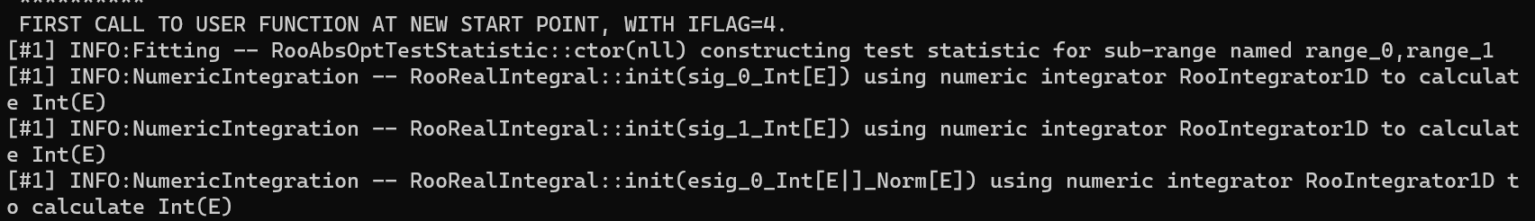


Simultaneous fit over separate ranges for silver data
Fit with two gaussians where sigma = a*E+b with a and b = for both peaks
This is without clipping, so in fact the constant backgrounds add up
→ Investigate clipping
➔ Clipping increases the calculation time drastically ☹
(without clipping, the algorithm is done in <5sec)
Sig[ii] = new RooGenericPdf (sig_name.str().c_str(),"(exp(-((@0 - @1)/(@2)) * ((@0 - @1)/@2)/2) /(@2*2.5) + (@0 > @4)*(@0 < @5) * @3)",RooArgList(E,*mx[ii],sig, *constback[ii], *Roodown[ii], *Rooup[ii]));

Slide 21
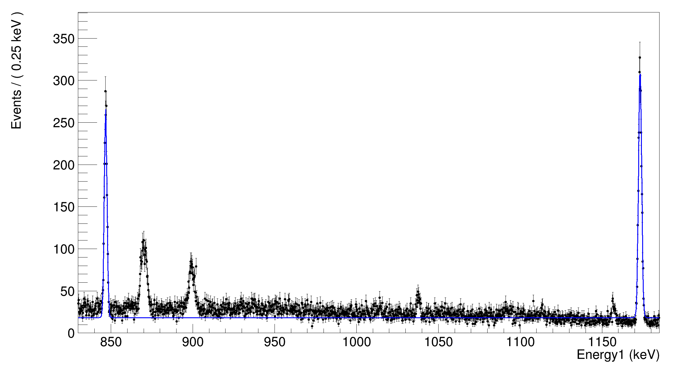
Simultaneous fit over separate ranges for silver data
After ~1h
Seems like the clipping did not work…

Slide 22
Effect of anti-coincidence window size
Saw some interesting things, but I first want to doublecheck my ELET optimization

Slide 23
Effect of anti-coincidence window size
muon
tHigh
tLow
t

Slide 24
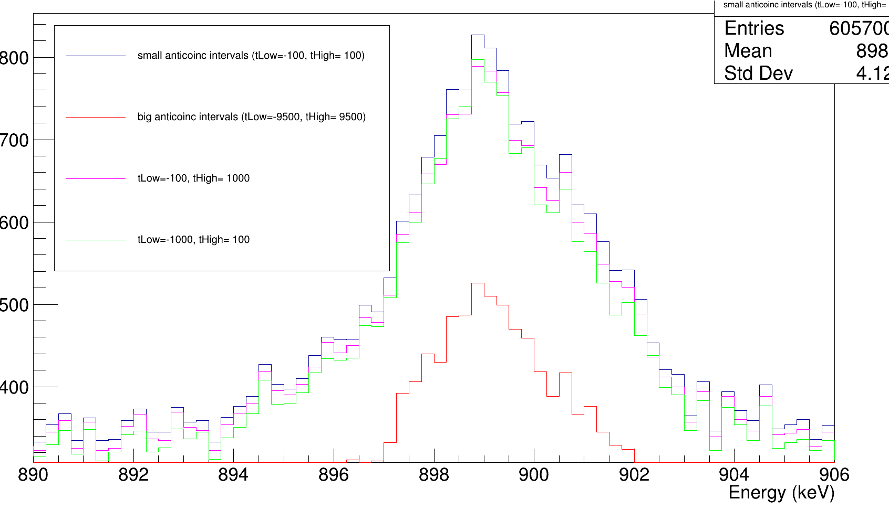
Effect of anti-coincidence window size
899keV (muonic gold x ray(nf-3d))

Slide 25
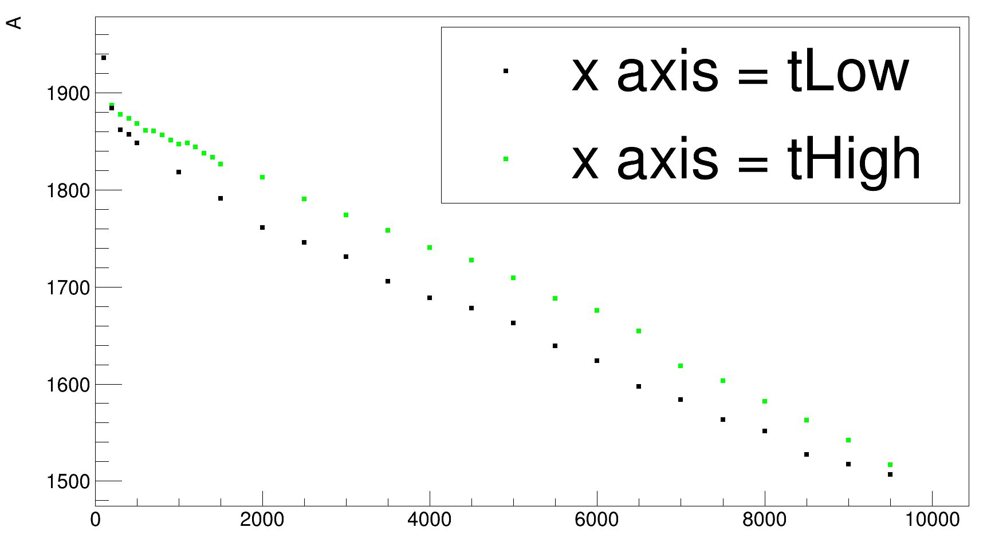
Effect of anti-coincidence window size
899keV (muonic gold x ray(nf-3d))
Effect of tLow and tHigh is rather similar
→ expected since muonic gold x ray is ‘continuous’ and thus just cutting more events

Slide 26
Effect of anti-coincidence window size
899keV (muonic gold x ray(nf-3d))
Effect of tLow and tHigh is rather similar
There seem to be two peaks
not sure what the rightmost peak corresponds to??

Slide 27
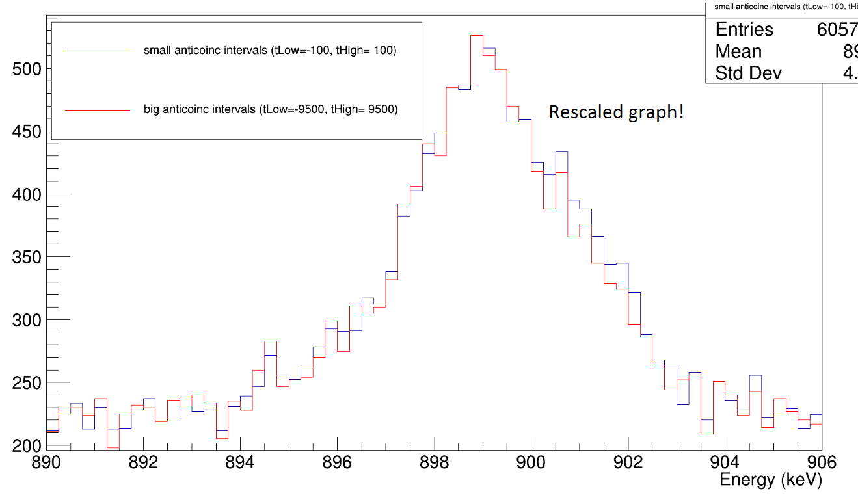
Effect of anti-coincidence window size
899keV (muonic gold x ray(nf-3d))
Effect of tLow and tHigh is rather similar
There seem to be two peaks
not sure what the rightmost peak corresponds to??

Slide 28
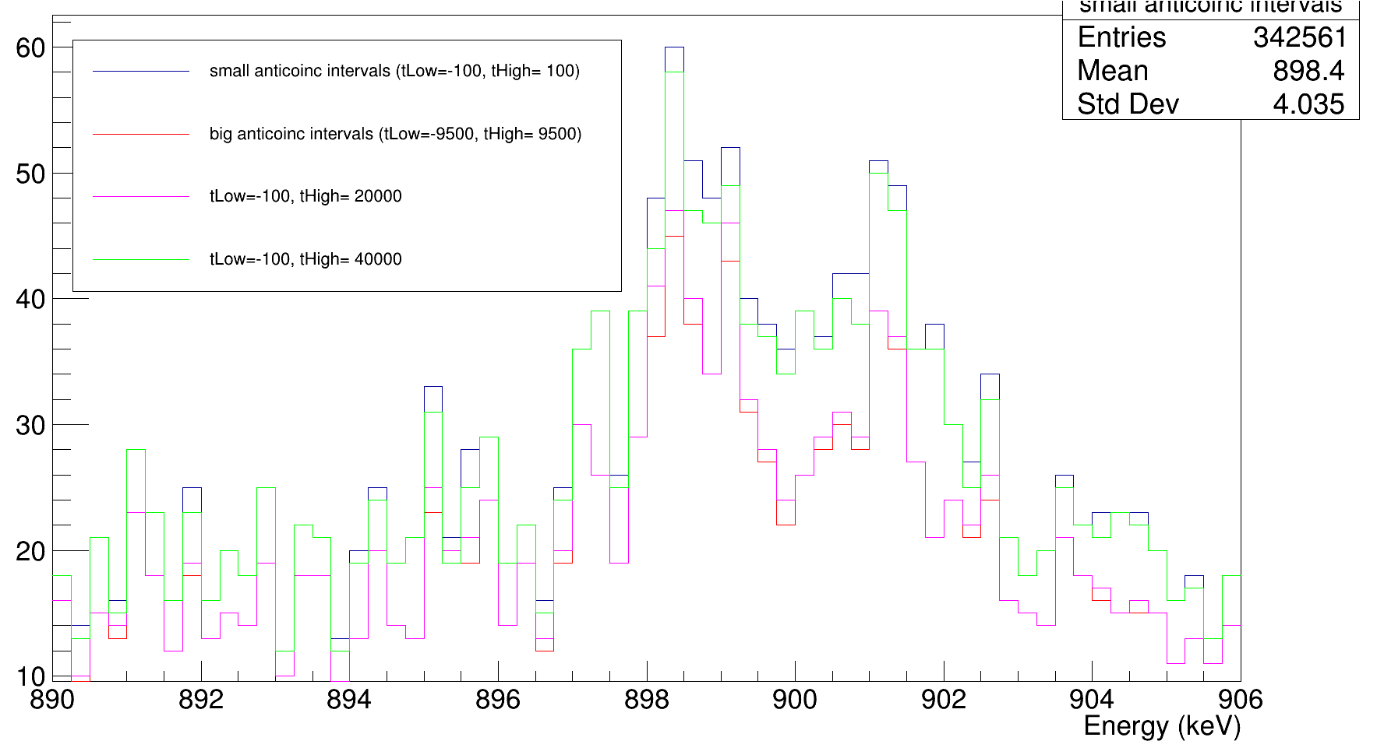
Double peak near 899keV
899keV (muonic gold x ray(nf-3d))
Effect of tLow and tHigh is rather similar
There seem to be two peaks
not sure what the rightmost peak corresponds to??
→ very clear in Ge03

Slide 29
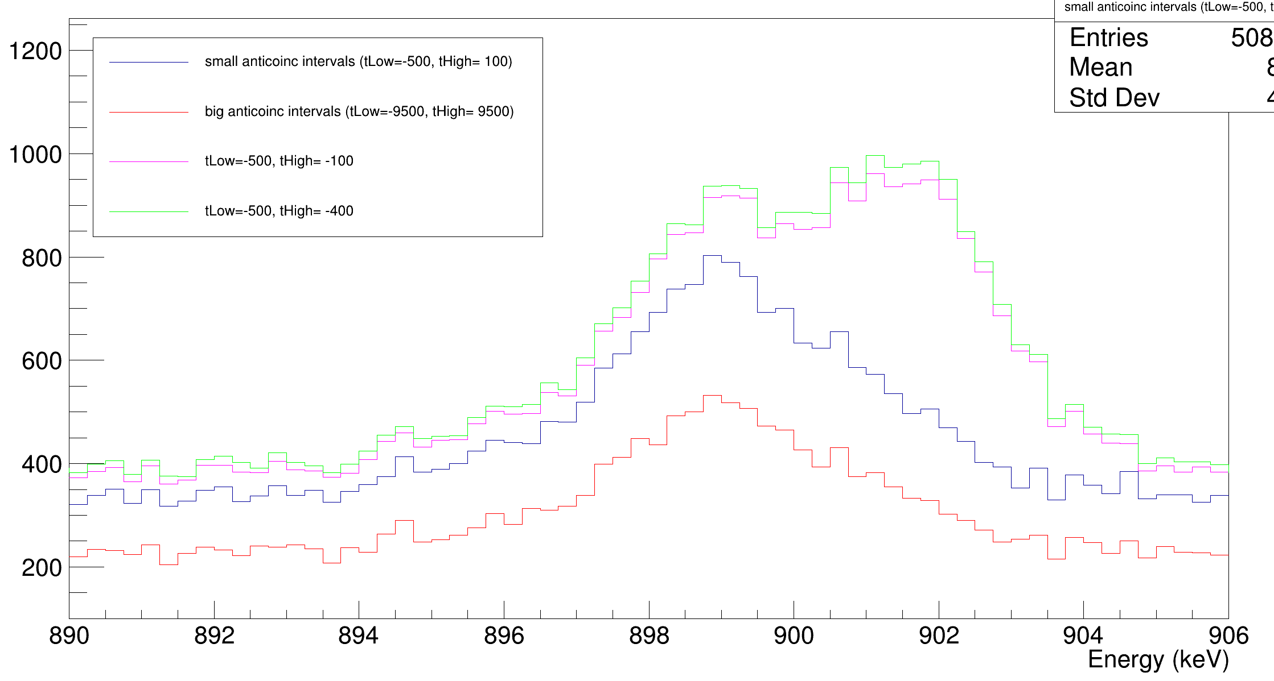
Double peak near 899keV
Rightmost peak looks partially dependent on muon

Slide 30
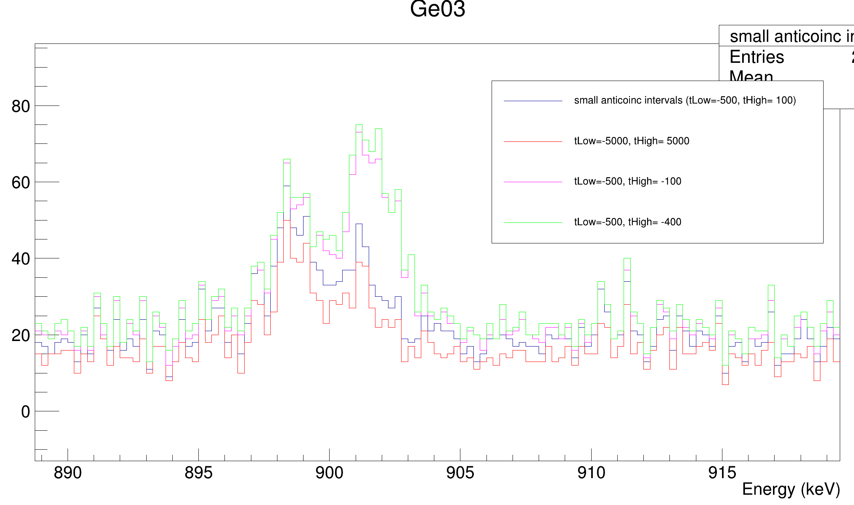
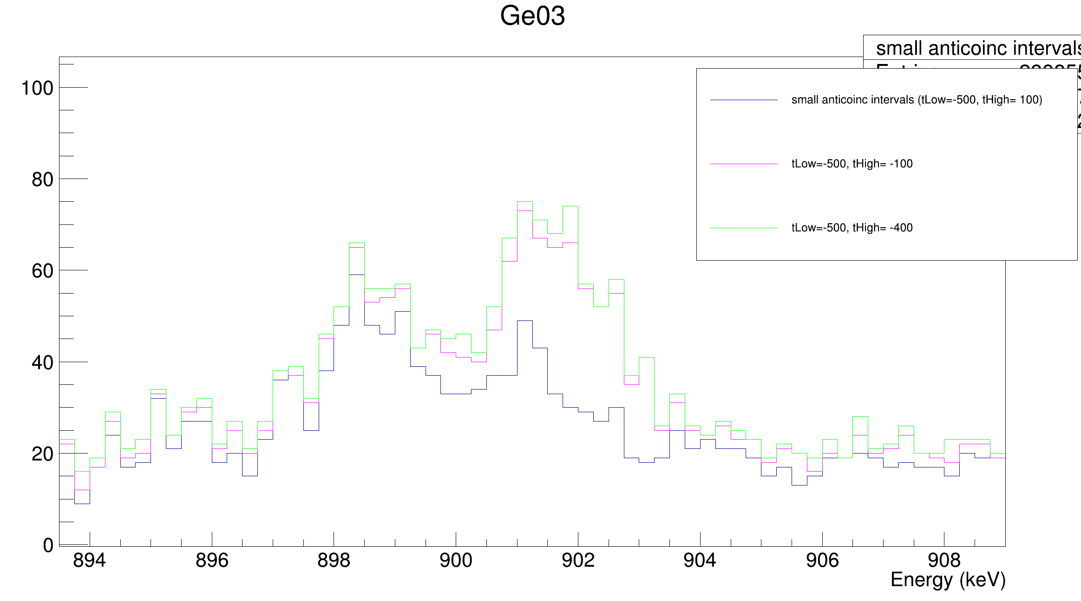
Double peak near 899keV
Rightmost peak looks partially dependent on muon
Could it be the 900.7keV Ag muonic x ray?
Compare to other Ag muonic x rays (870keV one also overlaps with Au, 1171keV overlaps with Co calibration source)

Slide 31
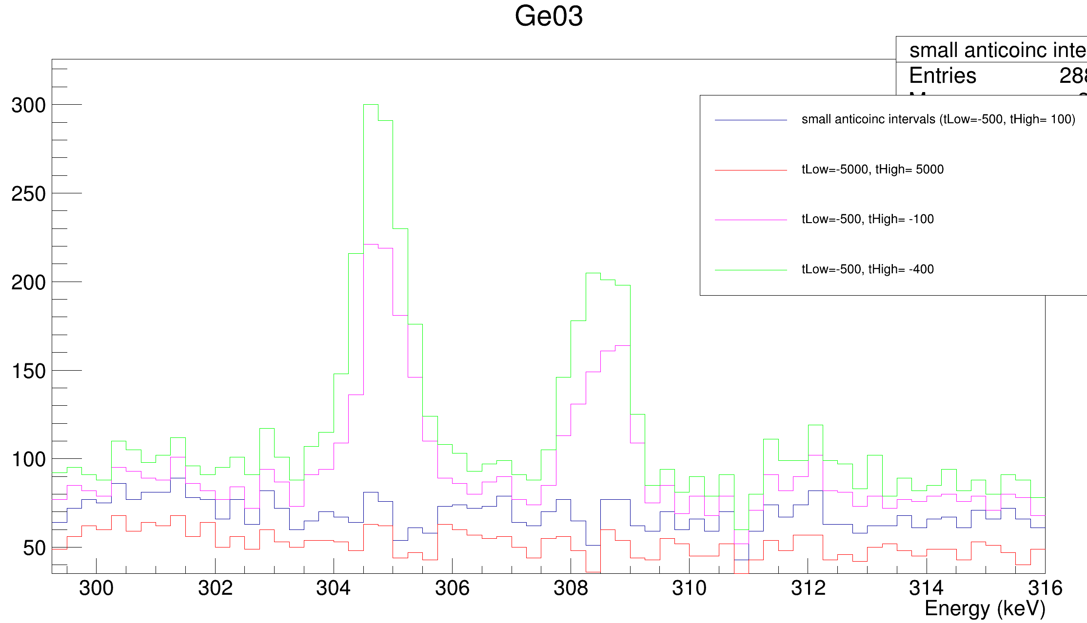
Double peak near 899keV
304keV and 308keV (Ag muonic x ray) peak are completely gone for larger anticoincidence windows → completely muon related, while at 899keV the rightmost peak does not completely disappears???
Only partly Ag peak that is leaking in

Slide 32
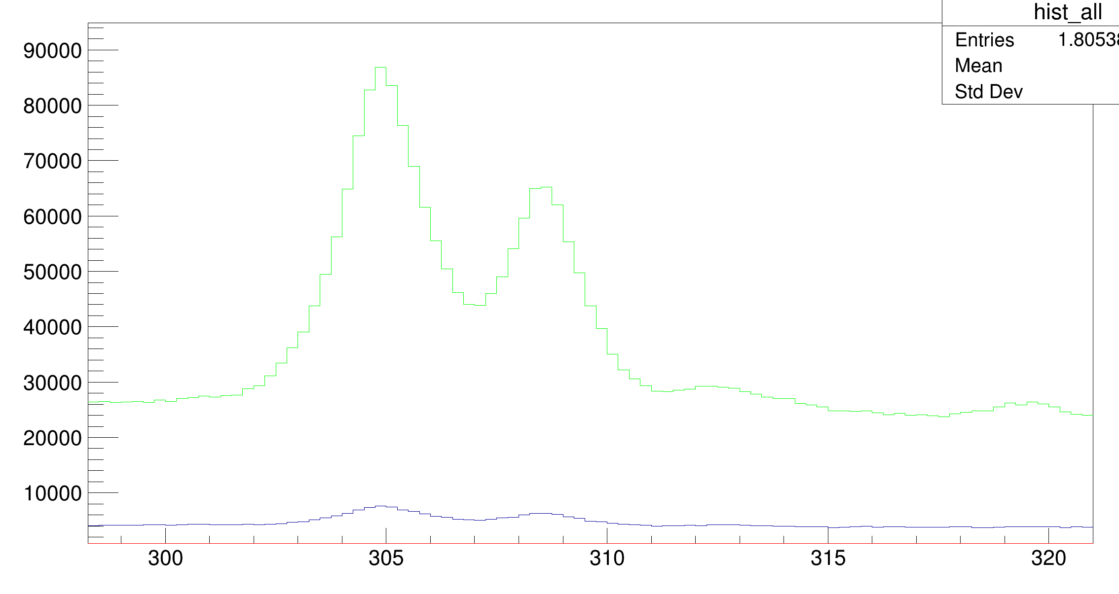
Double peak near 899keV
Is it hyperfine splitting of Au?
Check by taking events in muoncoinc spectrum that have GeTime>10000ns or GeTime<-5000ns and compare to spectrum that is also in coincidence with Au 3d_{3/2} → 2p_{1/2} or 3d_{5/2} → 2p_{3/2}
At 305keV and 308keV it gives
strong suppression

Slide 33
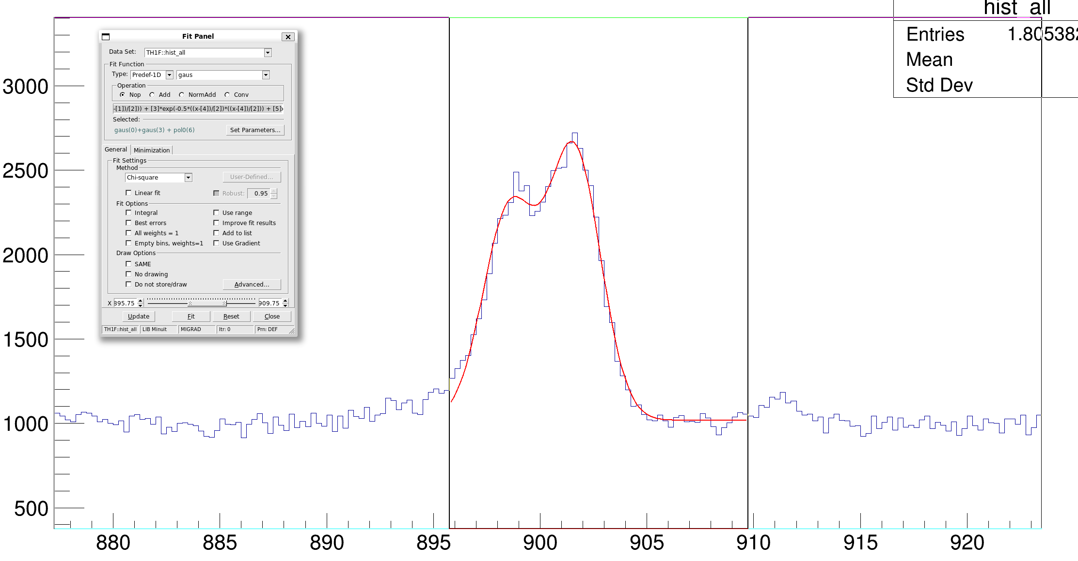
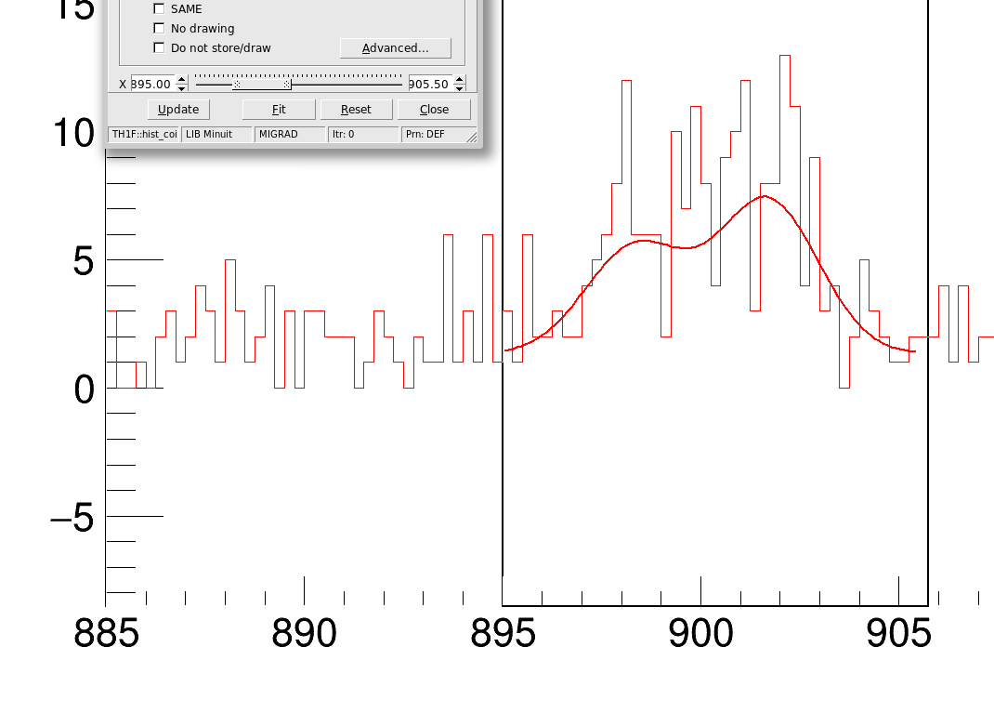
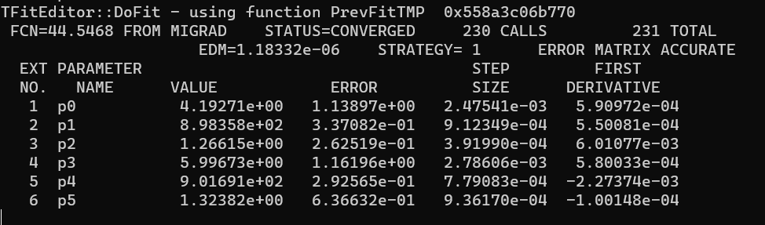
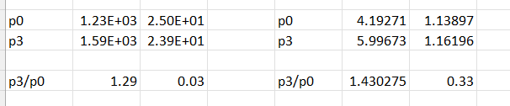
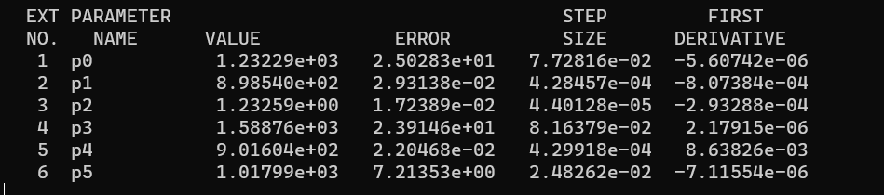
Double peak near 899keV
Fit with [0]*exp(-0.5*((x-[1])/[2])**2) + [3]*exp(-0.5*((x-[4])/[2])**2) + [5]
I want to test this for multiple timecuts to see if the p3/p0 ratio without the coincidence with Au 3d3/2 → 2p1/2 or 3d5/2 → 2p3/2 decreases when the coincidence is required

Slide 35
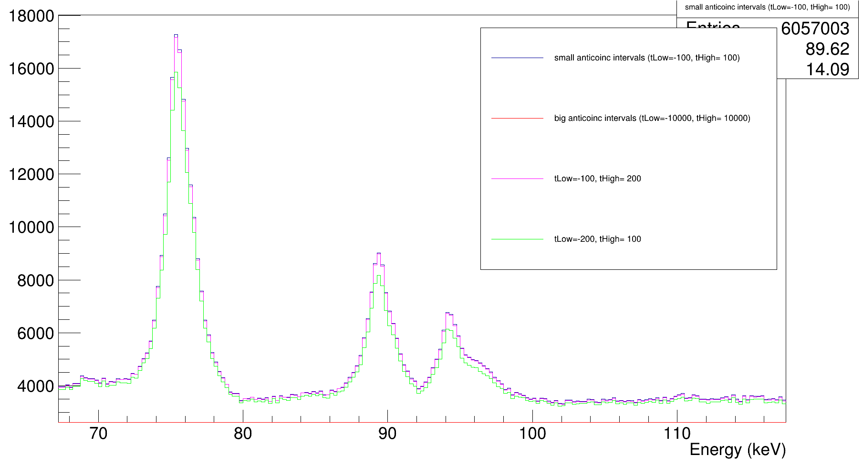
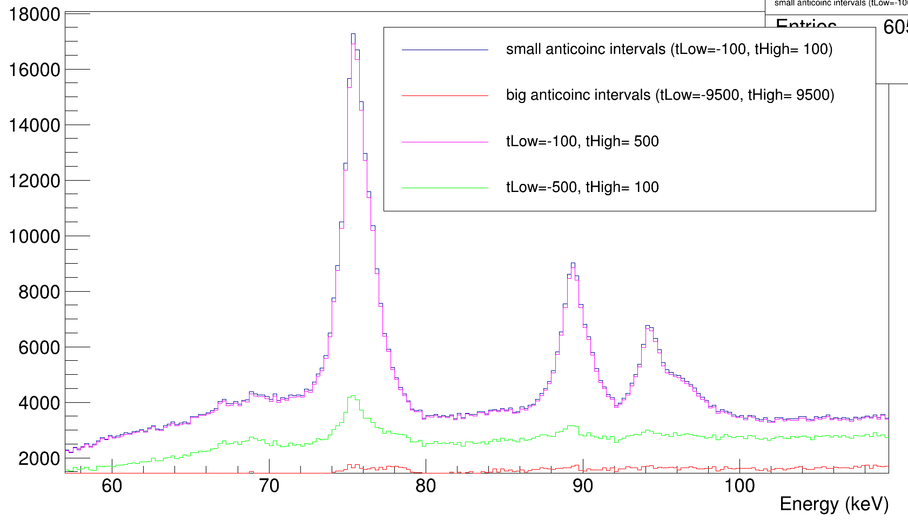
Effect of anti-coincidence window size
74.4keV, 88.4keV, 93.4keV, 95.8keV = C muonic x rays (np-1s)
tLow has more impact (for all of the detectors separately too) → time window after muon dominates

Slide 36
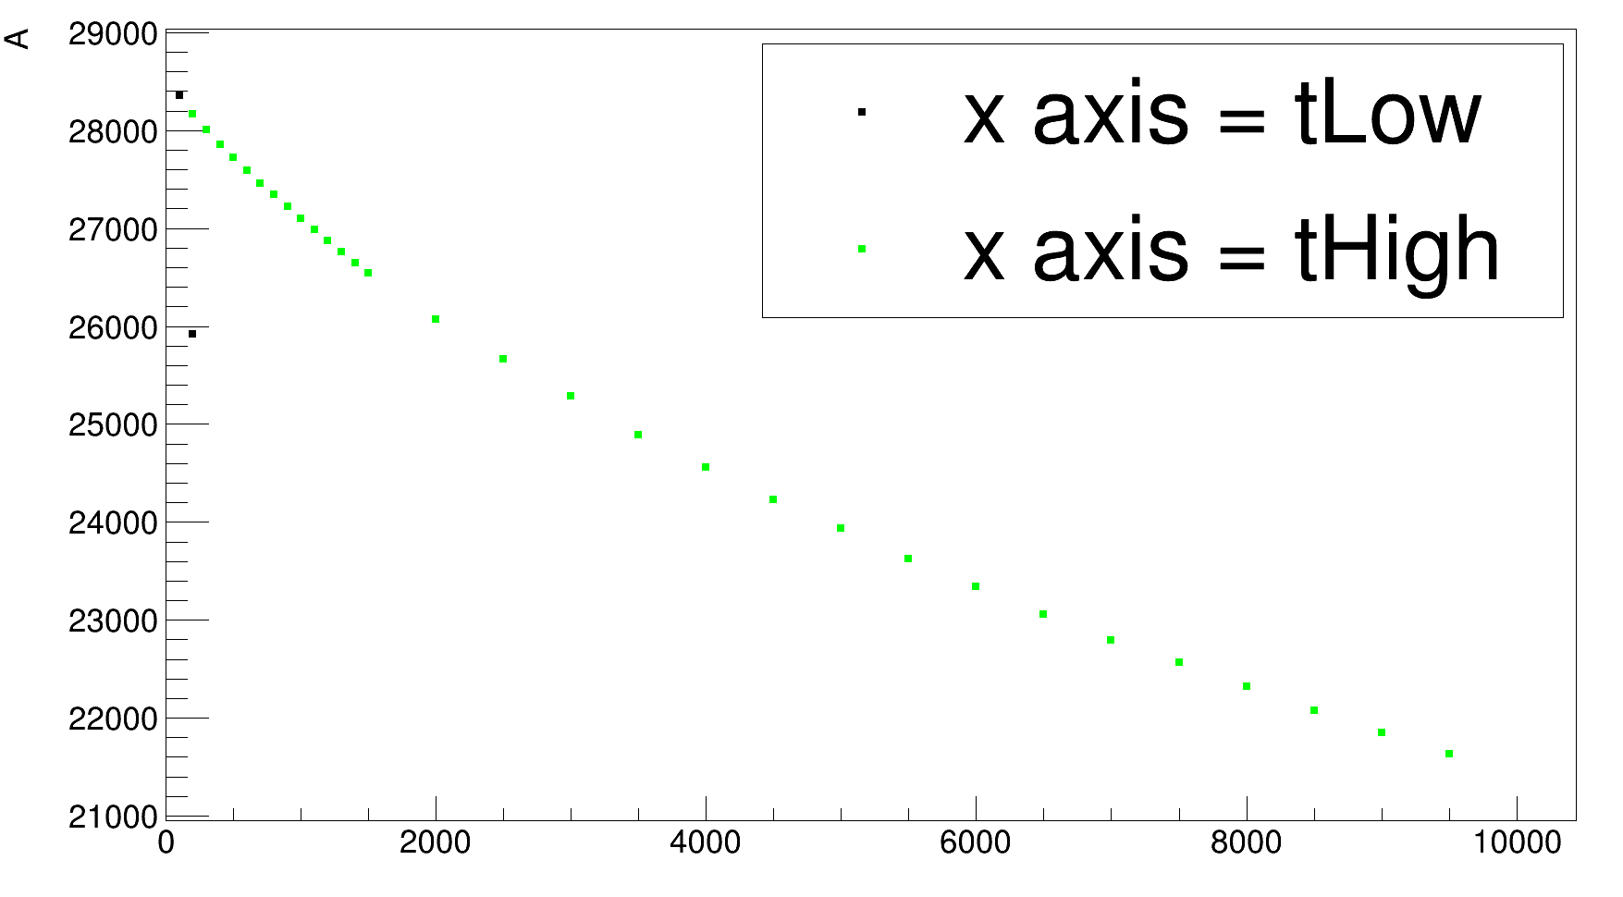
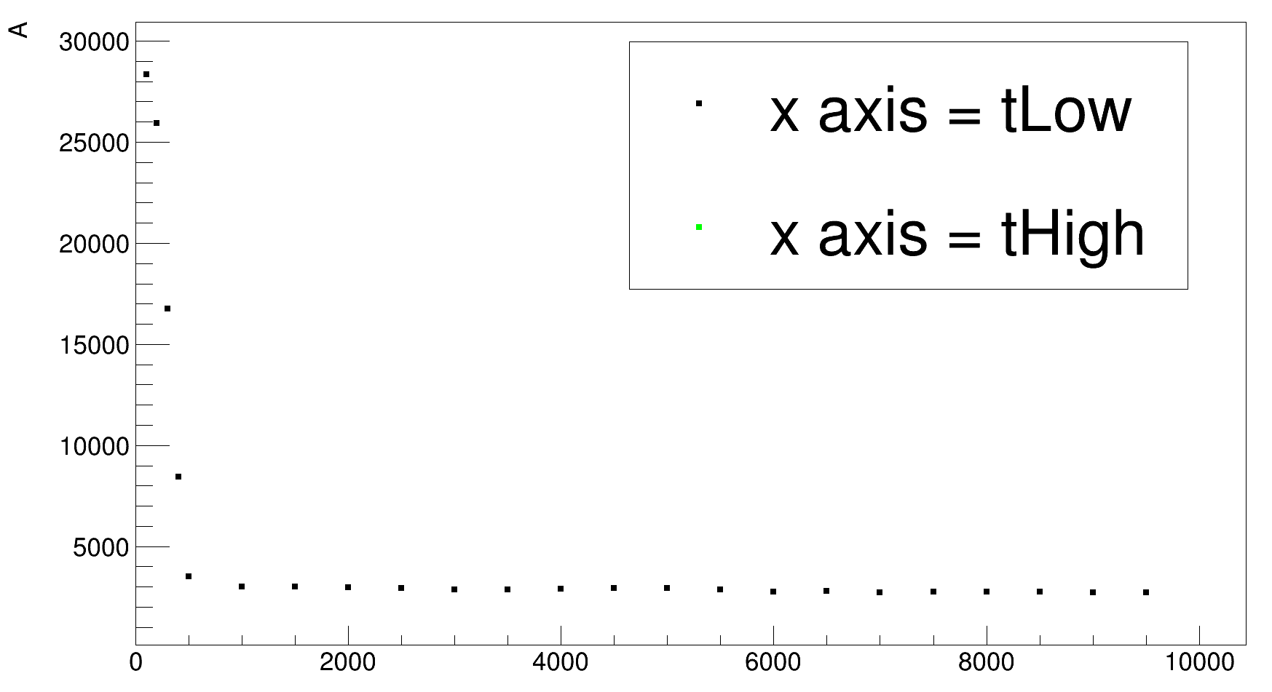
Effect of anti-coincidence window size
74.4keV, 88.4keV, 93.4keV, 95.8keV = C muonic x rays (np-1s)
tLow has more impact (for all of the detectors separately too) → time window after muon dominates

Slide 37
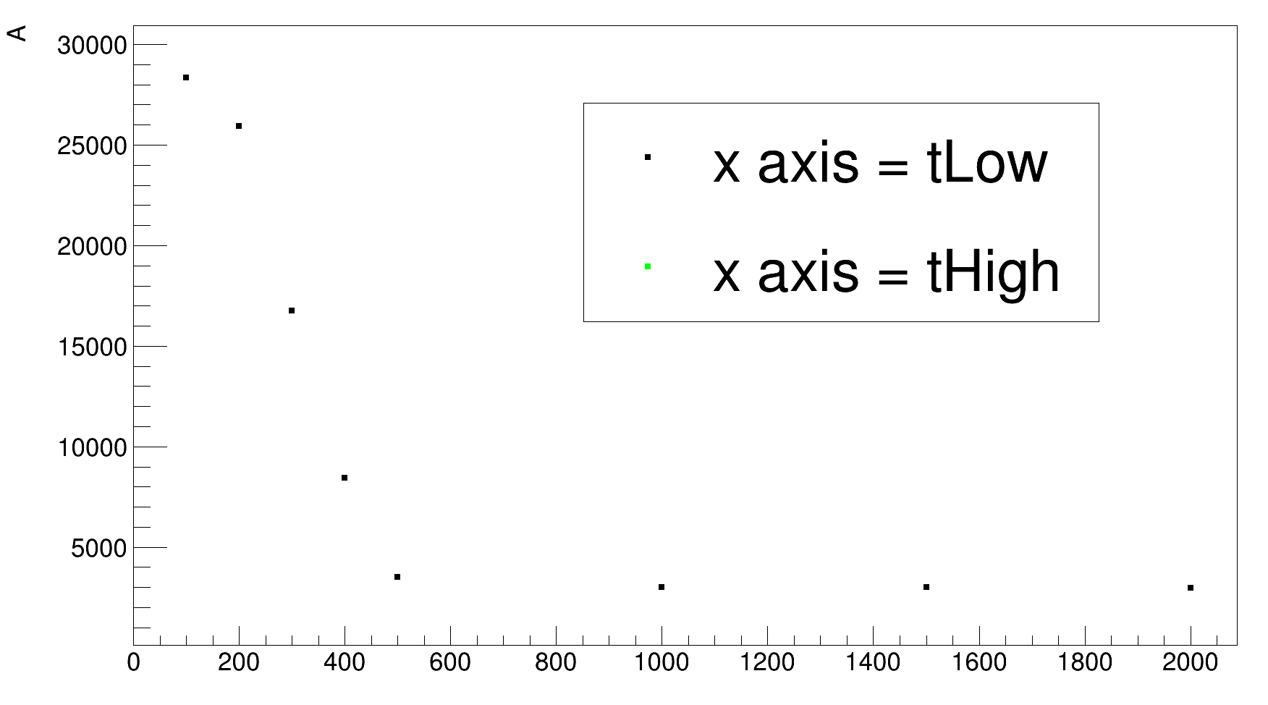
Effect of anti-coincidence window size
74.4keV, 88.4keV, 93.4keV, 95.8keV = C muonic x rays (np-1s)
tLow has more impact (for all of the detectors separately too) → time window after muon dominates

Slide 38
Effect of anti-coincidence window size
74.4keV, 88.4keV, 93.4keV, 95.8keV = C muonic x rays (np-1s)
tLow has more impact (for all of the detectors separately too) → time window after muon dominates → Go to negative tHigh to investigate possible shift

Slide 39
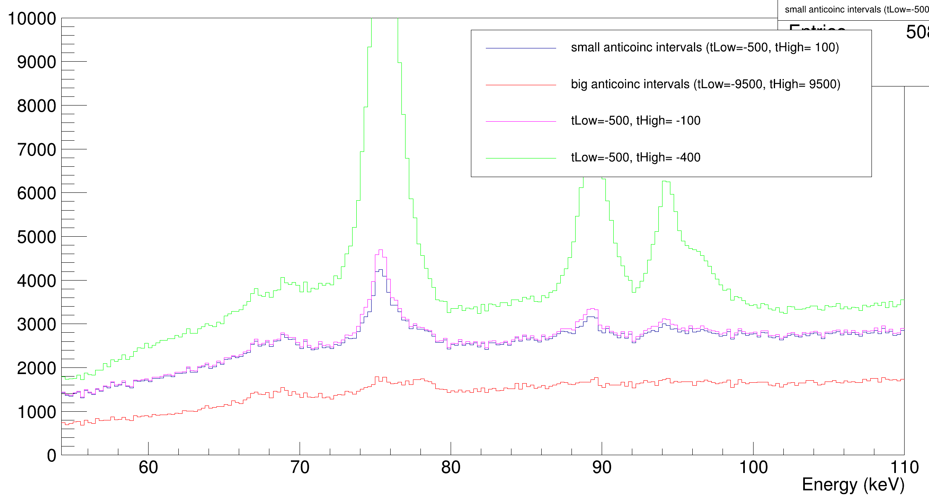
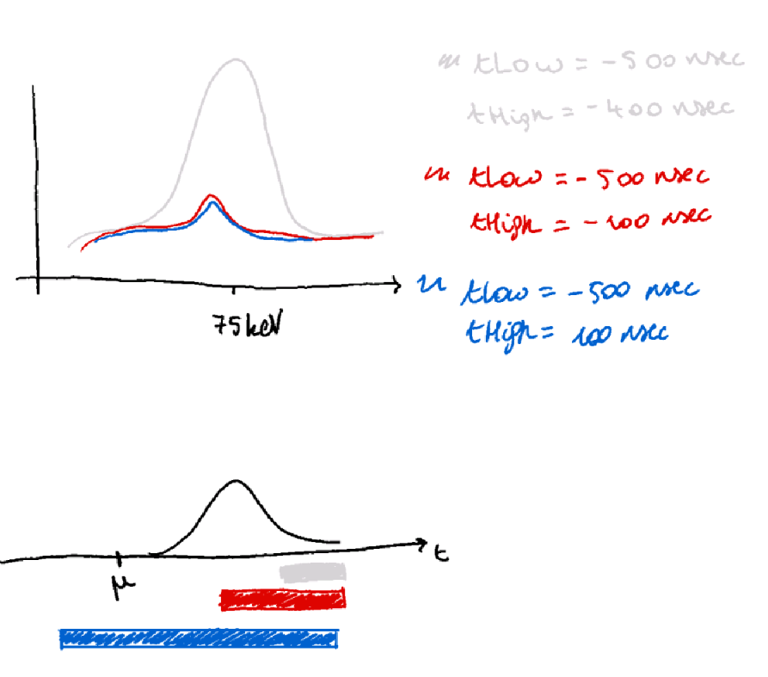
Effect of anti-coincidence window size
74.4keV, 88.4keV, 93.4keV, 95.8keV = C muonic x rays (np-1s)
It looks like the peak is shifted
in time wrt muon:

Slide 40
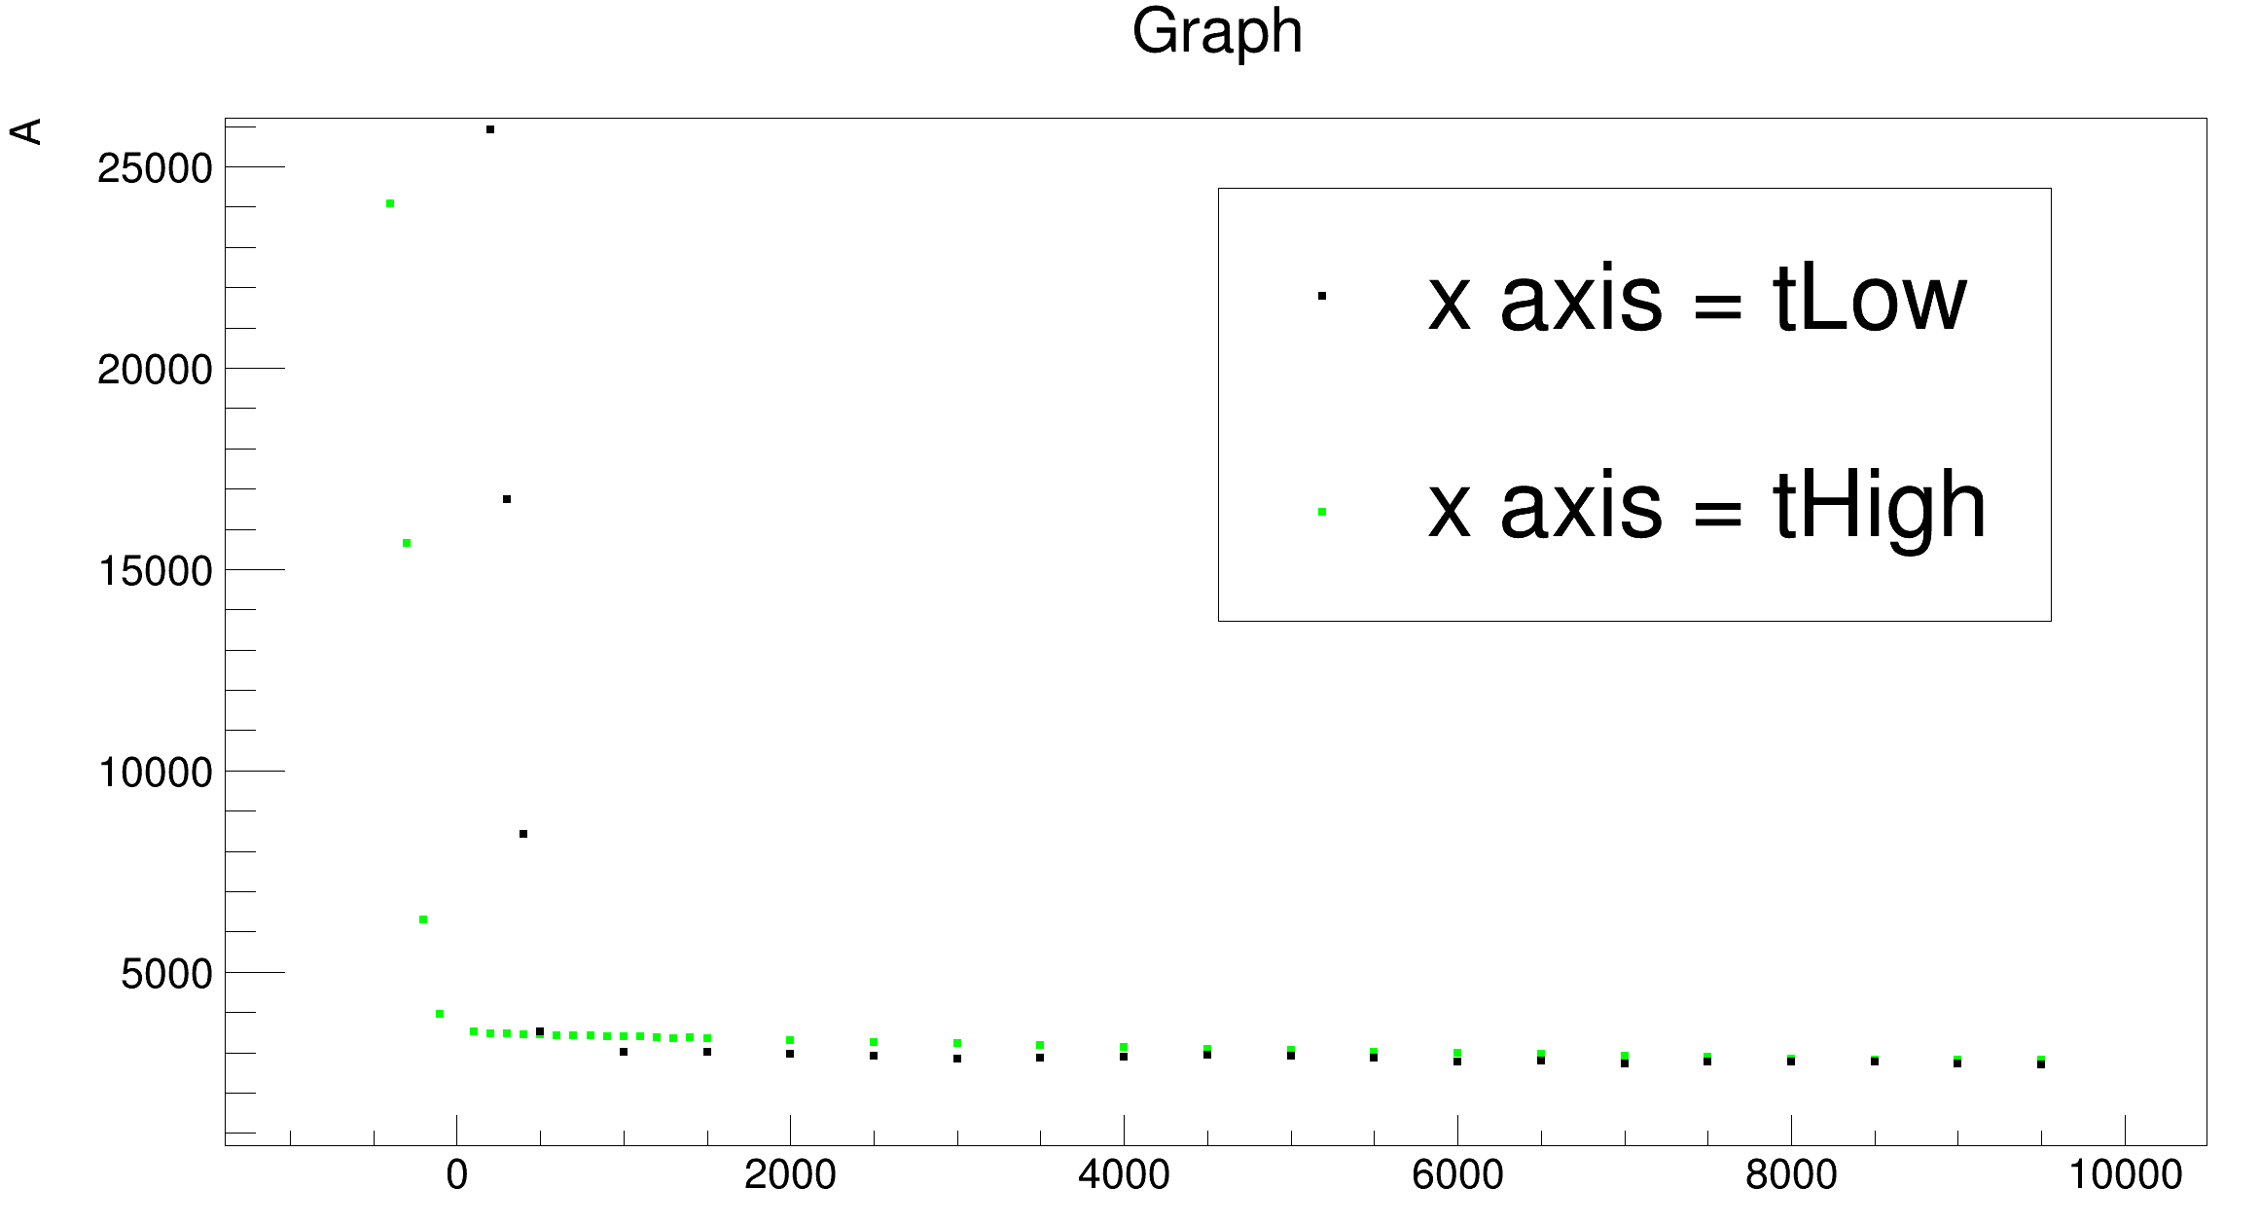
Effect of anti-coincidence window size
74.4keV, 88.4keV, 93.4keV, 95.8keV = C muonic x rays (np-1s)
It looks like the peak is shifted
in time wrt muon:

Slide 41
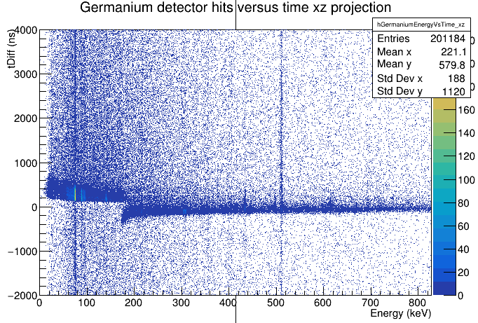
Effect of anti-coincidence window size
74.4keV, 88.4keV, 93.4keV, 95.8keV = C muonic x rays (np-1s)
It looks like the peak is shifted
in time wrt muon
BUT in fact it is because of the
jump in the ELET algorithm when
the threshold is no longer reached

Slide 43
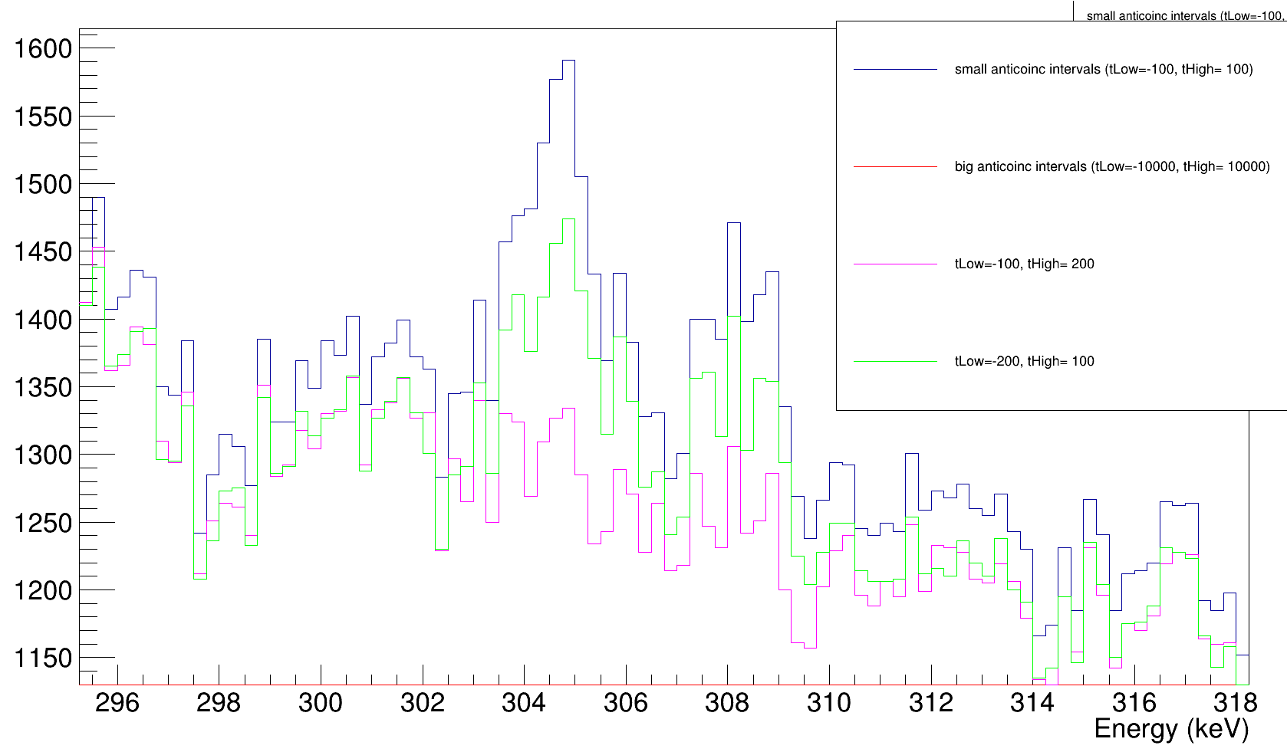
Effect of anti-coincidence window size
305 keV and 308.5keV (Ag muonic x rays, nf-3d)
tHigh has stronger effect
→ time before muon
???

Slide 44
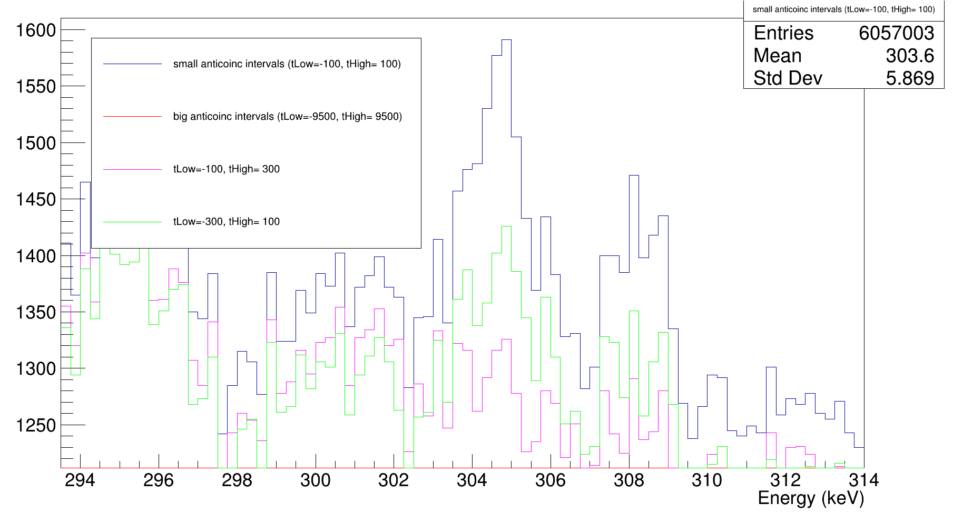
Effect of anti-coincidence window size
305 keV and 308.5keV (Ag muonic x rays , nf-3d)
tHigh has stronger effect
→ time before muon
???
tLow also has reasonable impact

Slide 45
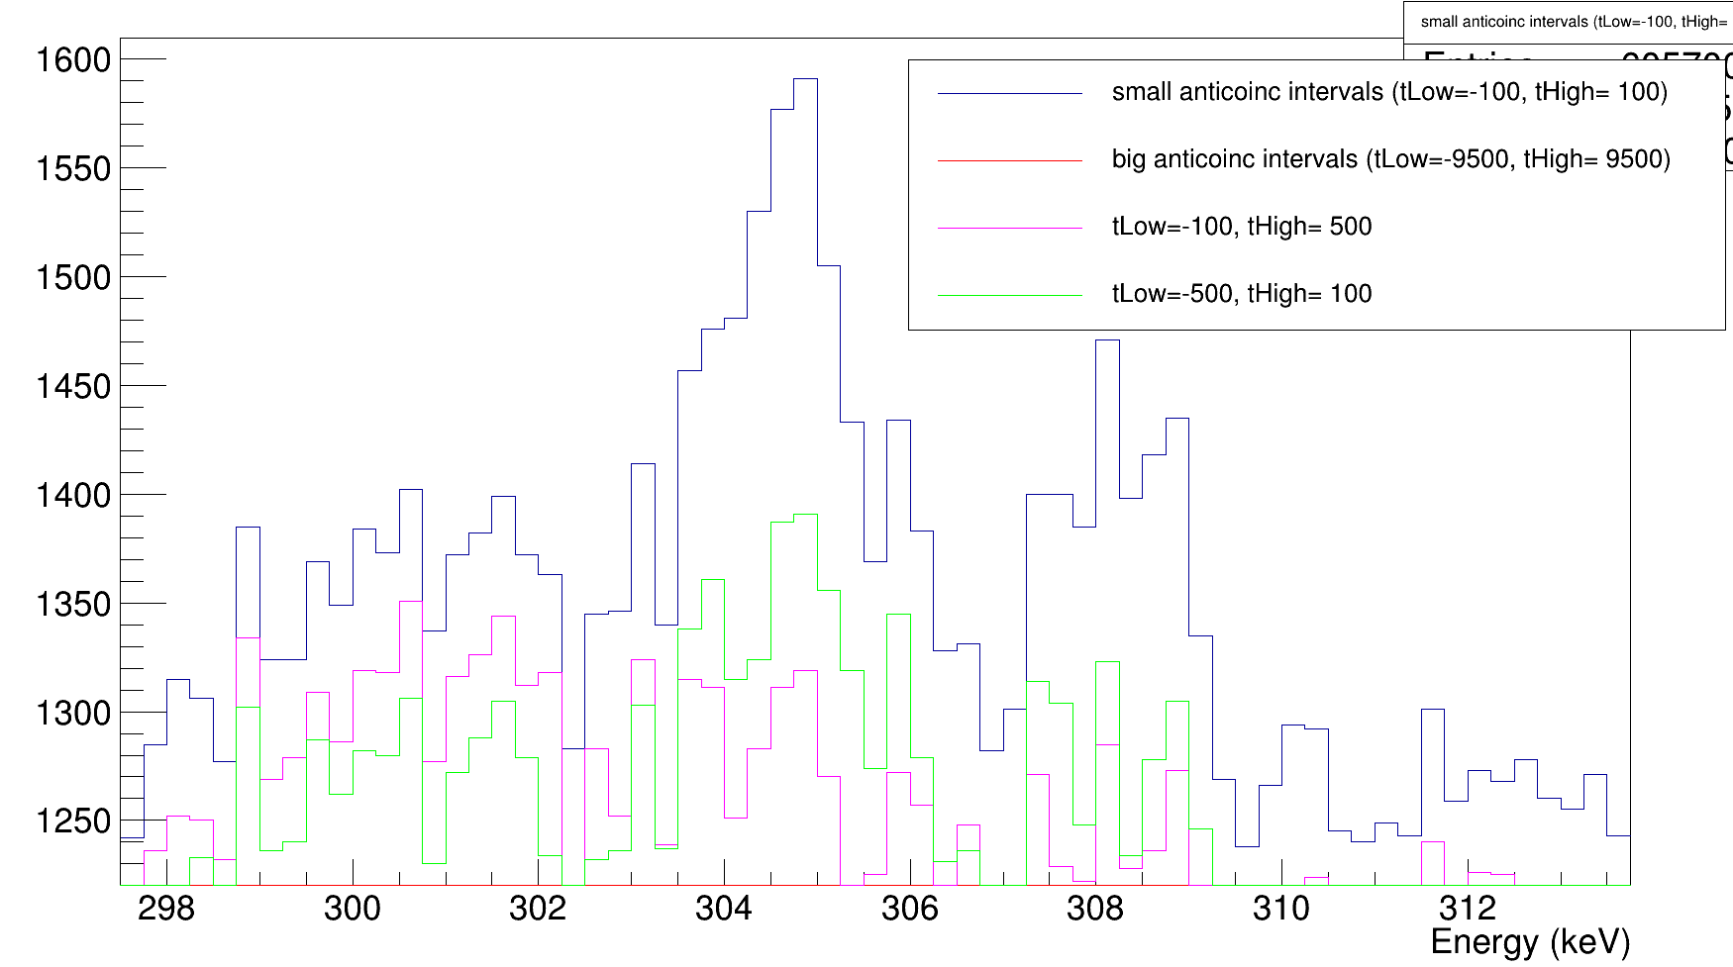
Effect of anti-coincidence window size
305 keV and 308.5keV (Ag muonic x rays , nf-3d)
tHigh has stronger effect
→ time before muon
???
tLow also has reasonable impact
For tLow = -500 ns or tHigh = 500 ns, the muonic silver x rays are almost completely gone

Slide 46
Effect of anti-coincidence window size
305 keV and 308.5keV (Ag muonic x rays , nf-3d)
tHigh has stronger effect
→ time before muon
???
tLow also has reasonable impact
→ per det

Slide 47


Effect of anti-coincidence window size – 305keV peak

Slide 48

Effect of anti-coincidence window size – 305keV peak
Only one run
→ not always enough statistics

Slide 49


Effect of anti-coincidence window size – 305keV peak
Not enough statistics | tHigh increase gives strongest decrease | |tLow| increase gives strongest decrease
Ge05, Ge06A, Ge06B, Ge06C, Ge06D, Ge08, Ge09, Ge11, Ge12, Ge13 | Ge02, Ge04, Ge10, Ge14 | Ge01, Ge03
Ge01
Ge02
Both BEGe

Slide 50

Effect of anti-coincidence window size – 305keV peak
Not because of bad timing at low E, since same behavior is also seen for higher E muonic Ag x rays
Ge02
Revisit my ELET params

Slide 51
Effect of anti-coincidence window size – 305keV peak
Not enough statistics | tHigh increase gives strongest decrease | |tLow| increase gives strongest decrease
Ge05, Ge06A, Ge06B, Ge06C, Ge06D, Ge08, Ge09, Ge11, Ge12, Ge13 | Ge02, Ge04, Ge10, Ge14 | Ge01, Ge03
|tLow| increase is a bit stronger decrease
tHigh increase is a bit stronger decrease
Both BEGe

Slide 52







Slide 53

Effect of anti-coincidence window size
434keV (Ag muonic capture)

Slide 54

Effect of anti-coincidence window size
434keV (Ag muonic capture)
tLow (time after muon) has stronger effect (expected since delayed peak)

Slide 55

Effect of anti-coincidence window size
434keV (Ag muonic capture)
tLow (time after muon) has stronger effect (expected since delayed peak)

Slide 56

Effect of anti-coincidence window size
434keV (Ag muonic capture)
tLow (time after muon) has stronger effect (expected since delayed peak)

Slide 57
Blocking the gammas from ^{108m}Ag with layer of lead??

Slide 58


Blocking the gammas from ^{108m}Ag with layer of lead??
Gamma rays emitted from ^{108m}Ag
What if the rates become too large?
→ target with ~MBq of ^{108m}Ag
4p3/2 → 1s
4p1/2 → 1s
3p3/2 → 1s
3p1/2 → 1s
2p3/2 → 1s
2p1/2 → 1s
4s → 2p1/2
4d3/2 → 2p1/2
4s → 2p3/2
2p3/2 → 4d5/2
4d3/2 → 2p3/2
4p3/2 → 2s
4p1/2 → 2s
3s → 2s
3s → 2p3/2
3d3/2 → 2p1/2
3d5/2 → 2p3/2
3d3/2 → 2p3/2
3p3/2 →2s
3p1/2 → 3p1/2
2s → 2p1/2
2s → 2p3/2

Slide 59



Blocking the gammas from ^{108m}Ag with layer of lead??
$$I= I_{0}e^{−\frac{μ}{ρ} ρ x}$$
$\frac{μ}{ρ}$ depends on energy:

Slide 60


Blocking the gammas from ^{108m}Ag with layer of lead??
$$I= I_{0}e^{−\frac{μ}{ρ} ρ x}$$

Slide 61

Blocking the gammas from ^{108m}Ag with layer of lead??

Slide 62


Blocking the gammas from ^{108m}Ag with layer of lead??

Slide 63


Blocking the gammas from ^{108m}Ag with layer of lead??
Effect of rho

Slide 64

Blocking the gammas from ^{108m}Ag with layer of lead??
Effect of rho

Slide 65
Recoil-sputtering for Ra implantation

Slide 66

Recoil-sputtering: principle

Slide 67


Recoil-sputtering: 1) implantation
TRIDYN simulation for 180kBq (1.31*10¹⁶ particles) of ²²⁶Ra at 30keV (1cmx1cm implantation spot)
NOTE: surface binding energy of Ra is by default taken to be 0 in TRIDYN

Slide 68


Recoil-sputtering: 1) implantation
TRIDYN simulation for 180kBq (1.31*10¹⁶ particles) of ²²⁶Ra at 30keV (1cmx1cm implantation spot)
NOTE: surface binding energy of Ra is by default taken to be 0 in TRIDYN

Slide 69
Recoil-sputtering: 2) Recoil-sputter simulation
Generated target from depth profile (discrete: 23 layers of 21A (Ra+C), backing of 1500A (C))
Generate recoiling ²²²Rn particles based on the Q-value by simulating ~90000 recoiling particles with position according to the depth profile

Slide 70


Recoil-sputtering: 2) Recoil-sputter simulation
Sputtering yield per simulation layer
Ra

Slide 71

Recoil-sputtering: 3) Activity lost after 1 year

Slide 72

Recoil-sputtering: 3) Activity lost after 1 year
Ra
5.67*10¹² particles lost due to decay
Ra
Note that this is only for the first alpha decay, there are 4 subsequent alpha decays → rough estimate: < 1Bq lost after one year

Slide 73

Recoil-sputtering: 3) Activity lost after 1 year

Slide 74
Ag collection analysis

Slide 75

Plan for next collection
Contacted Maria and BR2
Contacted Lino and Andre to test the self-sputtering simulations for Ag

