Slide 1
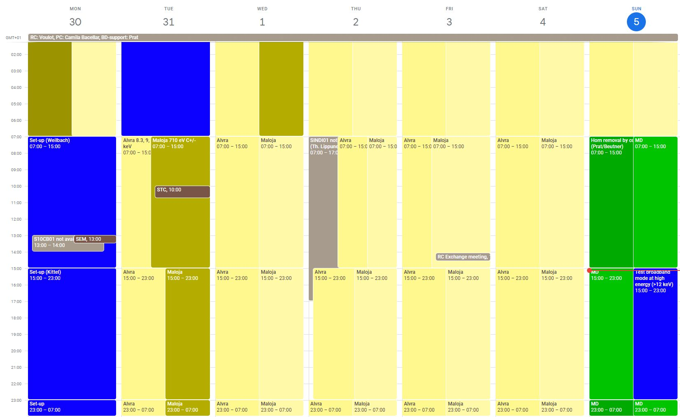
Aramis: Alvra 8.3, 9, 7.7, 6.55 keV
Athos: Maloja 710 eV C+/-

Slide 2
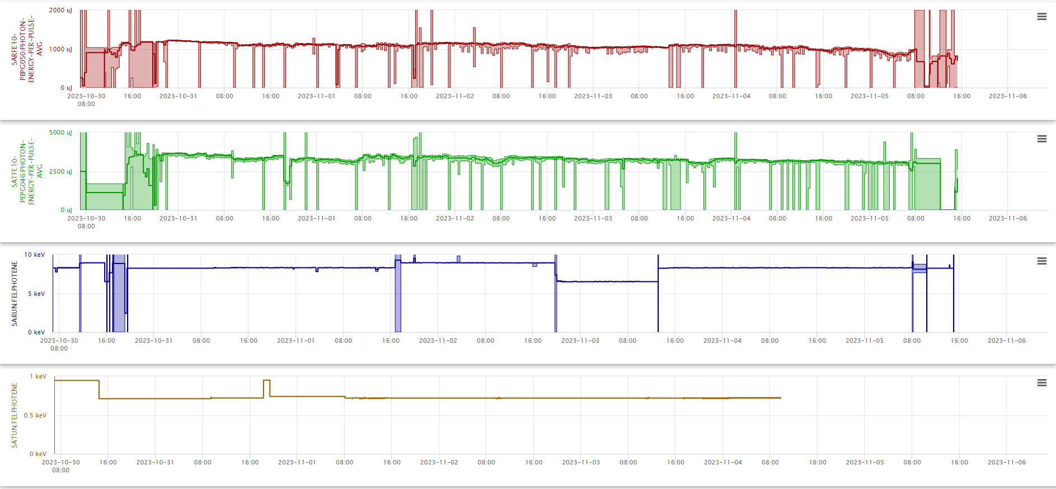

Slide 3
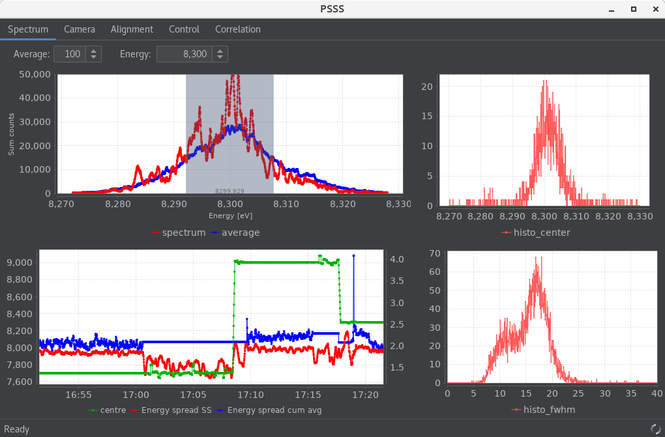
Set-up
Bunch length measurement before the set-up (after Cristallina week)
-> electron bunch length (23 fs rms) + passive streaker measurements of the photon pulse length (??)
Aramis settings:
9 keV, 1.16 mJ
8.3 keV, 1.15 mJ (not fully optimised)
6.5 keV, 1.055 mJ (quick optimisation)
7.7 keV, 1.13 mJ (quick optimisation)
BW 0.17-0.20 %
Electron bunch length (measured on Sunday) 21 fs rms
Athos settings:
710 eV, C+ 3.6 mJ
PMOS?

Slide 4
Technical problems
Problems causing downtime
None…
Other problems
focusing of SARBD02-DSCR050 not correct (was corrected on Monday)
New VRF server, some time lost during energy change
Collimator motors stuck (was not in the beam, wait for Monday)
Athos undulators are getting stuck again, controller power cycled by Maloja (2x)
Several energy changes + many scans: lasing tends to decay, maybe good to take some time during the week to check the settings

