Slide 1
Single-quadrupole-magnet scan to measure the slice emittance of electron beams
Tyler Schowalter :: Paul Scherrer Institute
Tyler Schowalter Progress Report on 24.10.2023

Slide 2
Contents
Background on symmetric single quadrupole scans
Projected emittance measurement
  Elegant and analytical calculations
  Emittance verification
Slice emittance measurement
  Proposed lattice
  Elegant and analytical calculations
  Test results

Slide 3
Background
Importance of measuring transverse beam properties:
  Low normalized emittance makes smaller and more efficient FEL accelerators feasible
  Measuring the longitudinally-resolved or slice properties is fundamental for FELs
Typical methods for measurement:
  Multi-screen (FODO) scans:
    Use a series of profile monitors for one optical setup
    Requires more components and typically longer beamlines
  Multi-optics (specifically multi-quad approach):
    Use a series of quadrupole-magnets to vary the optics at a single profile monitor
    Less components, more flexible, and typically more compact

Slide 4
Overview
Overall Goal: Expand the symmetric single-quad scan to measure slice parameters
Works by changing optics at the quad position such that the phase advance varies much more in the measurement direction than in the streaking plane
The optimum measurement setup was calculated analytically and then tested at the injector and after bunch compression experimentally
Benefits over Multi-Quad Scan:
  Only one quadrupole is incrementally scanned (in principle less prone to error)
  More intuitive
  Smaller magnetic strengths
  Phase advances and β functions can be analytically calculated and easily changed

Slide 5
Tools Used
A variety of tools were used for this project:
  Elegant
    Software designed to simulate accelerator lattices
    Used to simulate optics measurements
  sdds
    File structure used by elegant
    Provides many options for analyzing and selecting data
  Python
    Many modules (pandas, numpy, scipy, pathlib, sympy, matplotlib, etc.)

Slide 6
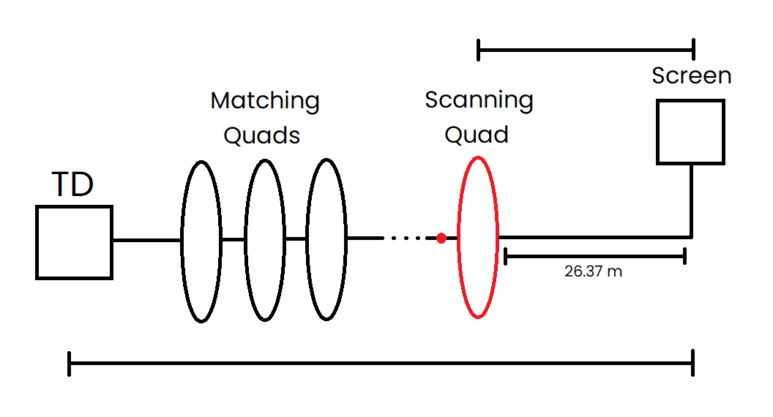
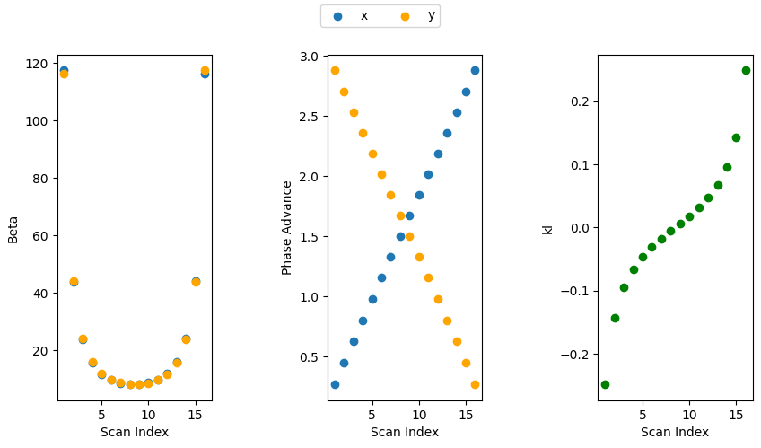


SQS Projected Emittance Measurement
Initial Twiss Parameters
  $α_{0}∙L=β_{0}$
Relation between quad strength and phase advance
  $\frac{1}{f}=kl=−\frac{1}{\tan{μ_{x}}∙β_{0}}=\frac{1}{\tan{μ_{y}∙β_{0}}}$
Beta function
  $β=\frac{L^{2}}{β_{0}∙\sin^{2}{μ}}$
  $β_{min}=\frac{L^{2}}{β_{0}}$
$$α_{0}L=β_{0}$$
L
β₀ = 15
α₀ = 1.385
L = 10.83

Slide 7
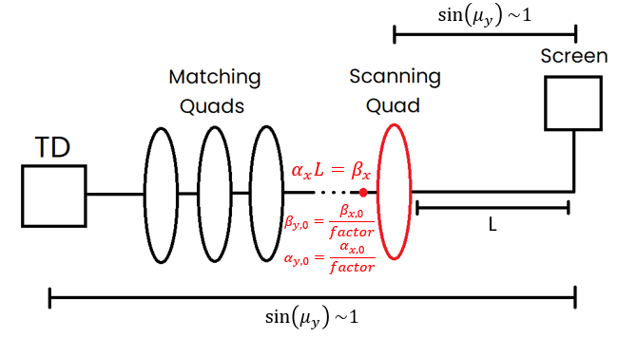
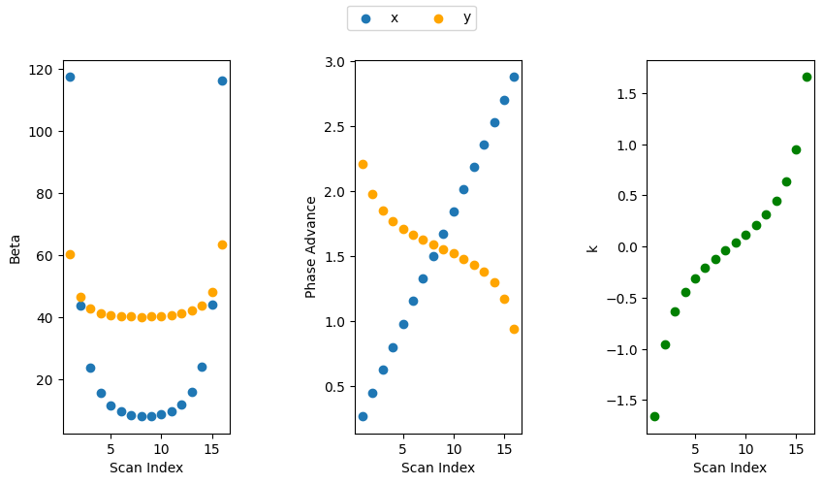
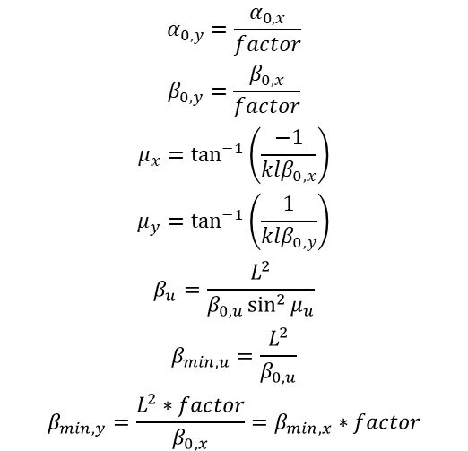
SQS Slice Emittance Measurement
$$α_{0,y}=\frac{α_{0,x}}{factor}$$
$$β_{0,y}=\frac{β_{0,x}}{factor}$$
$$μ_{x}=\tan^{−1}\left(\frac{−1}{klβ_{0,x}}\right)$$
$$μ_{y}=\tan^{−1}\left(\frac{1}{klβ_{0,y}}\right)$$
$$β_{u}=\frac{L^{2}}{β_{0,u}\sin^{2}{μ_{u}}}$$
$$β_{min,u}=\frac{L^{2}}{β_{0,u}}$$
$$β_{min,y}=\frac{L^{2}∗factor}{β_{0,x}}=β_{min,x}∗factor$$
β_{x} = 15
α_{x} = 1.385
L = 10.83

Slide 8
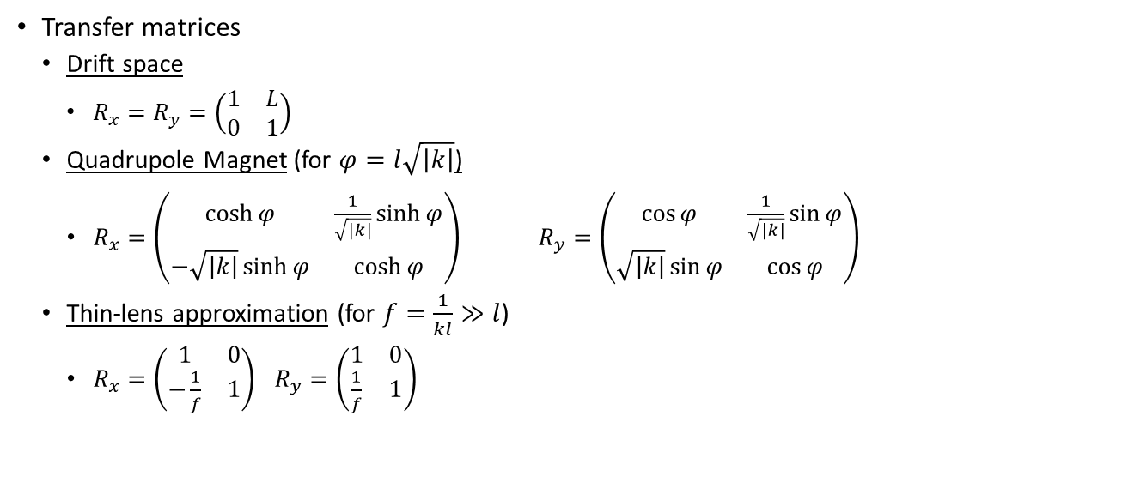
Verification of the SQS Calculation (Analytical)
Transfer matrices
  Drift space
    $R_{x}=R_{y}=\left(\begin{matrix}1 & L \\ 0 & 1\end{matrix}\right)$
  Quadrupole Magnet (for $φ=l\sqrt{\left|k\right|}$)
    $R_{x}=\left(\begin{matrix}\cosh{φ} & \frac{1}{\sqrt{\left|k\right|}}\sinh{φ} \\ −\sqrt{\left|k\right|}\sinh{φ} & \cosh{φ}\end{matrix}\right)$ $R_{y}=\left(\begin{matrix}\cos{φ} & \frac{1}{\sqrt{\left|k\right|}}\sin{φ} \\ \sqrt{\left|k\right|}\sin{φ} & \cos{φ}\end{matrix}\right)$
  Thin-lens approximation (for $f=\frac{1}{kl}≫l$)
    $R_{x}=\left(\begin{matrix}1 & 0 \\ −\frac{1}{f} & 1\end{matrix}\right)$ $R_{y}=\left(\begin{matrix}1 & 0 \\ \frac{1}{f} & 1\end{matrix}\right)$

Slide 9

Verification of the SQS Calculation (Analytical)
Matrix Multiplication
  $R_{x}=\left(\begin{matrix}1 & L \\ 0 & 1\end{matrix}\right)\left(\begin{matrix}1 & 0 \\ −\frac{1}{f} & 1\end{matrix}\right)=\left(\begin{matrix}1−\frac{L}{f} & L \\ −\frac{1}{f} & 1\end{matrix}\right)=\left(\begin{matrix}\sqrt{\frac{β_{x}}{β_{0,x}}(\cos{μ_{x}}+α_{0,x}\sin{μ_{x}})} & \sqrt{β_{x}β_{0,x}}\sin{μ_{x}} \\ \frac{1}{\sqrt{β_{x}β_{0,x}}}(\left(α_{0,x}−α_{x}\right)\cos{μ_{x}}−\left(1+α_{x}α_{0,x}\right)\sin{μ_{x}}) & \sqrt{\frac{β_{0,x}}{β_{x}}}(\cos{μ_{x}}−α_{x}\sin{μ_{x}})\end{matrix}\right) =\left(\begin{matrix}C & S \\ C′ & S′\end{matrix}\right)$
  $\left(\begin{matrix}y \\ y′\end{matrix}\right)=\left(\begin{matrix}C & S \\ C^{′} & S^{′}\end{matrix}\right)\left(\begin{matrix}y_{0} \\ y_{0}^{′}\end{matrix}\right)\overset{⇒}{}y_{0}=S^{′}y−Sy^{′},y_{0}^{′}=−C^{′}y+Cy^{′}$
  $\overset{⇒}{}ε=γ_{0}{\left(S^{′}y−Sy^{′}\right)}^{2}+2α_{0}\left(S^{′}y−Sy^{′}\right)\left(−C^{′}y+Cy^{′}\right)+β_{0}\left(−C^{′}y+Cy^{′}\right)=γy^{2}+2αyy^{′}+βy^{′2}$
  $β\left(s\right)=C^{2}β_{0}−2SCα_{0}+S^{2}γ_{0}$
  $α\left(s\right)=−CC^{′}β_{0}+\left(SC^{′}+S^{′}C\right)α_{0}−SS^{′}γ_{0}$
  $γ\left(s\right)=C^{′2}β_{0}−2S^{′}C^{′}α_{0}+S^{′2}γ_{0}$

Slide 10
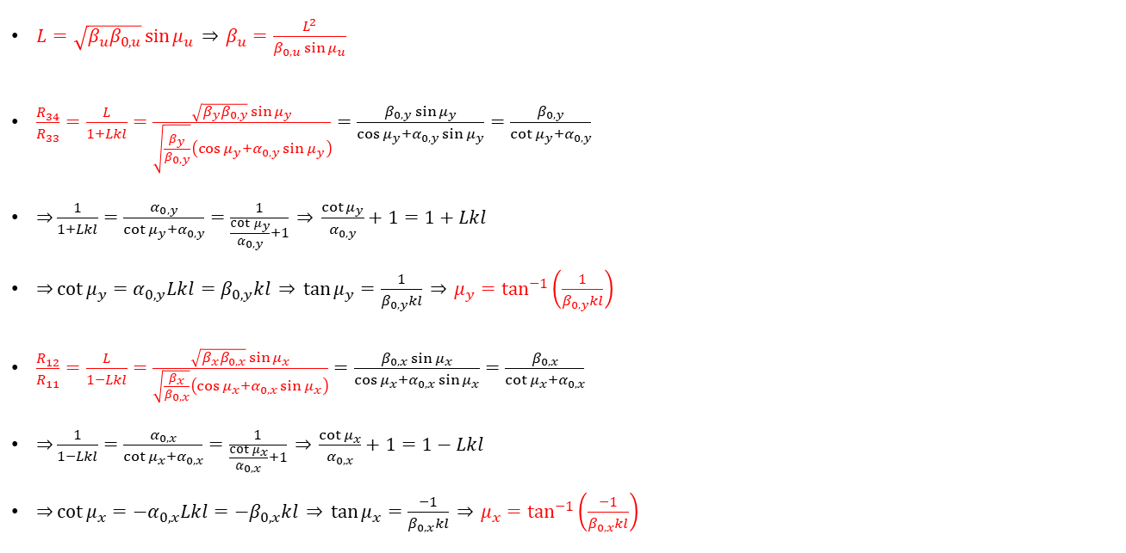
Obtaining the Formulas
$L=\sqrt{β_{u}β_{0,u}}\sin{μ_{u}} \overset{⇒}{} β_{u}=\frac{L^{2}}{β_{0,u}\sin{μ_{u}}}$
$\frac{R_{34}}{R_{33}}=\frac{L}{1+Lkl}=\frac{\sqrt{β_{y}β_{0,y}}\sin{μ_{y}}}{\sqrt{\frac{β_{y}}{β_{0,y}}}\left(\cos{μ_{y}}+α_{0,y}\sin{μ_{y}}\right)}=\frac{β_{0,y}\sin{μ_{y}}}{\cos{μ_{y}}+α_{0,y}\sin{μ_{y}}}=\frac{β_{0,y}}{\cot{μ_{y}}+α_{0,y}}$
$\overset{⇒}{}\frac{1}{1+Lkl}=\frac{α_{0,y}}{\cot{μ_{y}}+α_{0,y}}=\frac{1}{\frac{\cot{μ_{y}}}{α_{0,y}}+1} \overset{⇒}{} \frac{\cot{μ_{y}}}{α_{0,y}}+1=1+Lkl$
$\overset{⇒}{}\cot{μ_{y}}=α_{0,y}Lkl=β_{0,y}kl \overset{⇒}{} \tan{μ_{y}}=\frac{1}{β_{0,y}kl} \overset{⇒}{} μ_{y}=\tan^{−1}\left(\frac{1}{β_{0,y}kl}\right)$
$\frac{R_{12}}{R_{11}}=\frac{L}{1−Lkl}=\frac{\sqrt{β_{x}β_{0,x}}\sin{μ_{x}}}{\sqrt{\frac{β_{x}}{β_{0,x}}}\left(\cos{μ_{x}}+α_{0,x}\sin{μ_{x}}\right)}=\frac{β_{0,x}\sin{μ_{x}}}{\cos{μ_{x}}+α_{0,x}\sin{μ_{x}}}=\frac{β_{0,x}}{\cot{μ_{x}}+α_{0,x}}$
$\overset{⇒}{}\frac{1}{1−Lkl}=\frac{α_{0,x}}{\cot{μ_{x}}+α_{0,x}}=\frac{1}{\frac{\cot{μ_{x}}}{α_{0,x}}+1} \overset{⇒}{} \frac{\cot{μ_{x}}}{α_{0,x}}+1=1−Lkl$
$\overset{⇒}{}\cot{μ_{x}}={−α}_{0,x}Lkl={−β}_{0,x}kl \overset{⇒}{} \tan{μ_{x}}=\frac{−1}{β_{0,x}kl} \overset{⇒}{} μ_{x}=\tan^{−1}\left(\frac{−1}{β_{0,x}kl}\right)$

Slide 11
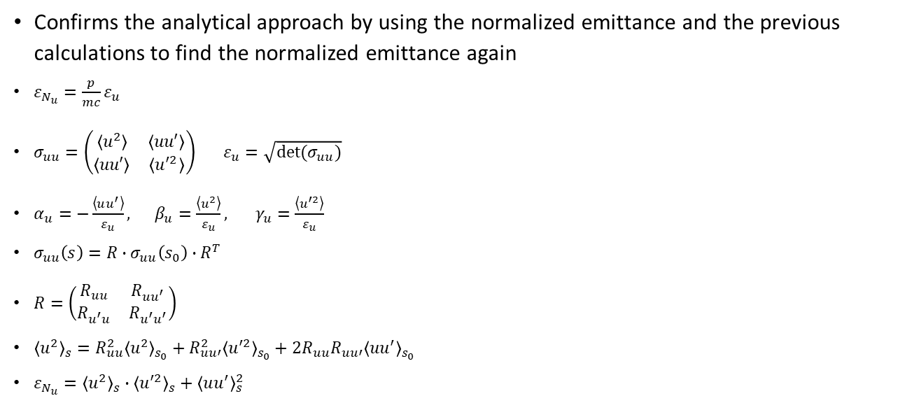
Emittance Verification
Confirms the analytical approach by using the normalized emittance and the previous calculations to find the normalized emittance again
$ε_{N_{u}}=\frac{p}{mc}ε_{u}$
$σ_{uu}=\left(\begin{matrix}\left\langle u^{2}\right\rangle & \left\langle uu′\right\rangle \\ \left\langle uu′\right\rangle & \left\langle u^{′2}\right\rangle \end{matrix}\right)$ $ε_{u}=\sqrt{det⁡(σ_{uu})}$
$α_{u}=−\frac{\left\langle uu^{′}\right\rangle }{ε_{u}}, β_{u}=\frac{\left\langle u^{2}\right\rangle }{ε_{u}}, γ_{u}=\frac{\left\langle u^{′2}\right\rangle }{ε_{u}}$
$σ_{uu}\left(s\right)=R∙σ_{uu}\left(s_{0}\right)∙R^{T}$
$R=\left(\begin{matrix}R_{uu} & R_{uu^{′}} \\ R_{u^{′}u} & R_{u^{′}u^{′}}\end{matrix}\right)$
${\left\langle u^{2}\right\rangle }_{s}=R_{uu}^{2}{\left\langle u^{2}\right\rangle }_{s_{0}}+R_{uu′}^{2}{\left\langle u^{′2}\right\rangle }_{s_{0}}+2R_{uu}R_{uu′}{\left\langle uu^{′}\right\rangle }_{s_{0}}$
$ε_{N_{u}}={\left\langle u^{2}\right\rangle }_{s}∙{\left\langle u^{′2}\right\rangle }_{s}+{\left\langle uu^{′}\right\rangle }_{s}^{2}$

Slide 12
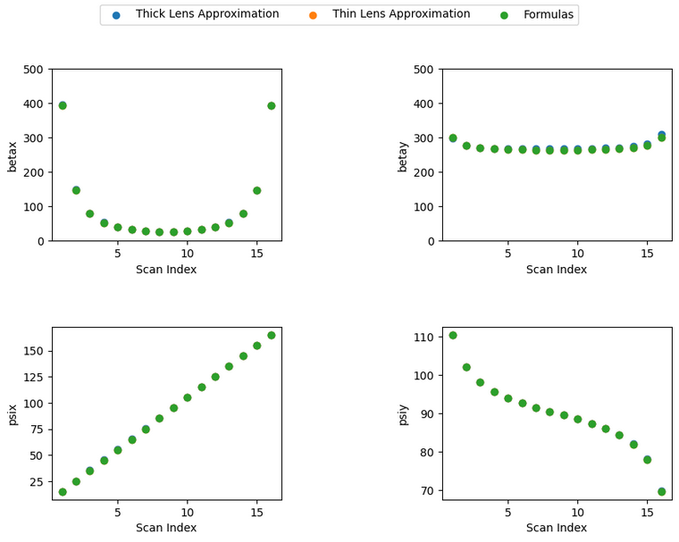
Verifying the Equations for Slice Emittance
Comparing the thin-lens approximation to the equations, there is no difference
The equations are therefore valid to calculate the beam parameters
β_{0,x} = 26.37
α_{0,x} = 1
L = 26.37 m

Slide 13


Proposed Lattice Summary
The proposed lattice to be used for this measurement was initially contained within the line BC1
Due to complications with the optimization, the lattice was revised to extend another ~100 m out to the S10MA01 section
Utilizes 27 matching quadrupoles to create the proper conditions for the scanning quadrupole in section S10BC01, L = 26.37 m from the screen in S10MA01
SINDI02.MQUA020 –
S10BC01.MQUA060
S10BC01.MQUA080
S10MA01.DSCR090
$$\sin\left(μ_{y}\right)\sim 1$$
SINDI01.RTDS100
L
$$\sin\left(μ_{y}\right)\sim 1$$

Slide 14
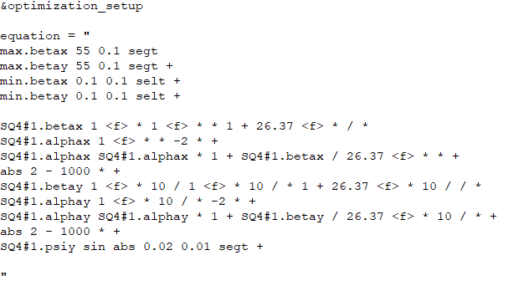
Slice Emittance Measurements for the Proposed Lattice
The program runs through different alpha (and coincidentally beta) values to find the minimum optimization value
Many solutions found, β_{x} = 26.37, α_{x} = 1, factor of 10 was chosen

Slide 15
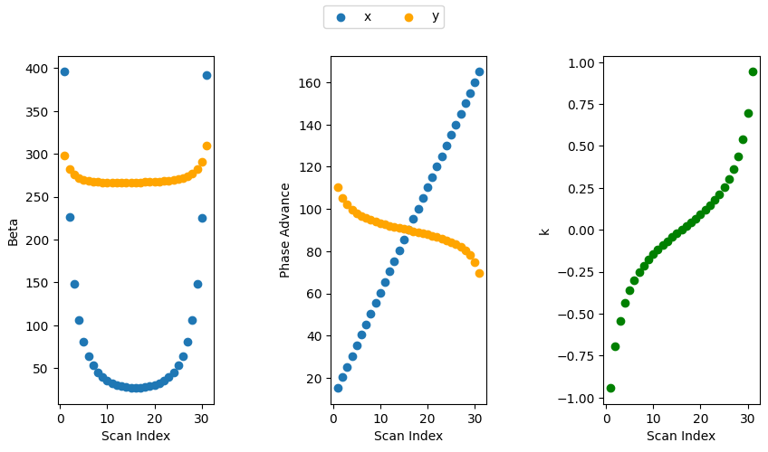
Analytical Verification of Previous Results
Using previous analytical calculations for slice emittance, the results from elegant were confirmed by plotting the optics
β_{0,x} = 15
α_{0,x} = 1.385
L = 26.37 m

Slide 16
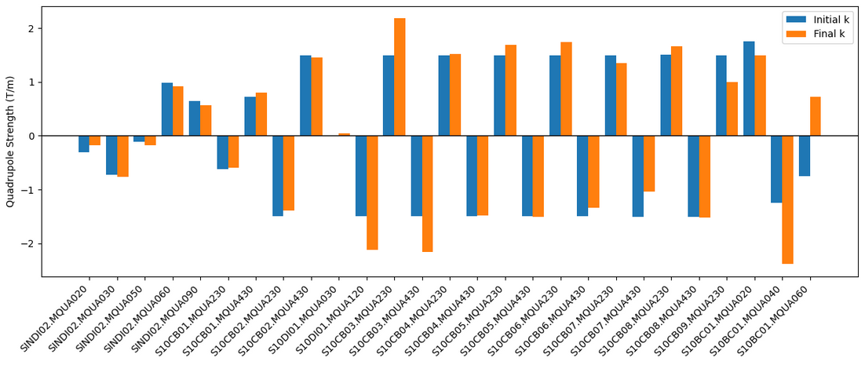
Quadrupole Strength Variation
Very little variation in the majority of the matching quadrupole strengths

Slide 17
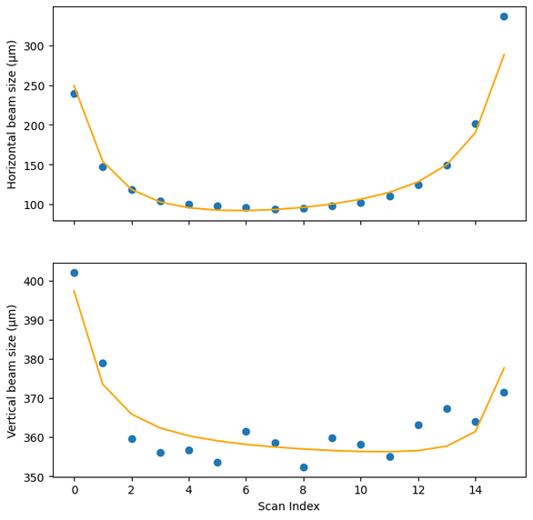
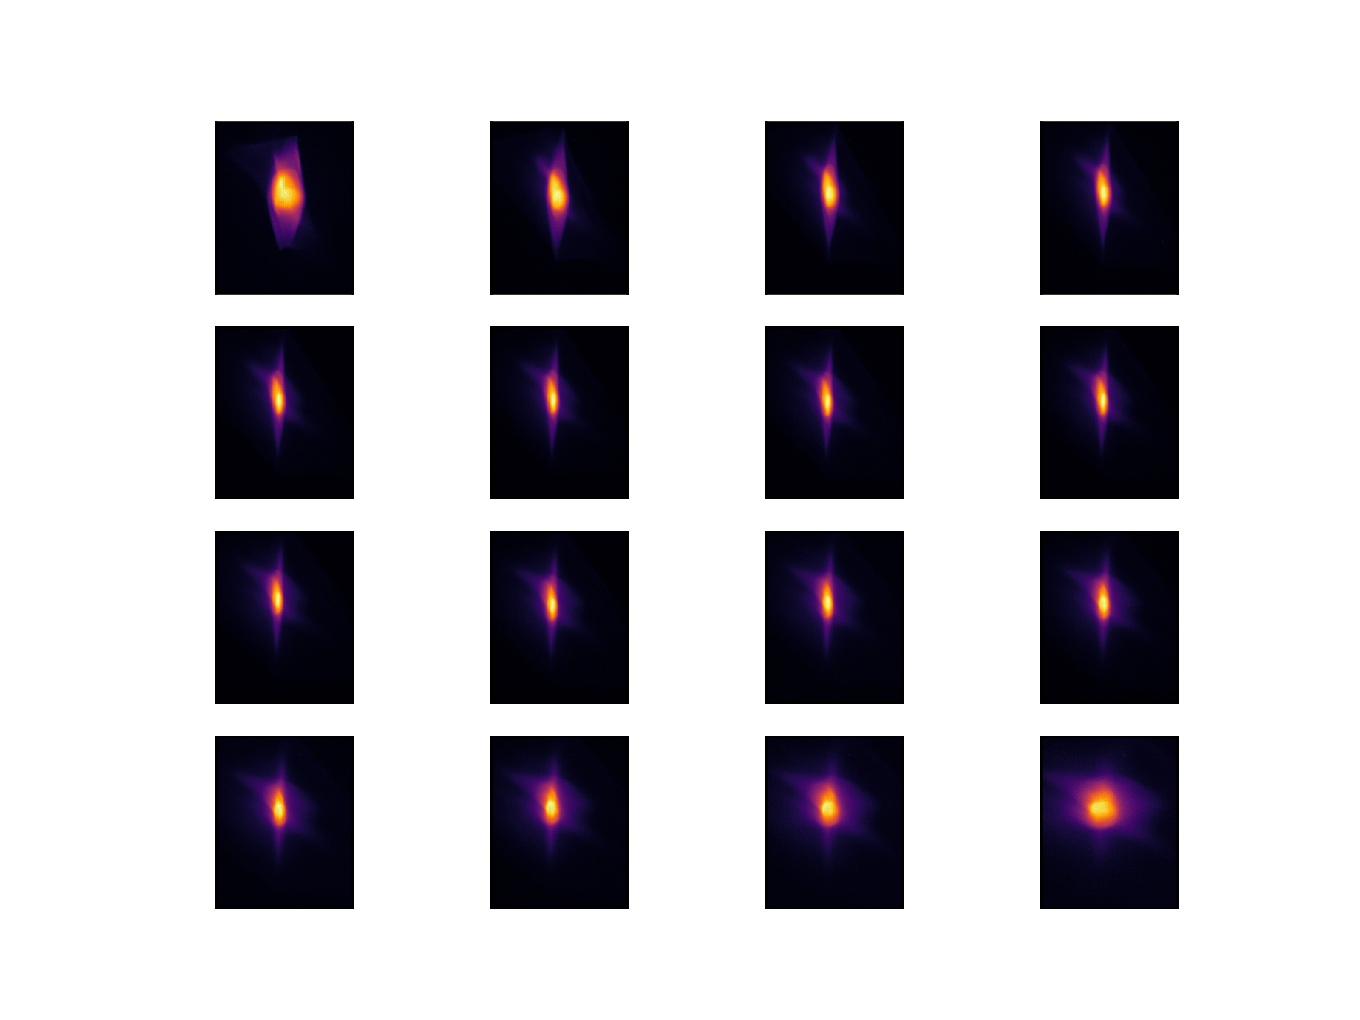
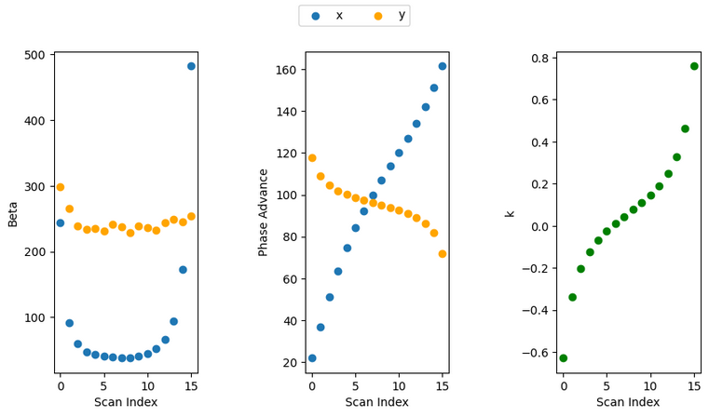
Testing the Technique on the Beamline
Mismatch = 1.08
Projected measurement
Mismatch = 1.01
15°
25°
35°
45°
55°
65°
75°
85°
95°
105°
115°
125°
135°
145°
155°
165°
Y (mm)
X (mm)

Slide 18
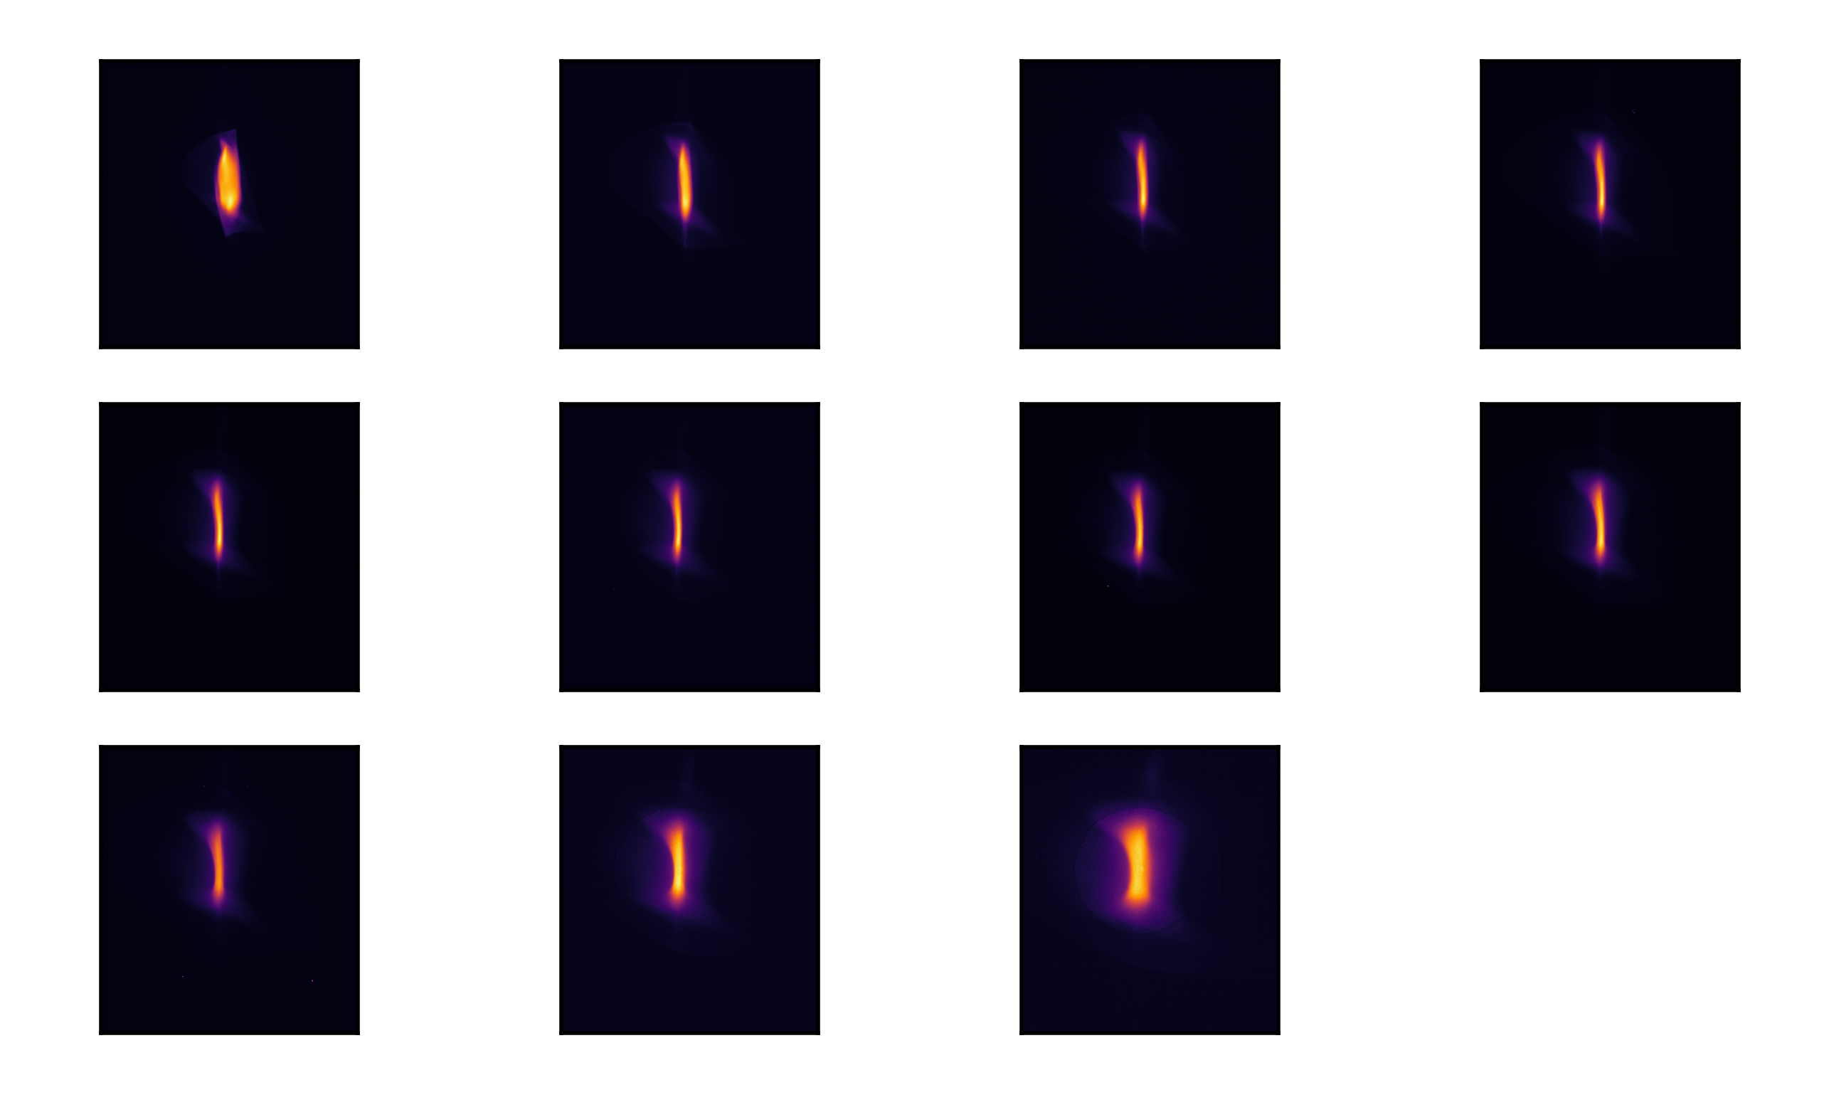
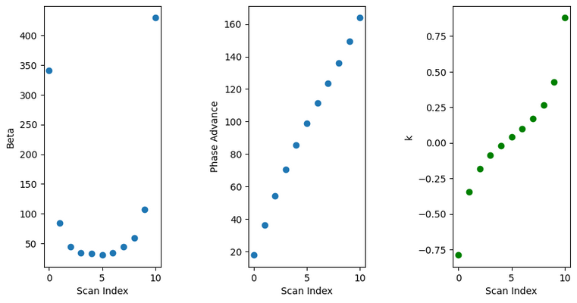
Testing the Technique on the Beamline
Slice emittance measurement
Core Optics
15°
30°
45°
60°
75°
90°
105°
120°
135°
150°
165°
Y (mm)
t (s)
X (mm)

Slide 19
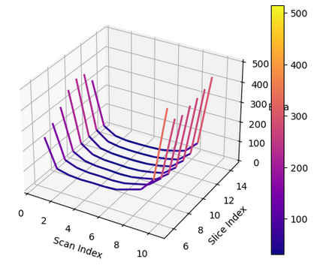
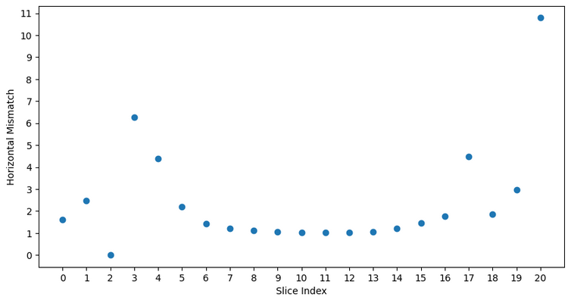
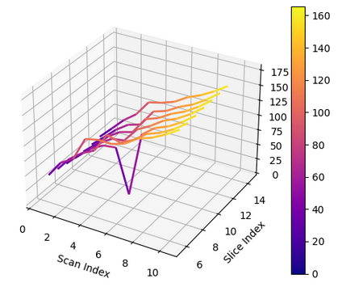
Testing the Technique on the Beamline
Slice Betas
Slice emittance measurement
Slices 7-13
Slice Phase Advance

Slide 20
Conclusions
Test results show success in the implementation of this technique
  Mismatch is low in x
Technique is limited in its application
  Needs enough space between the transverse deflector and screen
Technique has many benefits
  Only one quadrupole is scanned
  More intuitive matching process
  Simple equations

Slide 21
Acknowledgements
Thank you to the Paul Scherrer Institut, without whom this project would not be possible
Special thanks to Eduard Prat Costa, Philipp Dijkstal, and Sven Reiche for their help understanding the background for this project and the techniques used in it

Slide 22
References
Dattoli, G., Sabia, E., Ronsivalle, C., Del Franco, M., & Petralia, A. (2010). Slice emittance, projected emittance and properties of the Sase Fel Radiation. Nuclear Instruments and Methods in Physics Research Section A: Accelerators, Spectrometers, Detectors and Associated Equipment, 671, 51–61. https://doi.org/10.1016/j.nima.2011.12.099
Roßbach, J., & Schmüser, P. (1993). Basic course on accelerator optics. DESY.
Prat, E. (2014). Symmetric single-quadrupole-magnet scan method to measure the 2D transverse beam parameters. Nuclear Instruments and Methods in Physics Research Section A: Accelerators, Spectrometers, Detectors and Associated Equipment, 743, 103–108. https://doi.org/10.1016/j.nima.2014.01.021
Prat, E., Aiba, M., Bettoni, S., Beutner, B., Reiche, S., & Schietinger, T. (2014). Emittance measurements and minimization at the Swissfel Injector Test Facility. Physical Review Special Topics - Accelerators and Beams, 17(10). https://doi.org/10.1103/physrevstab.17.104401

