Slide 1
Recent activities with the PolariX deflecting cavity
Fabio Marcellini, Paolo Craievich :: Paul Scherrer Institute
SwissFEL Progress Meeting (SPM): 12 December 2023

Slide 2
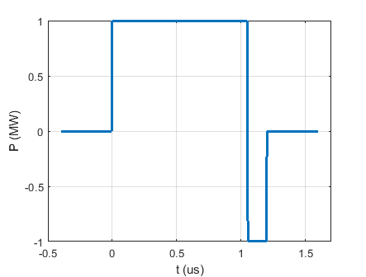
Analysis and optimization of the TDS efficiency as a function of the RF pulse shape.
Short summary of a recent summer student (Riccardo Sansone) work.
    Structure filling time: 130 ns
    Maximum RF pulse length: 1.2 us
Ideal vs. actual (measured through a directional coupler at the klystron output) RF pulse.
For consistent comparison in both cases pulse energy is normalized to 1.2 J

Slide 3
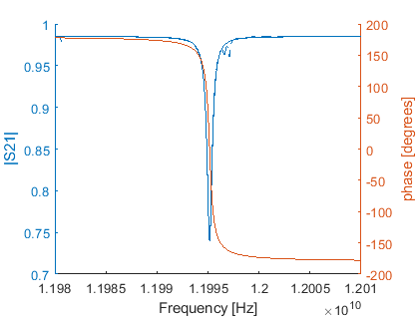
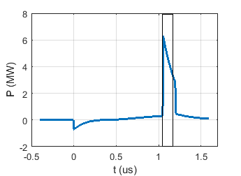
Ideal pulse – flat in amplitude and phase
Klystron output
BOC frequency response
BOC output
β = 7.0714;
Q_{L}=18378;
f₀=11.995158GHz;
Waveguide attenuation not considered.
We are operating with the phase inversion time at 1.05us → compressed pulse length is 150 ns.
Deflecting voltage (V_{Ʇ}) produced by the compressed pulse propagating along a single TDS is 12.4MV.
Without compression V_{Ʇ} = 6MV.

Slide 4
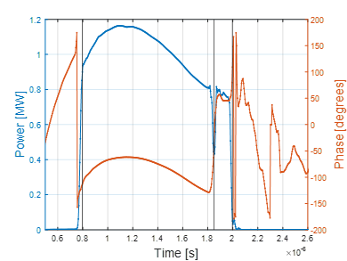
Actual pulse shape
Same calculations with the real pulse shape gives V_{Ʇ} = 10.3 MV (-17%).
In case of ideal pulse we could have the same V_{Ʇ} with 30% less power.
considering the actual pulse amplitude and an ideally flat phase, or vice versa, ideal amplitude and actual phase, we found that amplitude and phase have similar weigth in lowering the efficiency.
First attempt to modulate the LLRF signal to get a flatter RF pulse.
V_{Ʇ} increases by about 8% (calculated, not yet measured with beam).

Slide 5
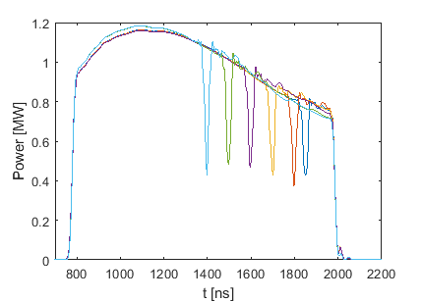
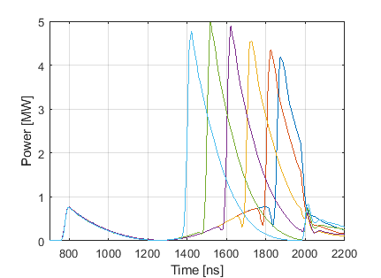
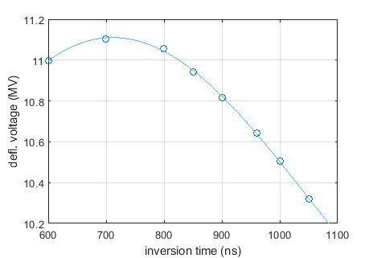
Actual pulse, different phase inversion time
Due to the slope in the RF pulse it seems to be beneficial bringing forward the phase inversion time.
Without applying any flattening of the pulse by means of LLRF, and simply moving the phase inversion time, it should be possoble to gain about 7% in deflecting voltage.

Slide 6
MD shift activity
Goal of the last MD shifts was: verify the analytical results, maximize the ratio deflecting voltage / RF power (calibration factor), improve the precision of calibration factor estimate.
We measured the beam centroid with the BPMs downstream the TDS (SATBD01-DBPM020/060/100) and in the beam dump (SATBD02-DBPM040) correlating for every single beam shot the measured position with the RF phase (set value + jitter).
SATBD02-DSCR050 screen was difficult to be used because Gaussian fitting is not always available in the ROI and the rep rate of the measurement is limited to 1 Hz.
Deflecting voltage is V=S*E/(c*k*R12), with k the RF wave number and S is obtained from the BPMs as S=Delta_centroid/Delta phase.
Phase jitter at the zero-crossing RF phase is not enough to get reproducible estimates of S. Measurement error sources are orbit and arrival time jitters. Then it is necessary to make a scan of the RF phase around the zero-crossing phase. But the width of the scan is limited by the radiation losses in DRPS. With horizontal polarization the losses made the measurement impossible.
During the last shift, past Friday, we used vertical polarization and we got reproducible measurements when the RF phase was moved in the range -/+1 deg wrt zero-crossing.
Verification of the analytical results is very complicate, beacause when we tried to move the inversion time in the RF pulse, we noticed that the working point on the klystron curve moved, then the comparison among different inversion times is not possible.

Slide 7
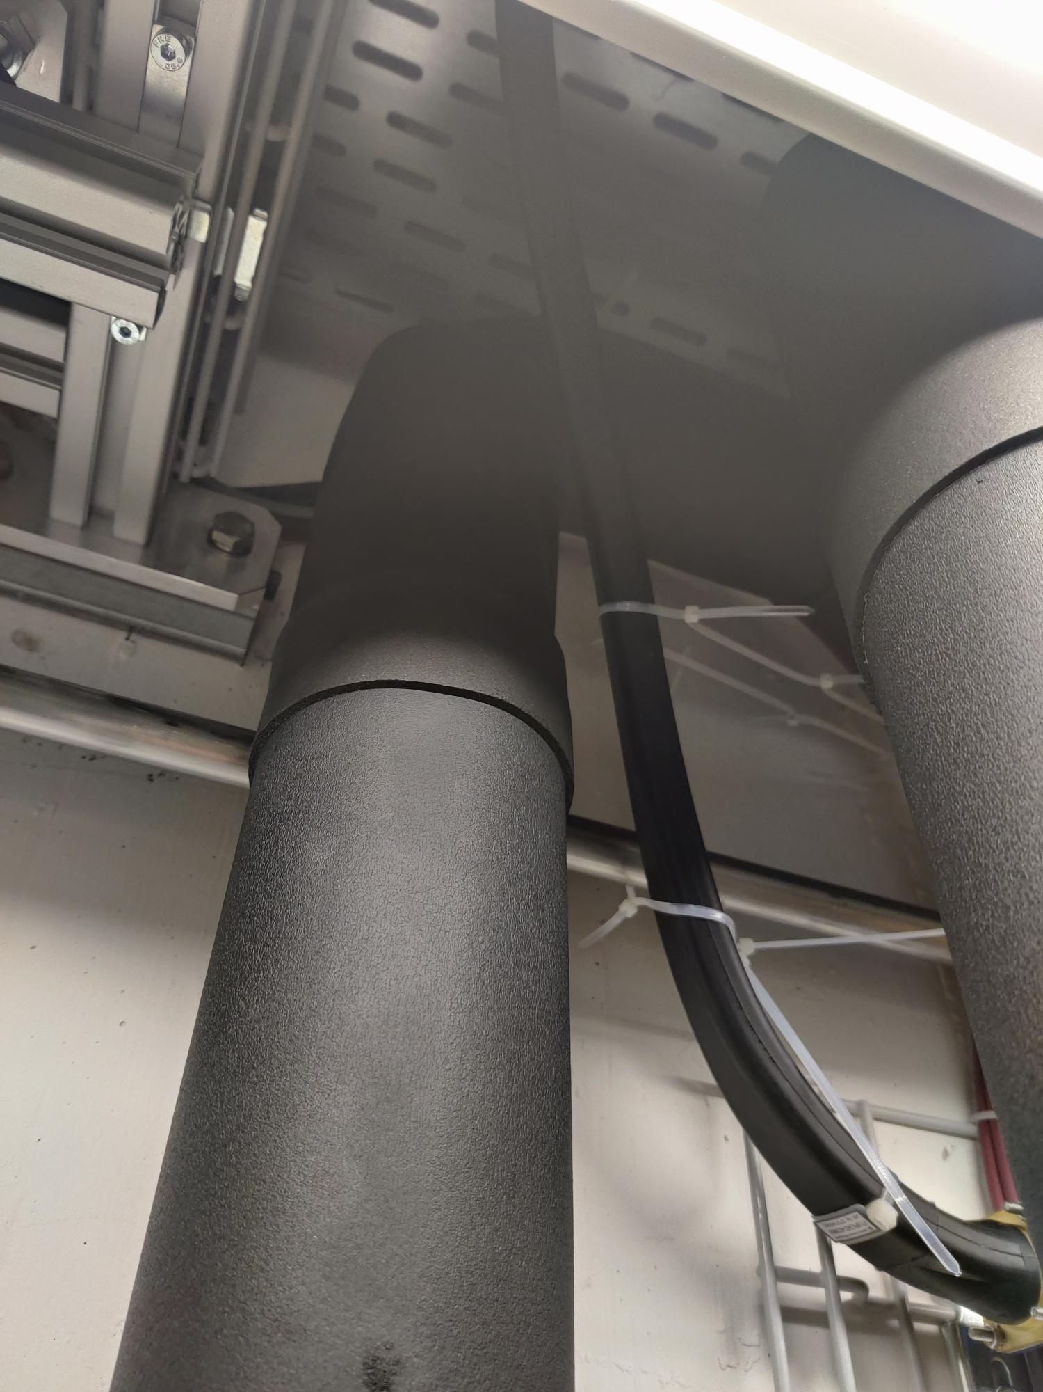
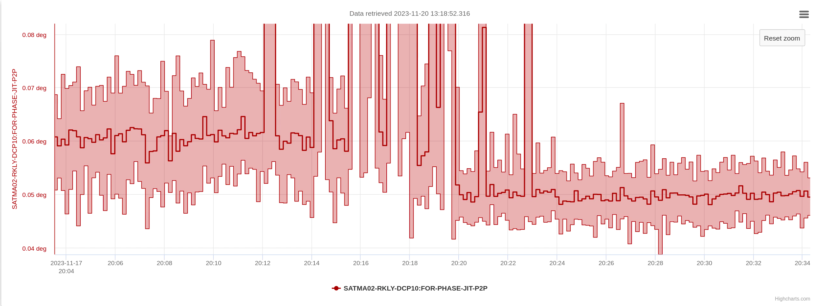
Phase jitter
Another on going activity concerns the RF phase jitter.
Recently we that the waveguide connecting the pre-amp to the klystron was in canctact with a water pipe. We removed the contact by means of of cable ties. The phase jitter soon improved by about 20%.
We are confident that in general the waveguide support system can be improved. Past Friday Xinyu Wang performed vibration measurements of the waveguide and their support. Still waiting for the report, but quite strong vibrations at 25-30 Hz are evident.

Slide 8
Wir schaffen Wissen – heute für morgen
Conclusions
Consequences of a not flat RF pulse and some ideas to optimize the system efficiency (V_{Ʇ} / P_{klystron}) have been recently studied.
Verification with beam measurements is not an easy task due to the complexity of the RF system and beam losses.
Started an activity aimed at finding the causes of RF phase jitter and finding solutions to remove or mitigate them.

Slide 9
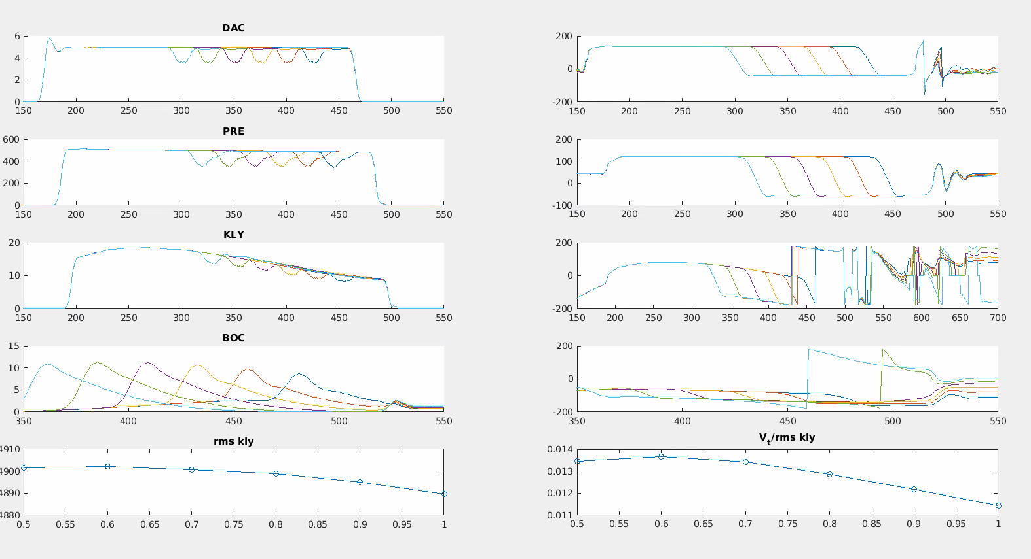

Slide 10
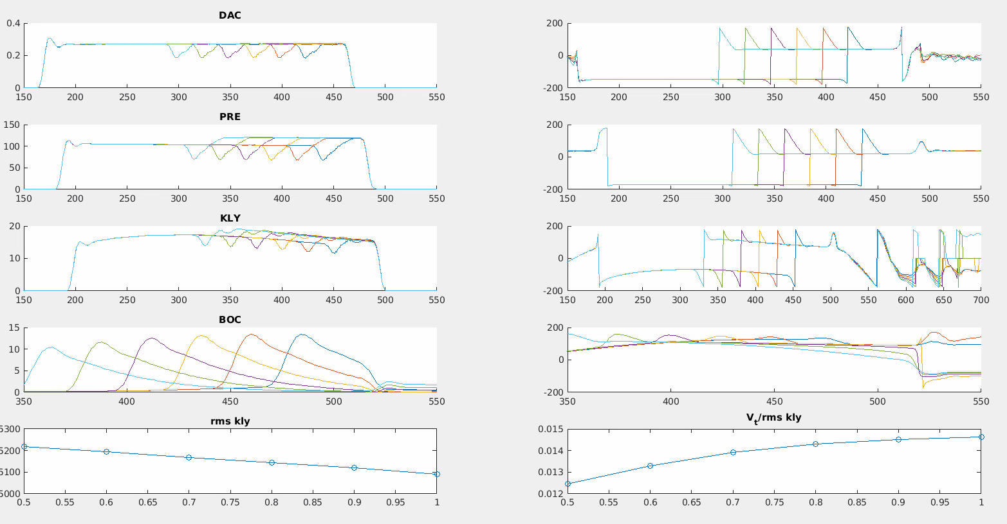
RF power from the preamplifier presents a step up or down depending on the sign of the phase inversion if the power is less than about 100 W. This is equivalent to modulation that greatly affects RF compression. In this case, the voltage power coefficient is no longer valid.

