Slide 1
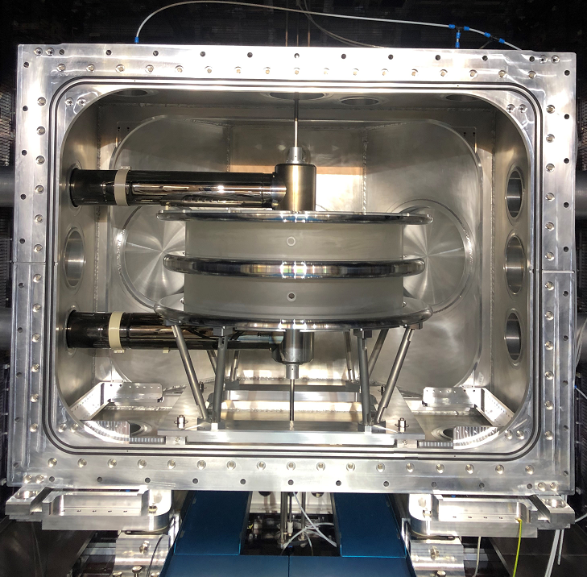

n2EDM: Quest for the
Electric Dipole Moment
LTP(izza!)hD Seminar
Victoria Kletzl

Slide 2





An experimentalist’s view on the EDM
$$\hat{P}$$
$$\hat{T}$$
$$d_{n} \vec{E}$$
$$d_{n} \vec{E}$$
S
S
S
$$d_{n} \vec{E}$$

Slide 3

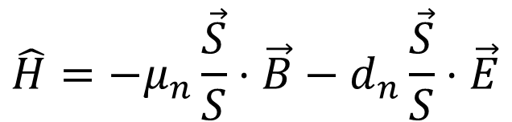
An experimentalist’s view on the EDM
Separation of charges $d_{n}$
$$\hat{P}$$
$$\hat{T}$$
$$d_{n} \vec{E}$$
$$d_{n} \vec{E}$$
S
S
S
$$d_{n} \vec{E}$$
$$\hat{H}=−μ_{n}\frac{\vec{S}}{S}⋅\vec{B}−d_{n}\frac{\vec{S}}{S}⋅\vec{E}$$

Slide 4

An experimentalist’s view on the EDM
Separation of charges $d_{n}$
$d_{n} ≠0$ CP violation
$$\hat{P}$$
$$\hat{T}$$
$$d_{n} \vec{E}$$
$$d_{n} \vec{E}$$
S
S
S
$$d_{n} \vec{E}$$
$$\hat{H}=−μ_{n}\frac{\vec{S}}{S}⋅\vec{B}−d_{n}\frac{\vec{S}}{S}⋅\vec{E}$$

Slide 5
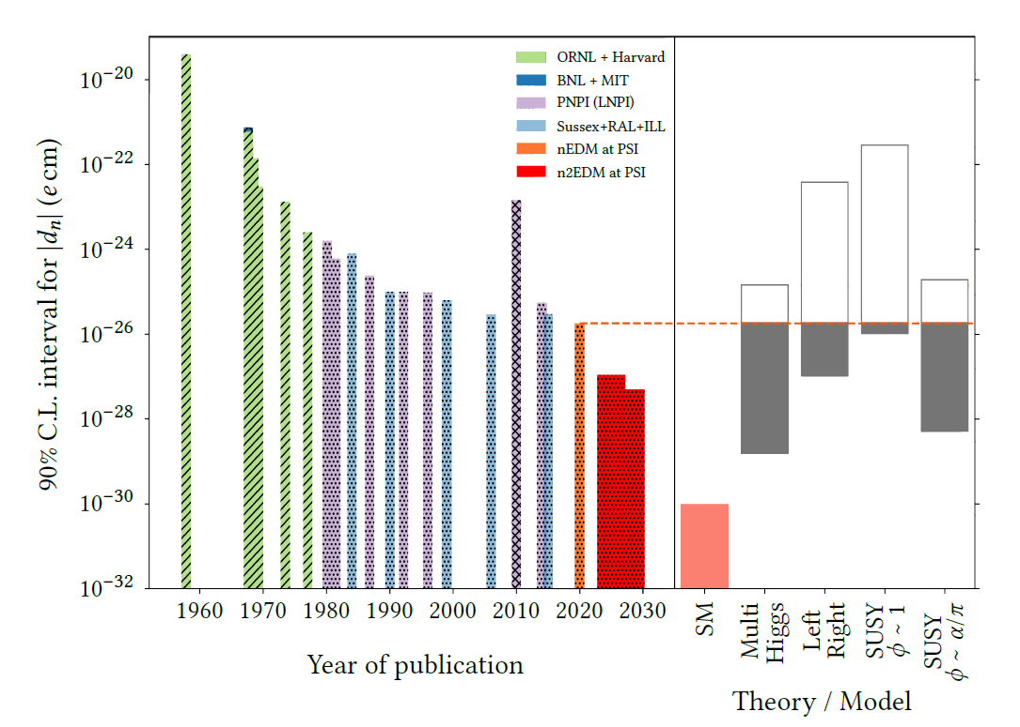

Search for the nEDM
$d_{n, SM} \sim {10}^{−32} e$cm
${|d}_{n, 2020}| <{1.8×10}^{−26} e$cm
New Physics!

Slide 6
Search for the nEDM
$d_{n, SM} \sim {10}^{−32} e$cm
${|d}_{n, 2020}| <{1.8×10}^{−26} e$cm
If you want to know
about this part:
Ask your theory friends ☺
New Physics!

Slide 7

How to detect a nEDM?
Measure neutron precession frequency:
${hf}_{L}=d_{n}E$

Slide 8

How to detect a nEDM?
Measure neutron precession frequency:
${hf}_{L}=d_{n}E$
BUT:
$f_{L}≈7 nHz$

Slide 9
We need a trick …

Slide 10




Use the magnetic moment!
neutron’s magnetic moment $μ$
Apply magnetic field $B_{0}$
Observe Larmor precession
${hf}_{L}=2(μB_{0}±d_{n}E)$
Depends on
orientation of $E$
$$≈30\text{Hz}$$
$$≈7 \text{nHz}$$

Slide 11
Interlude:
Ramsey’s method of separated oscillating fields

Slide 12


Ramsey’s method
$$B_{0}$$
$$E$$
Polarised
neutrons
Time

Slide 13

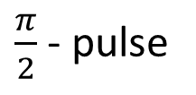
Ramsey’s method
$$B_{0}$$
$$E$$
$$B_{osc}$$
Polarised
neutrons
$\frac{π}{2}$ - pulse
Time

Slide 14
Ramsey’s method
$$B_{0}$$
$$E$$
$$B_{osc}$$
Polarised
neutrons
Free
precession
$\frac{π}{2}$ - pulse
Time

Slide 15

Ramsey’s method
$$B_{0}$$
$$E$$
$$B_{osc}$$
$$B_{osc}$$
Polarised
neutrons
Free
precession
$\frac{π}{2}$ - pulse
Time

Slide 16
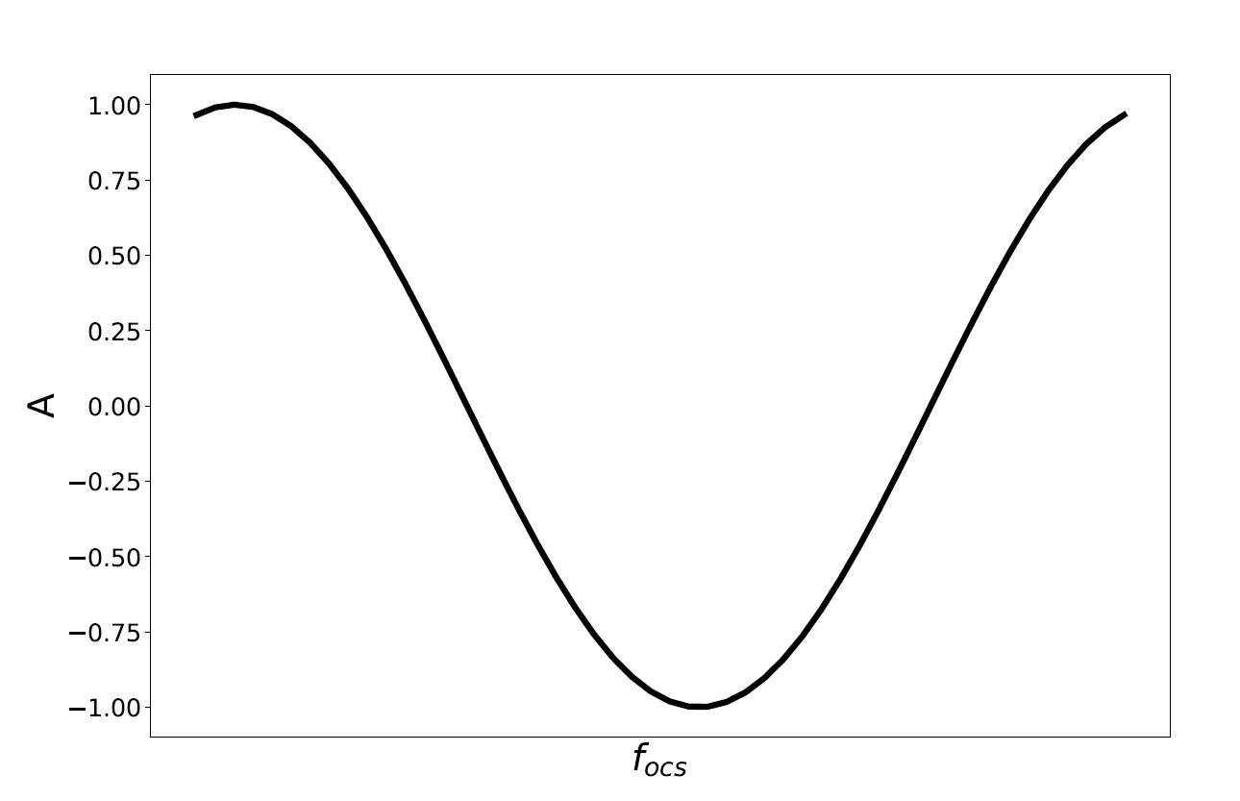
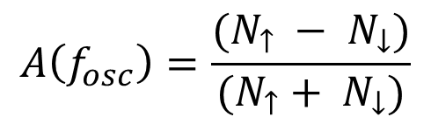

Scan of $f_{\text{osc}}$
$$A\left(f_{osc}\right)=\frac{(N_{↑} − N_{↓})}{(N_{↑}+ N_{↓})}$$

Slide 17
Scan of $f_{\text{osc}}$
$$A\left(f_{osc}\right)=\frac{(N_{↑} − N_{↓})}{(N_{↑}+ N_{↓})}$$
Apply strong
electric field !

Slide 18
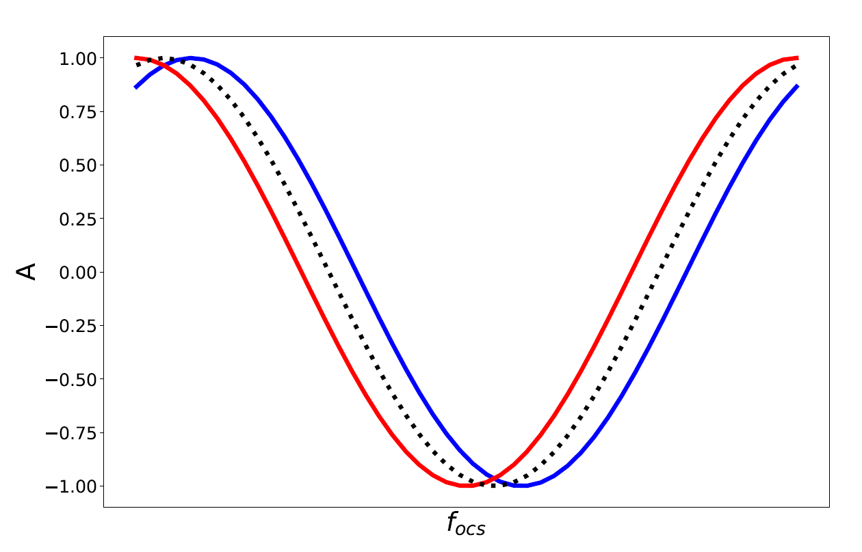

Scan of $f_{\text{osc}}$
$$A\left(f_{osc}\right)=\frac{(N_{↑} − N_{↓})}{(N_{↑}+ N_{↓})}$$
$$∆f\sim d_{n}$$

Slide 19
So, what do we need for n2EDM?
Think super basic ;)

Slide 20
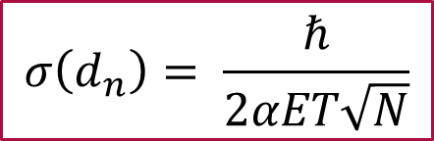
Our ingredient's for a successful experiment:
Neutrons!
High electric field
Spin dependent neutron detection
Precisely known and controlled magnetic fields
$$σ\left(d_{n}\right)= \frac{ℏ}{2αET\sqrt{N}}$$

Slide 21
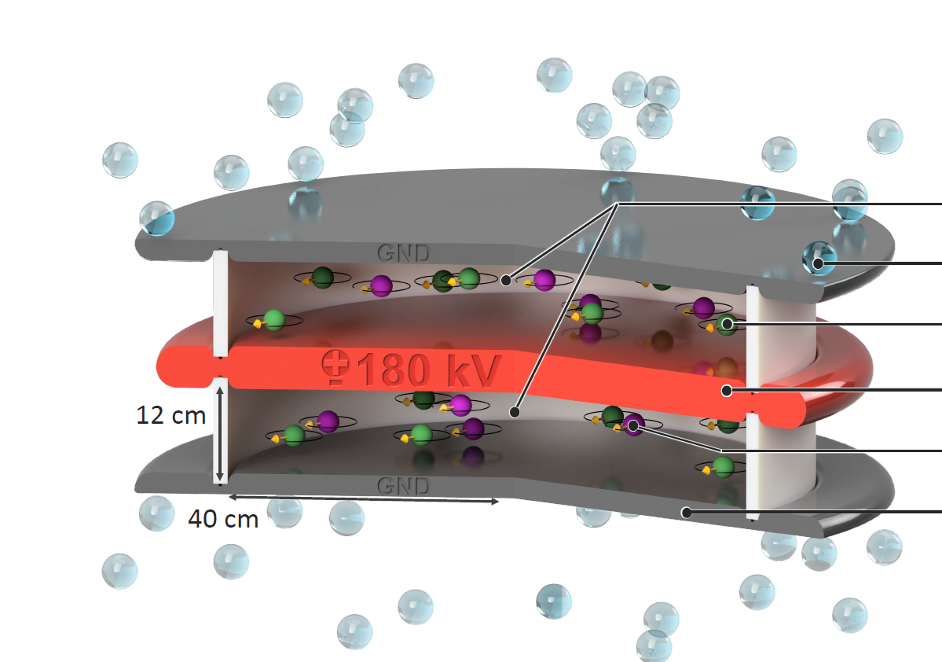
Neutrons @ n2EDM
Ultracold neutrons (UCN)
Produced via spallation + cooling
< 300 neV
5 m/s
Reflected off materials (storage
possible! )

Slide 22

Electric field @ n2EDM
GND
1 HV electrode (± 180kV)
2 ground electrodes
HV
$$\vec{B_{0}}$$
GND

Slide 23
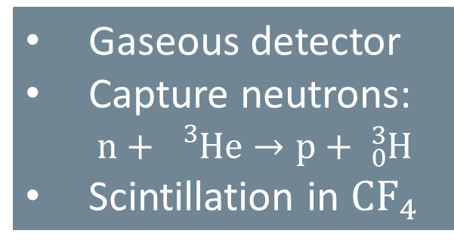
Neutron detectors @n2EDM
Gaseous detector
Capture neutrons:
$\text{n}+ {}_{}^{3}{\text{He}}→\text{p}+ {}_{0}^{3}{\text{H}}$
Scintillation in ${\text{CF}}_{4}$
Spin flipper ON
Spin flipper OFF
Spin
analysing
foil
Spin up
Spin down

Slide 24
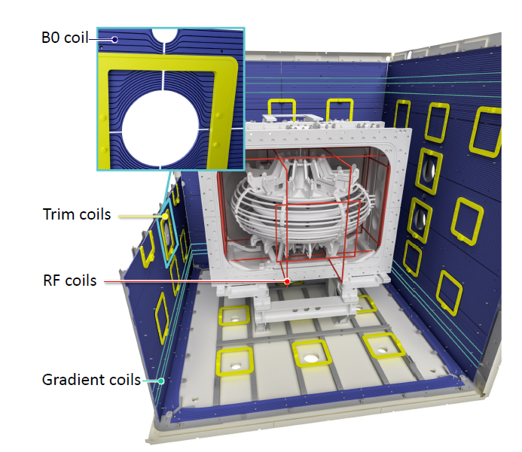
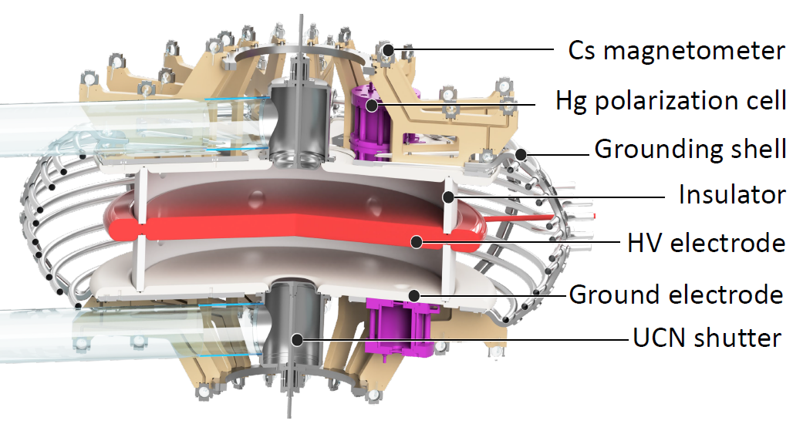


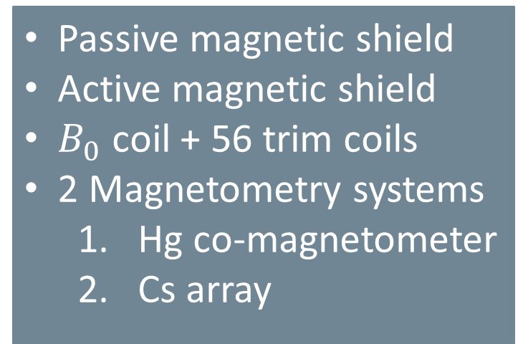

Magnetic field @ n2EDM
$B_{0}$ coil
Passive magnetic shield
Active magnetic shield
$B_{0}$ coil + 56 trim coils
2 Magnetometry systems
  Hg co-magnetometer
  Cs array
Trim coils
$B_{\text{osc}}$ coils
Gradient
coils
$$\vec{B_{0}}$$

Slide 25
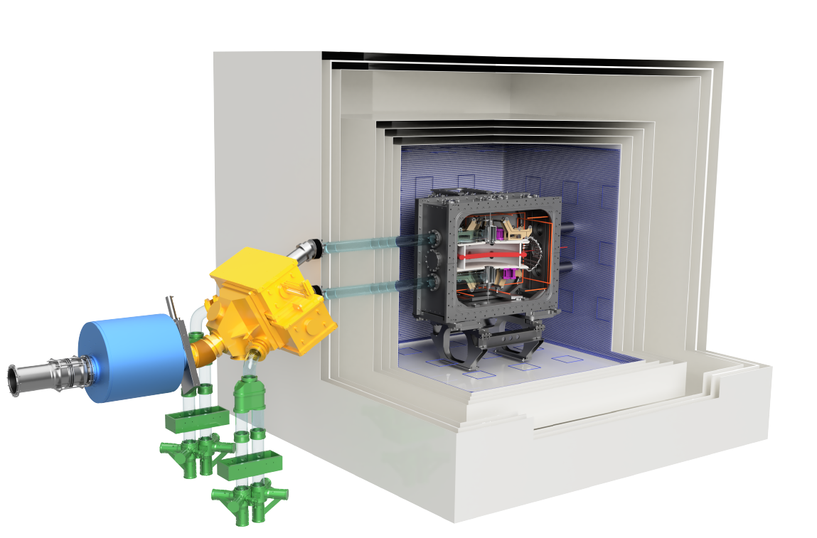

The n2EDM experiment
Passive
Magnetic
Shield
Active
Magnetic
Shield
Polarizing
Magnet
$$\vec{B_{0}}=1μT$$
Precession
chambers
Neutrons
Detectors
Switch

Slide 26
And then last year …

Slide 27
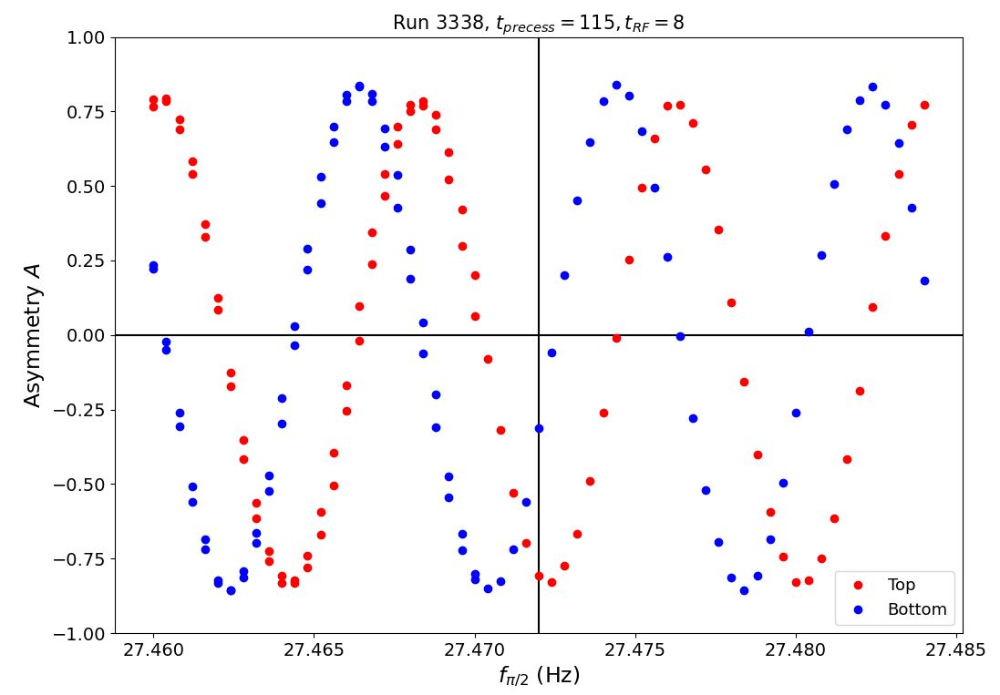
Our first Ramsey cycle!

Slide 28

Did we already find the nEDM?
$$∆f\sim d_{n}$$

Slide 29
Unfortunately, no … ☹
(Experiments are never as easy as we hope!)

Slide 30
We still have some things to look forward to!!
Online magnetic field characterisation
Increased neutron statistics
High voltage

Slide 31
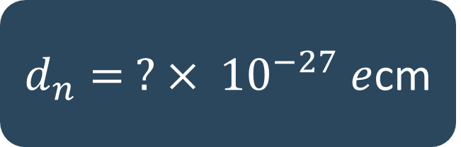
We still have some things to look forward to!!
Online magnetic field characterisation
Increased neutron statistics
High voltage
$d_{n}= ? × {10}^{−27} e$cm

Slide 32
Tours?
Thr 22.2. 5pm/after the colloquium
Fr 23.2. 5pm
(Or just e-mail me any time)

