Slide 1
AWI Department Update
Alun
Online 16/10/23

Slide 2
Today’s Agenda
(presenters present from your own zoom session.)
Update from
  7900 Alun
  7901 Sven
  7902 Markus
  7903 Leo
  7903 Leo
  7905 Derek
  7906 Simon

Slide 3
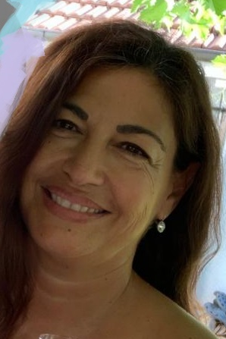
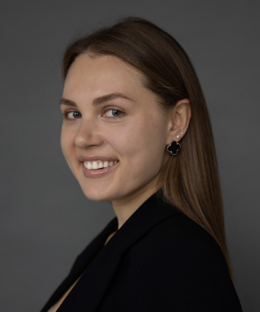
AWI organization
16/10/23
Alun Ashton
(Head of AWI)
(Deputy: Sala)
Xingxing (Marie) Yao
(Coordinator and Architect, SLS2.0)
Leonardo Sala
Data and Analysis Research Infrastructure
Leonardo Sala a.i.
Scientific Data Curation
Markus Janousch
Data Processing Development and Consulting
Sven Augustin
Experiment IT Development and Operations
Derek Feichtinger
HPC and Emerging Technologies
Marc Caubet
Scientists
(Merlin)
Achim Gsell
Senior Scientist
Elsa Germann Scientific Computing System Engineer
Ivano Talamo
(Ra Sys Admin)
Alvise Dorigo
(SwissFel)
Joshua Taylor
(SLS Online)
Carlo Minotti
Software Engineer
(SciCat)
HC Stadler
(cSAXS)
Alain Studer
(TOMCAT)
Ivan Usov
(SwissFEL/NUM)
Jun Zhu
SLS 2.0 Data reduction and compression
Dmitry Ozerov
(SwissFEL)
Klaus Wakonig
(SLS and SwissFEL)
Jan Wyzula
SLS 2.0
Simon Ebner
Core Linux Research Services
Konrad Bucheli
System Engineer
Basil Bruhn
System Engineer
Hans Viessmann Scientific Computing System Engineer
Boris Sharapov
(Junior Sys Admin)
Ali Vahdati
ReMaDE Data Steward
Spencer Bliven
Scientist (OpEM)
Greta Assmann
BIO
ORD M2?
(TBC)
Christian Appel PSD RSE
(joint cSAXS/LSB)
Matias Guijarro Sabbatical
(Jan 24)
Krisztian Pozsa SwissTwins
ORD M2? (TBC)
Viviana Sabatini
Assistant SCD Division
Hanna Dabrytskaya
SCD Online content
Roles delta summary:
  7901
    Matias starts Jan
Key to Fixed Term Roles
EU Funded
PSI Funded fixed term
Swiss Funded initiatives

Slide 4
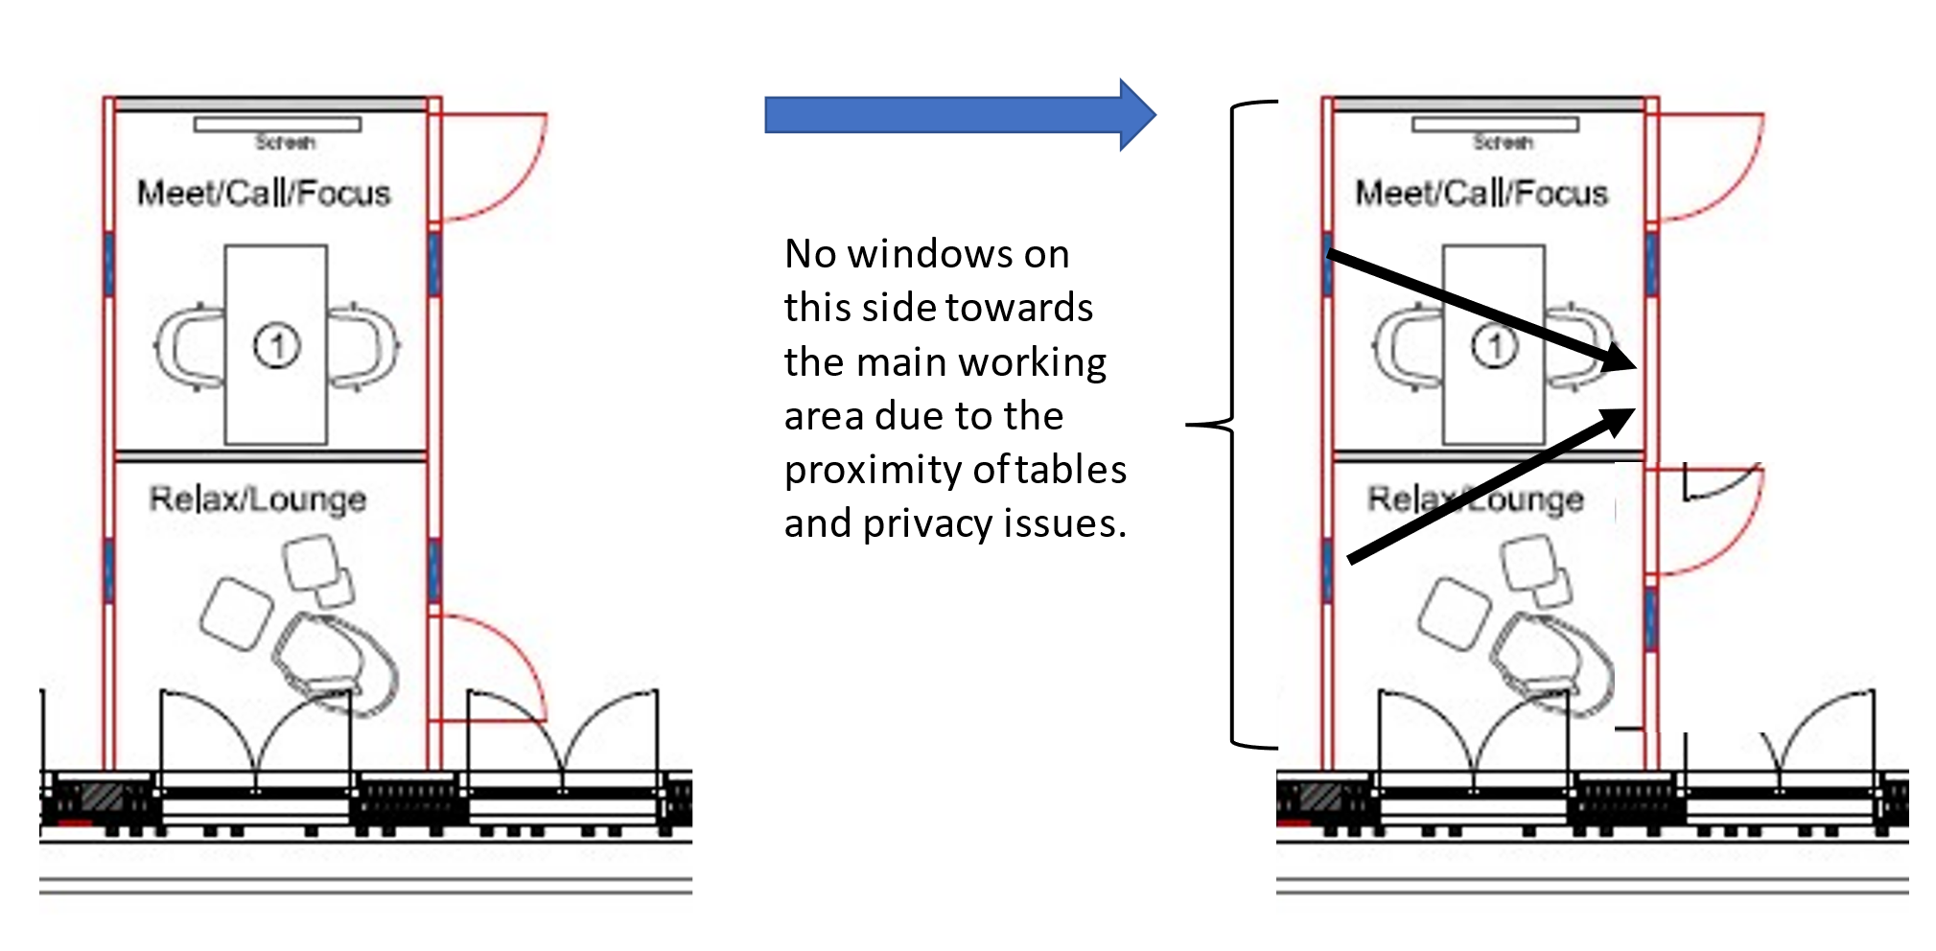
Office move
Still awaiting information or delivery on various aspects including missing chairs, coffee table, lockers,.….
Water, water everywhere but not a drop to drink….
  Potential change in supplier in the summer could mean a new/replacement system
Walls for last meeting rooms in
  January (2024?)

Slide 5
Installation of new VC equipment.
Zur Info.
  Nächste Woche vom 12-14.12 werden die Räume installiert.
  Bitte informiert intern das die Räume für die Techniker zugänglich sind.
  Danke.
Auftragsnummer Raum Kommission
AB1333 OBBA 113 Umbau MTR on Android / Windows
AB1331 OBBA 206 OBBA 206 Projektraum
AB1298 OBBA 212/213 OBBA OG2 - 2x MTRoW
Training details sent

Slide 6
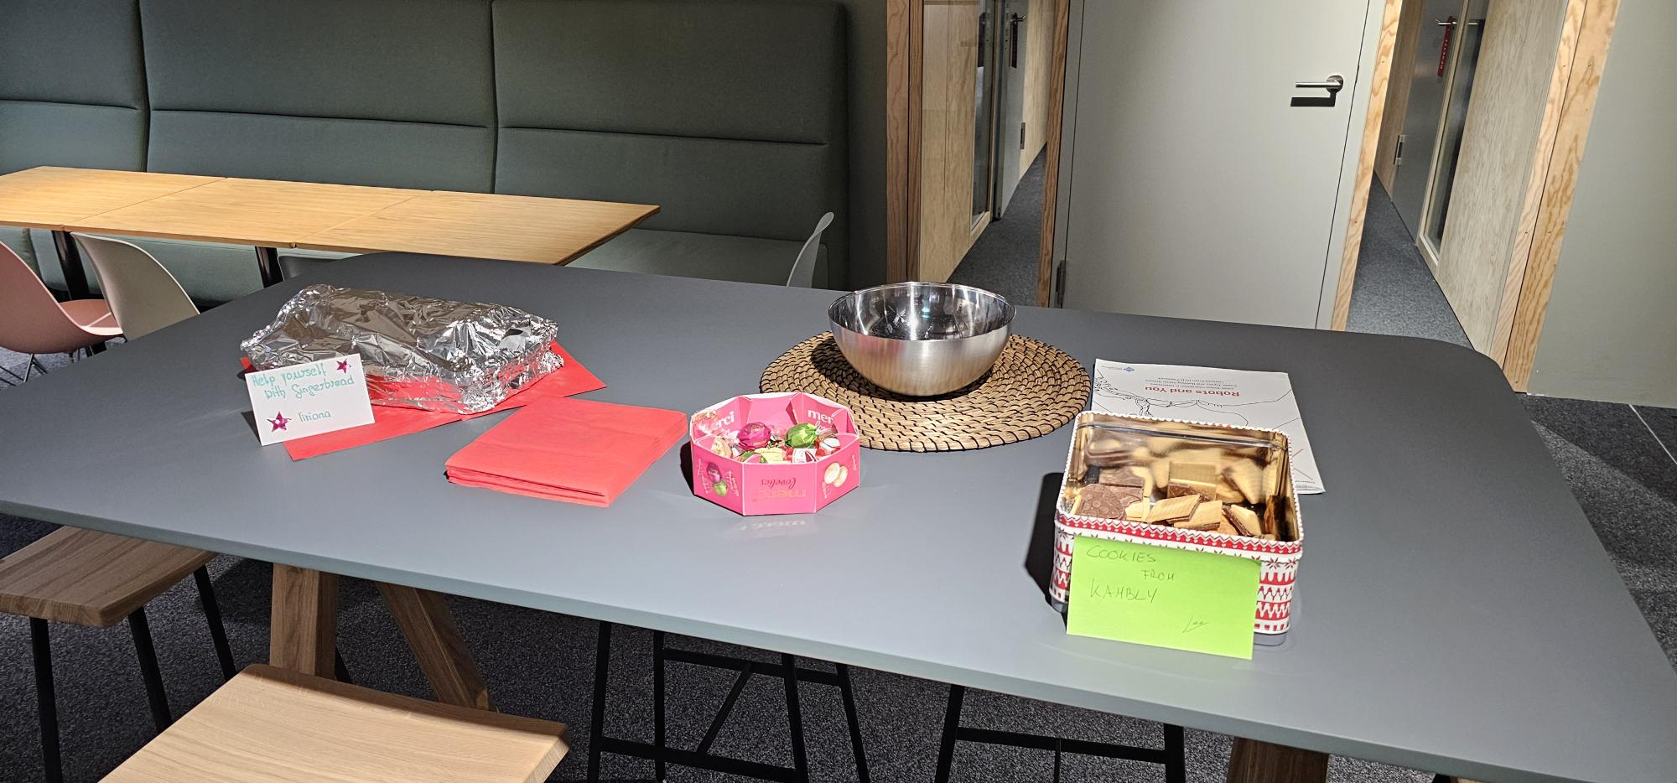
Unacceptable office behaviour…

Slide 7
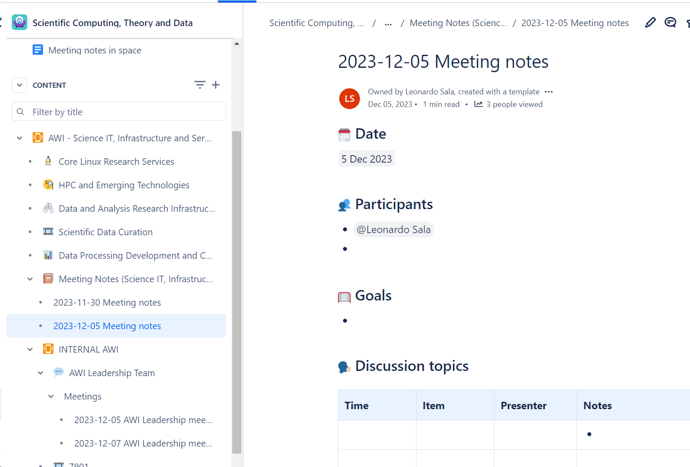
Confluence: https://psich.atlassian.net/wiki/

Slide 8
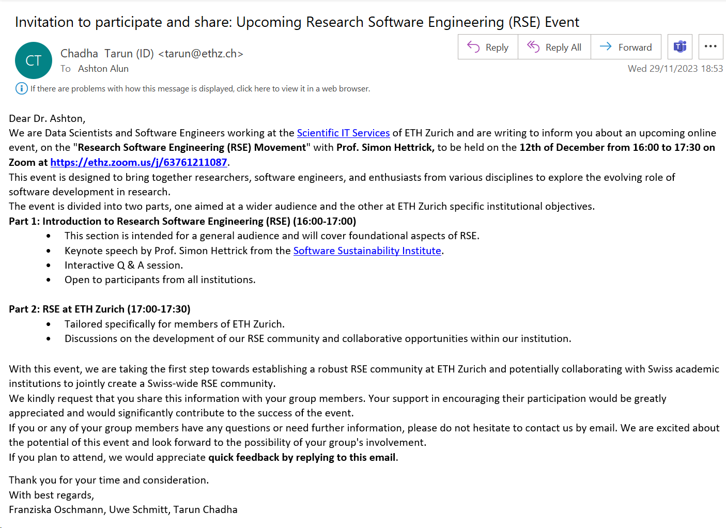
RSE ETHZ 12/12/23

Slide 9
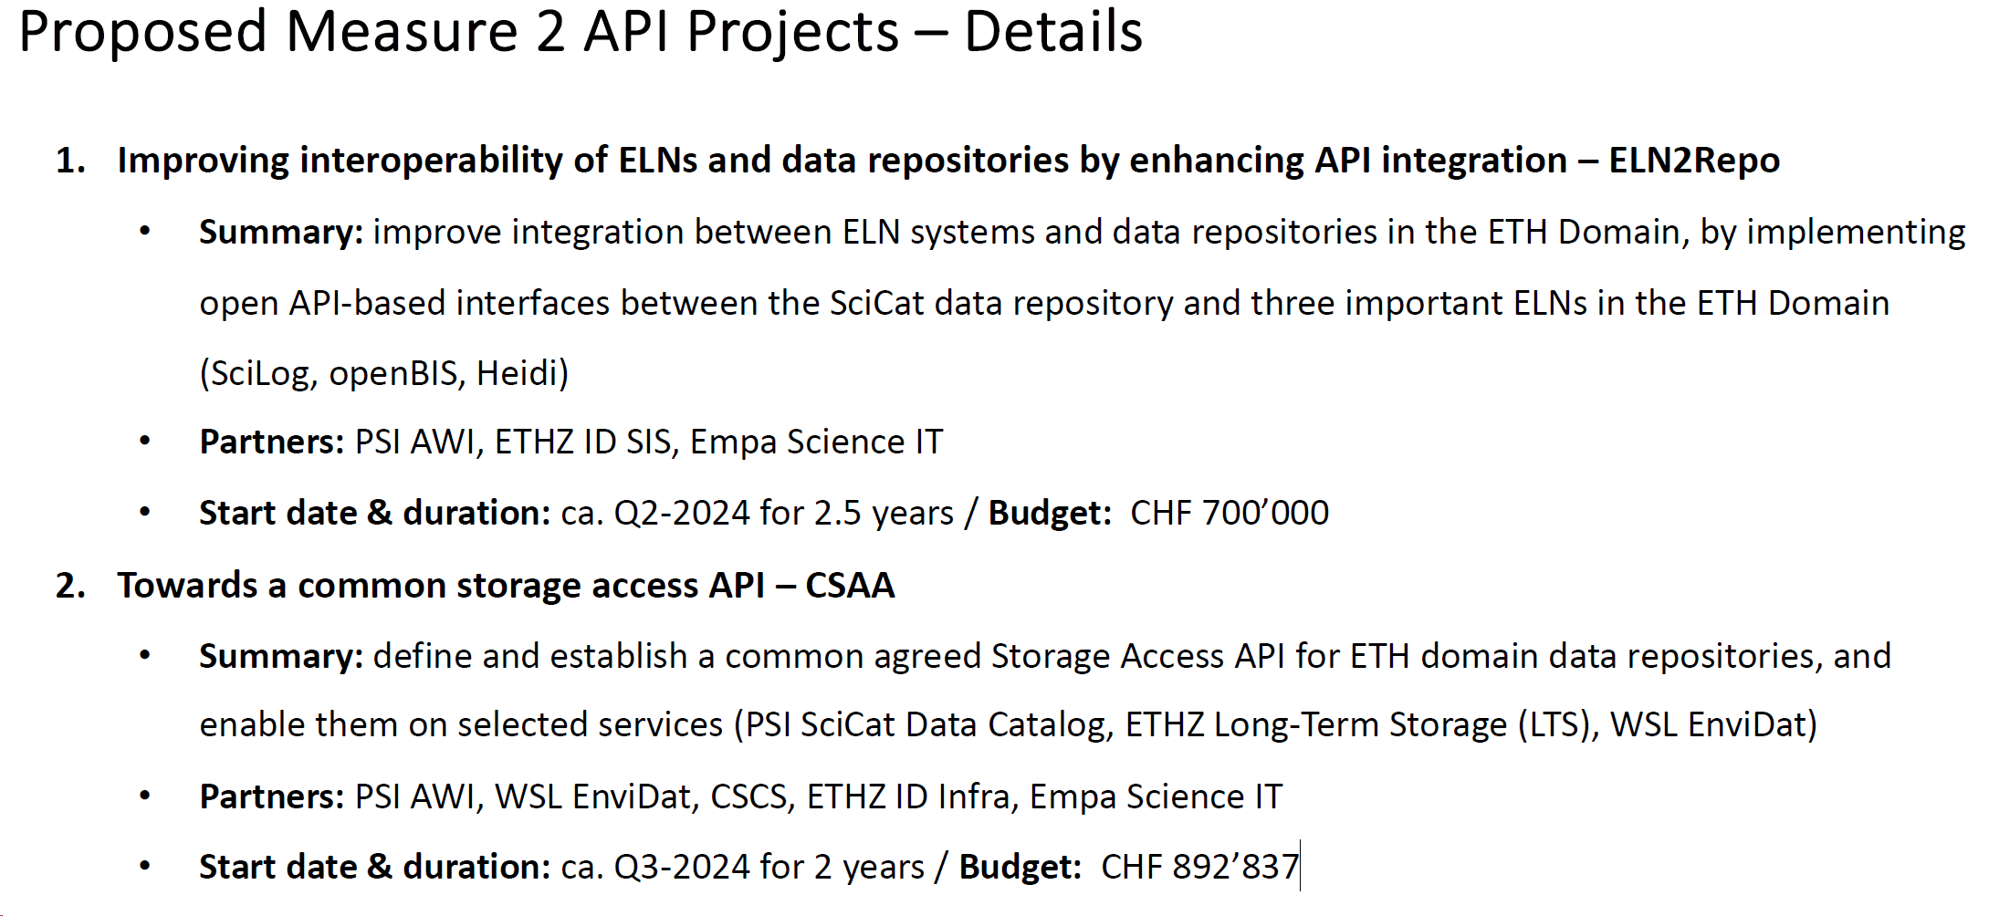
Measure 2 ORD ETH

Slide 10
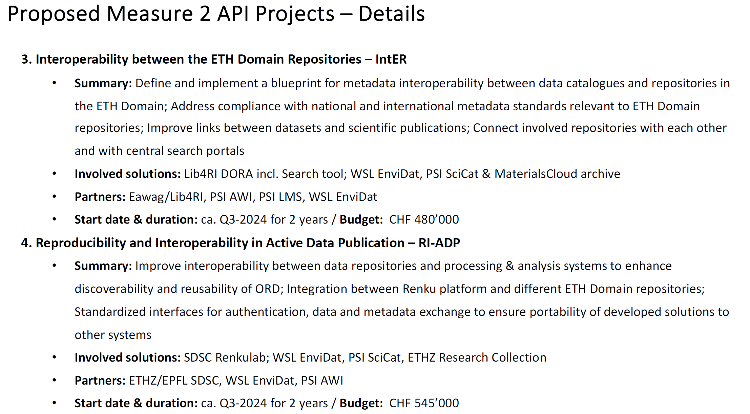

Slide 11
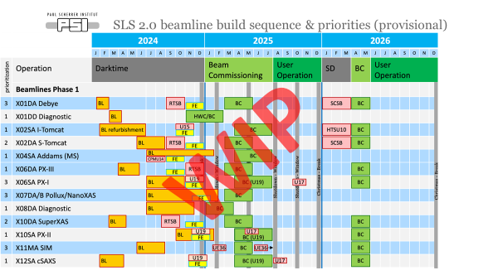
CaSIT overall planning for dark time and bringing beamlines back up.
Enabled by the PSD beamline priority plans, CaSIT is currently preparing
  Collating all outstanding decisions and dependencies.
  Working on beamline availability and staff availability.
  Potential late winter/spring retreat to agree/finalise
    All decisions/choices (or pathways to them), and
    Schedule, assign responsibility and target environment for CaSIT on beamlines as they start commissioning.

