Slide 1
EIDO (7901) Update
December 11, 2023

Slide 2
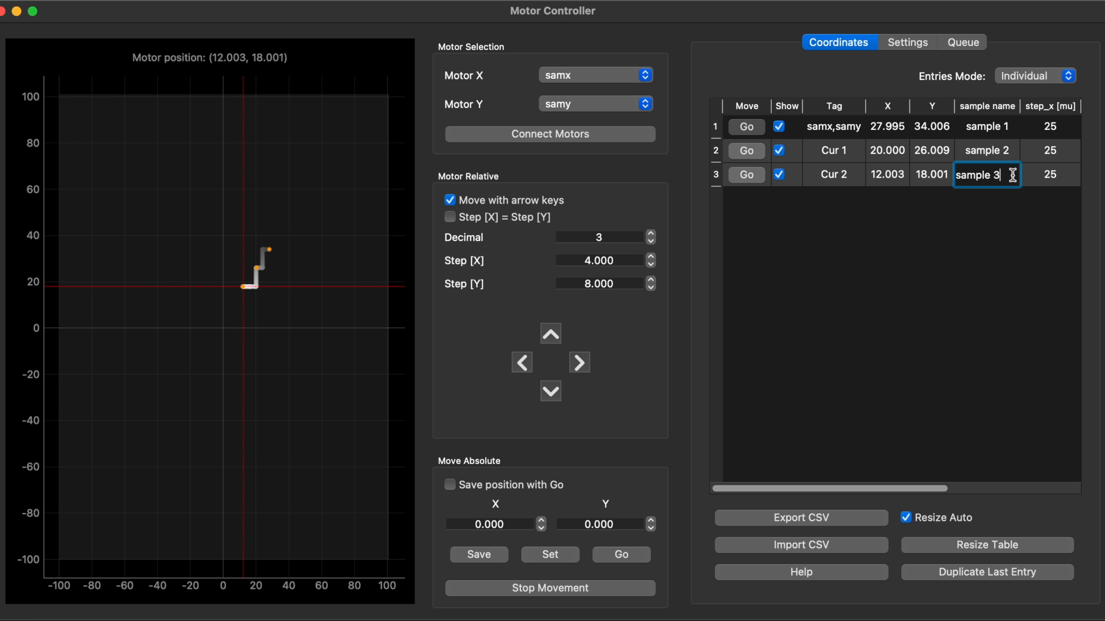
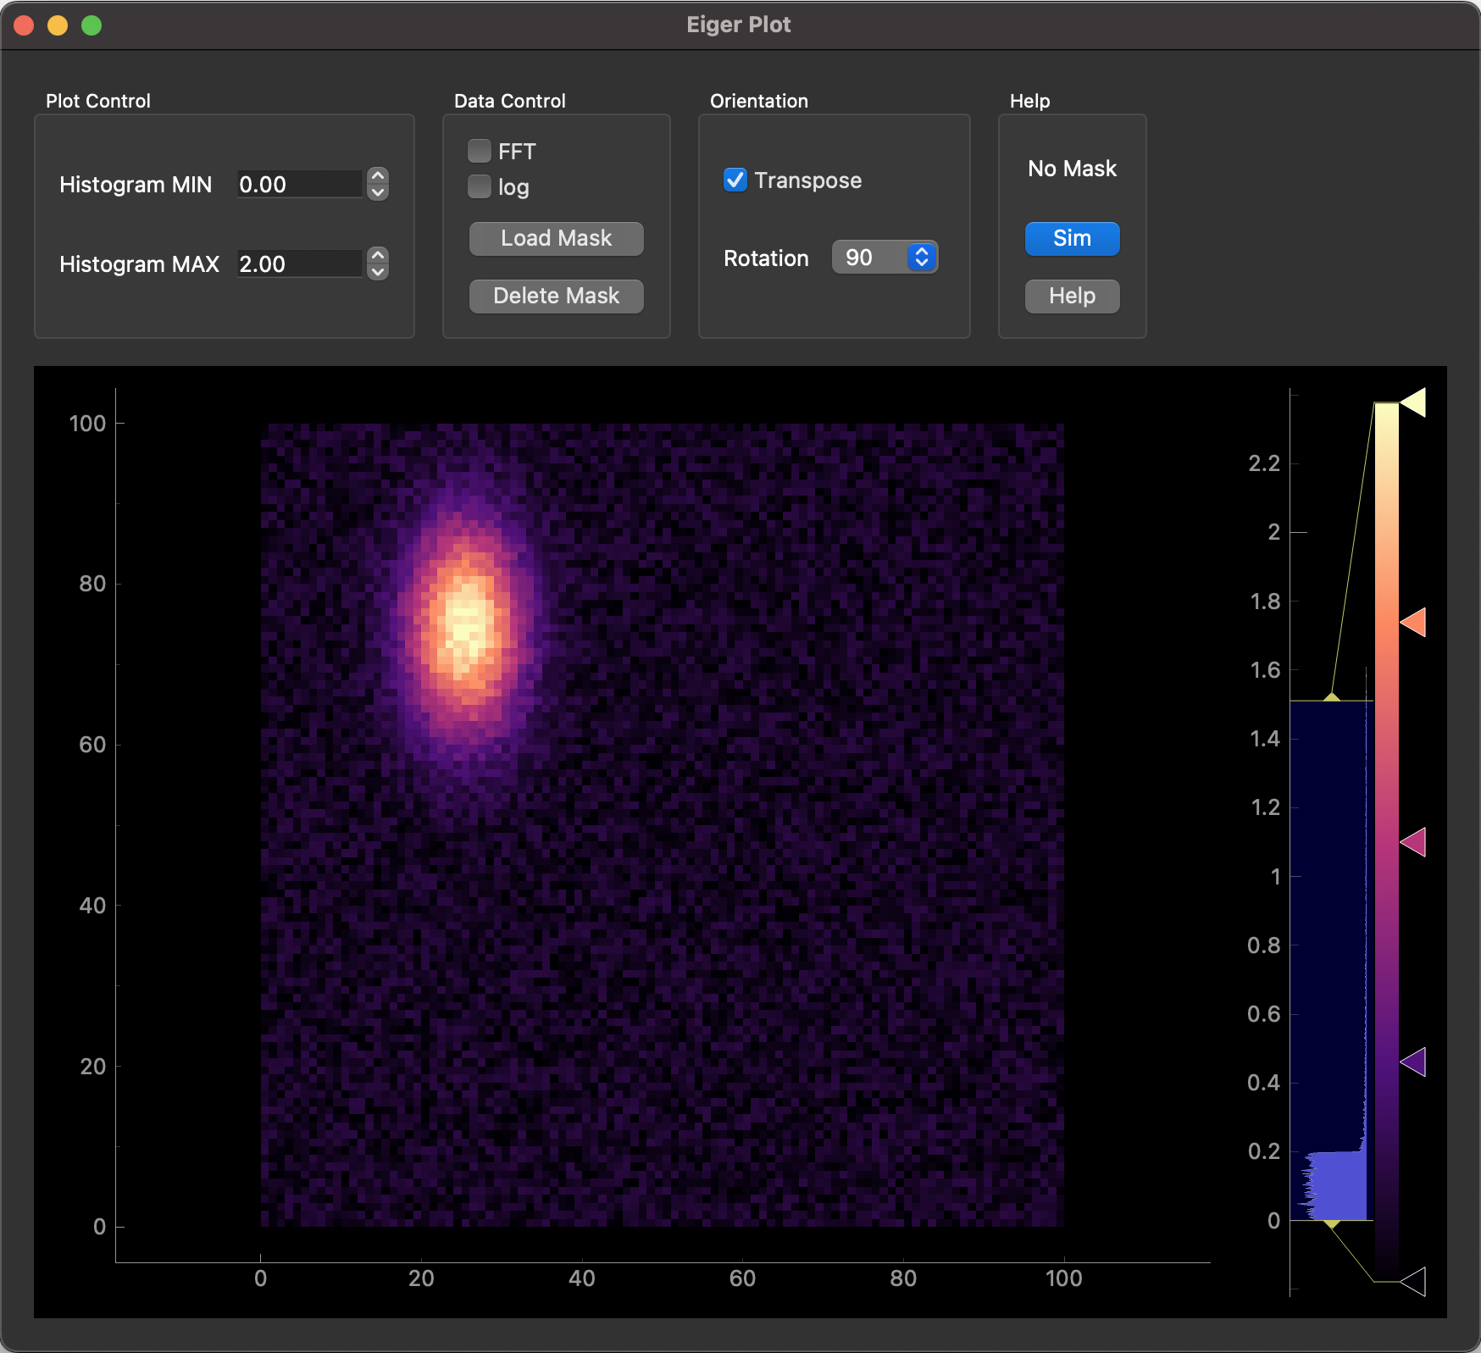
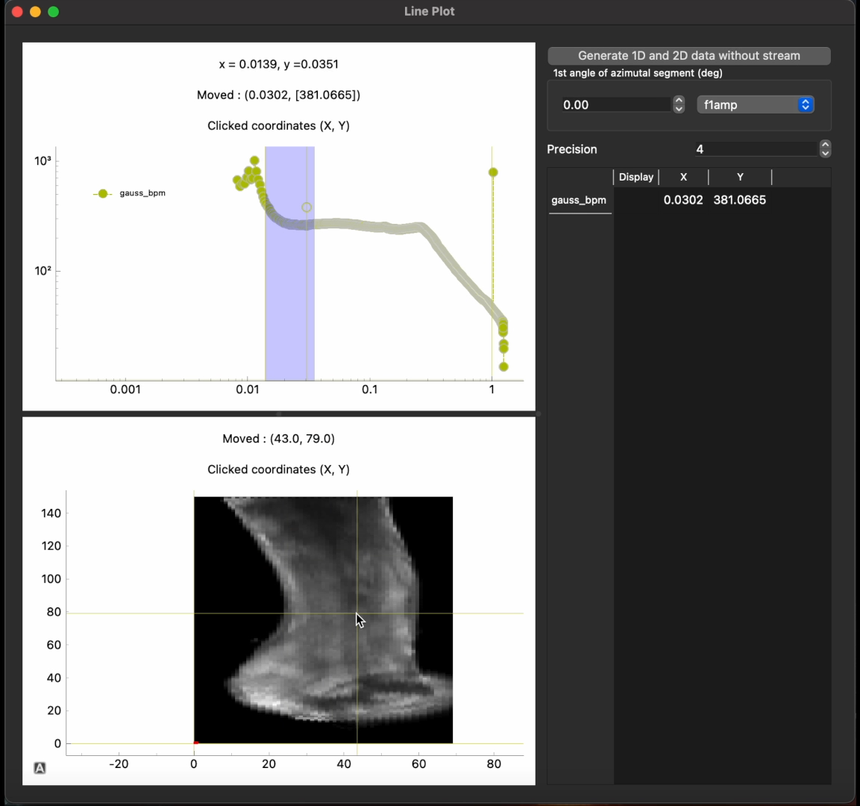
SLS 2.0 – BEC Developments
Core
  Development continues
  Data analysis pipelines (DAPs)
Beamline integration
  HW-based fly scans via Digital Delay Generator
  Several detectors (incl. Eiger via std-daq)
GUIs
  Continuous development
  Close feedback loop with BLs
  Examples:
    Motion control / setting up scans
    Eiger configuration / visualization
    Interactive live feedback via DAP

Slide 3
SwissFEL – Event-based Measurements
CTA (Complex Triggering Application)
  Allows user-defined event sequences
  Library hasn’t been updated since 2020
  Only conda package for Python 3.6
    Rebuild as noarch package
A year ago at Alvra: slow experiment with specific pulses
repeat for N shots:
move 2 motors to sample cell on 2D grid
CTA to open/close pulse picker for one shot
read and collect ID for that pulse
retrieve data for N collected IDs
Now at Cristallina-MX: fast experiments
  Send 2D movement pattern to motor controller
  Start CTA to trigger moves in sync with events
  Read start and stop pulse IDs
  Cut full range into digestible pieces
  Continuously retrieve data for these pieces
Envisioned final setup [Drawing courtesy of John Beale]

Slide 4
Wir schaffen Wissen – heute für morgen
Questions?

