Slide 1
7903 update
Leonardo Sala :: AWI :: Paul Scherrer Institut
AWI Department update meeting 2023.12.11 / PSI

Slide 2
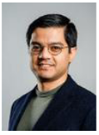
ReMade@ARI
Ali joined us in November!
He is the Data Steward for the EU ReMade@ARI project
Next steps: work out D1.6 - SWOT Analysis on Open Research within the project partners

Slide 3
Scicat
A lot of efforts on:
upgrade all the components (k8s, minio, keycloack, rabbitmq, …)
review the deployment system
improve security of the architecture

Slide 4
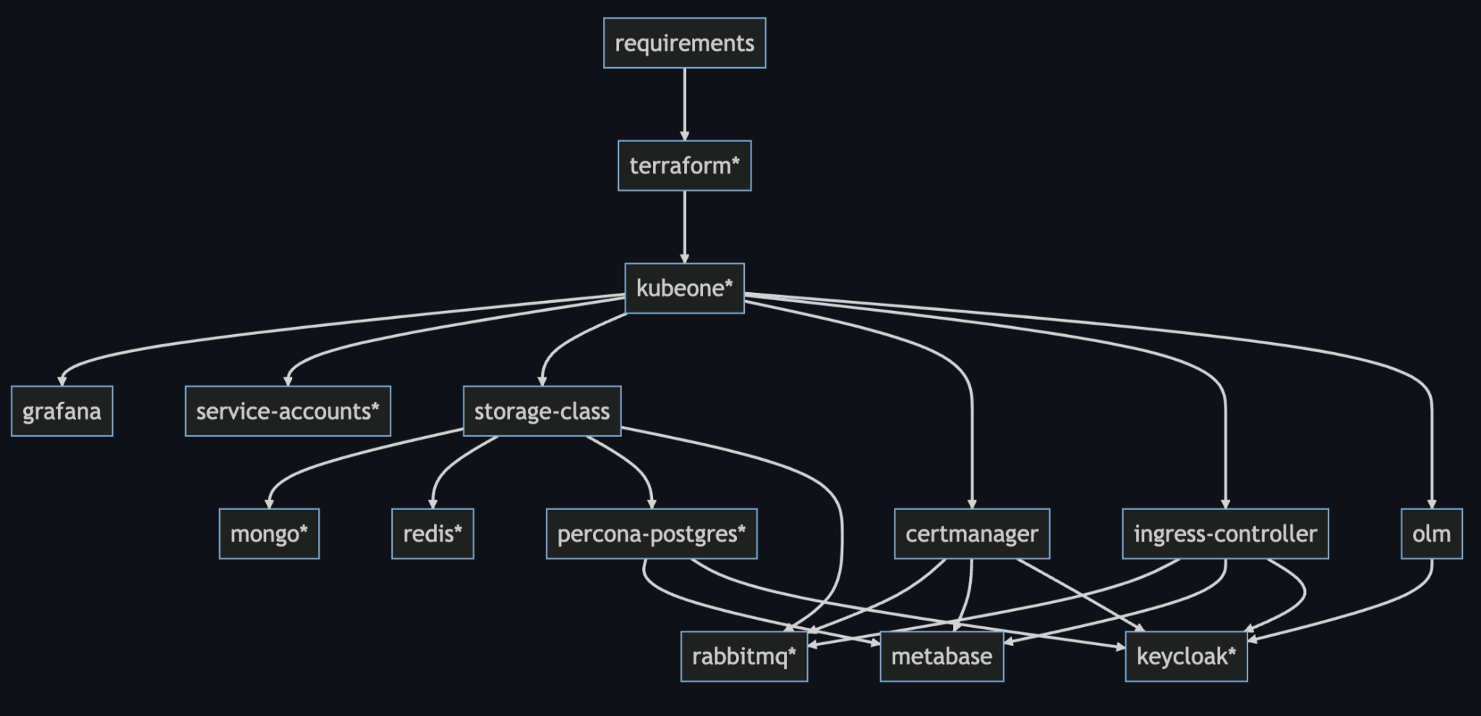
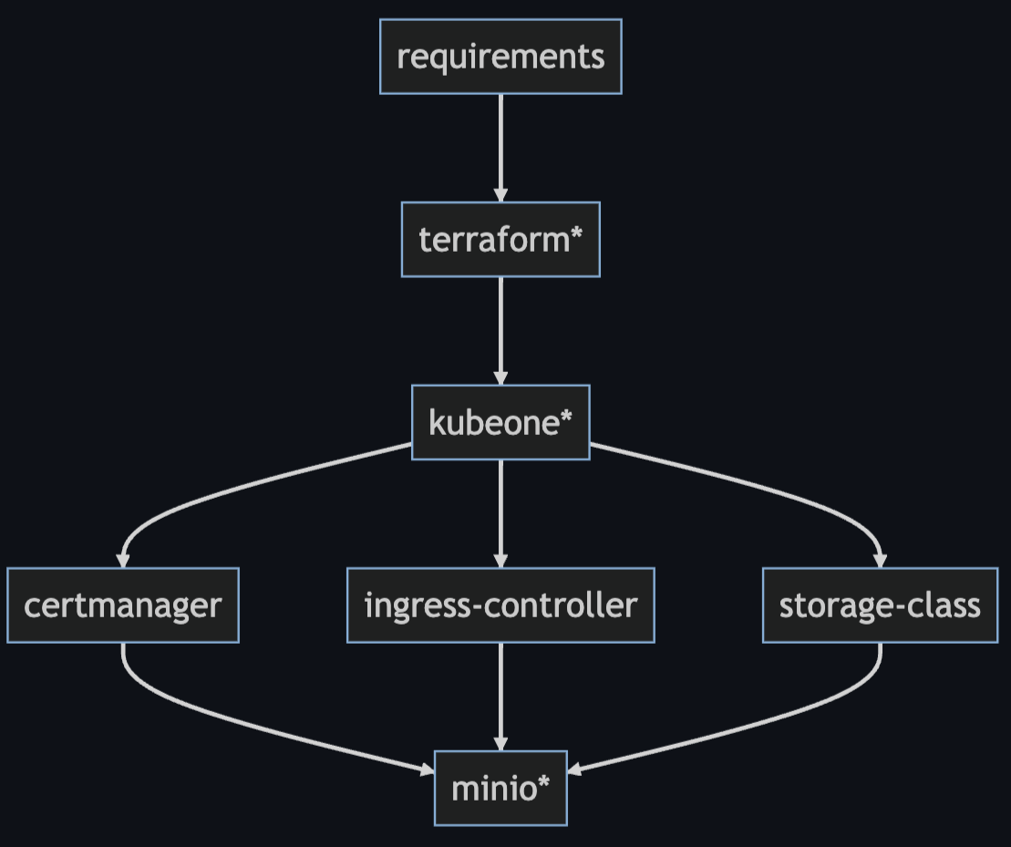
Cluster management
dev/prod
infra-backup
infra-backup

Slide 5
Cluster management
All components are installed following their suggested utility tool, notably:
CRDs
Helm charts
K8S manifests
Krew plugin manager
OLM
Upgrade and install procedure, along with their version.
The underlying utility tools ensure reproducibility, atomicity and idempotency.
All business and configuration data is backed-up and restorable with restore procedures.
All components, along with the underlying infrastructure, have been upgraded to their latest stable, supported version (e.g. K8S 1.27.6).

Slide 6
Improvements
Reproducibility of the whole workflow, investigate Ansible or similar
Better password management, Vault as a possible candidate
Critical infrastructure upgrade, namely controller nodes Centos7 → …
*.tfstate storage and recreation with terraform import.
Include 1-click data restore procedure

Slide 7
Security review
legend
Not exposed
Not restricted
Restricted to PSI
dev/prod/infra
Internal services
Business services
K8S management
before
after
dev/prod/infra
*
Internal services
Business services
K8S management
Bastion VM
* restrictions and exposures rules defined per service

Slide 8
OpenEM / ORD
ORD
submitted projects for Measure 2 (infrastructure)
  Improving the interoperability of ELN and data repositories by enhancing APIs
  Towards a common storage access API
  Interoperability between the ETH Domain Repositories (IntER)
  Reproducibility and Interoperability in Active Data Publication (RI-ADP)
preparing additional proposal for IAM guidelines
OpenEM:
Initial development for OpenEM features in Scicat
Coordination meetings with related initiatives (INSTRUCT-Eric, Scipion, EMDB)
Onboarding some project members & contributors, with more starting in January

Slide 9
Questions?

