Slide 1
7904 update
Leonardo Sala :: AWI :: Paul Scherrer Institut
AWI Department update meeting 2023.12.11 / PSI

Slide 2
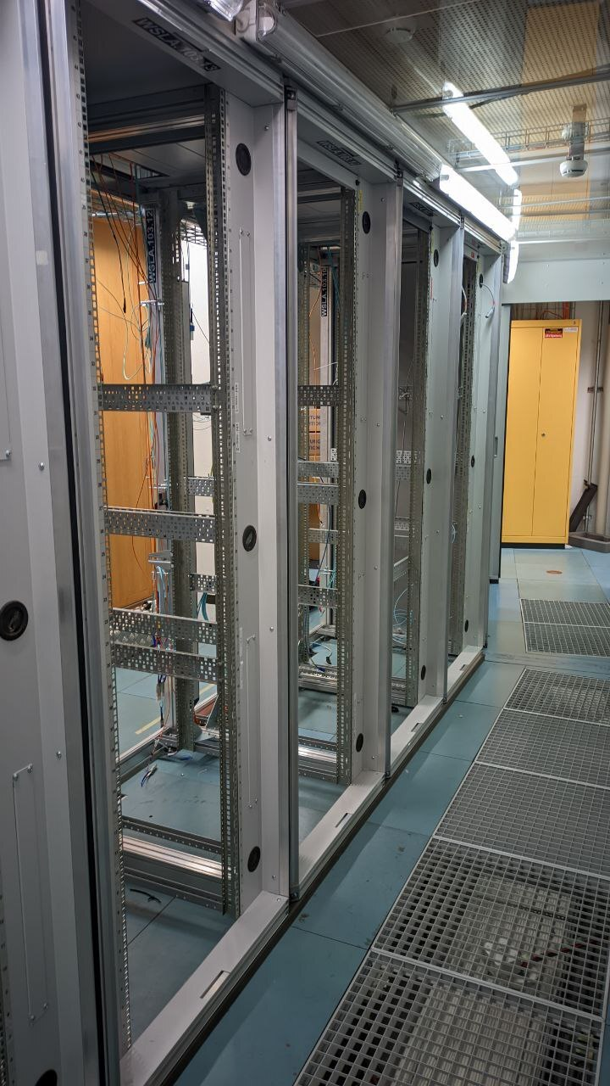
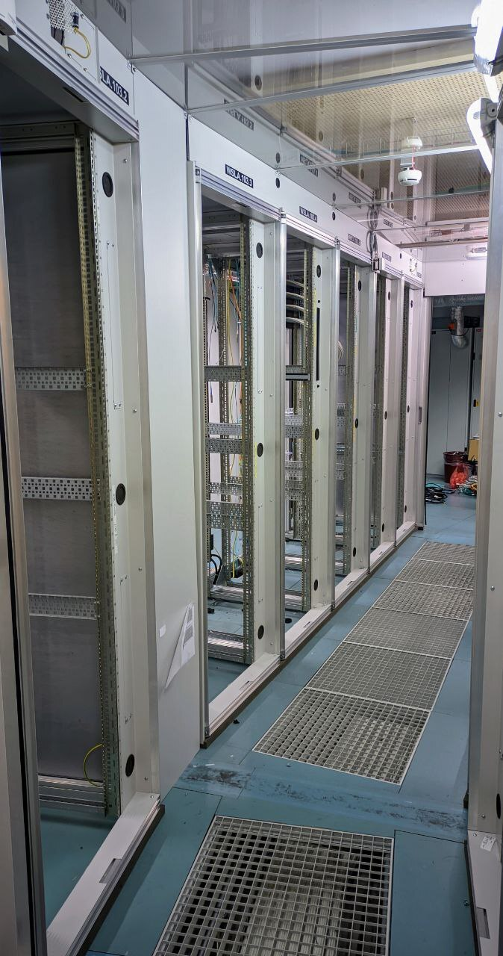
Such emptiness
WSLA is empty!
Sorting out cables etc
Future of server room:
no cooling
possibly we give it up for office space

Slide 3
RA updates
RHEL8 migration
dedicated queue for testing (day-rhel8) and login node (ra-l-005.psi.ch)
after Schaltertest:
  all login nodes (but one) reinstalled as RHEL8
around March
  all compute nodes (but a few) reinstalled as RHEL8
all new systems installed as RHEL8
please test
Resource management
preliminary version of resource management library
target: have beamline staff manage / request resources independently (so no emails)
at the moment in preproduction, used only internally

Slide 4
Schaltertest operations
Ra will be down from Friday 5th January 10:00 till Monday 8th ~12:00 (TBC)
SLURM:
migration to Slurm 23.05 (RA and SwissFEL)
flattening out the accounting to improve resource usage
JupyterHub
upgrade to latest 4.0.2, python 3.11, Lab 3.6.3
both RA and SwissFEL
Finalize Infiniband migration
last switch to upgrade, routing algorithm
plus various service packs, …

Slide 5
SwissFEL
SSD storage tests
half-filled system can write up to 30 GB/s
still some discussions on proper network integration
next: integration with existing Lenovo storage
DAQ
support for JungfrauJoch@Cristallina ongoing
tests with Controls for std_daq automated deployment

Slide 6
SLS / SLS2 updates
Discussions with IBM for next storage purchase in 2024
based on latest storage products
DAQ setups
set up of Material Science after migration
plan with network team to clean up and repatch existing fiber connections
preliminary work to support std_daq tests

Slide 7
Varia
Data Retention Policy
preliminary version ready
discussions with PSD ongoing
waiting for PSAC feedback
Tape
AIT started charging tape costs to divisions
7 CHF / TB / Year

Slide 8
Questions?

