Slide 1
PSI Particle Physics
Lea Caminada (PSI – University of Zurich), Angela Papa (PSI – University of Pisa),
Klaus Kirch (PSI – ETH Zurich) :: Laboratory for Particle Physics :: NUM Division PSI
Visit of the President of CERN Council at PSI, December 21, 2023

Slide 2
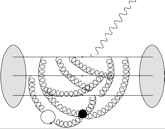
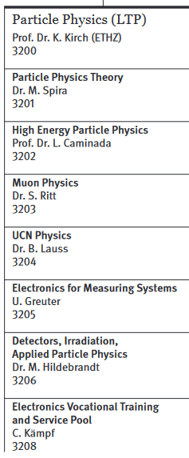
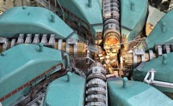
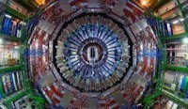
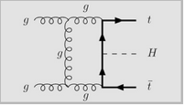
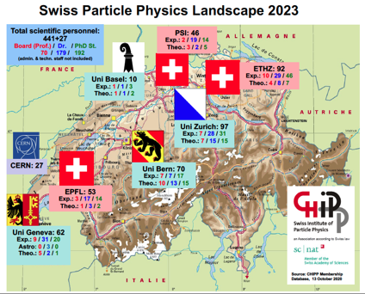
PSI Laboratory for Particle Physics
Pursue leading research in experimental and theoretical, accelerator-based particle physics at PSI and at CERN.
Develop, apply and make available
cutting-edge technologies.
Organize and support user activities at CHRISP.
Work together closely with CHIPP, universities
and international collaborations.
Train next generation of physicists and electronicians at PSI and at universities.
Inform and educate the broader public.

Slide 3

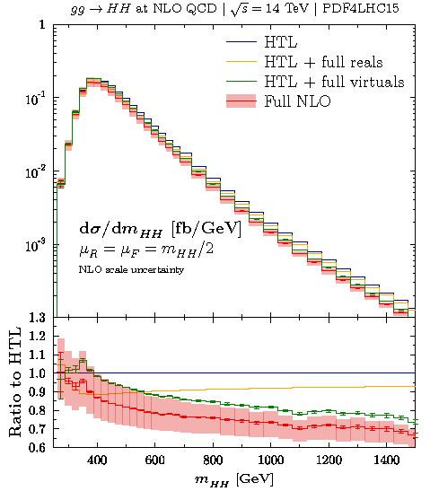
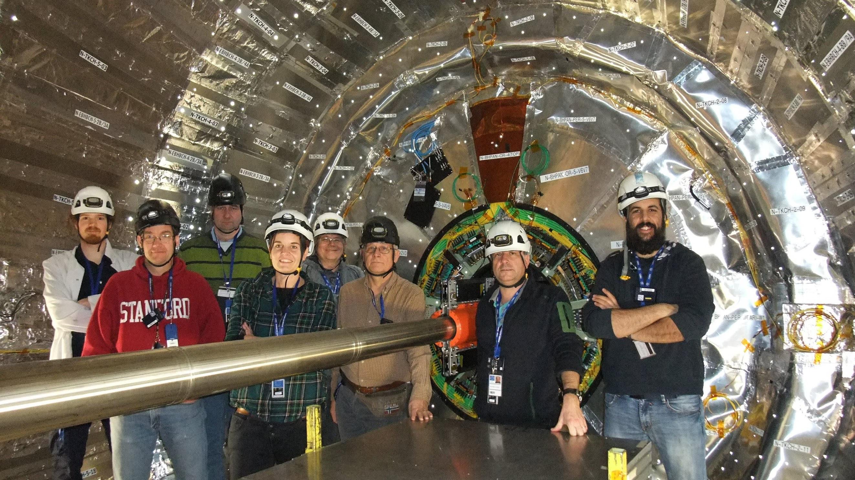
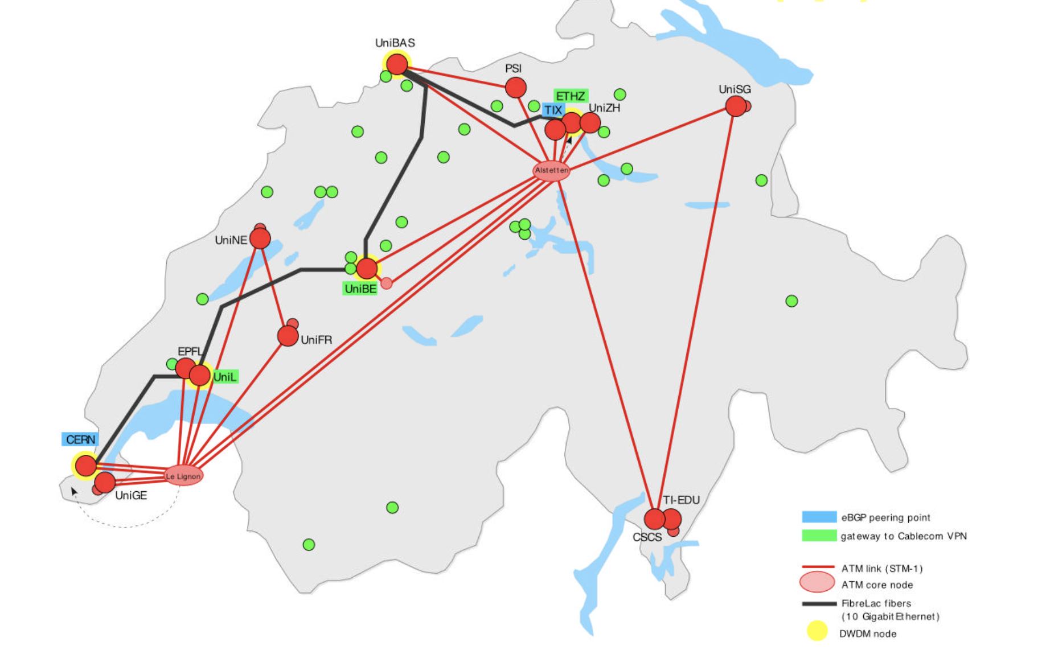
PSI groups at LHC
High-energy physics group in CMS
  16 CMS members (including senior scientists, postdocs, PhD students, technicians and emeriti)
  Leading contributions to detector development, physics analysis and ORD
  Holding key positions within collaboration: Trigger Coordinator (M. Missiroli), Common Analysis Tools Coordination (C. Lange), TEPX Upgrade Coordinator (W. Erdmann), Secretary of CMS Management Board (Q. Ingram)
High-performance computing and emerging technologies
  Tier3 computing centre at PSI and Tier2 computing centre at CSCS
LTP theory group
  Phenomenology of physics at the LHC (Higgs, SM, SUSY, Exotica)
  Coordination within LHC Higgs cross section working group (M. Spira)

Slide 4
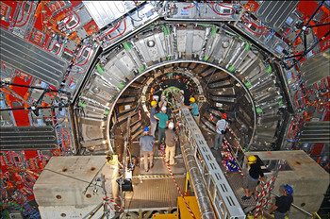
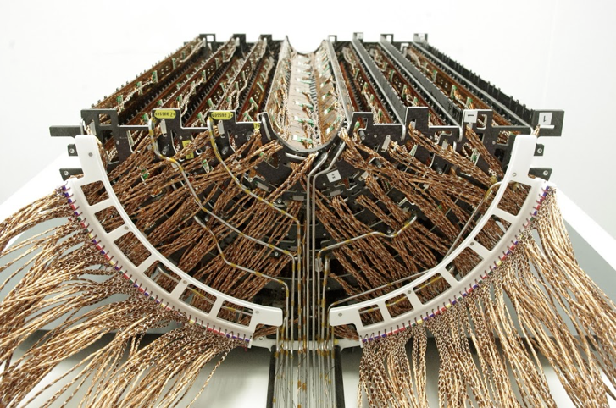
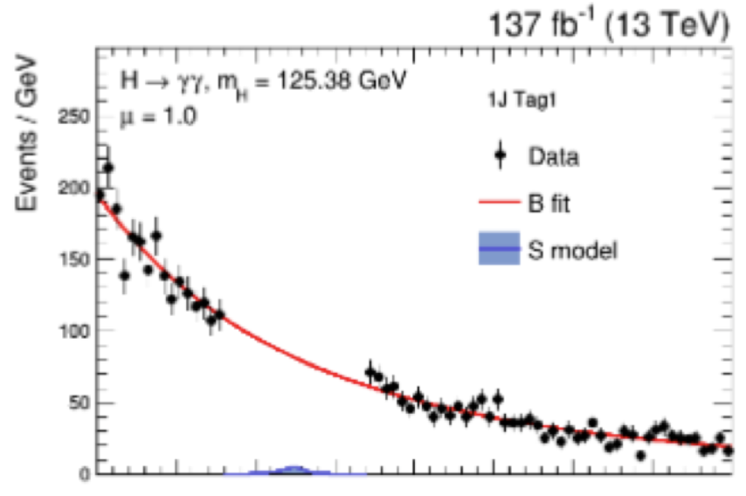
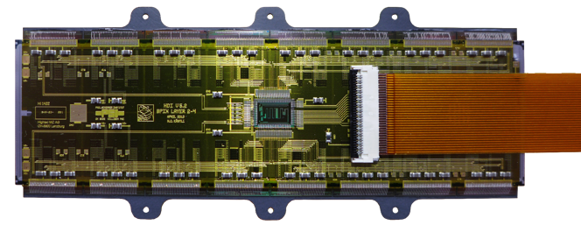
PSI activities in CMS
CH consortium (PSI, ETH,UZH) led design, construction, integration, commissioning of original and Phase-1 CMS pixel detector
  Major parts built at Swiss institutes with components from local industry
Key contributions to pixel detector operation, calibration, performance monitoring, local reconstruction, tracking and vertexing
Active in physics analysis, in particular Standard Model, B and Higgs physics
Installation of orginal CMS pixel detector (2008)
CMS Phase-1 pixel detector (2017)
c+H(→γγ)
SPS 2023
CMS work in progress

Slide 5
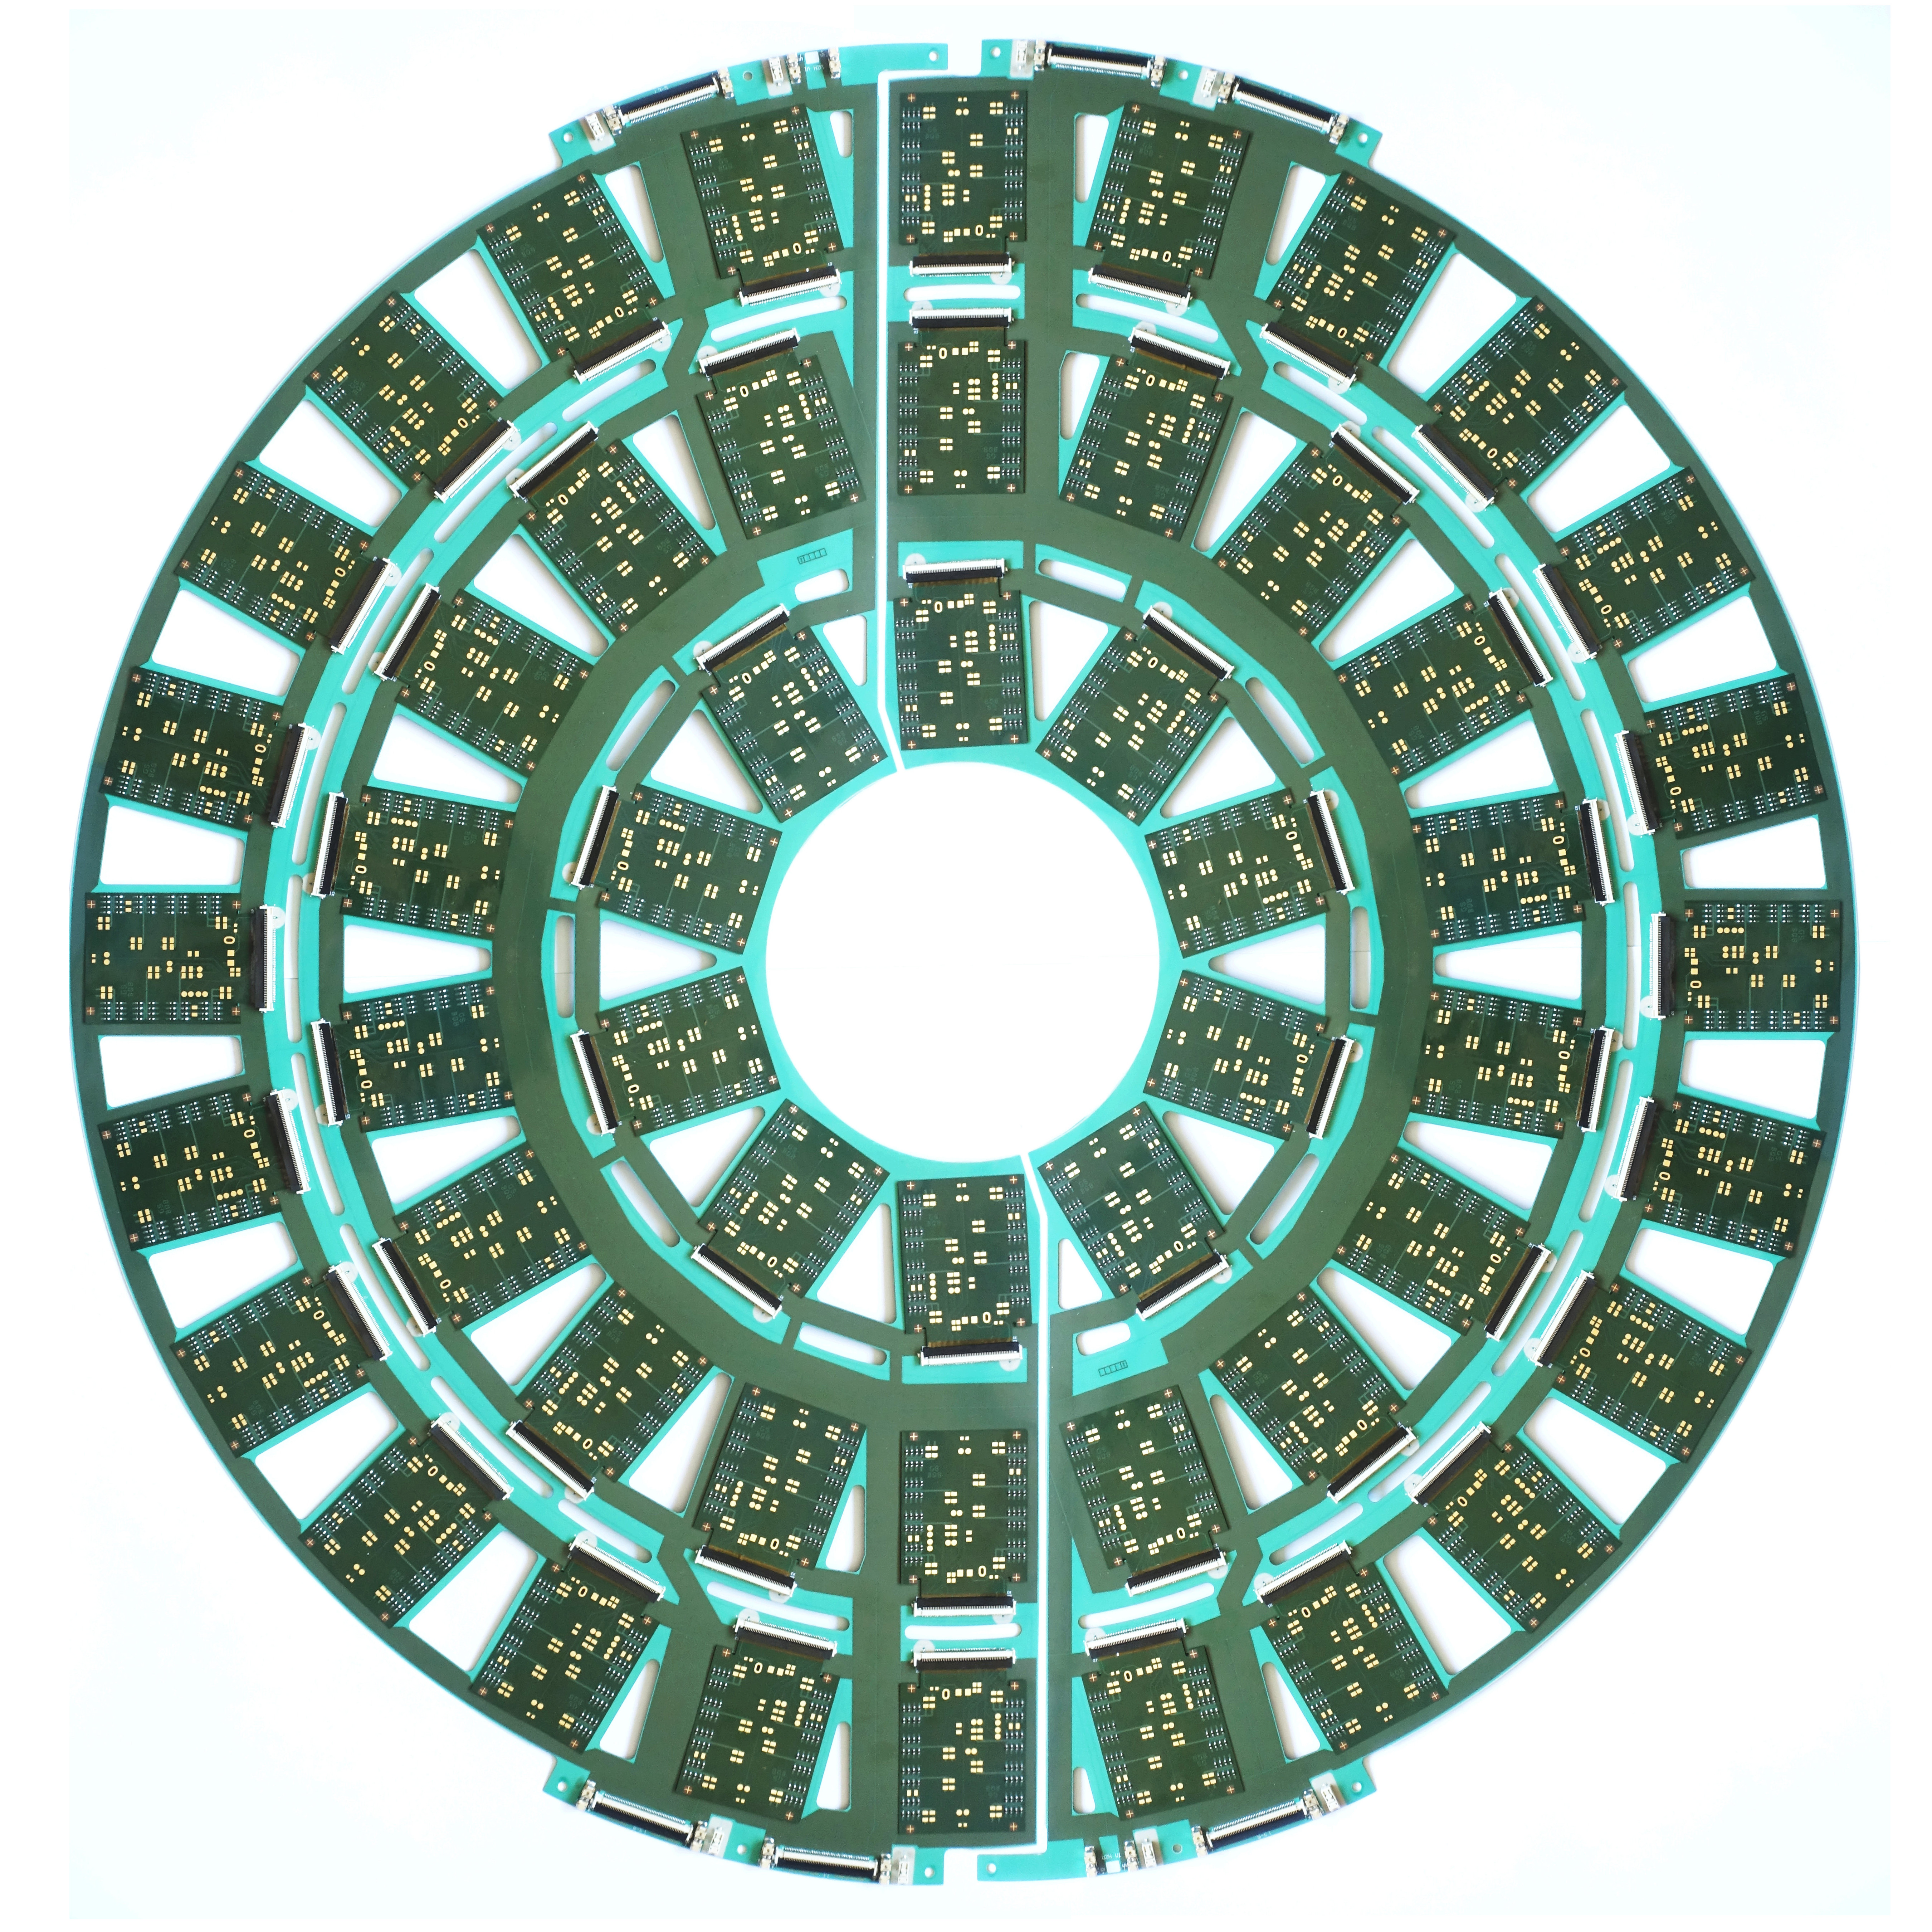
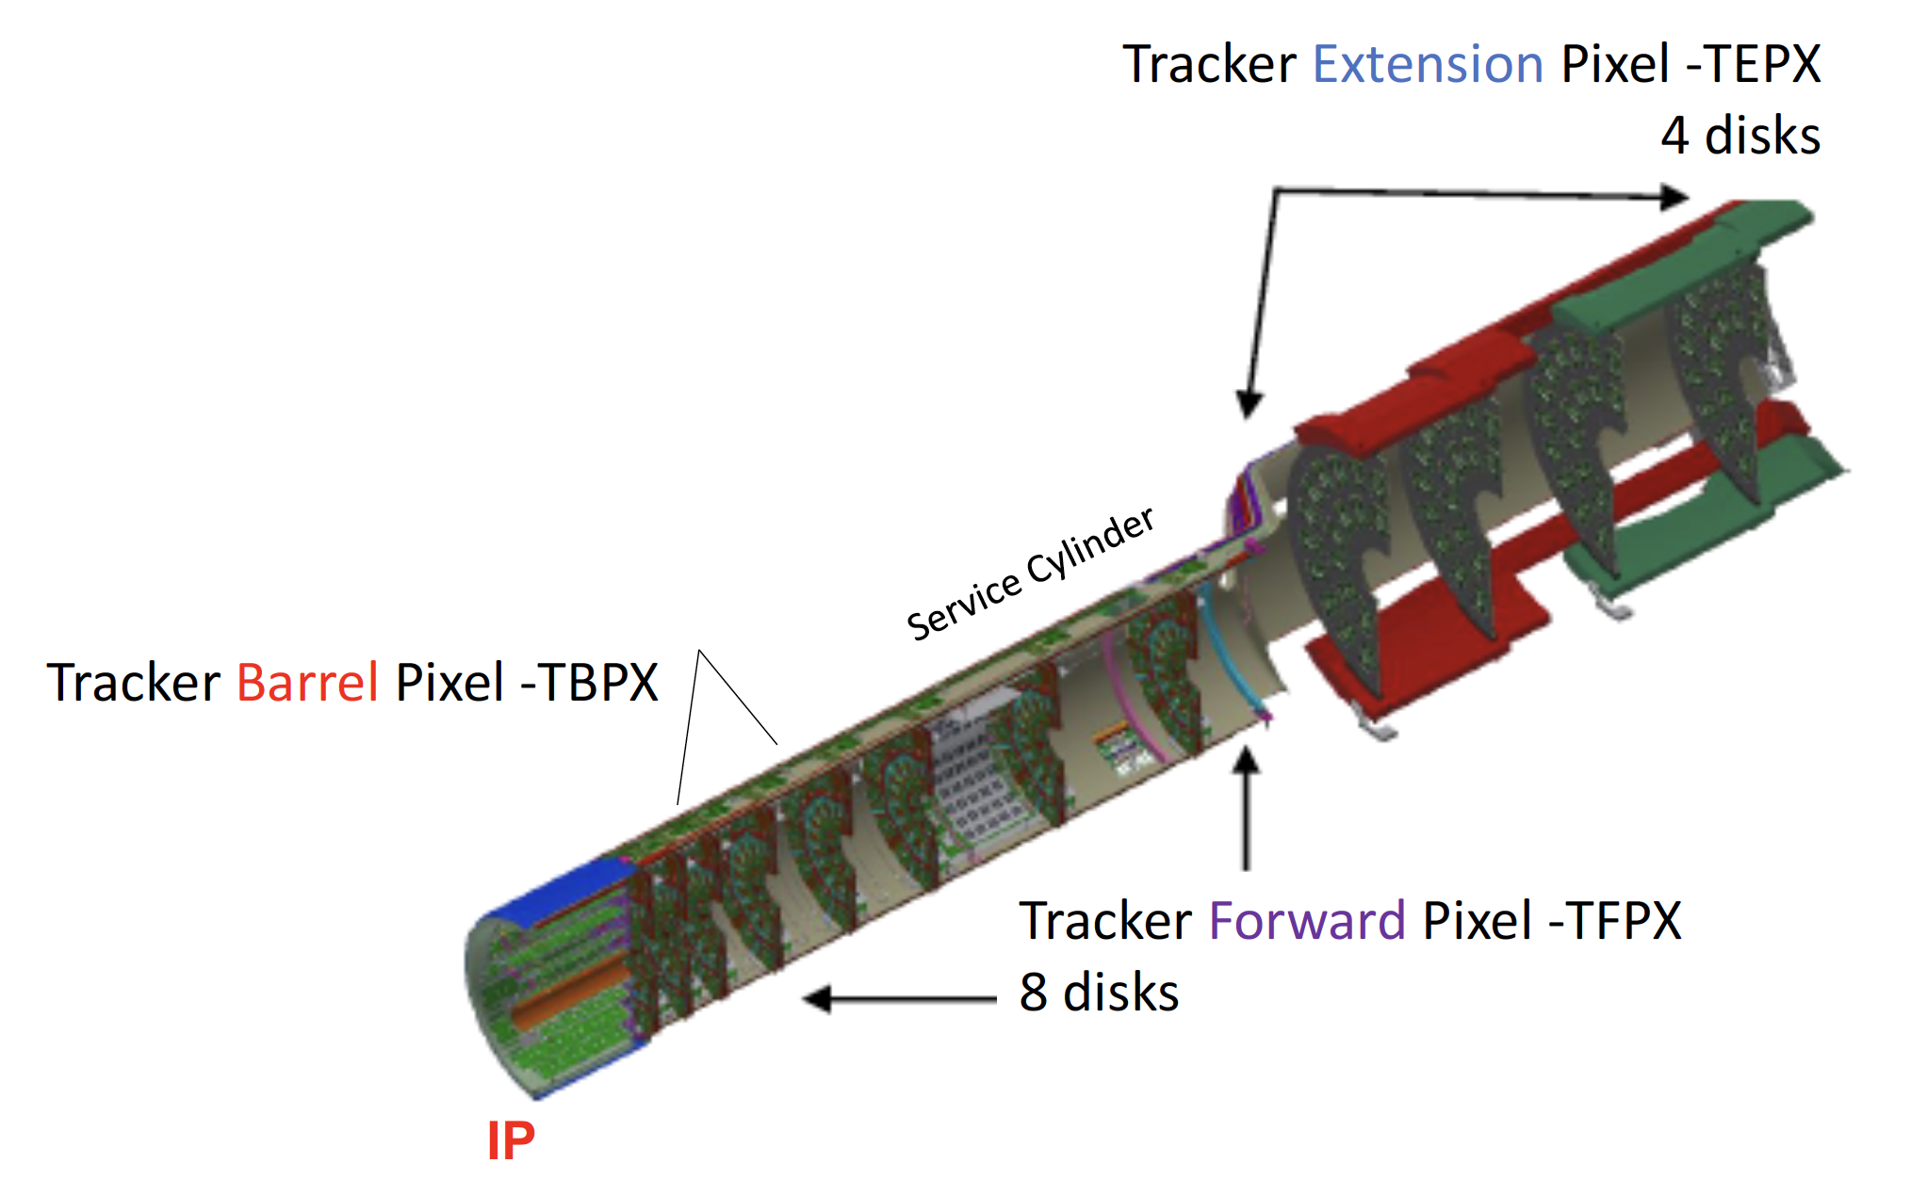
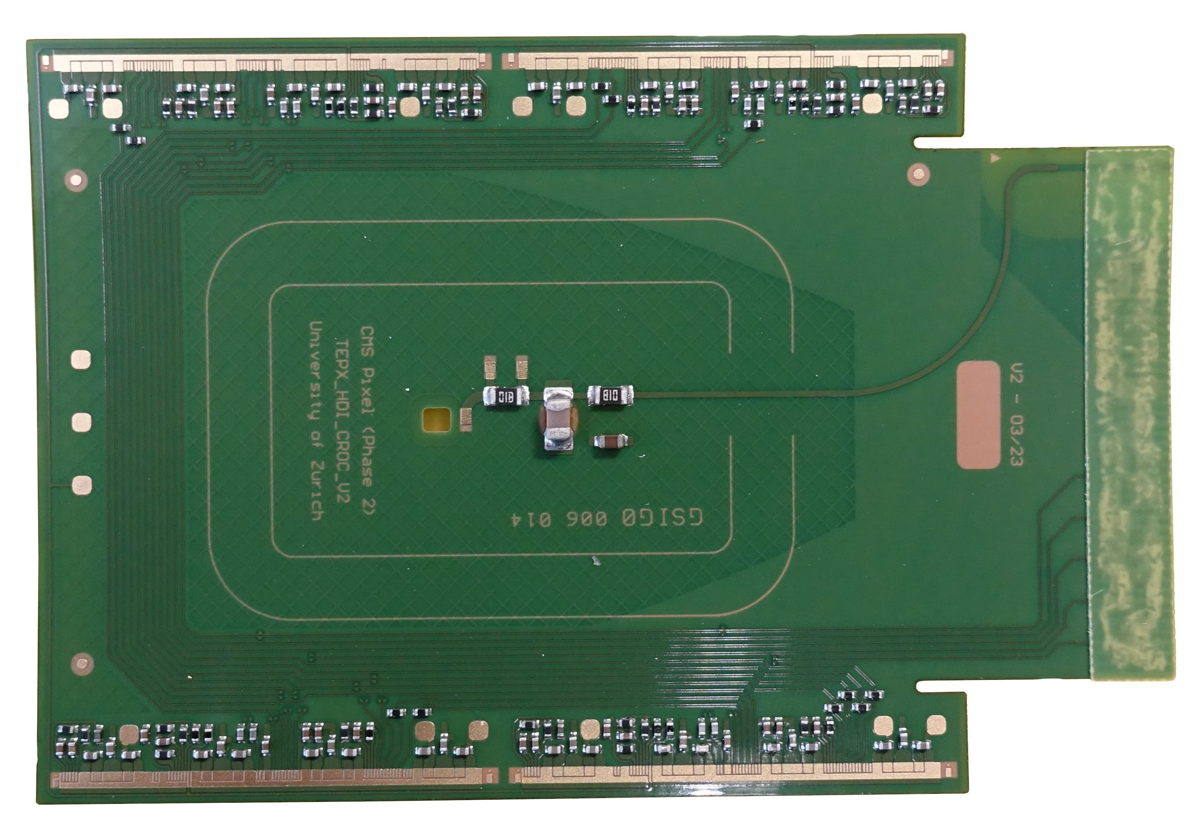
CMS at HL-LHC
TEPX prototype disk
PSI is responsible (together with UZH) for design and construction of extended pixel detector (TEPX) for CMS Phase-2
  Module production and testing, mechanics, readout system, integration and installation
Module production (about 1200 modules to be built at PSI, 60% of TEPX) will start next year
  Close collaboration with other groups building modules for TBPX (INFN, ETH, E), TFPX (USA) and TEPX (D, E)
Detector installation in 2028
TEPX module

Slide 6
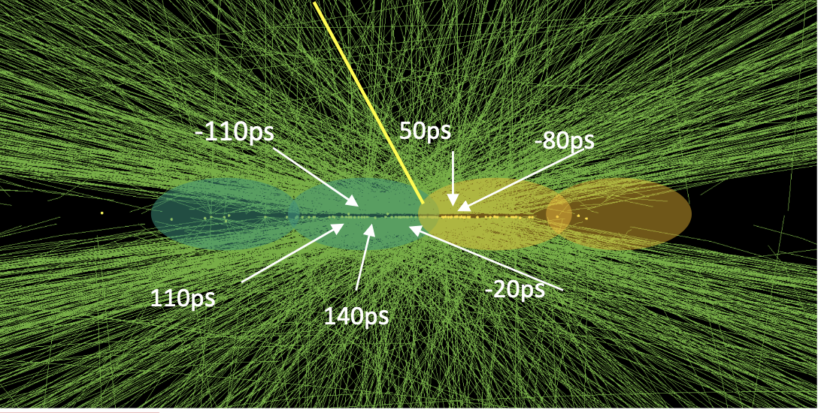
Detector R&D activities
4D tracking at CMS
Development of readout electronics for fast silicon timing detectors (with time resolution < 30ps)
  For “CMS Phase-3” (future upgrade in LS4) → timing information
  in TEPX → 4D tracking at CMS
  Forming collaboration PSI/UZH/CERN for chip development
  in 28nm CMOS process
Development of Depleted Monolithic Active Pixel Sensors
(DMAPS) for applications in particle physics and beyond
  Development of test structures and prototype chips in different processes
  Partner organization in AIDAinnova WP5
  Cooperation with ARCADIA
Active part in forming CH collaboration towards research at FCC (CHEF)
Participation in ECFA Detector R&D roadmap
  DRD3 - Solid-state detectors
  DRD7 - Electronics
MOTIC (Monolithic timing chip 2021)

Slide 7
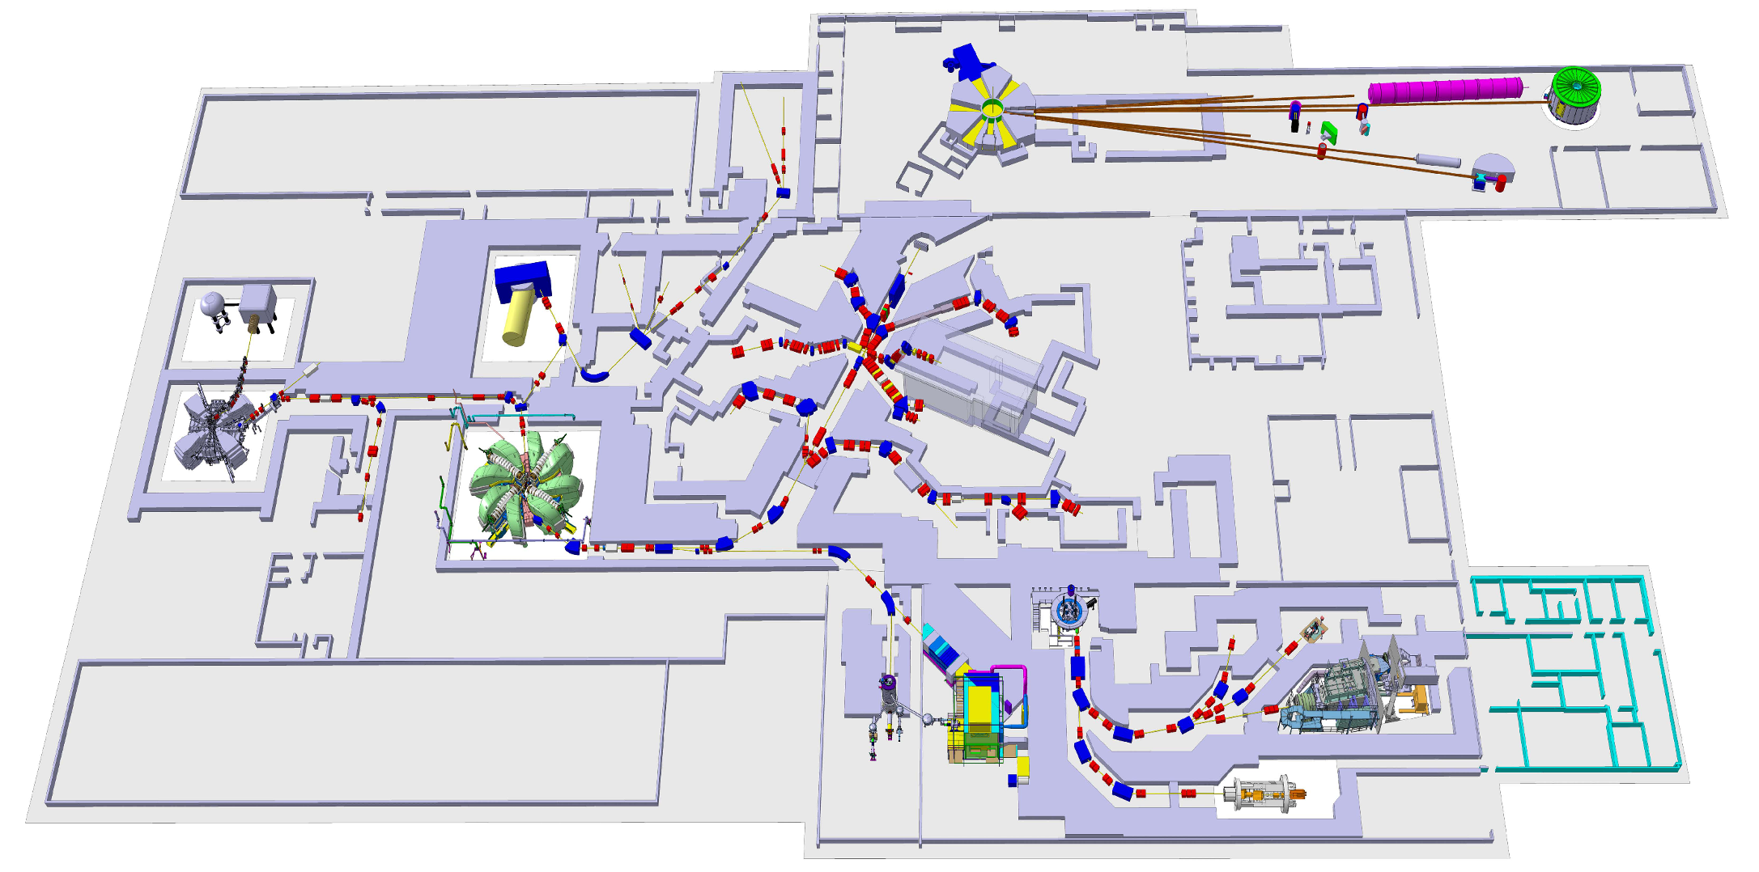
The intensity frontier at PSI: π, μ, UCN
Precision experiments with the lightest unstable particles of their kind
The most powerful DC (50MHz)
proton beam to targets:
590 MeV x 2.4 mA = 1.4 MW
HIMB project:
muon beams with
10¹⁰μ⁺/s < 30 MeV/c
LEMING
muEDM
muCool
πHe
MuX QUARTET
CREMA: μp / μd / μHe
MEG II, Mu3e
PIONEER
MUSE
The highest intensity
pion and muon beams, e.g.,
up to a few 10⁸μ⁺/s at 28 MeV/c
The high intensity
ultracold neutron source
PIF
nn’
n2EDM
τspect
Swiss national laboratory with strong international collaborations
See recent Particle Physics at PSI, https://scipost.org/SciPostPhysProc.5.001

Slide 8
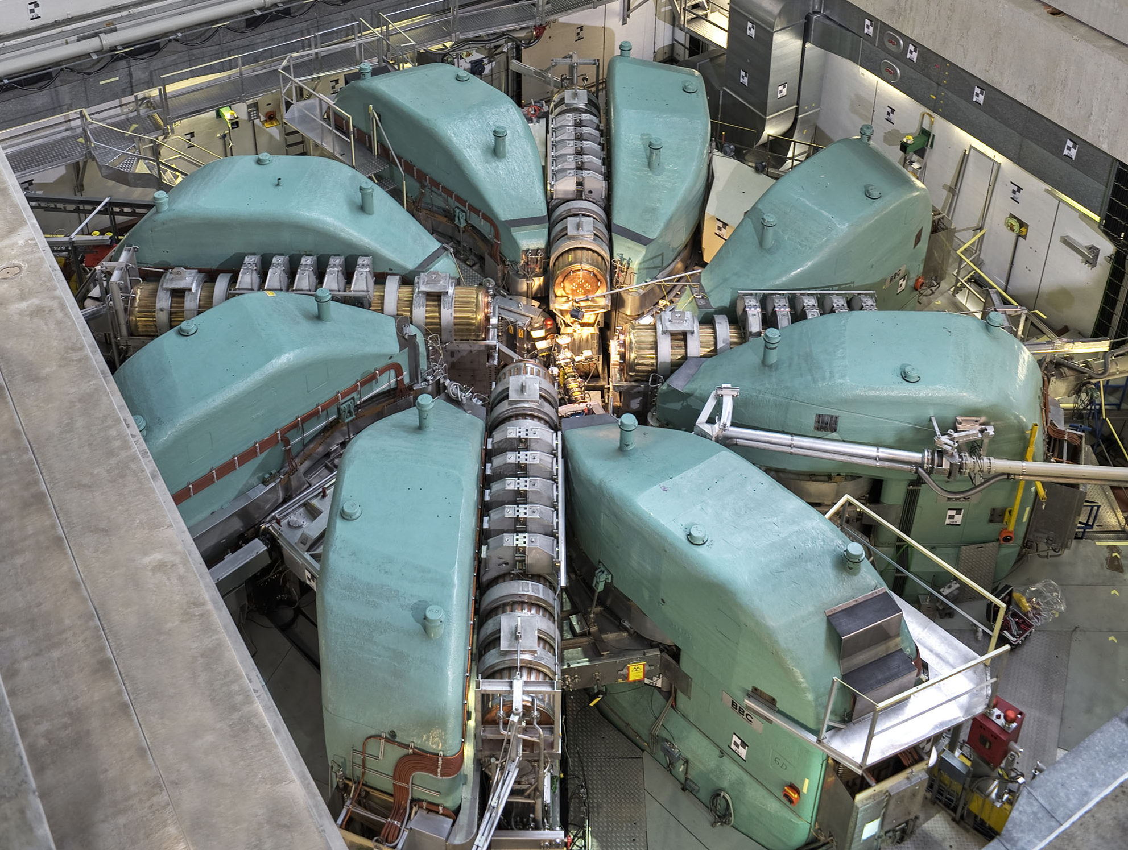
Ring cyclotron
at time of construction a new concept: separated sector ring cyclotron [H.Willax et al.]
8 magnets (280t, 1.6-2.1T),
4 accelerating resonators (50MHz), 1 Flattop (150MHz),
∅ 15m
losses at extraction ≤ 200W
reducing losses by increasing RF voltage was main upgrade path
[losses ∝ (turn number)³, W.Joho]
590MeV protons at 80%c
2.4mA x 590MeV=1.4MW
Notes:
Das Ringzyklotron hat 12 Meter Durchmesser und besteht im wesentlichen aus:
8 Dipolmagneten: Gesamtgewicht 2000 t
4 Kupfer-Beschleunigungskavitäten: Spitzenspannung von je 850 kV
40 Jahre Spitzenforschung:
Seit gut 40 Jahren (1974) ermöglicht der grosse Protonenbeschleuniger am PSI Spitzenforschung. Er wurde stetig ausgebaut und durch die Weiterentwicklung konnte der Protonenstrom über die Jahre um einen Faktor 24 erhöht werden. Heute liefert der Protonenbeschleuniger den leistungsstärksten Protonenstrahl der Welt.

Slide 9
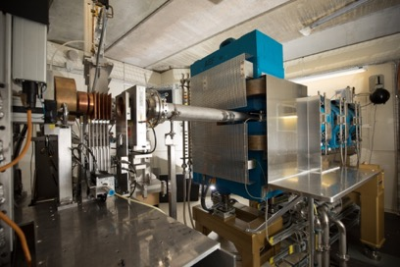

Proton Irradiation Facility PIF
Main functions:
user-lab for studies of radiation effects
realistic simulator of space radiation environment
source of mono-energetic particles
radiation qualification of space technologies
calibration of detectors
application oriented and user-friendly facility
part of ESA “European Component Irradiation Facilities ECIF”
Main parameters:
proton energy range: 6 – 230 MeV
proton flux range: 10² – 10⁹ p/s/cm²
Gaussian-like profiles (FWHM 9 cm)
options: focused (6mm) or flat beam profiles
Operation and User:
~120 test days/y with ~60 experiments/y
~150 visitors/y from about 40 institutions: research institutes, universities, aerospace and electronic industry from CH, EU, CHN and US
main users: ESA and CERN

Slide 10
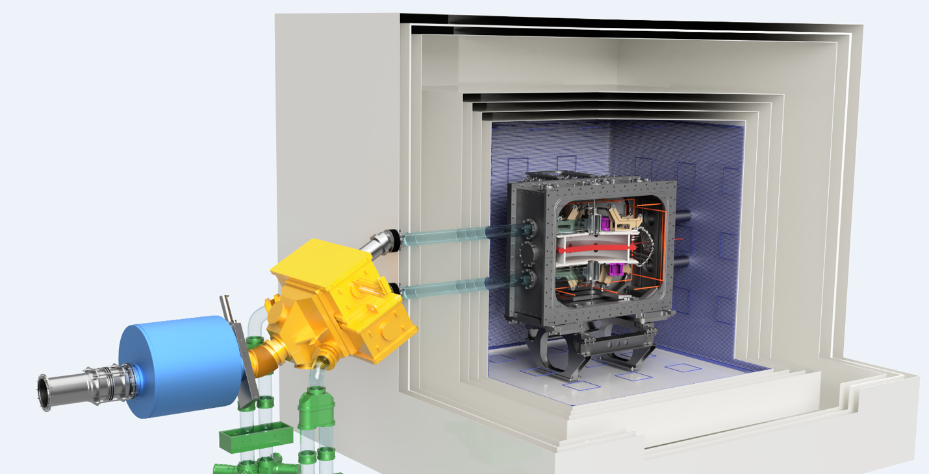
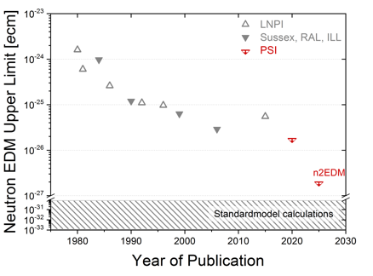
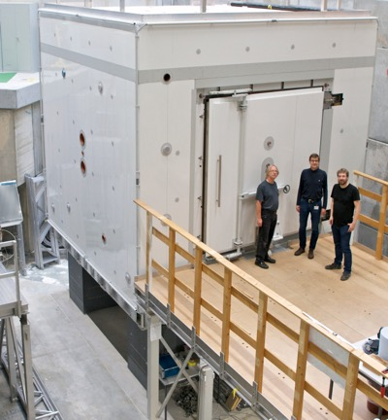





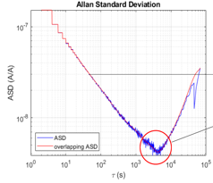


Search for a neutron Electric Dipole Moment nEDM Collaboration @ PSI
n2EDM project
World-best nEDM limit Phys.Rev.Lett. 124 (2020) 081803
- factor 10 higher sensitivity in baseline design
- apparatus with unique developments at PSI
nEDM
New magnetically-shielded room with worldrecord <150pT central field and field gradient (with VAC, Hanau)
n2EDM goal
nEDM result
E
B
High precision optically-pumped Cesium magnetometer array for realtime mapping of the magnetic field → precision magnetometry Lab
1ppb
stability
UCN
Development of ultralow-noise current source providing ultrastable magnetic field conditions
10⁻⁸
10²
10⁵

Slide 11
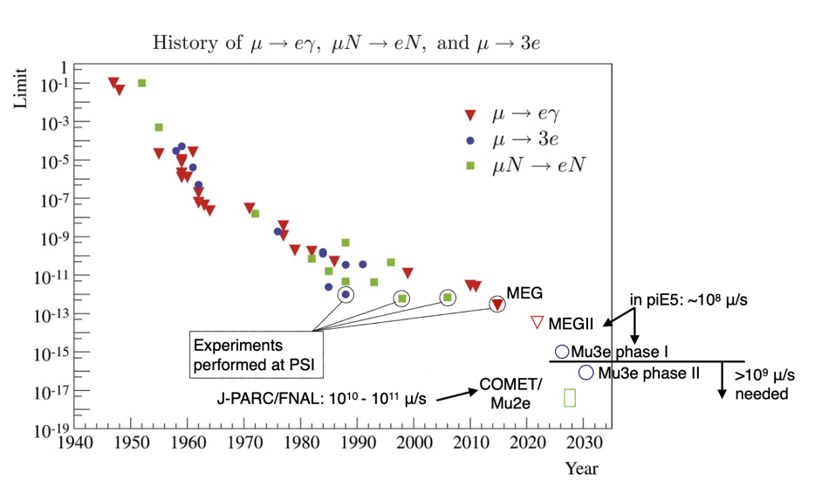
Future muon cLFV experiments at PSI
Neutrinoless muon decays are one of the most sensitive probes for new physics
μ→eγ and μ→3e only possible at DC, high-intensity machines, such as HIPA
→ New project (HIMB) for muon experiments with unique sensitivities

Slide 12
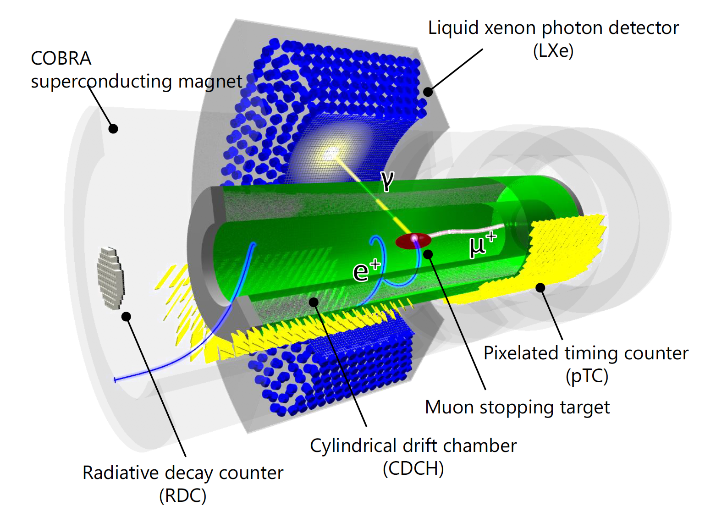
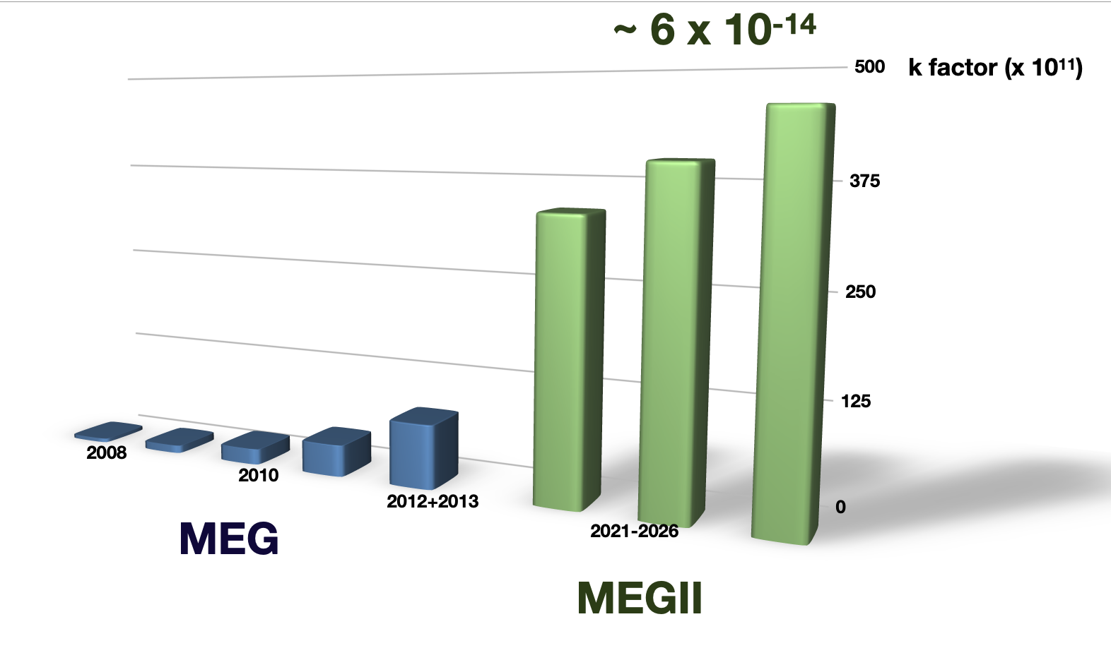


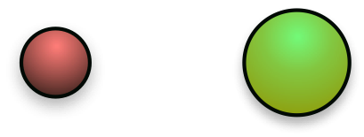


The MEGII experiment at PSI
  A. Baldini et al. (MEG Collaboration), Eur. Phys. J. C73 (2013) 2365
A. Baldini et al. (MEG Collaboration),
Eur. Phys. J. C76 (2016) no. 8, 434
The MEGII experiment aims at searching for μ⁺ → e⁺ γ with a sensitivity of ~ 6 10⁻¹⁴
Best upper limit on the BR (μ⁺ → e⁺ γ) set by the MEG experiment (4.2 10⁻¹³ @90% C.L.)
Five observables (Eg, Ee, teg, ϑeg, ϕeg) to identify μ⁺ → e⁺ γ events
New electronics:
WaveDAQ
~9000 channels at 5GSPS
Better uniformity w/
12x12 VUV SiPM
2x Resolution everywhere
Higher Beam Intensity
Updated and
new Calibration methods
35 ps resolution
w/ multiple hits
Quasi mono-chromatic positron beam
Full available
stopped beam intensity
7 x 10⁷
Single volume He:iC4H10
Background rejection

Slide 13
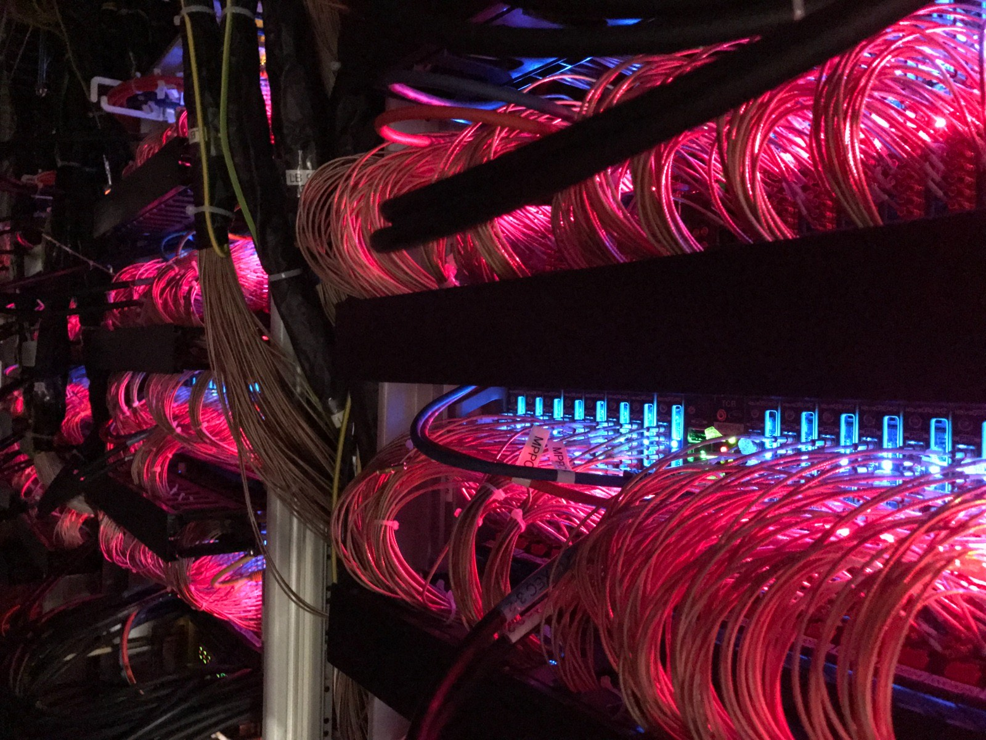
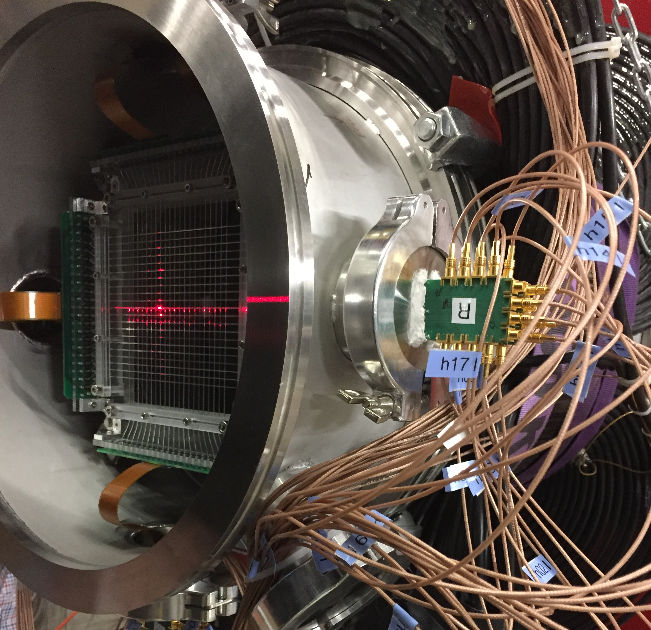
The WaveDAQ System
DRS4 chip
WaveDREAM Board
Data acquisition system based on patented DRS4 chip with 5 GSPS/12 bit developed at PSI
Novel custom crate design allows compact triggering and DAQ
WaveDAQintegrates signal amplification, triggering, DAQ andbias voltage generation in a single system
Boards used in MEG, FOOT (INFN Pisa), Beam profile monitorsand SwissFEL
MEGII TDAQ
Beam
monitoring

Slide 14
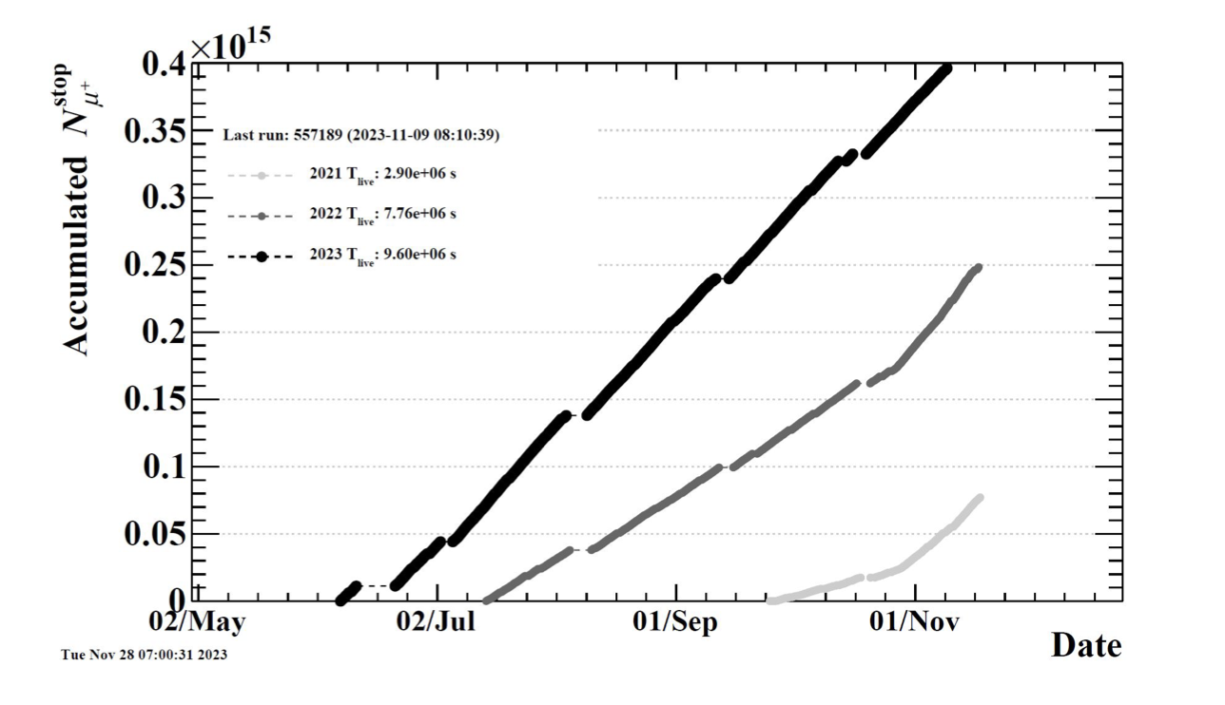
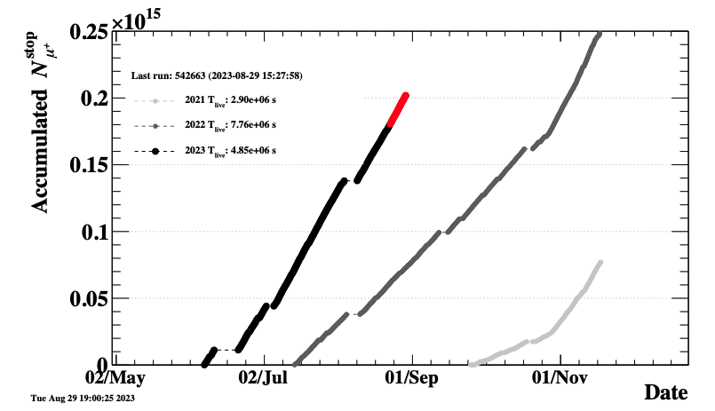
How is ongoing…Physics run 2023: completed
  Very successful data taking period!
Run2022
With a beam intensity = 4.27e7 mu/s@1.76 mA
Run2022
Analysis ongoing
Up to Aug 29th
Run2023
Run2023
Run2021
Data taking ongoing
Data taking: Finished
Analysis: Finished
Run2021
Analysis ongoing

Slide 15
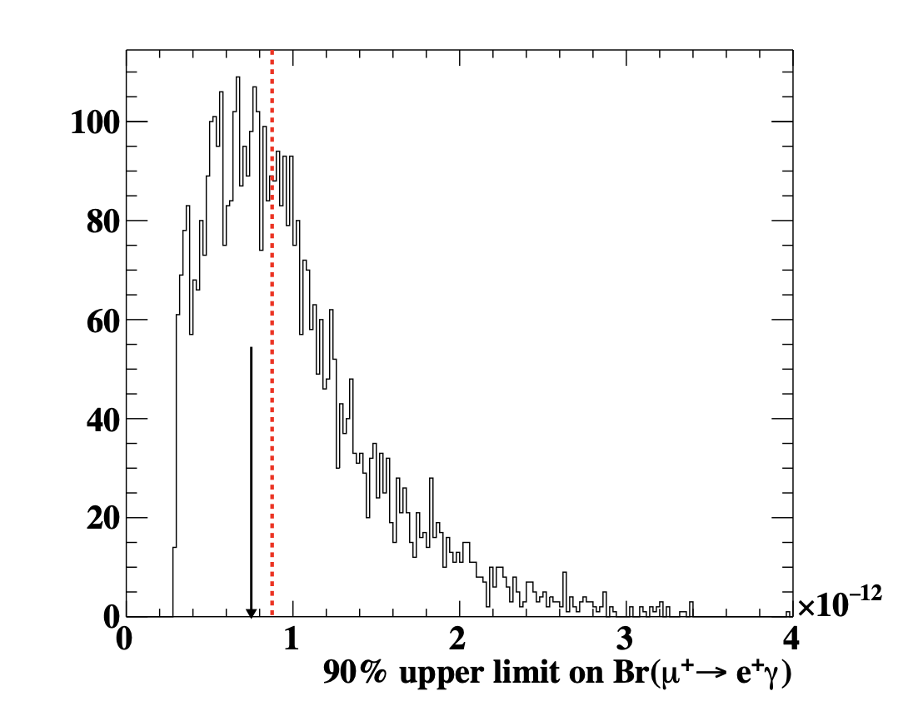
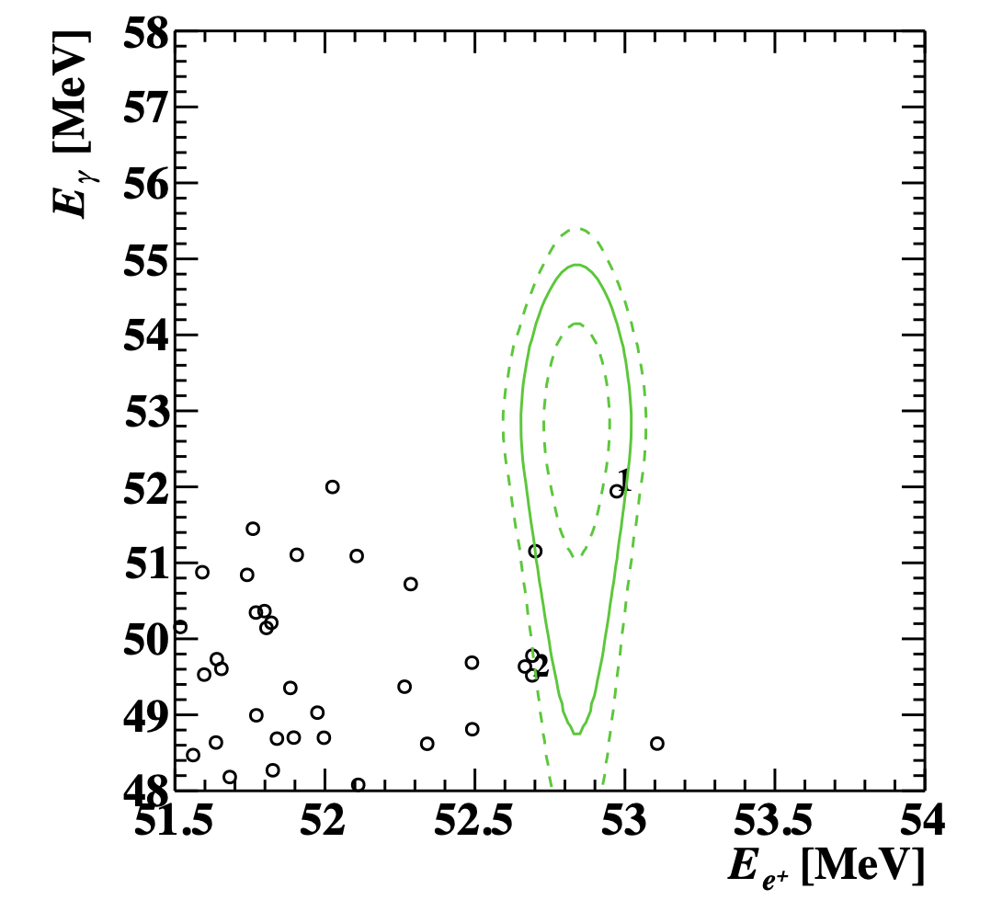
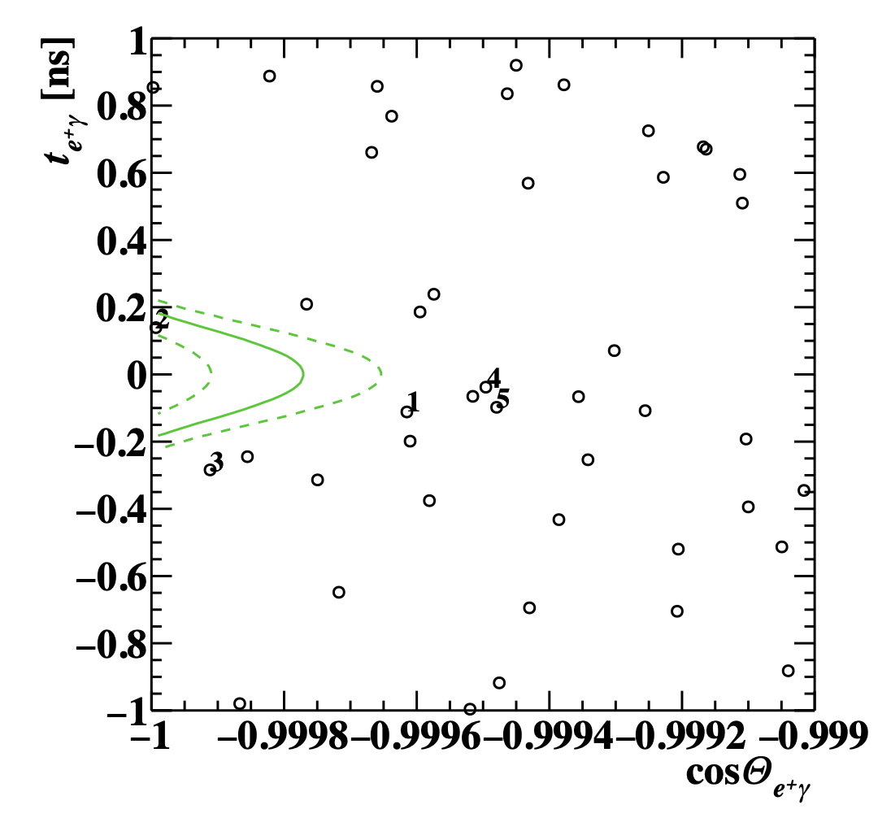
First MEGII results - data sample “Run2021” and MEG combination
https://arxiv.org/pdf/2310.12614.pdf
https://arxiv.org/pdf/2310.11902.pdf
Distribution of the 90% C.L. upper limits computed for an ensemble of pseudo-experiments with a null-signal hypothesis
The sensitivity is indicated by a red dashed line while the upper limit observed (Run 2021) in the analysis region with a solid black arrow
Upper limit on the BR (μ⁺ → e⁺ γ) set by the MEGII experiment Run2021 (7.5 10⁻¹³ @90% C.L.)
When combined with the final result of MEG, we obtain the most stringent limit up to date, BR (μ⁺ → e⁺ γ) < 3.1 10⁻¹³ @90% C.L.
The final goal (by 2026) is to reach a sensitivity to the μ⁺ → e⁺ γ decay of S90 ~ 6 10⁻¹⁴

Slide 16

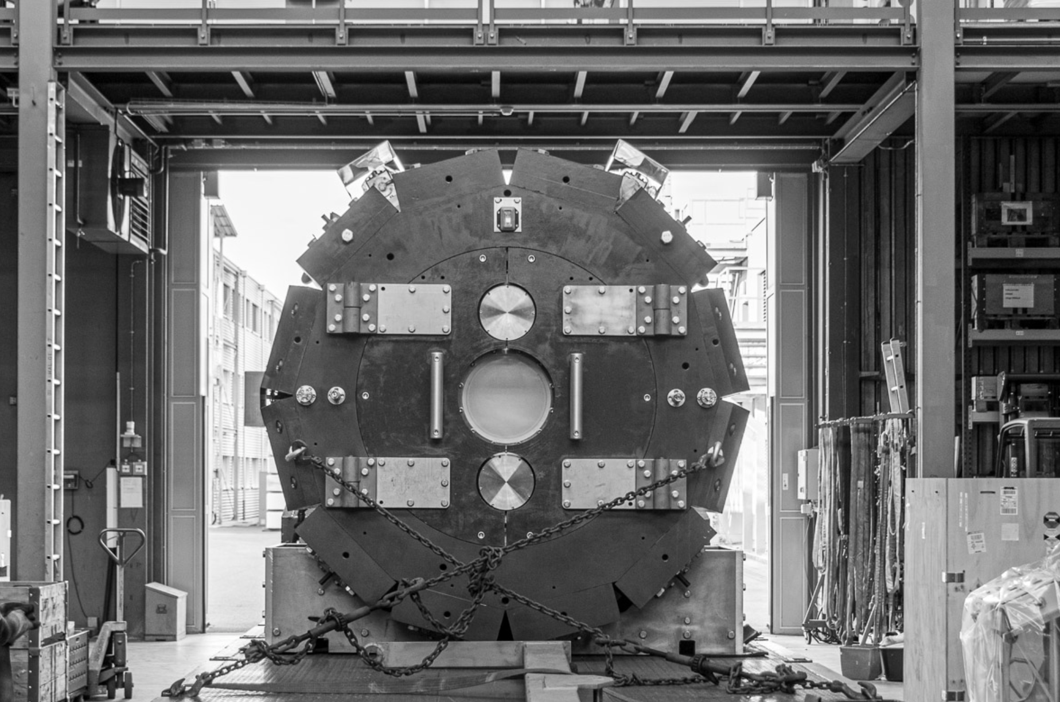
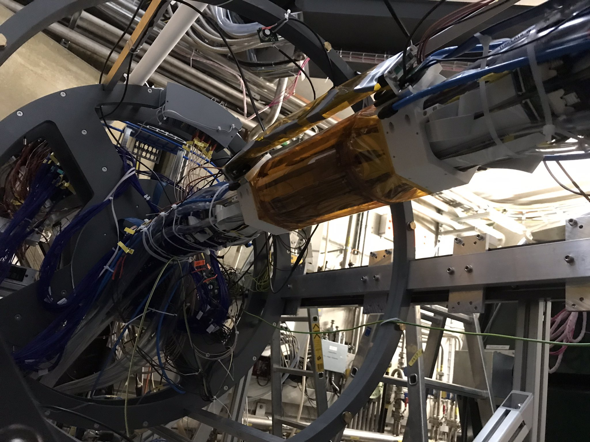
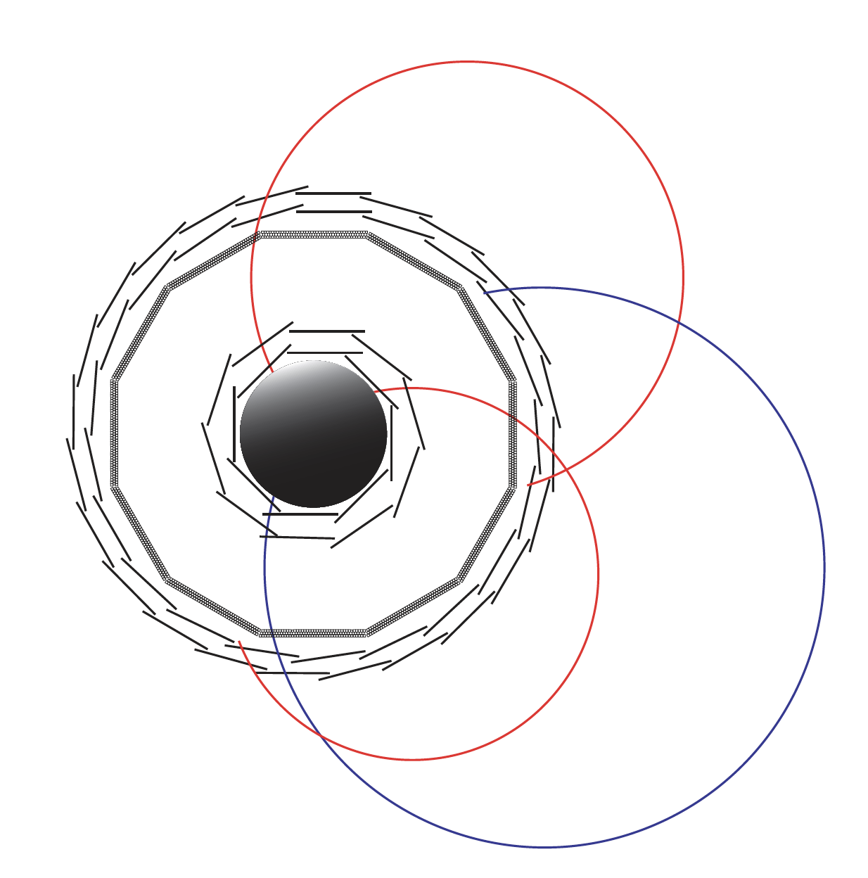
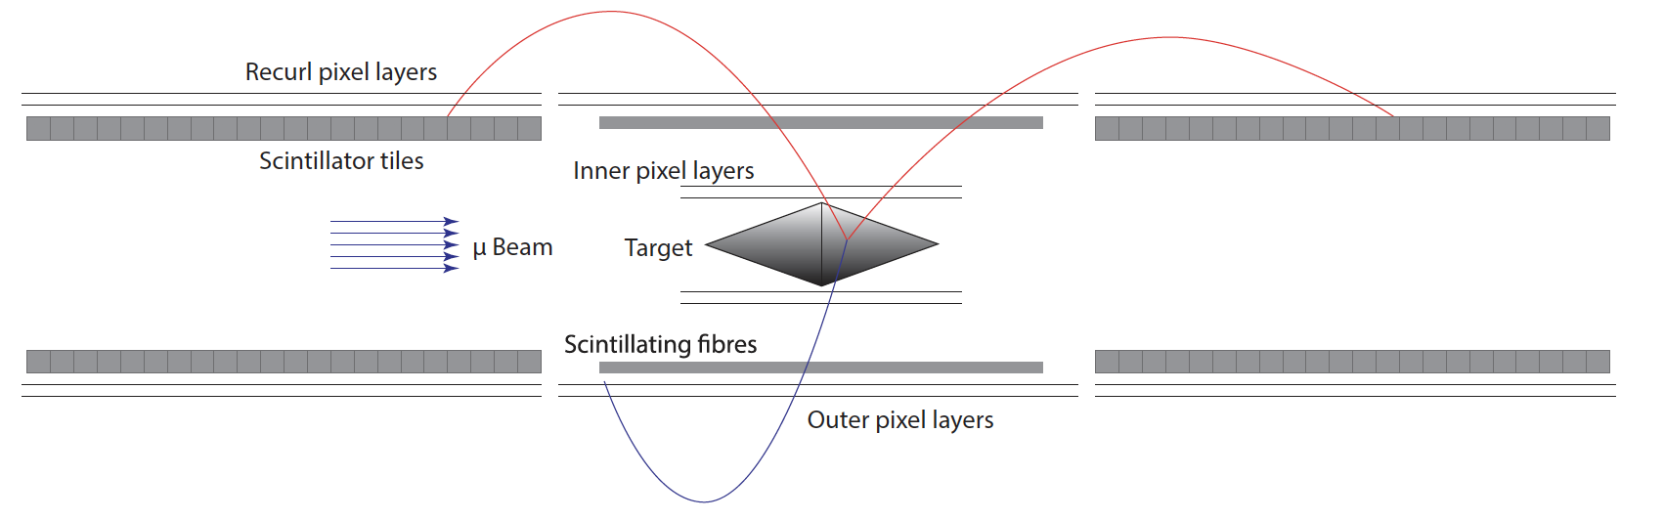
Mu3e: Latest news and currents status
The Mu3e experiment aims to search for μ⁺ → e⁺ e⁺ e⁻ with a sensitivity of ~10⁻¹⁵ (Phase I) up to down ~10⁻¹⁶ (Phase II)
  Previous upper limit BR(μ⁺ → e⁺ e⁺ e⁻ ) ≤ 1 x 10⁻¹² @90 C.L. by SINDRUM experiment)
Detector concept validated during the Integration run 2021
Full beam line commissioned during the beam time 2022 - fine tuning and further studies ongoing during the beam time 2023 [new record of transported muons at the collimator]
Very successful: TDR promised values matched!
  1.02e10⁸ mu/s @2.4 mA (Mu3e magnet) [run2022]
Full analysis performed on
Simulated data
Mu3e apparatus (phase I)

Slide 17
Mu3e: Latest news and currents status
The Mu3e experiment aims to search for μ⁺ → e⁺ e⁺ e⁻ with a sensitivity of ~10⁻¹⁵ (Phase I) up to down ~10⁻¹⁶ (Phase II)
  Previous upper limit BR(μ⁺ → e⁺ e⁺ e⁻ ) ≤ 1 x 10⁻¹² @90 C.L. by SINDRUM experiment)
Detector concept validated during the Integration run 2021
Full beam line commissioned during the beam time 2022 - fine tuning and further studies ongoing during the beam time 2023 [new record of transported muons at the collimator]
Very successful: TDR promised values matched!
  1.02e10⁸ mu/s @2.4 mA (Mu3e magnet) [run2022]
Time line phase I (exploiting current beamline intensity)
Engineering run: 2024
First physics run: 2025 - 2026
Phase II: It requires 10⁹ mu/s —> HiMB
Mu3e apparatus (phase I)

Slide 18
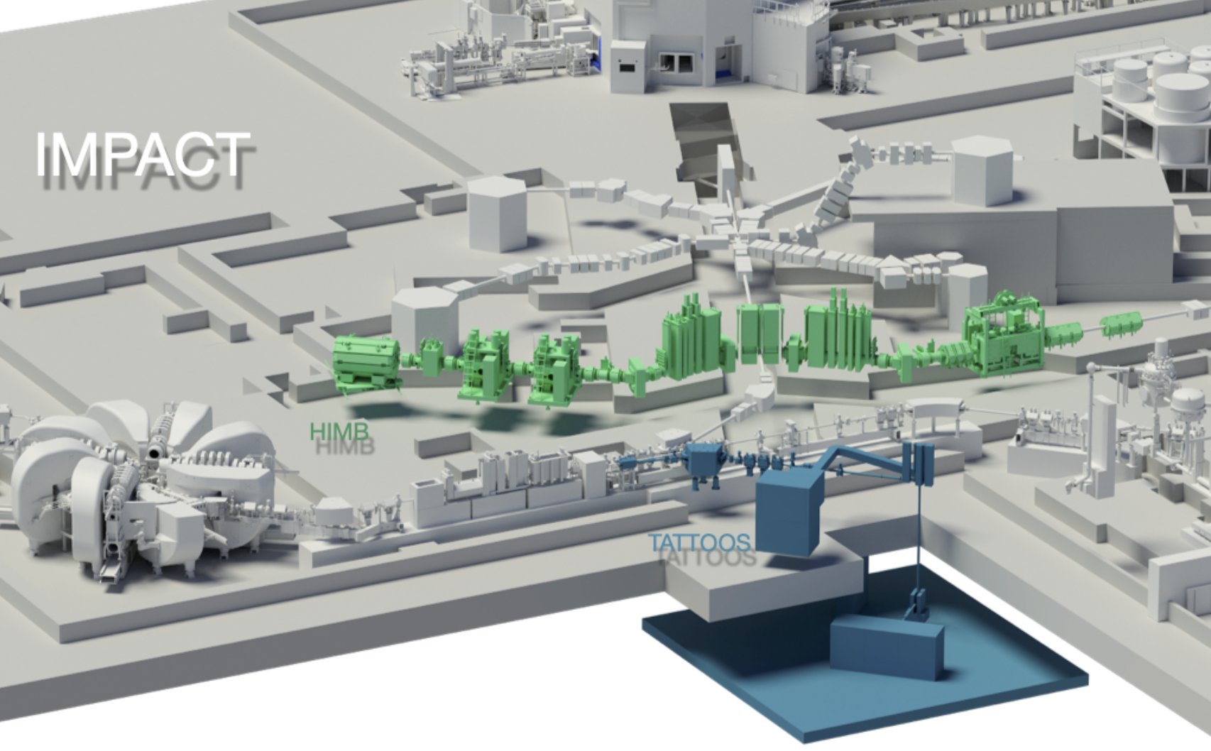
IMPACT – Isotopes and Muon Production using
Advanced Cyclotron and Target technologies
ü
01/22 CDR published
07/22 Scientific Review
12/22 ETH Board: IMPACT for
Swiss Roadmap of RIs 2023
2022-24 PSI funds pre-project
12/24 Swiss parliament
decision about funding 2025-28
Full implementation
08/28 start HIMB
08/30 start TATTOOS
ü
ü
ü
ü
https://www.psi.ch/impact
https://www.psi.ch/media/our-research/a-two-part-upgrade-for-the-proton-accelerator

Slide 19
LTP – Strategy and Vision for 2026+
Harvest physics results
2022-2028+
Future activities
2026+
Future infrastructure
2026+
  CMS
  MEG II
  Mu3e Phase I
  n2EDM
  CREMA, HyperMu
  Mu-MASS (@LEM)
  MUSE
  muX, QUARTET …
  ….
  CMS at HL-LHC
  Mu3e Phase II
  n2EDM++
  muEDM I & II
  PIONEER I & II
  Mu – spec&gravity
  …
  HIMB (2029+)
  muCool (2024+)
  EZE UCN (2026+)
  HL-LHC (2028+)
  Pixel detectors
  & other technology
Aim at leading efforts in high- and low-energy particle physics with discovery potential
Synergies of experiment + theory + technology development & transfer + education
Foster collaborations within LTP, NUM, PSI, ETH&UZH&more, CHIPP, &internationally

