Slide 1



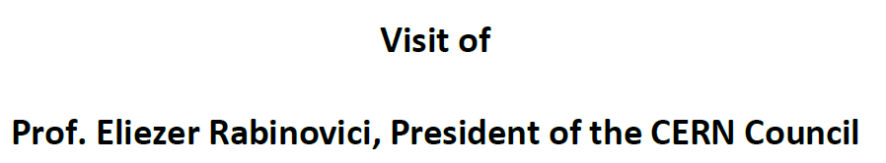
Proton Therapy for adults and Children @ PSI
PSI, December 20th 2023
Prof. Damien C. Weber :: Zentrum für Protonentherapie :: Paul Scherrer Institut

Slide 2
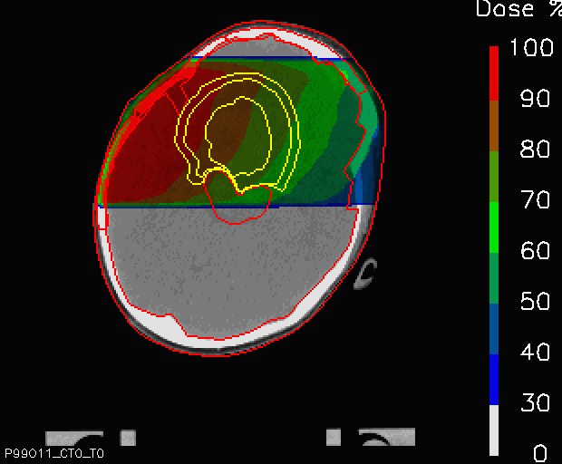
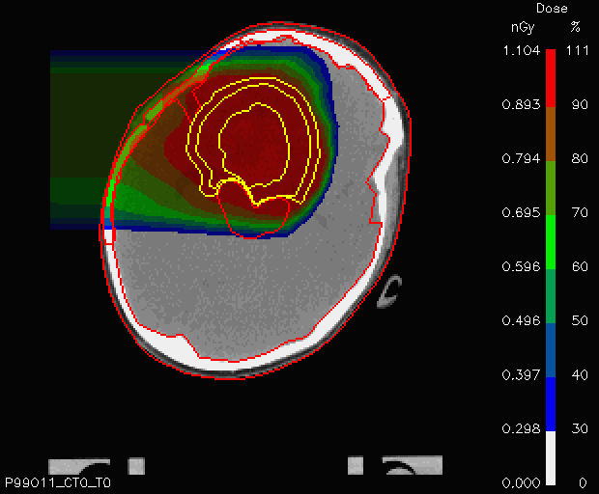
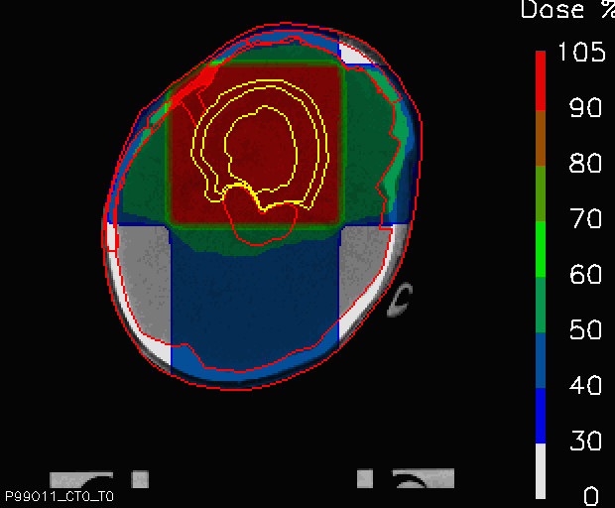
Generierte Dosis aus Photonen und Protonen
Animation adapted from:
D. Meer,
Photonen- und Protonentiefendosis-Kurven in Wasser
200
Photons 10 MeV
Tumor
Multi Photon Field
Protons 150 – xx MeV
Protons 150 MeV
50%
100%
50%
100%
100%
Spread-Out Bragg Peak
70%
50%
150
80%
Relative dose [%]
40%
100
Courtesy of A. Lomax
50
Critical
Organ
0
0
5
10
15
20
25
30
Courtesy of D. Meer
Penetration depth in water [cm]

Slide 3
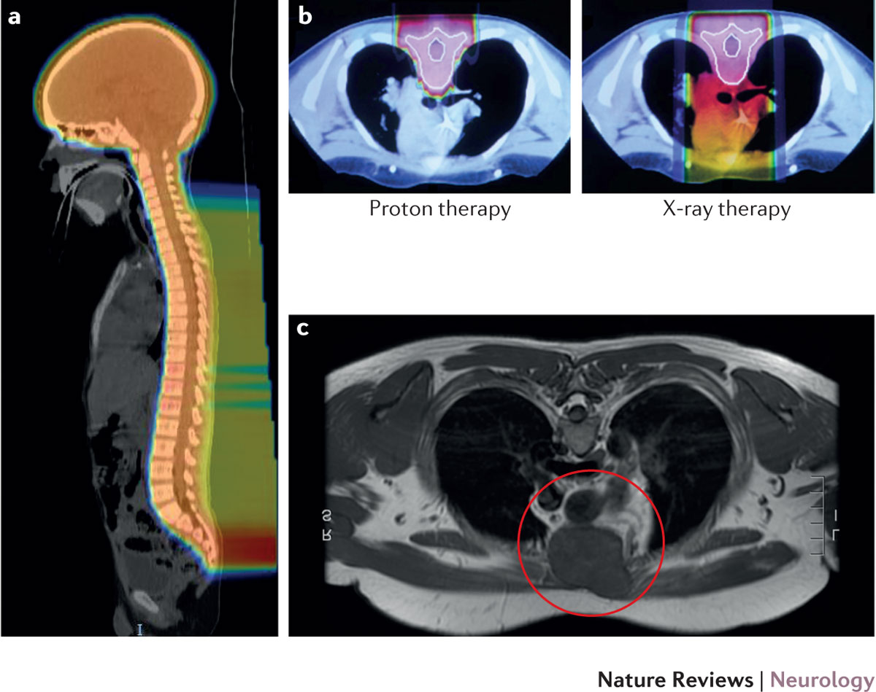
Unterschied zwischen Photonen und Protonen
Risikoreduktion von Sekundärmalignomen
Gondi, V. et al. (2016) Nat. Rev. Neurol.
Page 3

Slide 4


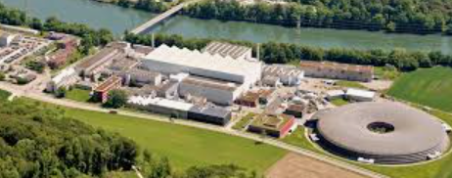
Only one Proton therapy Center
in Switzerland

Slide 5

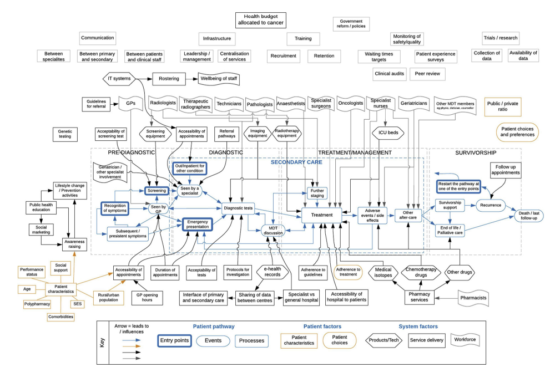
Health systems :: Cancer patient Journey

Slide 6

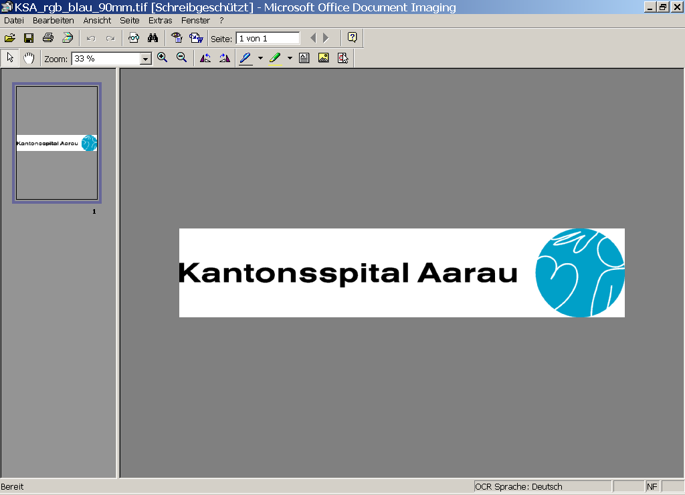




Zusammenarbeit
Radiologie
Chemotherapie
Gantry 2
Rotation Assistenzärzte
Gantry 3
Patientenversorgung

Slide 7
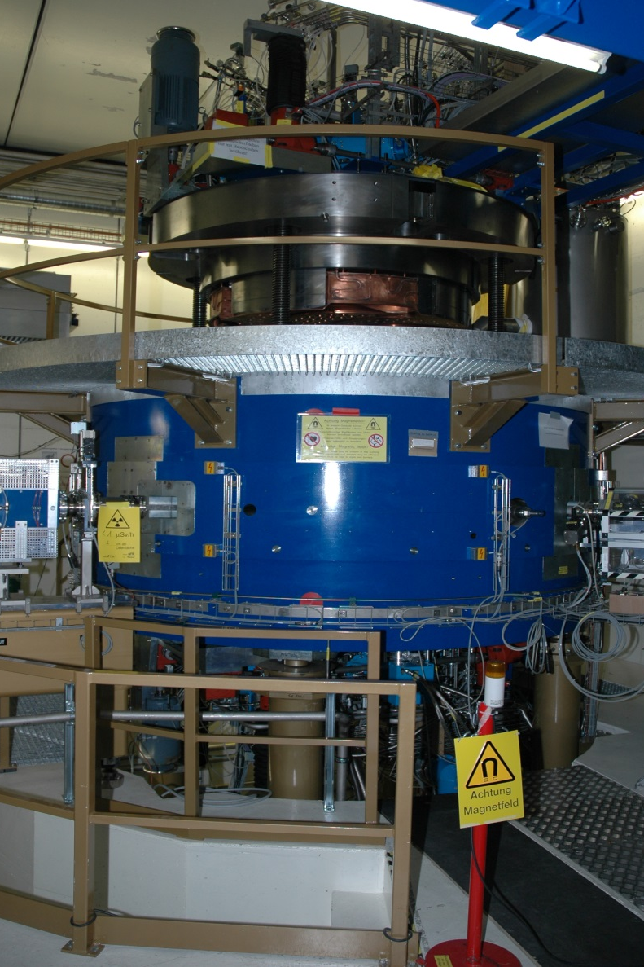
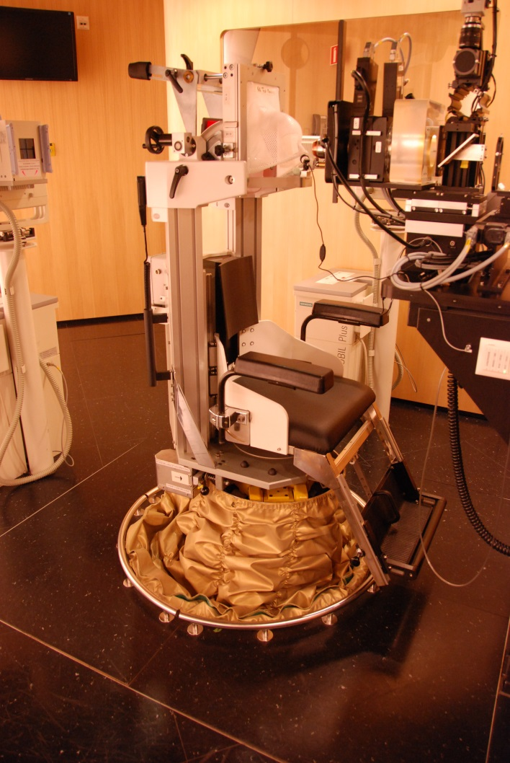
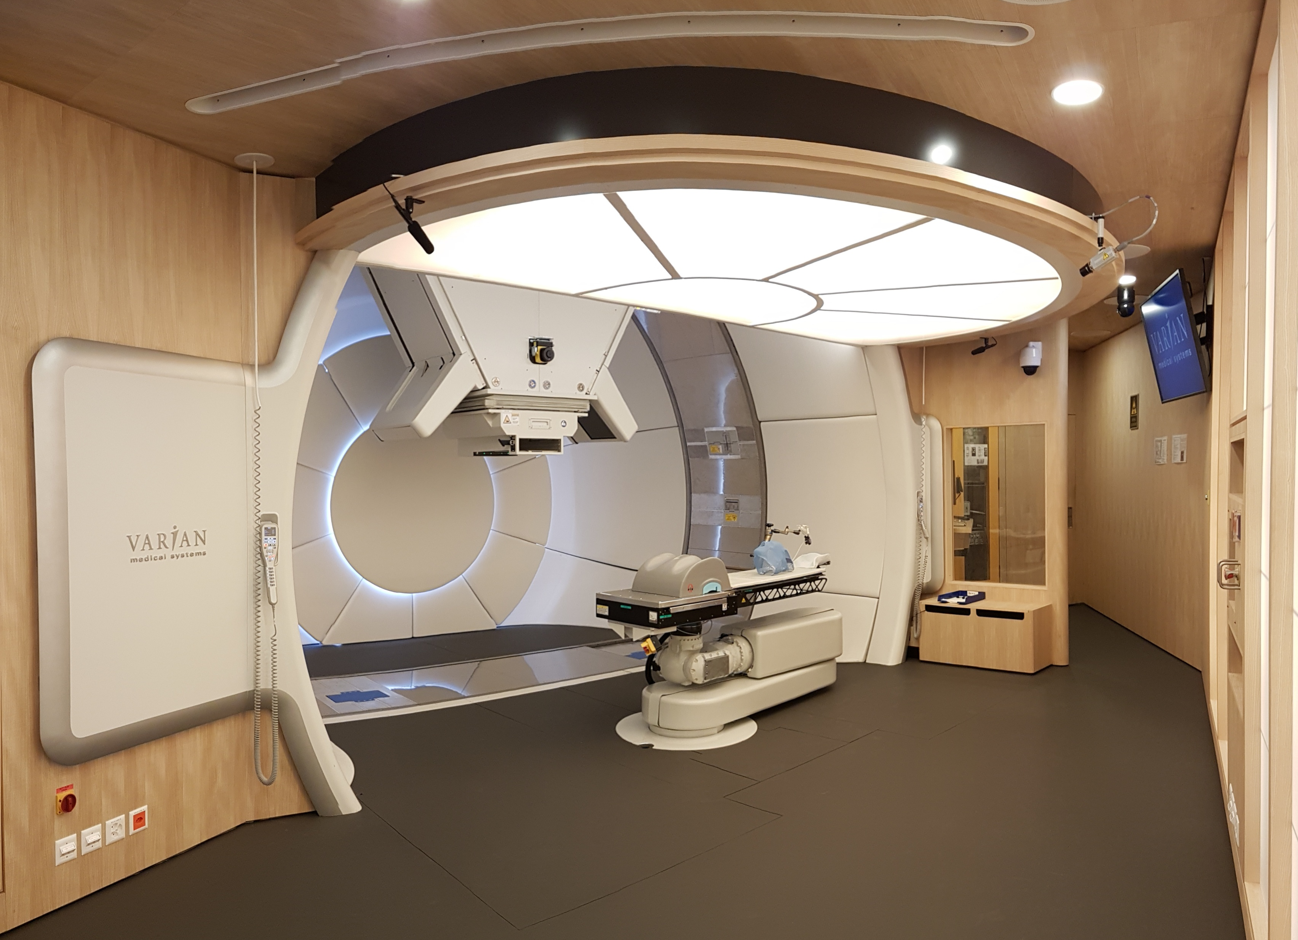
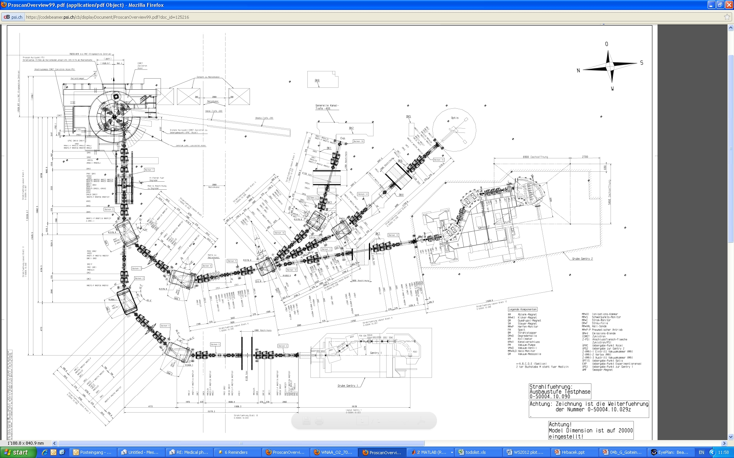
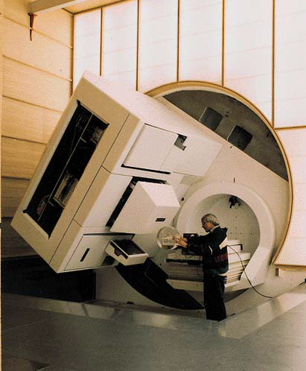
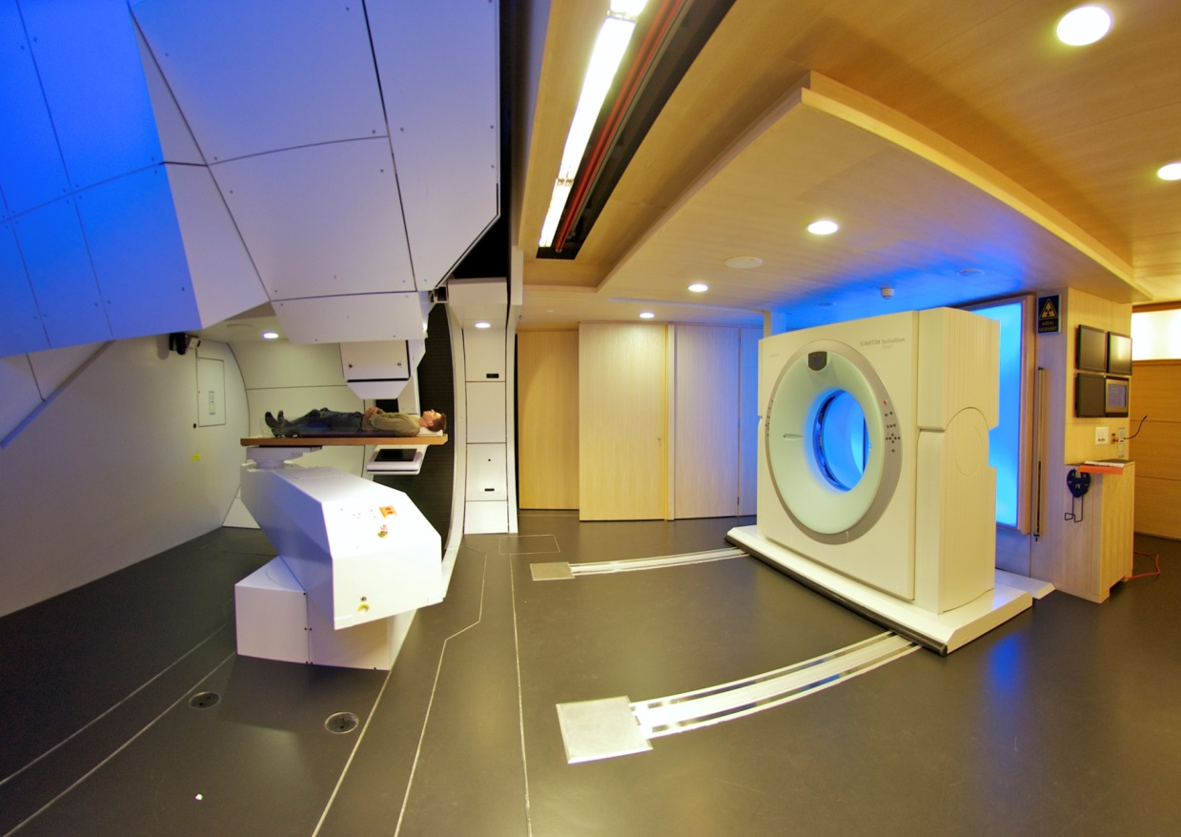
Proton therapy at PSI
1984
250 MeV Cyclotron
1st patients, July 2018
>7000 patients treated
1996
2013
~1300 patients treated
~180 patients treated

Slide 8
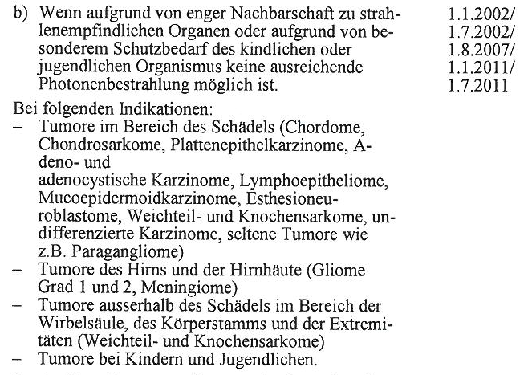
Established Indications treated at PSI
(accepted by insurance carrier and BAG)
  Ocular Melanomas
  Chordomas and Chondrosarcomas of skull base and axial skeleton, pelvis
  Head & Neck* Tumors and other histologies related to skull base and paraspinal location
  Meningiomas*
  Low Grade Gliomas
  Sarcomas
  Pediatric Neoplasms
  Advanced NSCLC Stage IIIA-B (RTOG 1308)
  Esophageal cancer (PROTECT)
Anhang 1 der Krankenpflege-Leistungsverordnung (KLV)

Slide 9
Anzahl der Patienten seit 2011
COVID

Slide 10
Anzahl der Patienten seit 2011 (O2+Gantries)

Slide 11
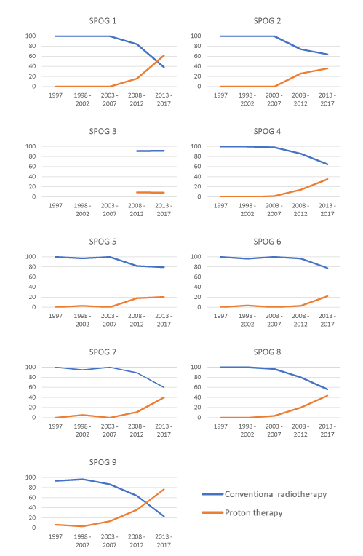
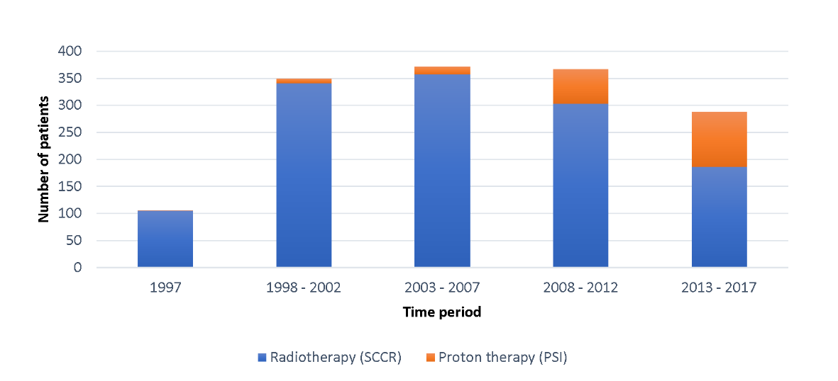
Schaller V et al. (KiSpi/UZH)
Proton therapy in
Switzerland
(Children)

Slide 12
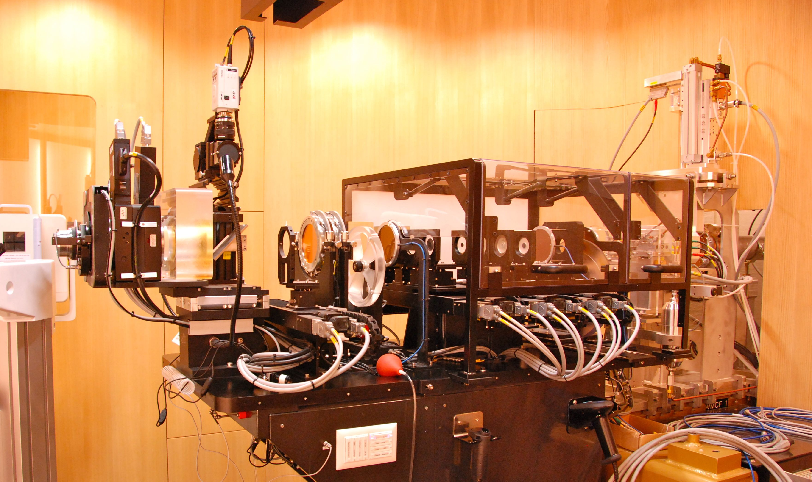
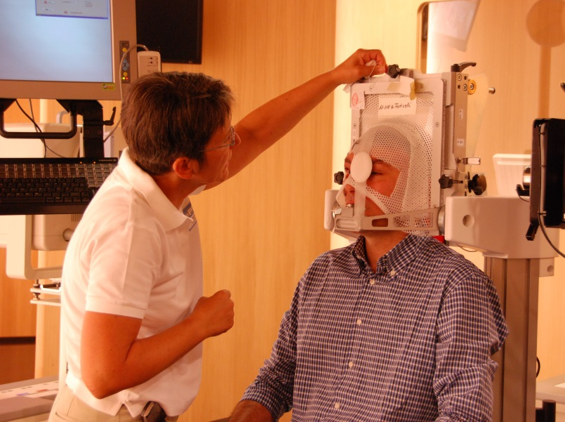
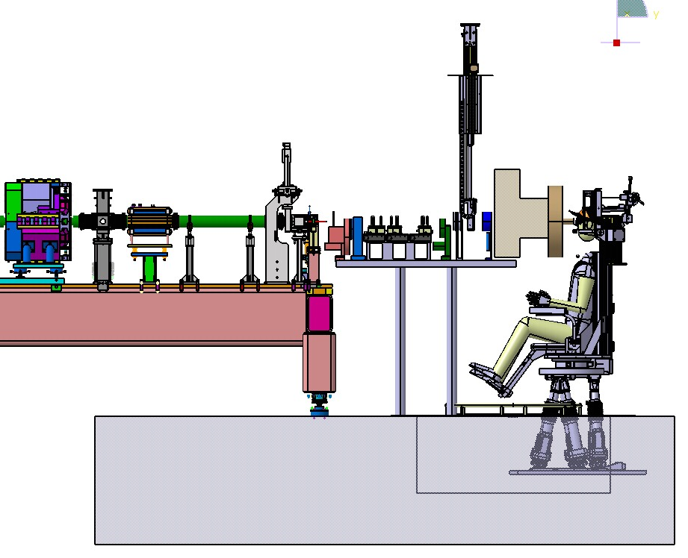
OPTIS 2 – Ocular Proton Therapy
Ocular Proton Therapy: A Success Story (1984)
irradiation of eye tumors
proton beam degraded to 70 MeV
Passive proton scattering:
scatter foils, collimator, compensator
Largest number of patients worldwide
> 6700 pts, 230 pts/year, 4-8 pts/day
4 fractions in one week
Tumor control rate of 98%!

Slide 13
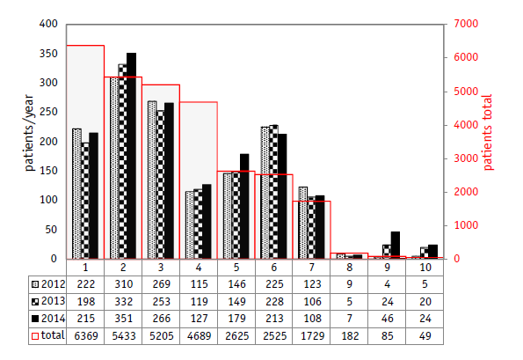
Ocular patient numbers world wide
PSI
Page 13

Slide 14

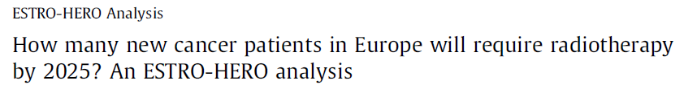

Radiotherapy :: Cancer management
GLOBOCAN
RT patients 2025 in
Europe
2025 | Mean
Increase in prostate Cancer | 24%
Increase in lymphoma | 13%
Increase in RT (range) | 16% (5-30%)
Notes:
Background: The objective of this HERO study was to assess the number of new cancer patients that will require at least one course of radiotherapy by 2025.
Methods: European cancer incidence data by tumor site and country for 2012 and 2025 was extracted from the GLOBOCAN database. The projection of the number of new cases took into account demographic factors (age and size of the population). Population based stages at diagnosis were taken from four European countries. Incidence and stage data were introduced in the Australian Collaboration for Cancer Outcomes Research and Evaluation (CCORE) model.
Results: Among the different tumor sites, the highest expected relative increase by 2025 in treatment courses was prostate cancer (24%) while lymphoma (13%), head and neck (12%) and breast cancer (10%) were below the average. Based on the projected cancer distributions in 2025, a 16% expected increase in the number of radiotherapy treatment courses was estimated. This increase varied across European countries from less than 5% to more than 30%.
Conclusion: With the already existing disparity in radiotherapy resources in mind, the data provided here should act as a leverage point to raise awareness among European health policy makers of the need for investment in radiotherapy

Slide 15

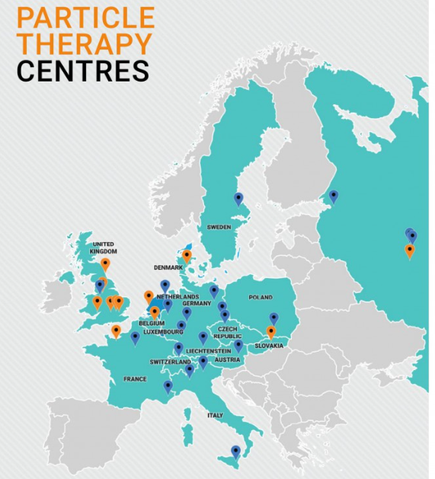
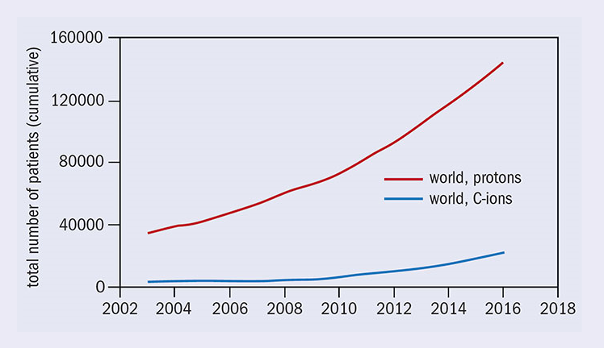

Slide 16




Dealing with moving targets
Advanced Ocular therapy
FLASH irradiation
Center for Proton Therapy
Biological models for treatment planning
Daily Adapted Proton Therapy (DAPT)

Slide 17

Conclusions
The most experienced PBS center worldwide (Nov 2021: 25 years of PBS delivery)
Patient throughput: available slots @ PSI
Proton theray in : limited indication, constrained by the FOPH
Active research program-substantial know-how
Clinical end educational experience
PSI willing to forster the creation of new Proton Center, providing that the patient-capture region and business plan is correct

