Slide 1
CristallinaMX 2025 update
7th SwissFEL Performance Workshop
John Beale
B6.1D13 (FHNW, Brugg), 21.01.2025

Slide 2




Goals/Developments for 2024
‘stop-go’
prove ‘open’ chip-orientation successful for pump-probe
complete move to CTA-based data-collection for fixed-target experiments
    e.g., synchronise motion start through CTA
make available >1 ms Δt delays for pump-probe experiments
    commission ‘stop-go’ motion
    begin development of ‘hit-and-return’
commissioning of droplet ejector with beam
move the ns pump-laser from LHx to the Cristallina hutch
fully commission new data-processing pipeline:
    with Jungfraujoch/Clara/Heidi
pump
pump
pump
pump
wait
wait
wait
wait
probe
probe
probe
probe
‘hit-and-return’

Slide 3
Review of user experiment for 2024-I and II
date | user | results
20.02.2024 | Standfuss | found and solved bugs with the CTA-based stage motion couldn’t deliver desired fluence for optical pump user successfully used SOS chips for pump-probe measurement ✅
22.02.2024 | Kapetanaki | very successful pump-probe measurements of OaPAC from 10 ns to 10 ms basis of successful Alvra proposal for 2024-II ✅
23.03.2024 | Yorke | failure of fibre coupling from LHx to Cristallina 😞 user collected useful non-pump-probe data precipitated decision to move ns laser into the hutch
04.06.2024 | Aller | droplet ejector commissioning and some improvements ..but managed to collect probe-pump instead of pump-probe 🫣
07.06.2024 | Weik | debugged timing issues encountered in the Aller beamtime successfully collected 10-30 ms delay data using ‘stop-go’ routine ✅
25.10.2024 | Fromme | pump-probe experiment on Photo-system I ostensibly success – some signal was observed – waiting for users to give more feedback 🤷‍♂️
04.12.2024 | Johnson | comprehensive comparison of optical pump excitation between fixed-targets and jets experiment appears successful – no significant difference was observed ✅
07.12.2024 | Stegmann | continuation of fragment-screening experiment in collaboration with Novartis used JFJ/Clara/Heidi processing pipeline ✅

Slide 4
The use of Jungfraujoch at SwissFEL
JFJ is a server sitting in the Athos server room for the real-time processing of JF data and streaming of data via the beam-synchronous data stream
    for MX e.g.,
        100 Hz spot-finding/indexing of images
        image selection
    for the rest of SwissFEL currently
        Azimuthal projections
        ROI area sum
    main advantage - images don’t have to be saved – only processed data via the bs
Progress
    integration of JFJ into slic on-going – thanks @sven
    1 Hz image stream now viewable via streamvis – thanks @ivan
    100 Hz data stream nearly into bs – thanks @ivan

Slide 5
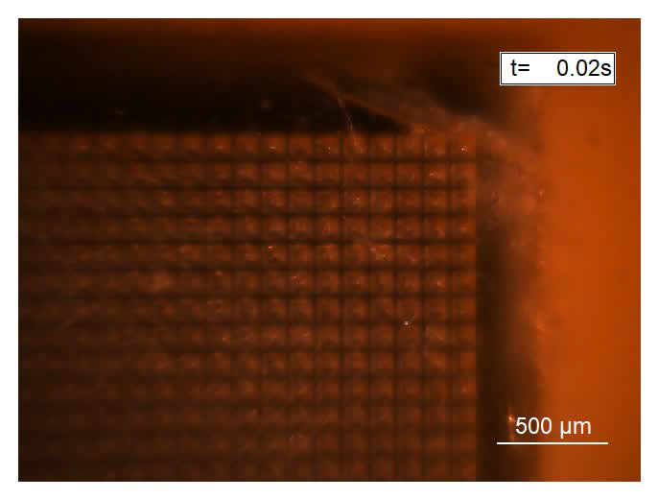

'Stop-go’ and ‘hit-and-return’ motion schemes
‘stop-go’
‘hit-and-return’
for 1≤Δt ≤ 30 ms
for 20 ms ≤Δt ≤ 5 min

Slide 6
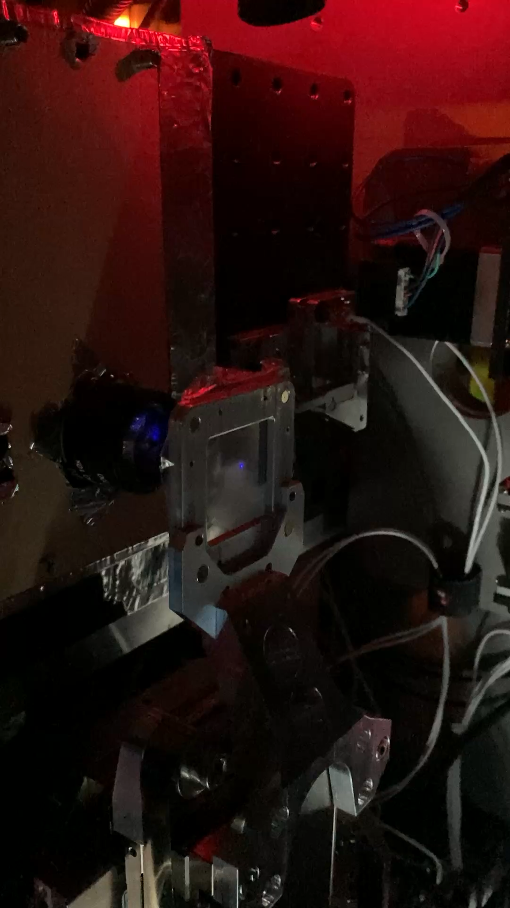
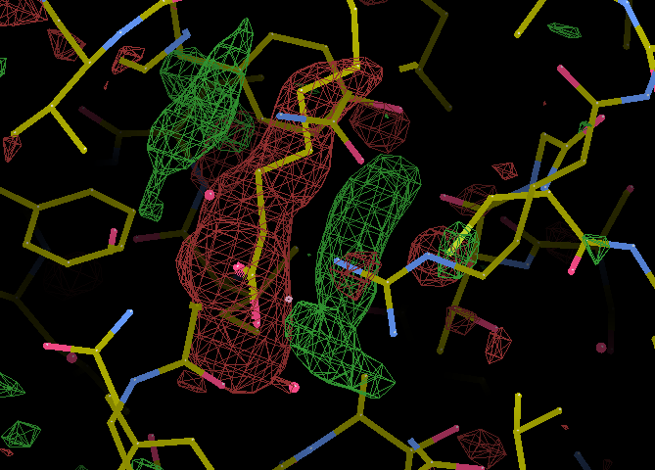
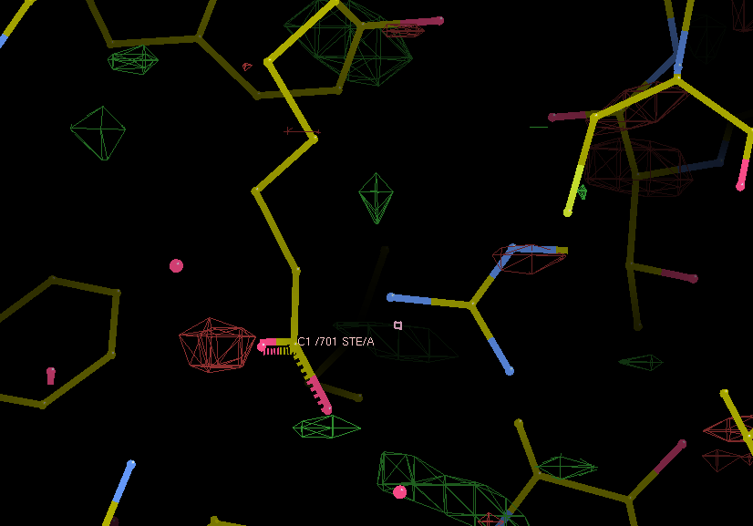
Pump-probe commissioning of ‘sheet-on-sheet’ (SOS) chips
SOS
interleaved light – true dark
not ideal for pump probe due to scatter
xtals
slightly viscous media
pump laser
however, can now achieve a 6 um (FWHM) focus at sample
true dark – interleaved dark
film x2

Slide 7
Many, many thanks go to:
MX Group
Meitian Wang
Katherine McAuley
Tom Mason
May Sharpe
Eric Plichta
Kate Smith
Filip Leonarski
Dominik Buntschu
Martin Appleby
Guillaume Gotthard
Dennis Stegmann
Jiaxin Daun
Quantum Photon/Cristallina
Bill Pedrini
Jakub Vonka
Alexander Steppke
Raphael Perrass
Röby Kälin
Scientific Computing
Sven Augustin
Alvise Dorigo
Greta Assmann
Detector Group
Aldo Mozzanica
Shqipe Hasanaj
Bernd Schmidt
Controls
Thierry Zamofing
Edwin Divall
Csaba Lombosi
Alexander Gobbo
Alvra
Camilla Bacellar
Claudio Cirelli
Florian Dworkowski
Emma Beale
Experiment Laser Group
Philip Johnson
AIK
Goran Kotrle

