Slide 1
SwissFEL Operation summary and outlook
Didier Voulot on behalf of SwissFEL operation team
SwissFEL Performance Workshop, 21 January 2025

Slide 2
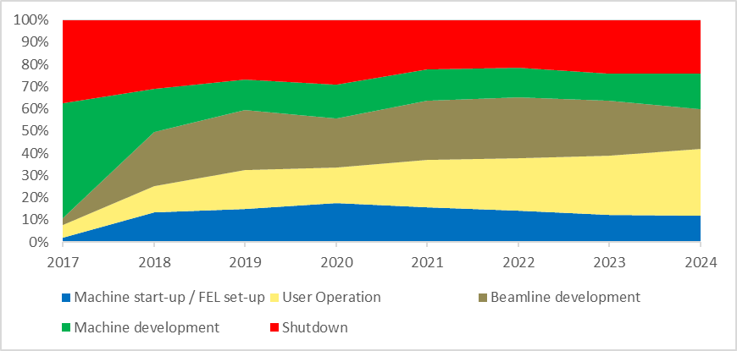
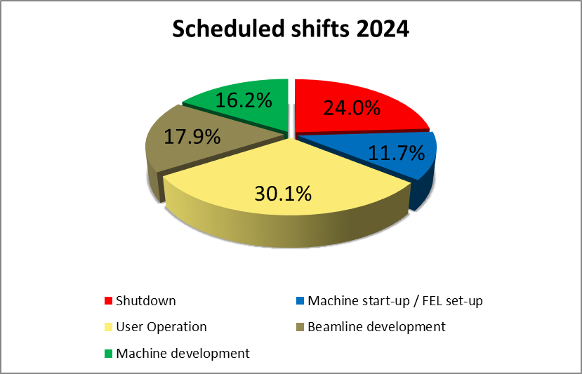
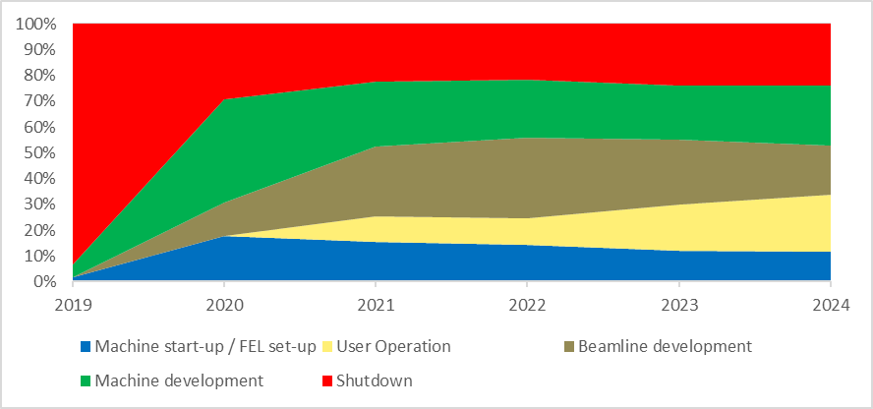
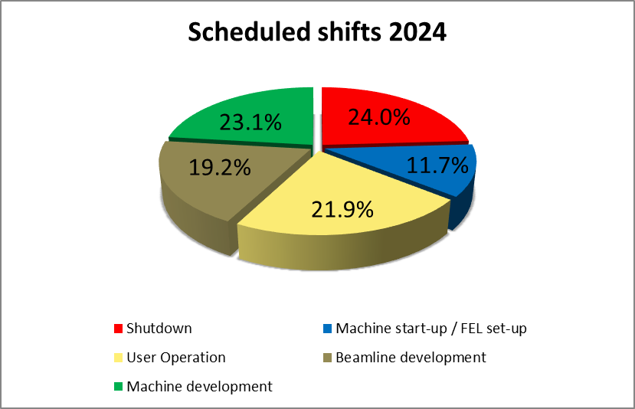
Shift distribution evolution (DUO)
Aramis
Athos

Slide 3
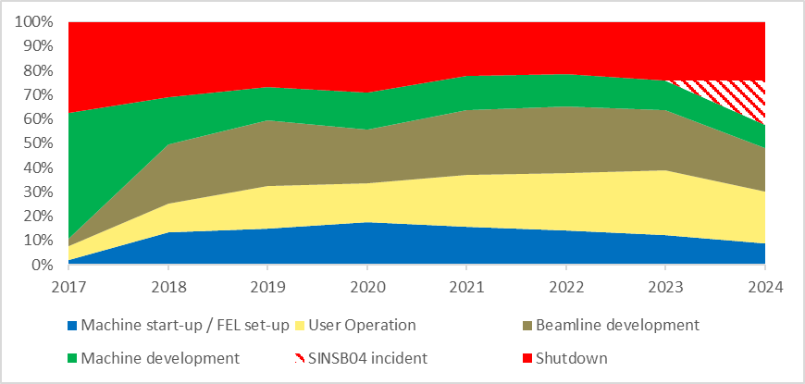
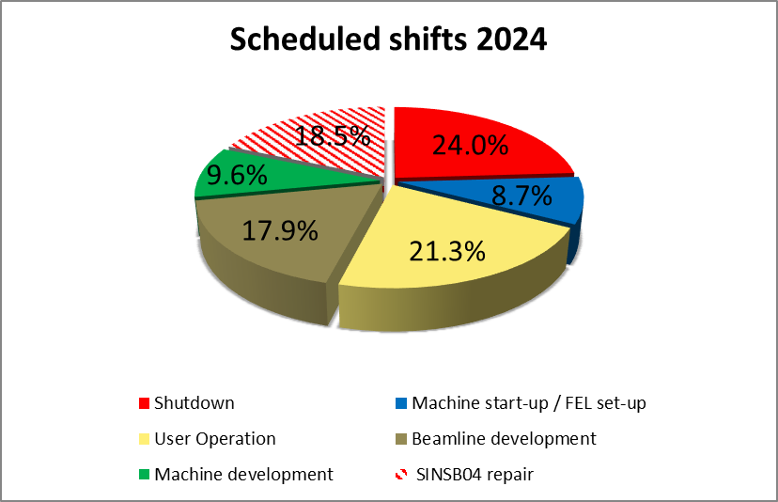
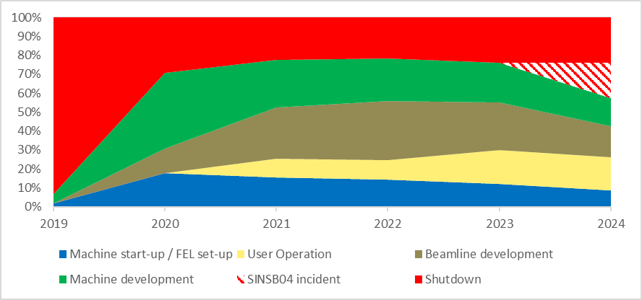
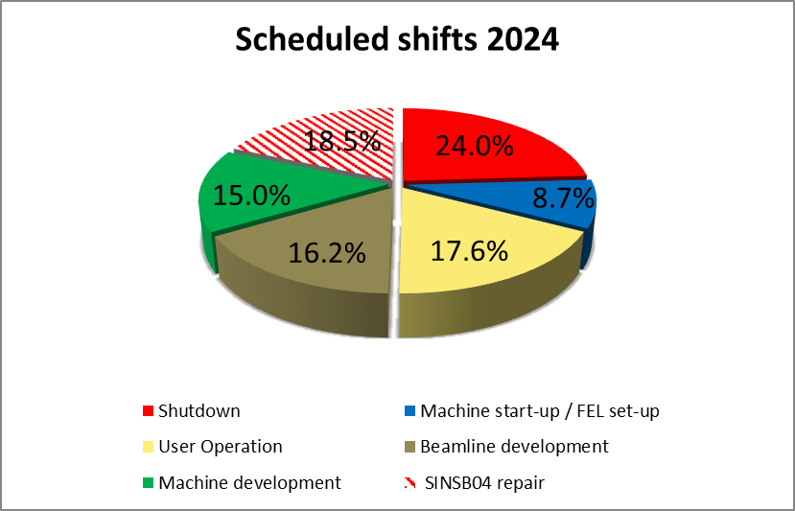
Shift distribution evolution (DUO)
Aramis
Fire on July 6th
SINSB04 down for 13 weeks (6.7 -> 4.10)
Athos

Slide 4
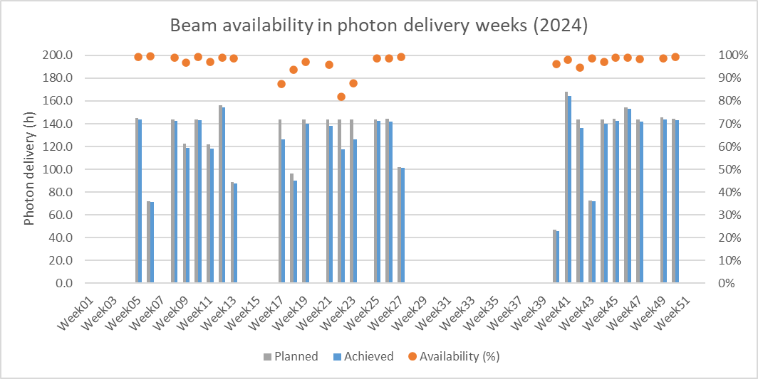
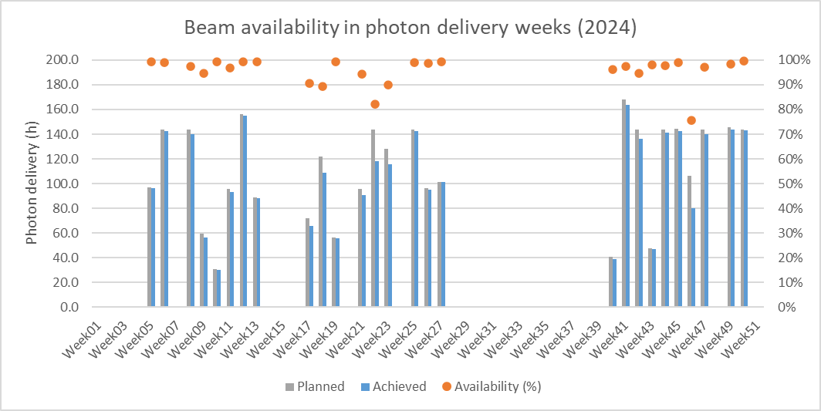
Beam availability 2024 (excluding SINSB04 incident)
RF problems
(SINSB02, SINSB03, S10CB06)
RF problems
(S20CB03, S30CB01)
Aramis
Power-cut (June 2nd)
 | 2024
 | Beam-time (h) | Availability (%)
Total photon delivery | 3508.5 | 96.5
Beamline development | 1652.1 | 95.3
User operation | 1856.5 | 97.6
SINSB04 fire & repair
RF problems
(SINSB02, SINSB03, S10CB06)
RF problems
(S20CB03, S30CB01)
Athos
Power-cut (June 2nd)
Mizar synchronization (November 15th)
 | 2024
 | Beam-time (h) | Availability (%)
Total photon delivery | 3003.7 | 95.9
Beamline development | 1472.5 | 97.0
User operation | 1531.2 | 94.9
SINSB04 fire & repair

Slide 5
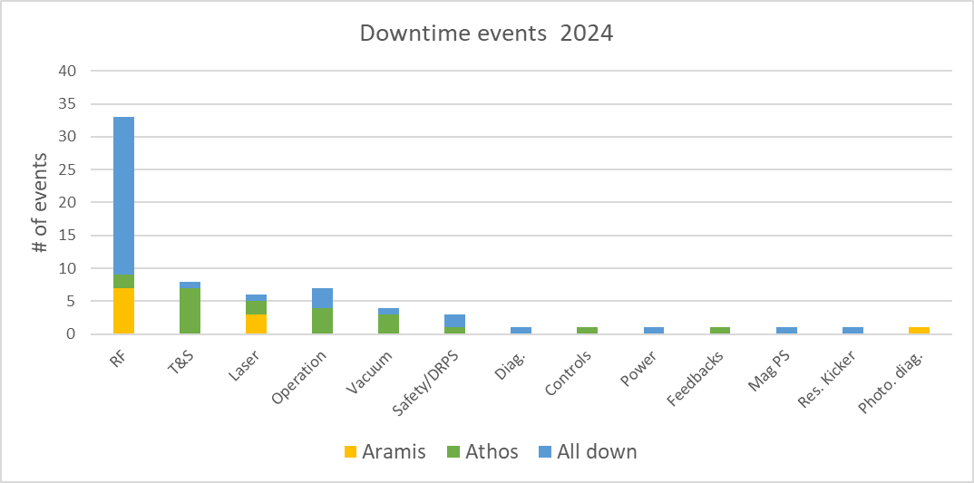
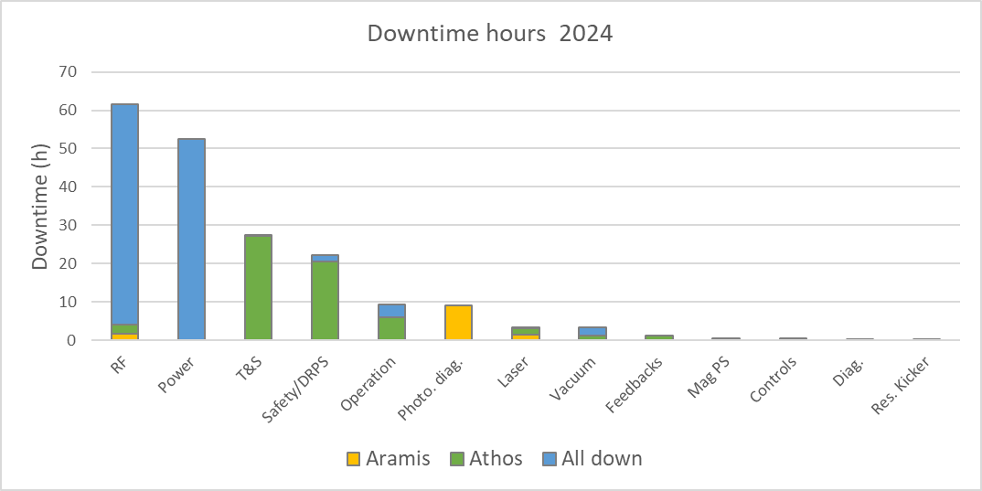
Downtime (2024)
Downtime events longer than 10 min documented by the shift crew in beam delivery shifts (user operation/beamline development)
Number of recorded RF events has decreased by nearly 50% compared to 2023 (not sure why)
A large fraction of the RF events and RF downtime is due to the injector
A few single events cause most of the downtime (power cut in June, T&S failure)
DRPS and PSYS events are still causing significant downtimes
Graph excluding SINSB04 incident
(incident caused 67.7 days = 1624 h)

Slide 6
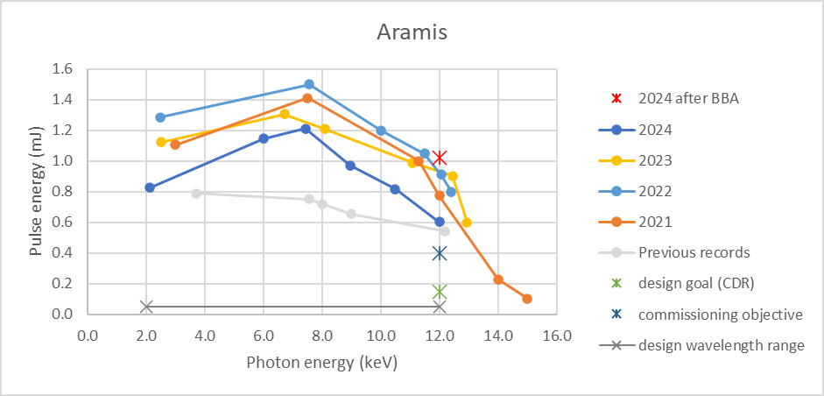
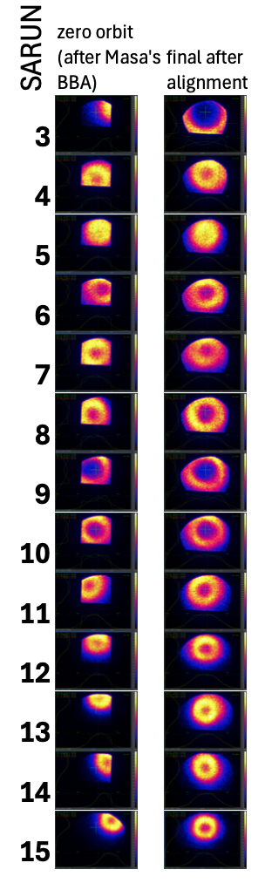
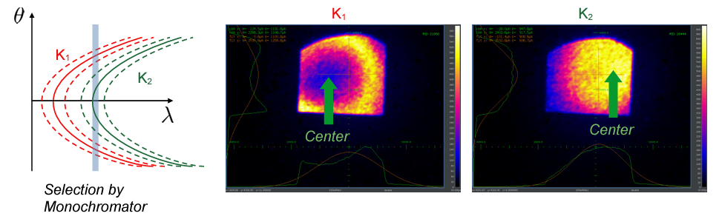
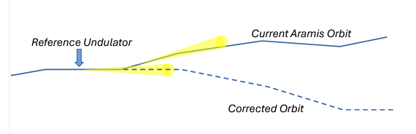
Re-Optimising FEL Performance in Aramis
Could not maintain pulse energy records from 2022! We noticed that either undulators in the beginning or the end of the line would not contribute
Alignment & optimization in December brought a new record: 1 mJ at 12 keV!
Photon based alignment
Current BBA procedure:
Electron Beam BBA by Minimal Steering
(Masamitsu’s Method) -> has some
ambiguity in the presence of “external
kicks”(e.g. undulator kicks)
Orbit Straightening with photon-based
BBA
  Take center module as pointing reference
  Bring adjacent undulator pointing to the same position by adjusting reference orbit about the previously found orbit
  Repeat step-wise to the next module (moving both backward and forward)
Scan undulator position and angle (in the vertical plane) to maximize output i.e. align the module axis on the optimized orbit
Re-Measure the Gap-to-K-calibration for each undulator (done but not yet applied)
Next steps:
Needs cross-check with dispersion free steering method to account for systematic undulator kicks and local kicks (Sven)
BBA in Athos may also be required

Slide 7
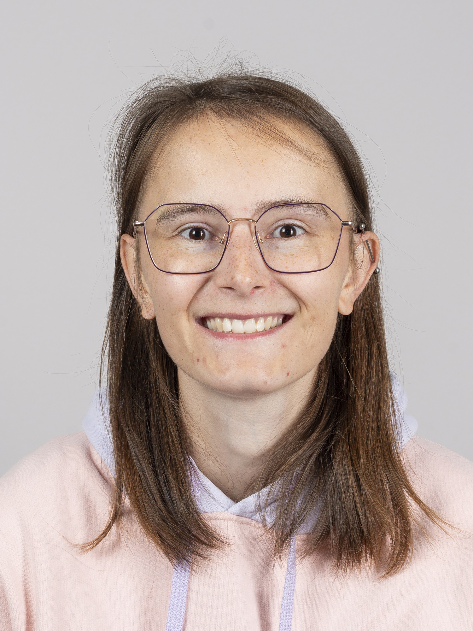
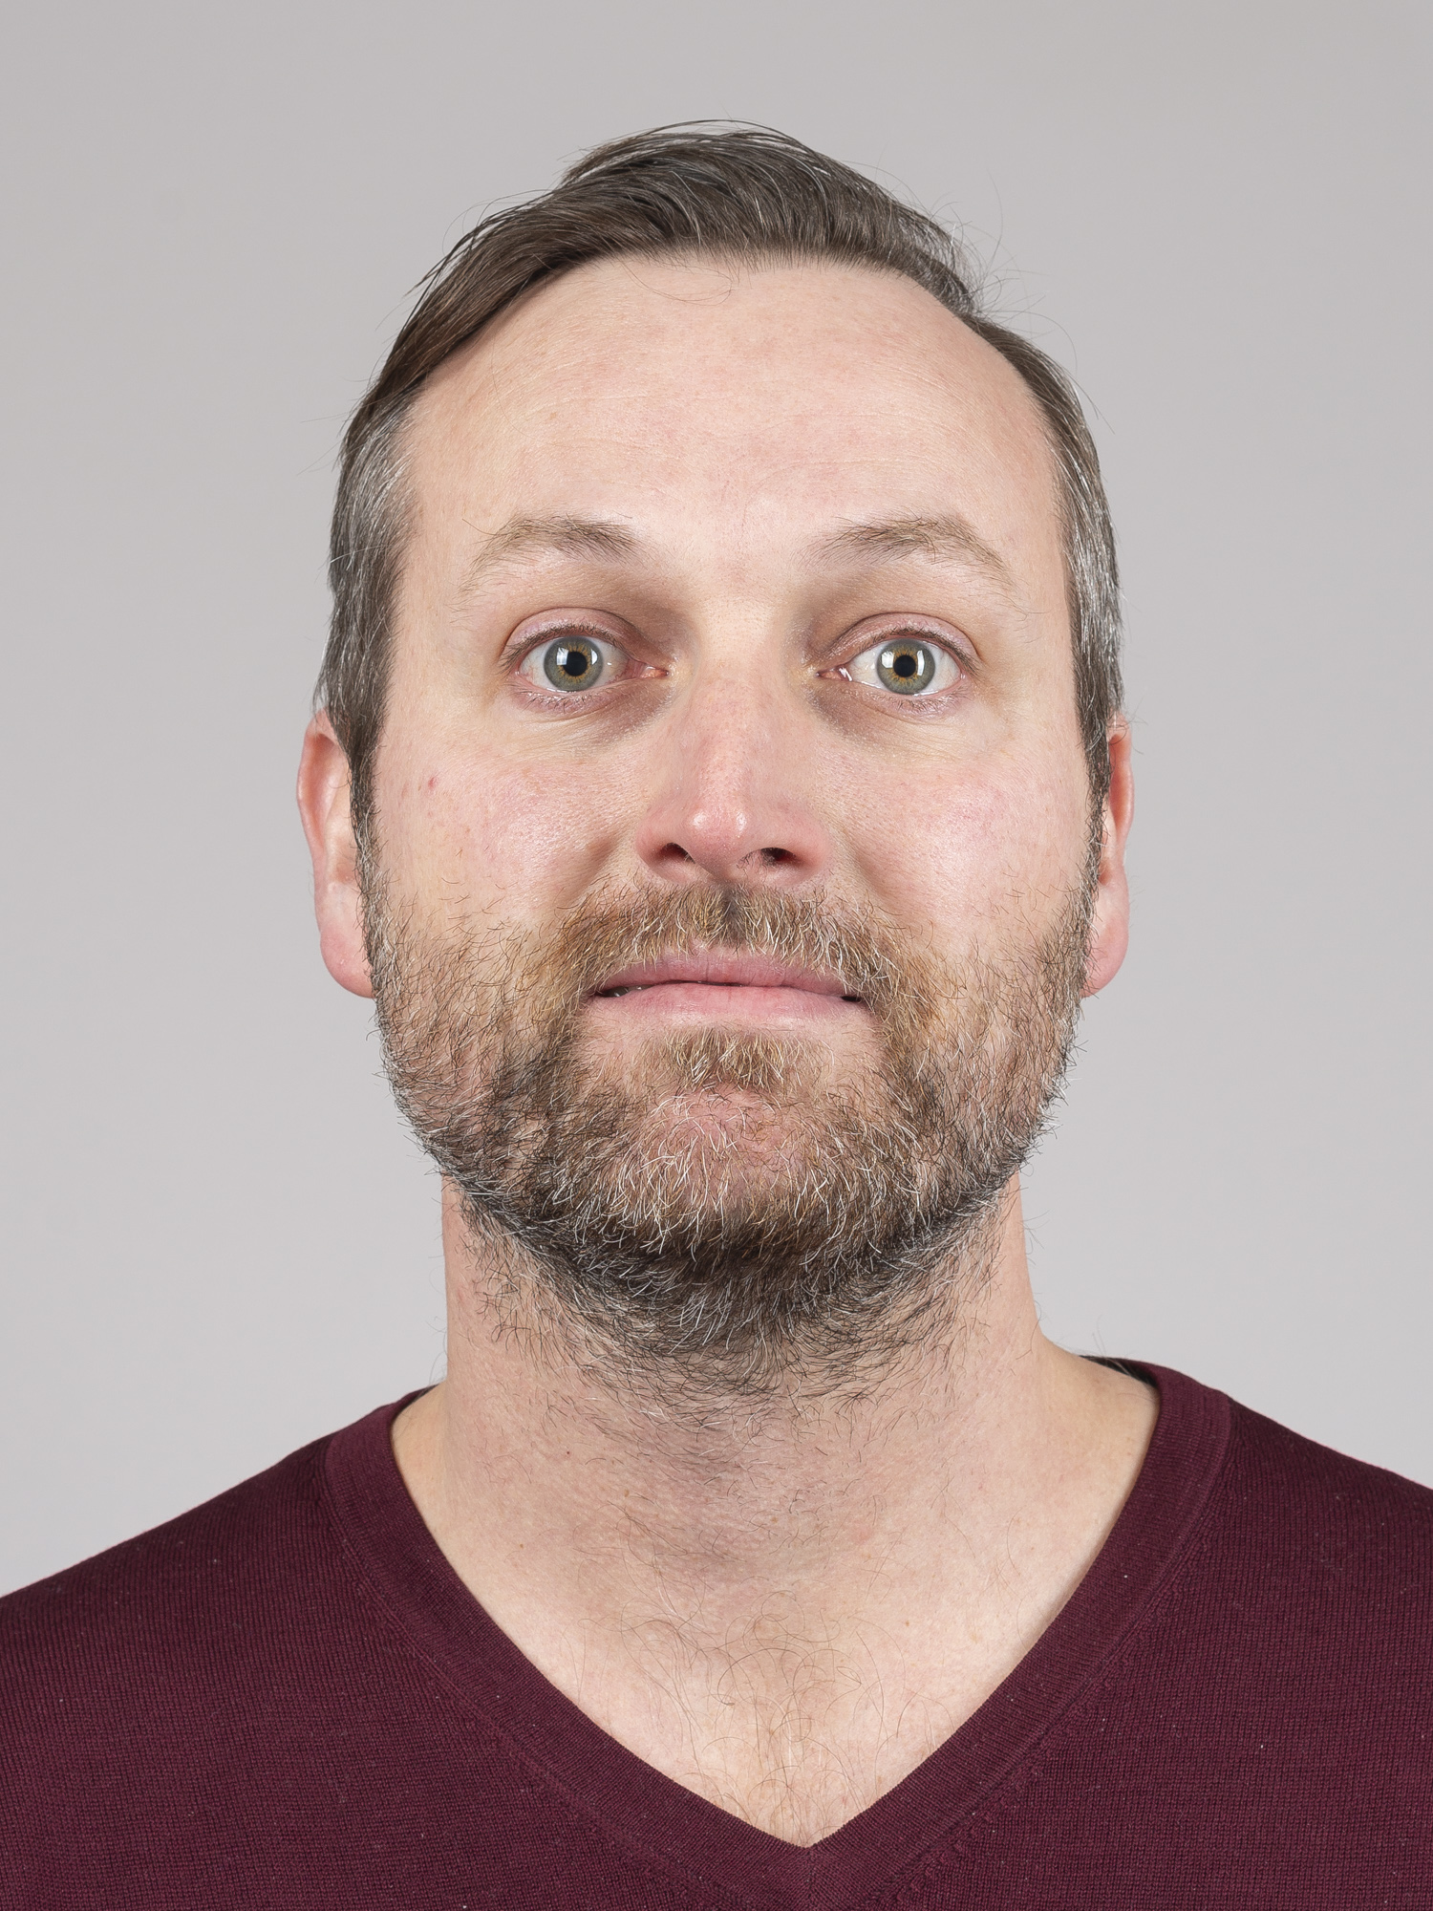
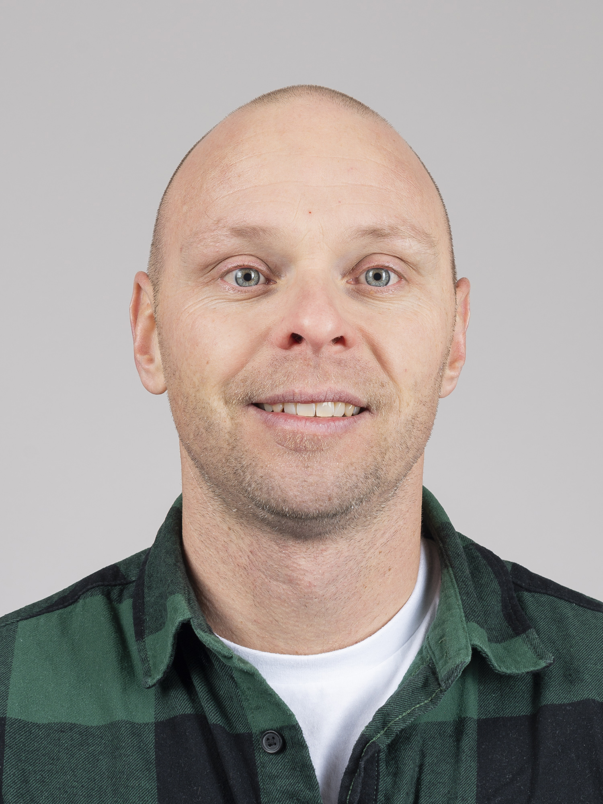

News from operation
Currently 4 operators in training (one more to follow in a couple of months)
Muriel Baldinger (Sept 2024), Andrew Cole (Jan 2024), Oliver Vogel (Jan 2024), Jean-Francois Thomsen (Oct 2023)
Beam requests/beam changes
Ideally beam requests should be discussed at the SEM one week ahead, in any case before the RC meeting (14h Friday).
Plan as much as possible beam changes in normal working hours. Some changes can be done on the fly by the shift crew (repetition rate, small energy changes, polarization changes), some changes require expert support (large energy change, pulse length, special modes, BW). Please coordinate with the RC.
For an overview of “how difficult / invasive” a change is: see table in the backup slides

Slide 9
Beam Requests and their “difficulties”
Undulator Line | Parameter | Comment
Athos | Repetition rate | On the fly (<= Aramis rate)
Athos | Polarization | C+-: on the fly, LH, LV need prep, but can be recalled easily
Athos | Photon energy | +-100 eV on the fly, larger changes need prep, but can be recalled easily
Athos | Pulse length | Needs prep and re-measurement when recalling (normal working hours)
Aramis | Repetition rate | Invasive to Athos if lowered below Athos rate
Aramis | Photon energy | On the fly: +-100 eV, rest needs prep, > 2 keV change typically invasive to Athos (needs re-opt), tender x-rays are stronlgy invasive
Aramis | Bandwidth | Needs optimisation during setup, then maybe re-tuning during the week
Aramis | Pulse length | Needs prep and ideally re-meausrement if/when recalled. If done with overall compression it is very invasive for Athos.

Slide 10
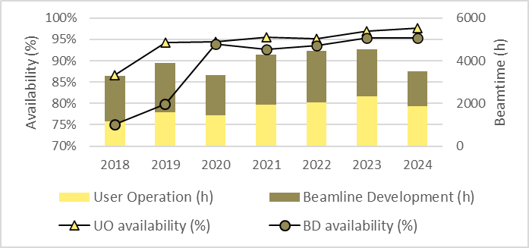
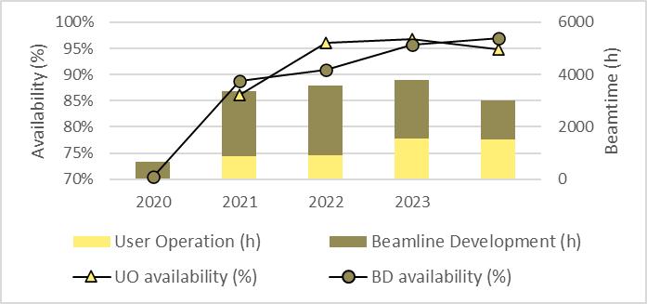
Evolution of availability
Aramis
Significant drop in beamtime due to SINSB04 incident
Beam availability excellent for both FELs (new record for Aramis)
Athos
* We use a relatively pessimist definition of availability (e.g. short interruptions are not filtered out, no compensation of downtime with extra time etc.) => cannot be compared directly to other facilities.

Slide 11
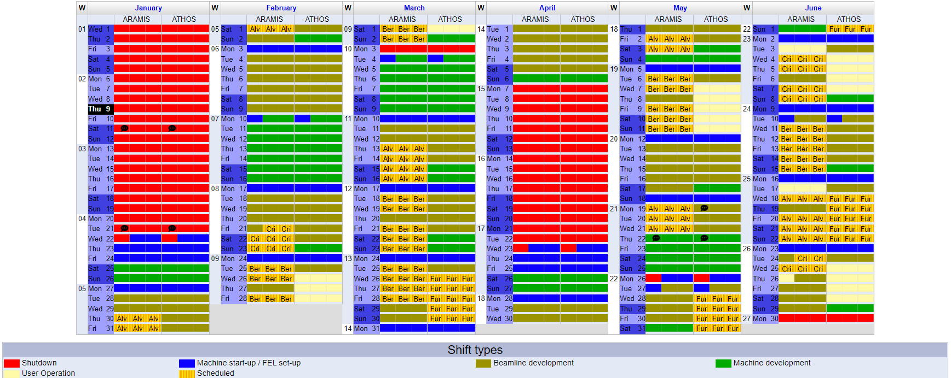
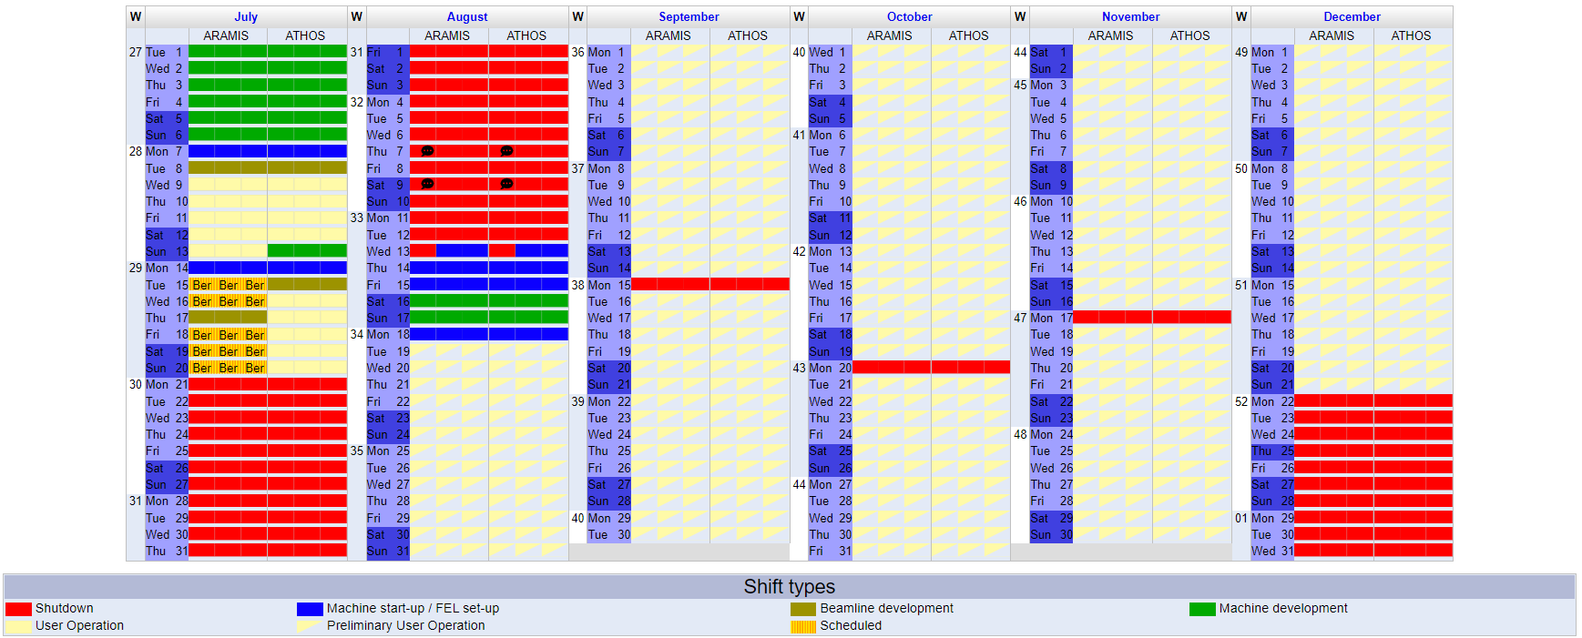
DUO 2025

