Slide 1
SwissFEL Diagnostics Developments for 2024
Pavle Juranić on behalf of EBI
Windisch, 21st January 2025

Slide 2
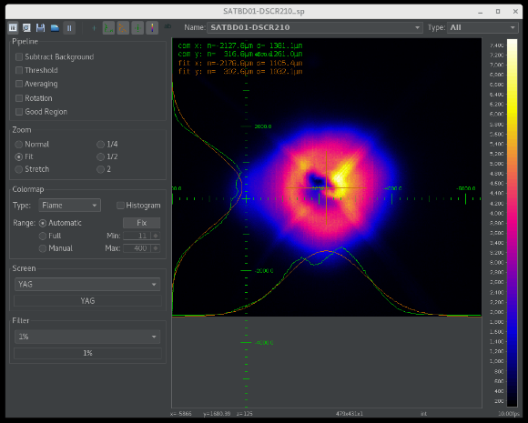
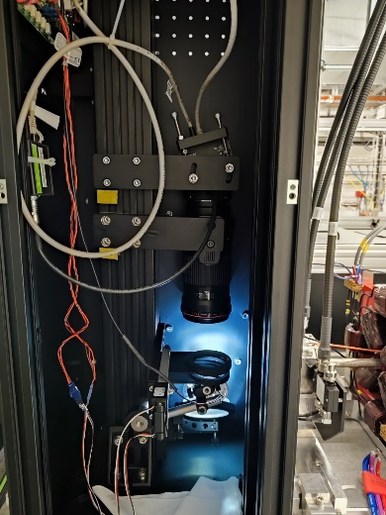
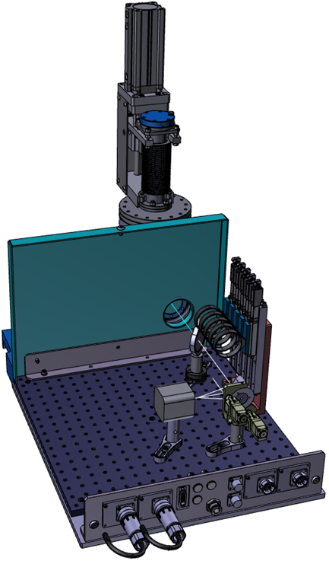
Ongoing work in 2024
SwissFEL EBI (core team):
Rasmus Ischebeck, Gianluca Orlandi, Antonios Foskolos, Pavle Juranić
Work done in 2024:
Fixed several radiated-damaged screens, like SARCL01-DSCR170 and SATBD01-DSCR210, regular re-alignment and calibration procedures.
Gas detector controls upgrades to make the setup and calibration settings easier, like for the spinning rotor gauge offset. Alarm handler updates.
Two new bunch compression monitors (DCDR) installed and ready for commissioning as soon as controls done.
Beam loss monitors upgraded and installed in all of SwissFEL, waiting for timing cabling installation.
HERO screen upgrade with better cameras and an adjustable focus to improve resolution of the screens (about 3x improvement).
Many thanks to controls, cabling, operations, beam dynamics, photon instrumentation, Kurt Bitterli, and the technicians for the support and help.

Slide 3
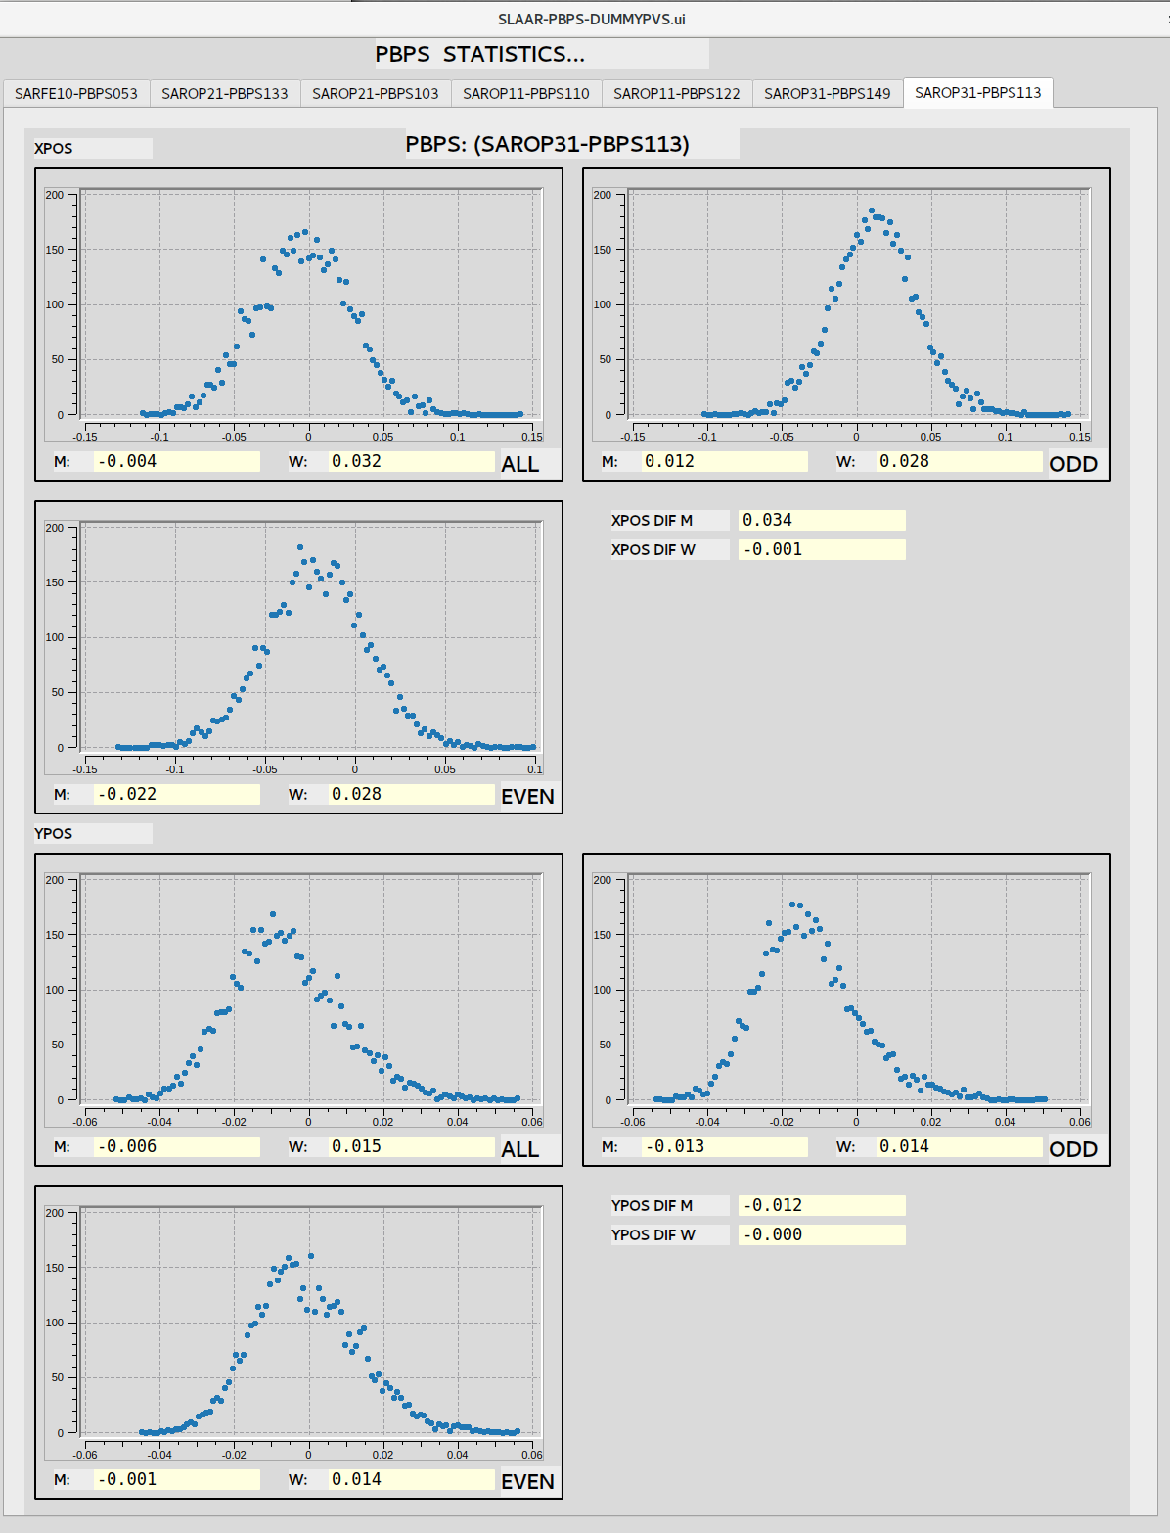
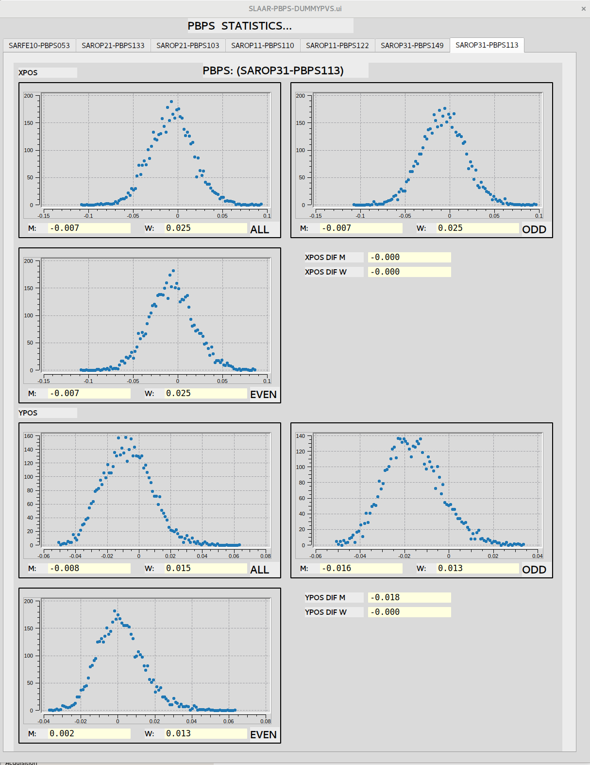
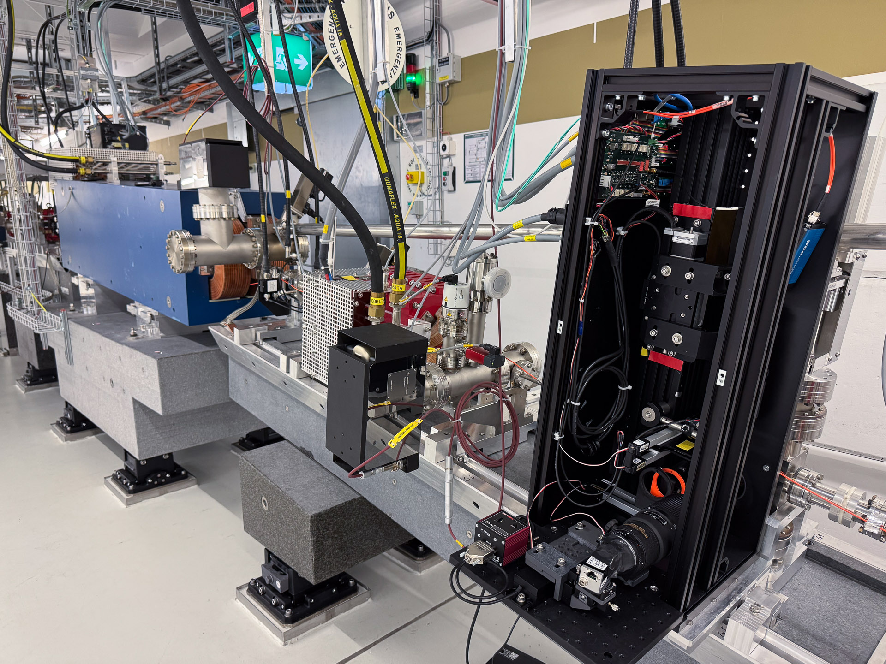
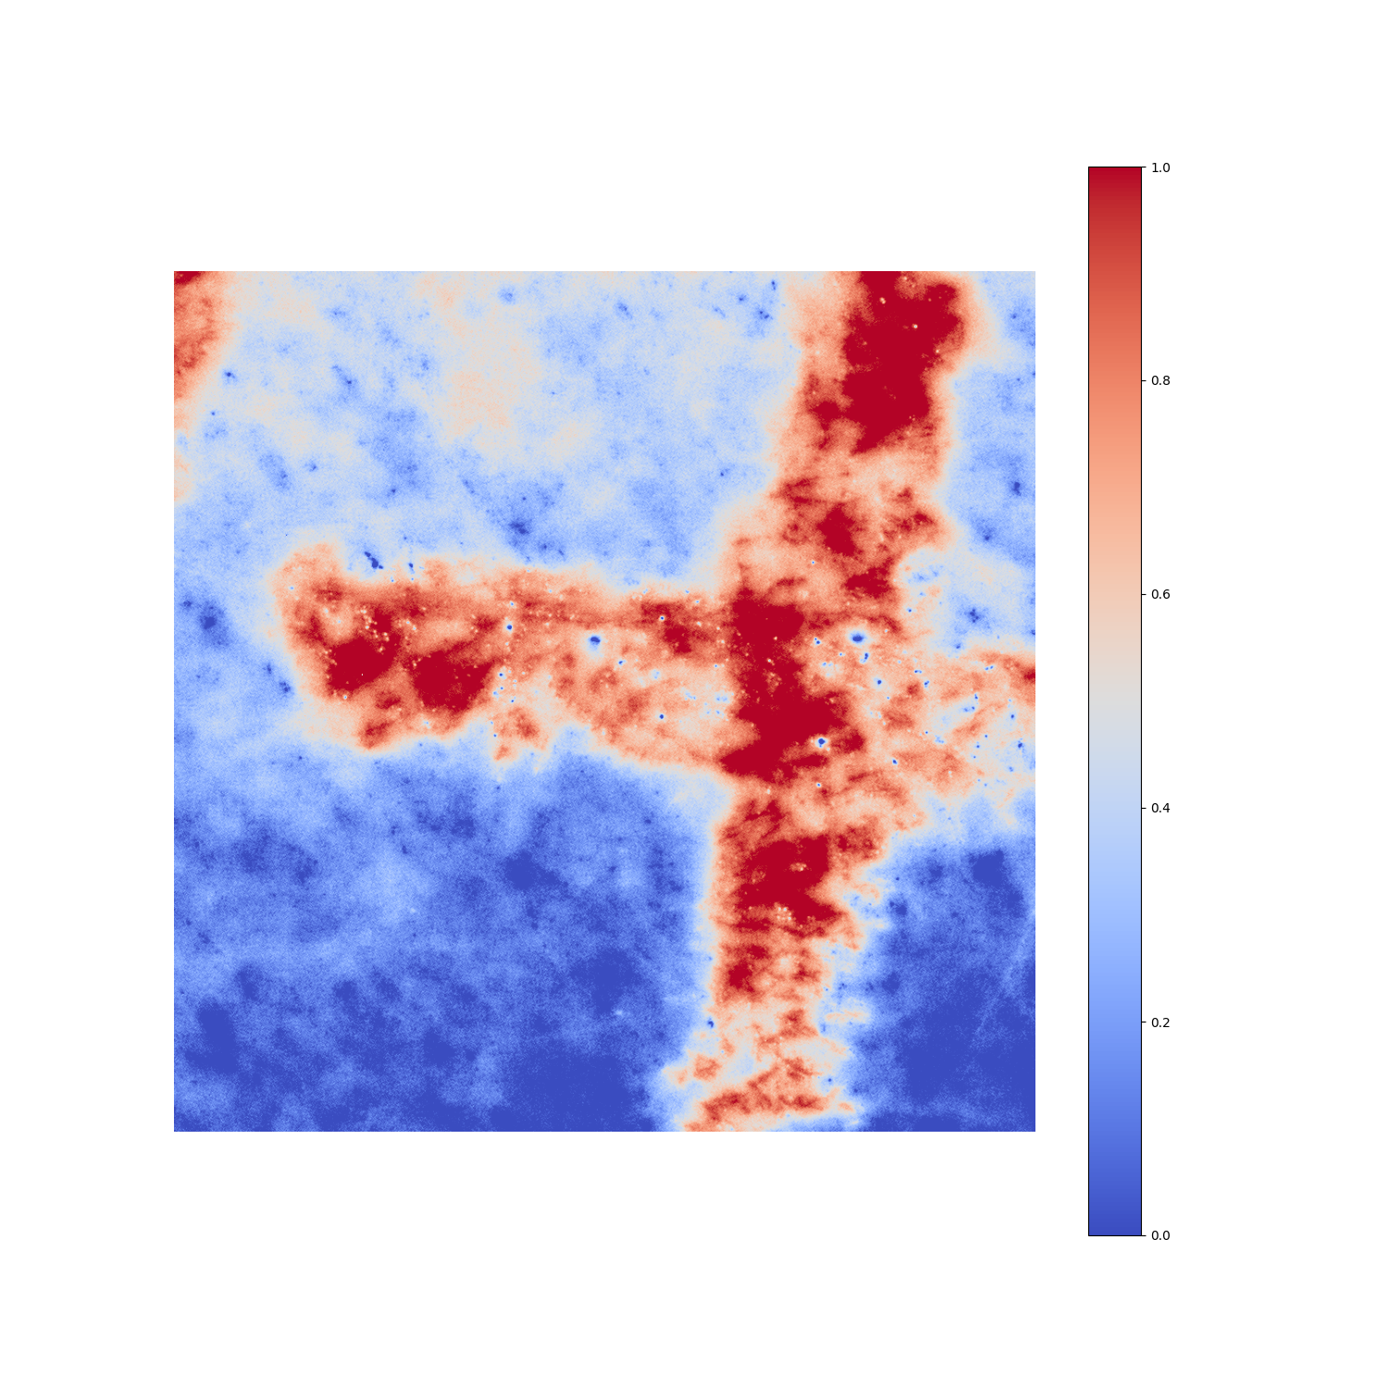
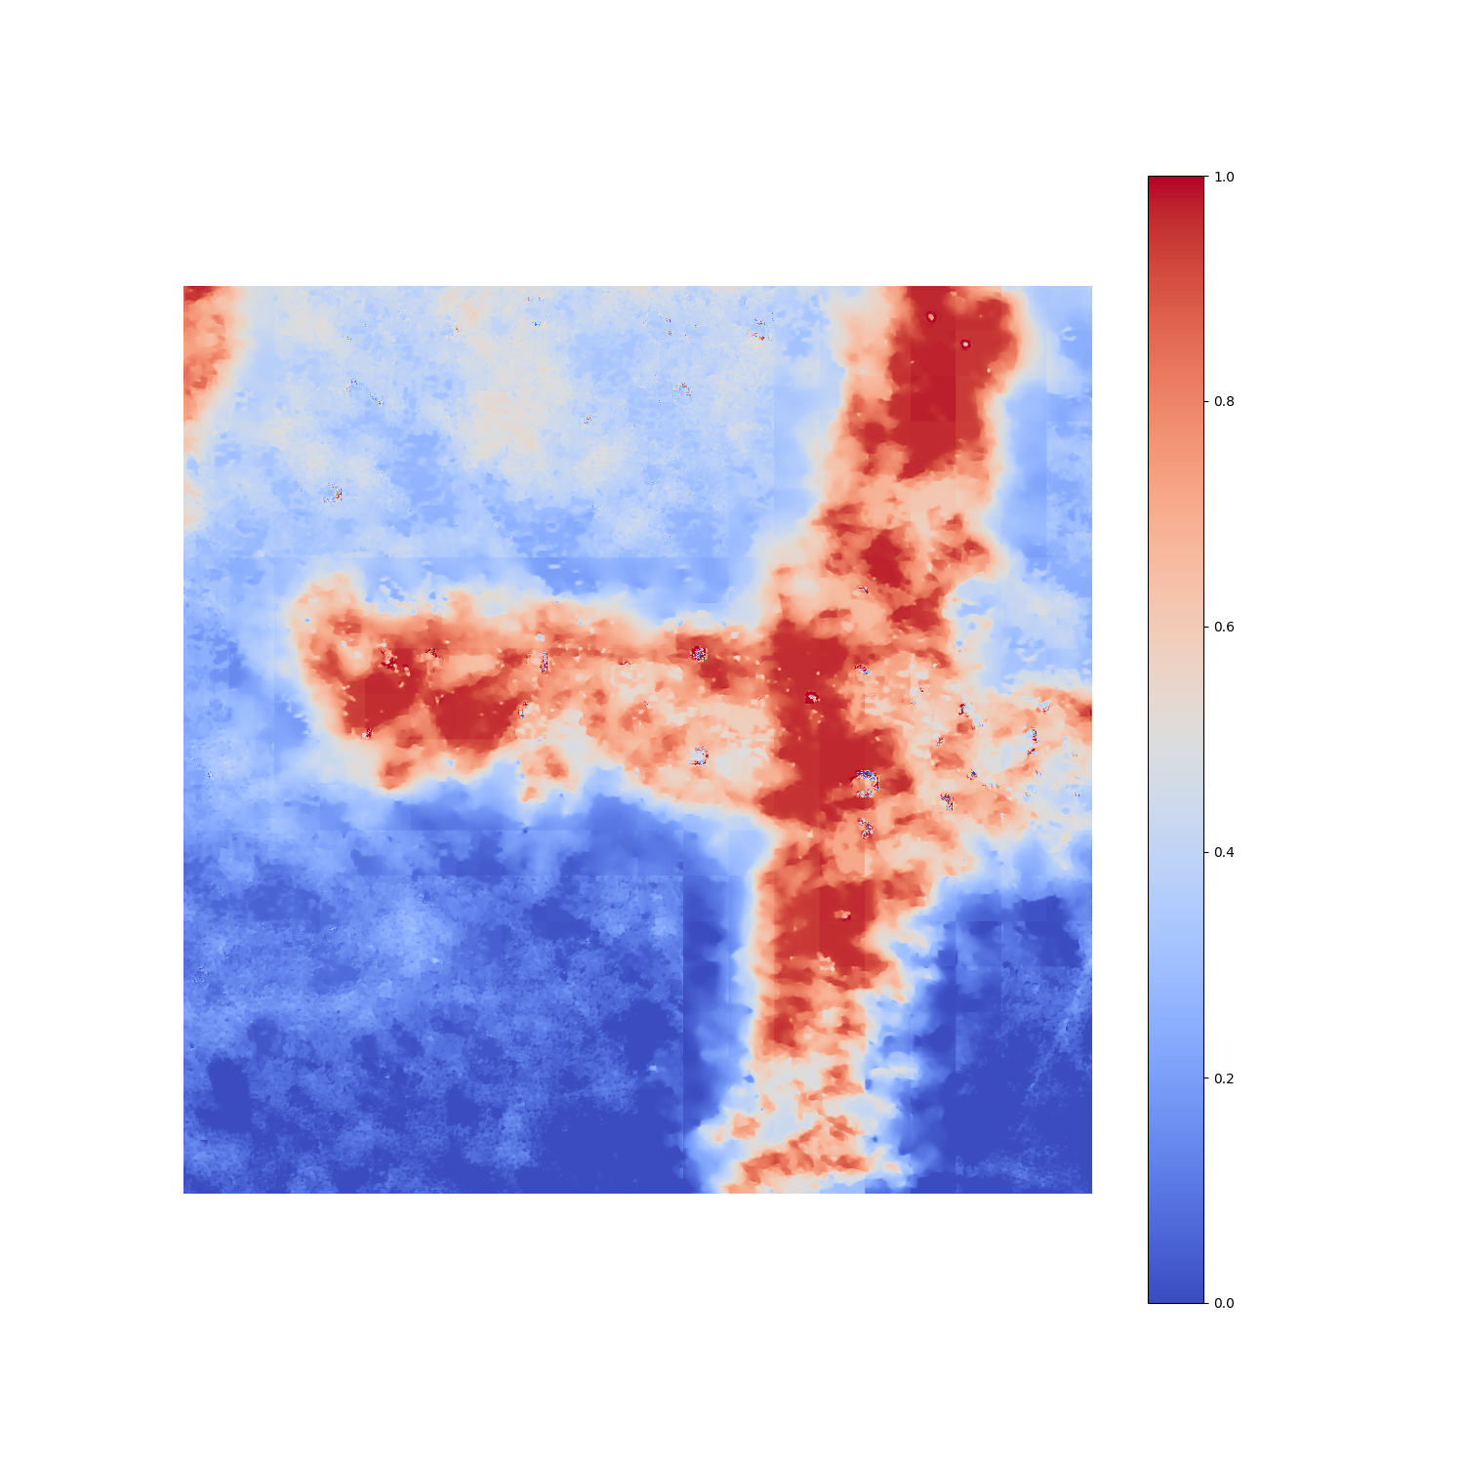
New developments in 2024
50 Hz jitter correction:
A combined effort of the Leistungselektronik Engineering group (Simon Richner), Controls (Uros Zezula, Arturo Alarcon), EBI (Pavle Juranić, Rasmus Ischebeck) to use the magnetic correctors to correct the beam orbit with 50 Hz.
Large field of view DSCR:
The Beam Dynamics group requested a larger field of view for the beam dump screen at Athos (SATBD02-DSCR050) for better measurements of the bunch shape and duration.
Ready for installation in April 2025.
Machine learning for image deblurring
A test setup that splits the image from a beam-dump screen for shot-to-shot comparison between the real image and a machine-learning deblurred image, to improve resolution.
0.034 mm
0.000 mm

Slide 4
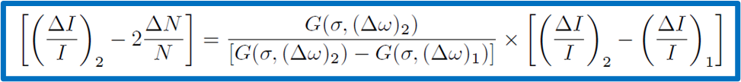
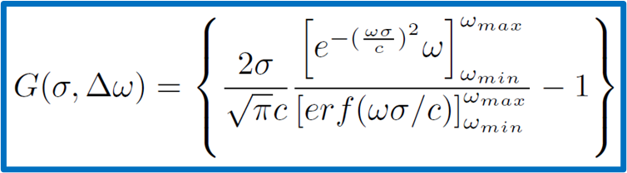
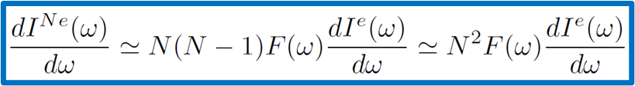
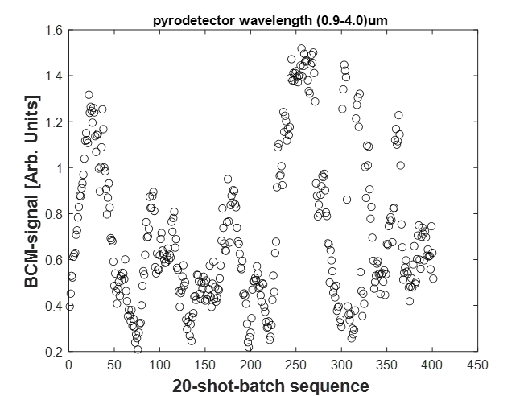
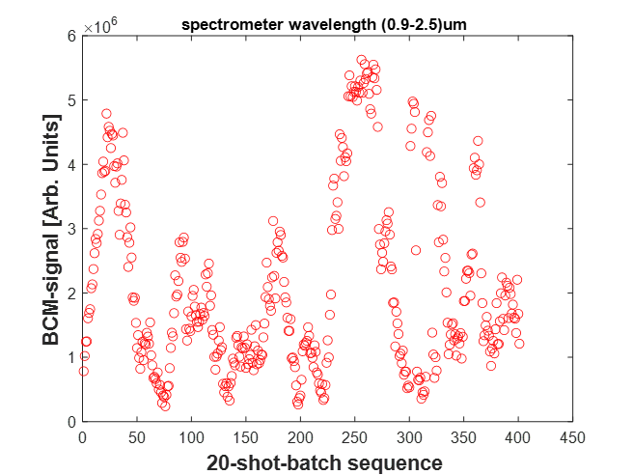
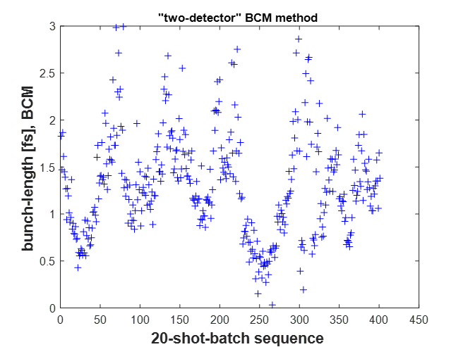
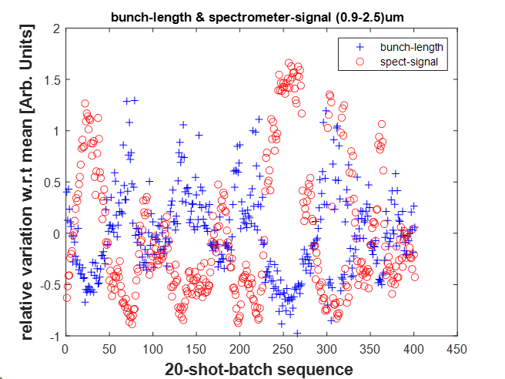
SARMA01-DBCM030: 2-detector Bunch-Compressor-Monitor (BCM) for absolute bunch-length measurements (*)
G.L. Orlandi, F. Addesa, H. Brands, P. Dijkstal, R. Ischebeck, E. Prat, S. Reiche, T. Schietinger
(1) Mathematical model, measurement environment and goal:
  Absolute bunch-length determination from the analysis of the relative statistical fluctuations of a BCM 2-detector (ΔI/I)_{1,2} - and charge monitor ΔN/N - signals
Result of the formal processing of the radiation energy spectrum of an electron beam at the temporal coherence threshold [hypothesis: Gaussian form factor F(ω)]
G(σ,Δω) function depending on the absolute value of the bunch-length σ and on the frequency band of acceptance of the two BCM detectors (Δω)_{1,2}
(2) Experimental implementation at SARMA01-DBCM030:
  BCM equipped with 2 independent detectors: pyro-detector (0.9-4μm) and spectrometer (spectrogram integrated over 0.9-2.5μm)
  Measurements during set-up of 10 pC and sub-fs machine operations: strong bunch-length instability and huge detector signal variations during acquisition
  Consider a sequence of BCM and charge signal acquisitions and split it into a sequence of shot-batch (for instance, 20 shots per batch in the example below)
  For every shot-batch, numerically solve in the variable σ the formula above by applying a standard deviation operator to both sides of the equation
  Formula predictions of the electron bunch length in agreement with the expectations.
  To be noticed the expected counterphase correlation between detector signals and predicted bunch-length (bottom-right picture)
(*) Orlandi, G.L. Absolute and non-invasive determination of the electron bunch length in a free electron laser using a bunch compressor monitor. Sci Rep 14, 6319 (2024).
https://doi.org/10.1038/s41598-024-56586-1

Slide 5
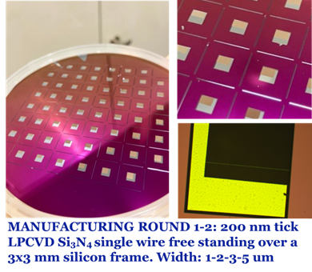
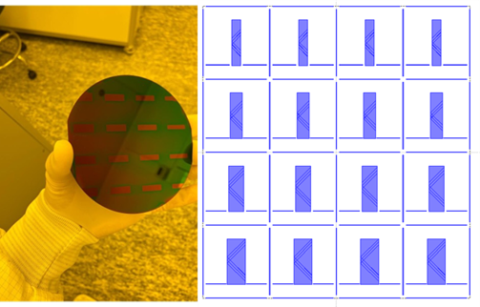
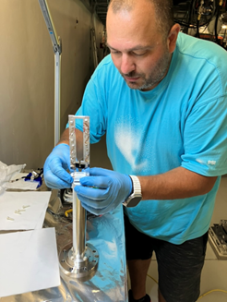
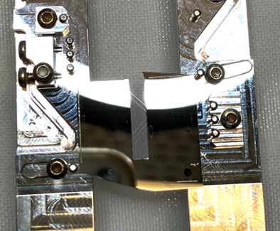
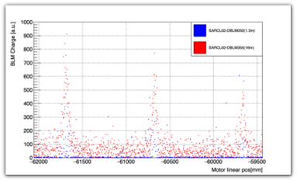
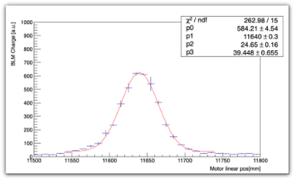
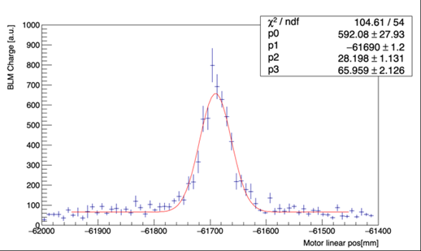
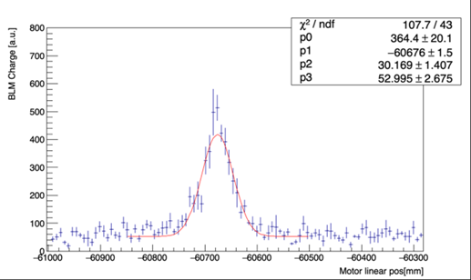
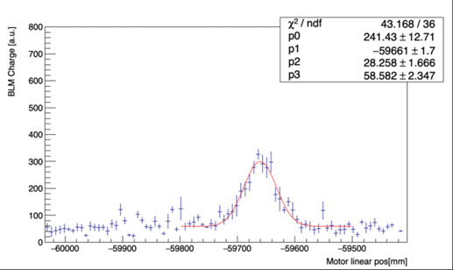
Nanofabricated Wire-Scanners (WS) for minimal invasive and sub-μm beam monitoring for standard SwissFEL operations
Francesca M. Addesa, K. Bitterli, A. Gobbo, A. Foskolos, V. Guzenko, R. Ischebeck, W. Koprek, S. Meaney, G.L. Orlandi, E. Prat
Standard Photolithography
Direct Laser writing
SiN chip installed on SwissFEL WS fork
(1) Fabrication at LNQ, PSI
MANUFACTURING ROUND 3-4-5: 200 nm tick LPCVD Si3N4 X-Y wire free standing over up to 6 mm wide silicon frame. Width: 1-3-4-5-6 um. Cleaving lines.
MANUFACTURING ROUND 5: 200 nm tick LPCVD Si3N4 X-Y wire free standing over a 3 mm wide silicon frame. Width: (2.8, 4.2, 6.2) um. Cleaving lines. On this chip, 3 pairs of wires
(2) Experimental test at SwissFEL
SiN wires
5 um W wire
SARCL01-DWSC160 (z=452m)
SwissFEL 10pC operations
beam energy 6.2 GeV @ WS position
SiN 9um
SiN 7um
SiN 5um

Slide 6
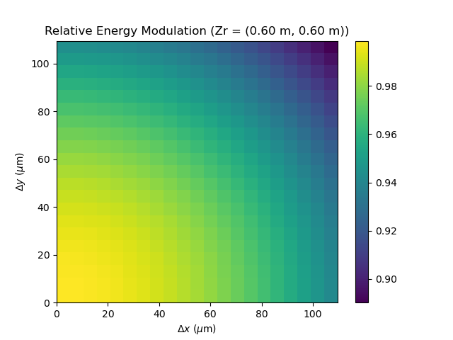
Laser/e-beam tomography
Laser
e-beam
Want to explore the FEL pulse energy loss due to laser/electron beam overlaps to scan the laser over the e-beam spatially. If we know the laser beam’s shape well, one could use it to reconstruct the e-beam transverse profile.
It may be useful for non-destructive measurements of the e-beam profile that avoids beam loss issues.
Theoretically it would be possible (but extremely, extremely difficult) to also scan longitudinally, but this is another topic altogether.
Normal SASE
Suppressed SASE
Partially Suppressed SASE

Slide 7
Publication List
Bettoni, S., Orlandi, G. L., Salomone, F., Boiger, R., Ischebeck, R., Xue, R., & Mostacci, A. (2024). Machine learning based longitudinal virtual diagnostics at SwissFEL. Review of Scientific Instruments, 95(1), 015110 (12 pp.). https://doi.org/10.1063/5.0179712
Vallis, N., Craievich, P., Schär, M., Zennaro, R., Auchmann, B., Braun, H. H., … Zykova, M. (2024). Proof-of-principle e⁺ source for future colliders. Physical Review Accelerators and Beams, 27(1), 013401 (16 pp.). https://doi.org/10.1103/PhysRevAccelBeams.27.013401
Błachucki, W., Johnson, P. J. M., Usov, I., Divall, E., Cirelli, C., Knopp, G., … Arrell, C. (2024). Correlation of refractive index based and THz streaking arrival time tools for a hard X-ray free-electron laser. Journal of Synchrotron Radiation, 31(Pt 2), 233-242. https://doi.org/10.1107/S1600577523010500
Chen, J., Li, Z., Zhang, T., Min, J., Sun, Z., Liu, Q., … Chen, W. (2024). Influence of interface on microstructure and mechanical properties of laser-direct energy deposited Ti60 alloy. Additive Manufacturing, 95, 104560 (12 pp.). https://doi.org/10.1016/j.addma.2024.104560
Juranić, P., Cirelli, C., Mamyrbayev, T., Uemura, Y., Vila-Comamala, J., Lima, F. A., … David, C. (2024). Transient X‐ray absorption near edge structure spectroscopy using broadband free‐electron laser pulses. Small Methods, 8(8), 2301328 (7 ppp.). https://doi.org/10.1002/smtd.202301328
Orlandi, G. L. (2024). Absolute and non-invasive determination of the electron bunch length in a free electron laser using a bunch compressor monitor. Scientific Reports, 14(1), 6319 (14 pp.). https://doi.org/10.1038/s41598-024-56586-1
Vallis, N., Craievich, P., Schär, M., Zennaro, R., Auchmann, B., Braun, H. H., … Zykova, M. (2024). Proof-of-principle e⁺ source for future colliders. Physical Review Accelerators and Beams, 27(1), 013401 (16 pp.). https://doi.org/10.1103/PhysRevAccelBeams.27.013401
Zhang, T., & Yuan, H. (2024). Thermo-mechanical creep-fatigue damage evolution and life assessment of TiAl alloy. Materials Science and Engineering A: Structural Materials: Properties, Microstructure and Processing, 909, 146806 (11 pp.). https://doi.org/10.1016/j.msea.2024.146806

