Slide 1
Maloja Update
SwissFEL Performance Workshop 2025
Kirsten Schnorr on behalf of the Maloja group

Slide 2

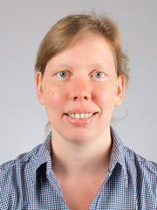
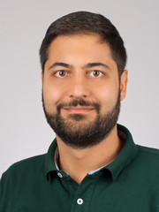

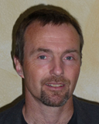



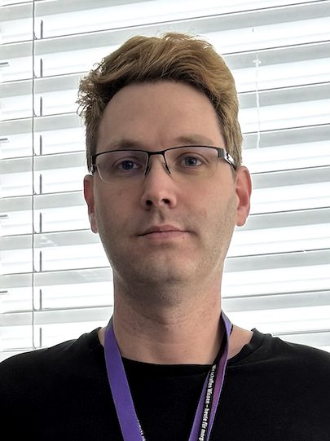
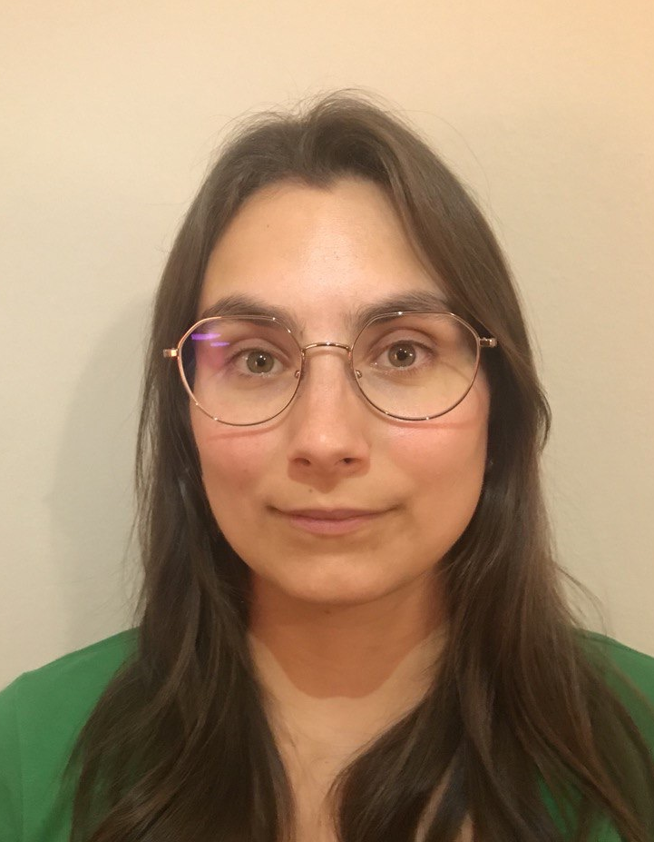

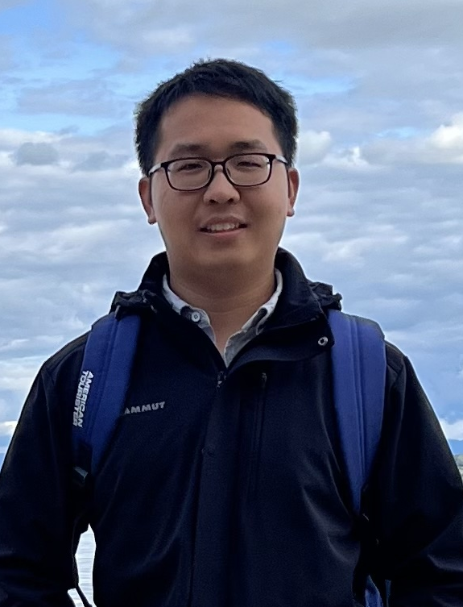
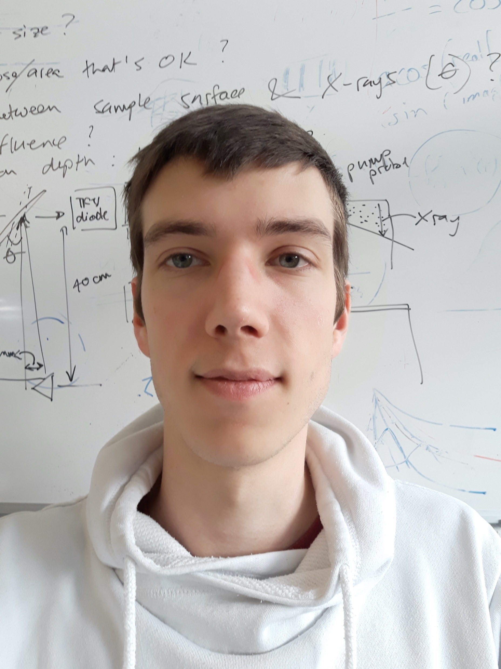
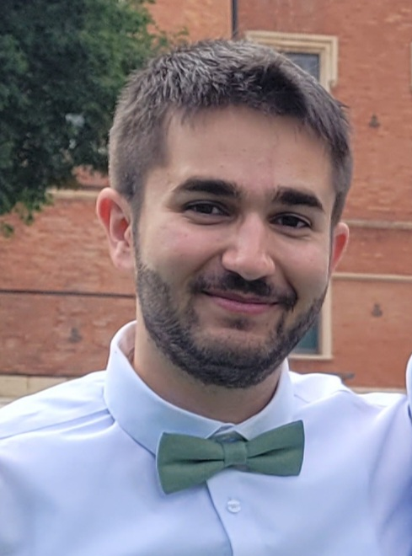
Thanks to everyone for making this possible!
Scientists
Since Sept. 2024
Technician
Laser
Controls
Kirsten
Schnorr
Andre
Al Haddad
Antoine
Sarracini
Gregor
Knopp
Christoph
Bostedt
Simon
Tiefenbacher
Xinhua
Xie
Csaba
Lombosi
Postdocs
PhD students
Suddhasattwa
Mandal
Zhaoheng
Guo
Jonas
Knurr
Ningchen
Yang
Hankai
Zhang
Eloisa
Manetti
Loïc
Bassement

Slide 3
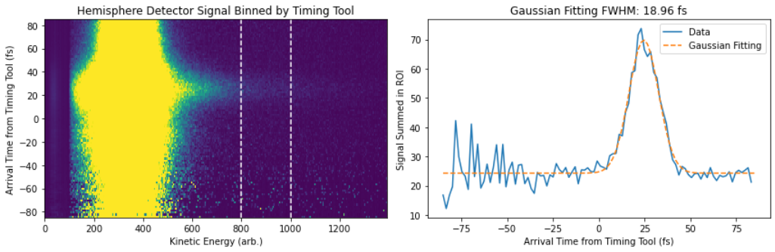
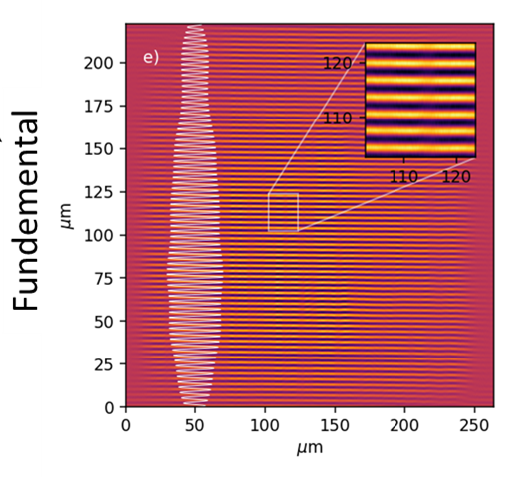
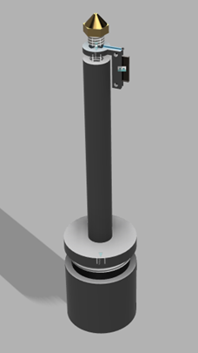
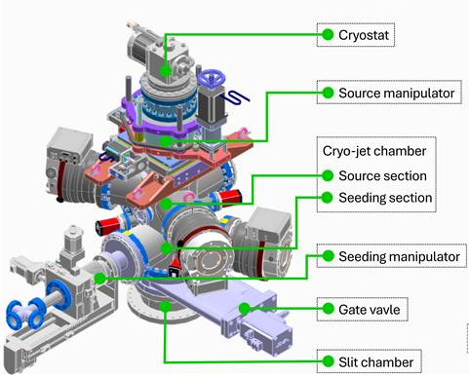
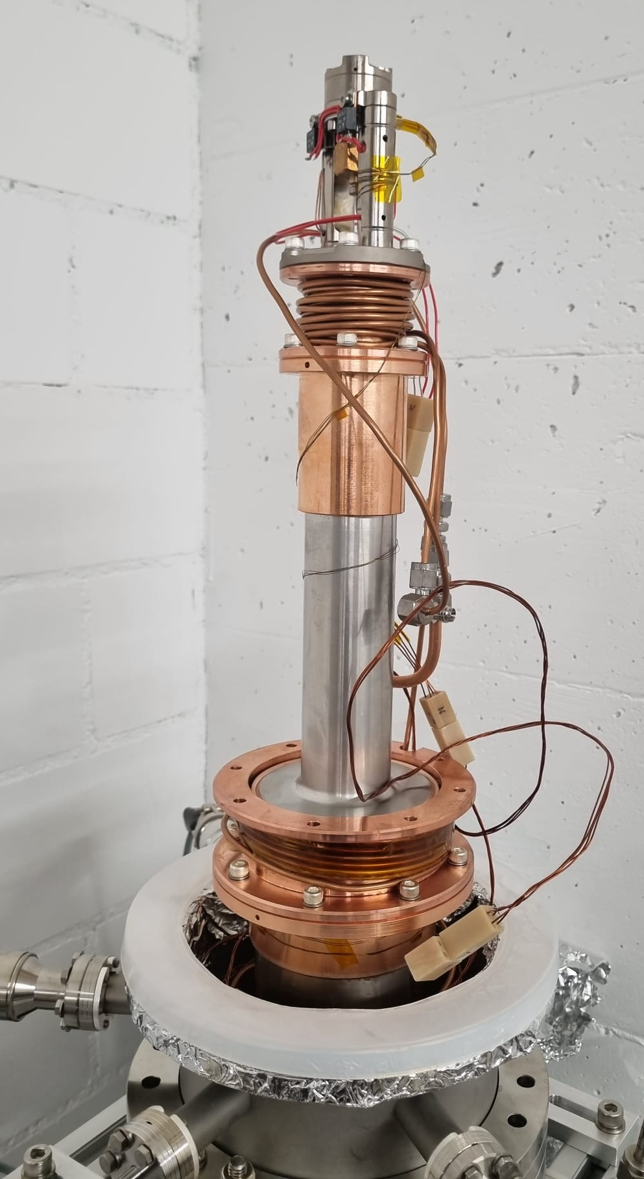
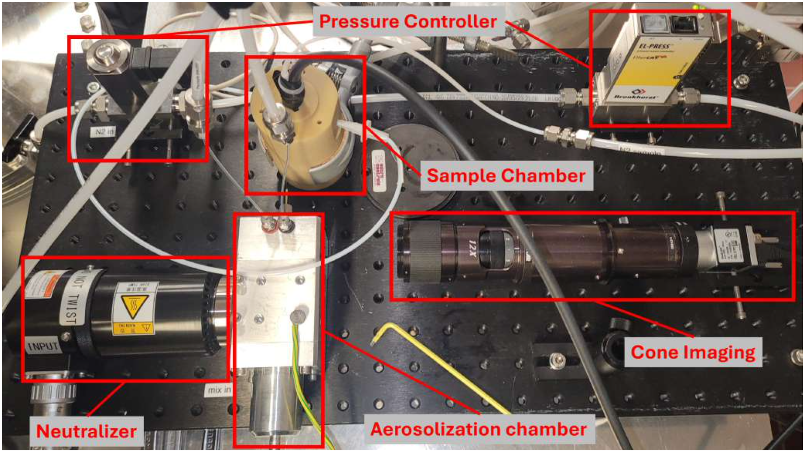
Instrument News 2024
Commissioning: Instrument response
Commissioning: Wavefront sensor
More news:
Time tool upgrade
OPA in optical regime in user call
First clusters from liquids
Very compact to fit in one Maloja chamber
Uses in-vacuum microscope
FWHM
20fs
Collaboration with Optics and X-ray Nanooptics groups
Upgrade: XPS oven injector for solid samples
Upgrade: Liquid He nanodroplet injector
Upgrade: Aerosol injector
Home-built injector based on EuXFEL design
Oven can go close to the interaction region
Higher target density for evaporated samples
High demand
Commissioning 1st half 2025
Commissioning at Maloja 1st half 2025

Slide 4
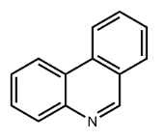
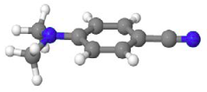
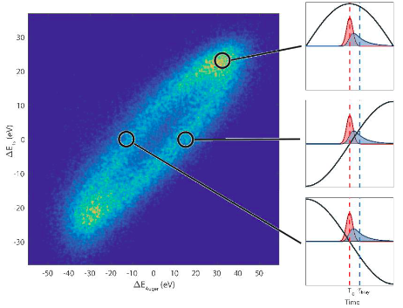
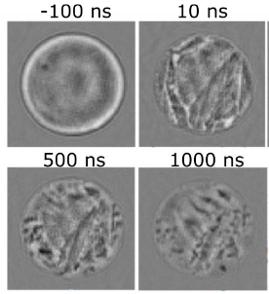
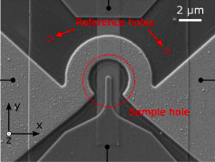
Overview and Updates 1st half 2024
Fischer et al.:
A UV pump/XPS probe study of phenanthridine:
The role of nπ* states in the photodynamics
XPS + XAS
Rudenko et al.: Imaging intramolecular charge transfer in 4 aminobenzonitrile derivatives via time- resolved XPS
XPS +
XAS
Haynes et al.: Attosecond time-resolved investigations into the effects of chemical environment on core-hole
decay processes in molecules
Non standard
~19 hours lost due to fire!
February
March
April
May
June
July
Commissioning: Instrument Response
Holography
Holography
Finizio et al.: Pump-probe X-ray magnetic holography imaging of the ultrafast electrical nucleation of magnetic skyrmions
Johnson -> Walls et al.: Ultrafast Coherent Imaging Spectroscopy of the Light Induced Phase Transition in Vanadium
Dioxide
FWHM
20fs

Slide 5
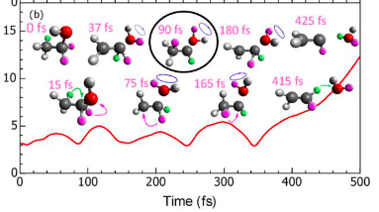
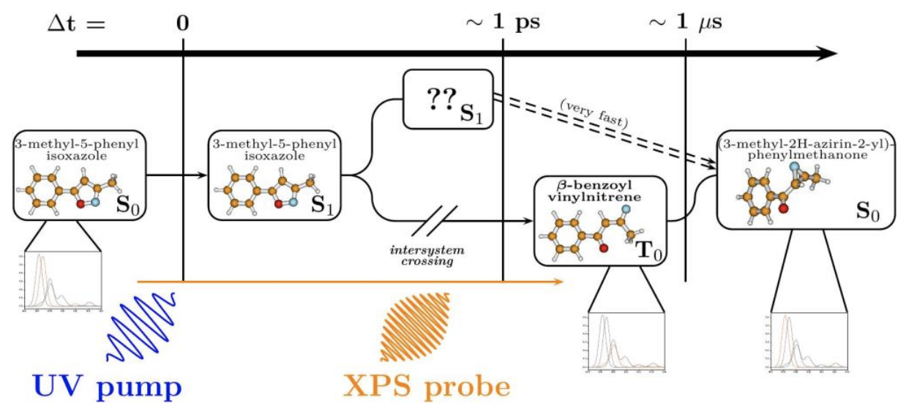
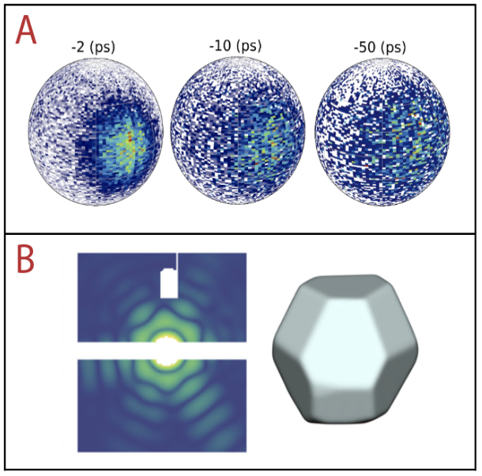
Overview and Updates 2nd half 2024 + Outlook 2025
Yang et al.: Unravelling the mechanism of hydronium ion formation in ethanol
Ion
TOF
Paolini et al.: Unveiling the ultrafast dynamics of nitrene radicals through site-specific probes
Special Call for 2025/I
XPS +
XAS
Limit amount of available setups
Electron spectroscopy (XPS/XAS)
One more setup -> SPI
5 user experiments (4 XPS + 1 SPI)
Commissioning He nanodroplet source
Benchmark modified time tool
Hero commissioning
October
November
December
Feb.
March
April
May
June
July
2024
2025
Summers -> Kling et al.:
Investigation of the effects of nanoscale facets on catalytic activity in photo-driven
nanosystems
Non standard
Al Haddad et al.: Ionization and fragmentation dynamics of Glycine: a case study for time resolved XPS
XPS
Prince et al.: Correlation analysis with SASE pulses: time-resolved core-level photoemission investigation
of ultrafast dynamics
XPS
User supplied injector and VMI spectrometer in JF module
Rescheduled due to fire

Slide 6
Feedback and wishes to machine
Machine 1st half 2024
😀
Machine 2nd half 2024
😢
Stable and reliable in standard operation
Multi-mJ on a daily basis
Good setup ready on first beamtime day
Shortening pulses by tilting had become routine
Generally reduced performance
Pulse energy ~1-2mJ maximum
Setups bad or not ready on first beamtime day
Multiple failed attempts to shorten pulses by tilt (less pulse energy but same duration)
Machine wish list 2025
🥳
Consolidation of existing special modes and development of new modes is both crucial
  Spread knowledge about special modes in operation team
  Two colors with shorter pulses (we are fighting the Auger lifetime)
  Single short pulses with few to sub-fs
  Bandwidth control (lower and broader)
Every new mode also comes with new challenges for the experiment -> Let’s try together!

