Slide 1
Furka status and updates
E. Razzoli
Seventh SwissFEL Performance Workshop
21 January 2025

Slide 2

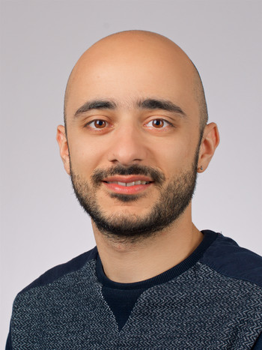
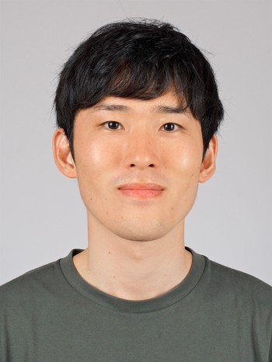
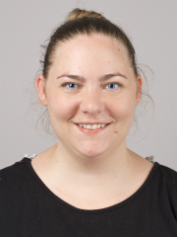
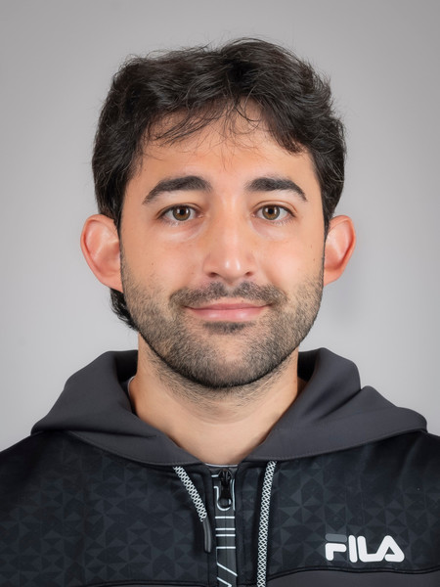
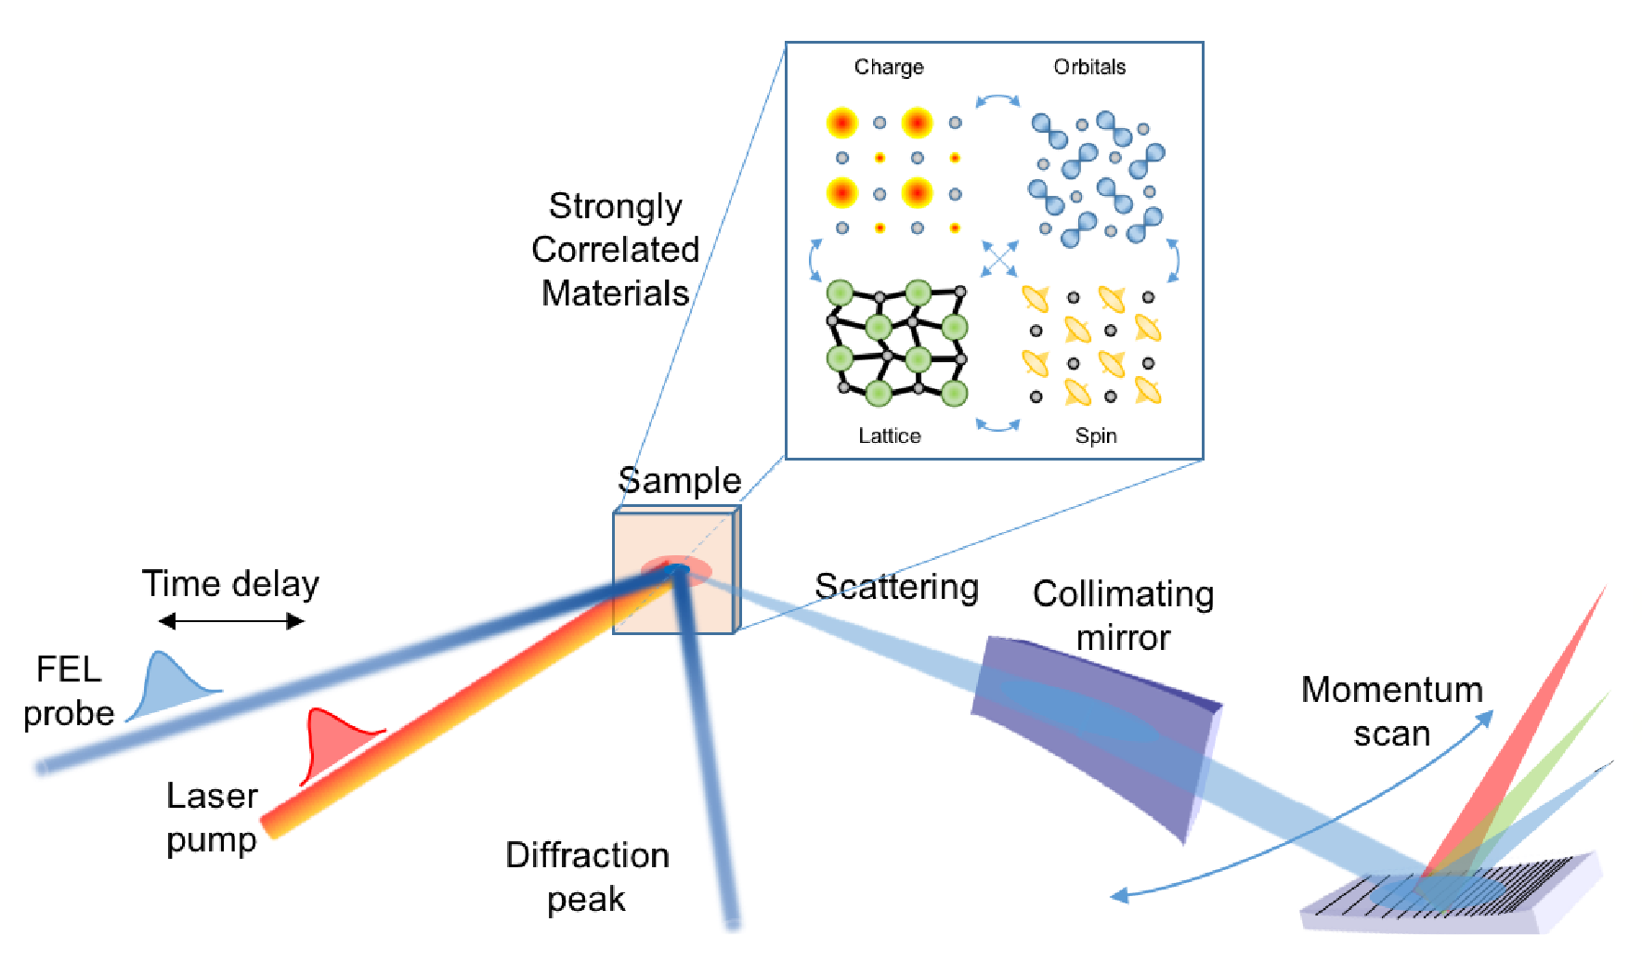
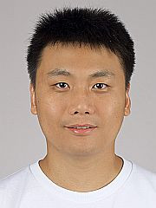
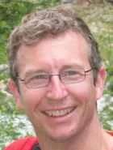
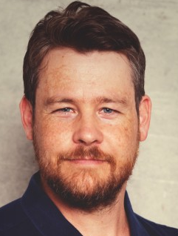
Furka: SwissFEL- ATHOS endstation for condensed matter
Furka team
Elia
Razzoli
Eugenio
Paris
Hiroki
Ueda
Elizabeth
Skoropata
Arnau Romaguera
Ken
Egli
Group leader
Scientist
Scientist
Scientist
Postdoc
Technician
Ultrafast spectroscopies of condensed matter group
Luc Patthey
Biaolong Liu
Thierry Zamofing
Christophe Tripode
Goal is to investigate the ultrafast dynamics of correlated and quantum materials
Lab head
LSX
Laser scientist
Pump laser group
Motion Control
Engineering

Slide 3
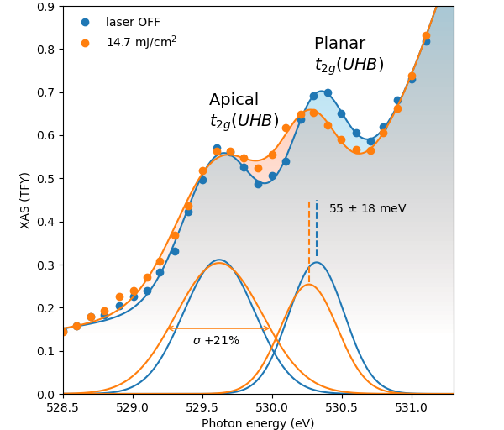
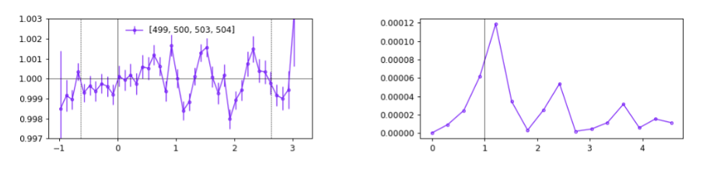
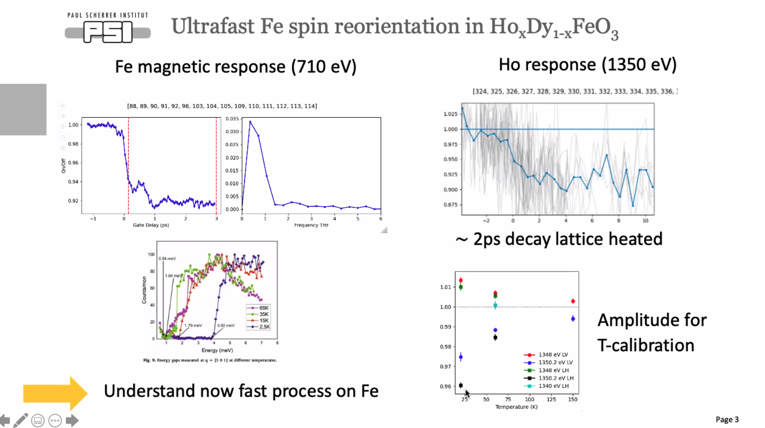
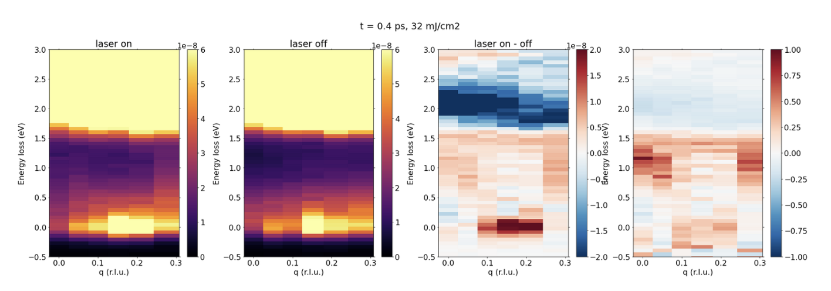
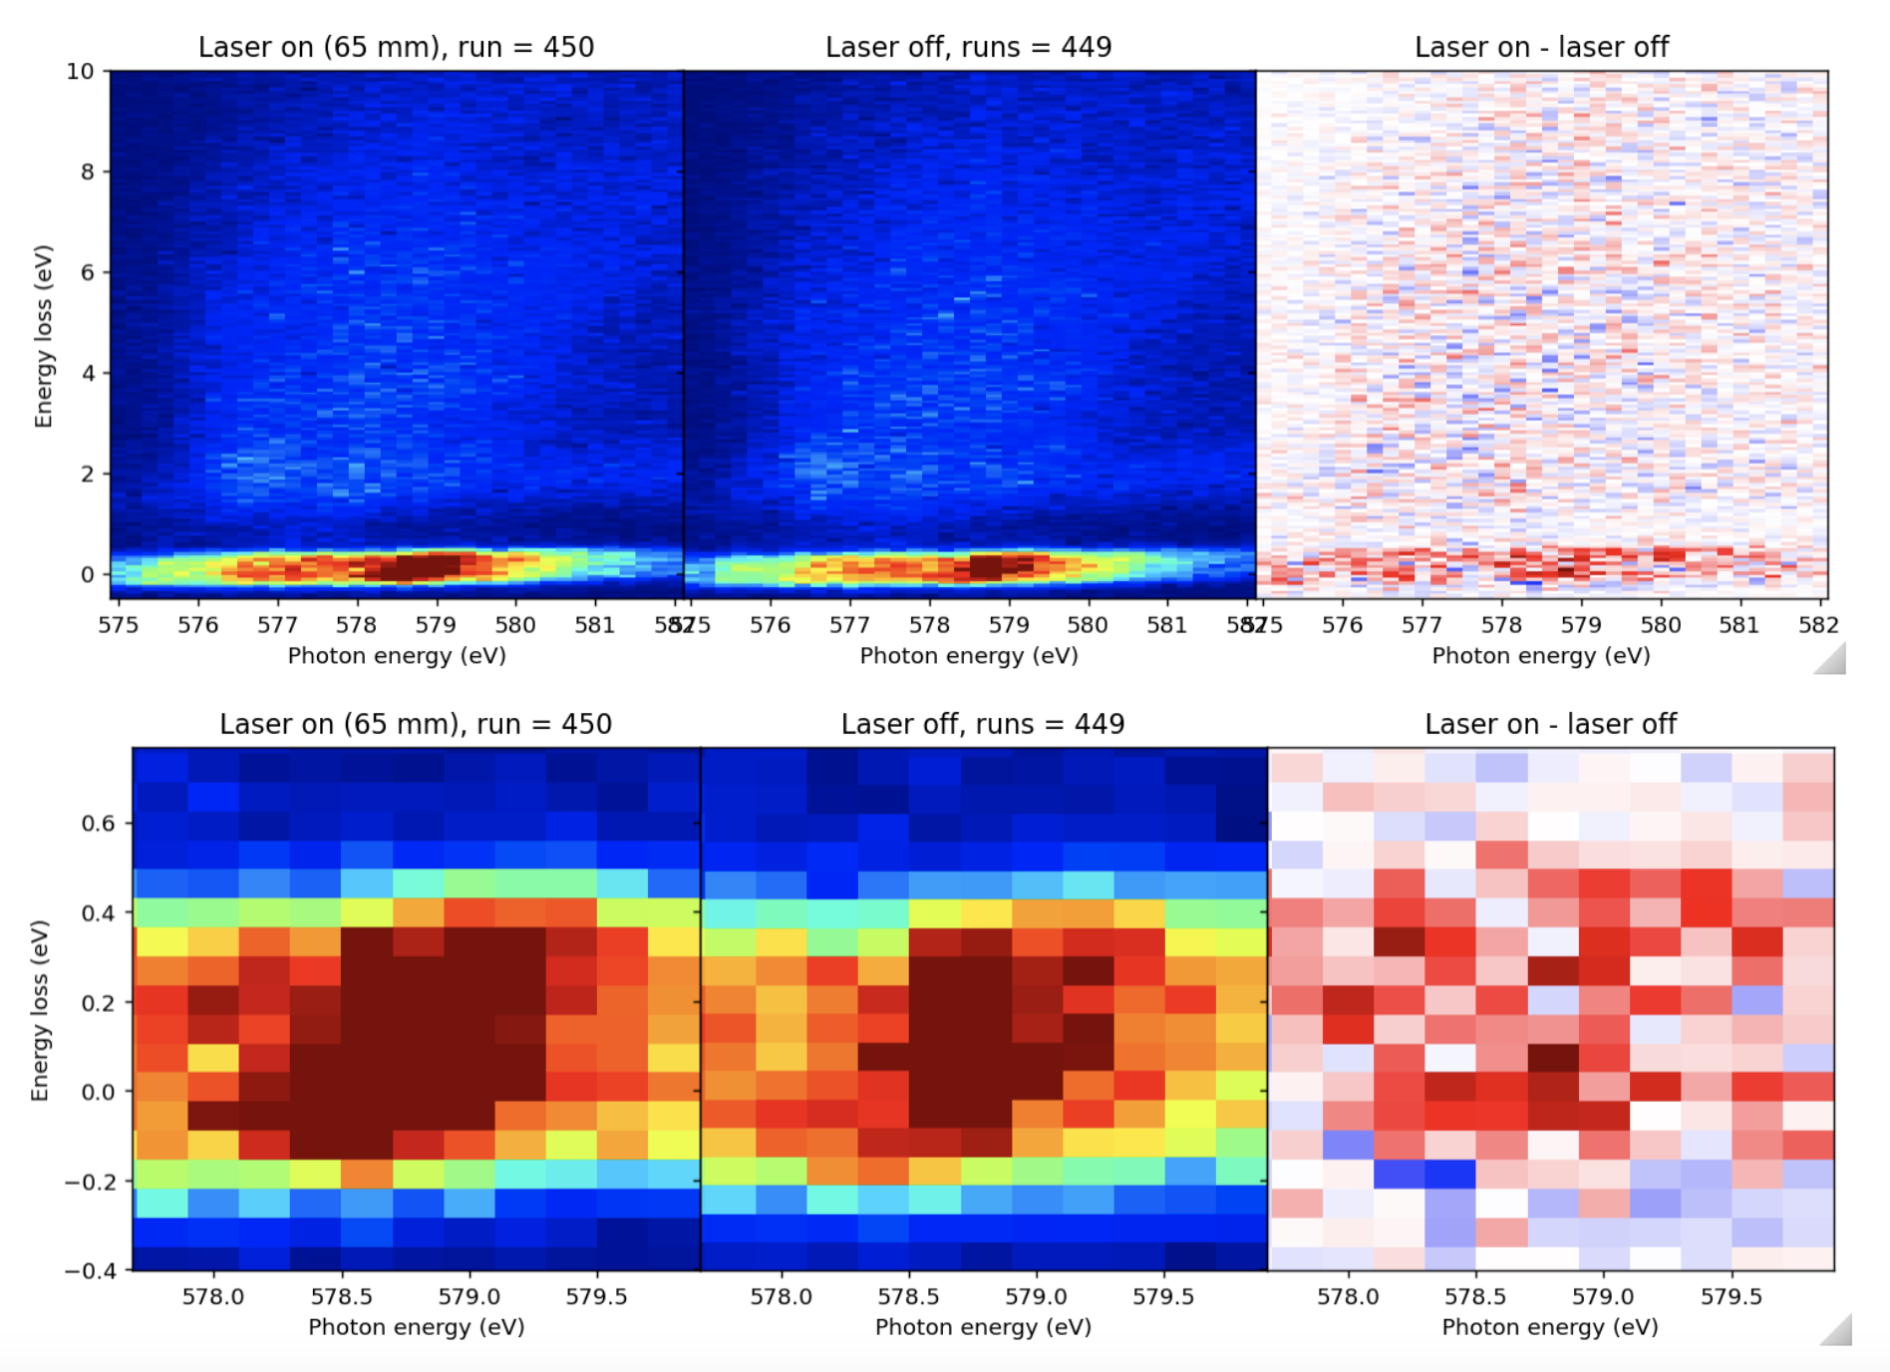
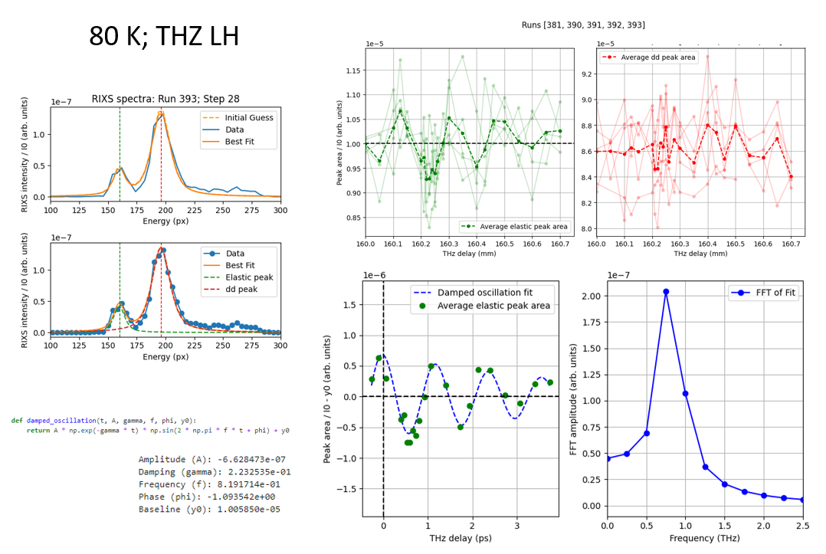
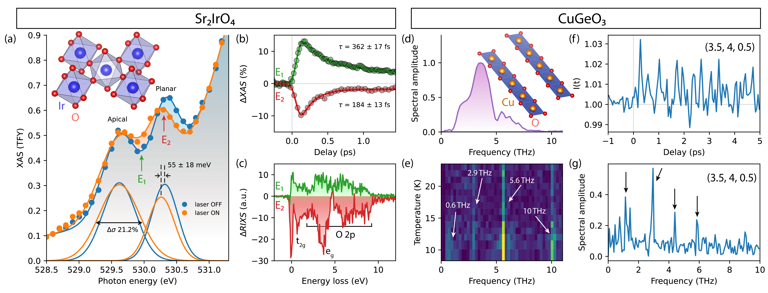
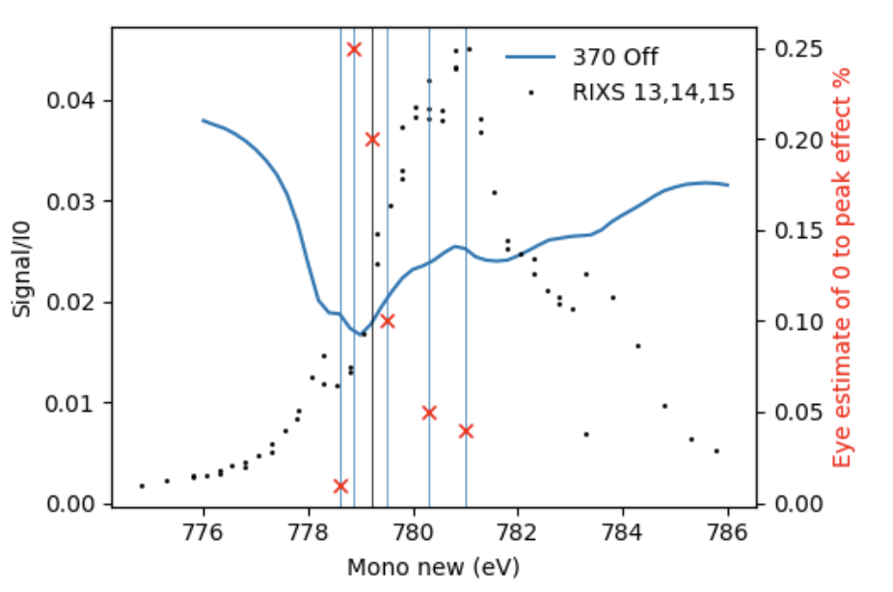
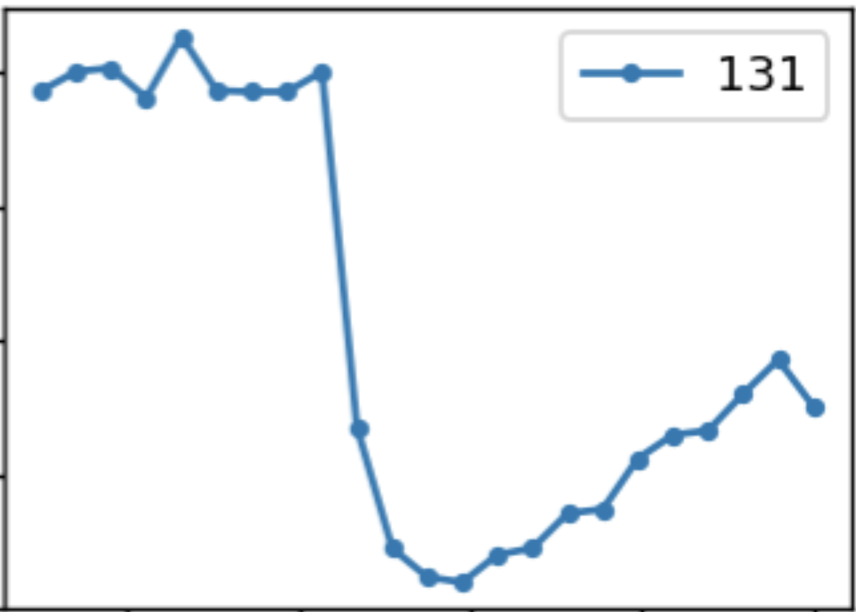
1 - First user call at Furka (S1-S2 2024)
- Allocated 8 user beamtimes, 6 performed, 2 postponed ( 1- S.Fan Brookhaven Nat. Lab, 2 - K. Zhou Diamond light source)
February
March
May
October
November
December
Non-equilibrium quasiparticle dynamics in a highly spin-orbit coupled correlated insulator
PI: E. Paris et al., Furka PSI
Nonequilibrium magnetic dynamics of antiferromagnetic CoF2
PI: S. Johnson, ETHZ and PSI
Ultrafast spin reorientation in Ho(x)Dy(1-x)FeO3
Pi: L. D. Leroy, U. Staub, et all PSI
Ultrafast dynamics of the spin-orbital excitations in the van der Waals antiferromagnet CrSBr by tr-RIXS
Pi: T. Schmitt, PSI
Resonant excitation of CO in cuprates: disentangling charge order and magnetic excitations in YBCO_{6+x} in the ultrafast time domain
PI: B. Liu, E. Razzoli, Furka PSI
Probing the collective excitations of a metastable light-driven state in a cuprate ladder
PI: M. Mitrano, Harvard
E₂
E₁
Delay (ps)
Delay (ps)
Frequency (THz)
Frequency (THz)
0
10
ps
Energy (eV)
Delay (ps)
Notes:
LGAD: Hybrid pixel detector (silicon and readout chip bonded together) with (1) charge multiplication through p-doped gain layer, 300 V. (2) Thin entrance window. QE>80% whole range. Stripcell 75x25 um2.

Slide 4
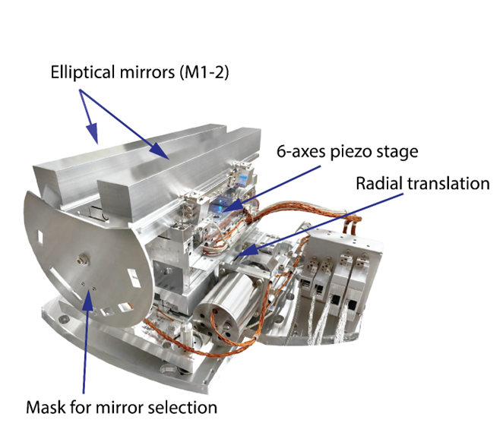
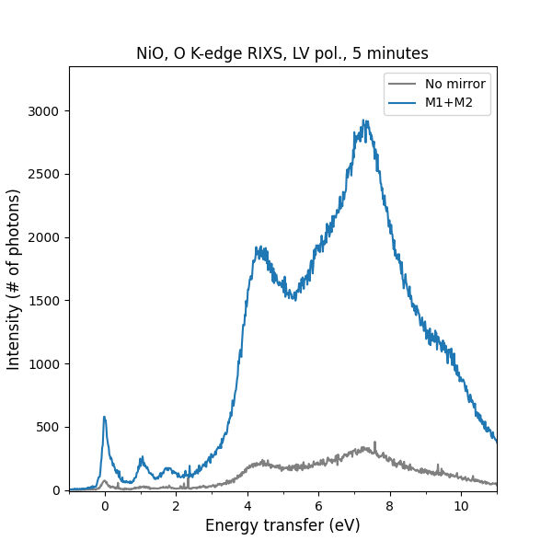
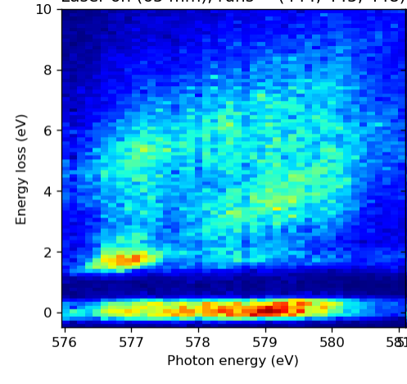
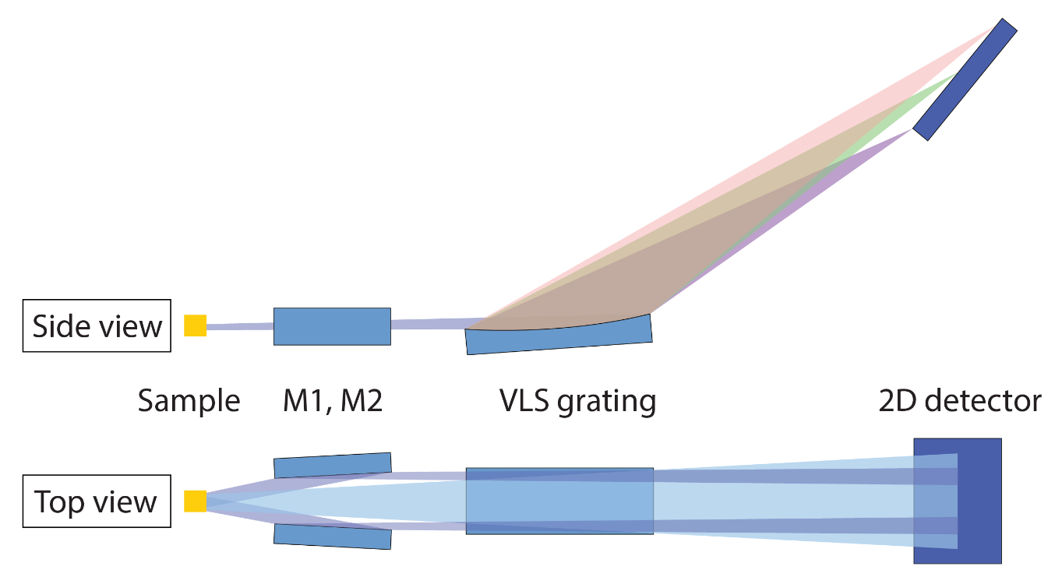
2 - Twin collecting mirrors
Goal: increase horizontal solid angle for TR-RIXS
Apr-Sept 2024: Installation and commissioning. Available to users since October 2024.
Countrate: 100-1000 photons/s - achieved
User beamtime October 2024
10x gain!
1D spectrum
Access to 2D energy/momentum maps!
From ≈2h down to ≈12 minutes for a map
Plane-elliptical mirrors
Notes:
CrSBr. Excite a particular magnetic coupled exciton and look at the response of orbital excitations.

Slide 5
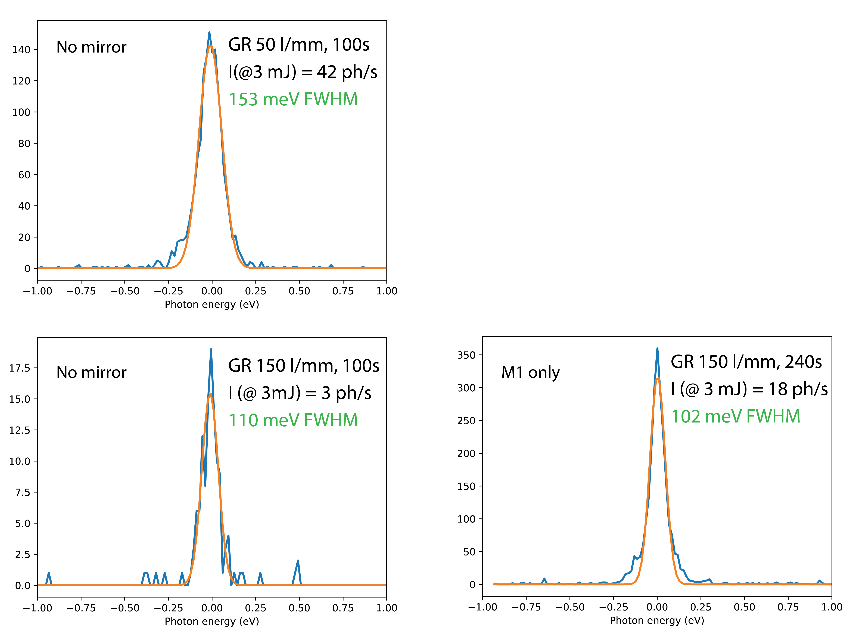
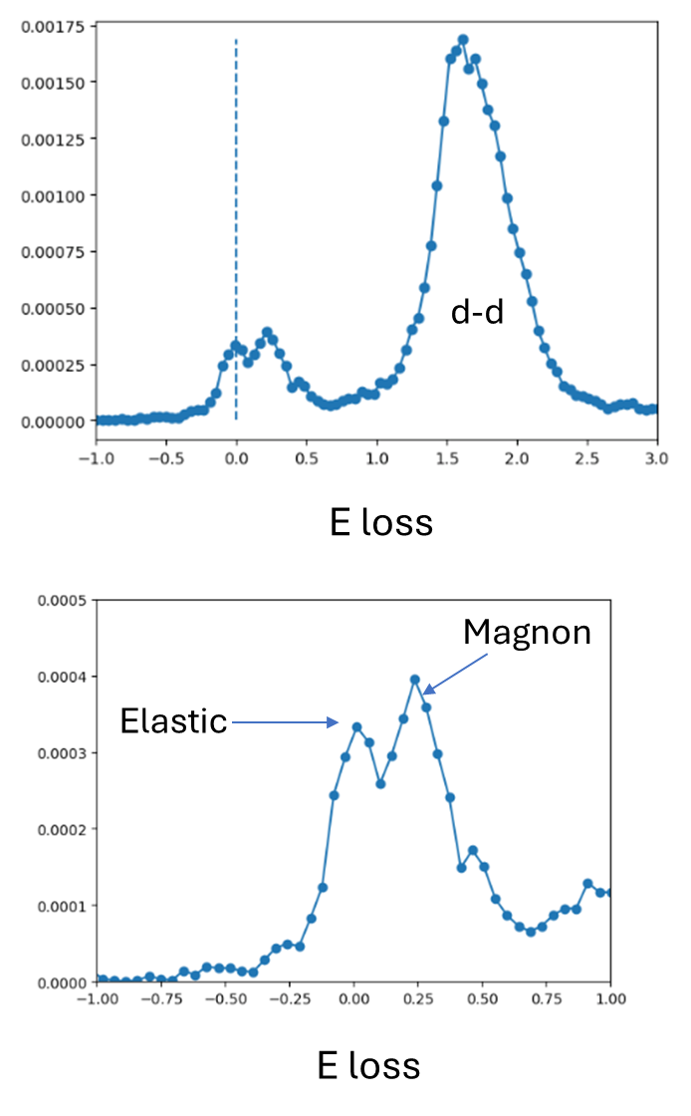

3-Spectrometer performances
O K-edge
Cu L₃-edge
The new mirrors allowed using 150 l/mm grating with low illumination for high-res
Nov 2024
Feb 2024
Feb 2024
illumination ~ 1/4
YBCFO
Exposure 200 s
M1 only
Feb 2024
Oct 2024
Feb 2024
Reduced grating illumination ~ 1/4
Reduced grating illumination ~ 1/4
grating illumination ~ 1/4
Res. ~ 230 meV (FWHM)
100 ph/sec
Resolving power: now up to 6’000 (goal 10’000)
Still limited by beamline
SNF R’Equip project accepted
E. Paris, T. Schmitt, C. Monney, L. Patthey and E. Razzoli,
“Ultrafast dynamics of elementary excitations with high resolution time-resolved RIXS at Furka endstation”
Scope:
Total budget: 280 kCHF
New high-res grating for Athos
New CMOS detector
Funding Period: Q3 2025-Q3 2026
Notes:
CrSBr. Excite a particular magnetic coupled exciton and look at the response of orbital excitations.

Slide 6
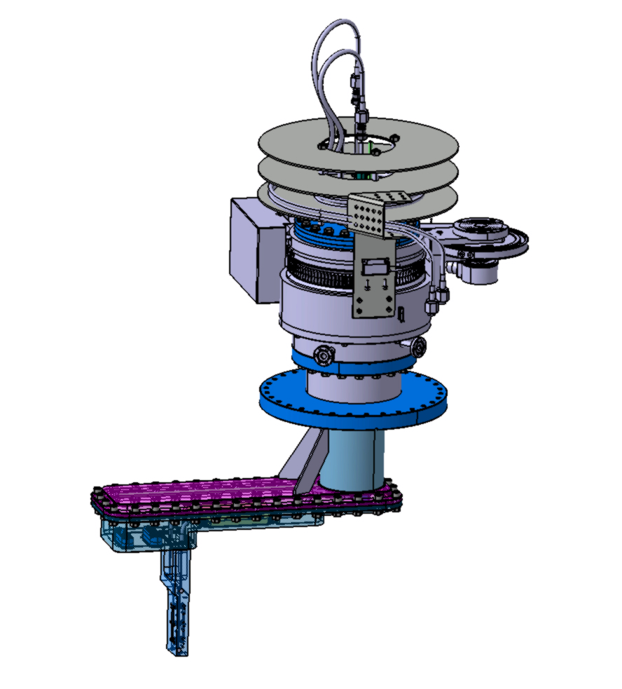
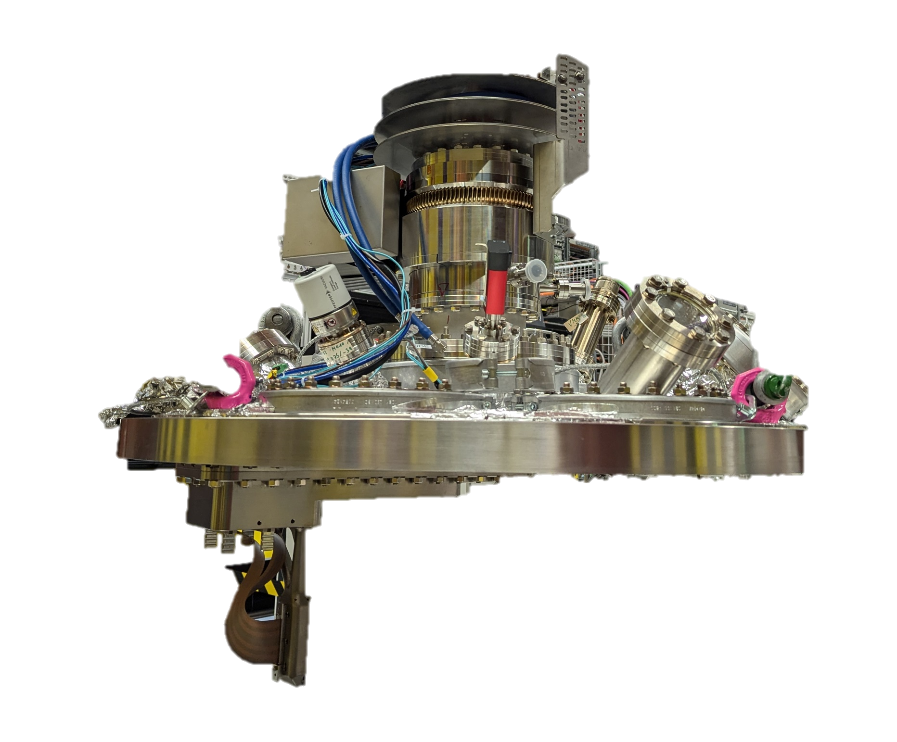
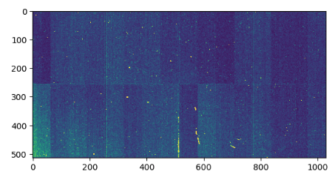
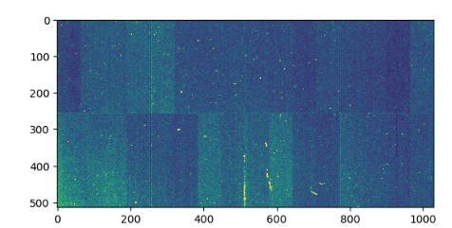
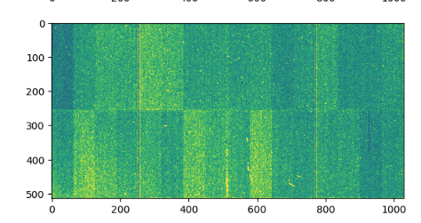
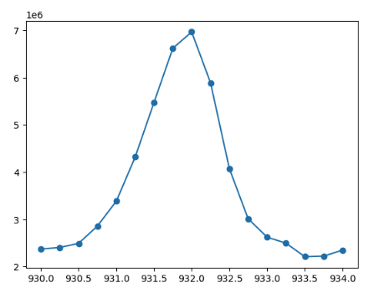
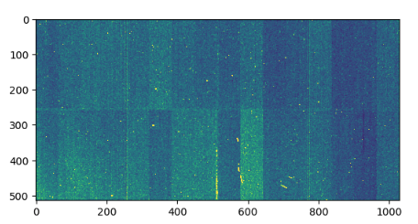
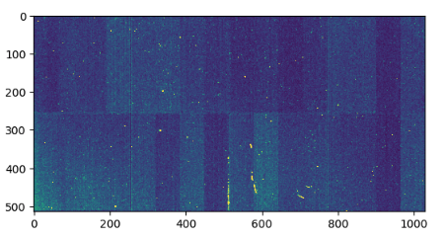
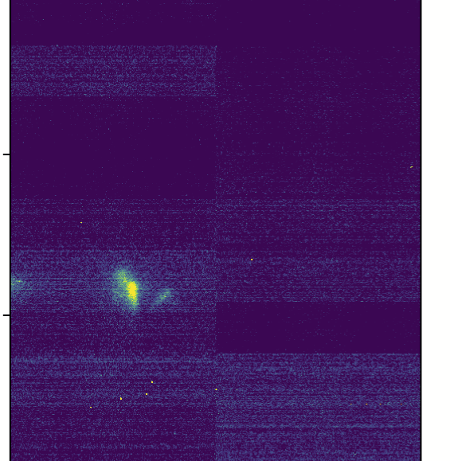
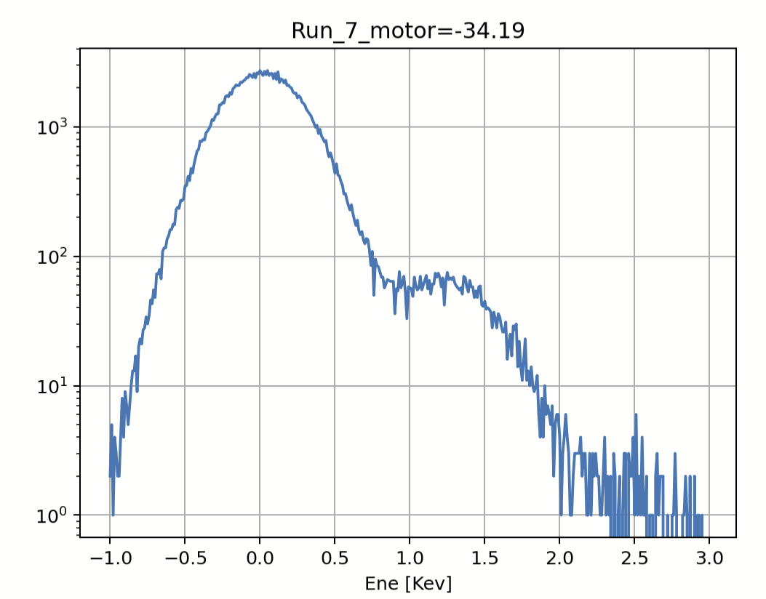
4 -Furka Jungfrau for diffraction
October 2024: First XAS spectra with the Jungfrau
Desing led by C. Tripod and Detector Group
November 2024: First diffraction test with the Jungfrau
Pixel 75 µm – 0.5 Mpixel
Developed by PSI
Active area 80 x 40 mm²
Reverse vacuum chamber
3D printed metal support/cooling guide
120 degree rotation in vacuum
Installation August 2024
Thanks to Aldo, Sven and Claudio for the help!

Slide 7
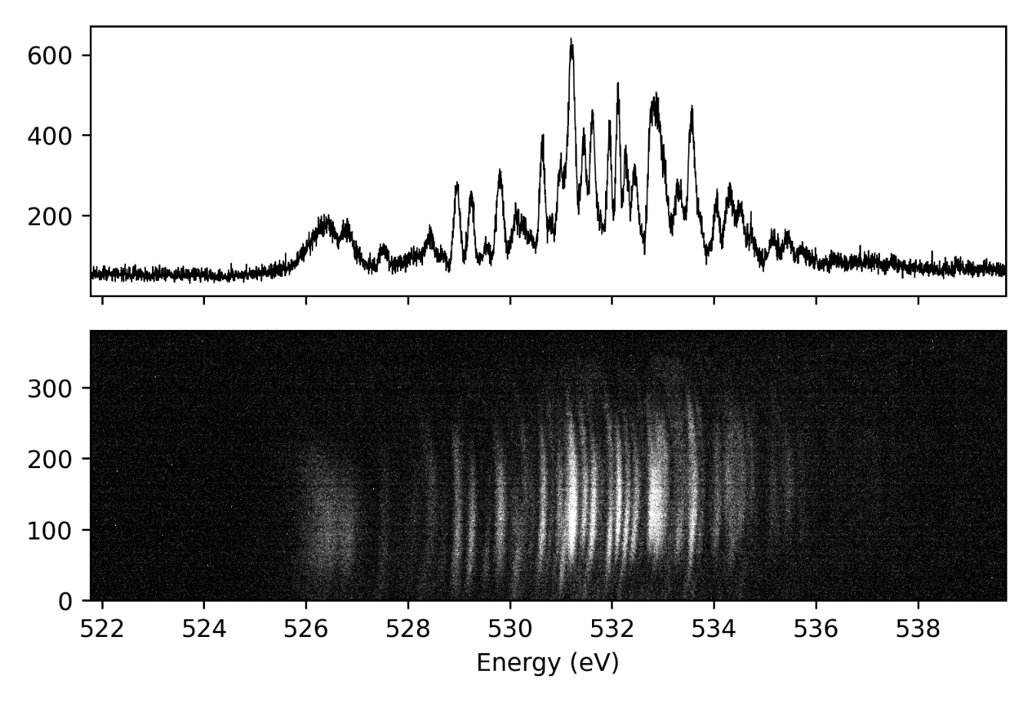
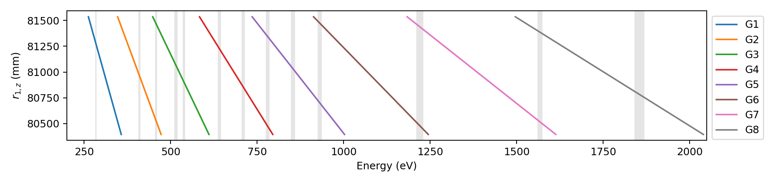
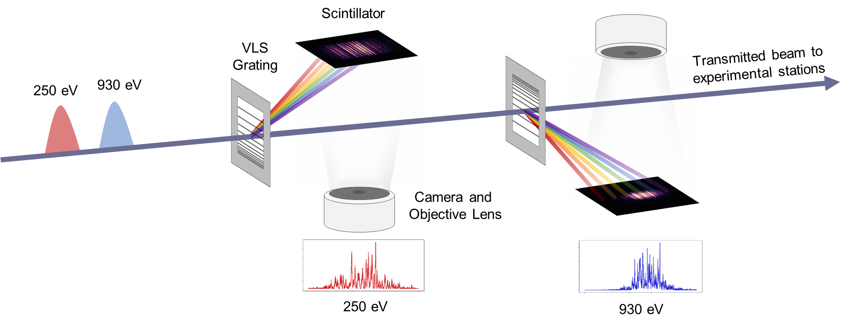
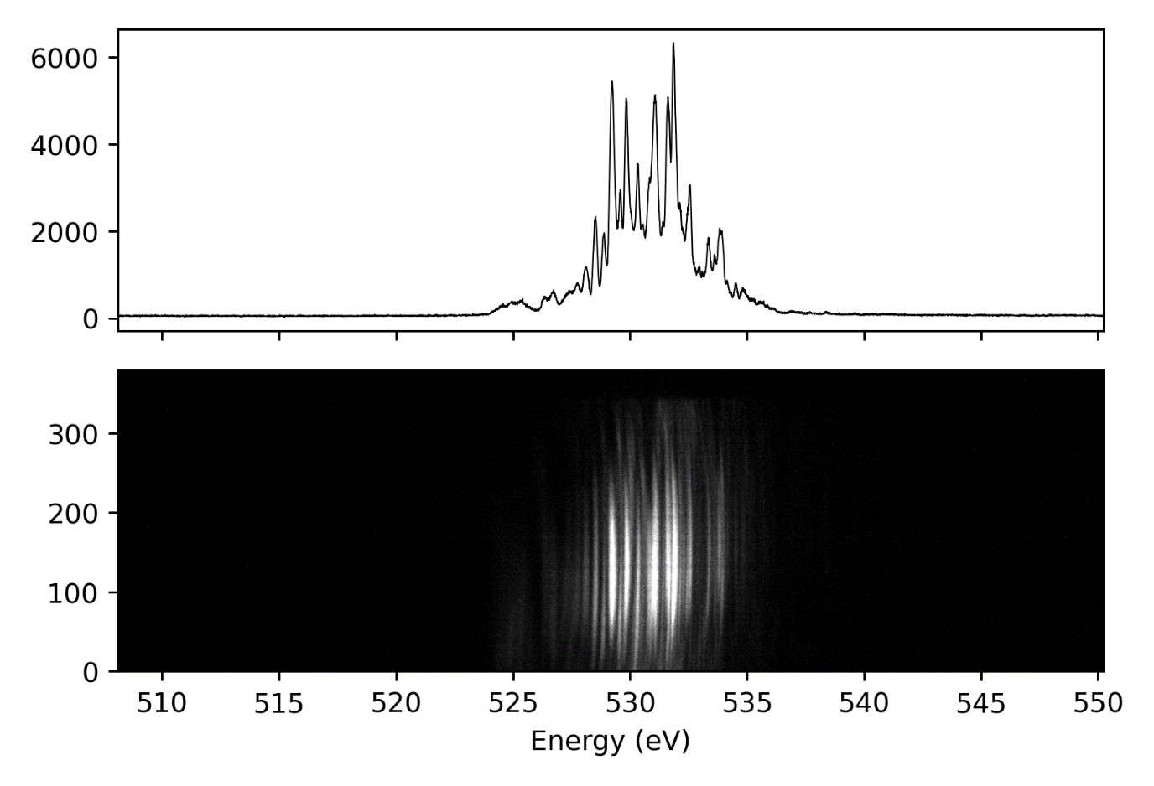
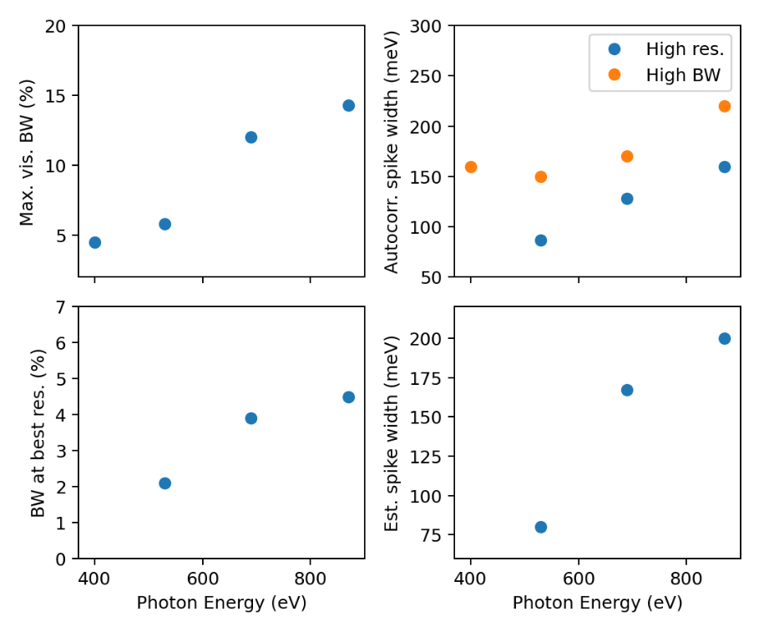
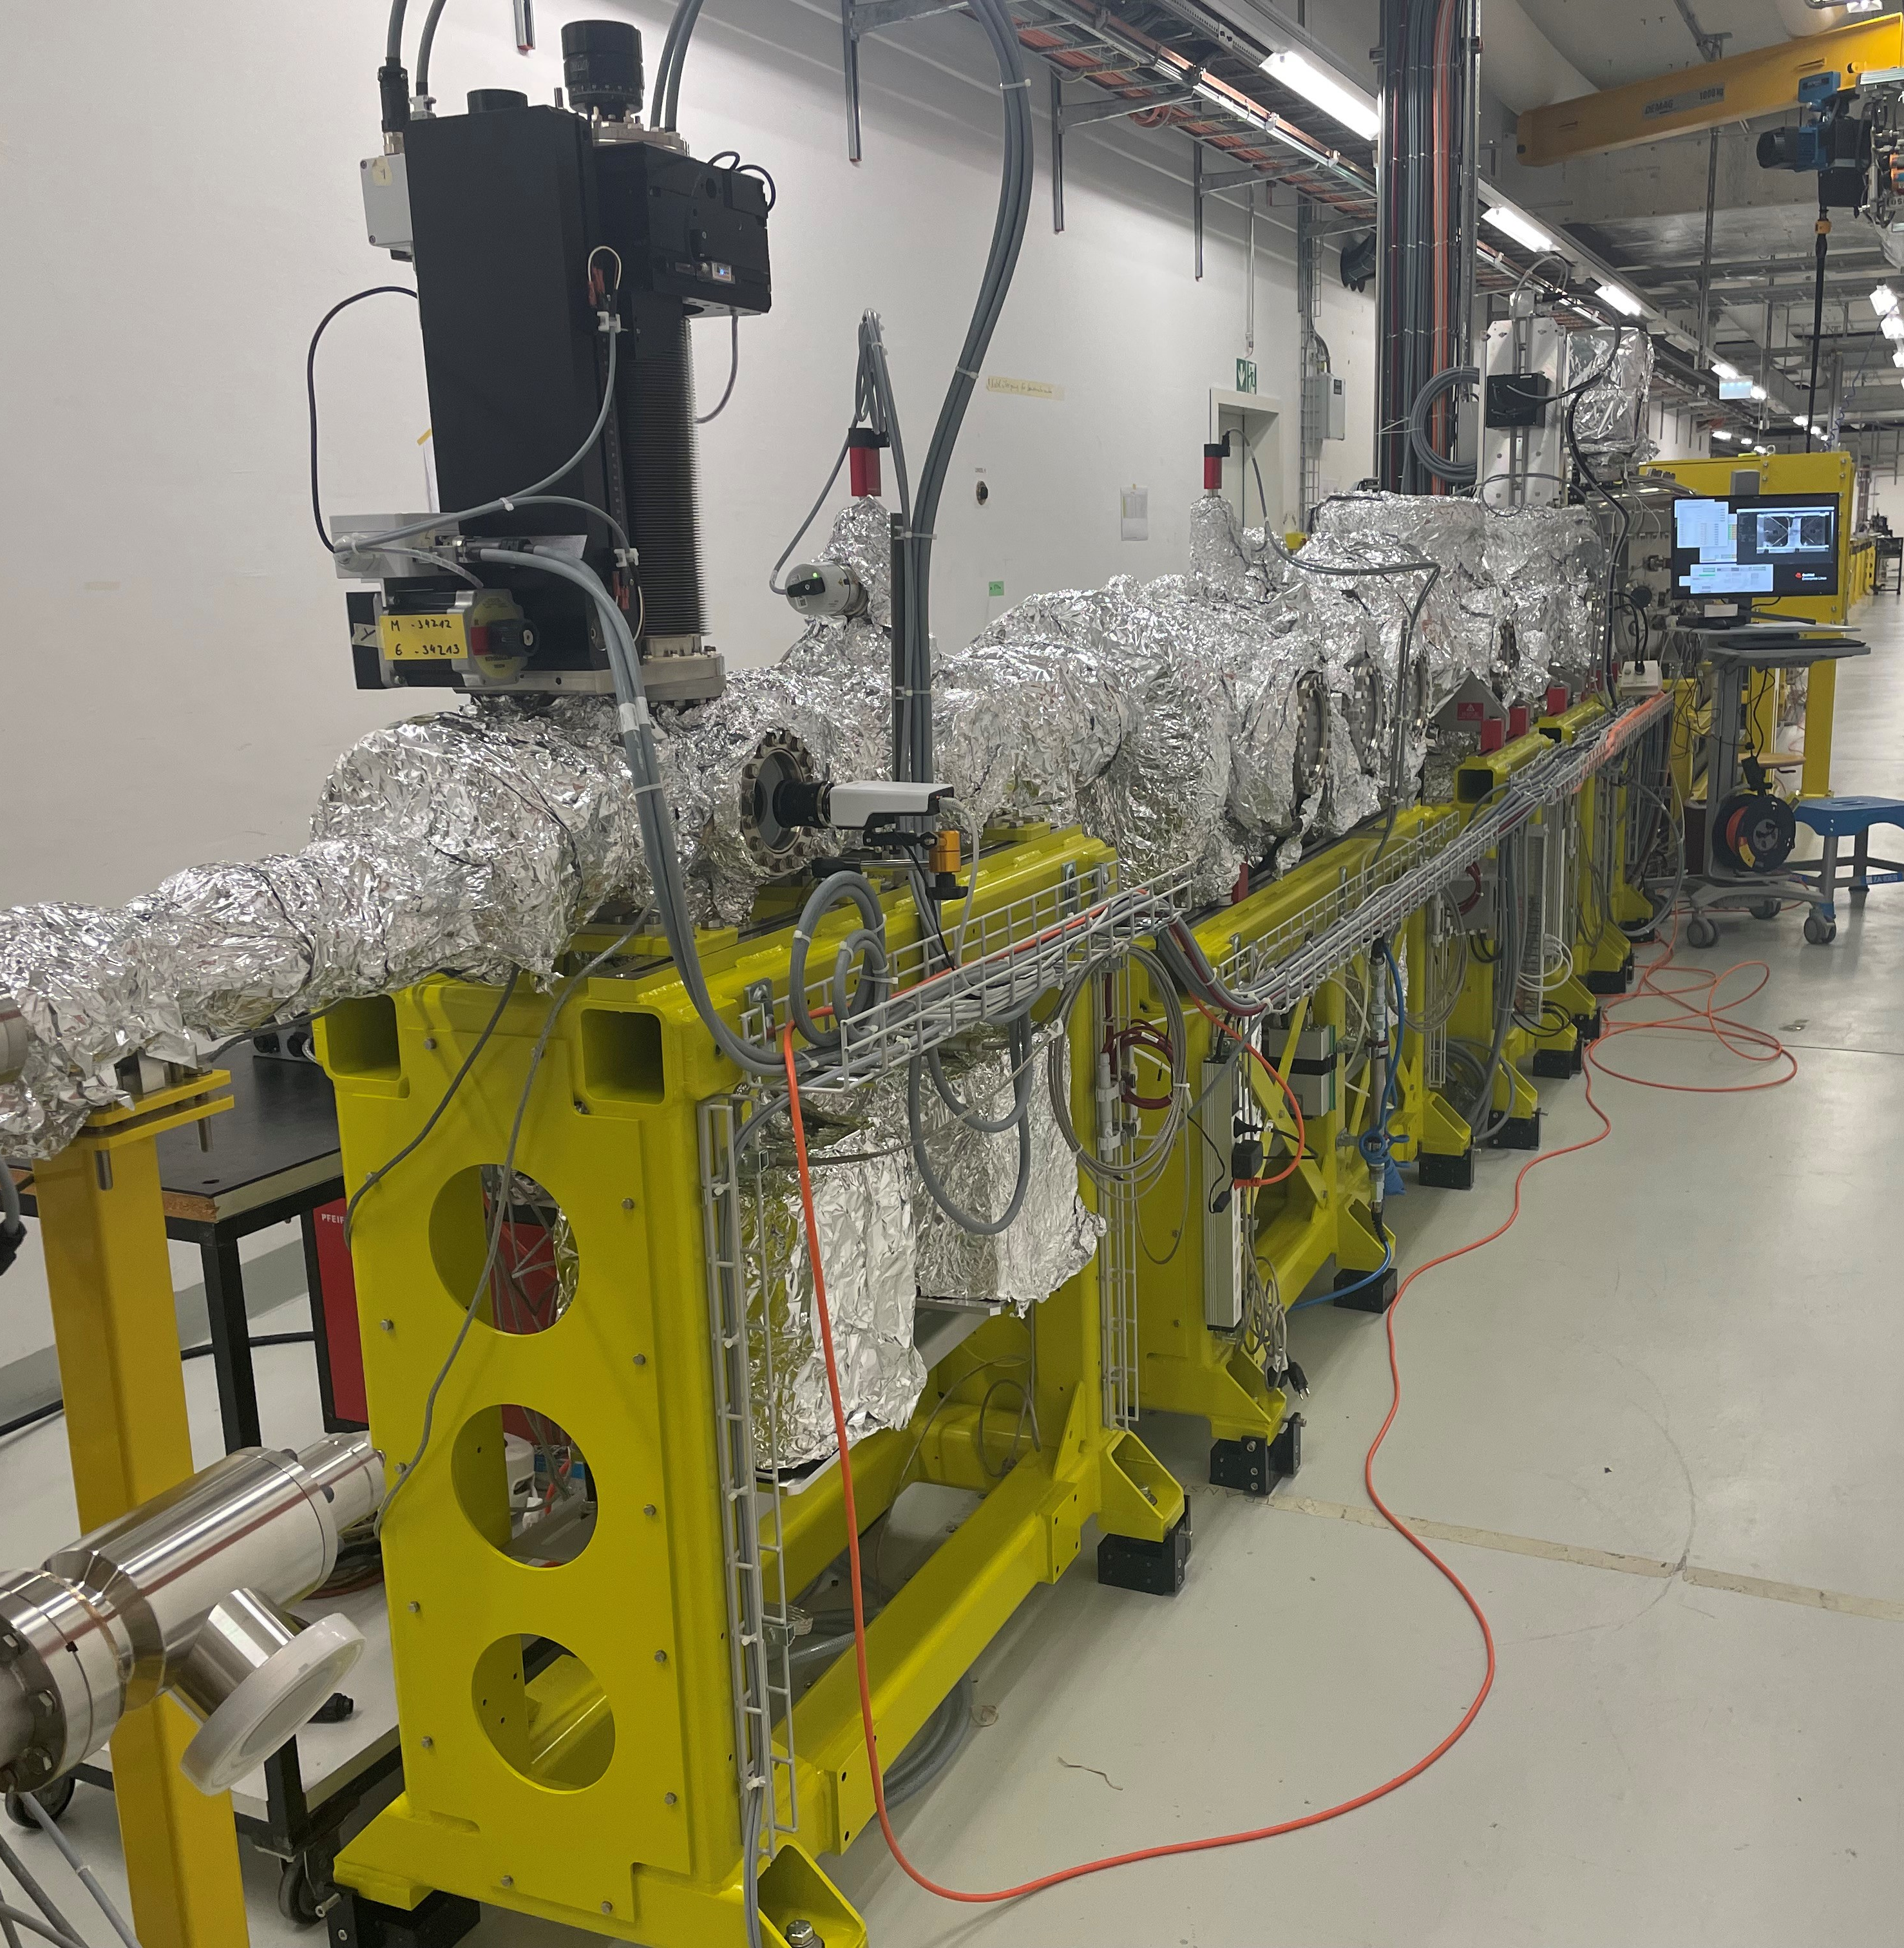
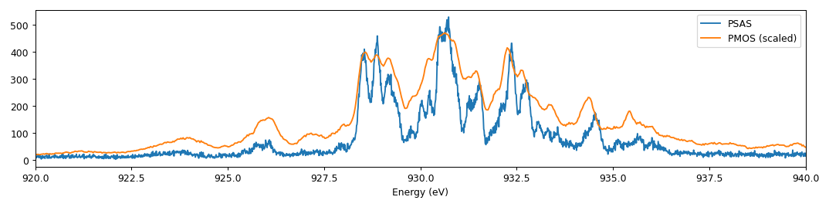
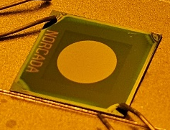
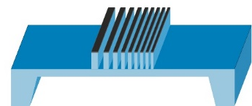
5 - Athos SASE spectrometer
N
K
Ti
L
V
L
O
K
Mn
L
Fe
L
Co
L
Ni
L
Cu
L
5 deg YAG pitch
50 μJ pulse energy
High Res.
1 deg YAG pitch
50 μJ pulse energy
High BW
Bandwidth
Resolution
Fully tunable
color 1 set up
Fixed energies ( up to 12) for color 2
YAG+camera
100 Hz detector
Commissioning ongoing
All gratings tested (400 – 970 eV)
Preliminary performance evaluated
Grating manufacture via e-beam (@ C. David, J. Vila at al.,)
E. Skoropata, C. Arrell, R. Follath,…

Slide 8
Outlooks and open issues
Outlook in 2025:
Commissioning of combined SASE-RIXS spectrometers (stochastic spectroscopy)
Commissioning for diffraction Jungfrau (check: performance for low intensity diffraction peaks and tagging)
Increase sensitivity of time-tool for tr-RIXS
What we wish for:
- new software tools such as:
continuous acquisition mode during scan (“crazy”-scans)
JF integration in pipeline
timing (edge finding) directly in the pipeline,
..
Open issues :
- Smaract reliability issues
- Undulators reliability issues

