Slide 1
Diavolezza Update
SwissFEL Performance Workshop
S. Neppl – Laboratory for Nonlinear Optics
SwissFEL Performance Workshop, Windisch/Brugg, January 21st 2025

Slide 2
Diavolezza project structure
Project Leader
Stefan Neppl
Project Owner
Adrian Cavalieri
Funding: currently LNO budget
Funding: R’Equip (09/2022) 1800 kCHF
(for beamline)
Beamline
Claude Pradervand
Endstation
Stefan Neppl
Working Group
Martin Huppert
(Hutch/Experiment Layout)
Yunpei Deng
(Laser System/Transport)
Juraj Krempasky
(DAQ)
HL/KB system
Rolf Follath
Layout/3D
Dominique Hauenstein
Optics/HOM
Ulrich Wagner
Diagnostics
Chris Arrell
Installation/ Coordination
Erich De Boni

Slide 3
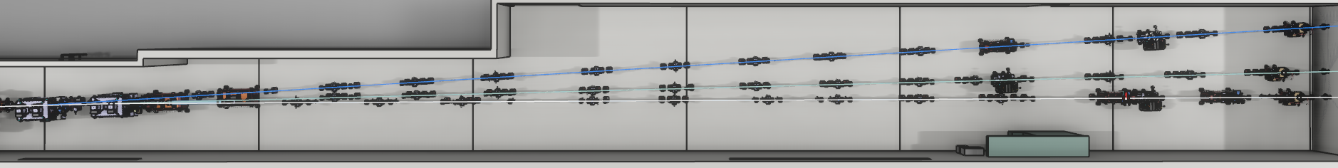
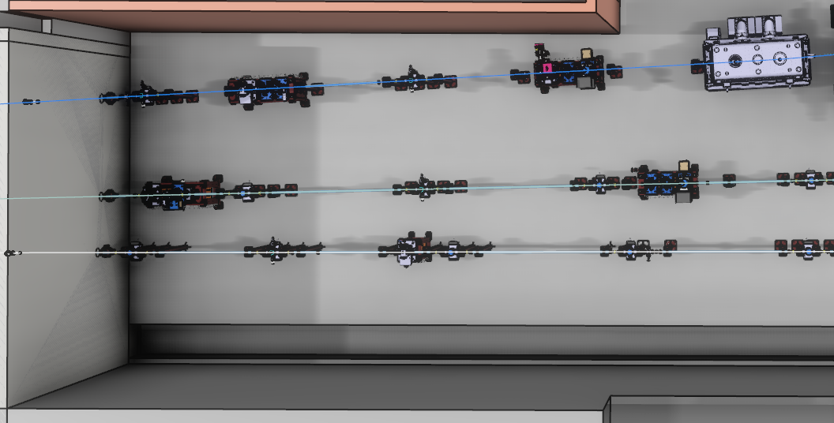
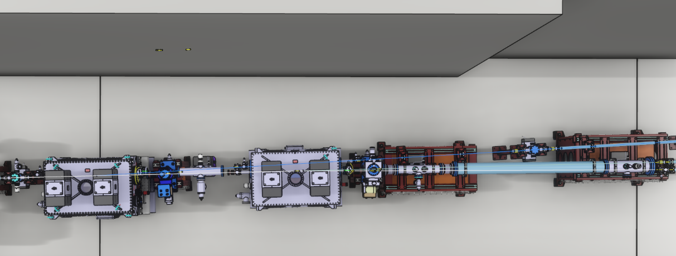
















Diavolezza beamline
OSCR
OEXS, PMOS
OPAU, PSCR
OPSH
$$560$$
$$565$$
$$570$$
$$575$$
$$580$$
$$585$$
$$590$$
$$595$$
$$600$$
$$605$$
Athos optics hutch UH.026
Diavolezza
OSCR
OLAS,OLIR
OPAU,OLIR,PSCA
KB mirror
Hor. Offset mirror
(2° deflection)
Furka
$$605$$
$$610$$
$$615$$
$$620$$
$$625$$
PSCR
Hor. Offset mirror
$$Z$$
Diavolezza hutch EH.030a
Maloja
Furka
Layout finalized; HL frozen

Slide 4
Timeline Diavolezza beamline (coarse)
Hor. offset mirror
KB system
KB optics
Vacuum (standard)
Diagnostics
Kick-off
2024 |  |  |  |  |  |  |  |  |  |  |  |  |  | 2025 |  |  |  |  |  |  |  |  |  |  |  |  | 2026
1 | 2 |  | 3 | 4 | 5 | 6 | 7 | 8 | 9 | 10 | 11 |  | 12 | 1 | 2 | 3 | 4 | 5 | 6 | 7 | 8 | 9 | 10 | 11 | 12 |  | 1 |  | 2 | 3 | 4 | 5 | 6
PDR
FDR
Design/Specification
PDR
FDR
Fabrication (in house)
Design/Specification
FAT
Installation (SD)
Fabrication (TOYAMA)
SAT
Specification
Shipment/Installation
Specification
Procurement/Production
Procurement
Installation
Design/Specification
Procurement/Delivery
Installation

Slide 5
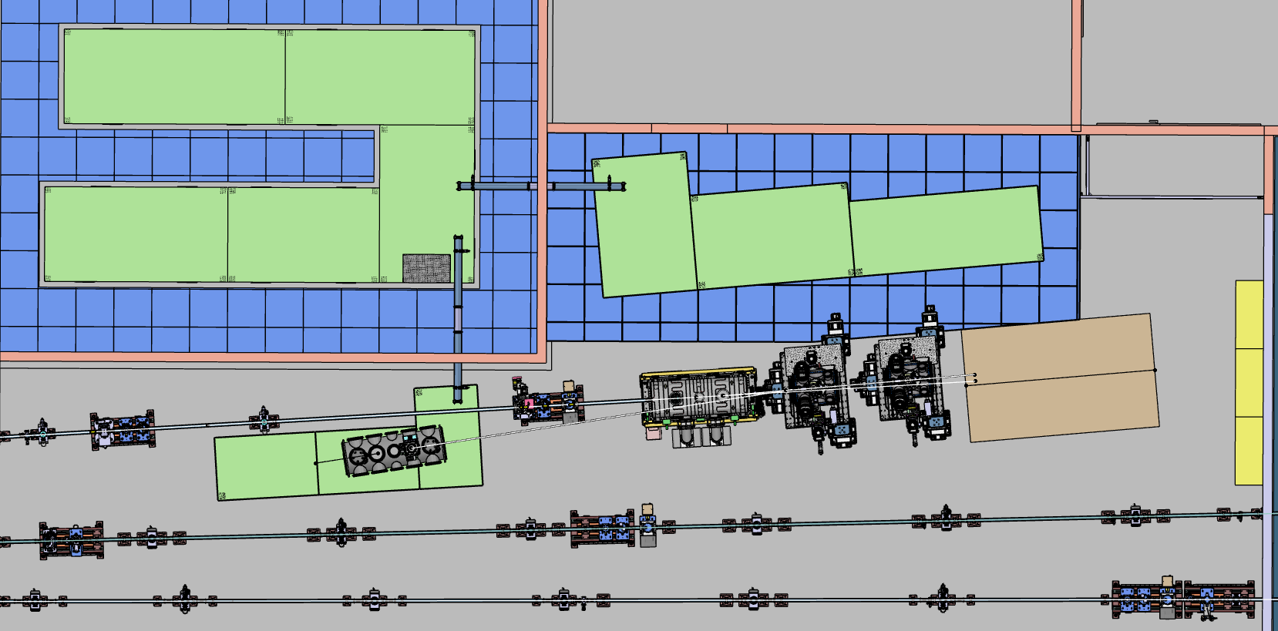
Diavolezza endstation layout
Control Room (EH.030b)
Athos pump laser I
800 nm
Athos pump laser II
800 nm
OPA
2-15µm
DIAVOLEZZA Hutch
(EH.030a)
1-2µm
Compr.
OPA
Compr.
800 nm
KB mirror
Open port
FEL
Broadband XUV
CMC
Phase-II (>2028)
Toroidal XUV mirror
THz setup
Mid streaking setup
HCF
Maloja
Furka

Slide 6
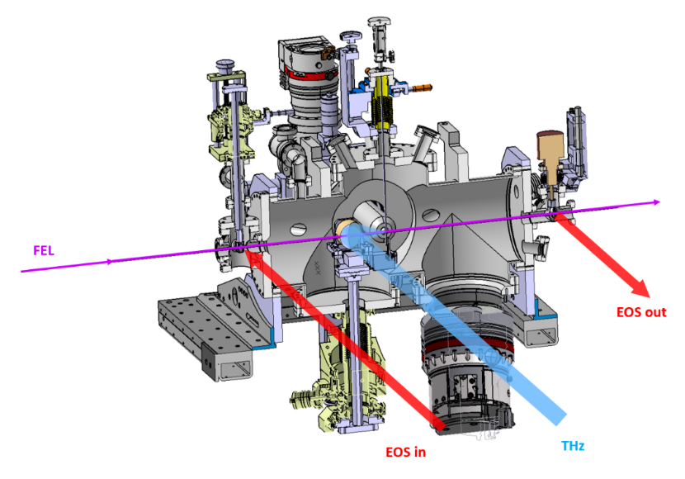
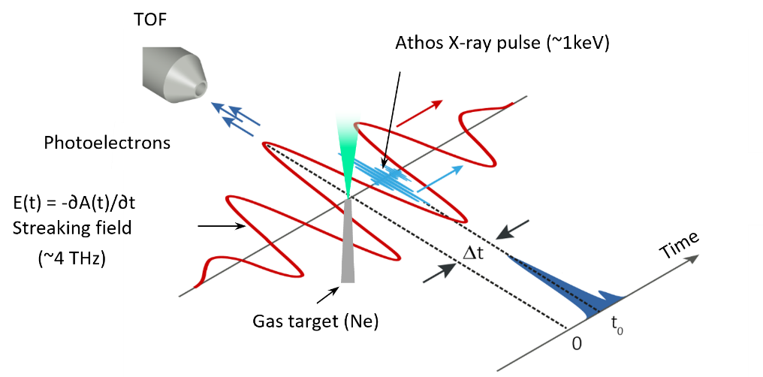
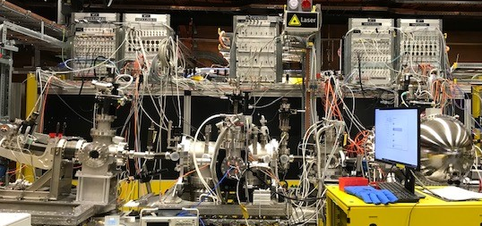
THz streaking setup
Tests @ Maloja (05/2023)
Athos standard pulse mode
S = 0.6 eV/fs
∆E = 80 eV
∆t = 130 fs
50 ± 10 fs
180 fs

Slide 7
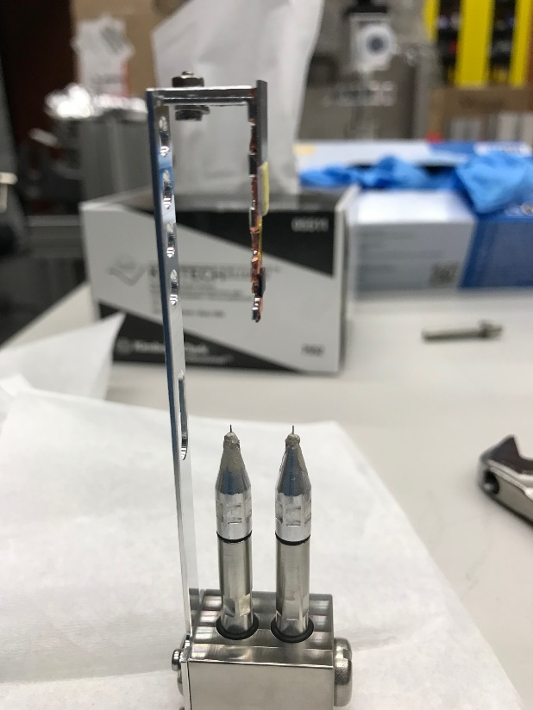
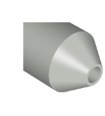
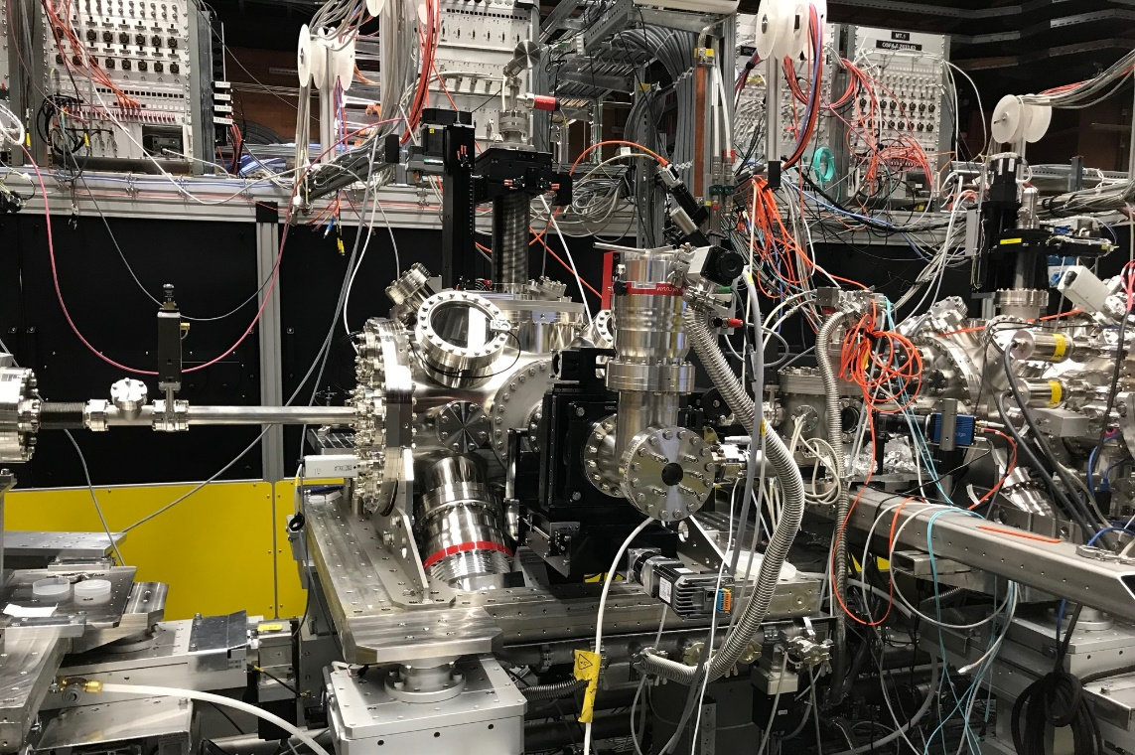
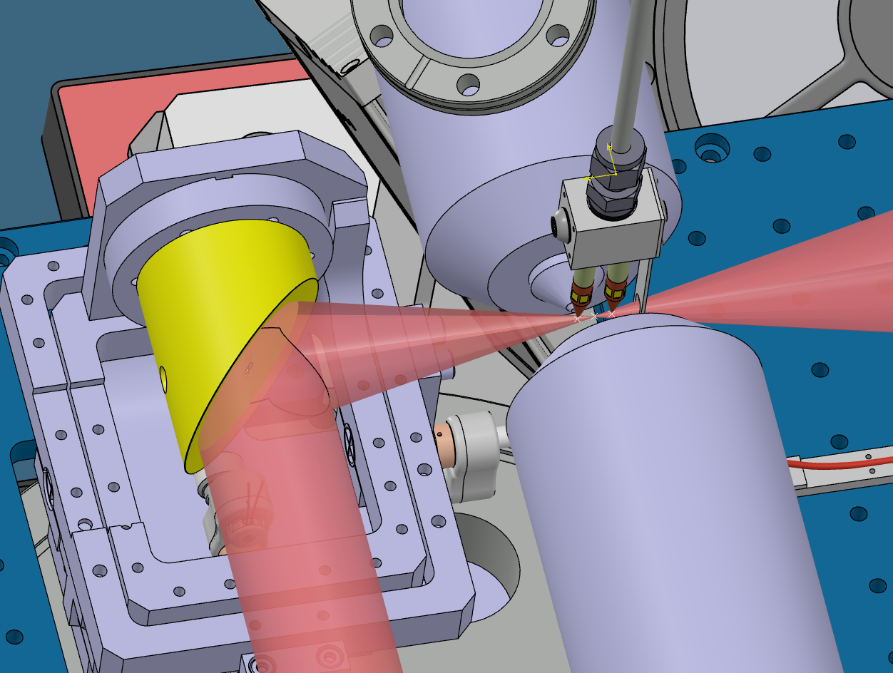
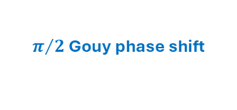
Mid-IR streaking setup
$π/2$ Gouy phase shift
Approach:
Self-referencing to mitigate timing jitter
Dual gas nozzle
Rayleigh length
Rayleigh length
TOF #1
TOF #2
Mid IR
e⁻
e⁻
FEL
focal plane
10-6 mm
FEL
Mid-IR
14 µm

Slide 8
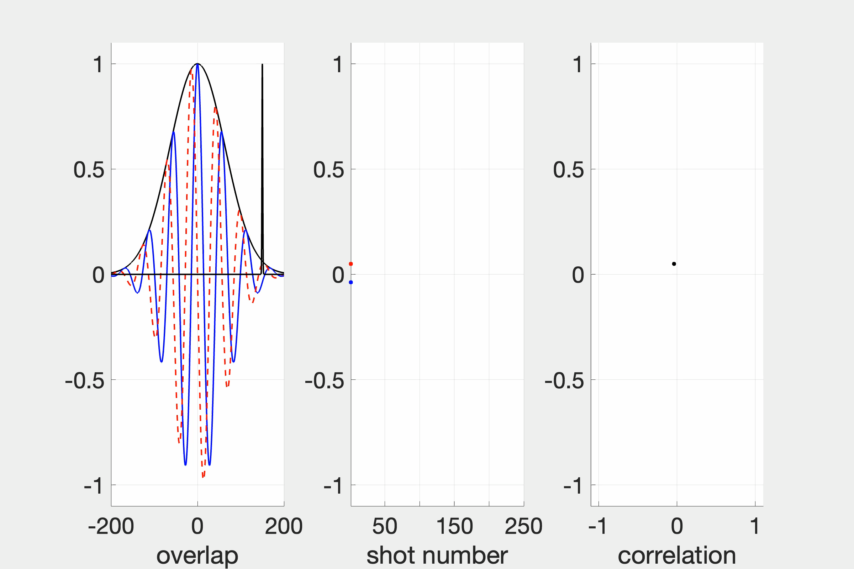
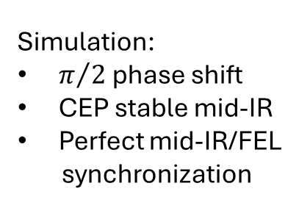
Mid-IR streaking setup
$π/2$ Gouy phase shift
Approach:
Self-referencing to mitigate timing jitter
Rayleigh length
Rayleigh length
TOF #1
TOF #2
Mid IR
e⁻
e⁻
FEL
focal plane
Streak Field Energy Shift Correlation
Simulation:
$π/2$ phase shift
CEP stable mid-IR
Perfect mid-IR/FEL
synchronization
Streak field
@ TOF #1
Streak field
@ TOF #2
Field Strength
ΔKE TOF #1 Δ KE TOF #2
Δ KE TOF #2
Delay Delay/Shot No. ΔKE TOF #1

Slide 9
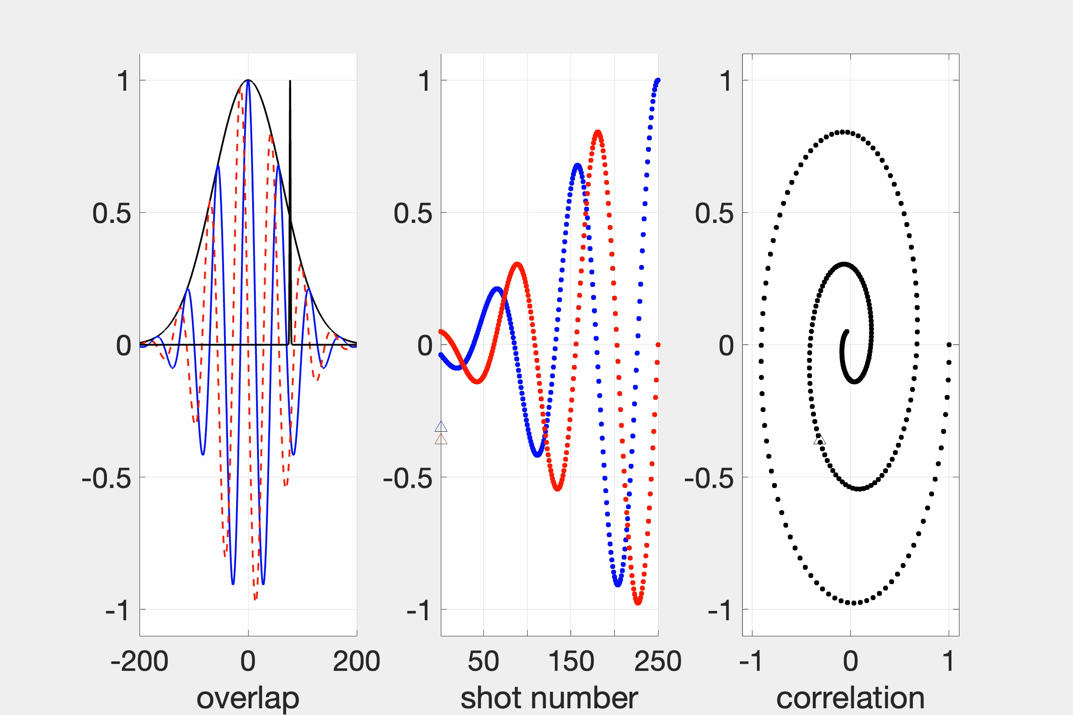
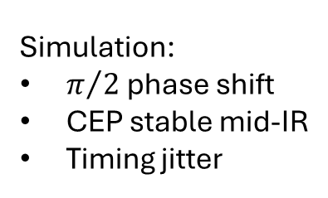
Mid-IR streaking setup
$π/2$ Gouy phase shift
Approach:
Self-referencing to mitigate timing jitter
Rayleigh length
Rayleigh length
TOF #1
TOF #2
Mid IR
e⁻
e⁻
FEL
focal plane
Streak Field Energy Shift Correlation
Simulation:
$π/2$ phase shift
CEP stable mid-IR
Timing jitter
Streak field
@ TOF #1
Streak field
@ TOF #2
t
Field Strength
ΔKE TOF #1 Δ KE TOF #2
Δ KE TOF #2
t
Delay Delay/Shot No. ΔKE TOF #1

Slide 10
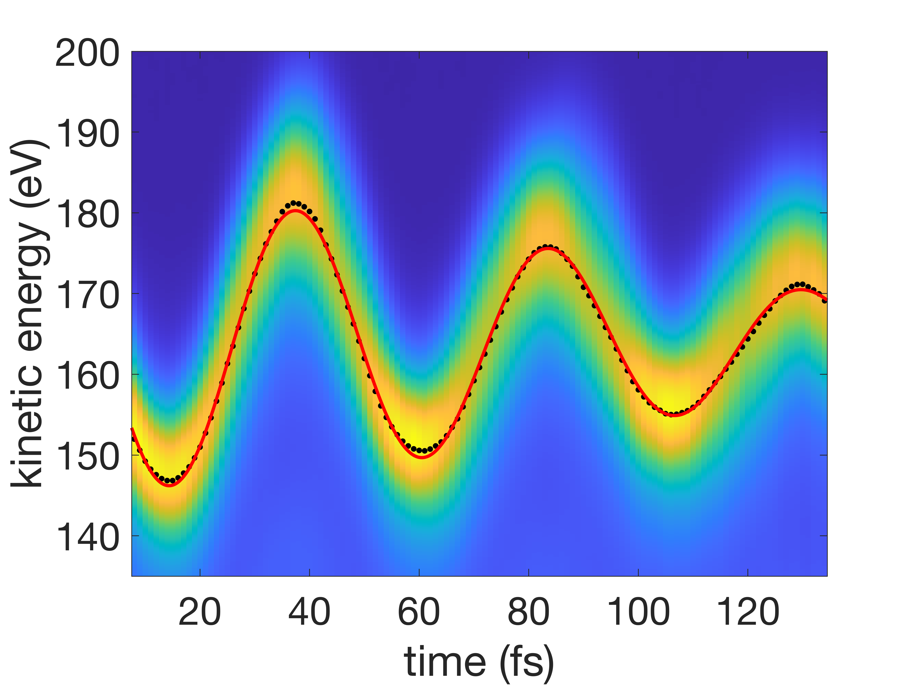
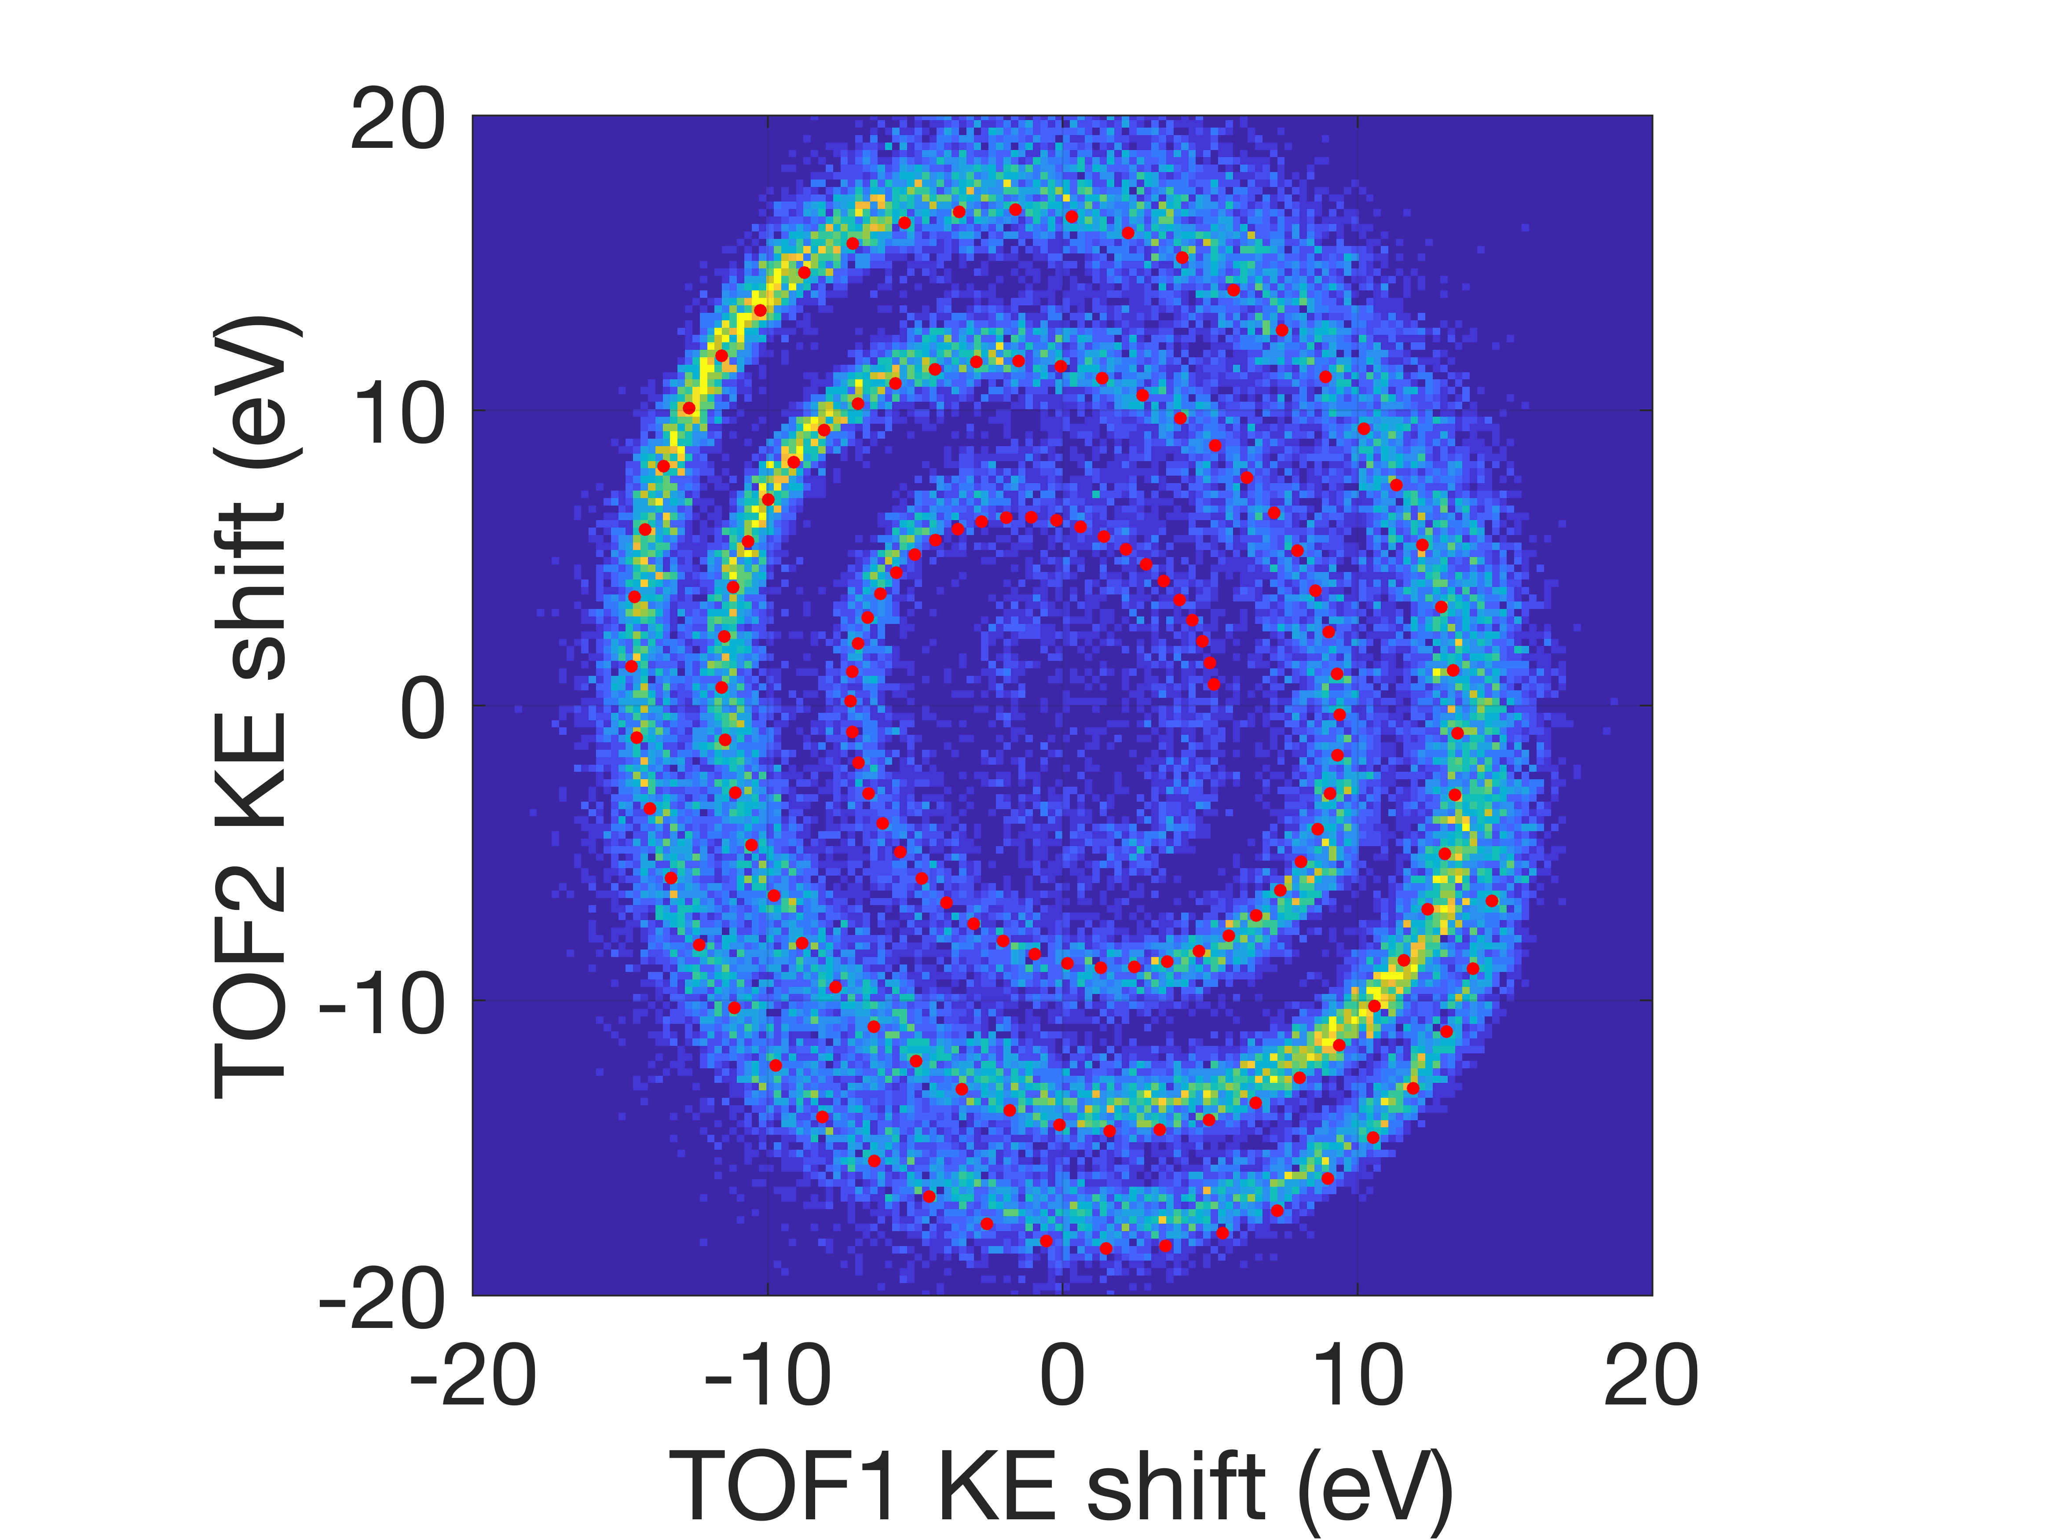
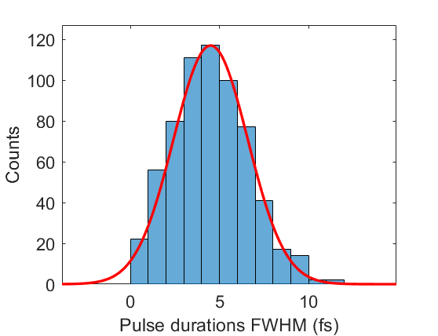
Mid-IR streaking setup
Retrieved Ne1s spectrogram
Tests @ Maloja (07/2024)
Athos low bunch current mode (20pC)
Passive CEP stable mid-IR (twinTOPA)
Mean 4.5 fs
Single-shot pulse
durations evaluated near
mid-IR zero-crossings
Ne1s-Ne1s correlation
(~70.000 shots)
Notes:
Composed of ca. 70.000 single shots

Slide 11
Summary & Outlook
Beamline:
Layout/design finalized; start of installation 2025
KB mirror system in production
Horizontal offset mirror in production
First focused beam in Diavolezza hutch expected in Q2/Q3 2026
Endstation:
Specification of laser infrastructure finalized
Hutch experimental layout finalized
THz and mid-IR setups successfully tested
To do:
Installation of basic media distribution in Diavolezza hutch
Design and construction of laser enclosure (Q2-Q4 2025)
Design and tests of chamber supports (Q4 2025)
Procurement and test of DAQ (10 GS/s digitizers), Laser components etc.
New eTOF design with higher resolving power & retardation (Q1 2026)

Slide 12
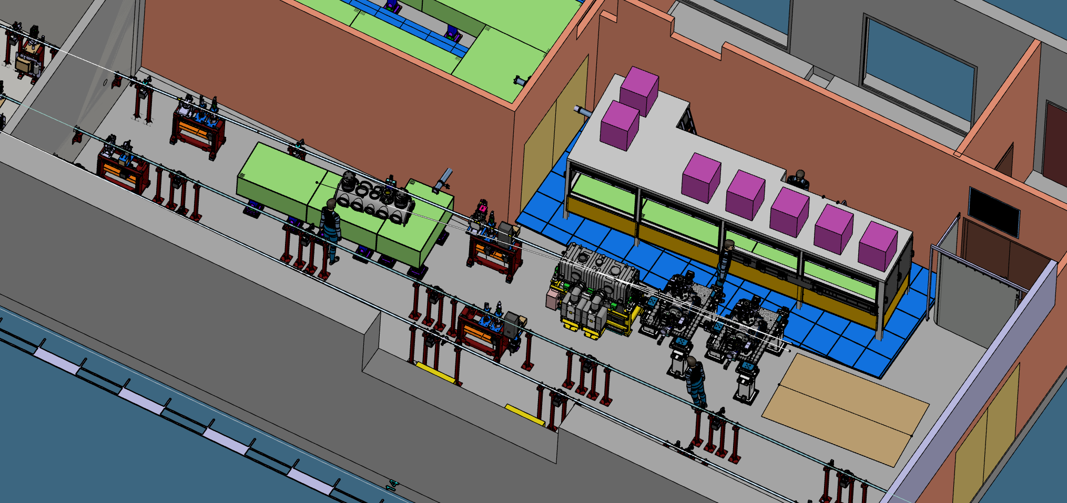
Thank you for your attention!
Pump laser conversion
/distribution
HH generation
KB mirror
THz setup
Space for roll-up experiments
(open port)
MIR setup

