Slide 1
Experiment laser systems: status & outlook
SwissFEL Performance Workshop
S. Johnson
Windisch, 21 January 2025

Slide 2

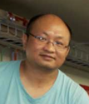
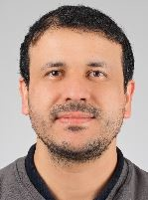
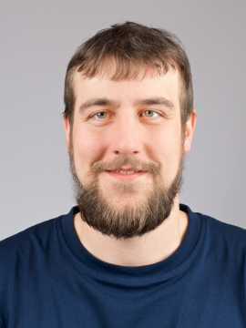
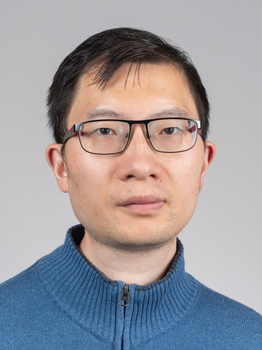
Experiment laser group: Who we are
Steven Johnson
Group leader
Yunpei Deng
LHX / Diavolezza
Philip Johnson
Alvra interface
Serhane Zerdane
Bernina interface
Rafael Perrass
Technician (< 25%)
Xinhua Xie
Maloja interface
Biaolong Liu
Furka interface
Peng Han
postdoc

Slide 3
Experiment laser status / plans
Development work:
  ATHOS oscillator swapped with spare, timing more stable
  Continuous delay sampling implemented at Alvra
  Single-shot CEP monitor for mid IR @ Bernina
  Worked with Maloja team to improve timing tool (19 fs resolution)
  Commissioned DUV pump sources for Maloja
  For 2025:
    Commission phase-stable mid-IR/THz pump
    VUV source development for Maloja
    Timing tool improvements, Circular THz @ Furka
    Investigate options for better beam sharing at ATHOS
Issues :
  Former ATHOS oscillator not possible to synchronize any longer, sent for repair (spare used to replace)

Slide 4
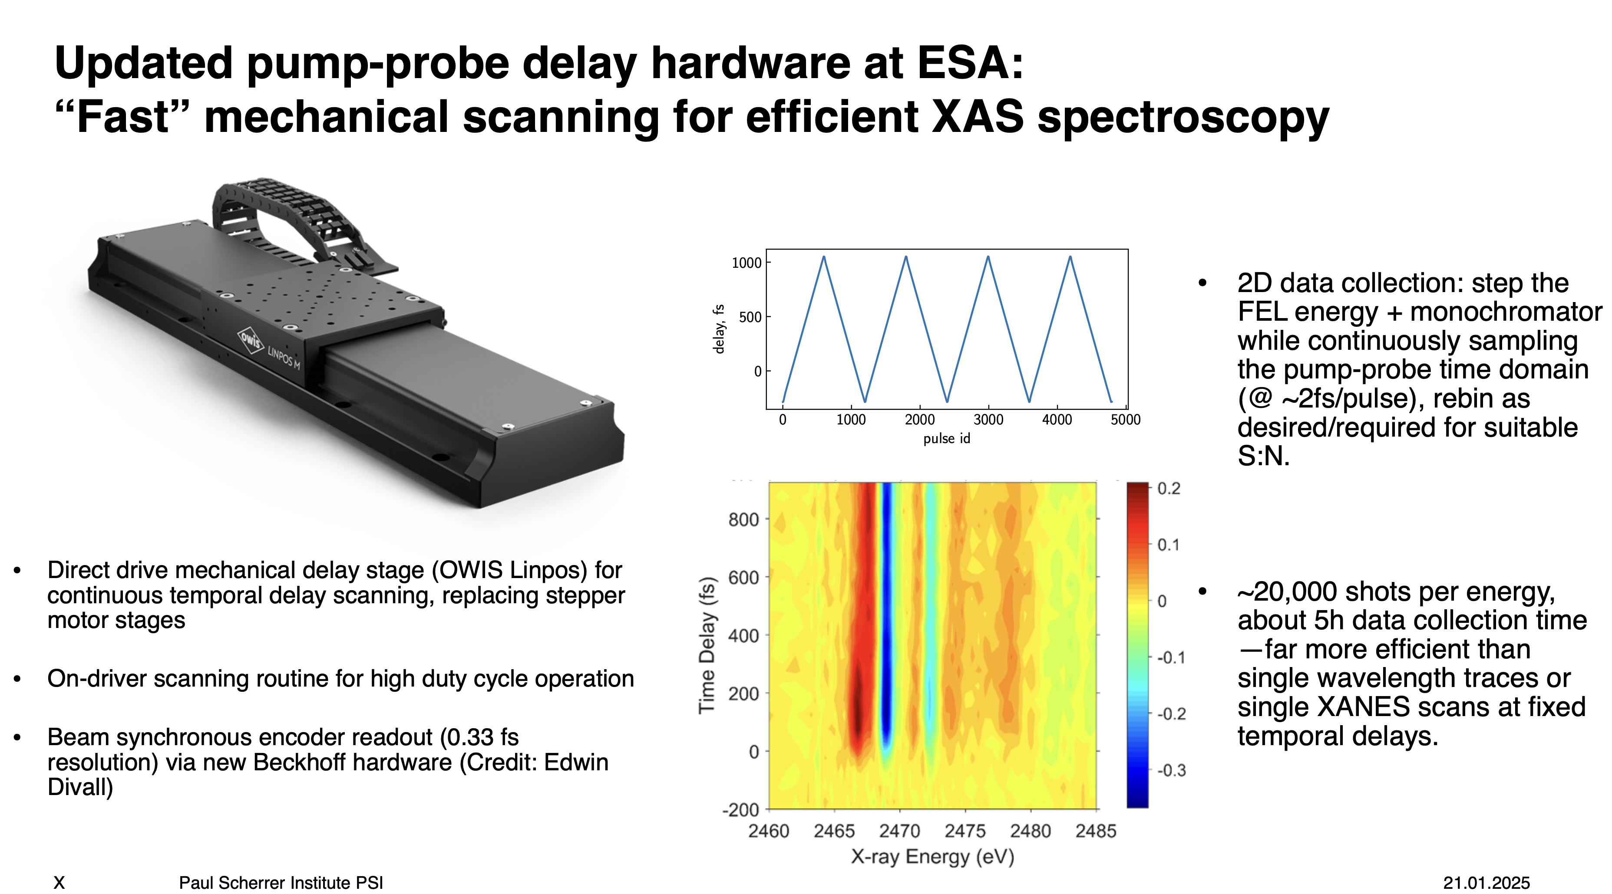

Slide 5
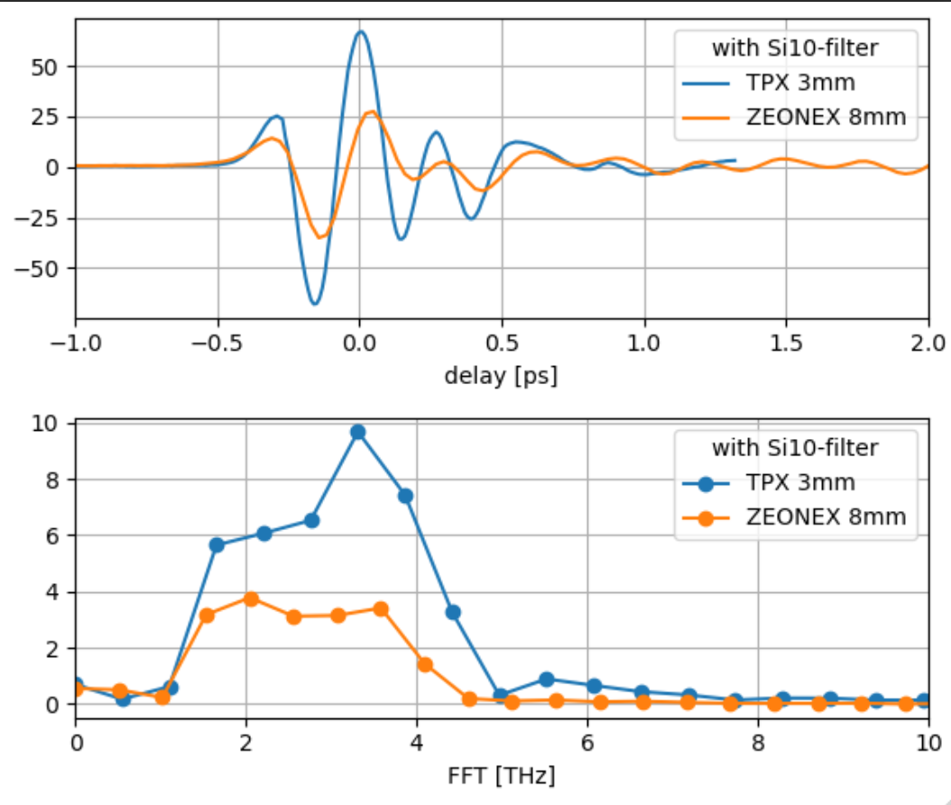
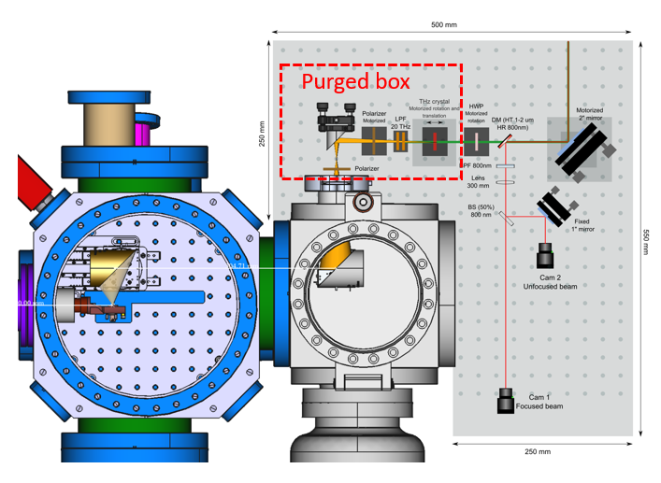
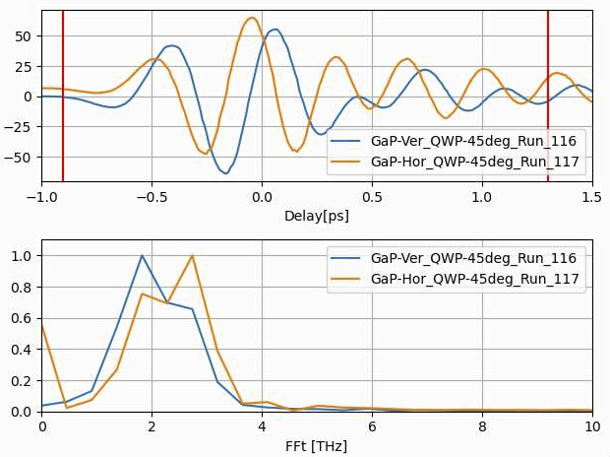
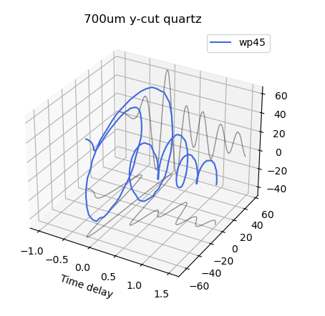
THz generation setup upgrade: High field, circular polarization
(S. Zerhane + Bernina group)
Controllable THz polarization and transmission.
Field strength estimation
  ZEONEX 8 mm: ~ 1.1 MV/cm
  TPX 3 mm: ~ 2.3 MV/cm
Circular polarized THz via Quartz waveplates

Slide 6
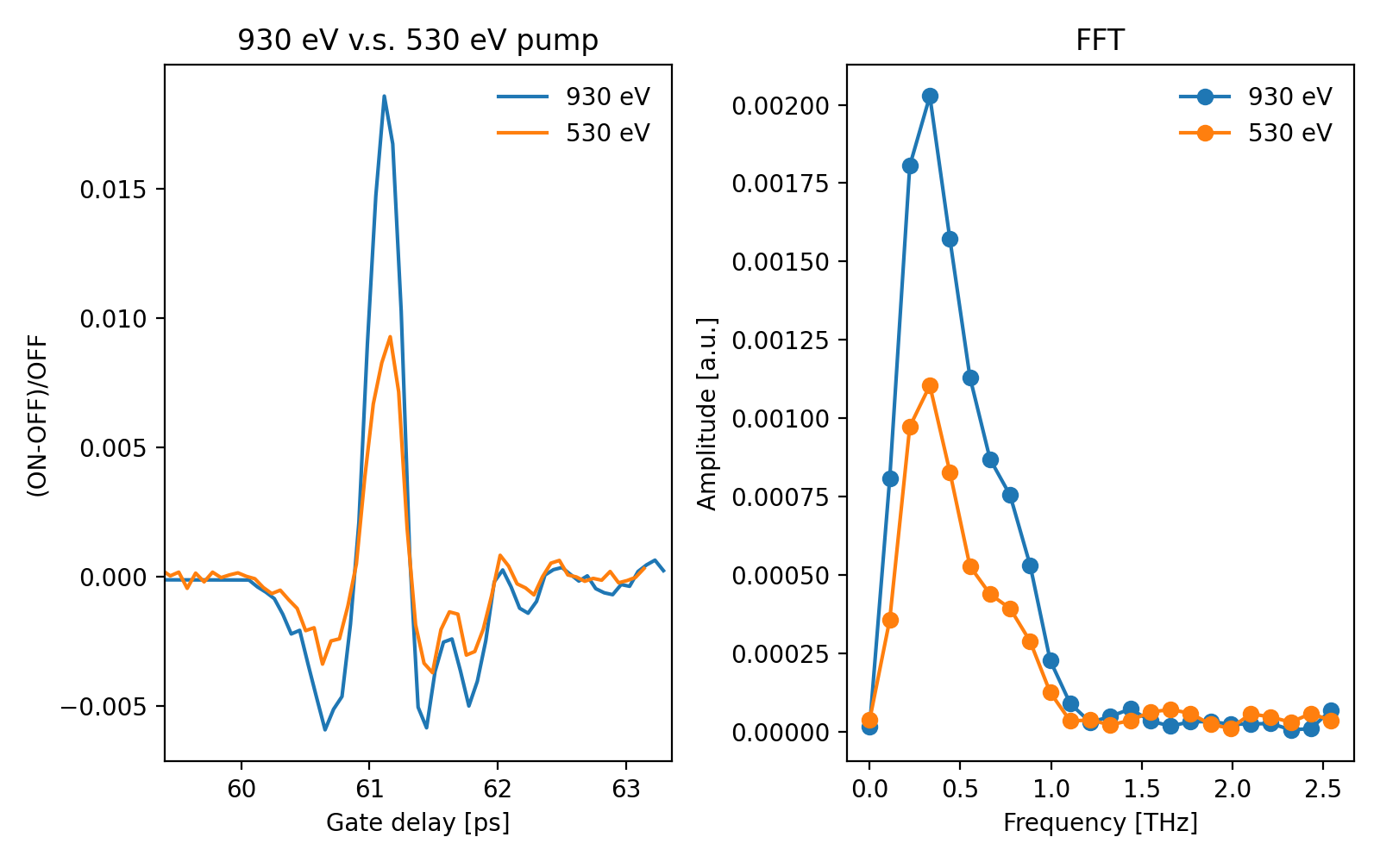
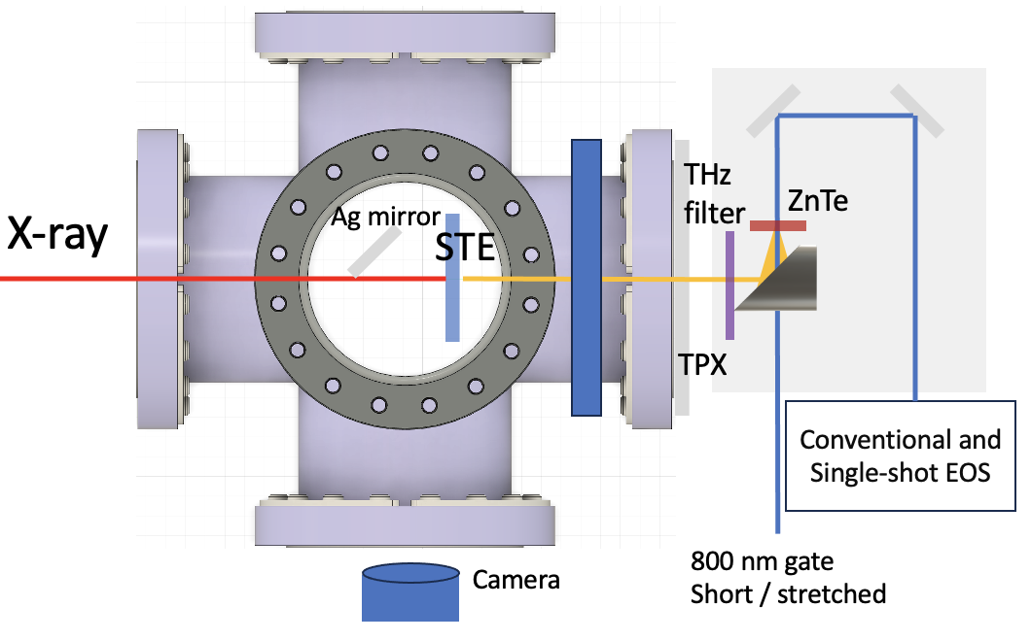
Furka spintronic timing tool
(B. Liu + Furka group)
Possible route to more efficient timing tool for soft x-rays
Idea: use x-rays to create spin-polarized current in a magnet + spin-charge conversion to make THz pulse, measure timing of THz pulse relative to laser
Initial tests at 530 eV and 930 eV

