Slide 1
SwissFEL
Photon Science Roadmap towards Porthos
Christoph Bostedt
SwissFEL Performance WS, January 2025

Slide 2
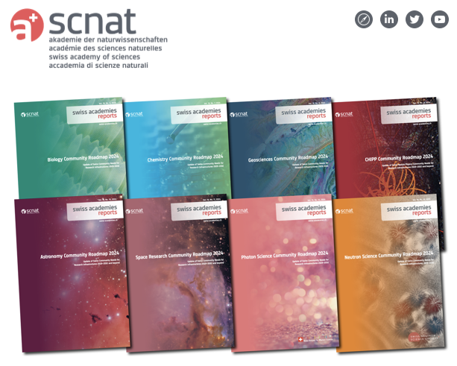
Community Roadmaps Published in December!
https://scnat.ch/de/for_a_solid_science/networks_and_infrastructures/research_infrastructures

Slide 3
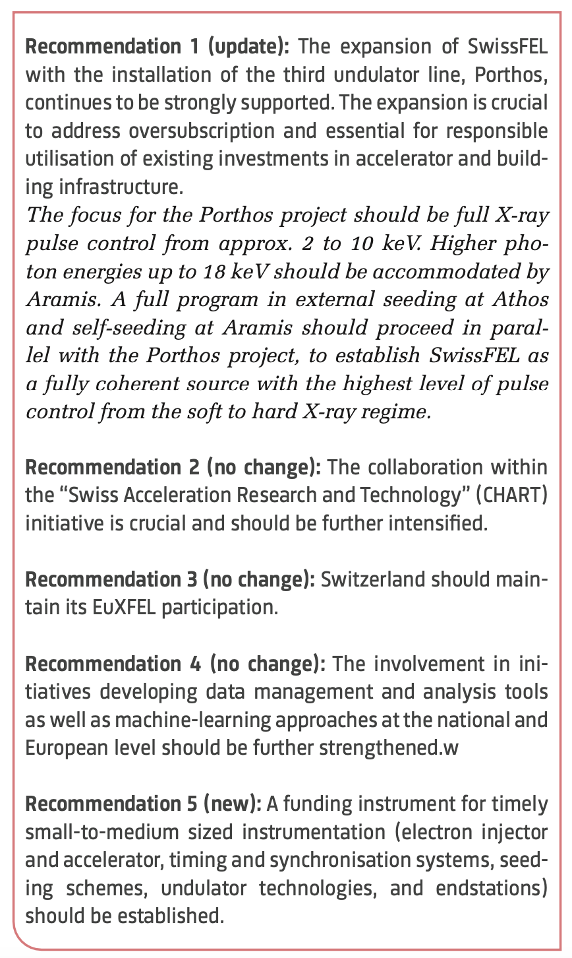

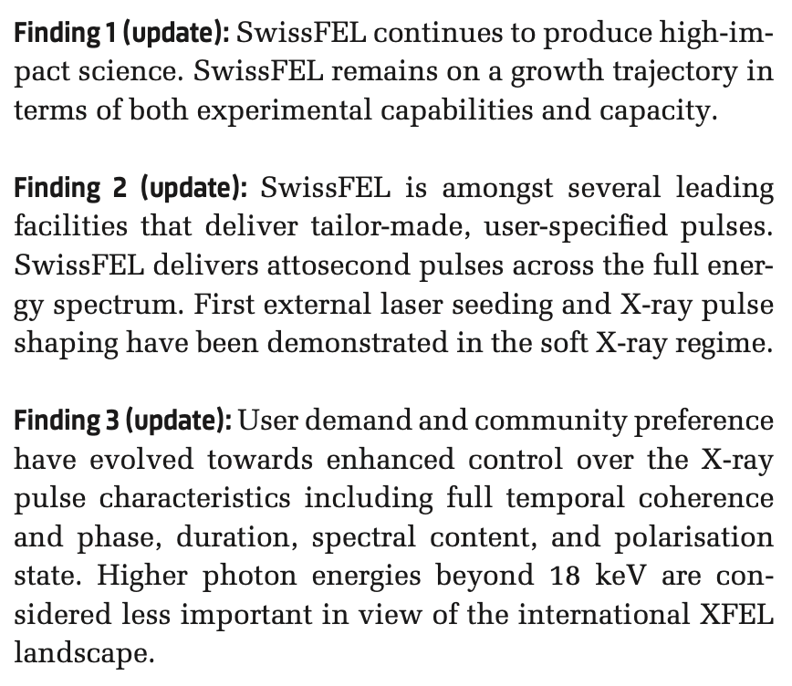
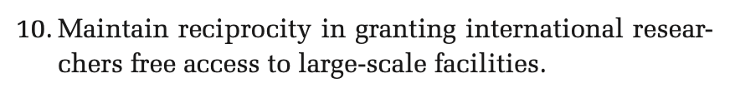
Community Roadmap: Main Findings and Recommendations
SwissFEL specific
General (international)

Slide 4
Community Science Case Examples (Roadmap)
Ultrafast chiral dynamics in photoexcited biological and chemical processes, including enantioselective catalysis as well as controlling spin and light polarization.
Coherent and incoherent vibrational excitations in nonequilibrium materials in particular Iridates, Ruthenates, Lanthanides, and Actinides
Coherent control and readout of prepared states in gases and solids
Charge- and energy-transfer mechanisms between specific sites in molecules and materials on electronic time and atomic length scales.
Gas-particle reactions at the surface of aerosols in atmospheric chemistry
Ultrafast laser-matter interaction for advanced manufacturing
Enahncements to structural biology program through higher photon energy and lower beam damage with (sub-) femtosecond pulses
Novel X-ray spectroscopy approaches, from non-linear X-ray spectroscopy to time-domain interferometry
Yves Bellouard (EPFL), Christoph Bostedt (PSI and EPFL), Hans Braun (PSI), Adrian Cavalieri (PSI and Uni Bern), Alessandro Colombo (ETHZ), Sascha Feldmann (EPFL), Lukas Gallmann (ETHZ), Simon Gerber (PSI), Steve Johnson (PSI and ETHZ), Claude Monney (Uni Fribourg), Malte Oppermann (Uni Basel), Daniela Rupp (ETHZ), Thomas Schietinger (PSI), Ruth Signorell (ETHZ), Jörg Standfuss (PSI and Uni Zürich), Michel Steinmetz (PSI and Uni Basel), Hans Jakob Wörner (ETHZ).

Slide 5
What is next?

Slide 6
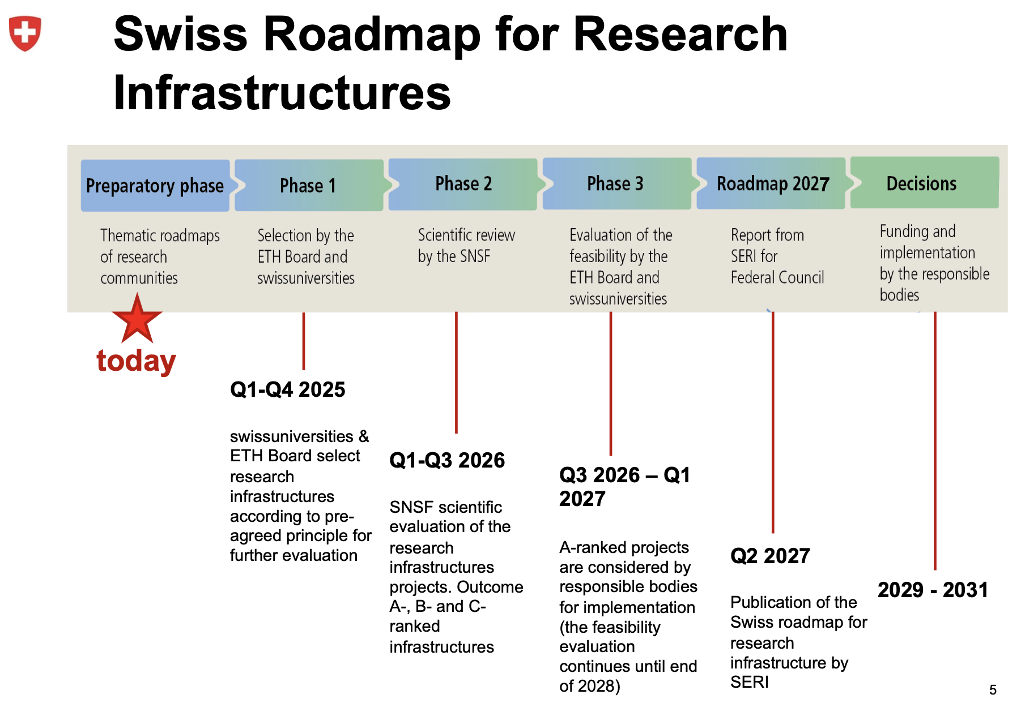
The Process Towards New Research Infrastructure

Slide 7
Boundary Conditions of BFI and Porthos Options: Staged or Not?
BFI*
2021–2024
BFI 2025–2028 BFI 2029–2032
BFI 2033–2036
Porthos I ???
Porthos II
SLS-2.0
beamlines
OR
SwissFEL endstations
IMPACT**
Porthos
2024 | 2025 | 2026 | 2027 | 2028 | 2029 | 2030 | 2031 | 2032 | 2033 | 2034 | 2035
2036


CDR
TDR
Porthos activities
Project realization?
Preparatory studies
Preproject?
(Injector, undulators,...)
Staged approach preferred by CAS & CPS to ensure continuity in SwissFEL development
* BFI = Swiss Government funding periods (four years)
** IMPACT = Upgrade of the PSI proton facility

Slide 8
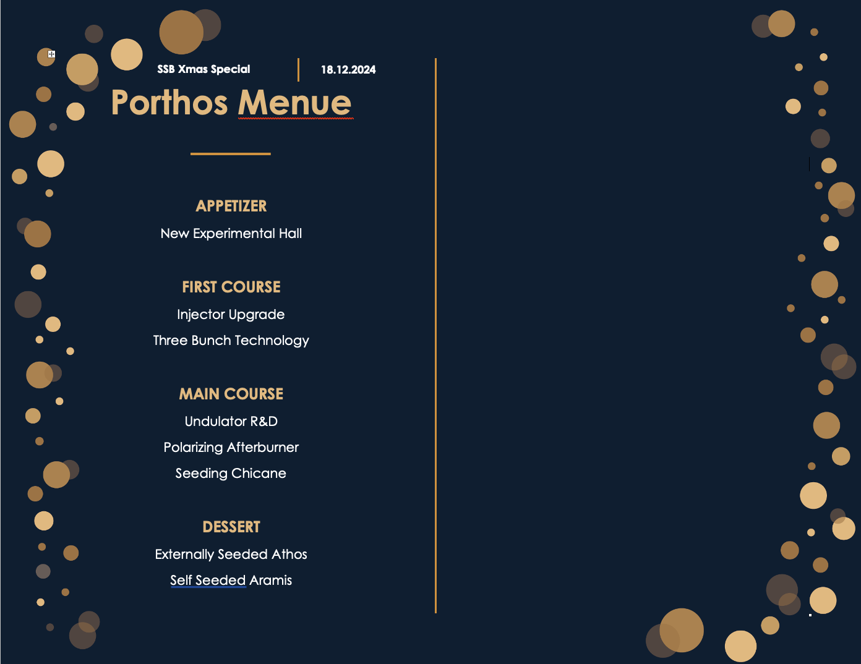
SSB Order
White Paper
for PSI-Rirector
Undulator R&D including afterburner
Injector RD for 3-bunch technology
Injector upgrade for lower energy spread beam, benefit to seeding
Self seeding R&D towards demonstration on Aramis
Design study for building for groundbreaking in 2033
Potentially energy upgrade for Aramis

