Slide 1
DAQ Updates
Sven Augustin
SwissFEL Performance Workshop, 21 January 2025

Slide 2
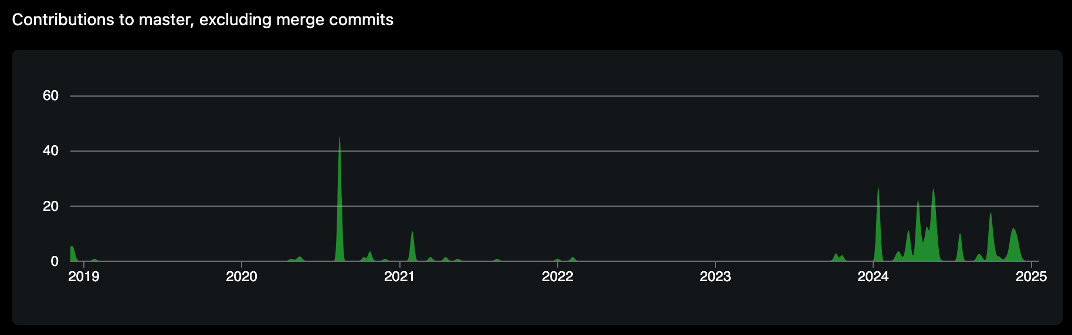
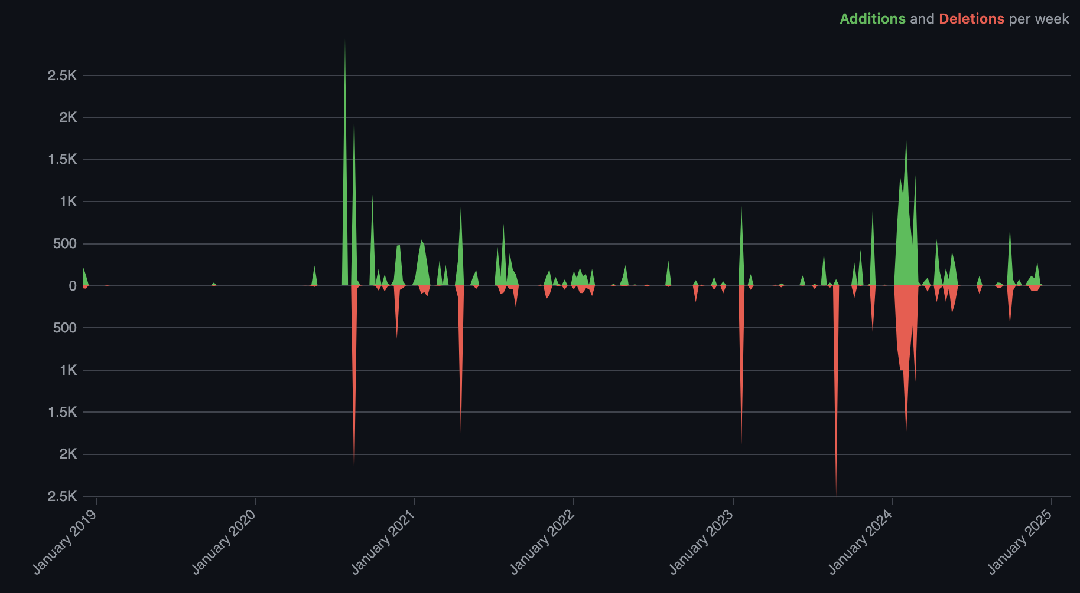
sf-daq-broker
REST-API as entry point to the server-side software
Complete rewrite while (mostly) keeping API/logic
API clean-up (mainly fixed confusing names)
Added useful error/log messages for everything
pep8, pylint, etc.
Use SSD for temporary raw files
  No more accumulating delays (even for JF 16M)
Improved detector interface
  May run several firmware versions in parallel
Added readout for detector temperatures, chiller water flow, problematic modules, etc

Slide 3
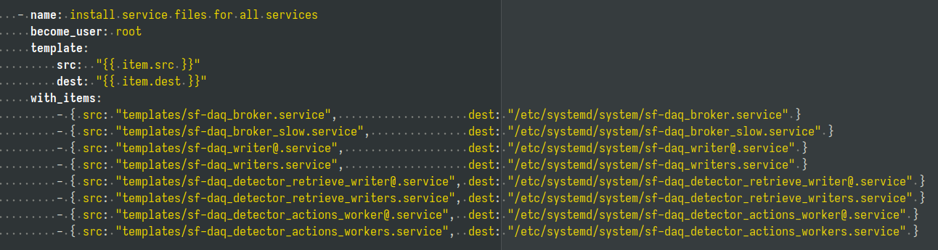
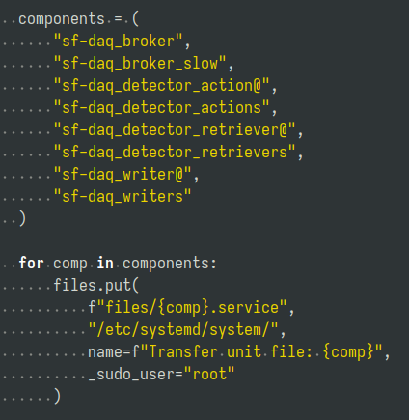
sf-daq deployment
Deploy sf-daq (broker, detector buffer, epics buffer, DAP, streamvis, etc.)
Complete rewrite from scratch
Switched from ansible to pyinfra
Full DAQ restart was 55 mins, now 7 mins
Added overview tools to map out what runs where (strongly simplifies adding detectors)
↑ A loop in ansible (yaml is not a programming language!)
A loop in pyinfra →

Slide 4
DAP (Detector Analysis Pipeline)
Online analysis of streamed JF data
Complete rewrite:
  Was one function of 454 lines, now divided into meaningful pieces:
  peak finder, azimuthal integration, thresholding, ROIs, aggregation, etc.
Removed ~10 useless in-memory copies made of the raw images and the image masks
  Memory footprint reduction by ~25%
  Throughput increase? (no performance metrics → cannot quantify improvements ☹️)

Slide 5
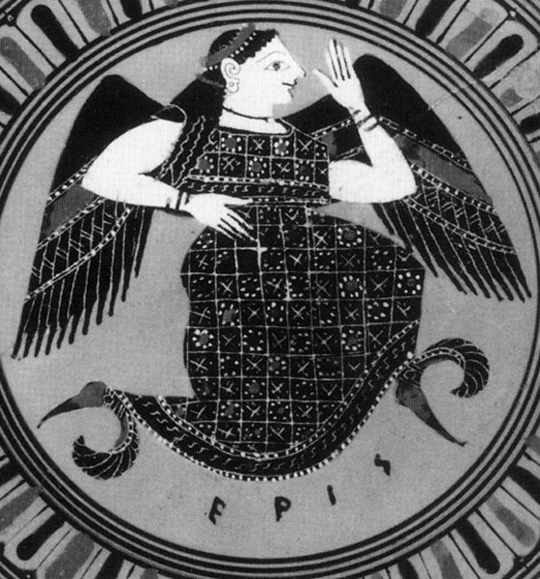
AP (Automatic Processing)
Runs crystfel on JF files on the online cluster (Eris)
Complete rewrite from scratch ongoing (Hi Natalia! 👋)
  General purpose tool, not only for crystfel, for user-friendly automatic submission to cluster
  Use broker messages instead of checking folders for new files
  Give users feedback via messages
  Use jinja templates instead of self-mutilating bash scripts
Worth noting:
Jungfraujoch @ Cristallina-MX is (mostly) up and running
Incl. pipeline (Clara) to the MX database Heidi
Next step: move interface into sf-daq and make it transparent for users

Slide 6


slic on the machine side
“History” in approximately chronological order:
Rolf: Athos photon energy via undulators
Didier: Scale N magnets together
Christoph: Rotate Athos polarization
Sven:
  Live BS acquisition via bstrd (bsread receiver with cache)
  Adaptive orbit feedback
  Dispersion tool
  HERO: coherent emission/space charge blow-up vs. energy modulation
  XTCAV stabilizer
Nicole & Stefan: Preliminary investigations (waiting for Sven’s BS acquisition to be in slic – sorry!)
Philipp: Spectral analysis

Slide 7
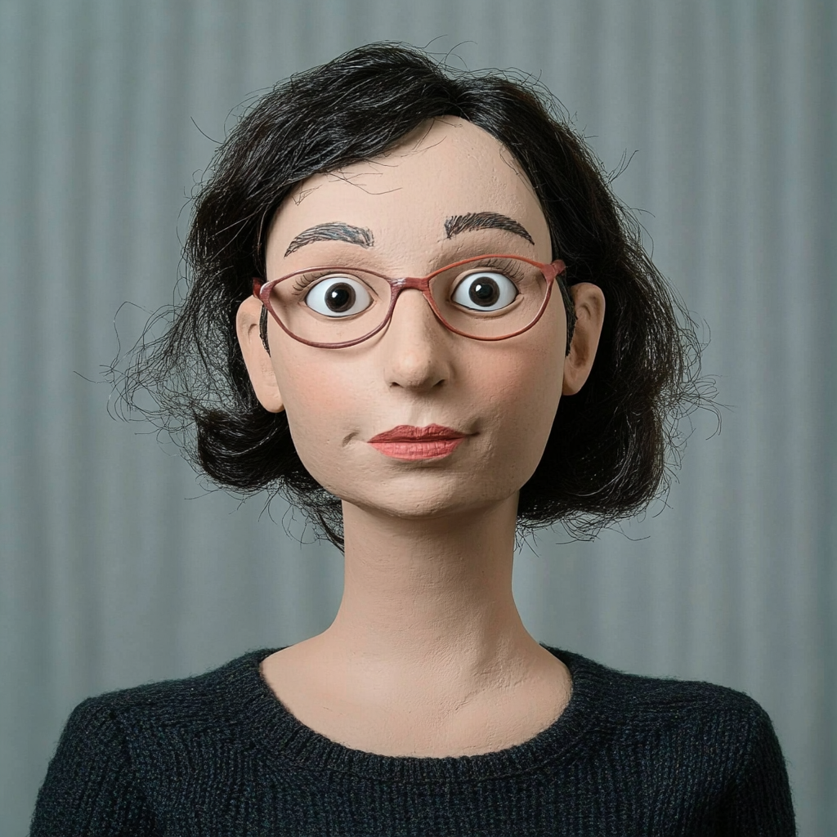
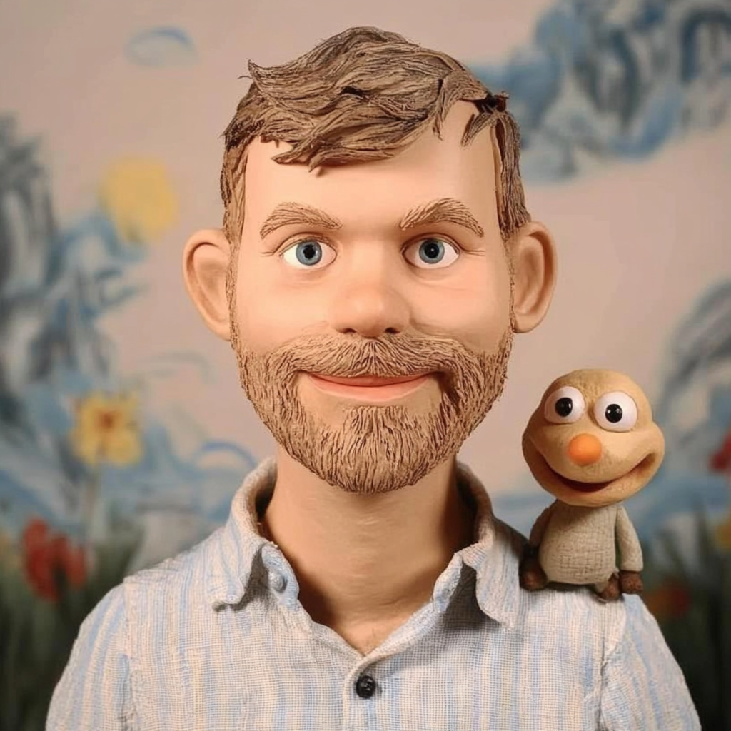
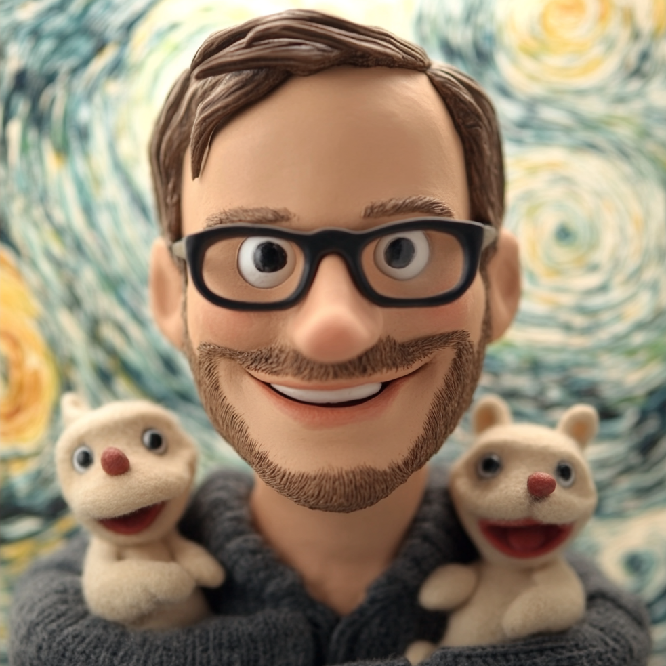
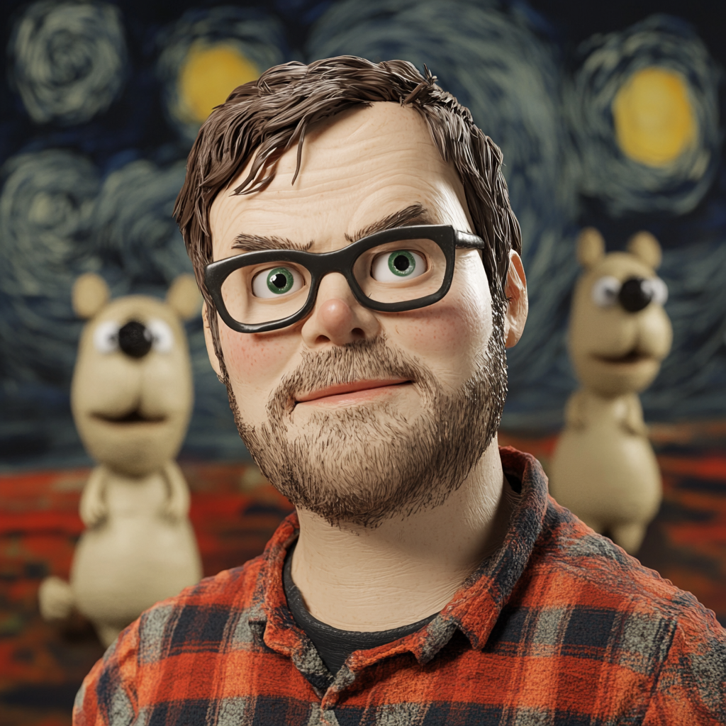
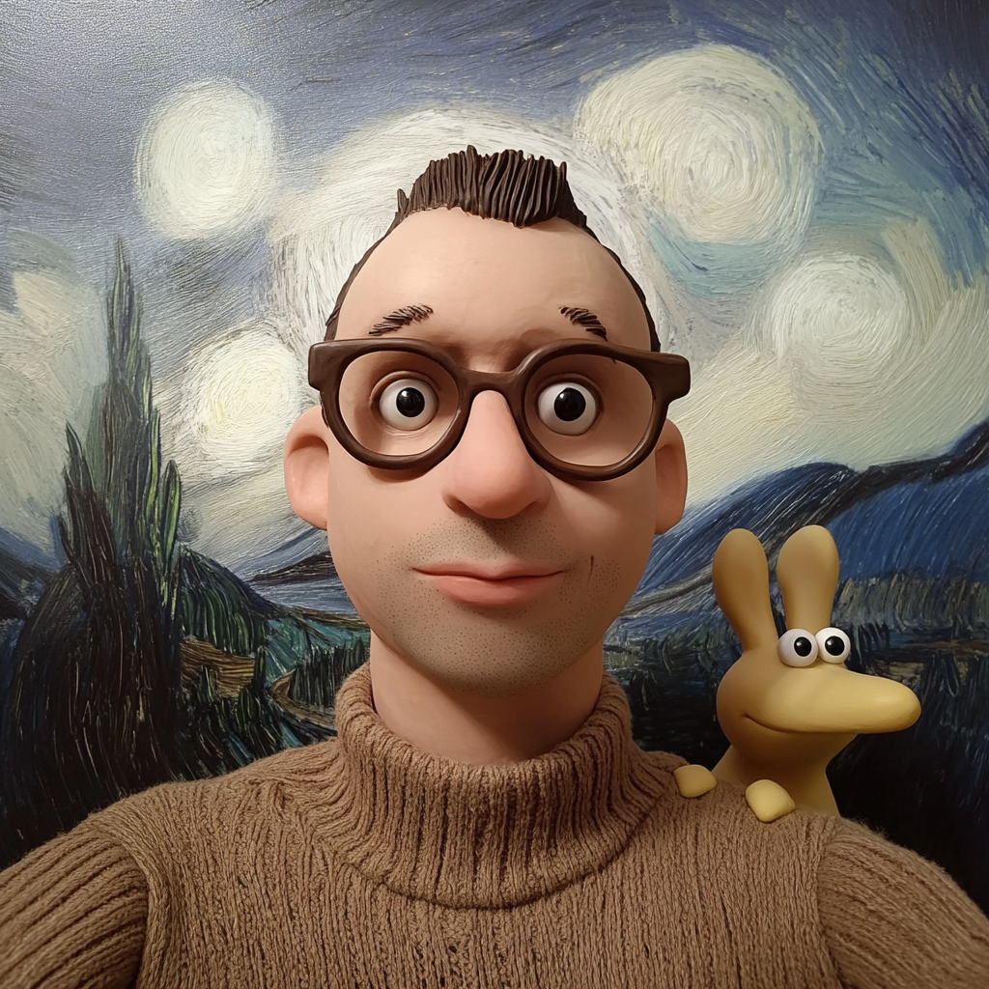
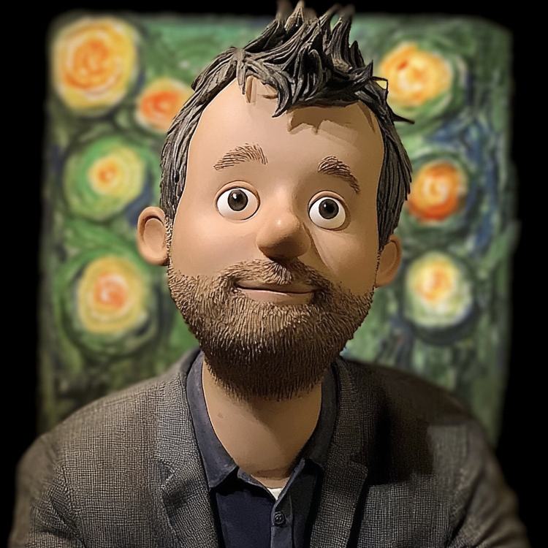
Experiment IT Development and Operations (eido)
SwissFEL
SLS 2.0
Natalia
Woznica
Sven
Augustin
Christian
Appel
David
Perl
Klaus
Wakonig
Jan
Wyzula
portraits generated from PSI photos with midjourney

