Slide 1
pyScan
M. Aiba
Jan. 2016

Slide 2
Yet another scan tool
Based on well established C.A. library
  i.e. CAFE
  All the complicate operations (monitor, set and match, etc.) are performed by CAFE
  Thus, the scan tool code itself could be compact
Implementation as a python class
  Easy to maintain and extend
  Can be wrapped (cython) to be C/C+ shared object
  Can be extended to be a scan server
Developer = Heavy user (namely myself)
  Good for commissioning

Slide 3
Demand
Generic and flexible scan tool
  Easy integration into high level applications
  Any kind of scan
    Single-knob scan (SKS), multi-knob scan (MKS) and series scan (SS)
    And combination of them
  Pre action, post action, monitor, etc.
Need a decent scan tool now for application development
  The code is ready (found in PSI git together with User’s manual) and briefly tested

Slide 4
Single/Multi knob scan
Schematic flow chart
PreAction
for Knob(s) in ScanValues:
In-loopPreAction
setAndMatch(Knob(s), Readback(s))
for i_meas in NumberOfMeasurements:
Measure observable(s)
sleep(Waiting)
In-loopPostAction
PostAction
Interrupt the measurement
If any problem
Monitoring(Monitor)
Color code:
CAFE method
pyScan user defined
ScanValues can be given in different format
  List of absolute values,
  Start/End values + Number of measurements
  Additive to the present values

Slide 5
Single/Multi knob scan example:
Quad scan
Schematic flow chart
GunOnDelay->Q cycling ->GunOn
for Q:I-SET in ScanValues:
In-loopPreAction = None
setAndMatch(Q:I-SET, Q:I-READ)
for i_meas in (0,5):
Measure beam size
sleep(1 sec)
In-loopPostAction = None
GunOnDelay->Qcycling->Q:I-SET restore->GunOn
Monitoring(BPMvalid)
Pause the measurement if no beam

Slide 6
Series knob scan
Schematic flow chart
PreAction=None
for Knob in Knobs:
for Knob in ScanValues:
In-loopPreAction
setAndMatch(Knob, Readback)
for i_meas in NumberOfMeasurements:
Measure observable(s)
sleep(Waiting)
In-loopPostAction
PostAction
Interrupt the measurement
If any problem
Monitoring(Monitor)

Slide 7
Series knob scan example:
Orbit response
Schematic flow chart
PreAction=None
for Knob in Knobs(Corrector:I-SET):
for Knob in (0,+ΔI):
In-loopPreAction=None
setAndMatch(Knob, Readback)
for i_meas in 5:
Beam position at many BPMs
sleep(1 sec)
In-loopPostAction=None
PostAction=None
Monitoring(BPMvalid)

Slide 8
Combination
SKS over MKS, for example, Multi Quad scans over various Gun solenoid setting
for Knob in ScanValues:
setAndMatch(Knob, Readback)
for Knobs in ScanValues:
setAndMatch(Knobs, Readbacks)
for i_meas in NumberOfMeasurements:
Measure observable(s)
sleep(Waiting)
Pre and post actions are omitted in the above flow-chart but they can be configured also in a combined scan at any level
Almost all kinds of scan can be build by combining SKS, MKS and SS

Slide 9
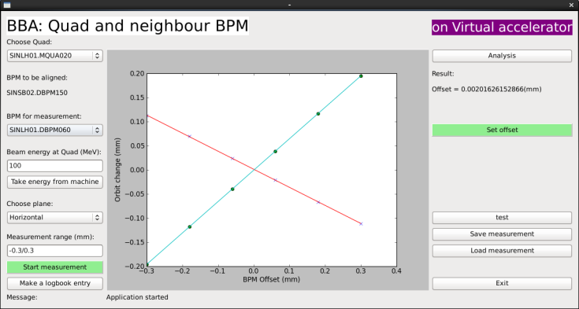
Combination example:
BBA to find Q centre
Knob:
Quad current
Orbit
feedback
Knob:
BPM offset
Observable:
Beam position
Input definition (only important fields are shown)
indict0={}
indict0['Knob']=[self.EC.prefix+BPM+':OFFS-X'] # Knob: BPM offset
indict0['ScanRange']=[-0.3, 0.3]
indict0['Nstep']=6
indict={}
indict['Knob']=[self.EC.prefix+Quad+':I-SET'] # Knob: Quad current
indict['Additive']=1 # Knob is varied with respect to the present value.
indict['ScanValues']=[-dI,0,dI] # dI is computed previously using on-line model
indict['NumberOfMeasurements']=5
# Wait until the orbit feedback (another application) brings the beam to the shifted BPM centre
indict['PreAction']=[[self.EC.prefix+'DUMMY:NUMBER',self.EC.prefix+BPM+':X1',0.0,0.005,60]]
# Monitor if BPMs and Q power supply are OK
indict['Monitor']=[self.EC.prefix+BPM+':X1-VALID',self.EC.prefix+BPMobs+':X1-VALID']
indict['Monitor'].append(self.EC.prefix+Quad+':ONOFF')
self.Measurement.indict=[indict0,indict]

Slide 10
Non Epics action
Pre/post-actions can be defined by a user defined function (so far, only in python application)
Example: close and open a feedback loop by talking to the feedback server during the scan

