Slide 1
RC Report Week 06/2024
Tobias Weilbach
SEM 12.02.2024

Slide 2
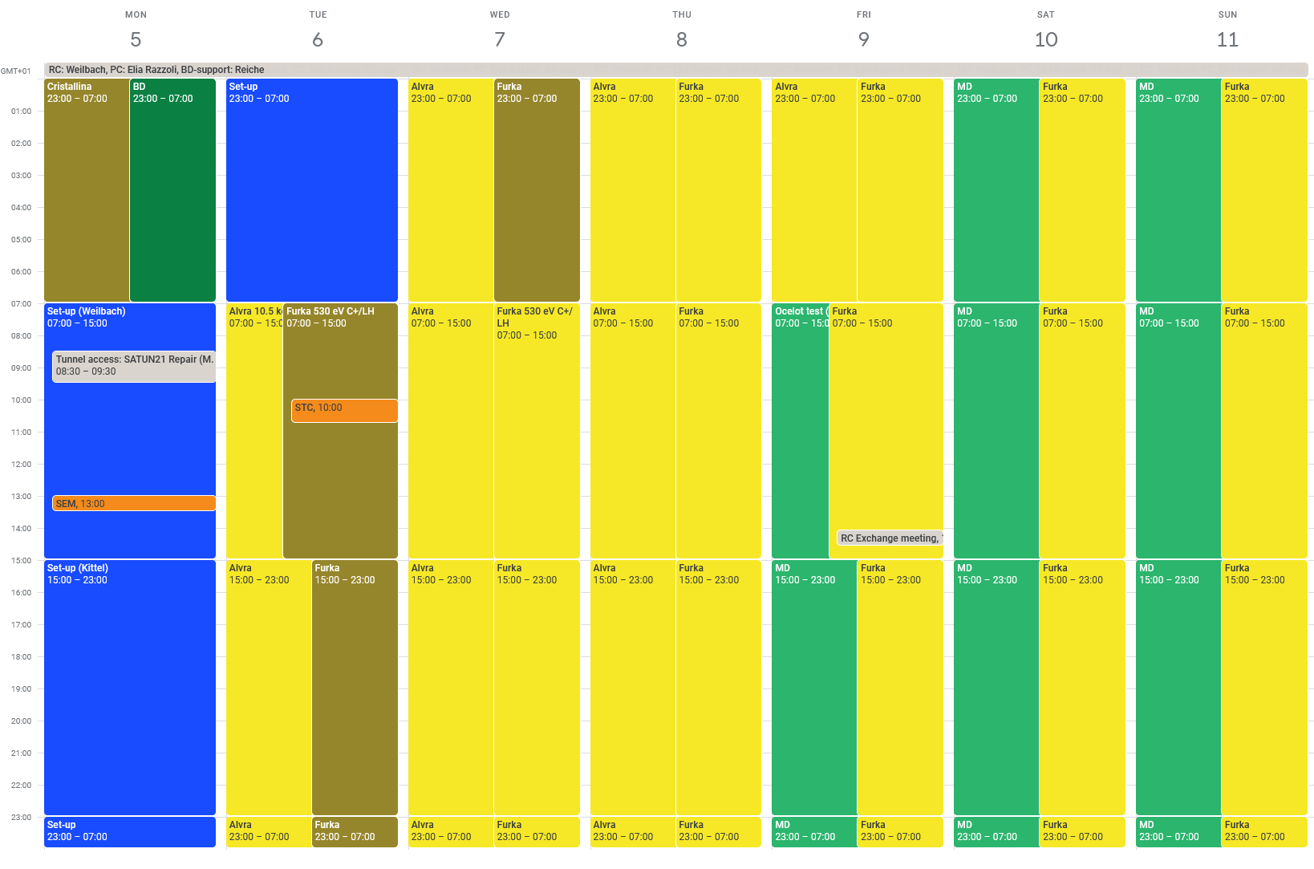
RC Report week 06/2024 05.02.-12.02.2024

Slide 3
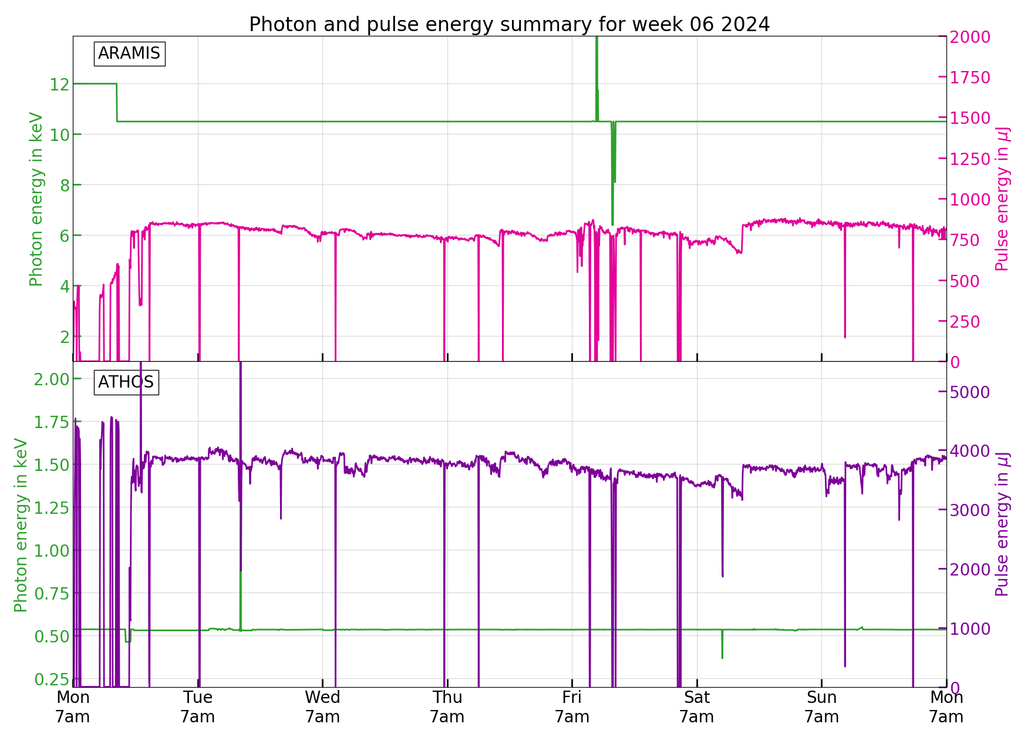
The week

Slide 4
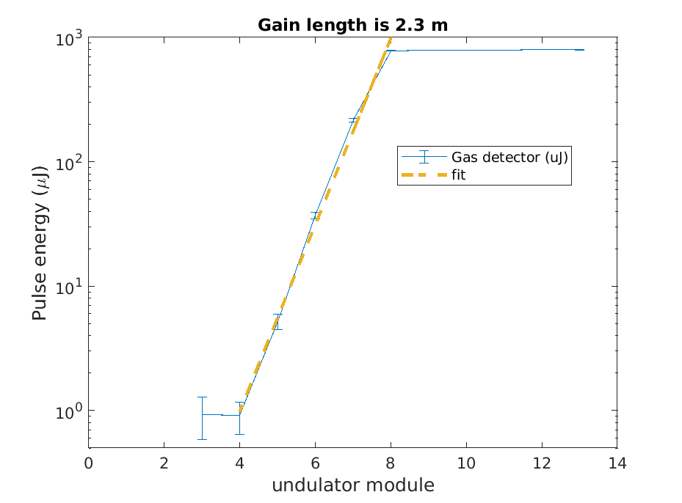
Issues last week
  Set-up (AR: 10.5 keV, AT: 530 eV C+ and LH)
  Tunnel access needed to fix SATUN21 upper motors control unit
  PSYS problem while exiting tunnel set tunnel to free, tunnel search needed
  S30CB10 modulator problem after tunnel access
  A timing jump in the LLRF master board of the gun
  Could not prepare 530 eV LH for Furka
  User Operation:
  Arrival time FBs drive the machine to a worse performance, probably some kind of jump in the BAM, switched off FBs, under investigation
  Gain curve measurements in Aramis showed first 5 undulators not contributing -> BBA needed
  T&S problems at Furka, an optical link lost its lock after a power supply failure

Slide 5
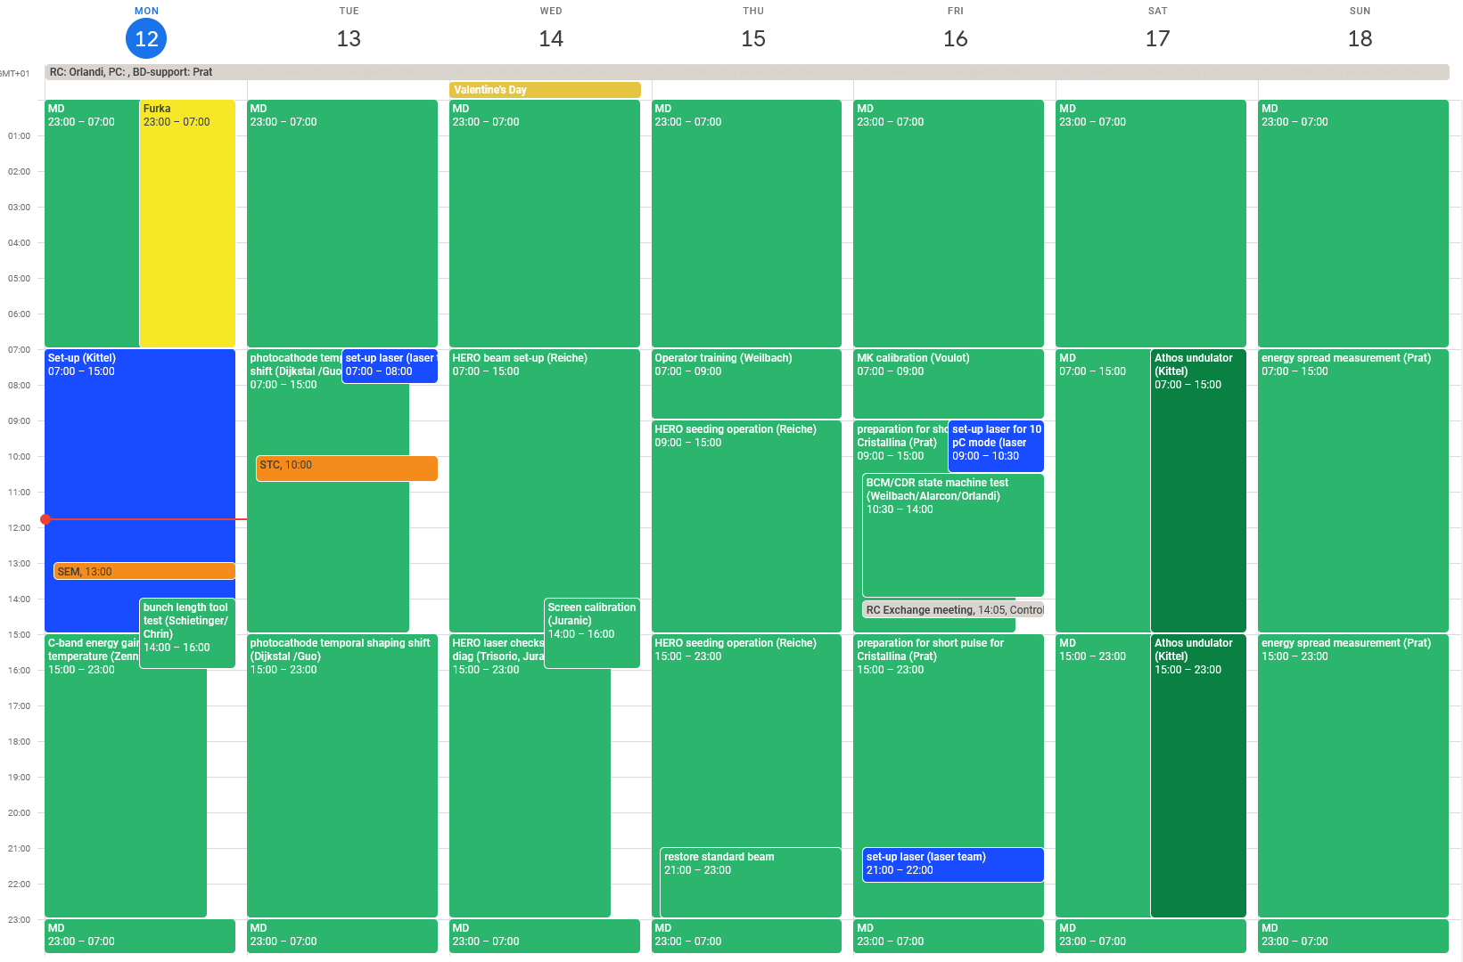
Preview week 07 12.-19.02.2024: MD week (RC Orlandi)

