Slide 1
Requests for week of 19.2.2024-26.2.2024
Requests at week’s begin:
Aramis:
  Cristallina: 12 keV, 25-45 Fs FWHM pulses, >500 uJ, standard bandwidth, stable beam until 24.2.2024 morning.
  Bernina: 6.7 keV, +/- 500 eV scans with undulators, small bandwidth, as much pulse energy as possible from 24.2.2024 to 26.2.2024.
Athos:
  Maloja: 600 eV linear horizontal, standard pulse length with option to shorten to 1/10th, pulse energy not critical.
  RC: Pavle Juranic, PC: John Beale

Slide 2
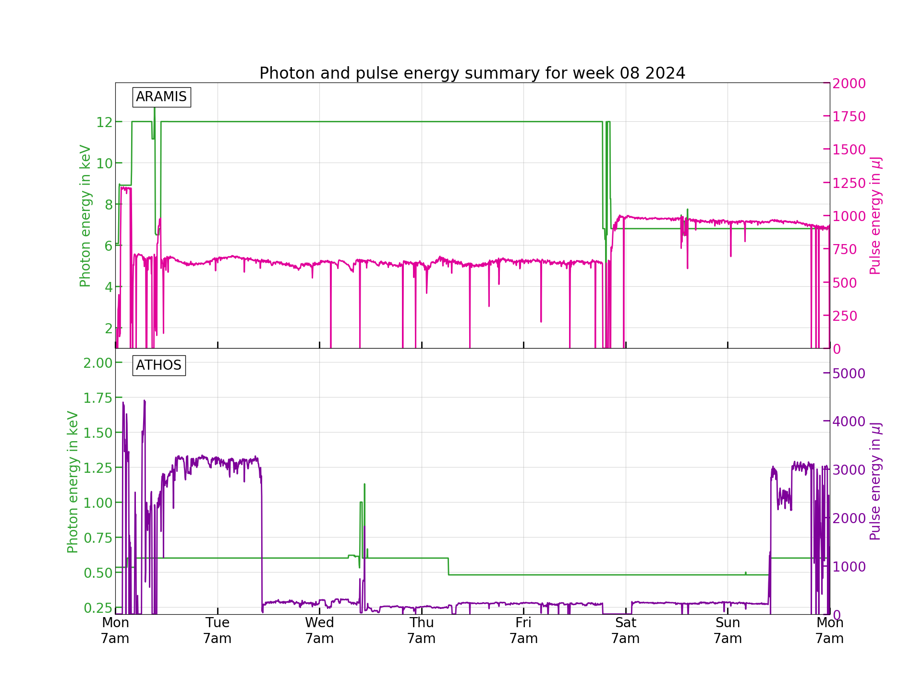
Performance
FEL performance was mostly stable. Maloja spent most of the week in the short pulse mode which is why the pulse energy is so low in Athos. There were a few interruptions issues over the week which weren’t show stoppers, and a few larger problems that happened on the weekend, which caused downtime in Athos for a few hours during the night. Setups on the weekend were tough, and it is obvious that some parameters of the machine degraded over the week.

Slide 3
Down time
A few RF interruptions, each one lasting only a minute or so.
Integrated charge interlock on 23.2.2024 caused a short downtime, but it was quickly reset. The WCM was fluctuating quite a bit.
Mizar issue on the morning of 24.2.2024 caused downtime for Athos for several hours, Pikett called to correct it.
Aramis reference snapshots weren’t restorable on 24.2.2024, caused 4 hours lost for the setup.
Athos reference snapshots couldn’t get the beam to long bunch length on 25.2.2024 nicely, required about two hours to get set up nicely. Laser arrival time had to be corrected by 1.6 ps.

Slide 4
Degraded performance
Repeated SATUN022 motors getting stuck. It often required the Maloja team to physically restart the motor controller to get moving again.
We had some lasing decrease in Aramis over time, cause of which is unknown, but we could recover by optimizing various parameters. Maybe fixable by arrival time feedback.
Temporarily unstable beam in Athos on 25.2.2024 in the morning, seems to have fixed itself within 10 minutes several. Occurred several times. Cause not clear.
DRPS losses in Athos caused us to use 25 or 50 Hz operation, likely due to the use of the XTCAV for Maloja.
The BC1 compensation seemed to be at its limit, but lasing was still mostly OK.
RF issues with S10CB07, going to filament, reacting strangely.
CDR had a strange reaction to a RF interlock.

Slide 5
Special notes
50 Hz jitter correction was set up for Cristallina’s measurements, and it seems to have helped.
It needs some more work on interalocks to prevent MPS alarms due to the fluctuating values with the correctors.

Slide 6
Plan for next week
Monday maintenance.
Aramis:
  Bernina: Energy stays at 6.7 keV, small bandwidth, lots of pulse energy.
Athos:
  Furka: 930 eV and 530 eV, C+ polarization.

Slide 7
Special thanks to
Laser Pikett (Carlo Vicario) for fixing the Mizar on Saturday morning.
Eduard Prat for helping set up Athos on Sunday afternoon when the restore didn’t work right.
All the piketts that helped get and kept the machine working.
Maloja end-station staff for restarting the SATUN022 movers.

