Slide 1



ICAT Metadata Catalogue
SciCatCon Meeting 2024
Louise Davies
Notes:
The abstract pattern can be removed or repositioned if required. Be careful to ‘Send to Back’ so that it does not obscure any important information.

Slide 2
About me
Worked at STFC for ~8 years
Worked on ICAT related software for 6 years
Lead frontend engineer in our group
Developed STFC’s ICAT frontend
Notes:
User can select (investigations, datasets or datafiles)
Not every facility offers multiple download types like this – this is showing Diamond use case
Note we also support single level storage so download would occur immediately after submitting

Slide 3


Agenda
1 ICAT overview
2 ICAT data model
3 Handling scientific metadata
4 Data Retrieval
Image © STFC Alan Ford
Notes:
To replace photo with one of your own. 1) Send the geometric shape overlay to the back – Right-Click > Send to Back > Send to Back. 2) Replace image – use the guides provided to correctly position it. 3) Send your image to the back so that the geometric overlay re-appears over the image. Remember to delete the image credit if using your own image.

Slide 4


ICAT Overview
Notes:
The abstract pattern can be removed or repositioned if required. Be careful to ‘Send to Back’ so that it does not obscure any important information.

Slide 5

ICAT Collaboration
HZB
STFC
ISIS
CLF
Diamond
ALBA
ESRF
SESAME
ICAT has been developed for at least 17 years
ICAT is used at several facilities worldwide
Handles many years of data (e.g. ISIS - 40 years) and large volumes (e.g. DLS - ~60PB data, ~5x10⁹ files stored in ICAT)
Sirius
CERIC
Notes:
Say billion instead of 10⁹ - it’s how to get around confusion between long and short billion
Alan Ashtun said 2006 is when DLS was involved in ICAT, and ISIS was even earlier, so likely 20+ years

Slide 6
ICAT
Overview

Slide 7
ICAT
Detailed View
Notes:
This is the “core” view – different facilities have different frontends and so have different APIs on top of ICAT (dg-api, ICAT+)
Plus some peripheral features e.g. icat.oaipmh, search-api component etc. doi minters
Mention multiple authenticators, this is a plugin system. Facilities can create their own to interface with their own specific user office for example

Slide 8
Integrations
Technology Overview
Written in Java EE
Runs on Payara
  open-source successor to Sun/Oracle Glassfish Application Server
Databases
MySQL/MariaDB & Oracle supported
Any JPA-compatible database ought to be possible
Storage
Simple filesystem access supported
Other storage integrations (eg. tape archive) achieved via plugin system
Notes:
Java Persistence API

Slide 9
Frontends
Two “main” frontends – DataGateway (STFC developed) and DataPortal (ESRF developed)
  Both written in React
Also some more domain specific frontends
  eCAT, Human Organ Atlas, Paleontology Database etc.
Older frontend, TopCAT, written in Angular.js v1 (deprecated)
Notes:
DGW is more successor to TopCAT – STFC was happy with TopCAT and so redeveloped it
ESRF developed DataPortal to suit their usecase more specifically – emphasis on using parameter metadata to e.g. visualise metadata
HOA and Paleontology are domain specific offshoots of DataPortal

Slide 10
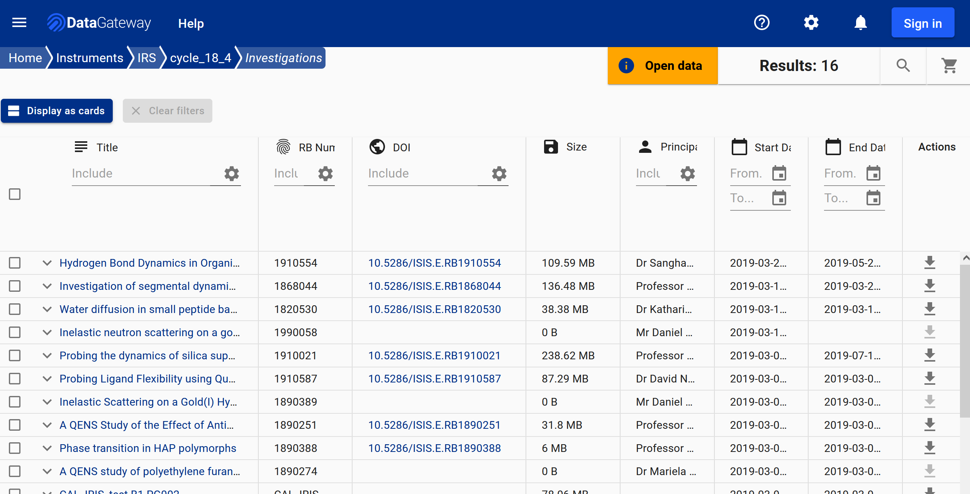
Frontends – DataGateway

Slide 11
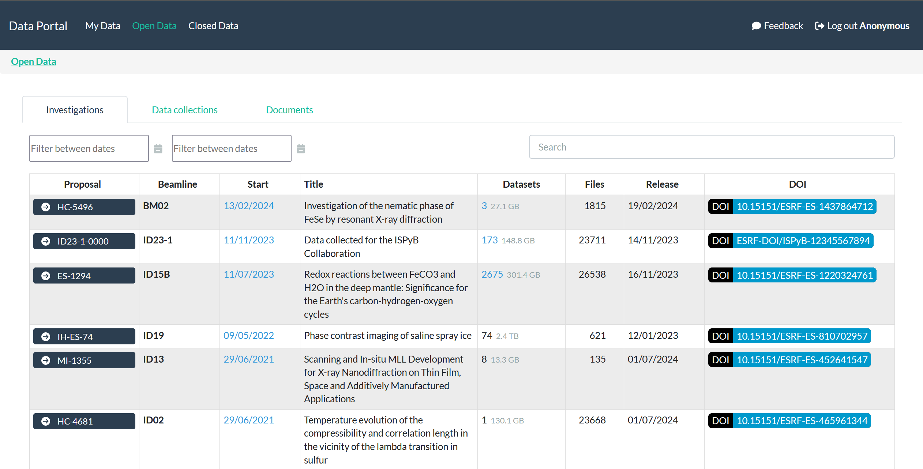
Frontends – DataPortal

Slide 12
ICAT Data Model
Notes:
The abstract pattern can be removed or repositioned if required. Be careful to ‘Send to Back’ so that it does not obscure any important information.

Slide 13
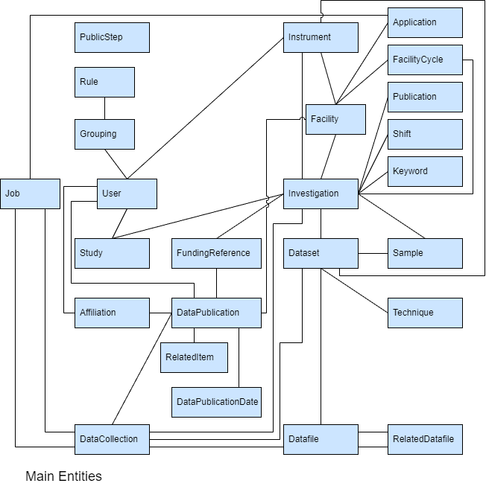
ICAT Data Model
Latest version: 6.0.0
Based on Core Scientific Metadata Model:
http://icatproject-contrib.github.io/CSMD/
Core Entities:
Investigation
Dataset
Datafile
Notes:
Note: there’s a missing link between Dataset and Instrument added as of ICAT 5

Slide 14
Data Model
Implementation
Each facility maps relevant entities from data model onto locally relevant concepts
Different at each ICAT instance
Metadata stored in Parameters
Attached to Investigation, Dataset, Datafile, Sample, DataCollection
Name
Value – Numeric/String/DateTime
No JSON, no hierarchy – except with ICAT+ (ESRF)

Slide 15
Data Model Comparison
Dataset fairly equivalent between ICAT and SciCAT
  However, Investigation is more “central” to ICAT*, whereas Dataset is more “central” to SciCAT
ICAT Investigation = SciCAT proposal
  Investigation is non-optional and is more “core”
Datafile equivalent
  No DataBlocks in ICAT
  Datafiles are queryable individually
ICAT Job != SciCAT Job
Notes:
*Central-ness in first point is kind of changing, more and more relations are getting added to Dataset e.g. DatasetInstrument, Technique is at Dataset level etc.
SciCAT Job is interesting, we normally develop external services to store that info e.g. dg-dl-api, IDS instead of storing it in ICAT itself. Same with user preferences etc.
Everything else is probably either unique to each facility, or maps so closely it’s not really worth commenting on e.g. Sample, Instrument, PublishedData vs DataPublications etc. Might be worth mentioning DataPublicationUser – is a snapshot of user info that doesn’t change (e.g. if a user changes their name, the DataPublication will still be associated with the name at time of publishing)

Slide 16
Authorization
Rules stored in ICAT database not in an external system
CRUD flags paired with simple table permissions or more complex SQL ‘what’ clauses
  crudFlags: R, what: Instrument​
  crudFlags: RU, what: SELECT df FROM Datafile df JOIN df.dataset d JOIN d.investigation i JOIN i.investigationInstruments ii JOIN ii.instrument inst JOIN inst.instrumentScientists instSci JOIN instSci.user u WHERE d.name!='raw' AND u.name = :user
Rules can apply to user groups or to all users
Can change authorization rules at any time
Notes:
Rules: first rule is a simple “public table” rule, second rule lets instrument scientists update their data as long as the dataset name is not raw
Note that InstrumentScientist and InvestigationUser are actual ICAT entities
Also, maybe mention public steps that allow you to “include” e.g. datafiles if you have permission to see their dataset?
Note last point – might require a restart to update public table caching

Slide 17
Authorization comparison
ICAT rules are more flexible but also more complex
SciCAT “rules” are baked in, ICAT each new facility needs to create their own rules – even “standard” ones
  E.g. isPublished makes data open, ICAT needs an explicit rule (e.g. ISIS has one based on releaseDate)
Facilities can change their ICAT rules at any time
Authorization can be a performance bottleneck in ICAT
Notes:
Generally want as few rules as possible to improve performance iirc

Slide 18
Handling Scientific
Metadata
Notes:
The abstract pattern can be removed or repositioned if required. Be careful to ‘Send to Back’ so that it does not obscure any important information.

Slide 19
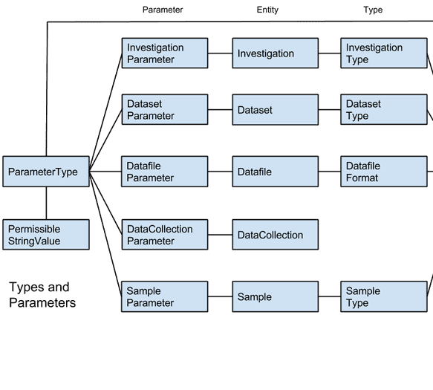
Parameters
____Parameter entities contain value
ParameterType gives metadata about that parameter (e.g. name, units, constraints etc.)
Need to create ParameterType before creating parameters that link to it
ESRF use parameters extensively, and use name prefixes to create “hierarchies” e.g. CRYOEM_xparameter

Slide 20
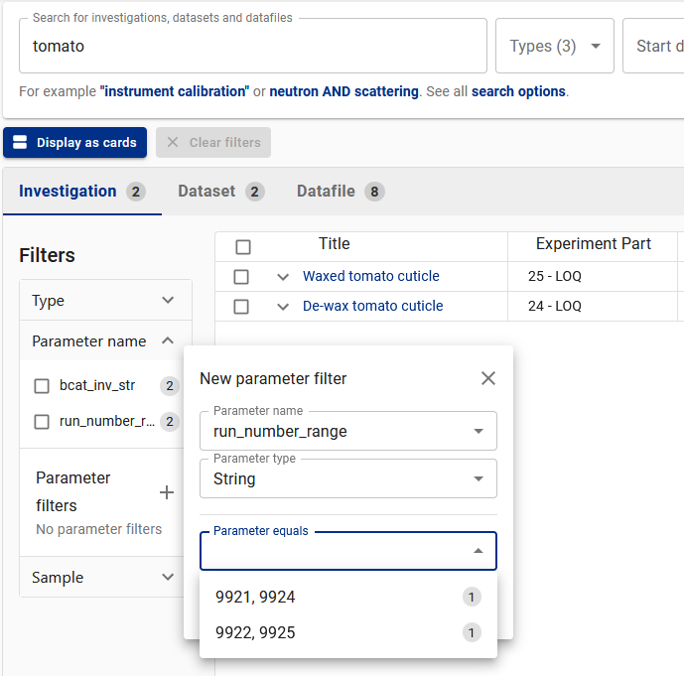
Searching Parameters
ParameterType is its own table, and so can be queried across to find e.g. Investigations which have a certain parameter type with certain value
At STFC, we index parameters in Lucene search component and can filter using them

Slide 21
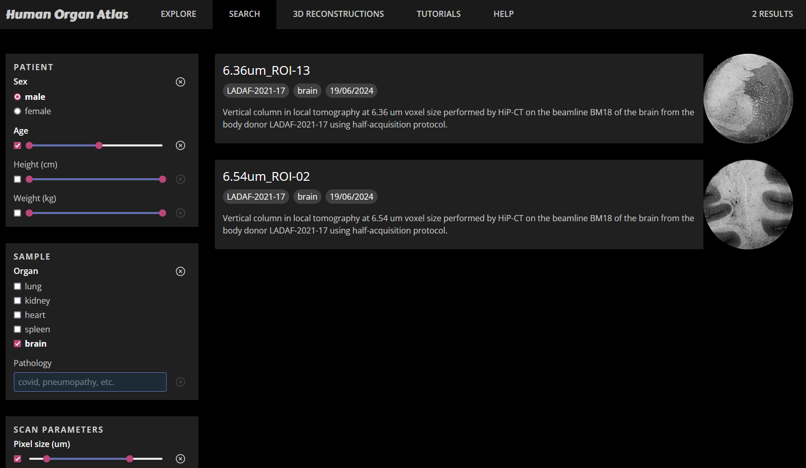
Searching Parameters

Slide 22
Data Retrieval
Notes:
The abstract pattern can be removed or repositioned if required. Be careful to ‘Send to Back’ so that it does not obscure any important information.

Slide 23
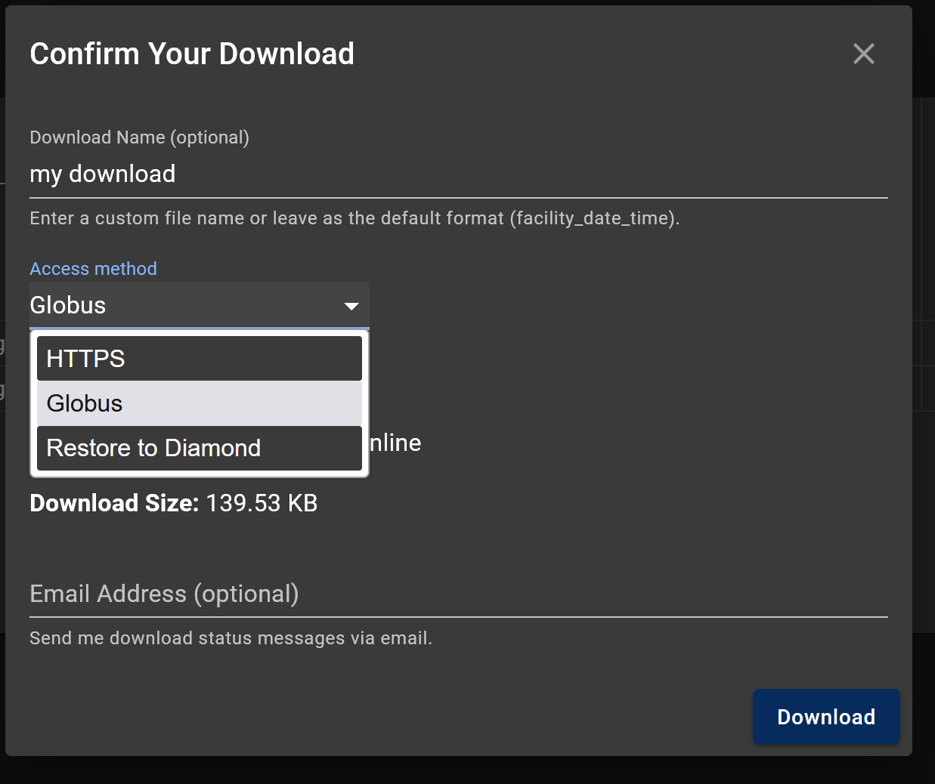
Data Retrieval
User selects data to add to their “cart”
User chooses download type
Download will be submitted for restoring
User can opt-in to an email notification
User visits web service to check download status & download HTTPS downloads
Other download types require interaction with 3rd party (e.g. Globus server, facility file system)
Notes:
User can select (investigations, datasets or datafiles)
Not every facility offers multiple download types like this – this is showing Diamond use case
Note we also support single level storage so download would occur immediately after submitting
Can also maybe mention we can leverage “cart” functionality to do other things on a selection of data, i.e. mint DOIs

Slide 24
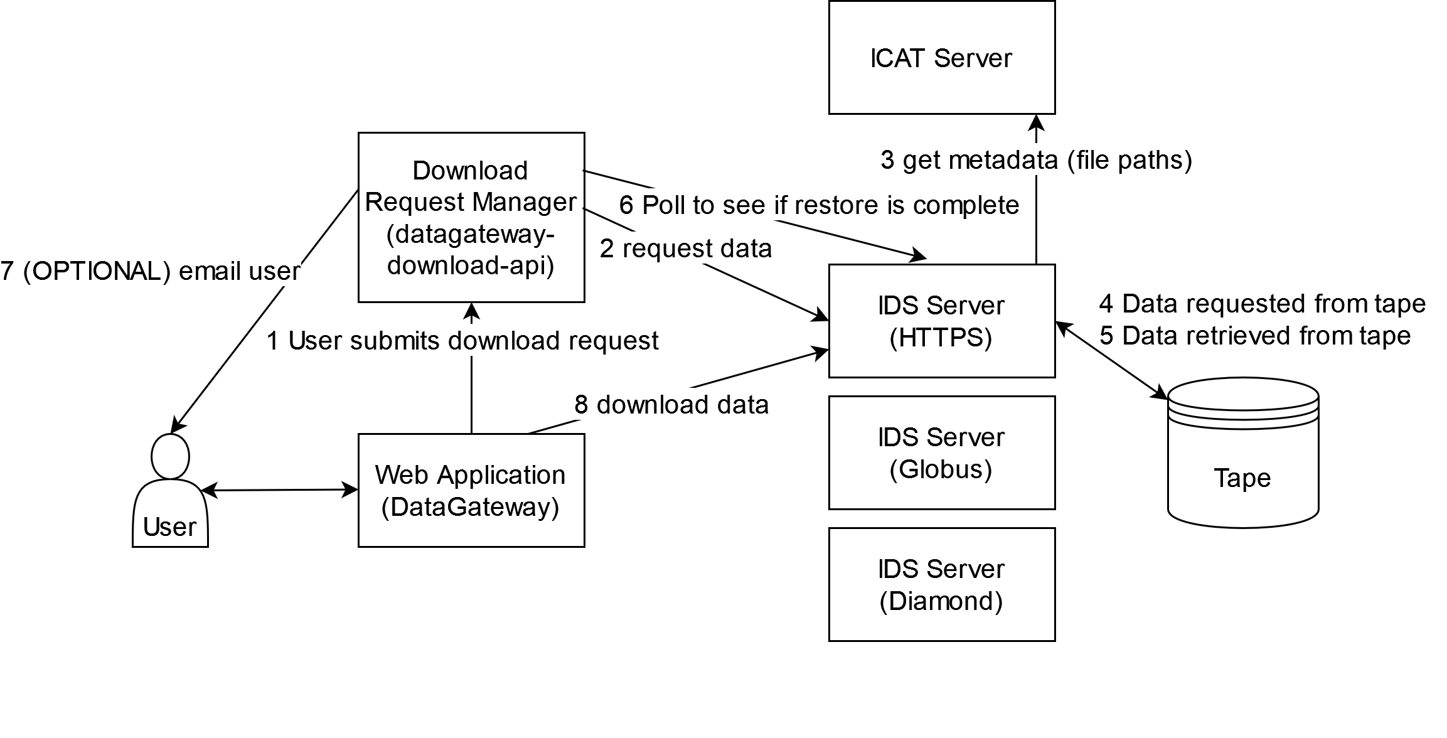
Data Retrieval - Technical

Slide 25
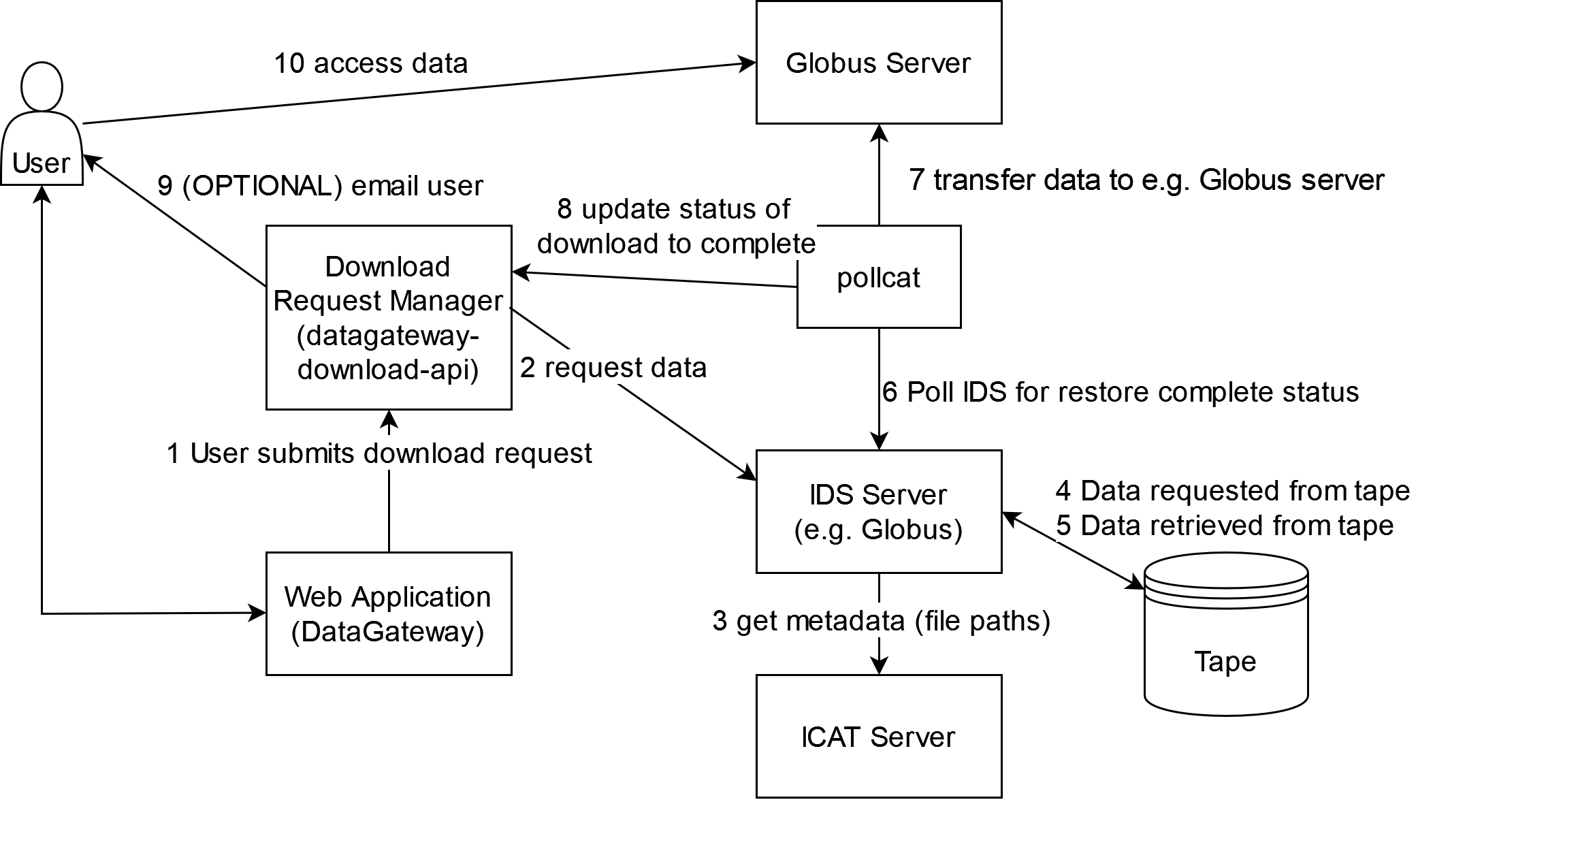
Data Retrieval - Technical

Slide 26

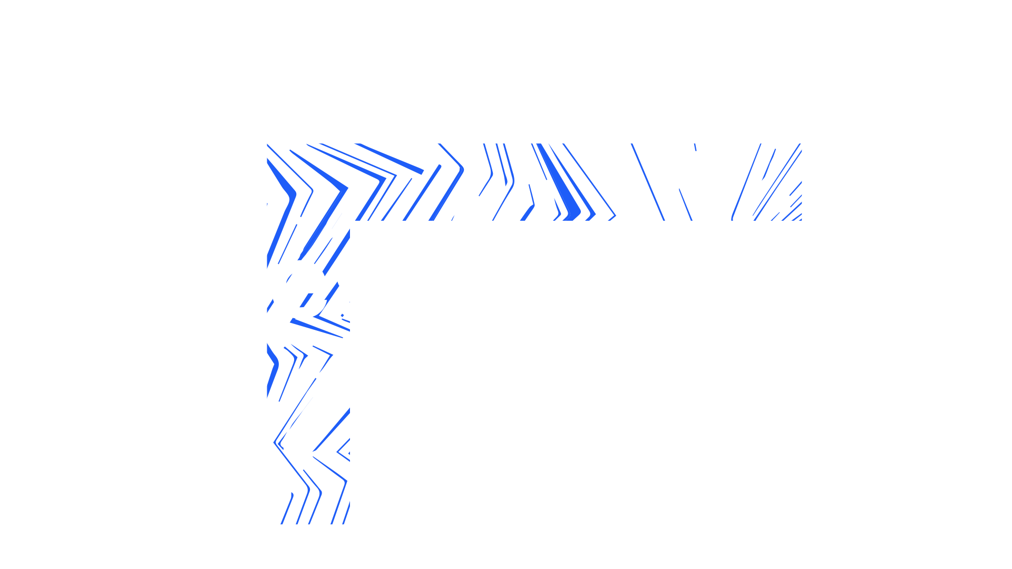

Notes:
The abstract pattern can be removed or repositioned if required. Be careful to ‘Send to Back’ so that it does not obscure any important information.

Slide 27






Science and Technology Facilities Council
@STFC_matters
Science and Technology Facilities Council
Notes:
The abstract pattern can be removed or repositioned if required. Be careful to ‘Send to Back’ so that it does not obscure any important information.

