Slide 1
Fine temperature tuning of a C-band module (S10CB02)
Fabio Marcellini & Riccardo Zennaro :: Paul Scherrer Institute
05/03/2024 SwissFEL Progress Meeting (SPM)

Slide 2
Energy gain vs. T simple model
Assumption:
Isotropic thermal expansion (quite weak assumption)
Perfect constant gradient
Negligible effect of the couplers
Broadband system, no power reflection for temperature variation
Energy variation due to only integrated cell to cell phase slippage, required information:
df/dT Thermal coefficient of copper
dphi/df dispersion curve (group velocity (vg) vs. cell #)

Slide 3
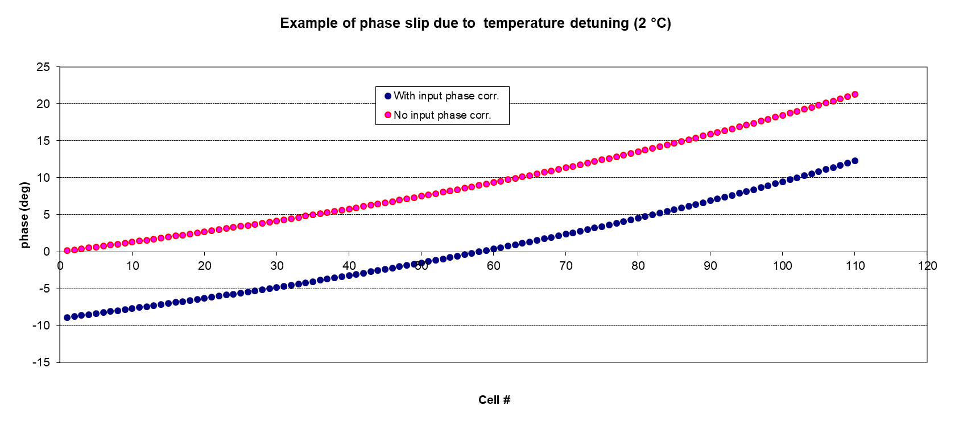
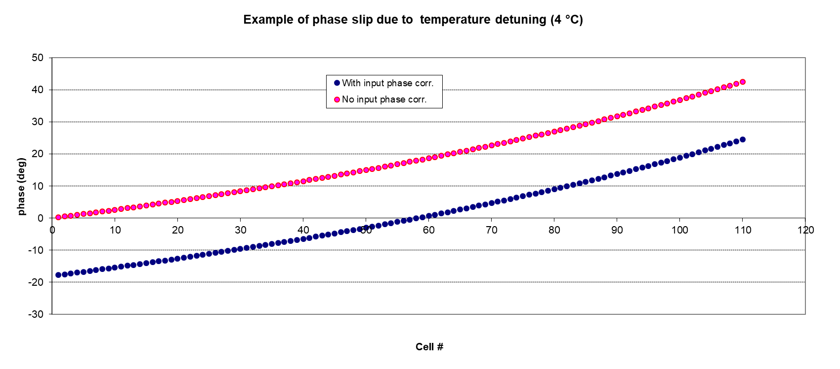
Phase slip
The integrated phase slippage is proportional to the temperature error:
~ 22 °for 2 °C
~ 44 °for 4 °C

Slide 4
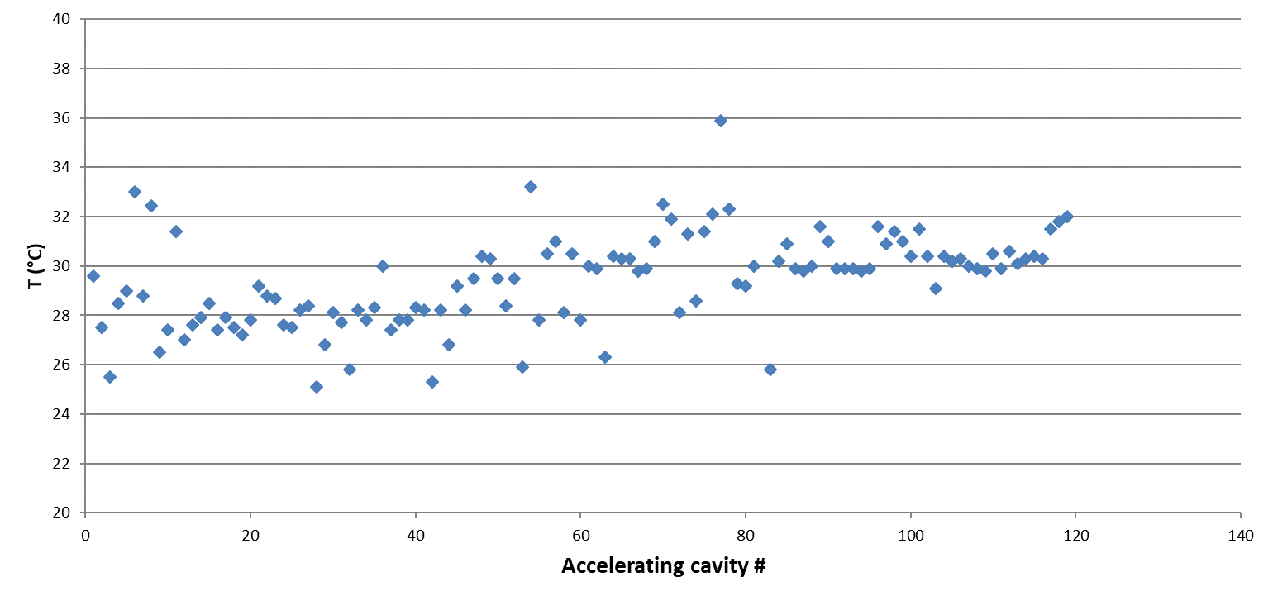
Bead pulling of ACs during production
NB: bead pulling without RF power

Slide 5
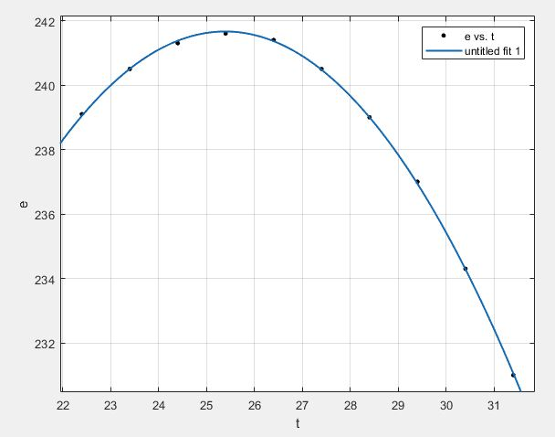
Energy gain vs. T measurement (S10CB02)
Beam shift on 12/02/2024
temperature fine tuning performed using the injector beam dump for energy measurements.
Rep. rate =50Hz
Klystron power output 36.6MW
RF feedbaks all off (ampl and phase)
beam enery feedback at BC1 ON
we found the optimum working temp of 25.4° which is 2.0° lower than present set point (27.4°). Corresponding energy gain is 1.1MeV. (see the plot)
Energy gain after correction: +1.1 MeV

Slide 6
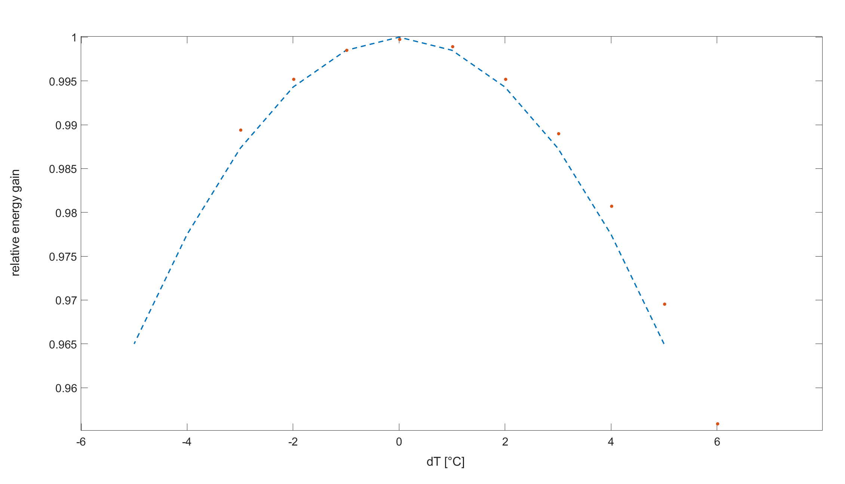
Meas. Vs. model
Model: y=-0.0014x²+1
Meas: y=-0.0012x²+1

Slide 7
Wir schaffen Wissen – heute für morgen
1.1 MeV is a relatively modest improvement (~30 MeV over the full linac).
Around 2 hours are required to tune one module.
The temperature correction could be anyway larger in other modules and the Egain is quadratic with T error.

