Slide 1
Mode-coupled FEL and high-brightness SASE
Eduard Prat and Sven Reiche
SPM, 5 March 2024

Slide 2
Contents
Concept
Simulations
Experimental results
Conclusion
Notes:
2

Slide 3
Contents
Concept
Simulations
Experimental results
Conclusion
Notes:
3

Slide 4
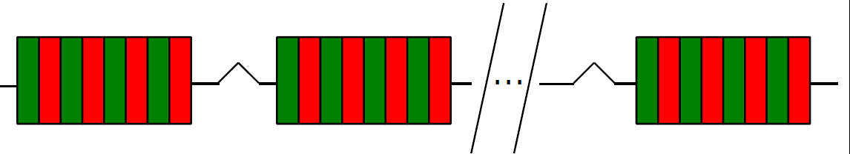
Intra-undulator chicanes in Athos
Chicanes for High power and Improved Coherence
Chicanes have two physical effects: longitudinal dispersion (R56) and delay. In dispersive chicanes, R56 and delay are always there and linked (R56 is about twice the delay).
Benefits:
R56: reduction of saturation length via optical klystron effect (fast conversion from energy modulation to density modulation). There is an optimum R56=λ/2πδ; going beyond it implies overbunching and FEL degradation.
Delay:
Coherence enhancement (this talk): mode-coupled FEL and high-brightness SASE (HB-SASE)
High-power and short pulses via fresh-slice multi-stage amplification
The delay of the chicanes is up to ~5 fs or ~1.6 µm
Notes:
There is an optimum R56 for best OK performance. Going beyond it may harm the FEL performance (overbunching)

Slide 5
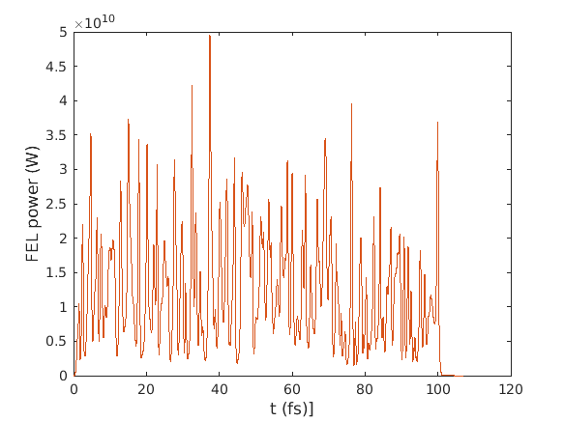
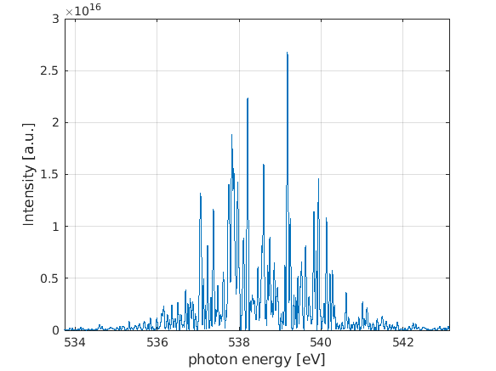
Coherence enhancement schemes
Standard SASE for X-rays:
  Poor longitudinal coherence.
  Coherence length proportional to slippage: one wavelength per undulator period or 0.1 fs for 1 nm in Athos.
  Spectral and power profiles with multiple uncorrelated spikes, spike/coherence length < 1 fs
Basic idea: increase coherence length due to delay of the chicanes. The delay shifts the radiation field forward, overcoming the limit given by the slippage.
Two variations: mode-coupled FEL and HB-SASE
Simulated power and spectra profile for Athos (540 eV)

Slide 6
Mode-coupled FEL
  Equal and periodic delays
  Power profile: superposition of trains of short pulses (separated by the delay) . In each train the pulses are phase-locked but no phase correlation between the different trains.
  Spectrum: tunable frequency combs. Envelope given by spike length in power profile, individual length given by coherence increase, separation given by delay.
  Bonus: energy modulation with external laser at same frequency as the delay →it filters out one of the trains, nicer power profile and spectra and no interference on short scale → mode-locked FEL
[N. R. Thompson and B. W. J. McNeil, Phys. Rev. Lett. 100, 203901 (2008)]
SASE
Mode-coupled FEL
Mode-locked FEL
SASE: superposition of single spikes.
Mode-coupled FEL: superposition of trains of spikes.
Mode-locked FEL: one train of spikes
Individual pulses in mode-coupled/locked FEL shorter because Lu<<Lg (not in our case)

Slide 7
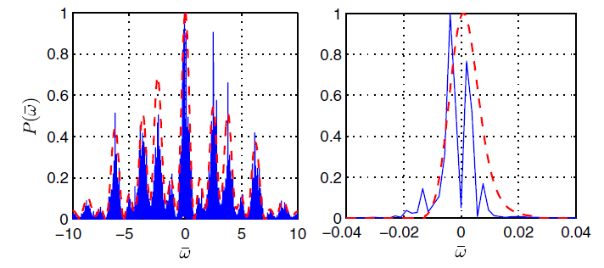
HB-SASE
  Different delays . Chose them such that the sideband modes can be made on a single mode, frequency modes interfere destructively except for a single mode.
  Power profile: one standard long pulse, but with less spikes than SASE (ideally one)
  Spectrum: one mode, significantly smaller BW due to coherence enhancement
  With isochronous chicanes and short (0.5 m) modules → expect almost transform limited pulses.
  At Athos → expect maximum and improvement of a factor of 8-10
Beginning
End
[B. W. J. McNeil, N. R. Thompson, and D. J. Dunning Phys. Rev. Lett. 110, 134802 (2013)]

Slide 8
Notes for both modes
  Optical klystron helps reducing the saturation length. For HB-SASE, delays should go from large to small in the undulator (to avoid overbunching) → compact HB-SASE
  Delays should be applied as often as possible (i.e. before SASE gain is too high).
  Reducing energy spread (δ) increases optimum R56, allowing larger delays without deteriorating FEL performance
  Both modes worked (better) last MD shift because of longer gain length (low current) and reduced energy spread. They seem incompatible with optimum conditions for Athos (unless very high photon energy).

Slide 9
Contents
Concept
Simulations
Experimental results
Conclusion
Notes:
9

Slide 10
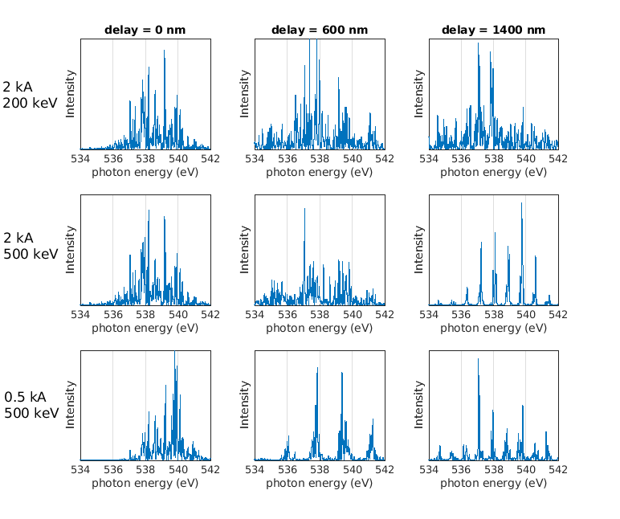
Mode-coupled FEL: initial simulations
Not working for very good beam (2 kA, 200 keV)
Starts to work for less good beam (2 kA, 500 keV)
Works better for even less good beam (0.5 kA, 500 keV)
Next: simulate mode-locked FEL pulses (include energy modulation)

Slide 11
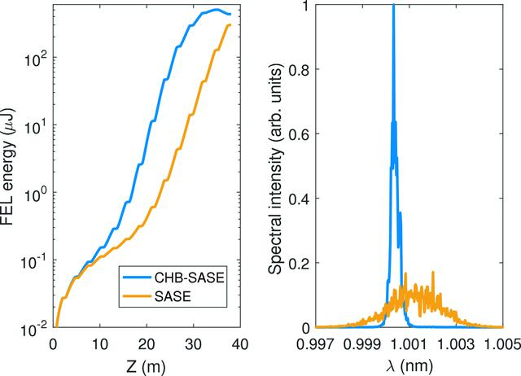
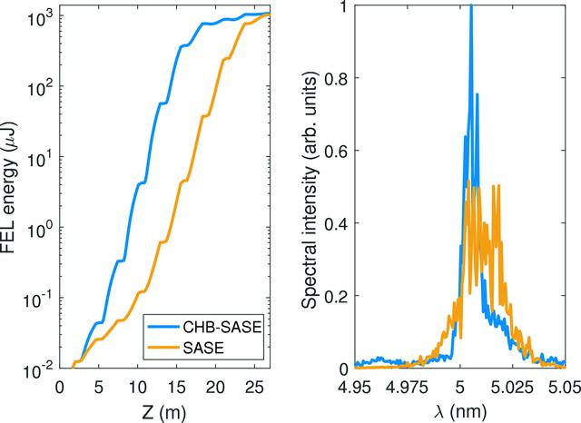
HB-SASE: simulations
Simulations done long time ago for 2 kA, 500 eV, 400 nm emittance, 10 m beta function. This is slightly worse than what we normally have (~3 kA, 1 MeV, 250 nm, 5 m)
BW improvements depend on photon energy: low photon energies have higher FEL gains and therefore perform worse
1.2 keV, BW improved by factor of ~9
250 eV, BW improved by factor of ~3
[E. Prat and S. Reiche, JSR 26, 1085, 2019]

Slide 12
Contents
Concept
Simulations
Experimental results
Conclusion
Notes:
12

Slide 13
Overview
Measurements done in Athos beamline, mostly during February 18. With Philipp Dijkstal, Sven Reiche and Wenxiang Hu.
Achievements:
  Demonstrated mode-coupled FEL at 500 eV: measured tunable frequency combs as a function of delay
  Demonstrated HB-SASE at 330 and 500 eV: BW improved by a factor of 2 to 3 wrt SASE. Saturation length significantly reduced.
Outlook:
  Demonstrate mode-locked lasing.
  Improve HB-SASE results (expect factor 5-10 improvements in BW): reduce energy chirp of the beam, better optimization of chicane delays.
More info: https://elog-gfa.psi.ch/SwissFEL+commissioning/32430
Notes:
13

Slide 14
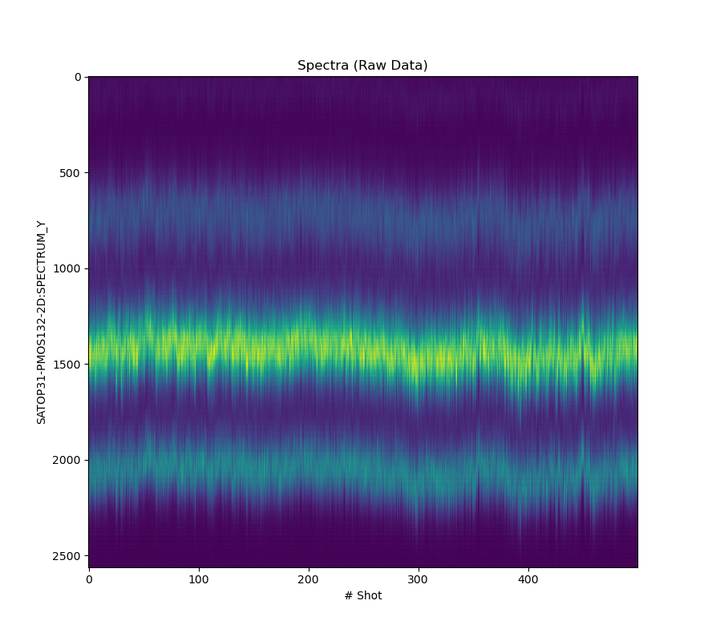
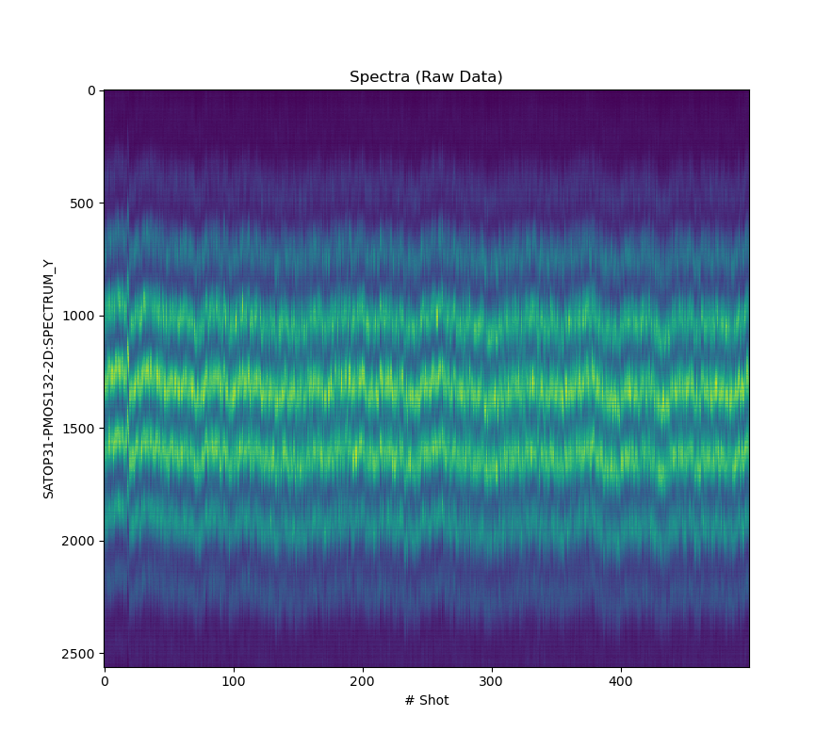
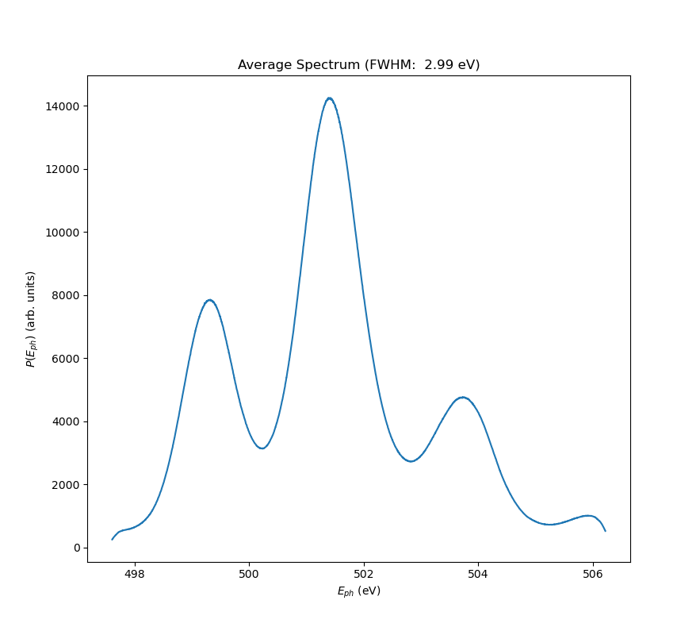
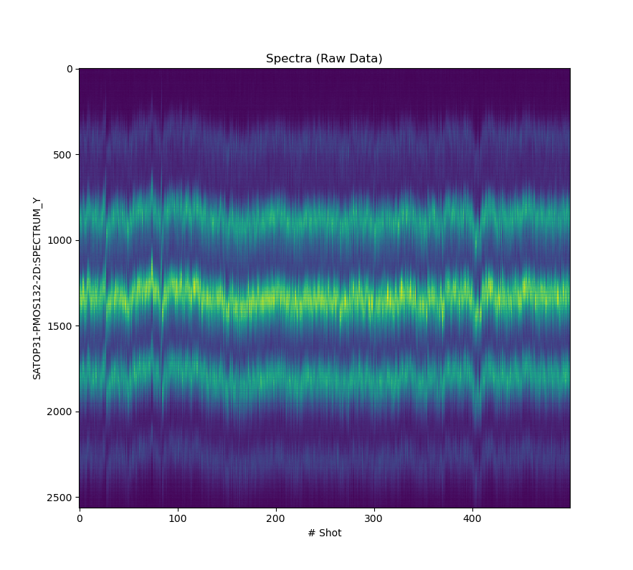
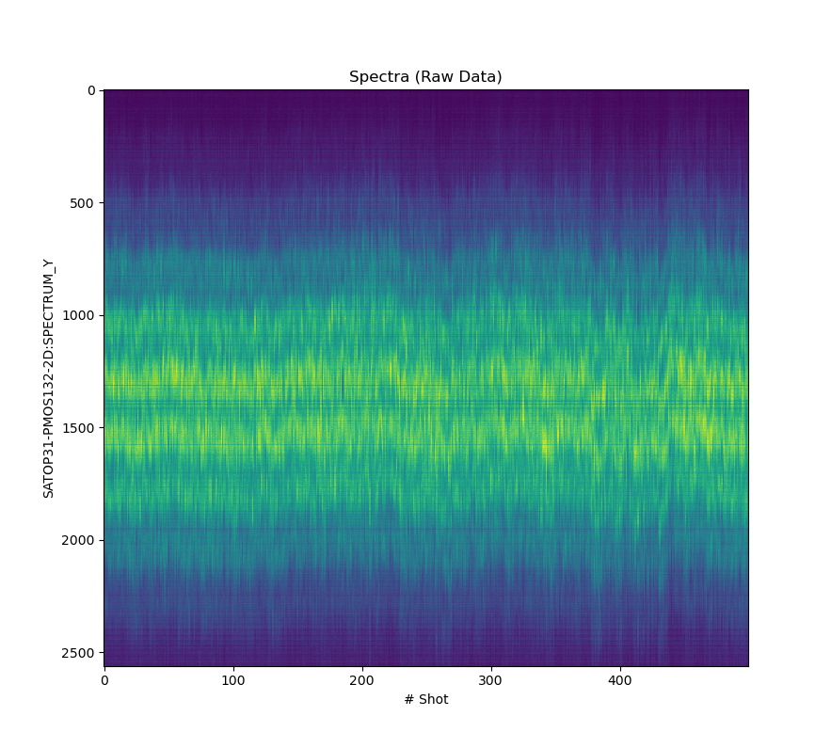
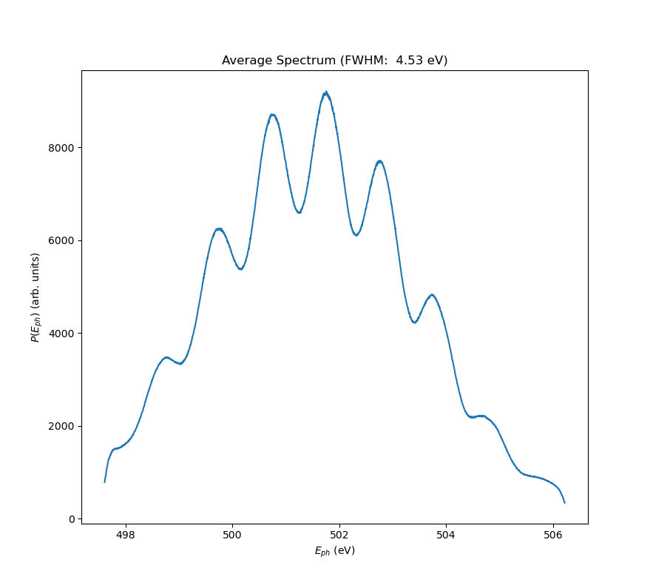
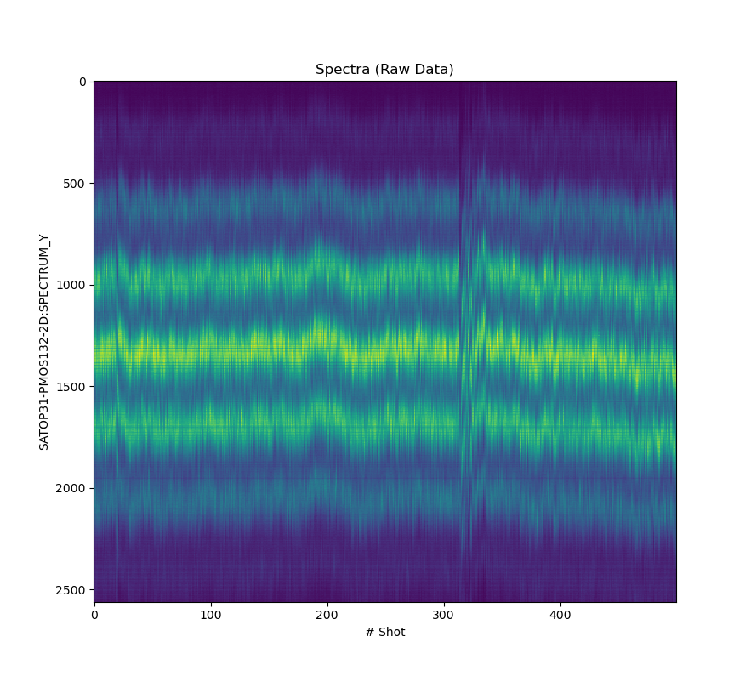
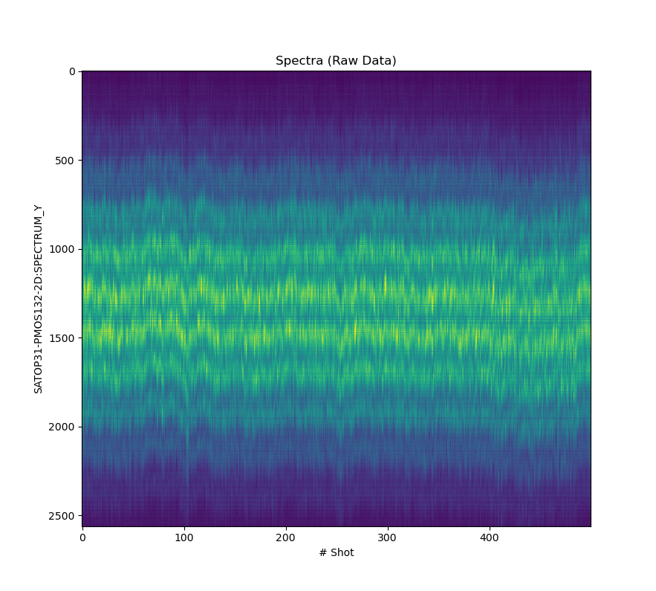
Mode-coupled FEL
Measured frequency combs for different delays. Number and separation of combs depends on delay (more delay → less separation and more combs). Delay + slippage corresponds approximately to mode separation.
Average spectra
Single-shot spectra
400 nm
1000 nm
400 nm
600 nm
1200 nm
1000 nm
800 nm
1400 nm
Notes:
14

Slide 15
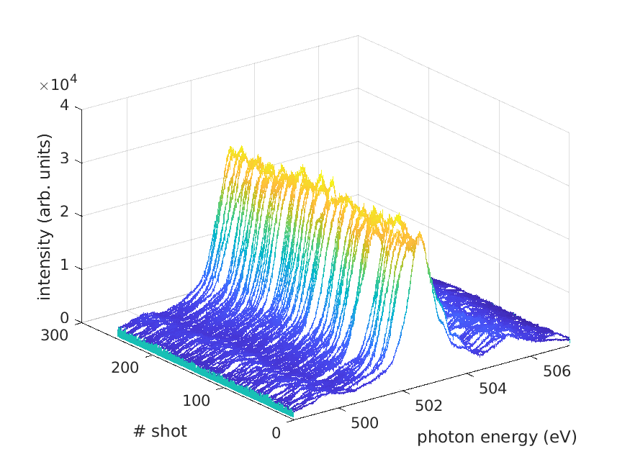
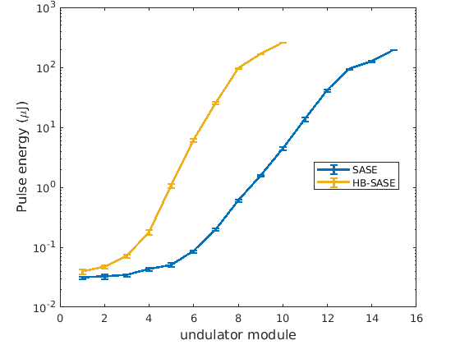
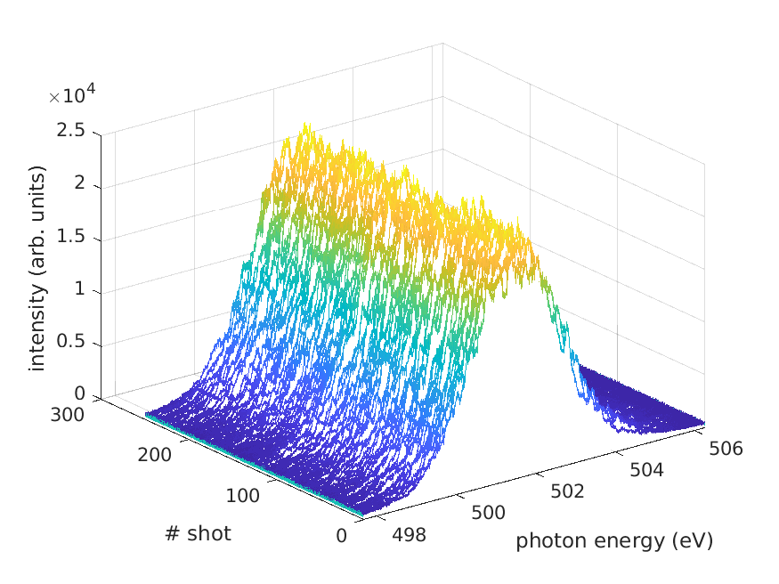
Spectra for 500 eV
HB-SASE
Demonstrated for 330 and 500 eV
  BW improvement by a factor of 2-3
  FEL saturation length significantly reduced due to optical klystron effect
HB-SASE
Gain curve for 500 eV
SASE
Notes:
15

Slide 16
Contents
Concept
Simulations
Experimental results
Conclusion
Notes:
16

Slide 17
Conclusion
Demonstrated:
Mode-coupled FEL: frequency combs with tunable separation.
HB-SASE: BW improved by factor 2-3.
Demonstration worked because of low FEL gain (Lu≤Lg) and low energy spread (no overbunching due to large R56, allowing longer delays)
Outlook:
Simulate mode-coupled/locked FEL
Demonstrate mode-locked FEL
Improve HB-SASE performance
Usability:
Mode-coupled/locked FEL: somebody in PSD interested?
HB-SASE: since it works better for long gain length, may be usable only for high photon energies
Thanks for your attention!
Notes:
17

