Slide 1
SwissFEL Seed Lasers Status
A. Trisorio: on behalf of the Gun Laser Group: Paul Scherrer Institute
12.03.2024

Slide 2
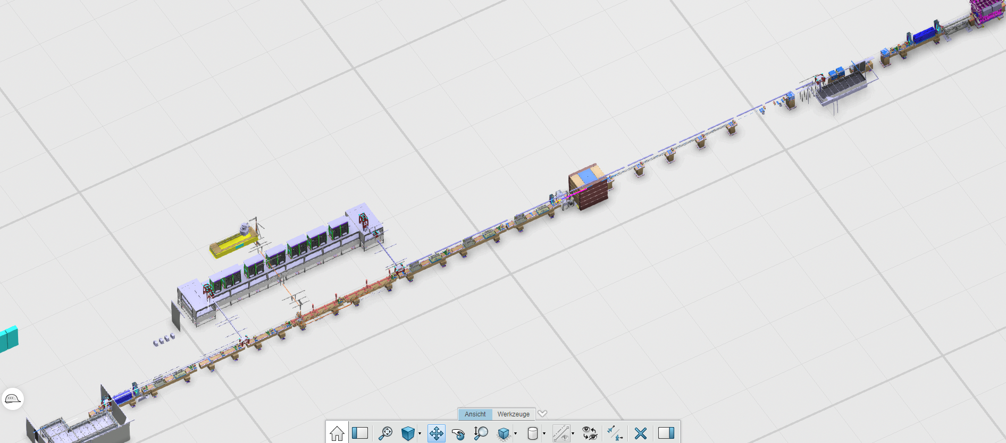
Seed laser facility overview
Installed & Commissioned
2nd magnetic chicane
1st magnetic chicane
Pollux / Seed laser 2
Laser Setup 2 - UV
Castor / Seed laser 1
10 m
2nd Modulator (U200)
Laser Transfer Line 2
Laser Transfer Line 1
Laser Setup 1 – IR / UV
1st Modulator (U200)

Slide 3
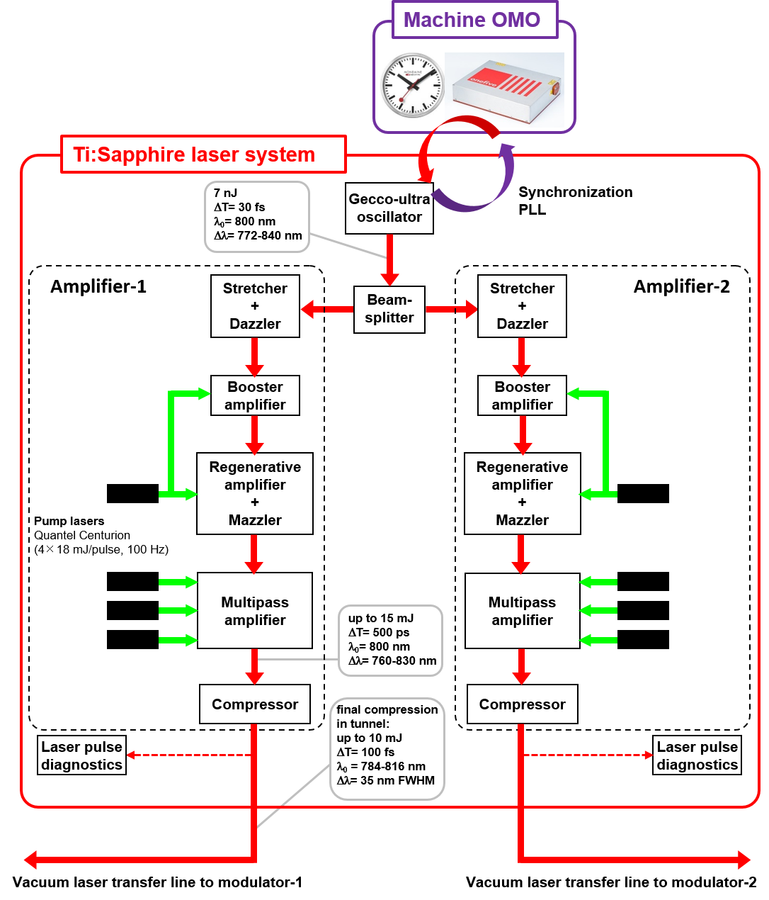
Seed Lasers - architecture
Common oscillator: Gecco-Ultra (Novanta)
RF synchronization
Synchronization quality improved: <16 fs RMS over 10Hz – 10MHz
Further R&D ongoing to improve timing jitter/drift
Twins amplifiers: Pulsar (Amplitude)
High pulse energy stability < 0.5 % rms (multiple pump lasers)
Robust pump laser units (Centurion – Quantel)
Wavelength tunning capability (Dazzler + Mazzler)
Active stabilization of the compressed pulse arrival time (in the lab) via
Balanced Optical Correlators (BOC) + feedback loop
Compressors moved to the tunnel optical tables after the
Optical transfer lines (avoid nonlinear effects)

Slide 4
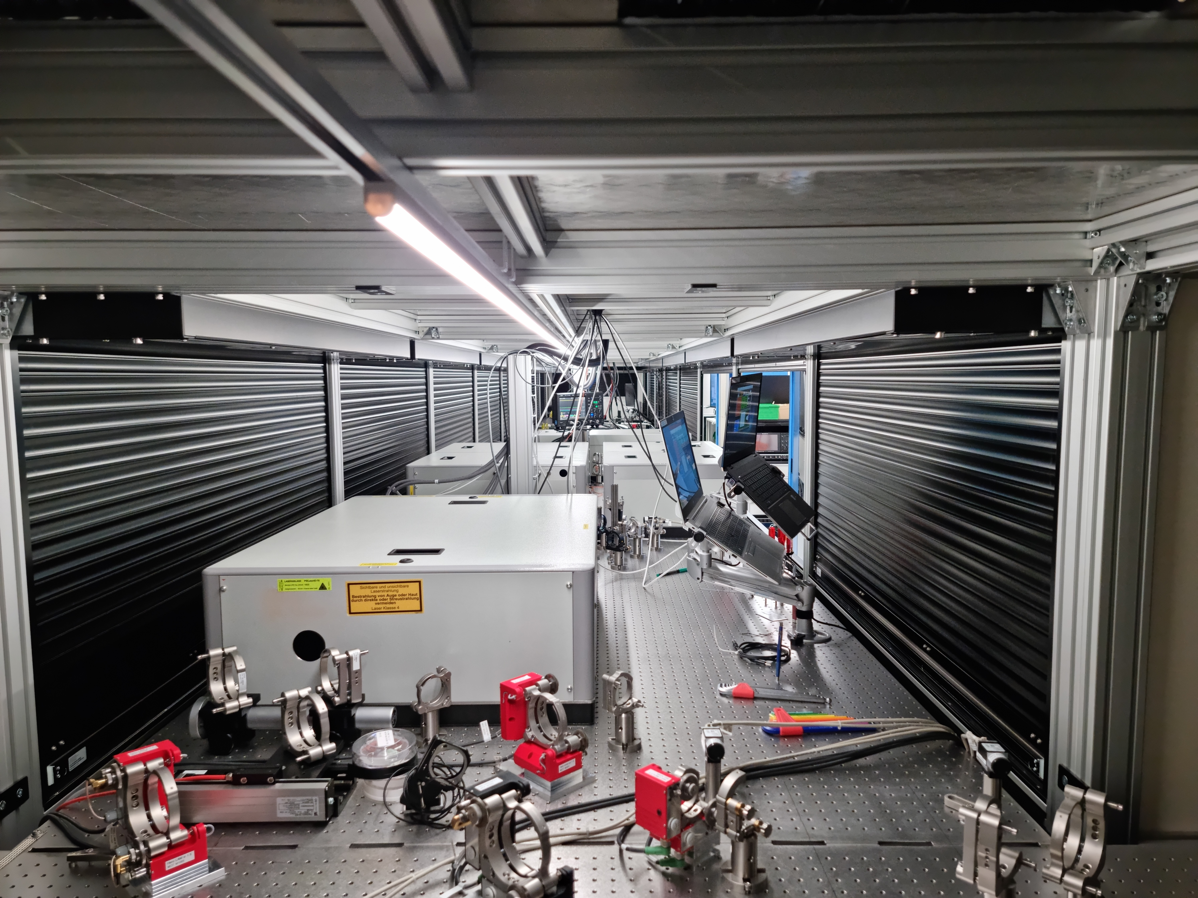
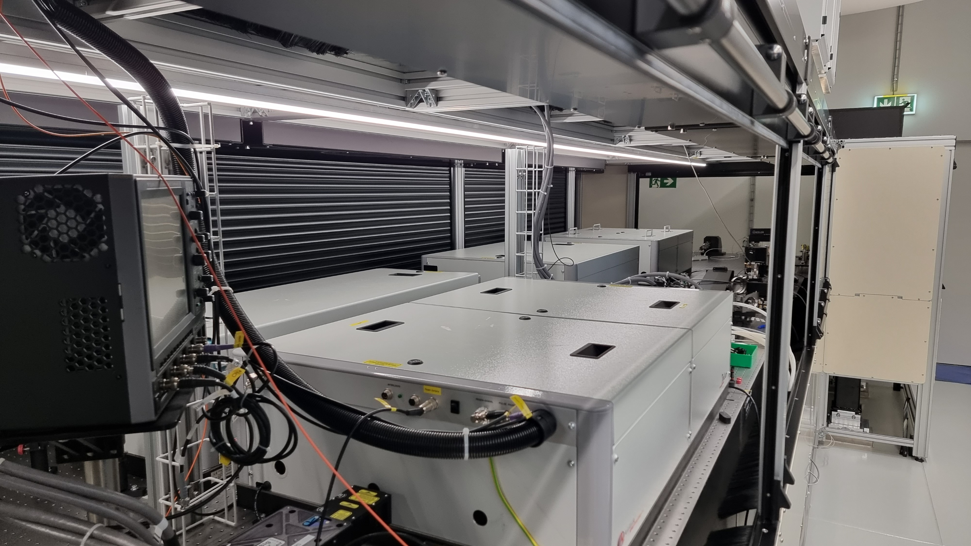
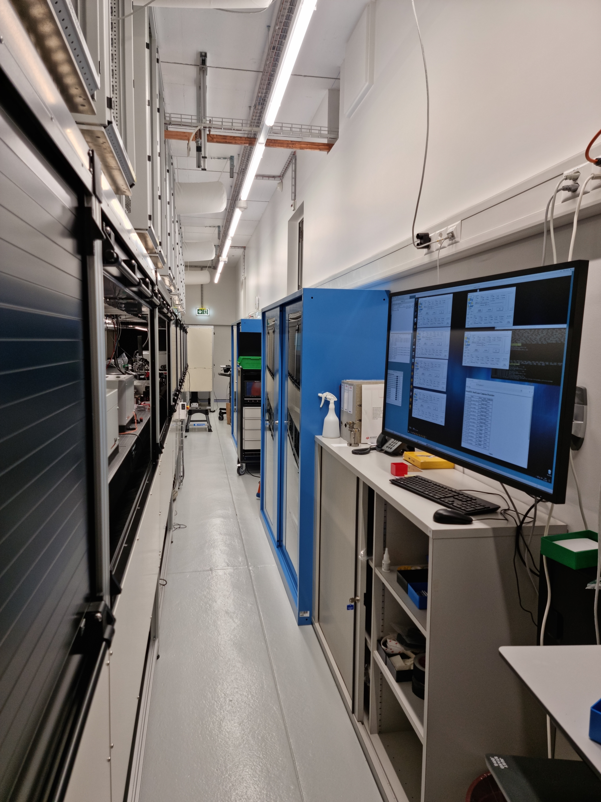
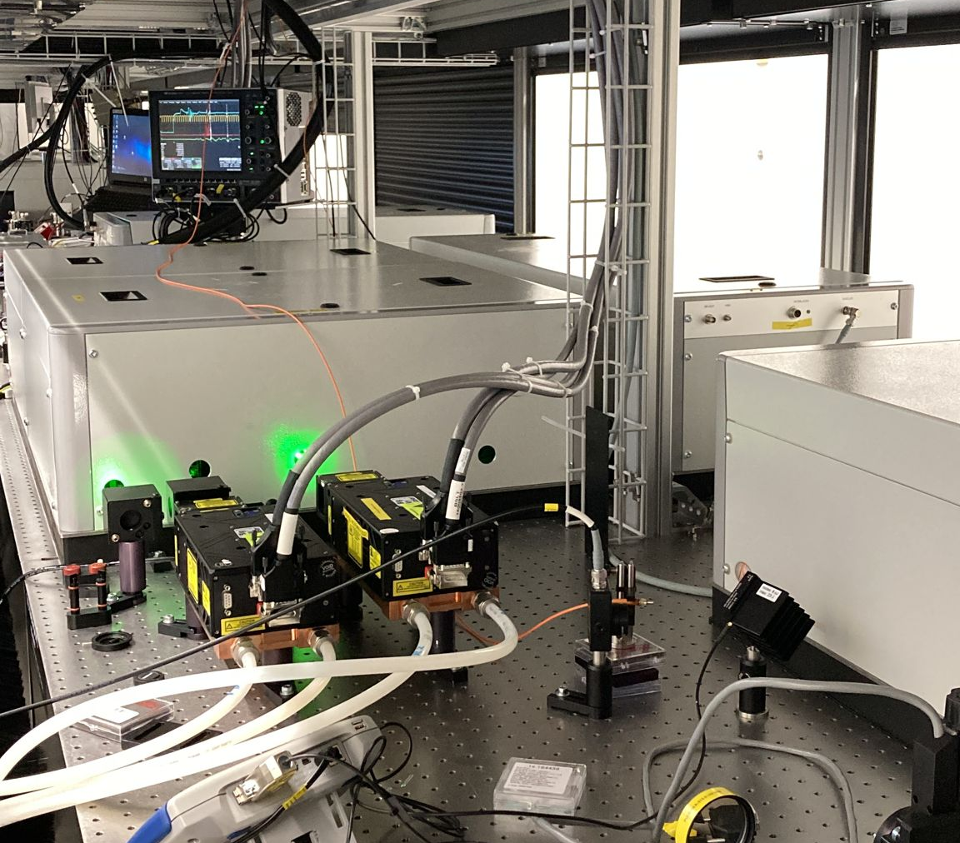
Seed Lasers – few photos
Laser 1 – Castor
(installed December 2021)
Laser 2 – Pollux
(installed December 2022)

Slide 5
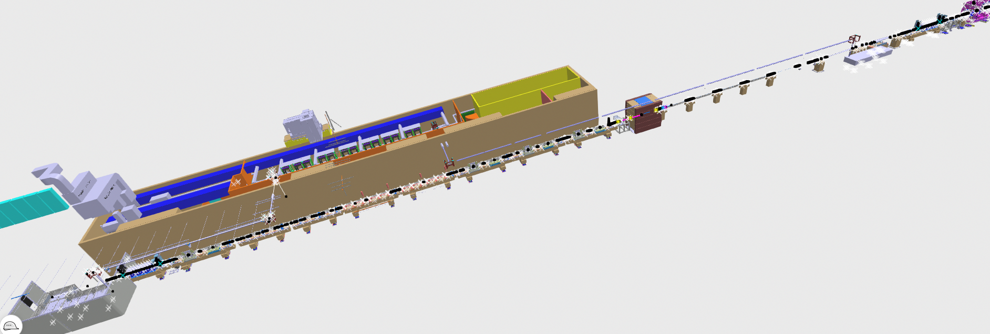
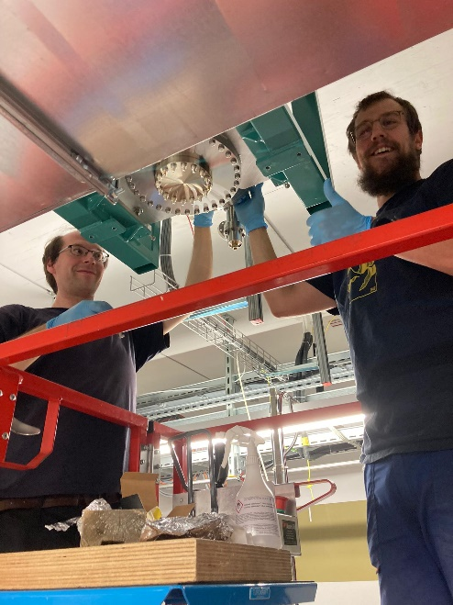
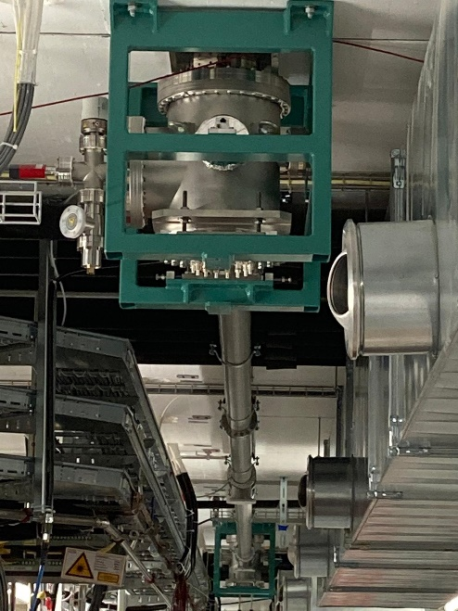
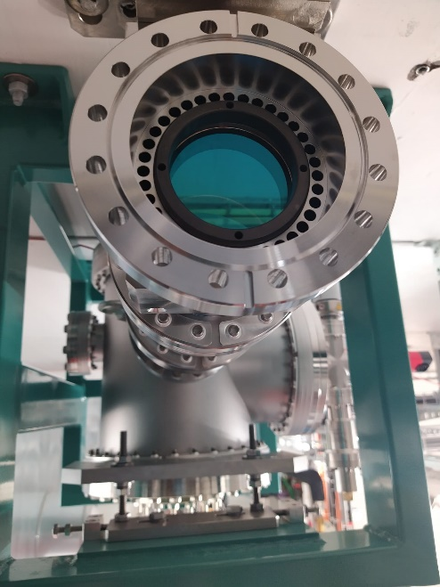
Seed Lasers – tunnel injections setups
2nd Laser TL
2nd Modulator
Z=410
1st Laser TL
1st Modulator
Z=350 m

Slide 6
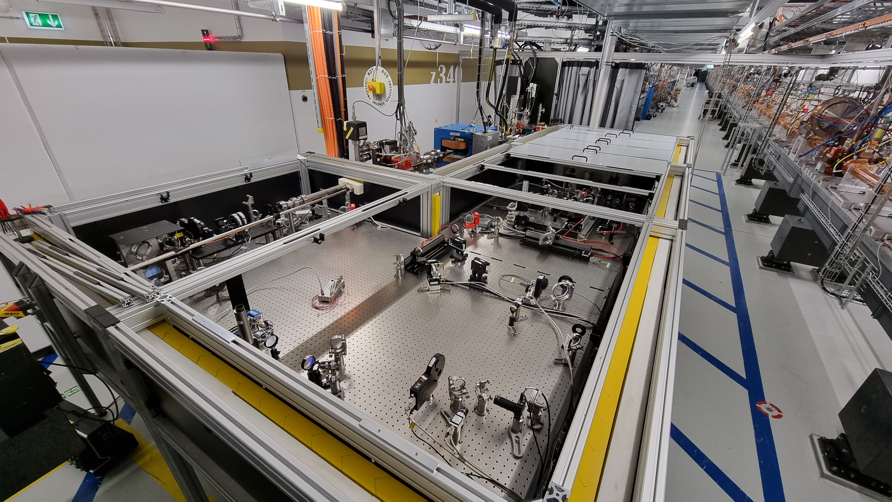
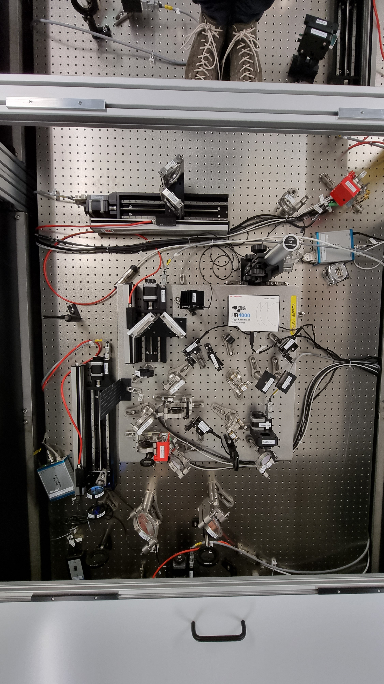
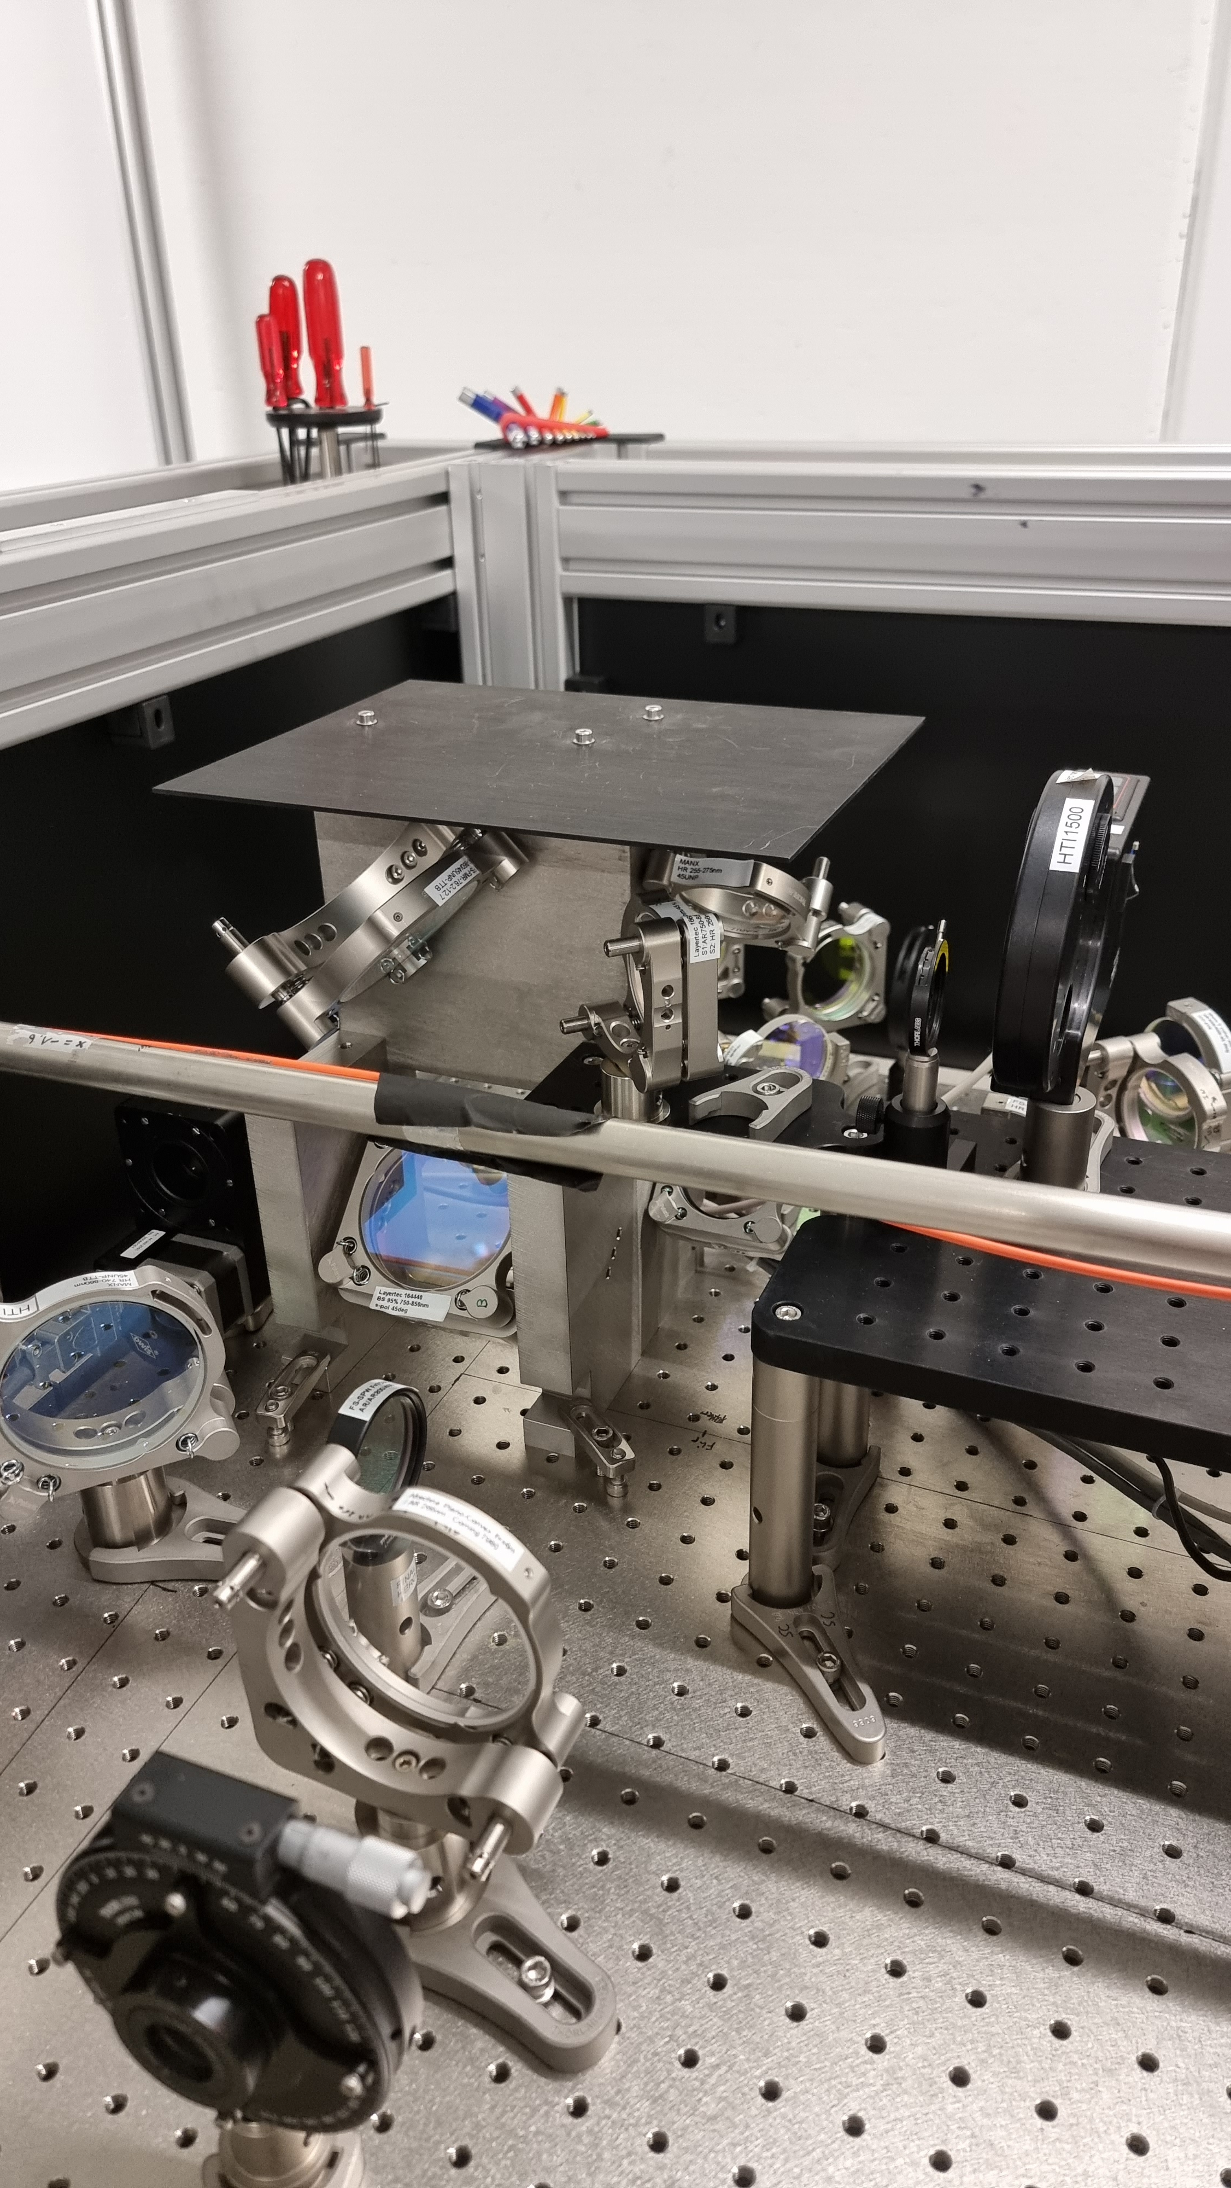
Seed Lasers – injection setup 1
Seeding of modulator 1 possible with:
T=60 fs FWHM – E≤5 mJ @ λ=793 nm
OR with T=160 fs FWHM – E≤0.45 mJ @ 261 nm<λ<272 nm

Slide 7
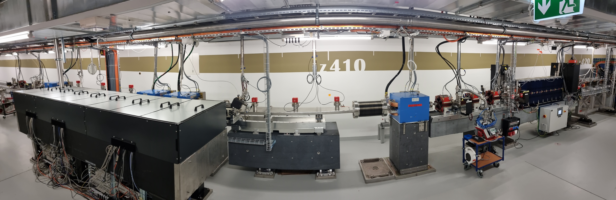
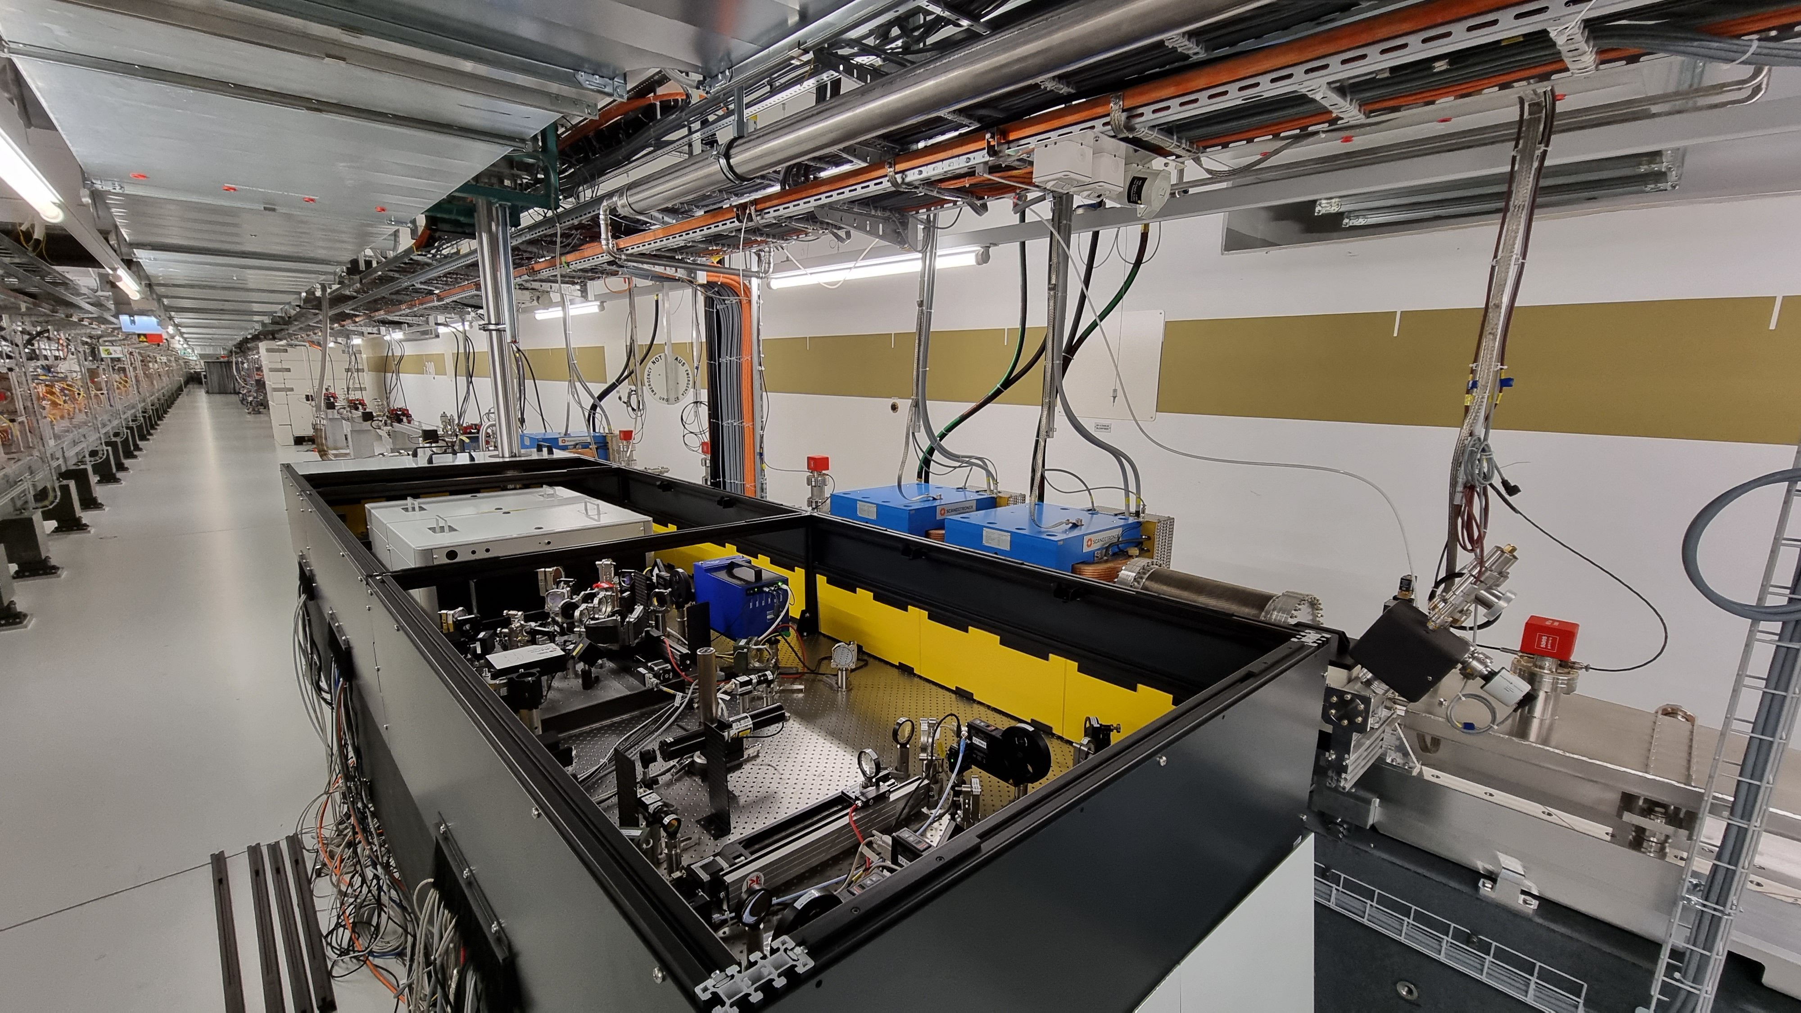
Seed Lasers – injection setup 2
We have upgraded the optical setup to be able to seed:
T=160 fs FWHM – E≤0.35 mJ @ 261 nm<λ<272 nm

Slide 8
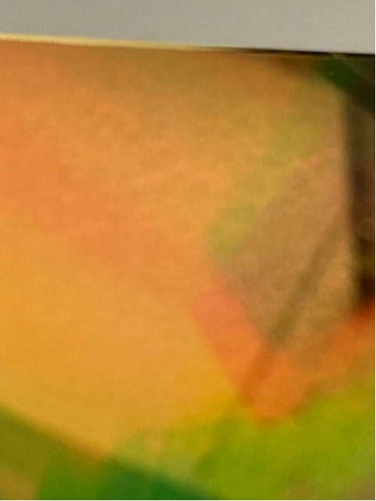
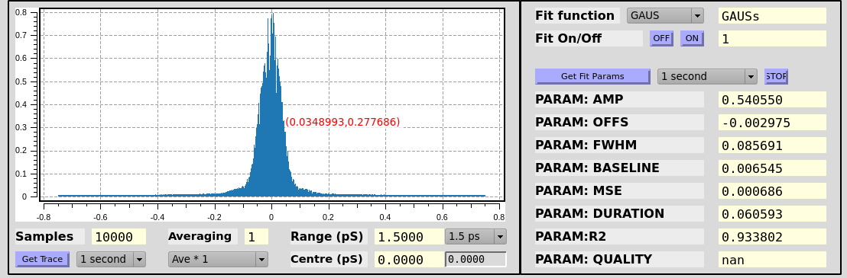
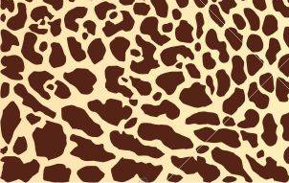
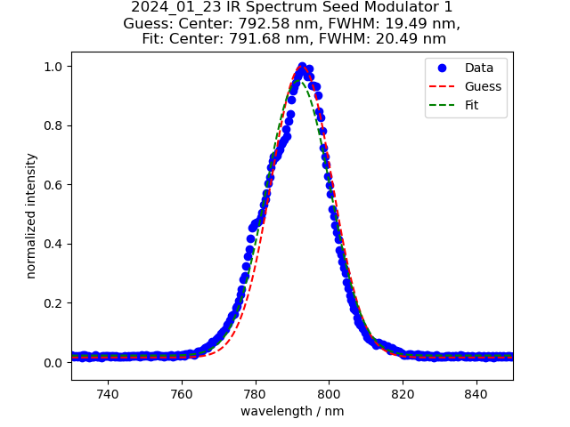
Changes compared to previous run IR
Check and adapt collimation of IR beam into the compressor
- Exchange small compressor grating: golden layer showed dark/bright structures
Compressor output characterized
IR Pulse temporal profile – T=61 fs FWHM (FL=51 fs)
IR Spectrum
λ=792.6 nm /Δλ=19.5 nm FWHM

Slide 9
Changes compared to previous run UV
Removed IR telescope before UV generation
Cleaned all optical elements on the setup and check stress
Replaced 1 damaged UV optic
Damaged in-coupling viewport was exchanged
Laser/Electron beam profile Diagnostics (Juranic):
New objective to increase the resolution (8 um with YAG screens)

Slide 10
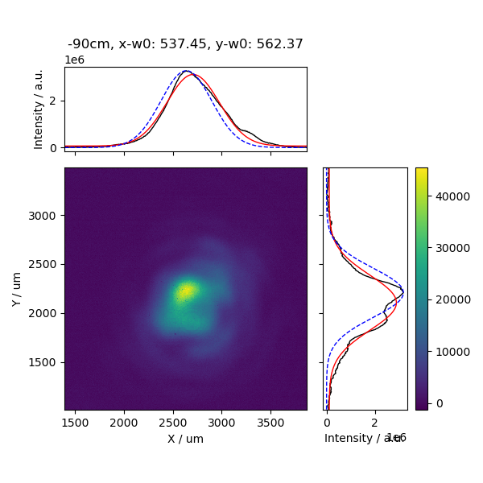
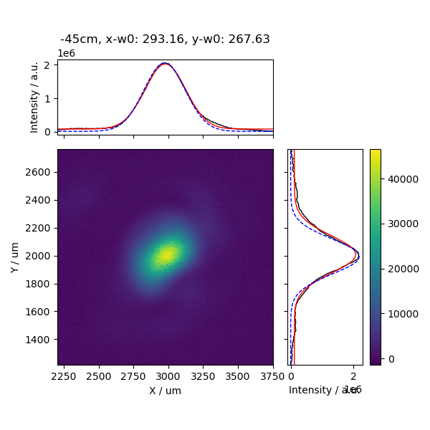
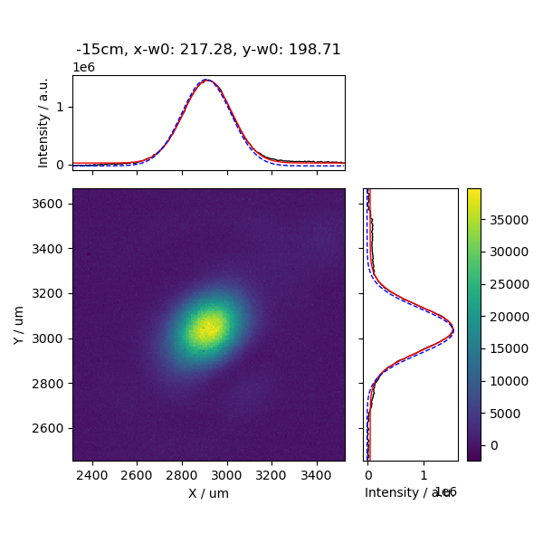
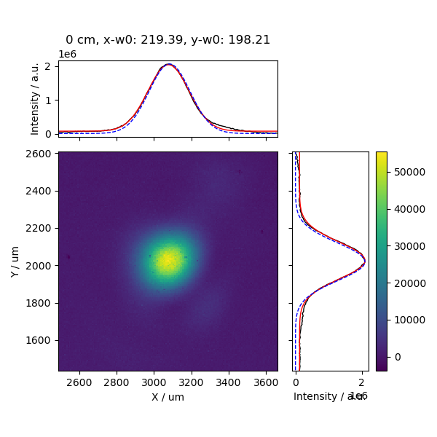
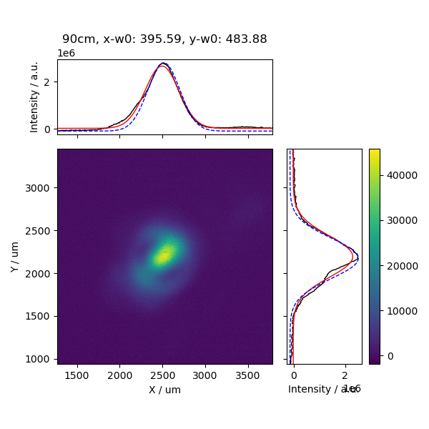
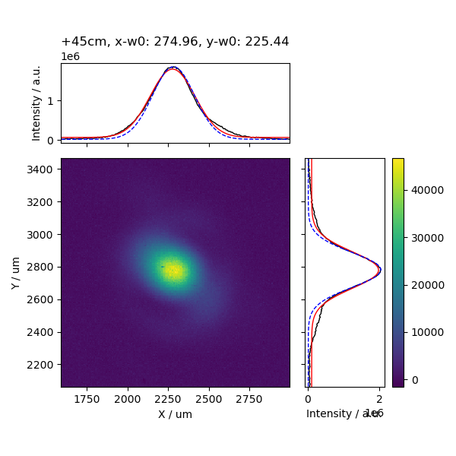
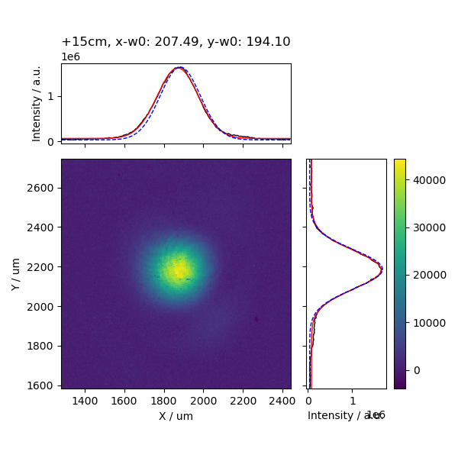
Modulator 1 – 8500 mm lens
Virtual path: Measured with Wincam.
Modulator Input
up stream
down stream
Modulator Output
Modulator Center

Slide 11
Modulator 1 – 8500 mm lens
Virtual path: Measured with Wincam.
Modulator Input
up stream
Good UV beam quality through the Modulator
down stream
Modulator Output
Modulator Center

Slide 12
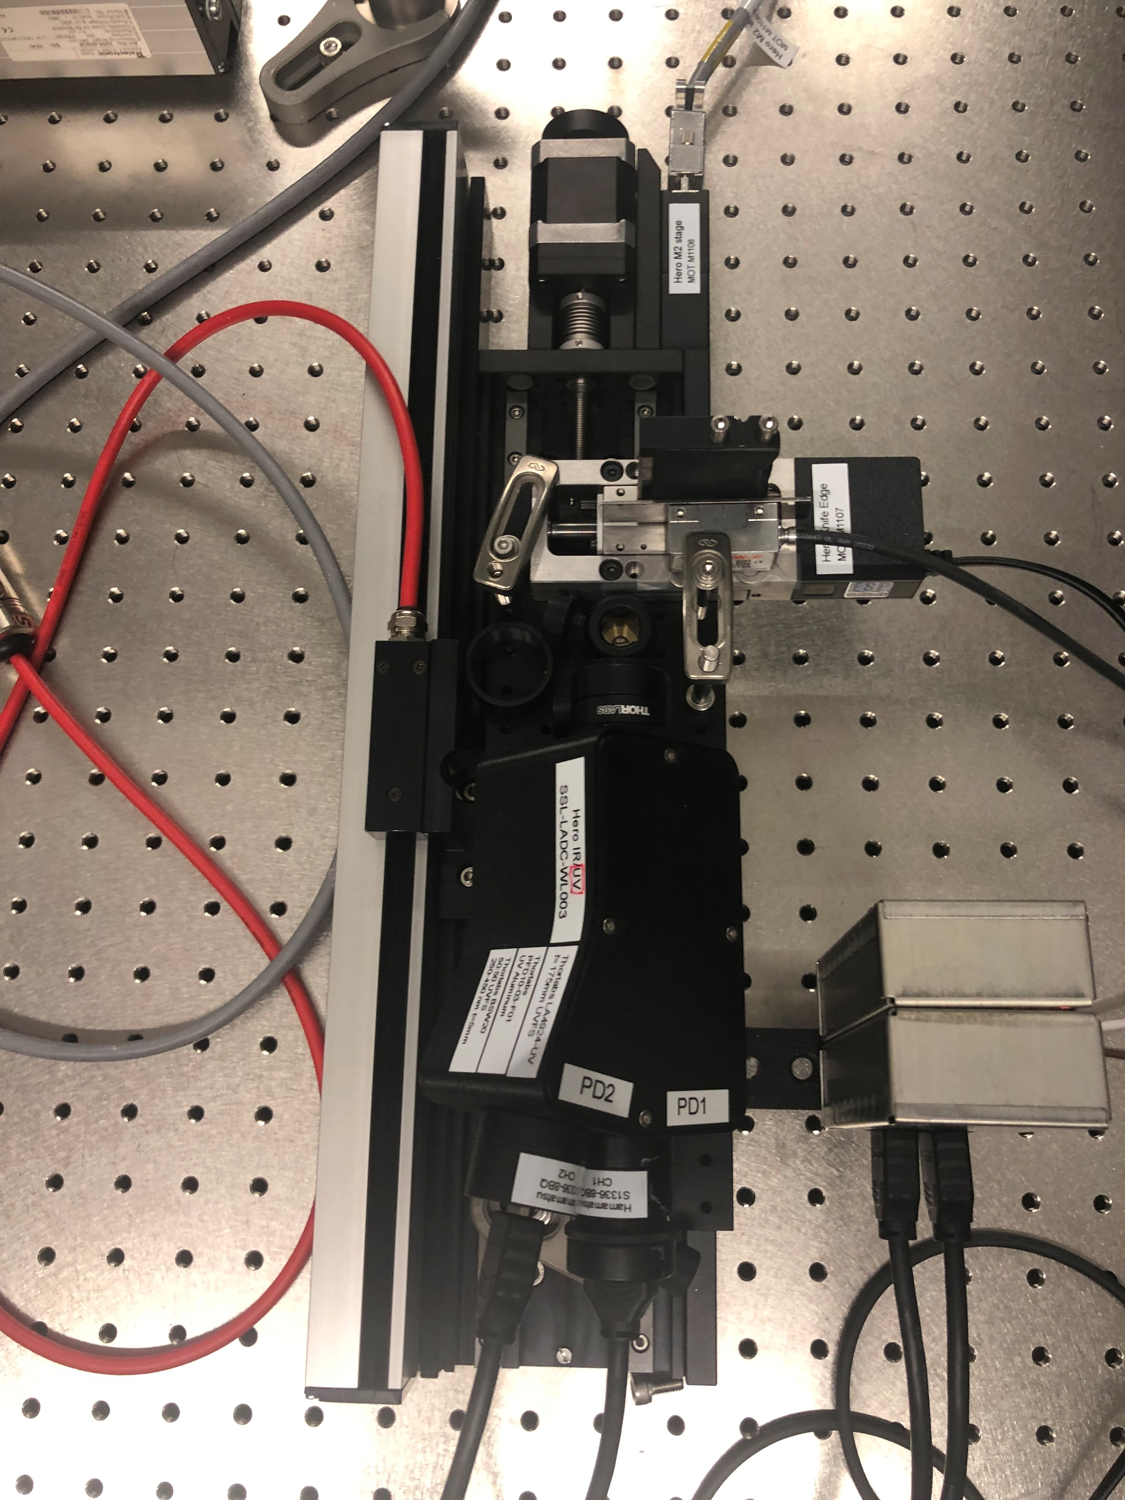
Setup for M2 measurement
Input beam
Focal length 1000 mm
Knife Edge on Newport MFA-PPA stage
Z-Translation on Owis 300 mm linear stage
Energy measurement with high resolution energy probe
(Wieser Photodiodes)
Moving knife
edge
Z - Translation
Pulse energy
detection

Slide 13
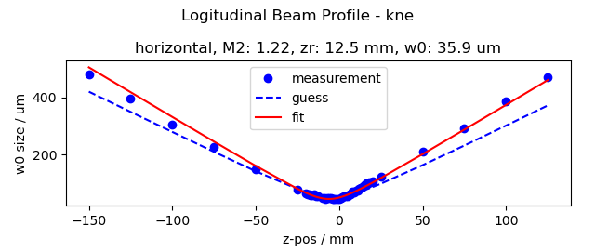
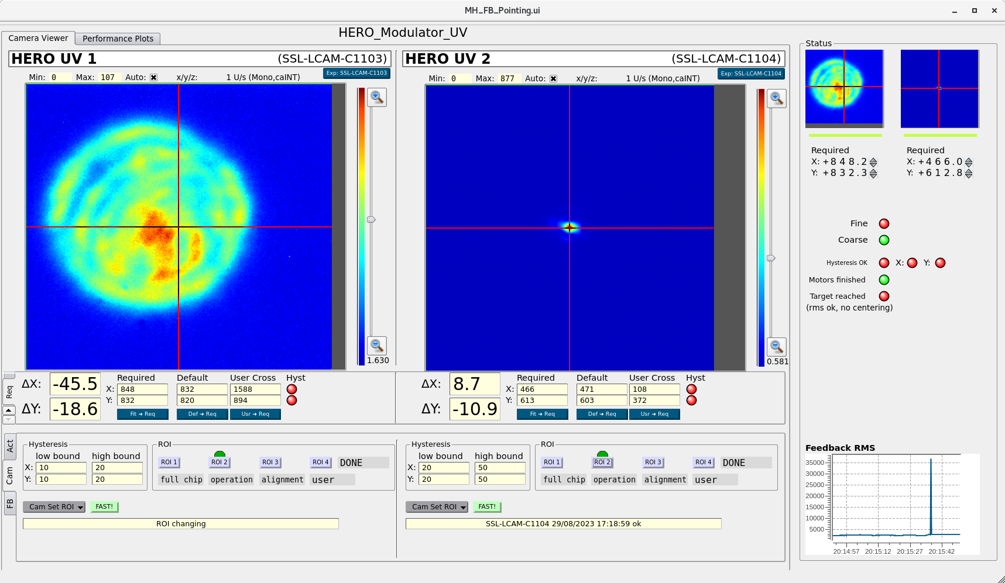
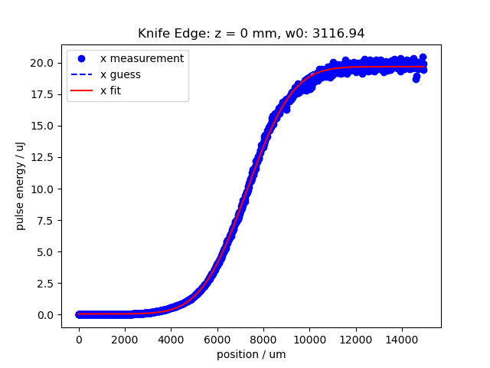
Modulator 1 – before change – full beam
Scaled to 8500mm lens:
zr: 903 mm
Radius w0: 305 um @1/e²
16.10.2023
Lens plane

Slide 14
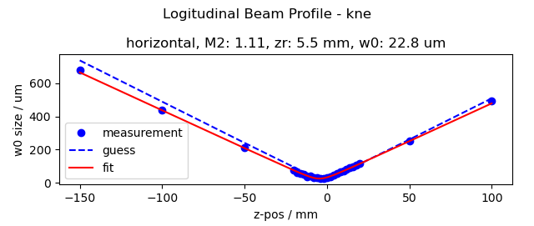
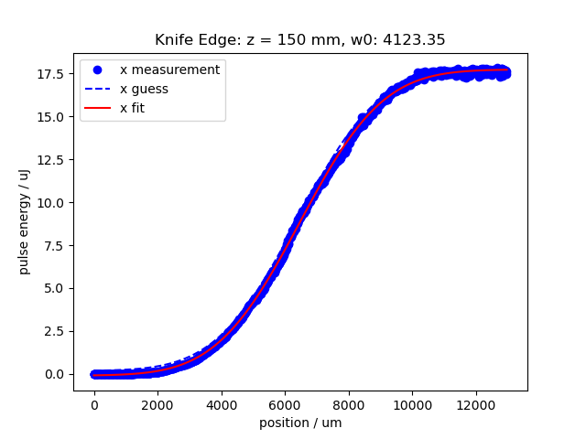
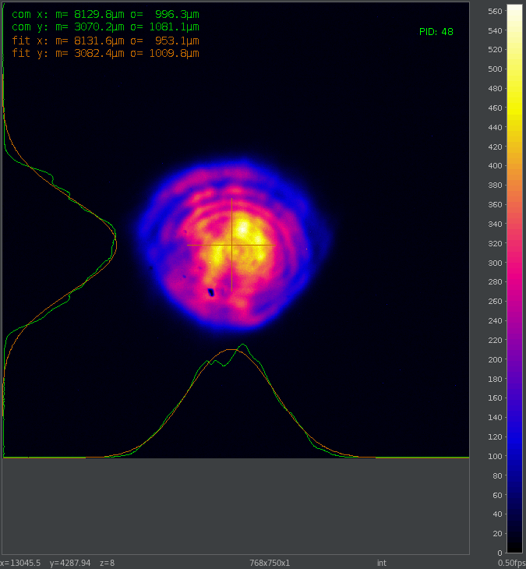
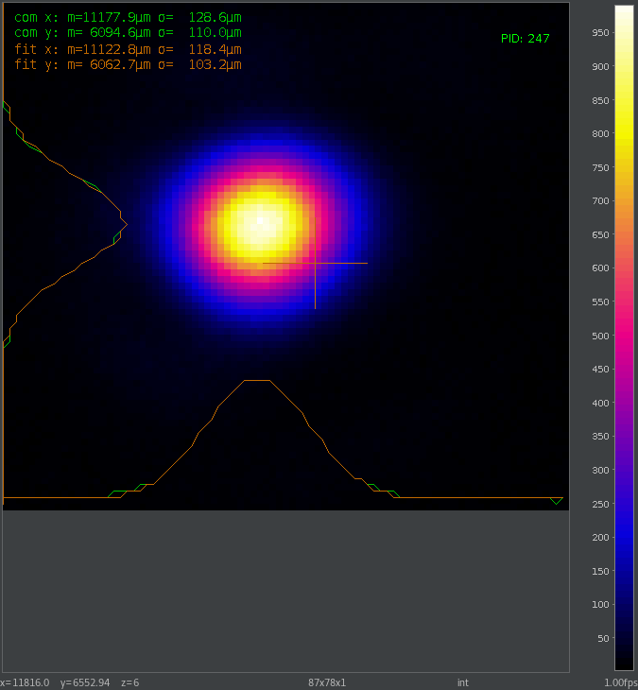
Modulator 1 – before change – full beam
Scaled to 8500mm lens:
zr: 397 mm
Radius w0: 194 um @1/e²
SSL-LCAM-C1103
imaging plane around WP
size not calibrated
SSL-LCAM-C1104
Modulator plane
Lens plane

Slide 15
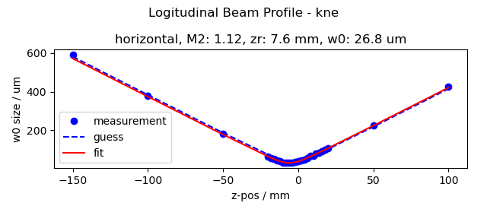
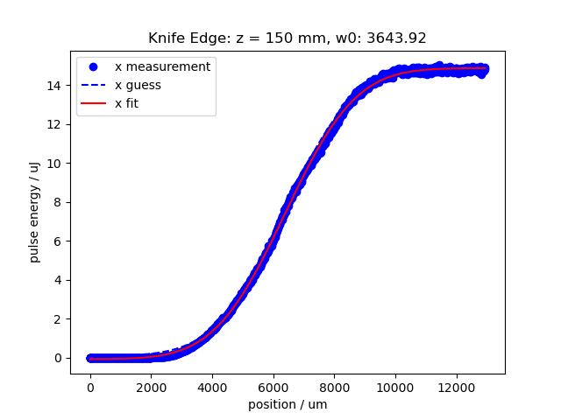

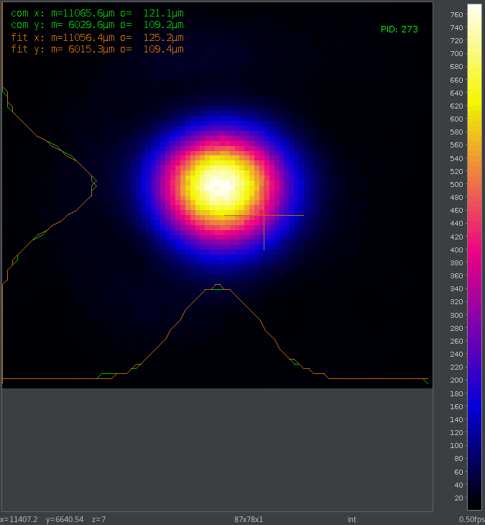
Modulator 1 – 10 mm iris
Scaled to 8500mm lens:
zr: 549 mm
Radius w0: 228 um @1/e²
SSL-LCAM-C1103
imaging plane around WP
size not calibrated
SSL-LCAM-C1104
Modulator plane
Lens plane

Slide 16
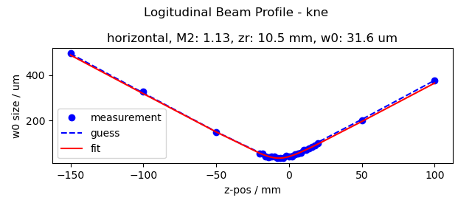
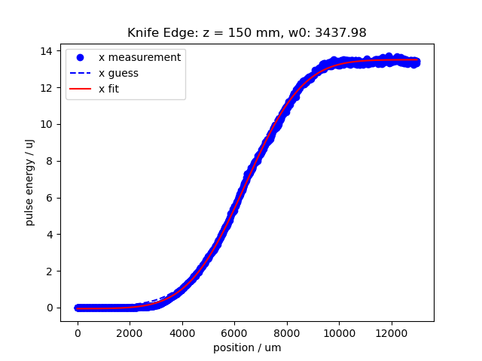
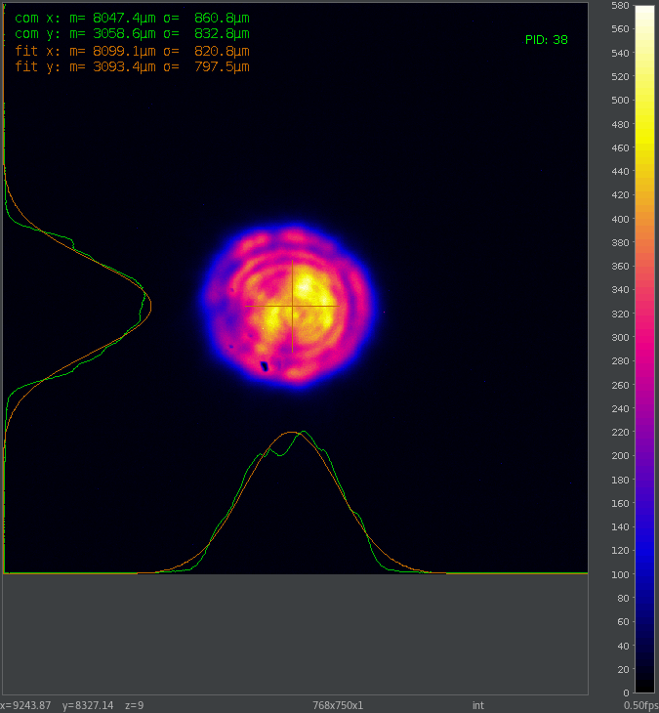
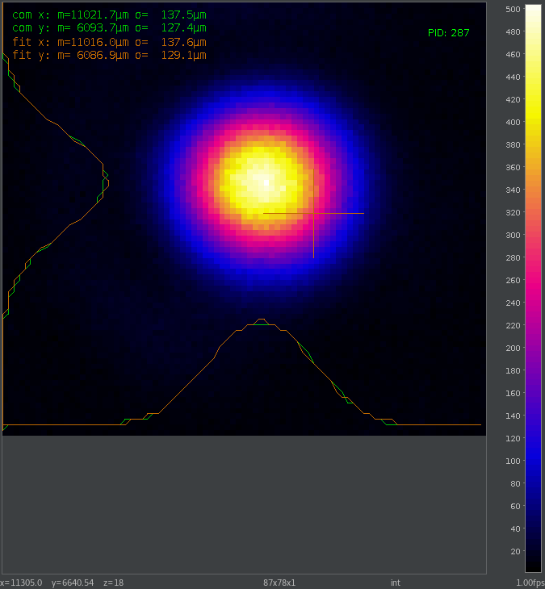
Modulator 1 – 8 mm iris
Scaled to 8500mm lens:
zr: 759 mm
Radius w0: 269 um @1/e²
SSL-LCAM-C1103
imaging plane around WP
size not calibrated
SSL-LCAM-C1104
Modulator plane
Lens plane

Slide 17
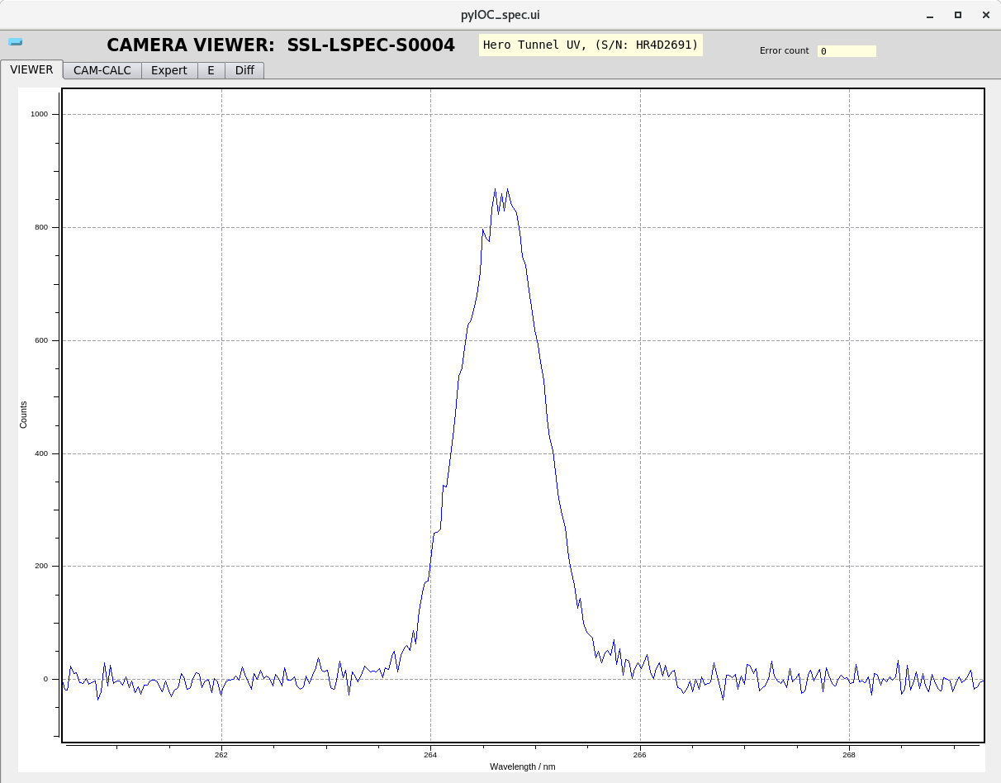
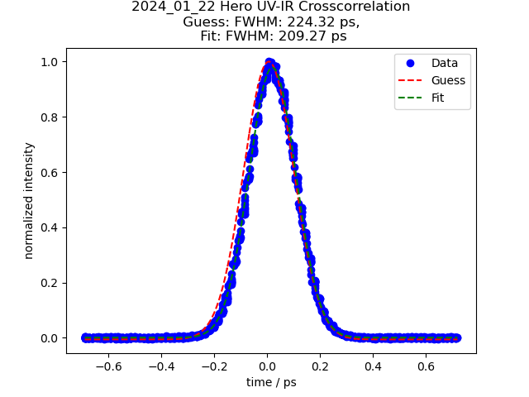
Modulator 1 – UV Pulse duration
UV pulse duration of 163 fs FWHM
(Assumed 132 fs IR pulse due to dispersion)
E_{IR}=5.4 mJ input /E_{UV}= 0.7 mJ
UV Spectrum
λ=264.7 nm /Δλ=1 nm FWHM
We are well capable of delivering expected UV beam parameters in modulator 1

Slide 18
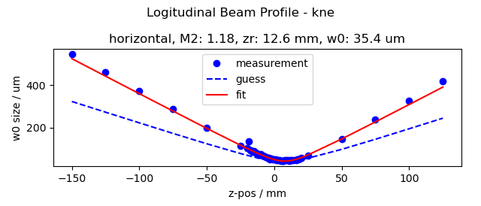
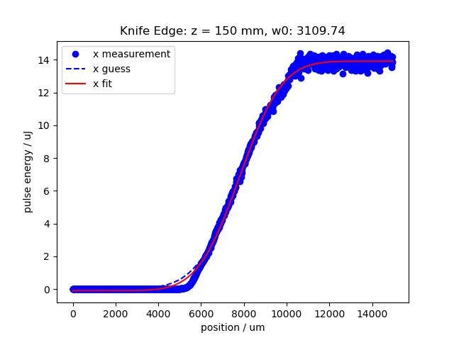
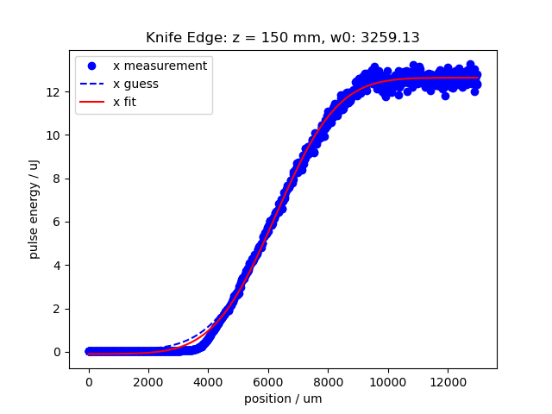
Modulator 2 – clipped beam as used in November 2023
Scaled to 8500mm lens:
zr: 910 mm
w0: 301 um @1/e²

Slide 19

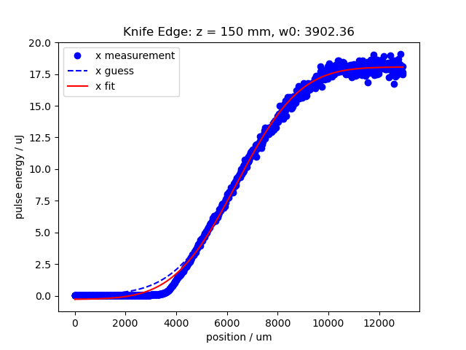
Modulator 2 – full beam as used in November 2023
Scaled to 8500mm lens:
zr: 680 mm
w0: 264 um @1/e²
More time required to improve and fully characterize seed laser 2 (@next shutdown?)

Slide 20
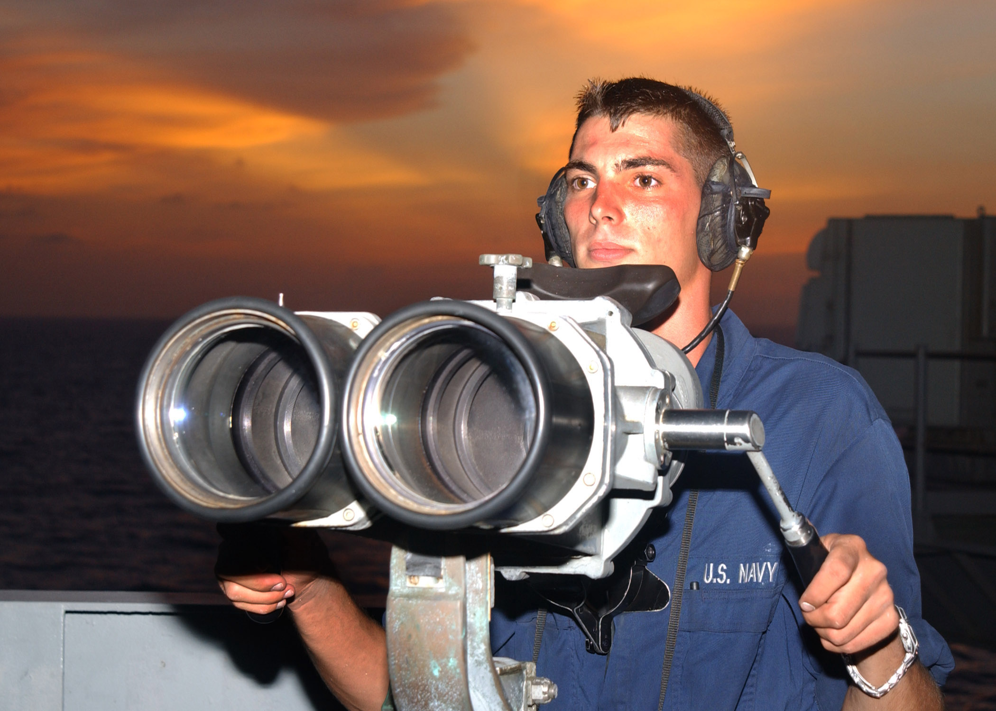
Conclusions
We have a commissioned Seed laser facility ready for MD shifts
We identified the source of the UV beam spatial structures: mainly IR compressor grating
Seed laser 1 UV beam fully characterized
The laser beam properties / parameters are well inside the specified ones
For Seed laser 2, we may improve the parameters with some time to work on the setup
What will be required for the Seed Lasers (and in what time frame)
to have an operative facility for experiments?

Slide 21
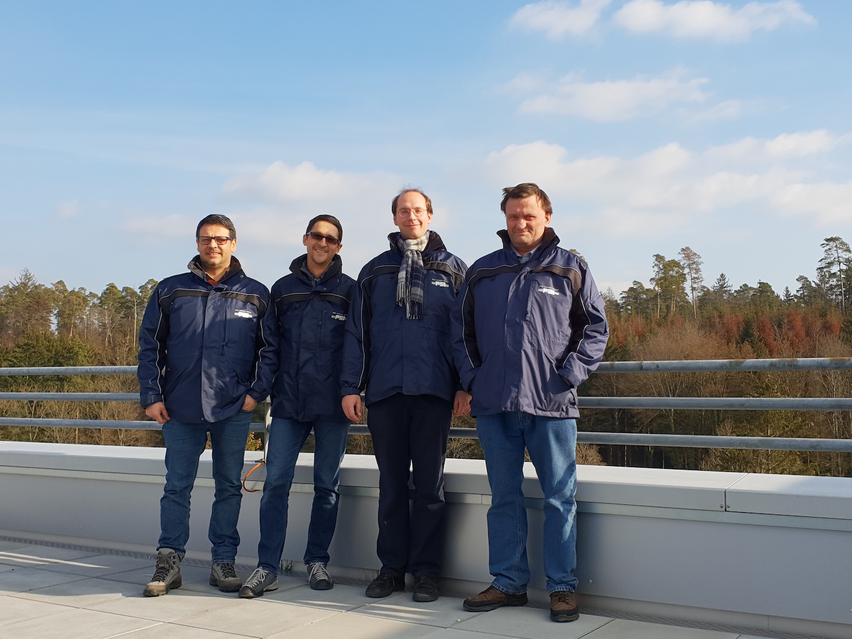
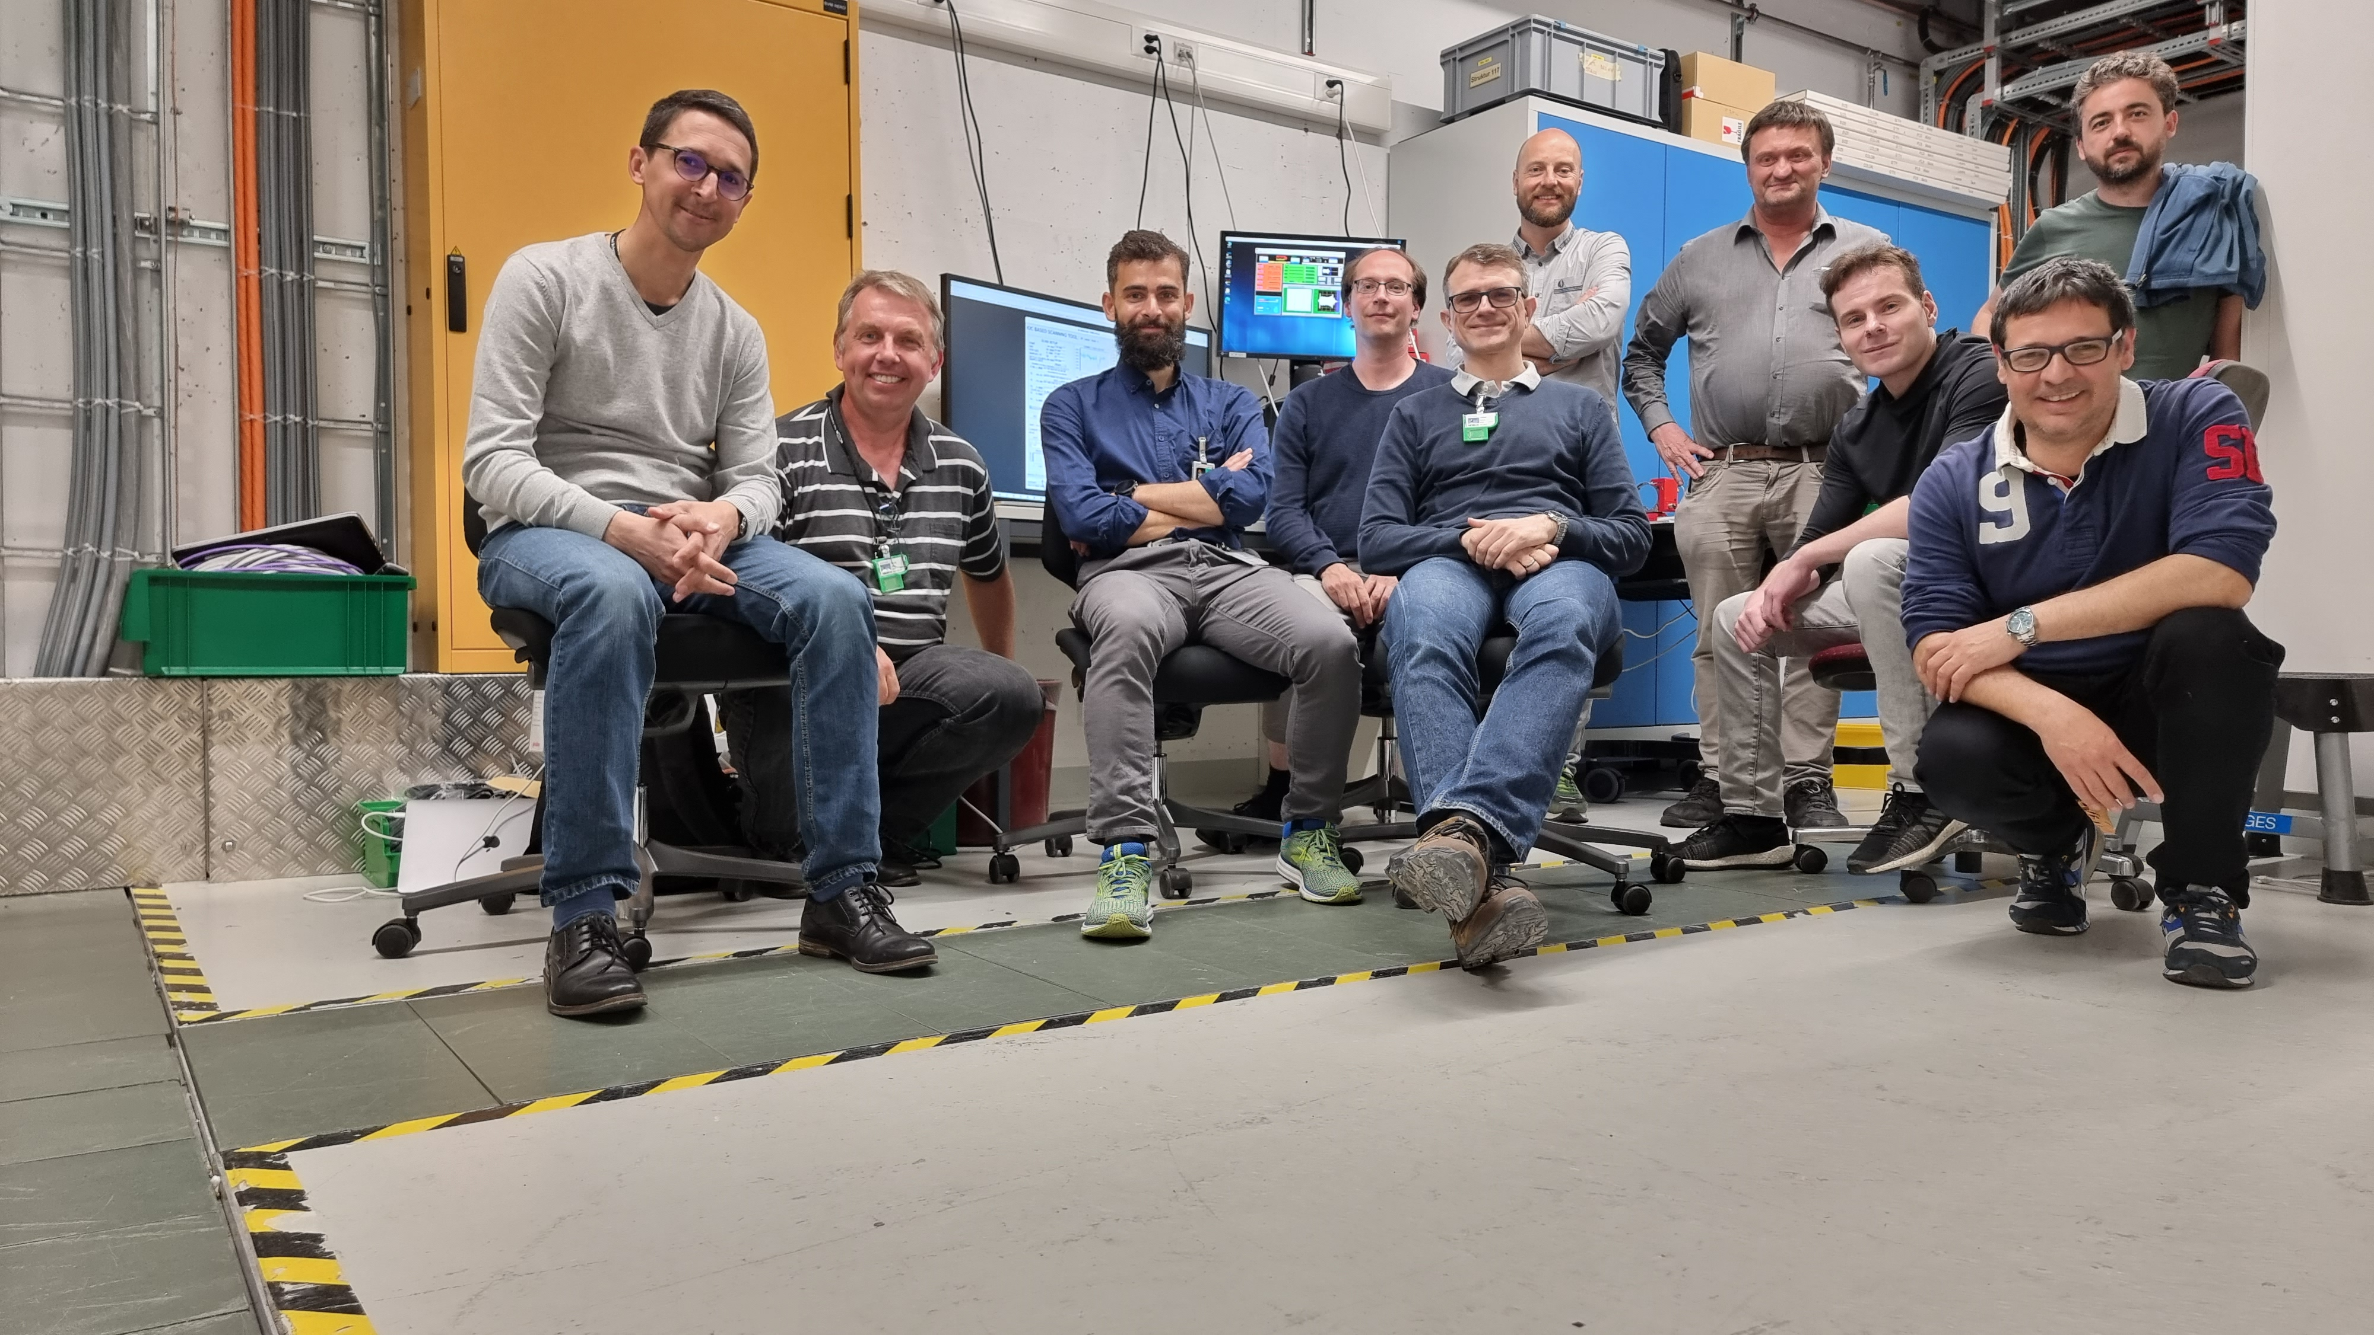
Wir schaffen Wissen – heute für morgen
Our thanks go to:
Timing & Synchronization, Diagnostics, Beam Dynamics & Operation groups
Control’s supporters
S. Neppl, A. Cavalieri

Slide 22


Seed Lasers - few numbers
Seed Lasers performances in a nutshell
November 2023, laser 800 nm
Laser wavelength (nm) | 800 / 266
Pulse duration on target FWHM (fs) IR/UV | 80 – 600 / 200
Pulse energy on target (mJ) IR/UV | 5 /0.2
Pulse energy stability on target ( % rms over 1000 shots) | <0.35 / <1.3
Beam diameter on target (um) | X=433 / Y=394 /
Relative pointing stability on modulator 1 (% of beam zize) | <1.1% over 30 min
Oscillator integrated jitter (fs rms) Over 10 Hz- 10MHz bandwidth | 16
Amplifier arrival time jitter with respect to oscillator (fs rms) over 1 min | <2.7
Relative time drift UV seed laser with respect to electrons (fs over 7h) | <36
Seed Laser Synch. quality improved a lot !
Joint effort with T&S group

Slide 23
Seed Lasers Focusing geometry
Stage 1 - UV
Motorized iris
THG
output
Mod 1
center
VA
HWP + TFP
HWP
Quartz viewport
3 mm/uncoated
F=8.5 m
UVFS
Stage 2 - UV
THG
output
Mod 2
center
2 lenses telescope
R=2/3
HWP
Quartz viewport
3 mm/uncoated
F=8.5 m
UVFS

Slide 24

Seed Lasers – UV generation
Deep-UV generation stage mounted and commissioned: required for EEHG
>400 uJ UV available in the tunning range, <1.3% RMS stability over 500 shots

Slide 25



Seed Laser 1 Upgrade December 2022
We have the compression in tunnel ->up to 5mJ/100fs FWHM @ 800 nm
We installed the UV generation stage

