Slide 1

Comparative study of microbunching instability at the FERMI FEL
Simone Di Mitri
Elettra Sincrotrone Trieste & University of Trieste

Slide 2
Motivations and contents
The design of MBI-sensitive FELs, such as the FERMI upgrade plan, asks for a comprehensive, accurate, and self-consistent modelling of the instability, for fast optimization of the machine parameters.
Since Huang’s note in 2002, several approximated IBS models have been proposed. Though in rough agreement with measurements and simulations, some formulas contain inaccuracies, implicit forms, and have never been systematically compared.
A validated MBI semi-analytical model including IBS, suitable for multi-stage compression, is presented. Two formalisms (HK, BK) are compared.

Slide 3
Outline
Instability and cures
Models
  Huang-Kim
  Bosch-Kleman
  IBS and other features
Comparison
FERMI-U
Conclusions

Slide 4
Credits
Acknowledgements
Giovanni Perosa (now Uppsala Univ.) – theory and modelling
Cheng-Ying Tsai (HUST), Alexander Brynes (Elettra, now STFC) – simulation techniques
FERMI team – measurements and discussions
References for modelling
Z. Huang K.-J- Kim, Phys. Rev. Spec. Top.-Accel. Beams 5 074401 (2002)
R. A. Bosch, J. Wu, Phys. Rev. Spec. Top. Accel. Beams 11, 090702 (2008).
Z. Huang, Technical Note No. LCLS-TN-02-8, also SLAC-TN-05-026 (2002)
S. Di Mitri, G. Perosa et al., New J. Phys. 22 (2020) 083053
G. Perosa, S. Di Mitri, Sci. Rep. (2021) 11:7895
M. Venturini, NIM A 599 (2009) 140–145.

Slide 5
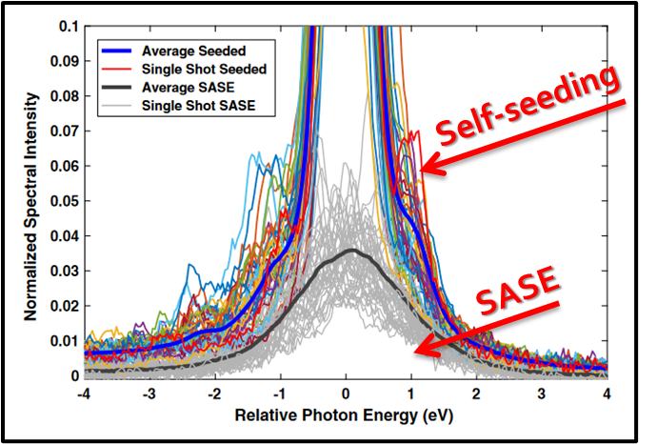
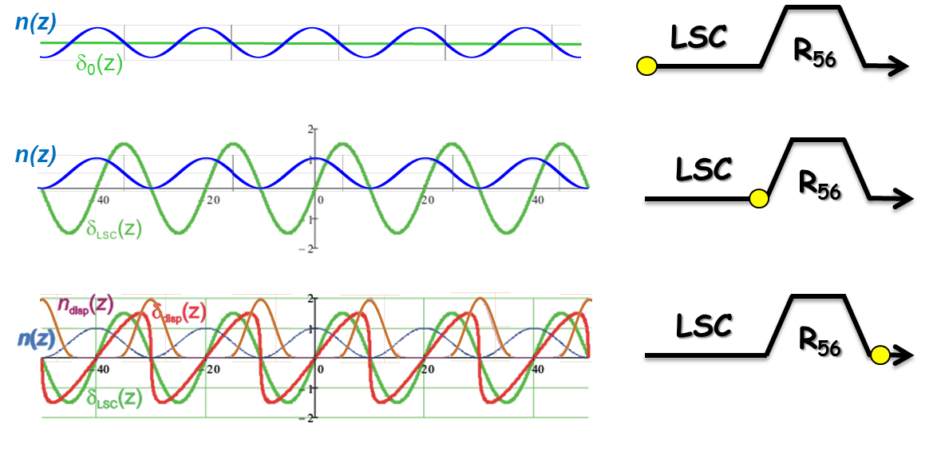
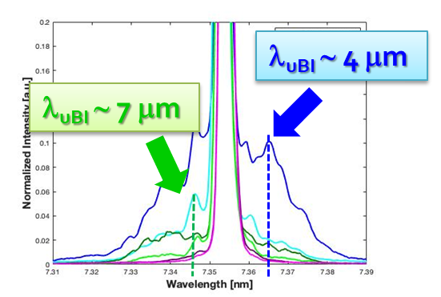
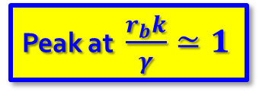
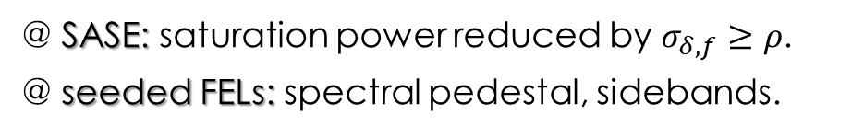
Instability
G. Marcus et al., PRAB 22 (2019)
compression & amplification
Peak at $\frac{r_{b}k}{γ}≃1$
energy mod.
λ_{f} ∼ 1 – 10 μm
R₅₆, CSR
LSC
density mod.
magnetic compressor
k_{FEL} = hk_{seed} ± mk_{ubi}
linac
G. Perosa et al., PRAB 23 (2020)
@ SASE: saturation power reduced by $σ_{δ,f}≥ρ$.
@ seeded FELs: spectral pedestal, sidebands.

Slide 6
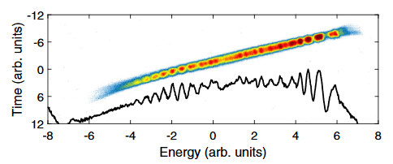
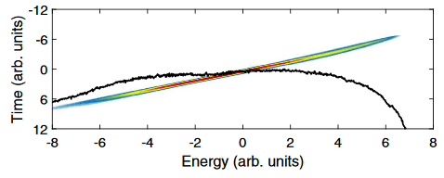
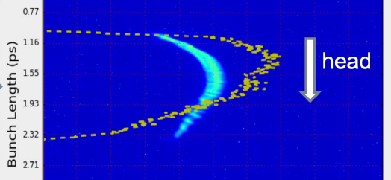
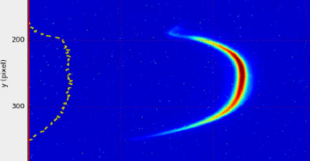
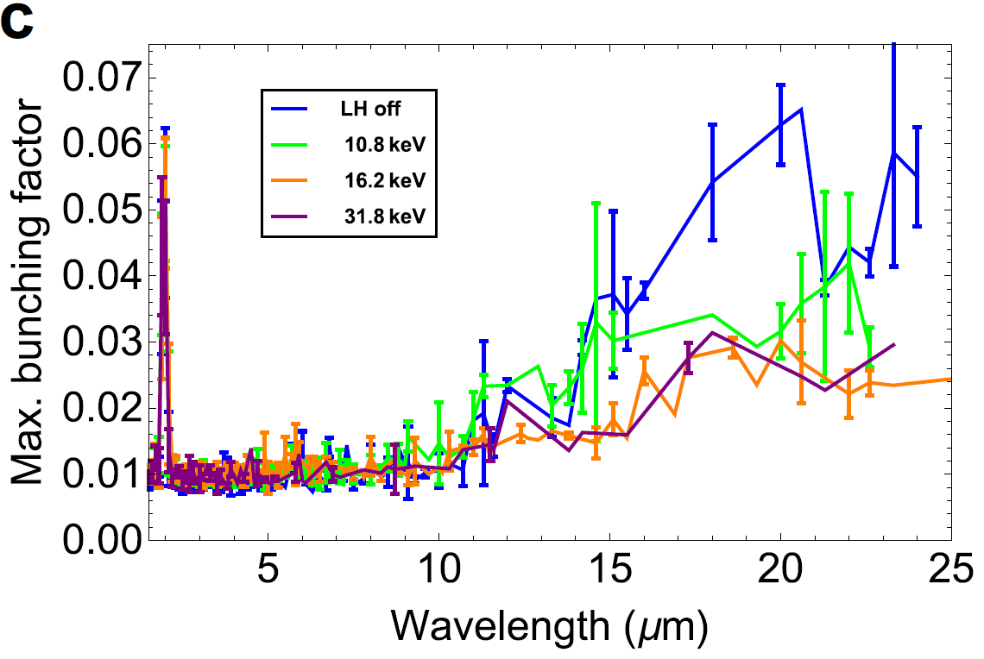
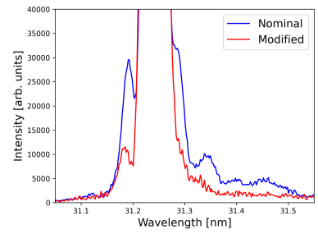
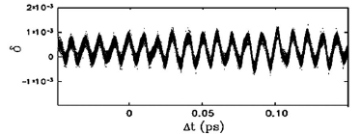
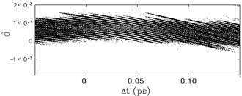
Cures
SwissFEL, S. Bettoni et al., PRAB 23 (2020)
SXFEL, Courtesy C. Feng
@ SwissFEL
  Pulse stretcher vs. stacking
  Slow-response photo-cathode
FERMI, A. Brynes et al., Sci. Rep. 10 (2020)
FERMI, Di Mitri, Spampinati, PRL (2014)
  Phase mixing
FERMI, A. Brynes et al., PRAB (2024)
  Laser heater
  Curl-H_{x} function

Slide 7
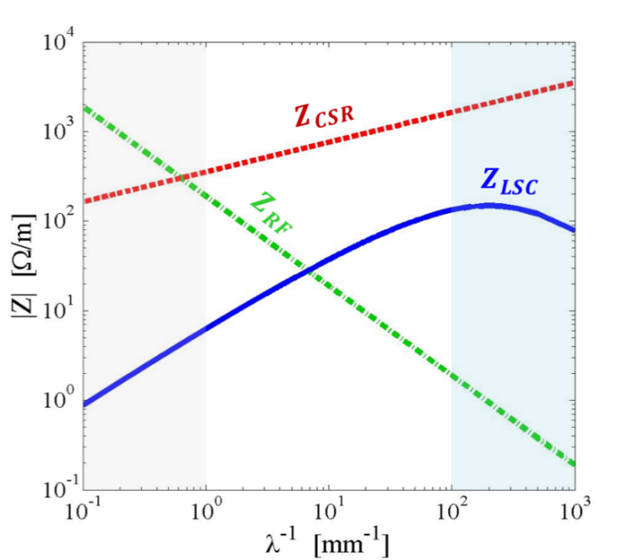

Impedances
S. Di Mitri, CAS 2018 Vol.I
compression & amplification
energy mod.
density mod.
Longitudinal Space Charge:
effective 3-D for round beam, energy-dependent, shielding
Coherent Synchrotron Radiation:
1-D, steady-state
a=10mm, R=5m, r_{b}=0.4mm, E=0.3GeV
RF geometric impedance:
1-D, short bunches
uncompressed
bunches
Coherent Edge Radiation:
1-D, steady-state
compressed
bunches
initial

Slide 8
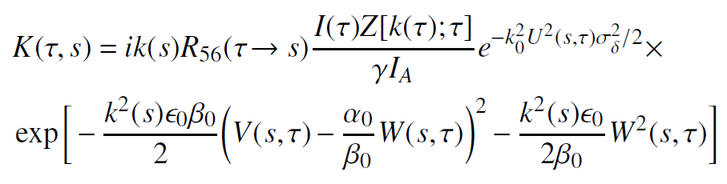


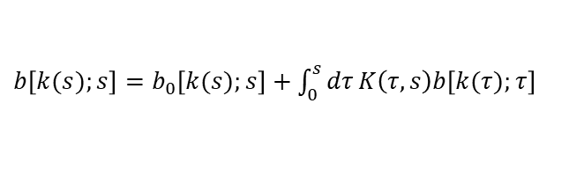
Huang–Kim model
Z. Huang, K.-J. Kim, PRST-AB 5, 074401 (2002)
compression & amplification
Integral linearized Vlasov eq., solved by iteration at 2nd order in kernel.
We keep low gain terms in.
energy mod.
density mod.
Bunching factor:
Energy modulation:
energy-dependent, s-integral
$b\left[k(s);s\right]=b_{0}\left[k(s);s\right]+\int_{0}^{s}{dτ}K\left(τ,s\right)b\left[k(τ);τ\right]$
where
Bunching factor:
1-D, shot noise
$$≈\frac{2ec}{I_{0}λ}$$
is specialized to a 4-dipoles chicane (most of CSR driven in the 4th dipole).

Slide 9



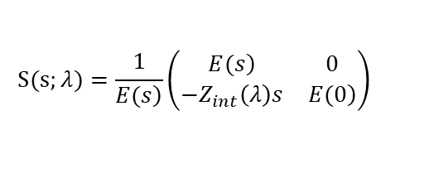
Bosch–Kleman model
R. Bosch et al., PRST-AB 5, 090702 (2008)
compression & amplification
Matrix model for modulations in the 2-D long. ph. sp.
Low gain terms included by def.
energy mod.
density mod.
Bunching factor:
Energy modulation:
energy-dependent, s-integral
$$S(s;λ)=\frac{1}{\left.E(s\right)}\left(\begin{matrix}\left.E(s\right) & 0 \\ −Z_{int}\left(λ\right)s & \left.E(0\right)\end{matrix}\right)$$
where
Bunching factor:
1-D, shot noise
$$F_{1}(λ)=\int{\left.dδf(δ)cos{[}k\left(λ\right)CR_{56}δ/E\right]}$$
$$≈\frac{2ec}{I_{0}λ}$$
$$G_{1}(λ)=\int{\left.dδf(δ)sin{[}k\left(λ\right)CR_{56}δ/E\right]}$$
are for generic dispersive terms.

Slide 10

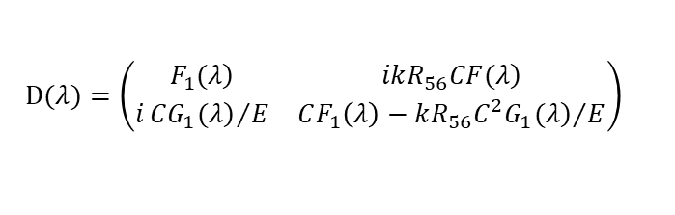
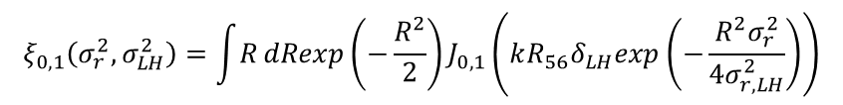
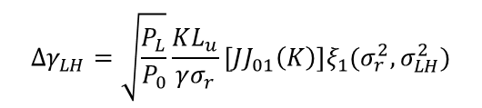

Longitudinal Landau damping
Intrinsic energy spread, IBS, LH: added in qudrature step-wise along the line. Exponential suppression of bunching.
Huang–Kim
Bosch–Kleman
$$exp\left[−\frac{1}{2}{\left(CkR_{56}σ_{δ,i}\right)}^{2}\right]$$
$$D(λ)=\left(\begin{matrix}\left.F_{1}(λ\right) & \left.ikR_{56}CF(λ\right) \\ i{\left.CG_{1}(λ\right)}/E & CF_{1}\left(λ\right)−{\left.kR_{56}C^{2}G_{1}(λ\right)}/E\end{matrix}\right)$$
Laser heater: round beam, Gaussian distributions, arbitrary electrons-laser overlap.
$$Δγ_{LH}=\sqrt{\frac{P_{L}}{P_{0}}}\frac{KL_{u}}{γσ_{r}}\left[JJ_{01}\left(K\right)\right]ξ_{1}(σ_{r}^{2},σ_{LH}^{2})$$
${\left(F,G\right)}_{LH}(λ)=exp\left[−\frac{1}{2}\left(CkR_{56}σ_{δ,i}\right)\right]$ $ξ_{0,1}(σ_{r}^{2},σ_{LH}^{2})$
$$ξ_{0,1}\left(σ_{r}^{2},σ_{LH}^{2}\right)=\int{R}dRexp\left(−\frac{R^{2}}{2}\right)J_{0,1}\left(kR_{56}δ_{LH}exp\left(−\frac{R^{2}σ_{r}^{2}}{4σ_{r,LH}^{2}}\right)\right)$$
where

Slide 11
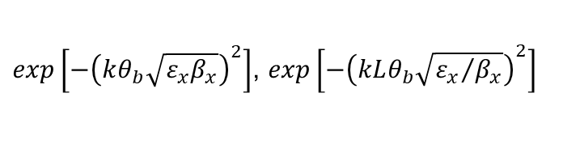

Transverse Landau damping
Dispersive motion coupled to betatron emittance: H_{x}ε_{x}.
Huang–Kim
Bosch–Kleman
$$exp\left[−{\left(kθ_{b}\sqrt{ε_{x}β_{x}}\right)}^{2}\right]$$
$exp\left[−{\left(kθ_{b}\sqrt{ε_{x}β_{x}}\right)}^{2}\right]$, $exp\left[−{\left(kLθ_{b}\sqrt{{ε_{x}}/{β_{x}}}\right)}^{2}\right]$
and related quantities for 1- and 2-stage amplification through a 4-dipole chicane.
and related quantities for uncompressed and compressed wavelengths through a 4-dipole chicane
The damping appears to be dominated by the derivative of dispersion, i.e., outer dipoles.
The damping is distributed along the chicane, associated to both dispersion and its first derivative.

Slide 12
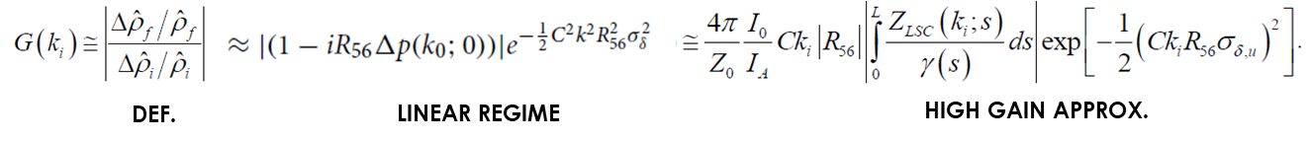


Gain & final energy spread
Gain = ratio of final and initial bunching:
  defined at any point along the line;
  linear regime, including low gain terms + 2nd order correction.
we include 2nd order correction
(frequency mixing)
we include low gain terms
$$σ_{γ}^{2}=\int{{\left|Δγ\left(λ\right)\right|}^{2}}=\frac{2ec}{I_{0}}\int{d}λ\frac{{\left|G\left(λ\right)Z_{int}\left(λ\right)\right|}^{2}}{λ^{2}}$$
+ intrinsic² + IBS²

Slide 13

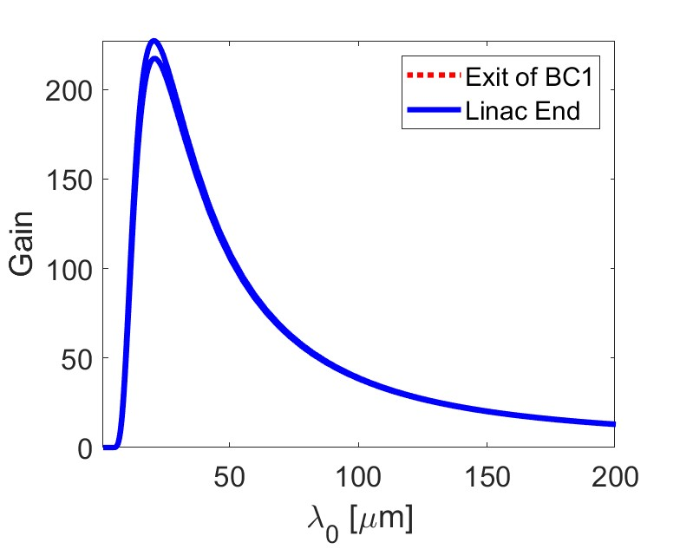
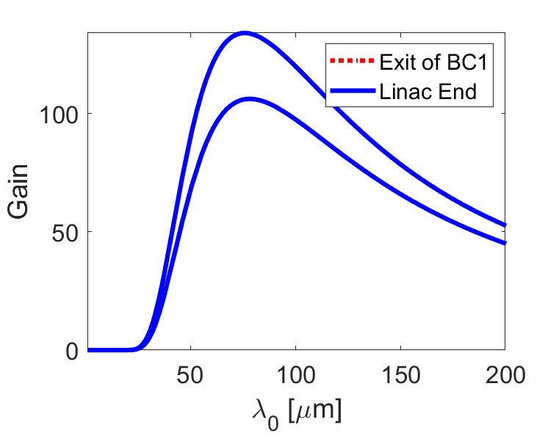



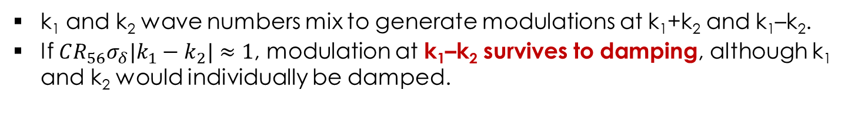
Venturini’s 2nd order gain correction
k₁ and k₂ wave numbers mix to generate modulations at k₁+k₂ and k₁–k₂.
If $CR_{56}σ_{δ}|k_{1}−k_{2}|≈1$, modulation at k₁–k₂ survives to damping, although k₁ and k₂ would individually be damped.
$$∝C^{2}R_{56}^{2}$$
M. Venturini, NIM A 599 (2009) 140
G₂
G₂
G₁
G₁
$$I0=65A, CF=10,$$
$$θ=85mrad$$
$$I0=65A, CF=10,$$
$$θ=170mrad$$

Slide 14
Intrabeam scattering
Z. Huang, LCLS-TN-02-8 (2002)
compression & amplification
energy mod.
density mod.
Added in quadrature to σ_{δ}, step-wise along the line
Sets the maximum scattering angle, discards single scattering effects (cutoff).
Cutoff time scale ≡ the time the bunch takes to travel along the section.
Piwinski, Bane
Raubenheimer

Slide 15
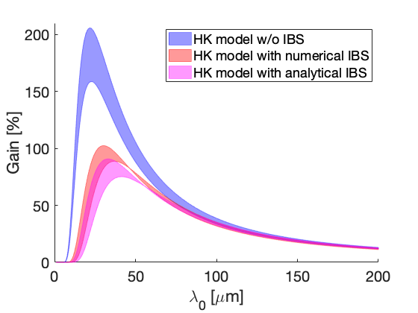
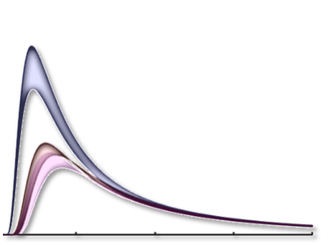

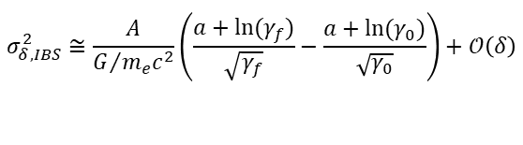

Impact of IBS on the gain
G. Perosa, S. Di Mitri, Sci. Rep. 11:7895 (2011)
Since the cutoff depends on the beam energy, its effect has to be properly integrated along accelerating sections.
FERMI linac, C1=10
No IBS
HK model
CONSTANT Clog
$σ_{δ,IBS}^{2}≅\frac{4}{3}\frac{k(\overline{γ})}{G/{m_{e}c^{2}}}\left(\frac{γ_{f}^{3/2}−γ_{0}^{3/2}}{γ_{f}^{2}}\right)$, $γ_{f}≈γ_{0}$
BK model
INTEGRAL,
approx.
$$σ_{δ,IBS}^{2}≅\frac{1}{G/{m_{e}c^{2}}}\frac{\int_{γ_{0}}^{γ_{f}}{dγ^{′}k\left(γ^{′}\right)}}{γ_{f}^{2}}+𝒪\left(δ\right)$$
IBS integral
CLOSED FORM,
approx.
$$σ_{δ,IBS}^{2}≅\frac{A}{G/{m_{e}c^{2}}}\left(\frac{a+ln⁡(γ_{f})}{\sqrt{γ_{f}}}−\frac{a+ln⁡(γ_{0})}{\sqrt{γ_{0}}}\right)+𝒪\left(δ\right)$$
IBS const. Clog
IBS reduces the peak gain by ∼50%.
Integral form predicts a gain ∼15% larger than the analytical form.
HK-model predicts a peak gain ∼20% larger than BK-model.

Slide 16
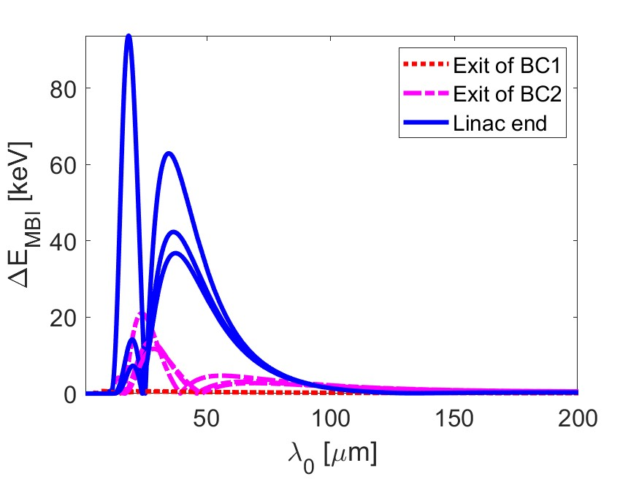
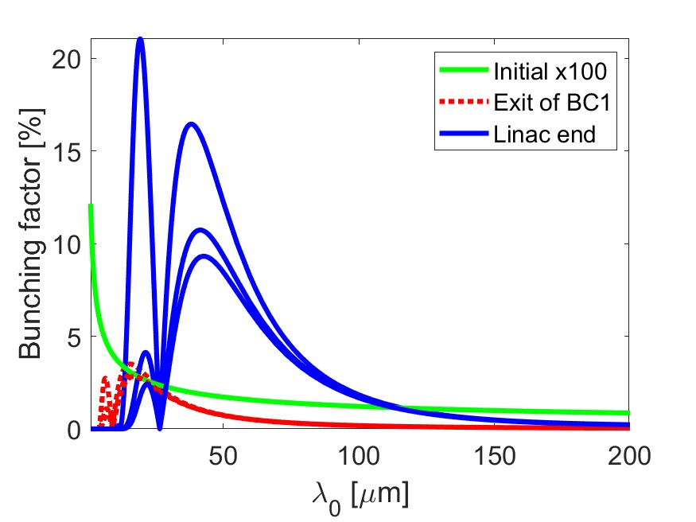
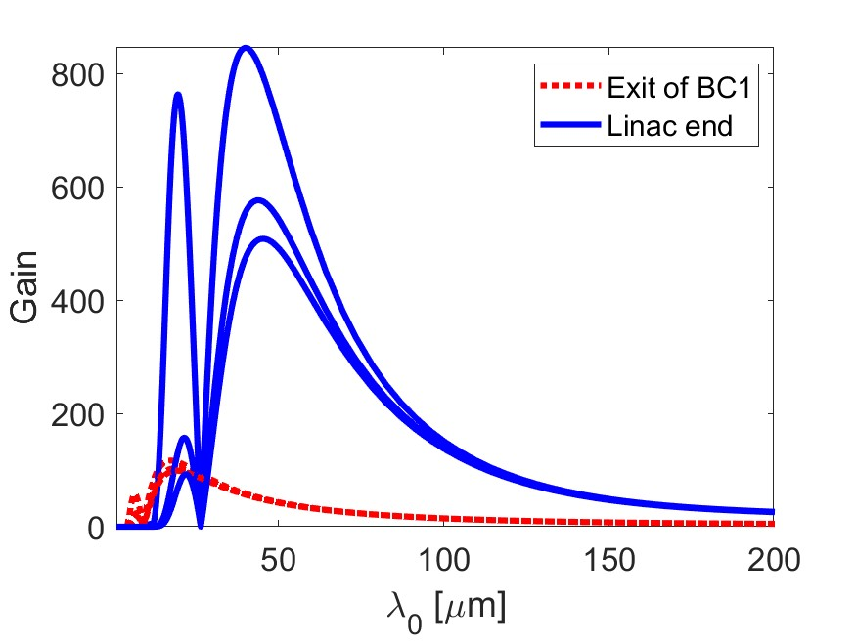
Comparison of IBS models
$I0=65A, CF=53, δ_{i}=1keV, δ_{LH}=3keV$
Integral
Integral,
93keV
Closed form
Closed form,
85keV
Constant
Constant,
88keV
All IBS methods well agree in one-stage compression.
Integral IBS form predicts peak gain up to 40% larger in 2-stage, but comparable final energy spread → conservative model

Slide 17
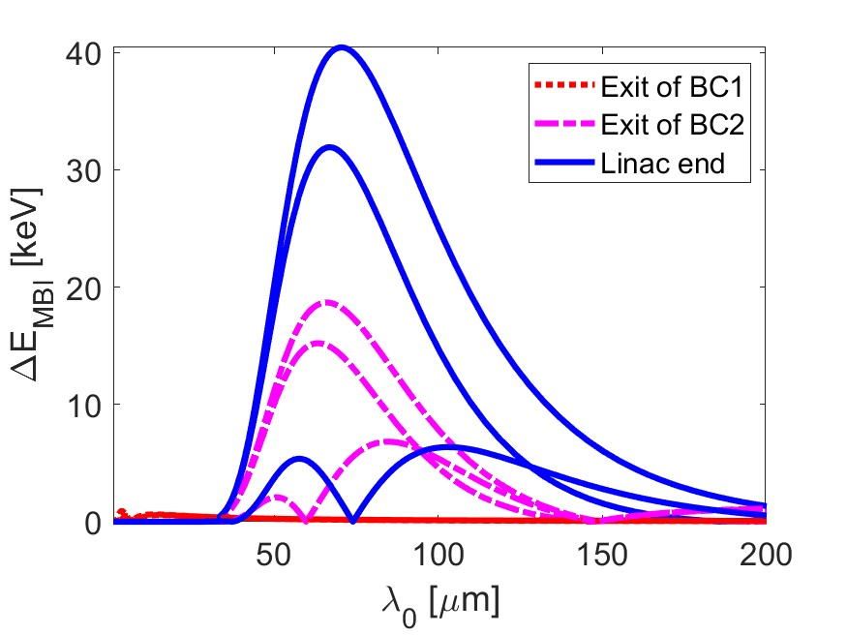
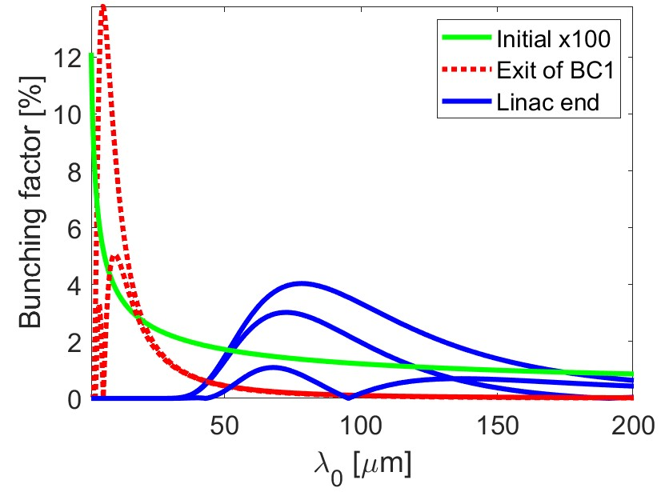
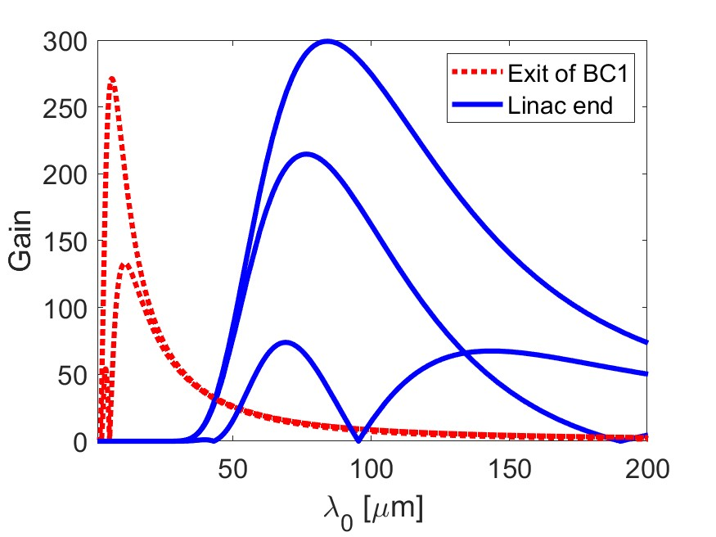
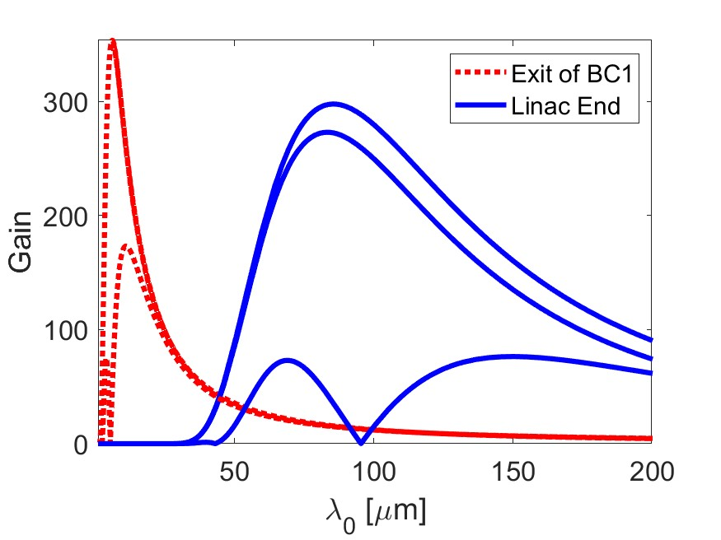
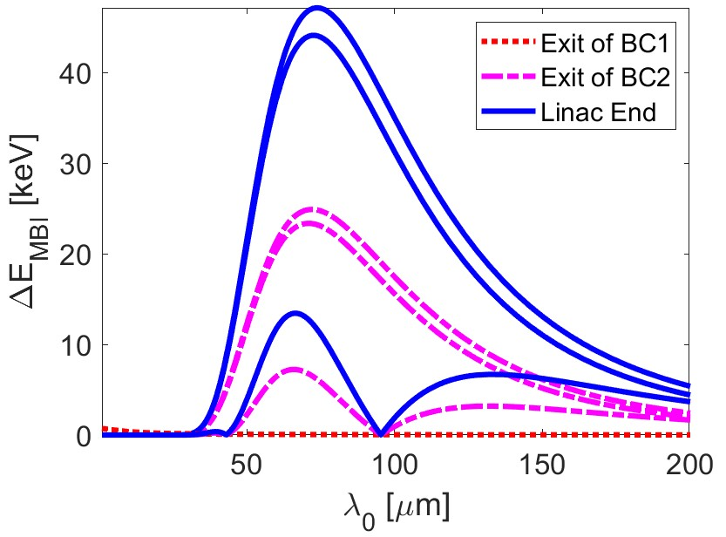
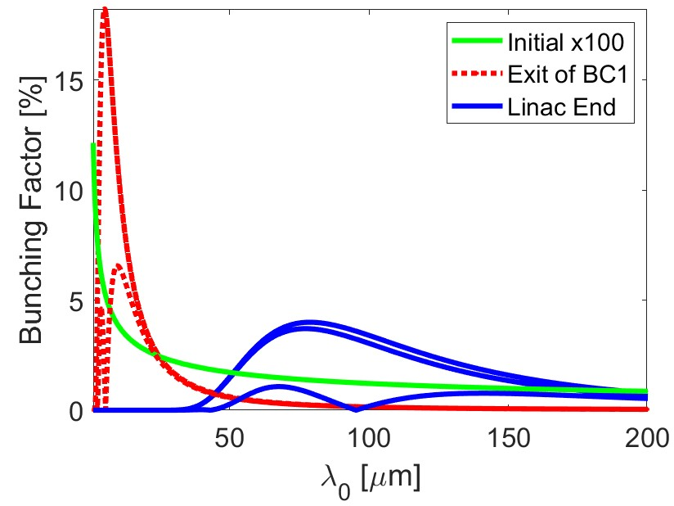
Comparison of BK and HK models
$I0=65A, CF=3 x 30, δ_{i}=1keV, δ_{LH}=3keV$
+CSR, CER
290 keV
BK
w/ IBS
288 keV
+ LH
349 keV
Agreement (within 20%) of BK and HK, both in gain and energy spread, 1- and 2-stage
+CSR
289 keV
HK
w/ IBS
288 keV
+ LH
395 keV

Slide 18
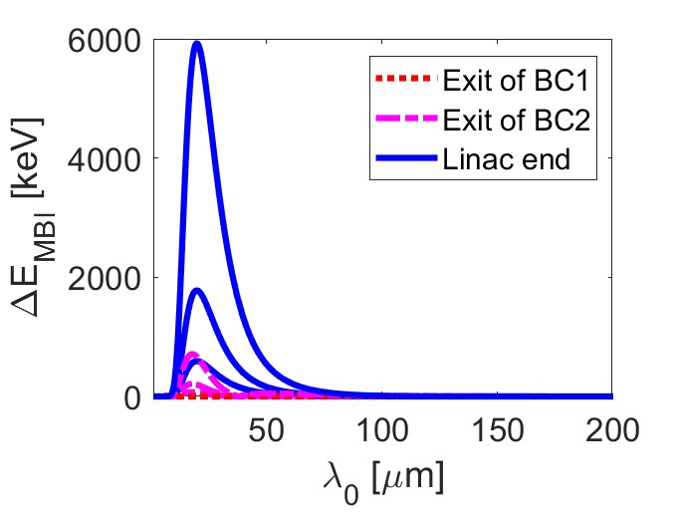
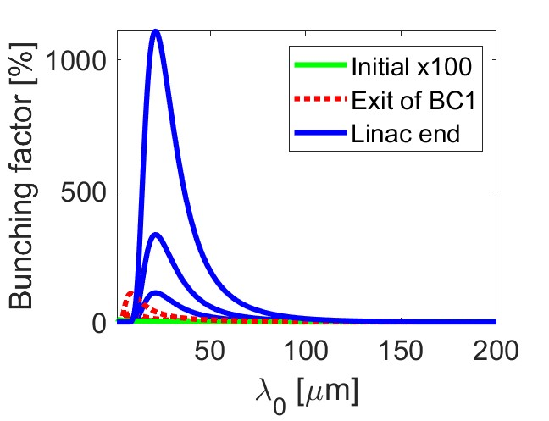
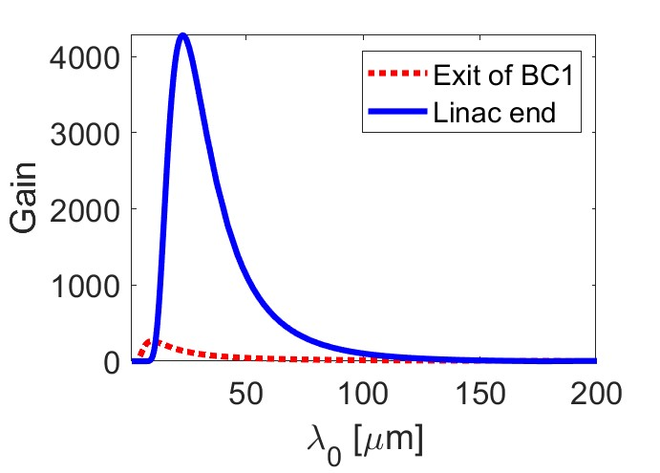
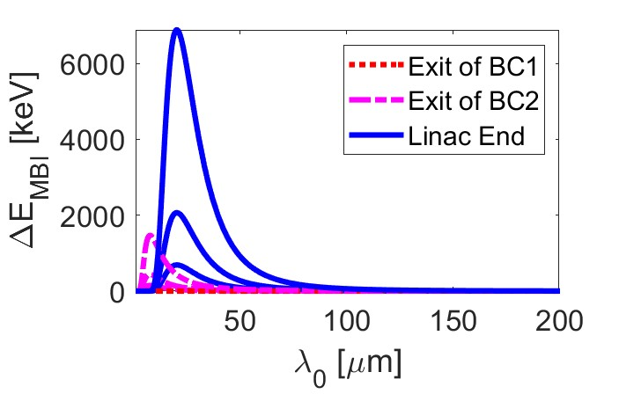
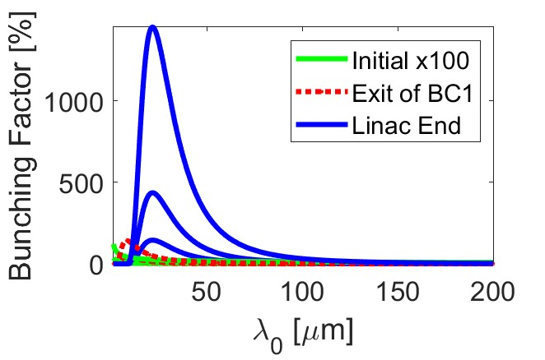
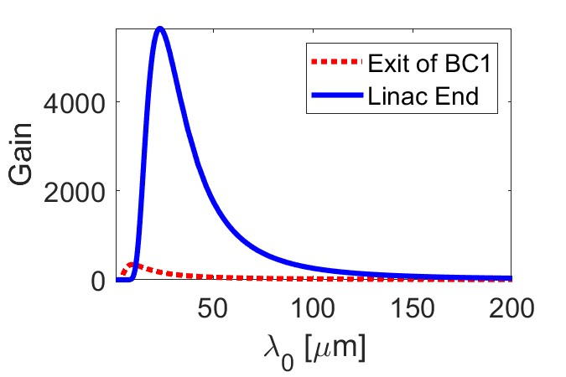
Validation: initial bunching
$I0=65A, CF=5 x 3, δ_{i}=1keV, δ_{LH}=0, b0=1, 3$, 10$$
BK
Linear gain is independent from initial bunching (somehow in contrast to J-W Park et al., NIM A 999 (2021))
HK

Slide 19
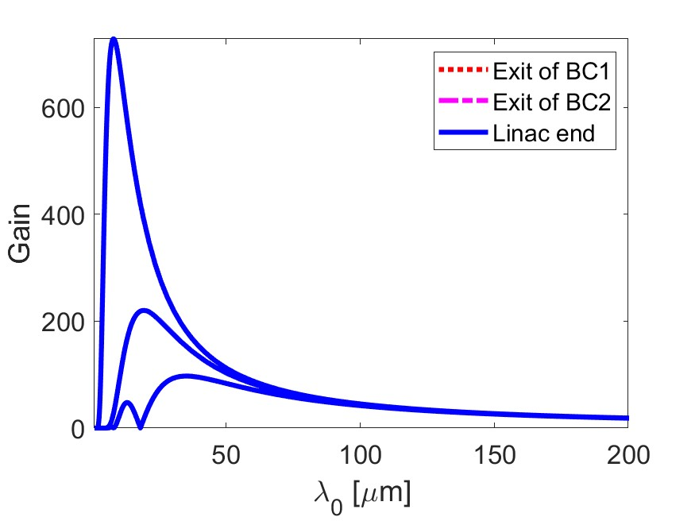
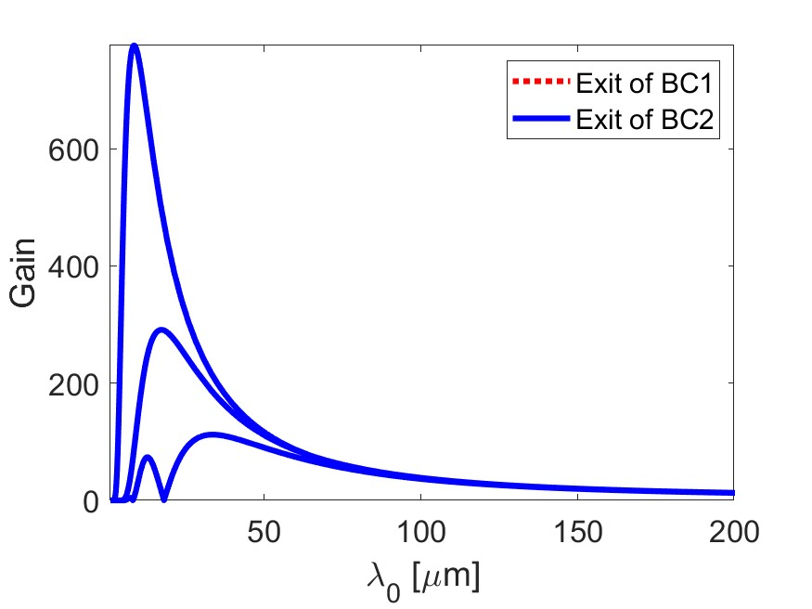
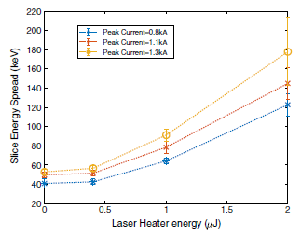
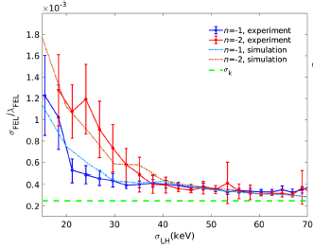
BK vs. HK: FERMI BC1 only
$I0=65A, CF=10,{ δ}_{i}=1keV, δ_{LH}=3keV$
G. Penco, G. Perosa et al., PRAB 23, 120704 (2020)
no IBS, no LH
493 keV
no IBS, no LH
505 keV
BK
HK
+ IBS
98 keV
+ IBS
126 keV
+ LH
49 keV
+ LH
54 keV
N. Mirian et al., PRAB 24, 080702 (2021)
”Cold-beam” observations confirmed (exp.2020)
Strong MBI in FERMI EEHG (exp.2019) has to be attributed to initial modulations above shot noise level - cathode surface disruption?

Slide 20
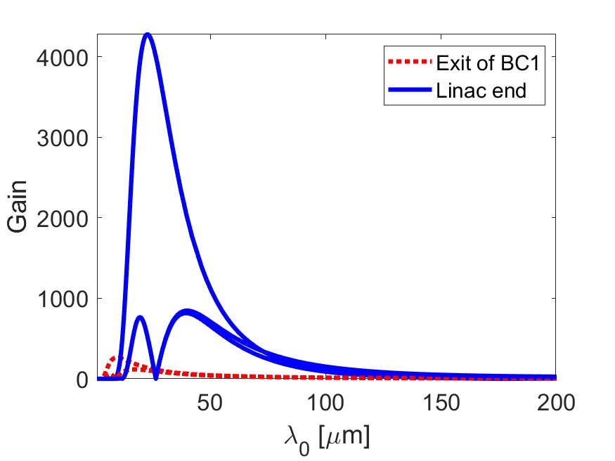

BK vs. HK: FERMI BC1+BC2
$I0=65A, CF=4 x 2.5,{ δ}_{i}=1keV, δ_{LH}=3keV$
w/ IBS, no LH
463 keV
w/ IBS, no LH
550 keV
BK
HK
+ LH
92 keV
+ LH
115 keV
+ CSR, CER
93 keV
+ CSR
119 keV
BC1+BC2 apparently still compatible with lasing (energy spread), BUT….
…peak gain 10-times larger than in BC1-only,
…final energy spread >> intrinsic one (120 vs. 30 keV) → strong residual MBI

Slide 21



FERMI-U, BC1 vs. BC1+BC2
See also S. Di Mitri et al., NJP 22, 083053 (2022)
$I0=65A, CF_tot=15,{ δ}_{i}=1keV, δ_{LH}=3keV$
BC1-only
BC1+BC2
BC1+BC2 optimized
67 keV
81 keV
83 keV
FEL L_{c} @ 2nm
FEL L_{c} @ 4nm
The model allows fast optimization of the compression scheme, e.g., lower initial current, stronger phase mixing in BC2.
2-stage can turn to be helpful for I> 1kA, C>>1, and w/ strong long. wakes

Slide 22

Conclusions
Both HK and BK theory is suitable for modelling MBI in multi-stage compression.
Reasonable agreement in a large variety of configurations, range of parameters, and implemented features.
  Discrepancy tends to exceed 30% for peak gain at $λ_{0}≤1 μm$ (numerical issue?), or for large gain in 2-stage (amplification).
Average optics along linac sections and definition of RMS bunch length add uncertainty to the prediction.
  The models need gauging vs. numerical or experimental result.
Still, both they capture the relevant physics and allow for fast optimization of machine parameters and layout.
  Next step is validation of 3-compressors, spreader, undulator line.

