Slide 1
Slice Energy Spread Measurements in the EuXFEL Injector
Stuart Walker, Sergey Tomin, Igor Zagorodnov, Nina Golubeva, Matthias Scholz, Winfried Decking, Bolko Beutner, Erion Gjonaj
LEDS Workshop 2024, Bern, 19/9/2024

Slide 2
Overview
Subheading, optional
Motivation
Context
Overview of the EuXFEL
Slice Energy Spread Measurements
Conclusion

Slide 3
Motivation
Uncorrelated (slice) energy spread is an important property in FELs, where high brightness is required.
However, usually energy spread from injector is too low and must be increased using the laser heater (LH) to increase SASE performance due to the microbunching instability.
  Ideally increased to 8 keV based on simulations from Martin Dohlus, but actual optimal value never measured.
Regardless, understanding uncorrelated energy spread is necessary to improve machine reproducibility and understanding.
Dynamics not understood, unable to recreate measured slice energy spread values with ASTRA simulation.
Notes:
spread spread

Slide 4
Context
Fermi, 2020: Intrabeam scattering measured, but result highly dependent on initial energy spread, which was treated as a free parameter.
SwissFEL, 2020: energy spread measurement in the injector using an energy scan—15 keV @ 200pC & >100MeV.
EuXFEL, 2021: Similar approaching involving a dispersion scan—6 keV @ 250pC & 130MeV.
PITZ, 2022: 2 keV @ 250pC & 20MeV.
SwissFEL, 2022: Contribution of the microbunching instability and intra-beam scattering evidenced by varying the optics -> reduced by adjusting optics and disabling LH chicane.
This talk: recent measurements and new results in 2024 in the EuXFEL injector.

Slide 5
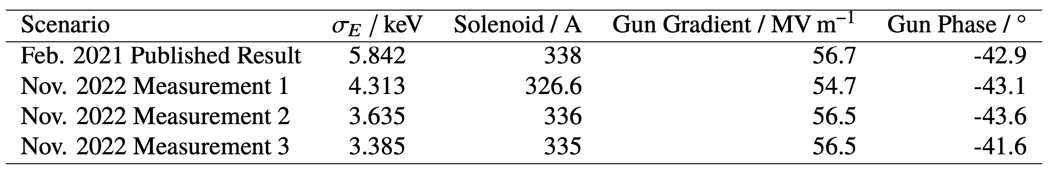
Our Results at Rome LEDS
Slice energy spread changed between 2021 and 2022 (5.8keV → 4.3 keV).
Strong dependence of the solenoid and gun gradient on the SES.
Scans:
  Strong bunch charge dependence on slice energy spread, from 50pC (3 keV) to 350pC (4.5 keV).
  Strong LH chicane R₅₆ dependence on the energy spread, from -1 mm (2keV) to -7mm (4.5keV).

Slide 6
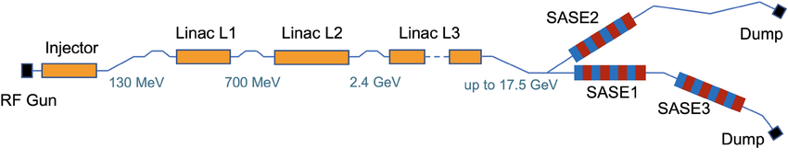
The EuXFEL
Overview
3.1 km machine.
Two hard x-ray undulator lines, SA1 and SA2.
One soft x-ray line, SA3.
Four chicanes, laser heater chicane in injector and three for compression.
Diagnostic stations in injector and after BC2 (at max compression).
One transverse deflecting structure (TDS) in the injector, and one after BC2.
Beam can be matched in diagnostic sections and just after BC1.
Hard x-ray self-seeding in SA2, wish recent pushes to more special modes.
Crucial to know longitudinal beam dynamics to deliver the best performance.
BC0 BC1 BC2
Dump
Dump
Dump

Slide 7
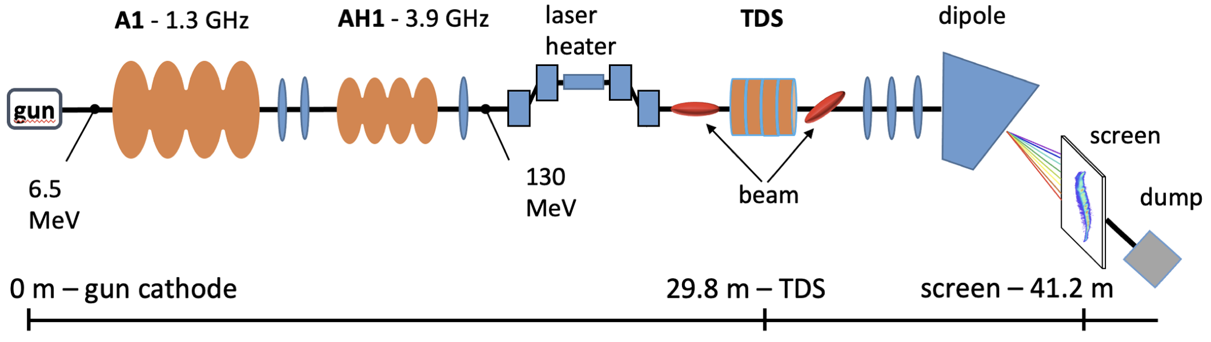
The EuXFEL
Injector

Slide 8
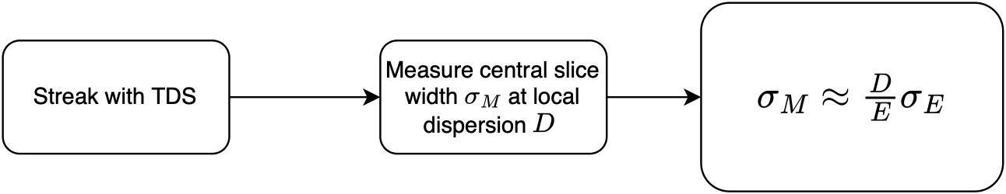
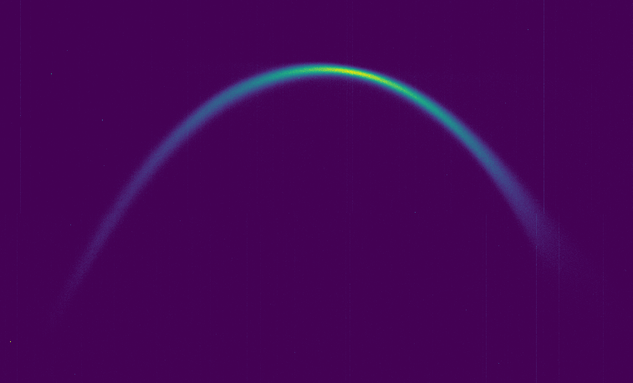
The Usual Approach
Energy Spread Measurement
Only provides an upper limit on uncorrelated spread σ_{E}.
Neglected contributions to size:
Intrinsic betatronic beam size
TDS-induced energy spread
Imaging resolution
In the injector these contributions can be larger than the slice energy spread's contribution!
Need to separate these effects...

Slide 9
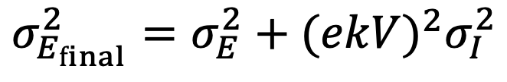
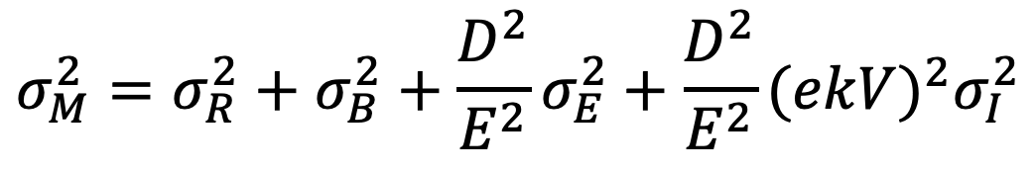
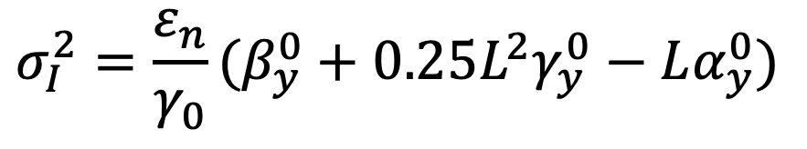
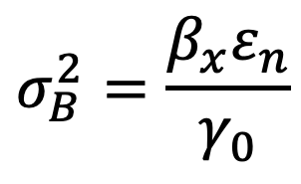
Separating the contributions to the slice size
Energy Spread Measurement
Assuming no correlation between TDS-induced energy spread and "true" energy spread, the final slice energy spread seen at the screen:
$$σ_{M}^{2}=σ_{R}^{2}+σ_{B}^{2}+\frac{D^{2}}{E^{2}}σ_{E}^{2}+\frac{D^{2}}{E^{2}}(ekV)^{2}σ_{I}^{2}$$
$$σ_{E_{final}}^{2}=σ_{E}^{2}+(ekV)^{2}σ_{I}^{2}$$
Imaging
resolution
Betatron
energy spread contribution
TDS contribution
Beamsize in the TDS
$$σ_{B}^{2}=\frac{β_{x}ε_{n}}{γ_{0}}$$
$$σ_{I}^{2}=\frac{ε_{n}}{γ_{0}}(β_{y}^{0}+0.25L^{2}γ_{y}^{0}−Lα_{y}^{0})$$

Slide 10
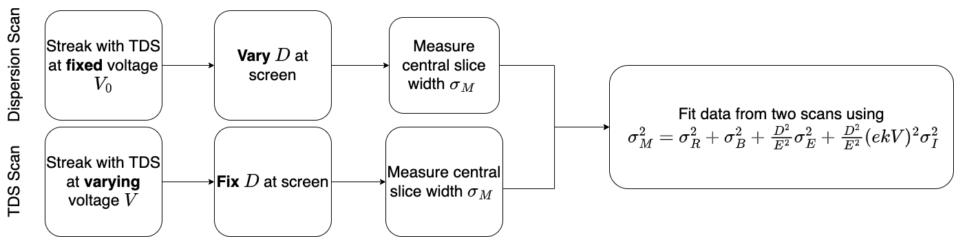
High Resolution Technique
Energy Spread Measurement

Slide 11
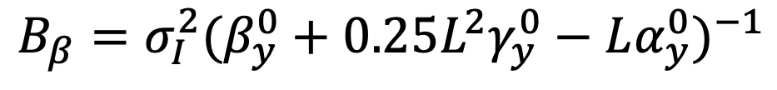
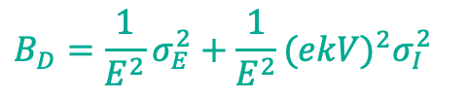

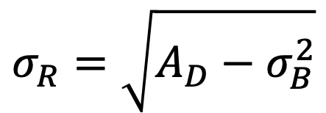


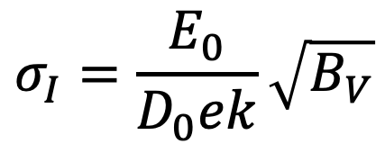
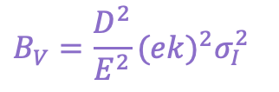
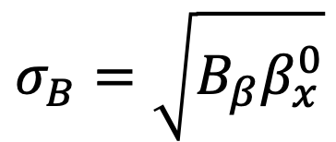
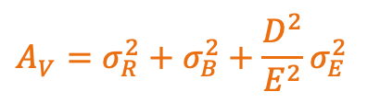
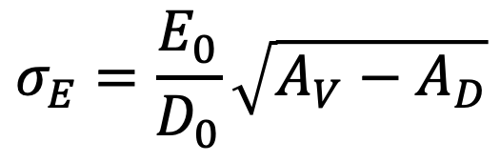
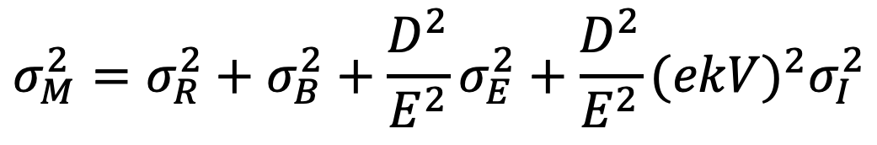
Derived Values
Energy Spread Measurement
$$σ_{E}=\frac{E_{0}}{D_{0}}\sqrt{A_{V}−A_{D}}$$
For the two scans:
$$σ_{I}=\frac{E_{0}}{D_{0}ek}\sqrt{B_{V}}$$
$$σ_{M}^{2}=σ_{R}^{2}+σ_{B}^{2}+\frac{D^{2}}{E^{2}}σ_{E}^{2}+\frac{D^{2}}{E^{2}}(ekV)^{2}σ_{I}^{2}$$
$$σ_{B}=\sqrt{B_{β}β_{x}^{0}}$$
$$σ_{M}^{2}=A_{V}+B_{V}V^{2}$$
$$σ_{M}^{2}=A_{D}+B_{D}D^{2}$$
$$B_{β}=σ_{I}^{2}(β_{y}^{0}+0.25L^{2}γ_{y}^{0}−Lα_{y}^{0})^{−1}$$
$$A_{V}^{ }=σ_{R}^{2}+σ_{B}^{2}+\frac{D^{2}}{E^{2}}σ_{E}^{2}$$
$$σ_{R}=\sqrt{A_{D}−σ_{B}^{2}}$$
$$A_{D}^{ }=σ_{R}^{2}+σ_{B}^{2}$$
$$B_{V}^{ }=\frac{D^{2}}{E^{2}}(ek)^{2}σ_{I}^{2}$$
$$B_{D}^{ }=\frac{1}{E^{2}}σ_{E}^{2}+\frac{1}{E^{2}}(ekV)^{2}σ_{I}^{2}$$

Slide 12
Injector Setup
Calibrate the gun phase.
Turn off AH1 for minimum chirp contribution to energy spread.
Go on crest in A1, adjust the voltage so we are at 130 MeV at the screen.
Turn the laser heater off.
Apply special optics to maximise the ratio of the dispersion to the betatron contributions to the spot size.
Match the central slice.
Measure the dispersion.

Slide 13
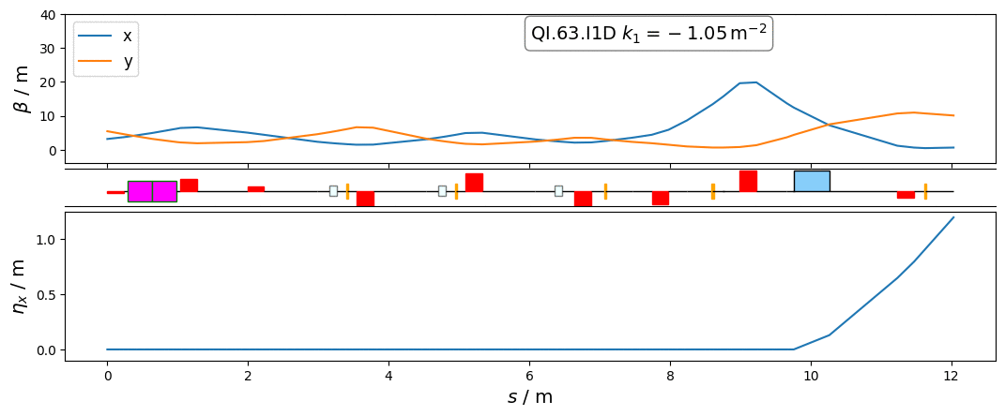
Special optics for measurement from TDS to the screen
TDS
Screen
Dipole

Slide 14
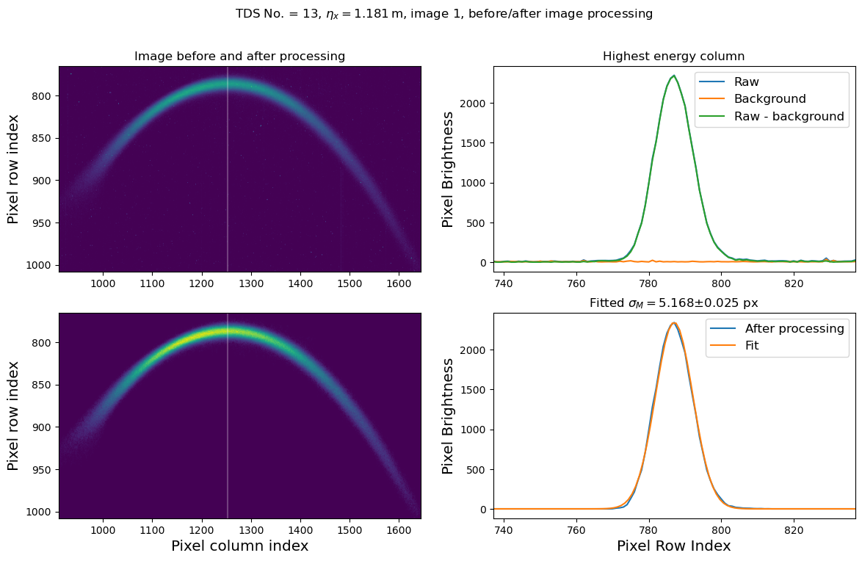
Procedure
Take 5 background images at the start of the measurement, and then 30 images:
At each TDS V in the voltage scan.
At each D_{x} at the screen in dispersion scan.
At each β_{x} at the screen in the beta scan.
Then:
Subtract background.
Mask to remove isolated blobs.
Pick the largest connected non-zero pixel blob to be "the beam".
Fit a Gaussian to 10 slices centred on highest energy slice & average.

Slide 15
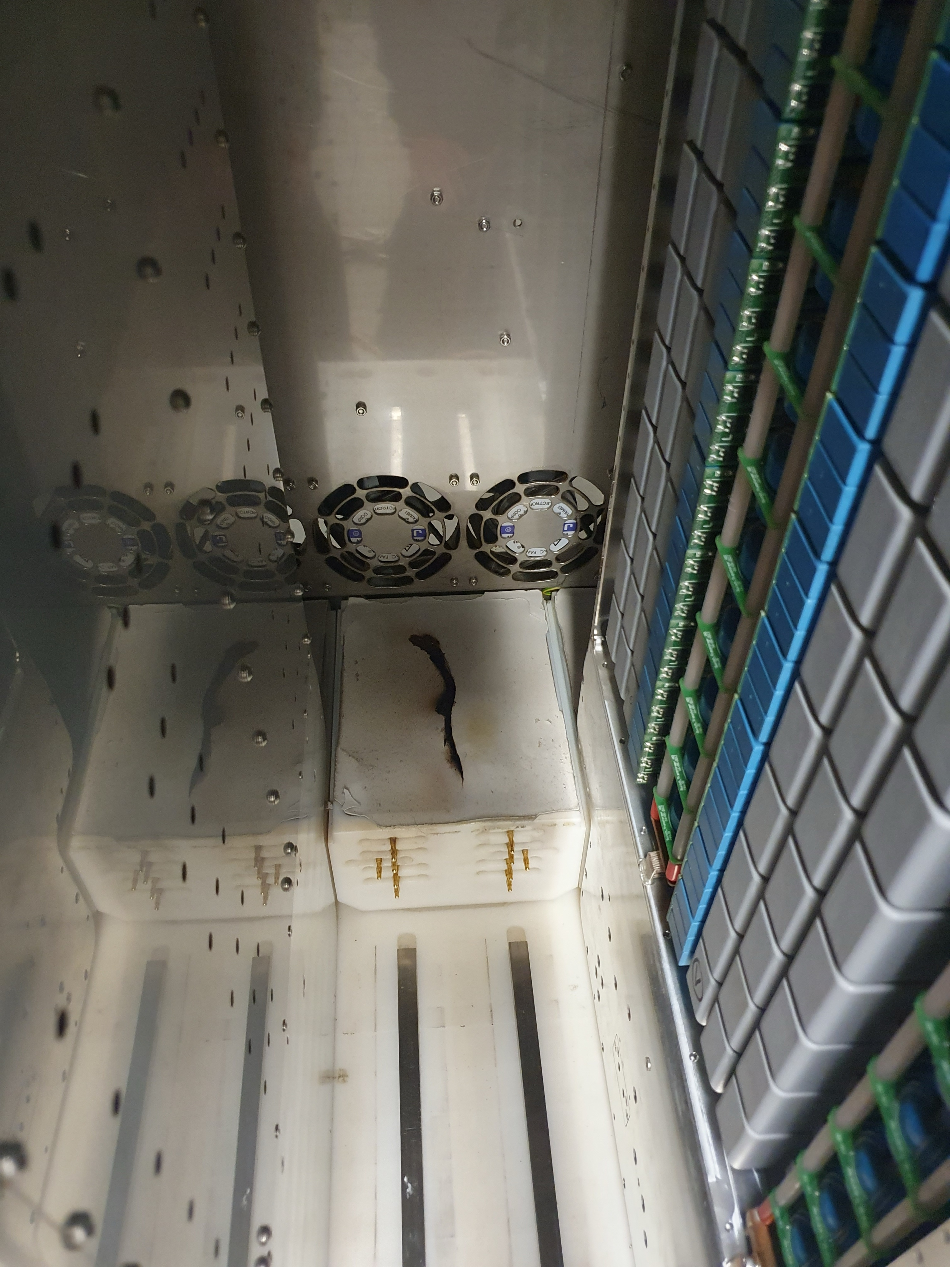
The State of the TDSs at the EuXFEL
Injector TDS
  Modulator caught on fire earlier in the year. Required borrowing modulator from REGAE to bring TDS back online in August.
  Modulator will be returned to REGAE most likely sometime in October.
  Going forwards turn around time to bring TDS back online using REGAE modulator ~2 weeks.
BC2 TDS (post full compression)
  After attempted pulse compressor upgrade in Winter 2023 to boost time resolution by up to factor 2.
  Since then, the BC2 TDS has not worked.
  Recently diagnosed as a timing problem in one of the components.
  Most likely operating again in 2025.
Injector TDS
BC2 TDS
Notes:
Injector resolution: ~200fs
BC2 resolution: ~8fs (down to ~4 with upgrade)

Slide 16
Laser Heater Chicane R₅₆ Scan
Slice Energy Spread
We previously scanned the R₅₆ of the laser heater chicane from -7 mm to -1 mm (the minimum) @ Q = 250 pC.
Design setting (-4.336 mm) not scanned in order with the other setpoints.
Strong dependence on LH R₅₆ is apparent, from 4.5 keV at maximum to 2.4 keV at minimum.
Undulator closed (as by design).

Slide 17
Laser Heater Chicane R₅₆ Scan
Slice Energy Spread
Repeated the scan with the new laser and with the undulator open:
  Remove any edge focusing from the undulator → simpler experimental setup.
Weak dependence on the undulator shown: small differences can be explained as due to undulator edge focusing → different optics → IBS.
Laser choice impact negligible.

Slide 18
Laser Heater Chicane R₅₆ Scan
Transverse Optics
D_{x} = 1.2m at the screen.
250 pC, so backtracked only to first cavity.
Matching Point

Slide 19
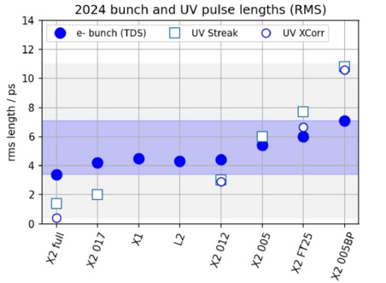
Energy Spread and Charge Density
With the new NEPAL laser we can vary the charge density:
  Keep bunch charge constant and vary the laser pulse length.
Right: various laser setpoints with RMS laser and resulting RMS bunch lengths from commissioning in July
Laser pulse lengths from 2ps to 25ps possible with constant charge.
Intended experiment: vary bunch lengtha nd measure energy spread
  Pushed back due to TDS maintenance and laser commissioning.
  Beam time for this experiment set set for October.
Courtesy of YE CHEN

Slide 20
Conclusion
We continue to investigate the physics of slice energy spread in the EuXFEL injector and linac.
We repeated our LH R₅₆ scan measurement, replicating the strong dependence of the energy spread on the R₅₆ independent of undulator setting and laser choice.
  Needs to yet be understood. Typically one would imagine a multi-stage compression scheme to cause MBI.
  However, we have only one, relatively weak, chicane in our measurement configuration.
  Possible microbunching coming out of the gun?
Our longitudinal diagnostics in the linac have had a tough year
  The injector TDS is now dependent on swapping in a modulator from a different accelerator as required.
  BC2 TDS has been offline all year, but forecasted to be available again from January 2025.
Measurements planned for October:
  Charge density scan (varying bunch length with constant charge).
  Laser Heater absolute calibration.
  Injector slice energy spread versus microbunching and energy spread in SA2.M

Slide 21
Thank you
Vielen Dank

Slide 22
Stuart Walker
MXL
stuart.walker@desy.de
4756

Slide 23
Backup

Slide 24
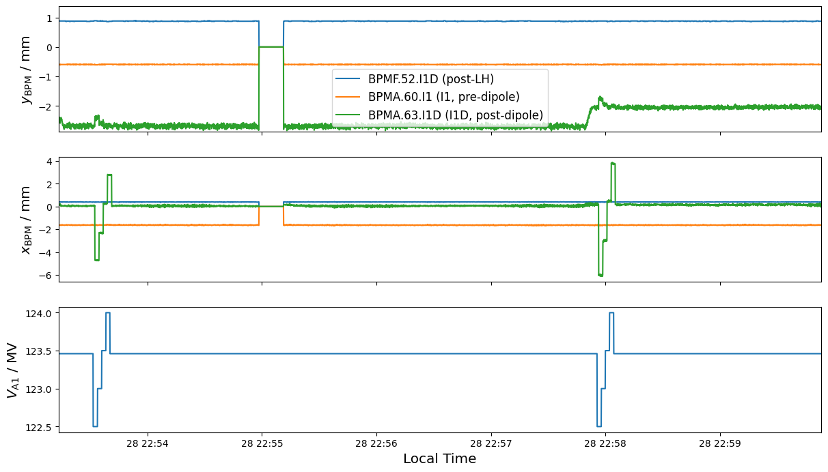
Do we get a kick from A1 when measuring the dispersion?
Measurement at lowest dispersion (~0.6m) followed by at highest dispersion (1.1m).

Slide 25
Possible Dispersion Leakage from the LH Chicane
We did not remeasure the dispersion at each setpoint of the laser heater R₅₆ scan.
  Possible: we have some leaked dispersion from the chicane at the screen.
First two dipoles have same power supplies, second two are each independent.
Consider: Identical 15% error in first two dipoles and independent 15% errors in second pair, perhaps some sort of ”worst case”.
Simulated in OCELOT.
Dispersion at the screen is tolerant to even large changes in the LH dipoles.
Nevertheless should measure the dispersion in future experiments.
Translates max ±10% error in energy spread.

Slide 26
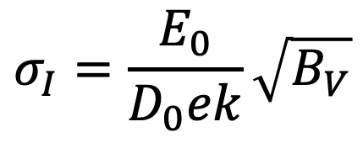
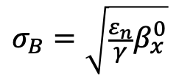
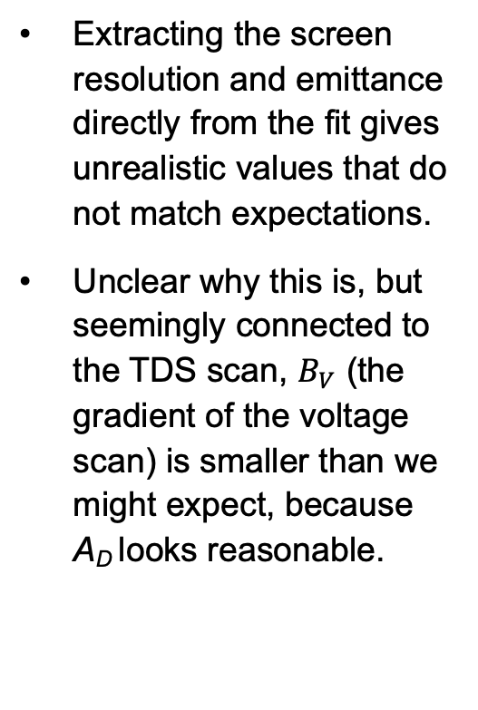
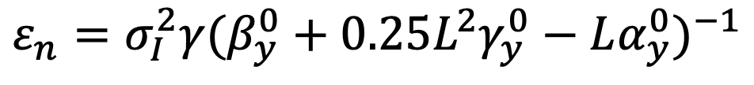
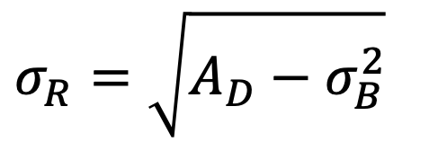
Extracting the emittance and screen resolution from the fits
Extracting the screen resolution and emittance directly from the fit gives unrealistic values that do not match expectations.
Unclear why this is, but seemingly connected to the TDS scan, $B_{V}$ (the gradient of the voltage scan) is smaller than we might expect, because A_{D} looks reasonable.
$$ε_{n}=σ_{I}^{2}γ(β_{y}^{0}+0.25L^{2}γ_{y}^{0}−Lα_{y}^{0})^{−1}$$
$$σ_{R}=\sqrt{A_{D}−σ_{B}^{2}}$$
$$σ_{I}=\frac{E_{0}}{D_{0}ek}\sqrt{B_{V}}$$
$$σ_{B}=\sqrt{\frac{ε_{n}}{γ}β_{x}^{0}}$$

Slide 27
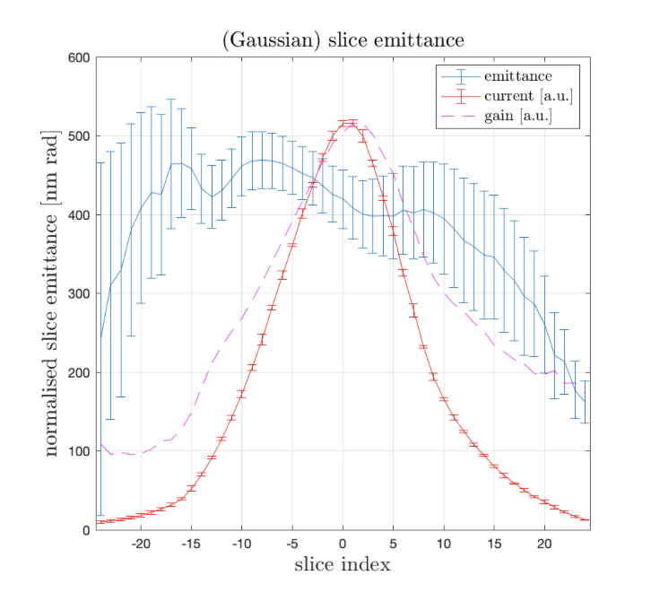
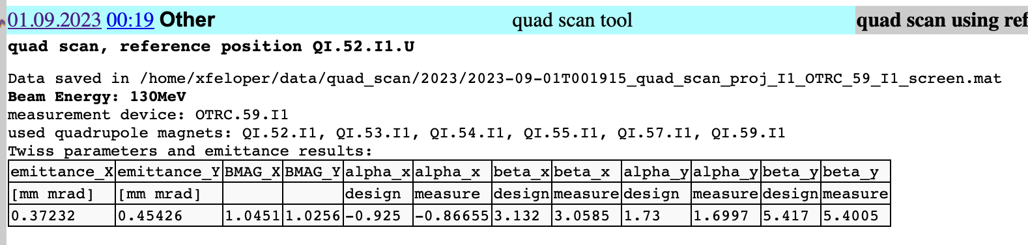
Emittance Measurements
Matthias matching/measurement tool is vital to our measurement.
We match projected and then measure slice—and normally this gives reasonable matching, but we extract much smaller emittances from our scans.
We see measured central slice emittances that are larger than the corresponding projected emittances even with apparently ”good” matching.
Is there any way we can reduce the error bars here?
Projected
Central slice (0.45 mm•mrad)
measured a minute later (no matching)

Slide 28
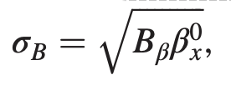
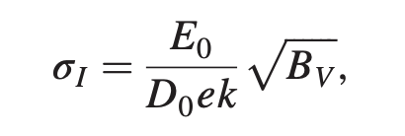
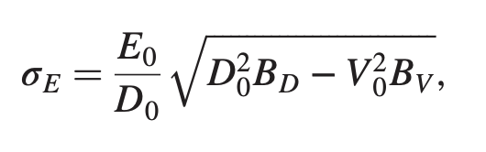
We fail to properly extract sigma_b and sigma_r now
A_D looks approximately correct, so problem comes from sigma_b:
i.e.
So our fitting of B_V is (somehow) wrong, i.e. our TDS scan is somehow not quite right, but..
Maybe our dispersion is wrong. If A_V ( a function of D) is wrong then we will have an incorrect B_V.
Option: assume B_V given sigma_R or the emittance or both (if we assume both we are assuming A_D and should fit accordingly…).
Then we have A_V and have some new slice energy spread.

Slide 29
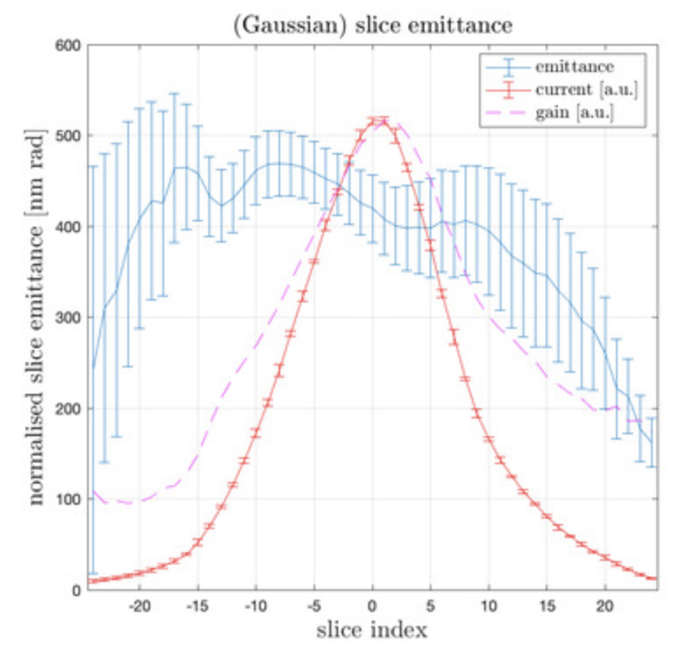
Constant Contributions to Measured Widths
In principle both are known:
  Screen resolution (σ_{R}) from dedicated optics simulations (Artem)
  Betatron contribution (σ_{B}) from slice emittance measurement and linear optics (Matthias)
σ_{R} = 28µm (from Artem and previous scans); β_{x} = 0.6 m and ε_{x} = 0.43 mm•mrad (Matthias matching tool)
Constant terms remain constant across the scan, but ~7% larger than expected (from Matthias+Artem).
The Matthias Tool

Slide 30
Deriving the emittance assuming the screen resolution
Fitting A_{D} and using a pre-calculated value of σ_{R}, we can extract a value for the slice emittance.
We independently measure, using Matthias’ matching tool, (0.43±0.05) mm•mrad for the slice emittance.
Not entirely in disagreement with our derived value.
Can we reduce the uncertainties in the emittance measurement?

Slide 31
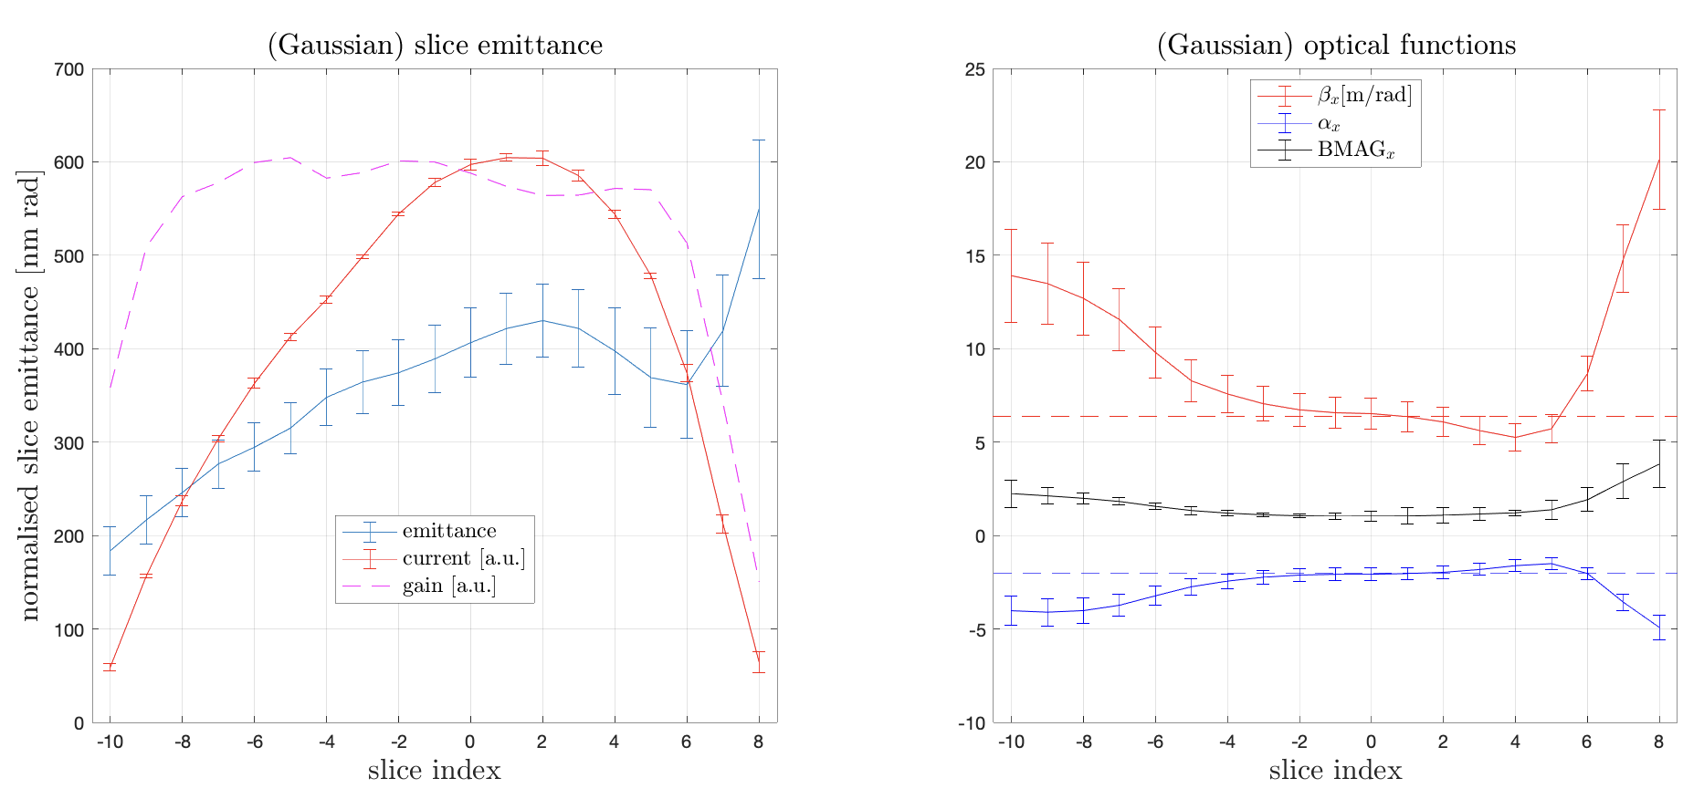
Beam Matching
Central slice always matched for measurements
  Very important, otherwise can get an artificially deflated energy spread result!
  Use screen just in front of TDS
We remeasured the dispersion at every single point in the dispersion scan and once per TDS scan.

Slide 32
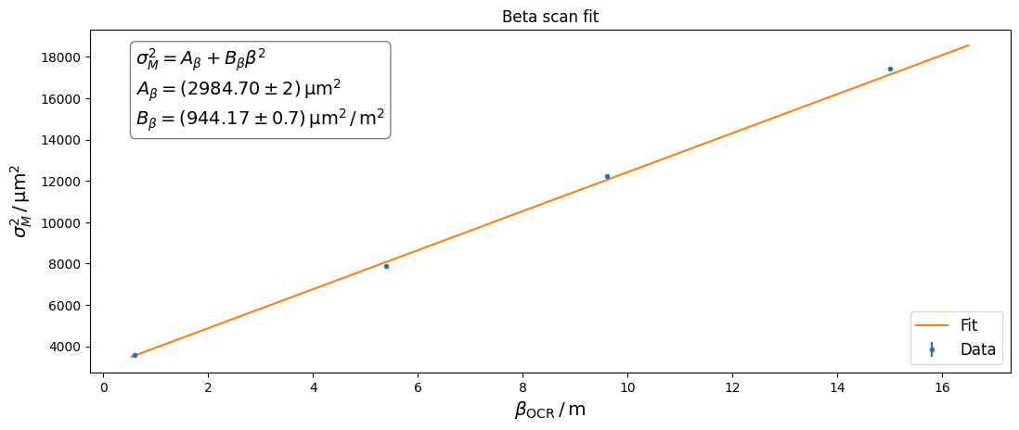
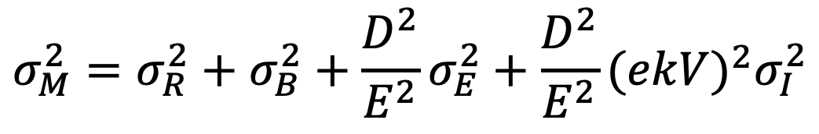

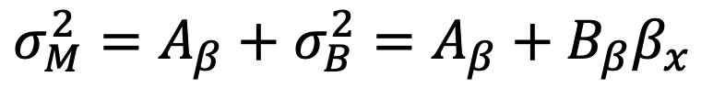
Beta Scan
$$σ_{M}^{2}=σ_{R}^{2}+σ_{B}^{2}+\frac{D^{2}}{E^{2}}σ_{E}^{2}+\frac{D^{2}}{E^{2}}(ekV)^{2}σ_{I}^{2}$$
  Can also measure the emittance by scanning beta
  We know the beta function at the TDS and therefore at the screen by linear optics.
  Scan QI.61.I1 (before dipole) to vary β without changing D.
Vary
Fix
$$σ_{M}^{2}=A_{β}+σ_{B}^{2}=A_{β}+B_{β}β_{x}$$
$$ε_{n,β}=(0.2402±0.0002)mm⋅mrad$$
QI.61.I1

Slide 33
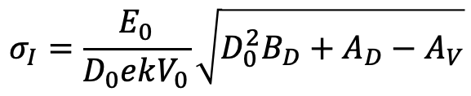

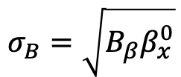
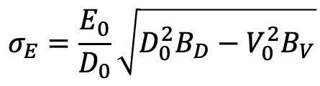

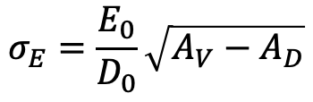

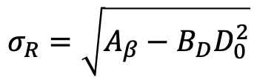
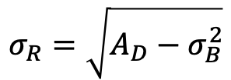
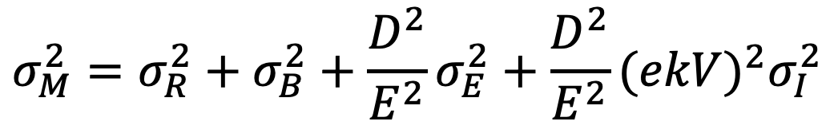

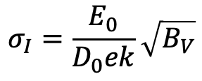
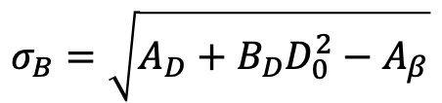
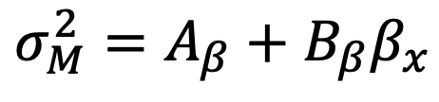
Consistency of results
$$σ_{M}^{2}=σ_{R}^{2}+σ_{B}^{2}+\frac{D^{2}}{E^{2}}σ_{E}^{2}+\frac{D^{2}}{E^{2}}(ekV)^{2}σ_{I}^{2}$$
$$σ_{M}^{2}=A_{V}+B_{V}V^{2}$$
$$σ_{M}^{2}=A_{D}+B_{D}D^{2}$$
Alternative functions:
What I've used so far:
$$σ_{M}^{2}=A_{β}+B_{β}β_{x}$$
$$σ_{E}=\frac{E_{0}}{D_{0}}\sqrt{D_{0}^{2}B_{D}−V_{0}^{2}B_{V}}$$
$$σ_{E}=\frac{E_{0}}{D_{0}}\sqrt{A_{V}−A_{D}}$$
$$σ_{I}=\frac{E_{0}}{D_{0}ek}\sqrt{B_{V}}$$
$$σ_{I}=\frac{E_{0}}{D_{0}ekV_{0}}\sqrt{D_{0}^{2}B_{D}+A_{D}−A_{V}}$$
$$σ_{B}=\sqrt{B_{β}β_{x}^{0}}$$
$$σ_{B}=\sqrt{A_{D}+B_{D}D_{0}^{2}−A_{β}}$$
$$B_{β}=σ_{I}^{2}(β_{y}^{0}+0.25L^{2}γ_{y}^{0}−Lα_{y}^{0})^{−1}$$
$$B_{β}=ε_{n}γ_{0}^{−1}$$
$$σ_{R}=\sqrt{A_{D}−σ_{B}^{2}}$$
$$σ_{R}=\sqrt{A_{β}−B_{D}D_{0}^{2}}$$
Both should be equivalent!

Slide 34
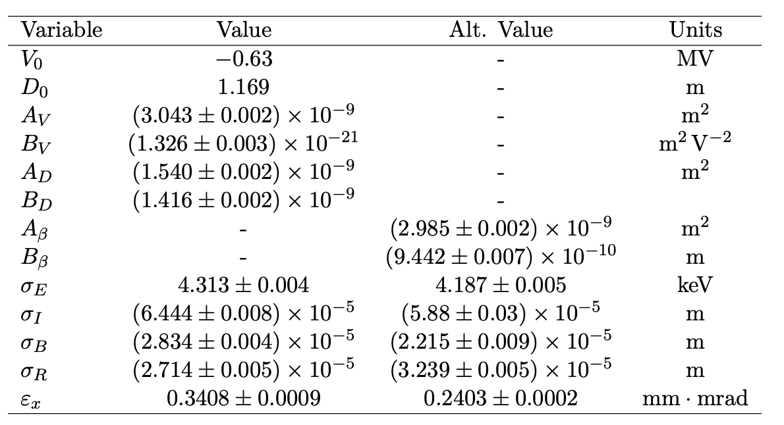

Consistency of Results 2
$$σ_{M}^{2}=σ_{R}^{2}+σ_{B}^{2}+\frac{D^{2}}{E^{2}}σ_{E}^{2}+\frac{D^{2}}{E^{2}}(ekV)^{2}σ_{I}^{2}$$
2022 data with beta scan
(Attempting to recreate 2021)

Slide 35

New Tooling
TDS Calibration
Additionally the TDS needs to be calibrated for each measurement campaign to get the voltage → also takes up to an hour.
Also developed an injector TDS calibration GUI
  Automatically scan TDS “amplitudes” and phases to build mapping of amplitudes [%] to voltages [MV] → Gives all downstream longitudinal calibrations!
  Also useful for non-invasive emittance and bunch length measurements.
Bottom line: calibrate the injector TDS in a few minutes with no human intervention.
Amplitude to voltage mapping
(the calibration final result).
Image centre of mass vs phase
B2 calibrator development ongoing.
Non-invasive development ongoing.
Extracted zero-crossing
gradients at each amplitude

