Slide 1


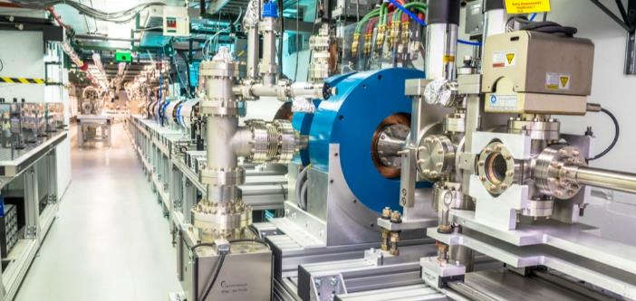

Progress on the
Ultrahigh Gradient, Short-pulse X-band Photogun at the
Argonne Wakefield Accelerator
Bern switzerland
JOHN POWER
On behalf of
GONGXIAOHUI CHEN
and the AWA facility at Argonne National Laboratory
Sept 17, 2024

Slide 2

outline
I am assuming (practically) no one here has heard of the AWA or SWFA.
Argonne Wakefield Accelerator (AWA) Facility
Structure Wakefield Acceleration at the AWA Facility
High Gradient X-band Photogun

Slide 3
The awa facility

Slide 4



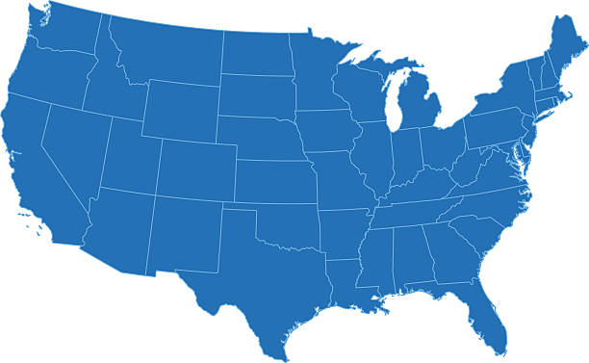



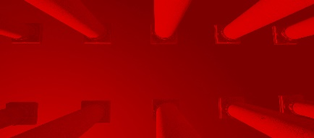







What is the Advanced acceleration concepts (AAC) program
AAC ~ Wakefield Acceleration: Laser Wakefield Acceleration, Plasma Wakefield Acceleration, and Structure Wakefield Acceleration (SWFA).
Beam Test Facilities: Demonstrating the viability of emerging accelerator science ultimately relies on experimental validation.
https://www.beamnetus.org/
FAST/IOTA
Particle Beam
FACET-II
AWA
BELLA
ELL
ATF
UT³
https://lasernetus.org/
Laser Beam
U.S. advanced and novel accelerator beam test facilities
[C. Clarke et al 2022 JINST 17 T05009, https://iopscience.iop.org/article/10.1088/1748-0221/17/05/T05009 ]
National Laboratories
Universities

Slide 5

Argonne wakefield accelerator (AWA)
Argonne Campus: 15 minutes west of Chicago
ATLAS: NP national user facility
200 AREA
400 AREA
300 AREA
APS: BES national user facility
AWA: HEP test facility
Notes:
Accelerators at Argonne

Slide 6
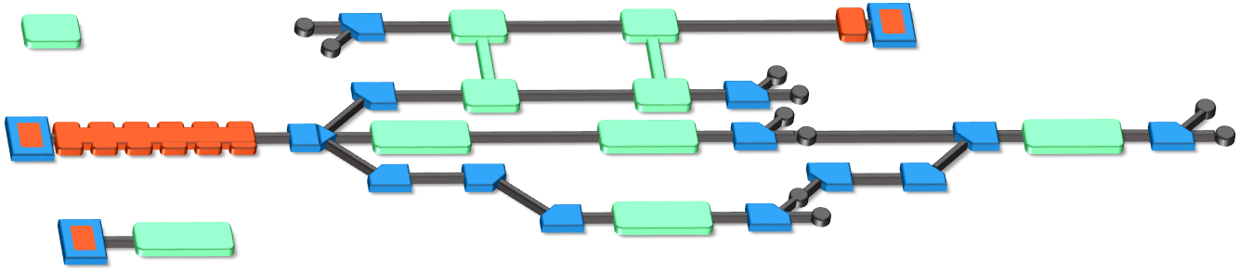
The Argonne Wakefield Accelerator (AWA) Facility
https://www.anl.gov/awa
A Beam Test Facility to enable the development of novel acceleration technology
Witness RF photoinjector (15 MeV)
Provides two-beam capability
Bright beams for low-energy experiments
Drive RF Photoinjector (65 MeV)
  single bunch: 100nC
  bunch train: 600 nC
Experimental Switchyard
Highly reconfigurable
6D phase space manipulation
Argonne Cathode Test Stand (2-4 MeV)
Cathode research and diagnostics
Physics of high-gradient breakdown
Laser
100 mJ (IR), 10 mJ (UV),
300 fs – 6 ps (UV)
temporal shaping

Slide 7
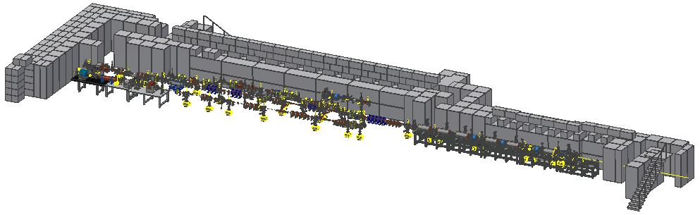
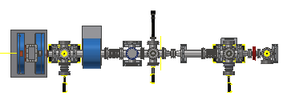

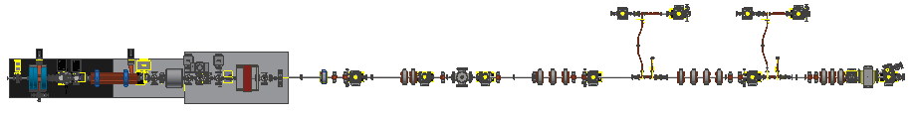
The Argonne Wakefield accelerator
5 Zones
The AWA Facility
Zones 2-5 are experimental areas
Zones 2, 4, and 5 have ~ 1 m experimental area
Zones 3A & 3B are fully re-configurable
AWA Bunker
https://www.anl.gov/awa
EXPERIMENTAL AREA
ACT
Drive
AWA Vacuum and Experimental Zones
Witness
7/36

Slide 8
The three awa research themes
To
support swfa

Slide 9

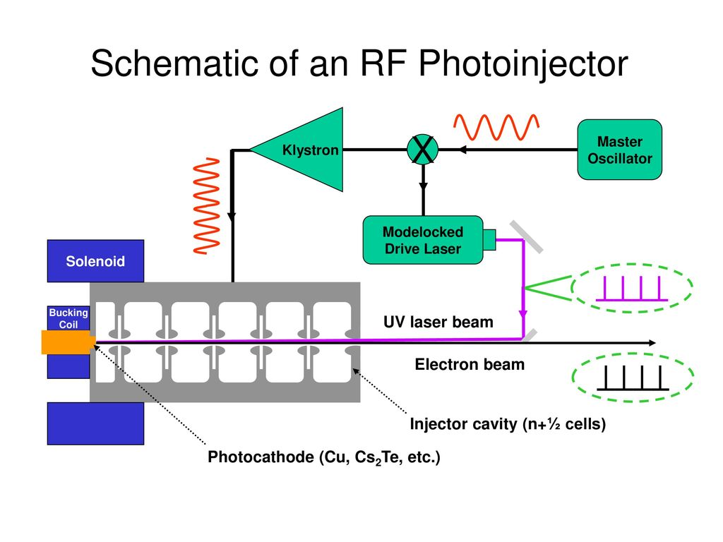
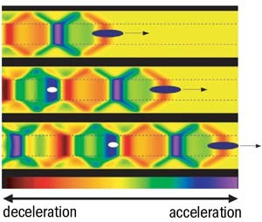

AWA Research themes
Timeless research themes
Applications
Beam Production
Beam Manipulation
Advanced Accelerator
e.g. SWFA
Linear Collider
  Compact XFEL
UED
not exhaustive
e.g. RF Photoinjector
e.g. Double Emittance Exchange
Beam shaping & control.
Beam Diagnostics.
Electron sources
  High-brightness
  High-intensity
SWFA & PWFA
  High-Gradient
  High-Efficiency
9

Slide 10
Research Theme:
Advanced Accelerator
Advanced Accelerator

Slide 11

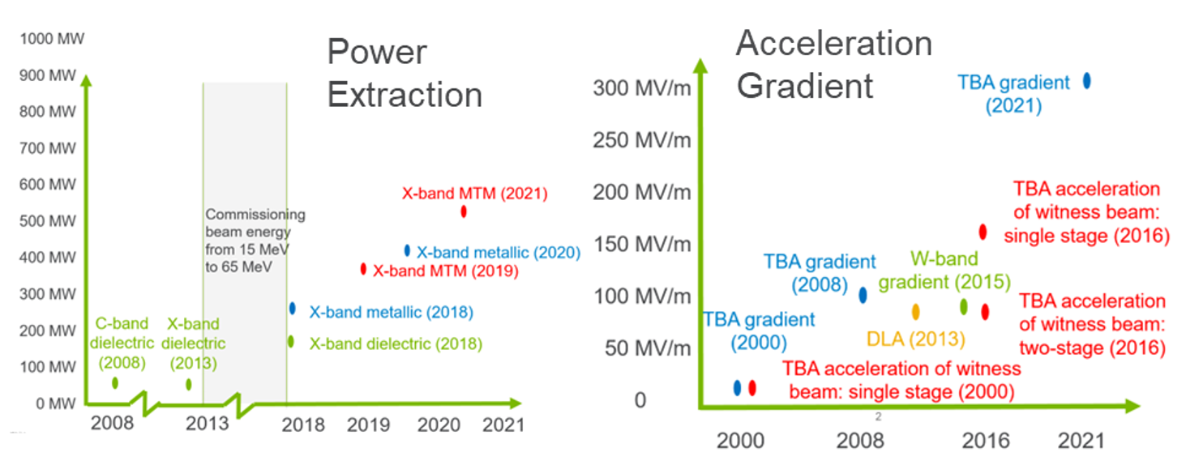
high-gradient normal conducting RF research
Rapid progress with short-pulse TBA since 2015 upgrade (started 2008)
AWA-II will enable demonstration of SWFA critical technologies in GeV range
AWA upgrade
AWA upgrade

Slide 12

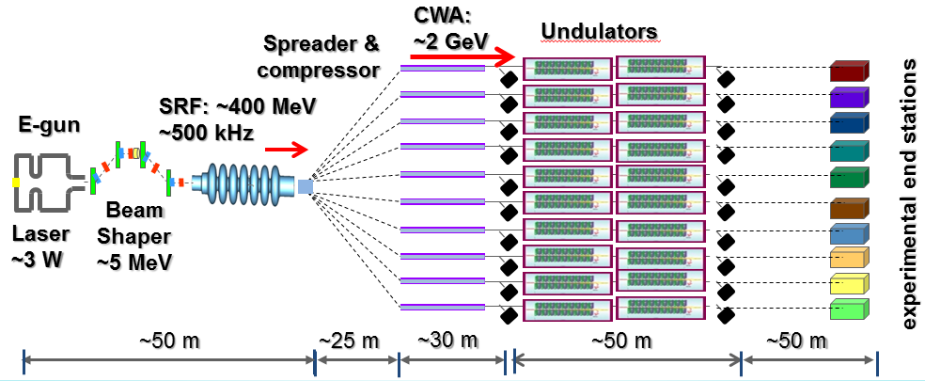
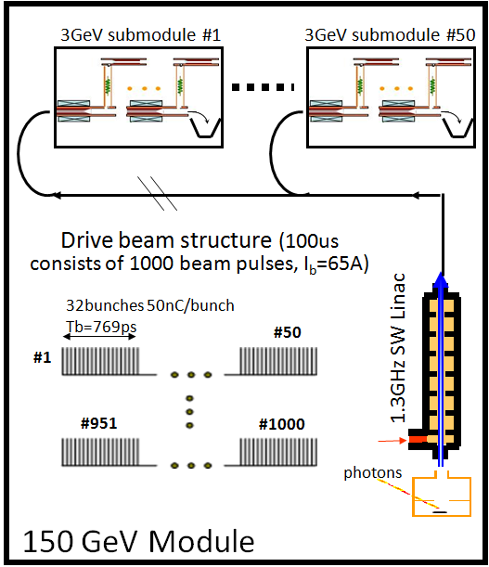
e-beam Driven Structure Wakefield Acceleration (SFWA)
Advanced Accelerator
Collinear Wakefield Acceleration
(CWA)
Two Beam Acceleration (TBA)
Klystron-like
PWFA-like
main beam
MB
main beam
Accelerator
drive beam
Power Extraction and Transfer Structure (PETS)
DB
drive beam
SWFA XFEL
SWFA 3 TeV linear collider
e⁻
e⁺
IP
3TeV
1
10
10
1
A. Zholents, et al, NIMA 829, 190-193 (2016)​
A. Zholents, et al, Proceedings of IPAC2018​
CLIC CDR​: https://project-clic-cdr.web.cern.ch/CDR_Volume1.pdf​
W. Gai, C. Jing, J.G. Power, JPP 78, 339-345 (2012)​

Slide 13
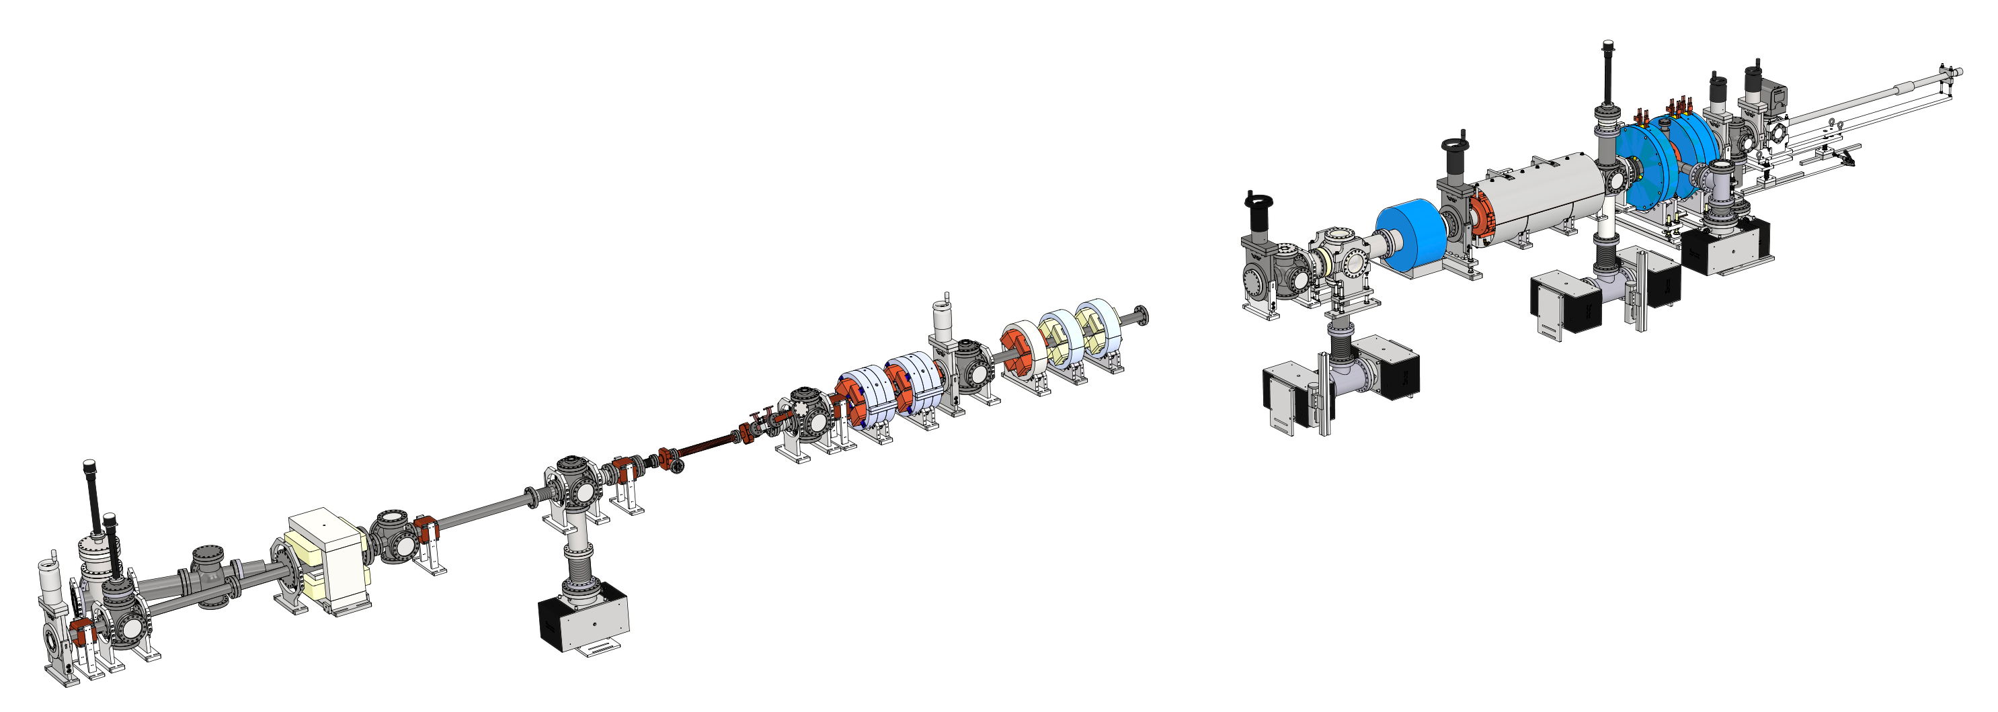
short pulse rf generation
Advanced Accelerator
TBA drive beam PETS
ZONE1
(Drive RF photoinjector)
Drive bunch train
-5 GW beam power
-100A, 6 nsec
……..
ZONE3a
(PETS)
…
magnets & diagnostics
1.3 GHz Drive gun (Cs₂Te photocathode)
  High charge bunch train (up to 600 nC)
  Final beam energy: ~65 MeV
…
Short RF pulse
(2 Hz)
11.7 GHz
  disk-loaded waveguide: 400 MW
  Metamaterial: 565 MW
Dielectric PETS: 80 MW
26 GHz
Notes:
X-band test has become a general capability of AWA (work underway for 26 GHz to THz)

Slide 14



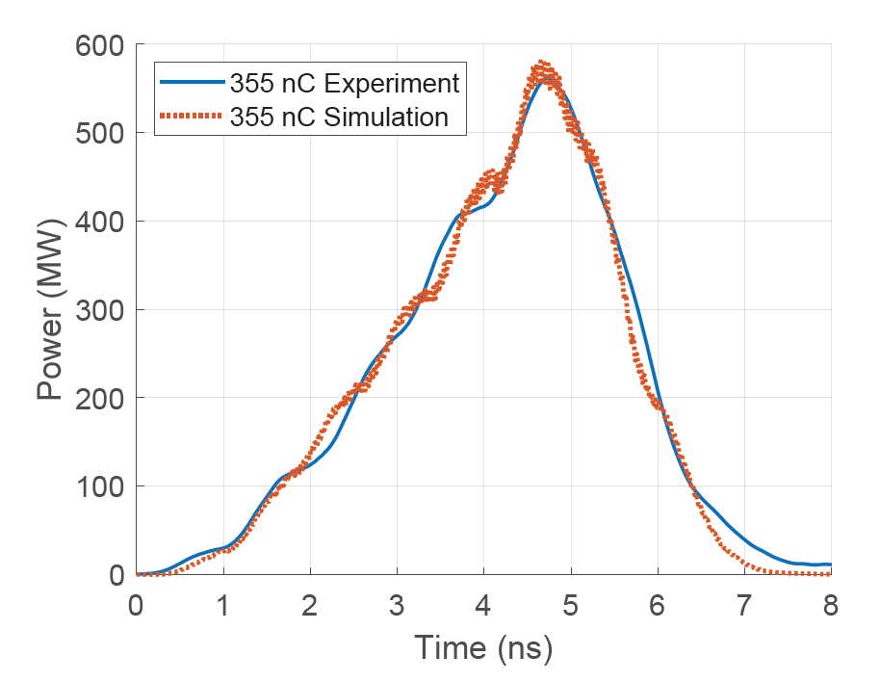
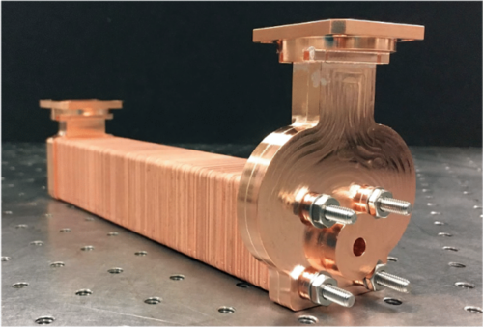
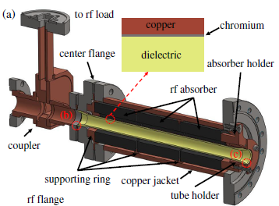
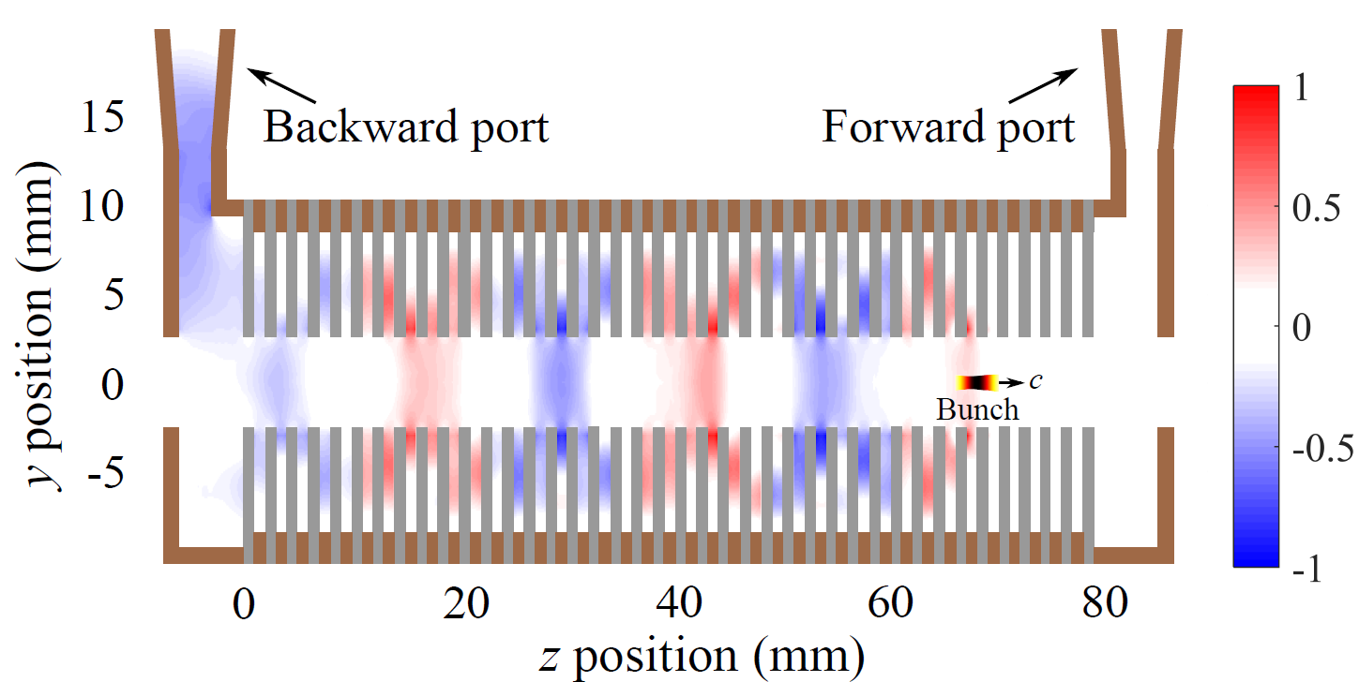
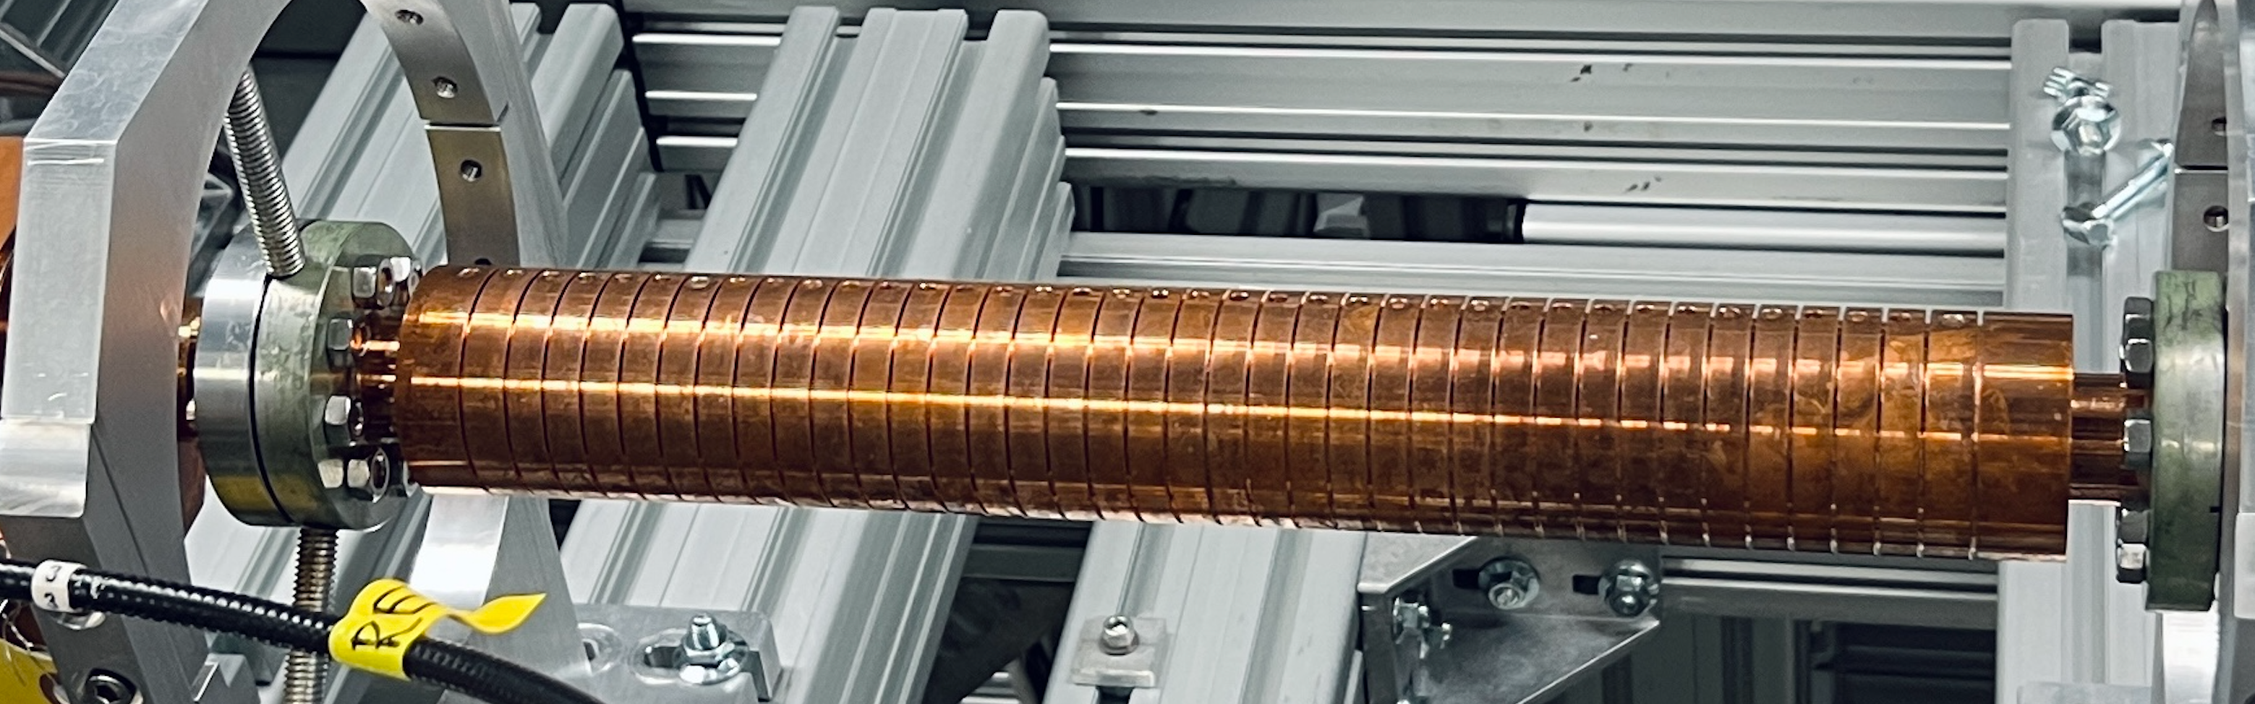
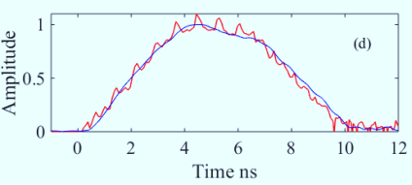
PETS results at AWA
Advanced Accelerator
MTM X-band PETS (565 MW)
Dielectric X-band PETS (200 MW)
DOI: 10.1103/PhysRevAccelBeams.23.011301
  Highest peak power as 565 MW from a train of eight bunches with a total charge of 355 nC
J. Picard et al., PRAB 25, 051301 (2022)
1000 MW
900 MW
800 MW
700 MW
600 MW
500 MW
400 MW
300 MW
200 MW
100 MW
0 MW
AWA energy upgrade
15 MeV → 65 MeV
X-band MTM (2021)
Metallic X-band PETS (400 MW)
X-band metallic (2020)
X-band MTM (2019)
C-band
dielectric
(2008)
X-band metallic (2018)
C-band
dielectric
(2000)
X-band dielectric (2018)
K-band dielectric (2010)
J. Shao et. al., https://accelconf.web.cern.ch/ipac2019/papers/MOPRB069.pdf
2000 2005 2010 2015 2020 2025

Slide 15
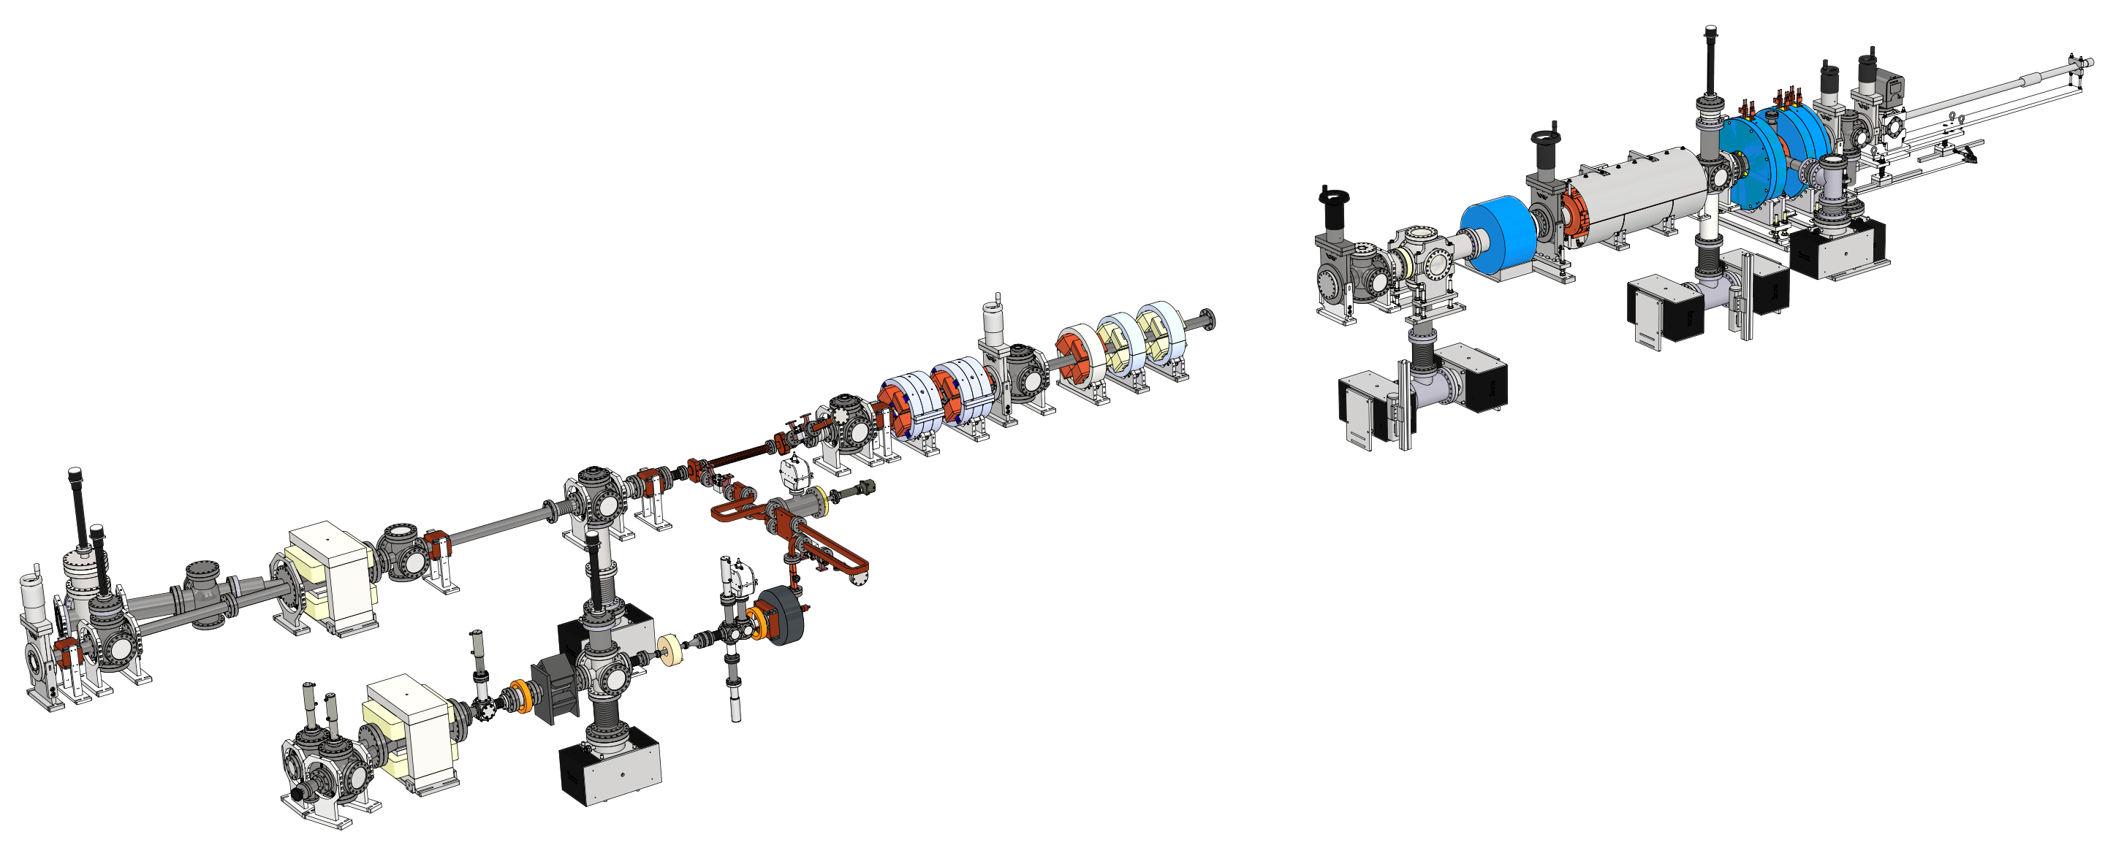
High gradient structure test stand
Advanced Accelerator
…
ZONE3a
(PETS)
ZONE1
(Drive RF photoinjector)
Beam on YAG1
…
Example:
X-band gun beamline
high gradient test stand

Slide 16
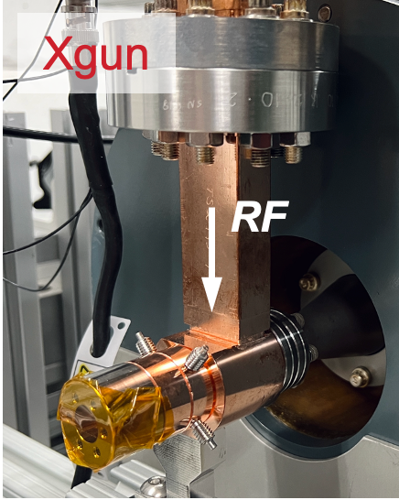
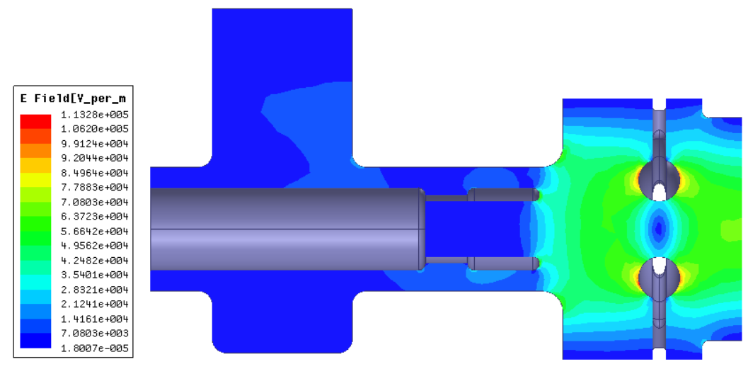
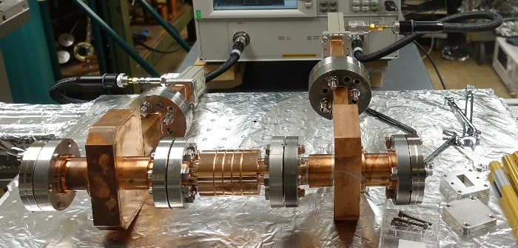
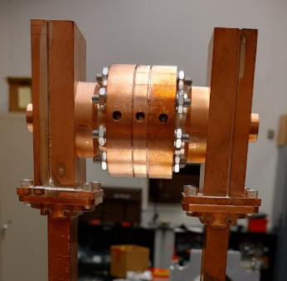
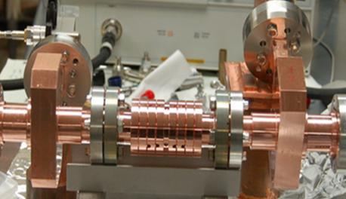
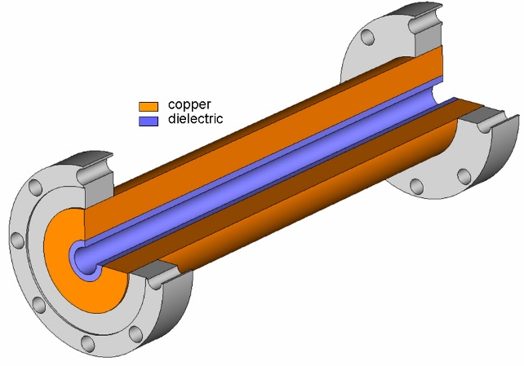
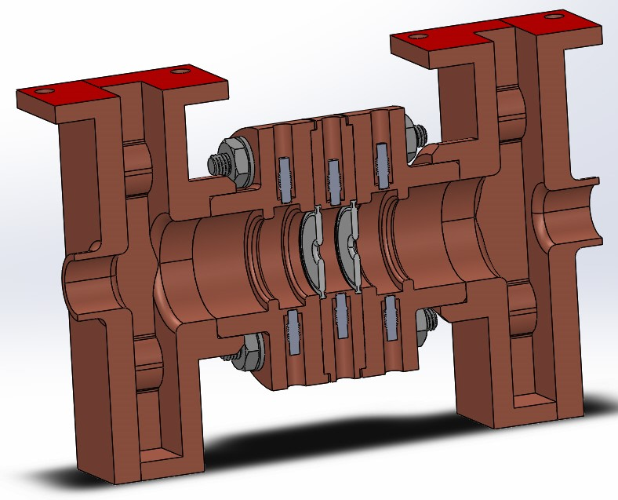
HIGH GRADIENT ACCELERATING STRUCTURES
Advanced Accelerator
400 MV/m
350 MV/m
300 MV/m
250 MV/m
200 MV/m
150 MV/m
100 MV/m
50 MV/m
0 MV/m
X-band PC Gun (2021)
AWA energy upgrade
15 MeV → 65 MeV
X-band metallic (2021)
1.5 cell X-band Photocathode Gun
X-band MTM (2023)
C-band TBA
DLA (2008)
W-band CWA metallic (2015)
X-band metallic (2018)
X-band TBA DDA (2022)
C-band TBA
DLA (2000)
C-band CWA
PBG (2009)
K-band TBA DLA (2018)
Metamaterial Accelerator
2000 2005 2010 2015 2020 2025
Single-cell Disk Loaded Waveguide
Dielectric Loaded Accelerator (DLA)
Single-cell Dielectric
Disk Accelerator (DDA)
3-cell Disk Loaded Waveguide

Slide 17
Research theme:
Beam Manipulation
Beam Manipulation

Slide 18
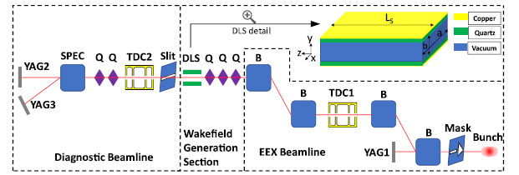
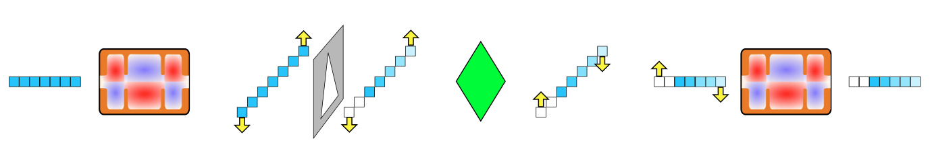
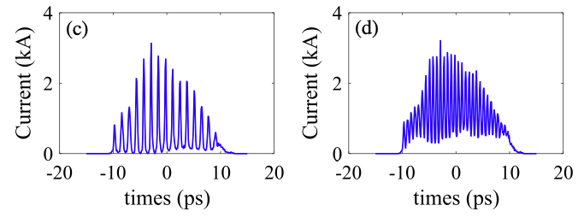
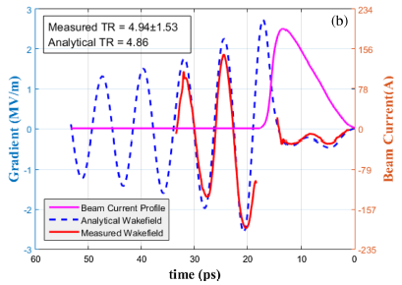
Shaped electron bunches
Beam Manipulation
longitudinal bunch shaping
  Emittance EXchange (EEX) beamline to produce a longitudinally triangular beam profile
  Deflecting cavity based long bunch shaping
Mask
TDC
Quad
TDC
Experimental demonstration planned for 2025. G. Ha, et al. PRAB (2020)
Experimental demonstration of enhanced transformer ratio (TR=4.9) Q. Gao et al., PRL 124, 114801 (2018)
Notes:
Either DEEX or
Multileaf collimator: https://journals.aps.org/prab/pdf/10.1103/PhysRevAccelBeams.26.022801
Bunch trains suitable for CWA (collinear wakefield accelerator) applications
->microbunch separation is ~10 ps

Slide 19
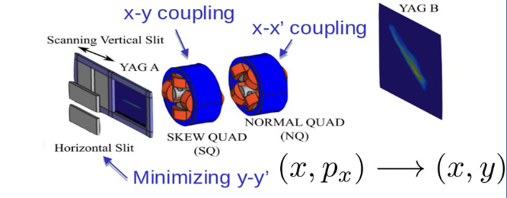
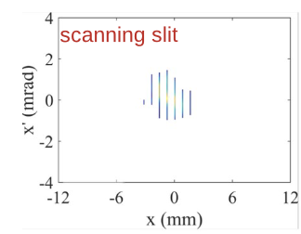
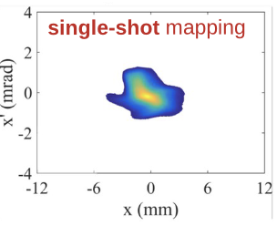
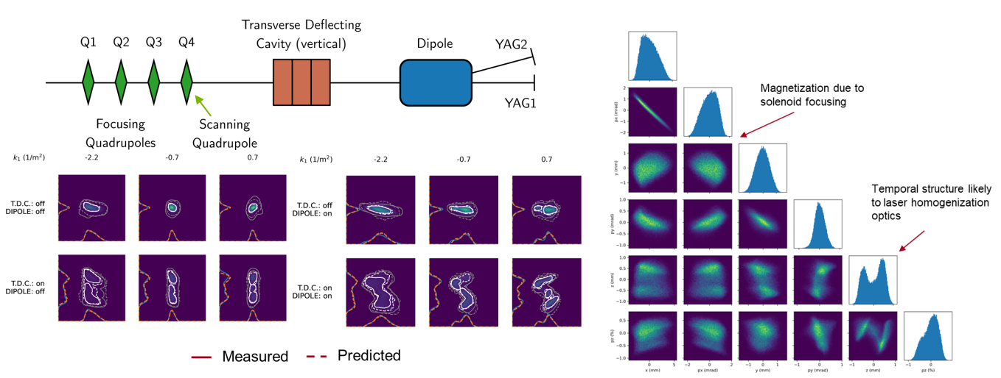
NOVEL DIAGNOSTICS
Single-shot trans. phase space diagnostics
Beam Manipulation
Ha, Gwanghui, et al. "Single-shot measurement of transverse second moments using the projection method." PRAB 24.1 (2021): 012802.
ML diagnostics
Generative Phase Space Reconstruction (GPSR), 6-dimensional phase space reconstruction of a beam distribution from 20 measurements / ~15 minutes analysis time. Roussel, Ryan, et al. PRAB 27.9 (2024): 094601.

Slide 20
Research theme:
beam Production
Beam Production

Slide 21
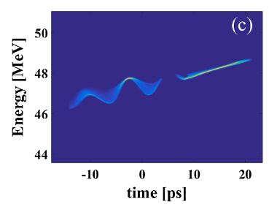
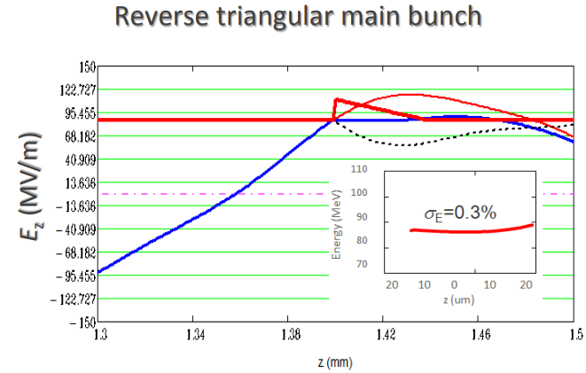
Bright Beam generation
Beam Production
Beams for acceleration and diagnostics
Witness beam: As a probe to investigate phase-space degradation in CWA and TBA
Main beam: needed for direct applications (linear colliders and light sources)
Gao et al., PRL 124, 114801 (2018)

Slide 22
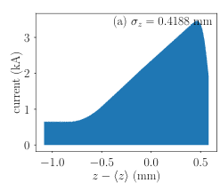
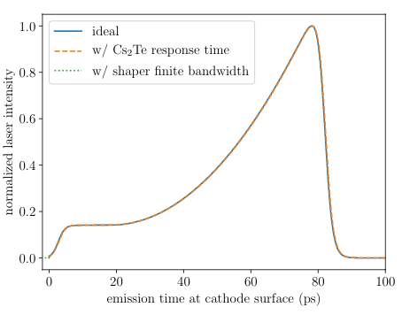
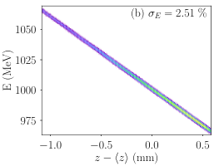
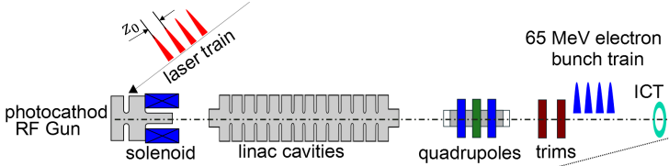
Intense bunches and bunch train generation
Beam Production
Drive beams are needed for TBA and CWA
Shaped laser w/ nonlinear e-beam manipulation
Produce single drive bunch for CWA
Charge level:
  100-nC/Xband
  10-nC/sub THz
pre-shaped bunch for efficient acceleration
laser
final drive bunch
[W. H. Tan, et al. PRAB (2021)]
Produce drive bunch for TBA
bunch trains w/ ~600 nC (total)]

Slide 23
High Gradient X-band Photogun

Slide 24

two Paths to high brightness e- sources
4D beam brightness
High Gradient
R&D
short-pulse and TBA
field experienced at emission (controlled by applied accelerating field)
$$B∝\frac{E^{α}}{MTE}$$
1<α<2 depends on ab-initio long-transverse ratio of the beam
Mean-Transverse Energy [a property of the
emitting surface (photocathode) and exciting laser]
Cathode
R&D
I. V. Bazarov et. al., PRL. 102, 104801 (2009). https://doi.org/10.1103/PhysRevLett.102.104801
P. Musumeci, et al., NIMA 907 (2018) 209–220. https://doi.org/10.1016/j.nima.2018.03.019
Notes:
motivation

Slide 25
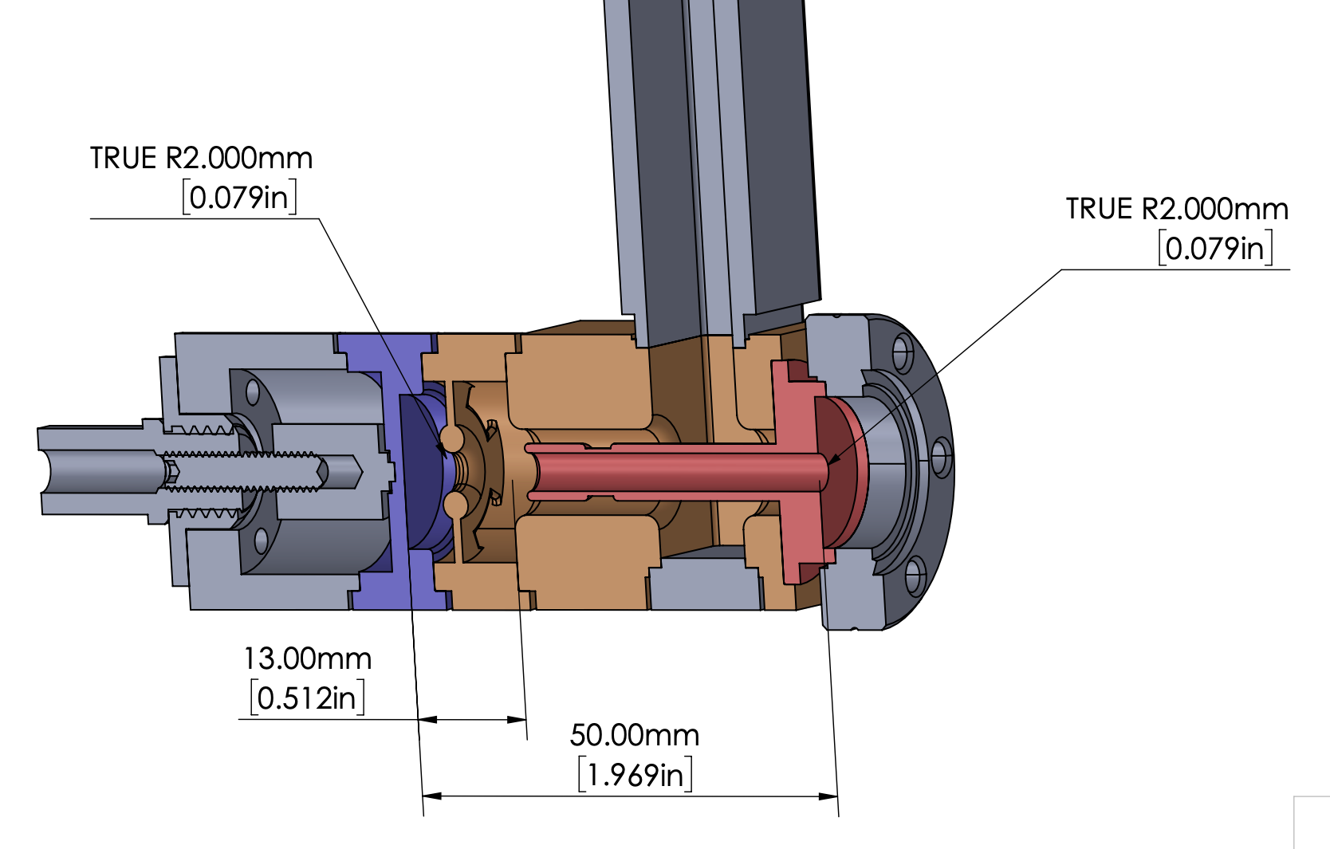
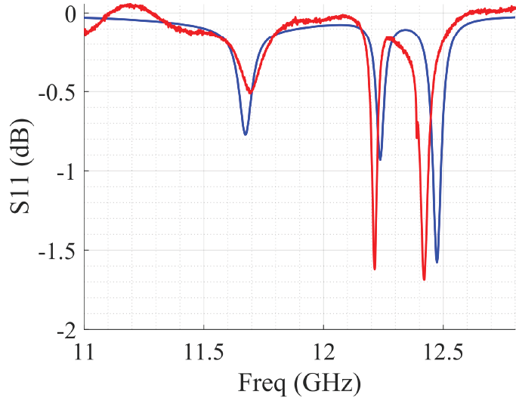

Xgun: 1.5 cell RF photocathode gun
RF
RF Design
IRIS DISK
COAXIAL RF-INPUT COUPLER
Parameter | Value
Frequency | 11.7 GHz
Mode | π
t_fill | 5.4 nsec
RF pulse length | 9ns (3 ns rise, 3 ns flat, 3 ns, fall)
Power | 250
Cathode Field | 470
beam
Cathode is the Cu backwall
1.5-CELL
XGUN
RF
S11 simulation (CST)
S11 measurement (N.A.)
Overcoupled (β~20) $π$-mode @11.7 GHz
S. Kuzikov et al., (IPAC21)
An X-band Ultra-high Gradient Photoinjector
https://accelconf.web.cern.ch/ipac2021/papers/wepab163.pdf
25/36

Slide 26
AWA drive and Xgun beamlines
High-power, short-pulse rf generation
      Metallic Power Extraction and Transfer Structure (PETS) installed
    PETS (our short pulse “Klystron”)
ZONE 1
Drive beam
ZONE 3A + Xgun beamline
…
Drive beam
PETS
Drive
beam
Beam on YAG1
L-band drive gun
Cs₂Te cathode
High charge bunch train (up to 600 nC)
Final beam energy: ~65 MeV
…
ZONE 5
(diagnostics)

Slide 27
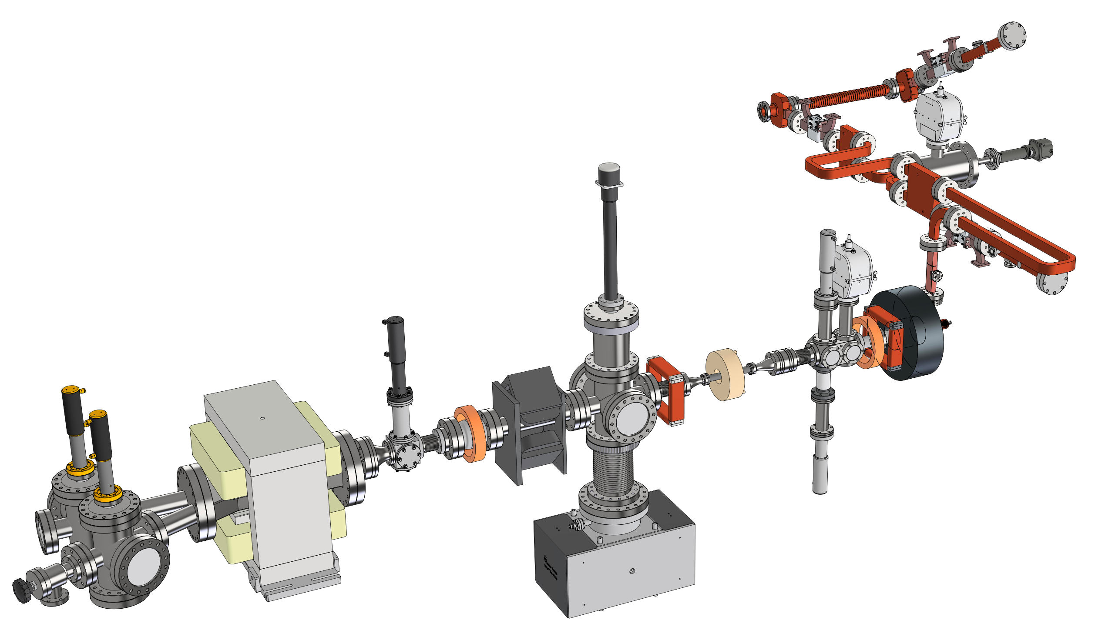
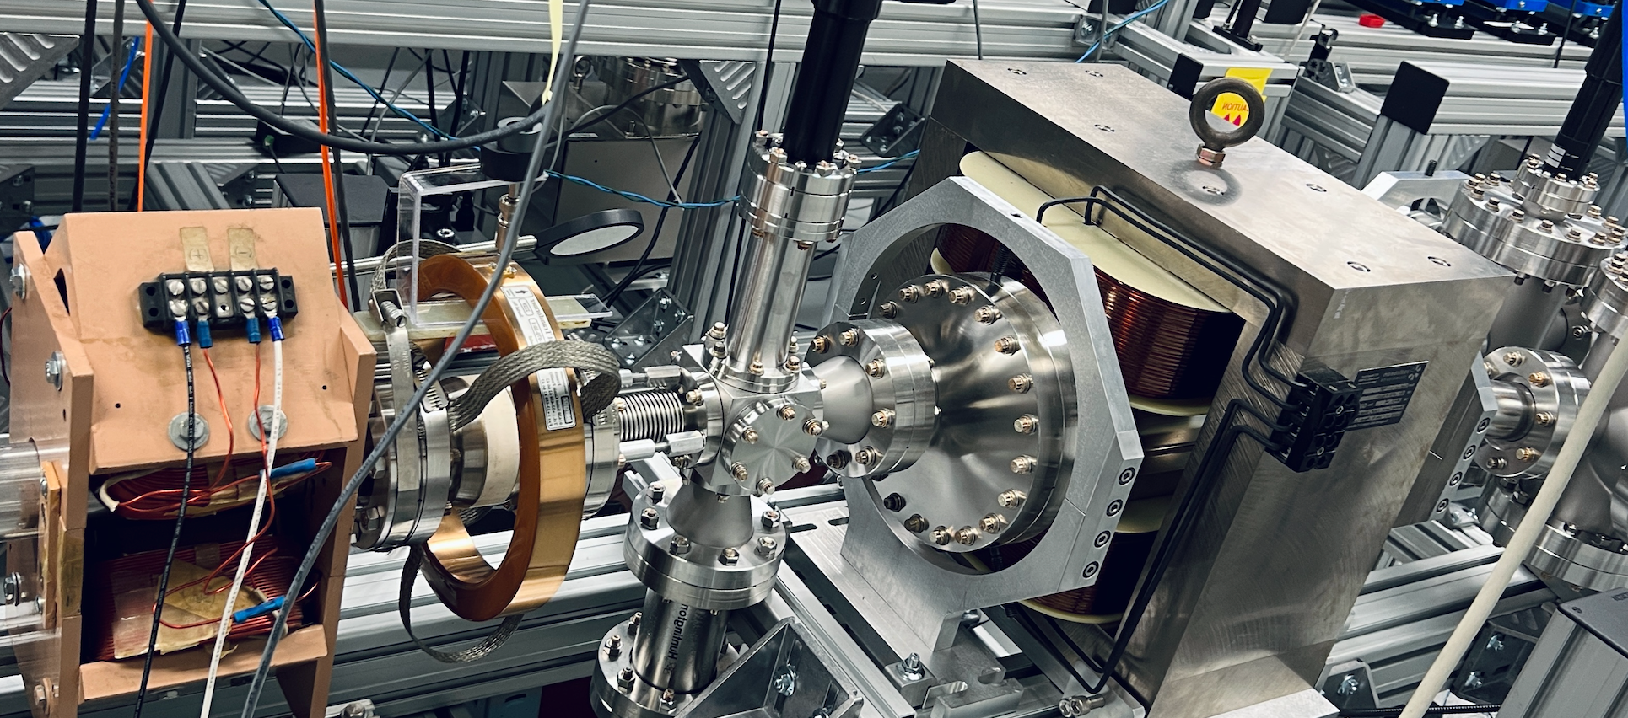
Xgun beamline
Power Extraction &
Transfer Structure (PETS)
2023 config. (will upgrade this Fall)
drive bunch train
Spectrometer
Quad
RF
power splitter
YAG &
Pepper pot
imaging
solenoid
Quad
rf load
YAG
(energy meas.)
spectrometer
dipole
Xgun
main solenoid
(w/ iron plate)
ICT
trim
magnet
BPM
laser injects from the 1st viewport
ICT
Xgun beam

Slide 28
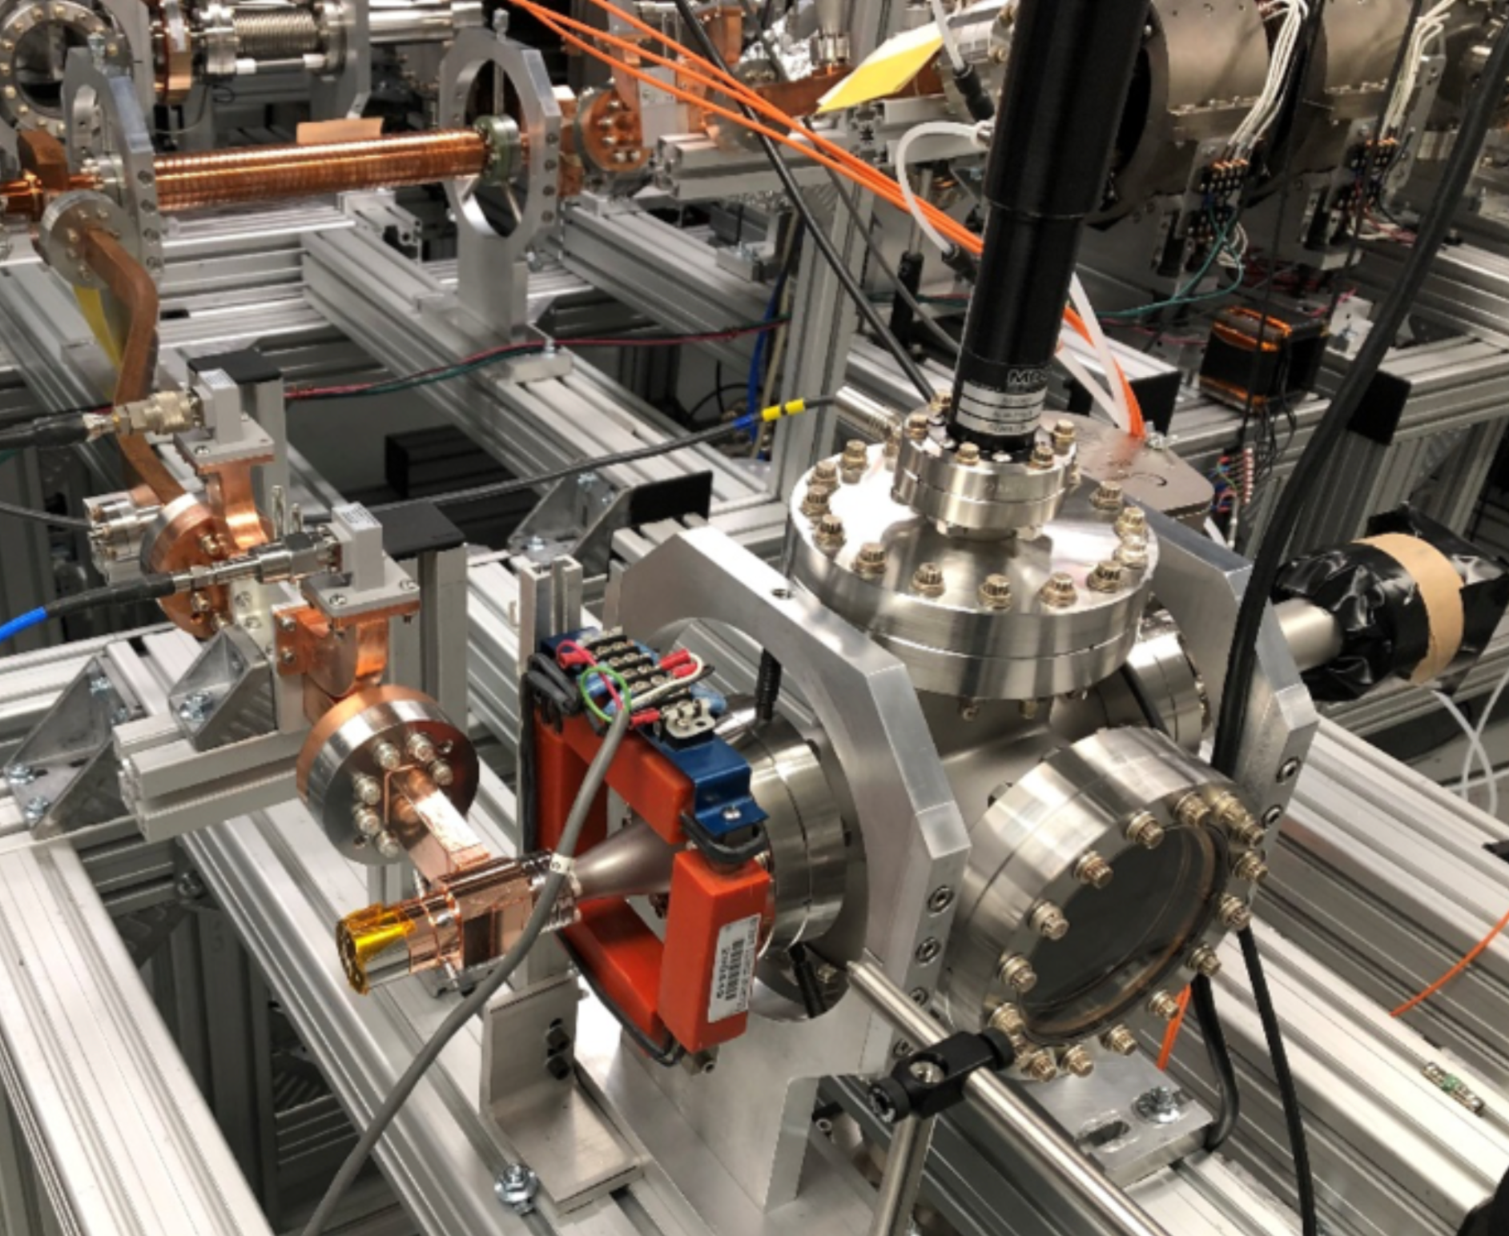
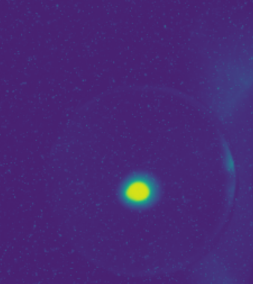
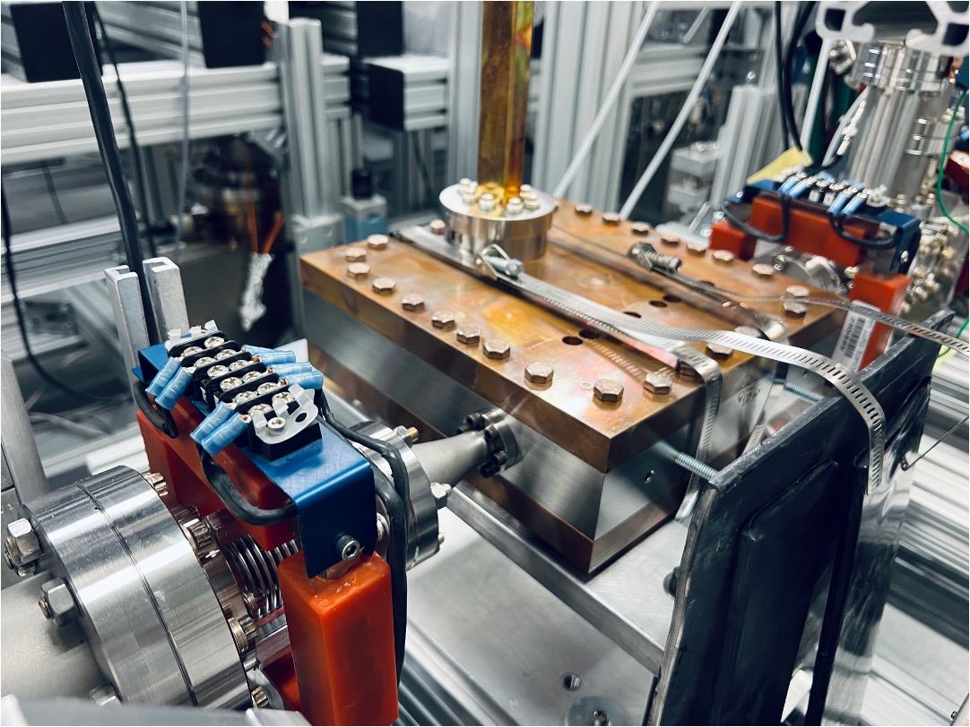
Xgun test history
[1] W.H.Tan et. al., Phys. Rev. Accel. Beams 25, 083402, August 2022 (2022)
See “EXTRA” slides for details
pre-2020
2021
2022
2023
Initial Xgun RF conditioning ^{[1]}
1st beam test ^{[1]}
2nd beam test
& re-conditioning
3rd beam test
(most recent)
High gradient (388 MV/m) verified through beam energy measurement.
Beam energy characterized (~2.7 MeV)
Low breakdown rate confirmed (>500,000 shots, BDR<10⁻⁵).
Achieved 350 MV/m within 70k pulses.
A dark current loading region observed.
No observable dark current after conditioning.
X-band power splitter and phase shifter conditioned.
A LINAC added to the Xgun beamline. Beam energy characterized.
Performed another rf conditioning, very few BD noticed. Good robustness.
Study the fundamentals of photoemission (Copper cathode):
Schottky studies at different gradients.
QE measurements at different gradients.
RF conditioning test
Beam on YAG1
stand
LINAC
Next
section
Xgun

Slide 29
Xgun progress
Fundamental photoemission studies
Schottky scans @ different gradients (60 MV/m to 320 MV/m)
  Simulation benchmarking
  Exploring the potential for other emission mechanisms
Exploring the potential for multipacting

Slide 30
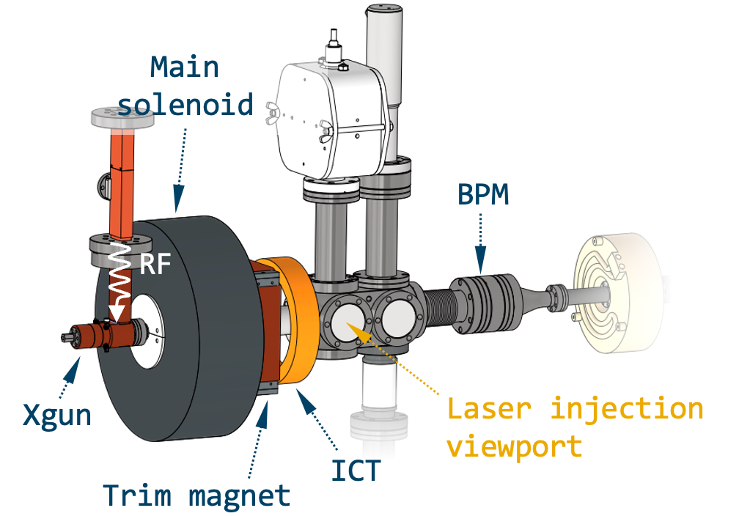






Schottky studies
Benchmarking Exp. Data to ASTRA simulations
Simulation setup
In ASTRA, bunch charge is evaluated as follows,
$Q=Q_{0}+S_{1}∙\sqrt{E}+S_{2}∙E$
where,
$S_{1}, S_{2}$: Schottky strength coefficients
$E$: field on the cathode
$E_{total}= E_{0}∙sin\left(φ_{rf}\right)+E_{sc} + { E}_{roughness}$
Possible field ($E$) contributions acting on the cathode:
Modeled separately using a sinusoidal surface [1-2]
Both included in ASTRA
where,
$E_{0}∙sin\left(φ_{rf}\right)$: applied rf field
$E_{sc}$: space charge shielding field
$E_{roughness}$: modeled 3D EM field introduced by surface roughness.
[1] D. J. Bradley, et al., J. Phys. D: Appl. Phys., Vol. 10, (1977).
[2] G. S. Gevorkyan, et al., Phys. Rev. Accel. Beams 21, 093401 (2018).
[3] G. Chen et al., https://accelconf.web.cern.ch/ipac2024/pdf/MOPR76.pdf

Slide 31







Schottky studies
In ASTRA, bunch charge is evaluated as follows,
Simulation benchmarking of exp. data
@ 60, 100, 180, 250, 320 MV/m
$Q=Q_{0}+S_{1}∙\sqrt{E}+S_{2}∙E$
Ref data for simulation param ($S_{1}$, $S_{2}$, $Q_{0}$) optimization
Peak charge discrepancy only at high gradient.
Other emission mechanism involved (i.e. photo-assisted field emission)?
At all gradients, simulations include the ${ E}_{roughness}$ shows a better agreement with the measurements.
Revealed a beam clipping issue at the Xgun exit.
Photo-assisted field emission might happen at high gradient.
Modified Folwer-Nordheim:
$J\left(E\right)=a\frac{β^{2}E^{2}}{φ_{eff}}exp⁡(−b\frac{φ_{eff}^{3/2}}{βE})$
?

Slide 32



Multipacting simulation
@ different gradients
An example of MP
simulation result
Simulation setup
Iris
Coupler
Solenoid
ICT
Half cell
Full cell
In the simulation:
3D Xgun field map + solenoid field map included.
Tracking to the downstream ICT.
Primary particles for MP simulation assigned to an 8 deg slice.
Cu SEY applied.
Zoom-in
Total number of primary macro-particles: ~3000.
Total generated secondary electrons: ~200.
NONE of the secondary e- made to the downstream ICT.

Slide 33




Multipacting simulation
@ different gradients
Half cell
①
③
②
④
MP scanning param.
Xgun E | 10 to 350 MV/m
Phase | 0 to 360 deg
Sol. B* | 0.05 to 0.22 T
* Solenoid B for each scan was predicted based on the recorded experimental values
Iris
Get an insight on the MP issue which is sensitive to the gradient, rf phase and solenoid strength.
Nearly NO secondary electrons can reach to the downstream ICT.
Tracking the MP in different regions separately:
① Half cell
② Iris
③ Full cell
④ Coupler (no MP from simulation)
Full cell

Slide 34

conclusion
AWA themes
Short-pulse TBA (NCRF): High-gradient demonstrated.
  ~300 MV/m X-band TW accelerating metallic accelerator
  ~400 MV/m X-band photocathode gun
Bunch manipulation
  6d phase space manipulation
  Longitudinal bunch shaping and associated diagnostics
X-band Photogun
Characterized parameters of Xgun, include:
  High gradient ~400 MV/m
  Beam energy 2.7 MeV
  Good robustness. No noticeable BDs after fully conditioning.
Fundamental cathode studies have been done:
  Schottky studies at different gradients have been performed.
  Benchmarking of experimental data to ASTRA simualtions.
  Studies on FE and MP issues through simulations underway.
Future work:
  New beam test in Fall 2024
  New designs of the Xgun have been proposed in parallel
WR90 port
E-field
Half cell
Full cell
beam
Cathode
Iris

Slide 35
Big Thanks to our team!
Gongxiaohui Chen (AWA) Scott Doran (AWA) Alex Ody (AWA) Wanming Liu (AWA) John Power (AWA) Charles Whiteford (AWA) Eric Wisniewski (AWA) Gwanghui Ha (was at AWA, now at NIU) Jiahang Shao (was at AWA, now at IASF) Maomao Peng (was at AWA) | Chunguang Jing (Euclid Techlabs / AWA) Ernie Knight (Euclid Techlabs) Sergey Kuzikov (Euclid Techlabs) Ben Freemire (Euclid Techlabs) Sergey Antipov (Euclid Techlabs, now at PALM Scientific) Xueying Lu (NIU / AWA) Philippe Piot (NIU / AWA) Emily Frame (NIU) Wei Hou Tan (NIU, now at SLAC) Sarah Weatherly (IIT)
We also thank funding agencies: DoE HEP and SBIR programs and ANL LDRD.

Slide 36
extras

Slide 37

The AWA facility
https://www.anl.gov/awa
65 MeV L-band photoinjector linac, 40 m long bunker, Support areas

Slide 38



Experiment #1: high-power rf conditioning
Xgun only
Experimental setup at AWA (Dec, 2020: 1 week run)
PETS [1]
drive beam
Short rf pulse
(9 ns)
INSTALLED
DIAGNOSTICS
[1] M. Peng, et al., (IPAC 19)
Generation of high power short rf pulses using an X-band metallic power extractor driven by high charge multi-bunch train
https://accelconf.web.cern.ch/ipac2019/papers/MOPRB069.pdf
Xgun [2]
YAG screen + Faraday cup
[2] J. Shao, et al., (IPAC 21)
High-power test of a highly over-coupled X-band rf Gun driven by short rf pulses
https://accelconf.web.cern.ch/ipac2021/papers/thpab331.pdf
Bi-directional coupler
38/36
Notes:
Milestone: 350 MV/m achieved

Slide 39




experiment #1: high-power rf conditioning
Xgun only
Experimental results (Dec, 2020: 1 week run)
RF conditioning history of the Xgun
I think we are onto something
Strong beam loading from dark current was observed during RF conditioning
E_{cathode} 350 MV/m (inferred from measured P=250MW)
Low Breakdown Rate
RF conditioned fast (~70k pulse)
No detectable dark current (<1pC)
J. Shao, et al., (IPAC 21)
High-power test of a highly over-coupled X-band rf Gun driven by short rf pulses
https://accelconf.web.cern.ch/ipac2021/papers/thpab331.pdf
39/36
Notes:
Milestone: 350 MV/m achieved
No breakdowns after fully conditioned, BUT not too many pulses so no stats for BDR

Slide 40


Experiment #2: first beam measurements
Xgun only
Experimental setup at AWA (Nov 2021: 3 week run)
PETS
RF
Additions to Exp’t #1
Installed a complete beamline w/ spectrometer installed for energy measurements
Added UV laser injection for e- beam generation
W.H.Tan et. al., PRAB 2022
Demonstration of sub-GV=m accelerating field in a photoemission electron gun powered by nanosecond X-band radio-frequency pulses
Phys. Rev. Accel. Beams 25, 083402, August 2022 (2022)
40/36
Notes:
Milestone 1: 350 MV/m confirmed with beam measurement
Milestone 2: Stable beam was produced, Jitter correlated with drive-beam jitter

Slide 41


experiment #2: first beam measurements
Xgun only
Results 1: first electron beam from Xgun (Nov 2021: 3 week run)
Phase Scan
100 pC photoelectron beam on YAG1 screen
No detectable dark current (<1pC)
Xgun phase scan @340 MV/m
Evidence of strong Schottky effect
41/36

Slide 42

experiment #2: first beam measurements
Xgun only
Results 2: energy and gradient (Nov 2021: 3 week run)
Gradient confirmed
Gradient inferred from FR power was beam energy measurement
Max achieved gradient = 388 MV/m from the beam energy measurement
Stable beam produced
Jitter due to drive beam charge jitter due to laser energy jitter
Energy fluctuation ~3%, likely due to the drive charge instability due to laser instability
Low breakdown rate confirmed
∼500,000 shots gives a conservative upper limit for the BDR <10⁻⁵
Low dark current
No detectable dark current (<1pC)
42/36
Notes:
GC: note there is a mystery. When drive Q was high, main beam was low energy. Weird!!!

Slide 43





Experiment #3:Power splitter and phase shifter test
Setup & design (2-day run, April 2022)
Phase shifter
High-power test of Broadband power splitter and phase shifter
(necessary for ultrashort pulse regime)
chokes
PETS
Power Splitter
trombones
S. Kuzikov et. al., IPAC22
Toward emittance measurements at 11.7 ghz short-pulse high-gradient rf gun
https://accelconf.web.cern.ch/ipac2022/papers/MOPOMS013.pdf
notch
43/36
Notes:
prep for experiment #4

Slide 44




Experiment #3: Power splitter and phase shifter test
Results (2-day run, April 2022)
Power splitter
Xgun
Power Splitter
Phase Shifter
linac
Phase shifter
PETS = 400 MW
Both components conditioned to >200 MW
Power splitter (power level): 0-100% power variation
Phase shifter: >180 deg phase shift
$∆∅$between the linac and Xgun
44/36
Notes:
We tested both compoents under high power. ->the power splitter can provide us a tunable from ..
Then, the phase difference between the linac and the xgun is plotted -> As we move the controller, the phase shift is pretty linear

Slide 45




Experiment #4: second beam measurements
Xgun, linac,
waveguide
Setup: add a linac and extended the beamline (3-weeks, June 2022)
“LINAC” ^{[1]}
G. Chen et. al., NAPACC22
Emittance measurements and simulations from an x-band short-pulse ultra-high gradient photoinjector
https://epaper.kek.jp/napac2022/papers/moze3.pdf
45/36

Slide 46




Experiment #4: second beam measurements
Xgun, linac,
waveguide
Results: Energy gain with linac demonstrated (i.e. staging!)
~1.13 m
~1.2 m
quad
spectrometer
First attempted emittance measurement (beamline not optimized)
  $ε_{n,x}=5.58 μm$
  $ε_{n,y}=11.26 μm$ (due to geometry asymmetry of the linac)
  Kinetic energy: 5.9 MeV
Breakdowns observed
G. Chen et. al., NAPACC22
Emittance measurements and simulations from an x-band short-pulse ultra-high gradient photoinjector
https://epaper.kek.jp/napac2022/papers/moze3.pdf
46/36

Slide 47

Experiment #4: second beam measurements
Xgun, linac,
waveguide
Results: Why is measured $ε$ high? And what next?
Issues in the 1st $ε$ measurement:
Non-ideal LINAC geometry
  New LINAC design is proposed
Non-ideal solenoid
  New solenoid design is under review
Unknown BDs happened randomly and prevent us reaching to a higher optimized gradient
  Has Xgun has been damaged? (We suspect bad vacuum due to clamped linac.)
Conclusion: pause program to understand breakdown
Vent the beamline and inspection Xgun
Reinstall Xgun without linac and with RF components
Add pumping
47/36

Slide 48

experiment #5: Second high-power rf conditioning
Setup at AWA (Oct 2022: 2-day run)
RF
PETS
Xgun alone
without linac
without phase shifter
without power splitter
YAG +
Faraday cup
bunch train
Xgun
Xgun RF test-stand
48/36

Slide 49


experiment #5: Second high-power rf conditioning
Result: Xgun has no damage, immediately back to ~350MV/m
1st Xgun conditioning (Dec. 2020)
2nd Xgun conditioning (Oct. 2022)
Conditioning process is quick.
A dark current loading region observed (~40,000)
The Xgun fully conditioned very smoothly. No damage
Did not observe dark-current
49/36
Notes:
GC: Shao left gaps, but GC removed gaps from data

Slide 50



New Xgun design
New Xgun is designed by Sergey Kuzikov and Ernie Knight at Euclid TechLabs.
1.5 cell gun with removeable cathode
Ez
WR90 port
E-field
H-field
Half cell
Full cell
S11
beam
beam
Cathode
Iris

