Slide 1

OpenEM Update
Spencer Bliven :: Scientific Data Curation :: Paul Scherrer Institute
2024-03-05 AWI Department Meeting

Slide 2
Goals
EM data should be FAIR and Open by default
Standardized data management at all facilities
Automatic metadata collection during acquisition
Streamlined deposition in EMPIAR/EMDB/PDB
Central data repository providing access to researchers & the public
  Authenticated access during the embargo period
  Open access after publication
  Indexed by search engines or accessible by DOI

Slide 3













Open EM Data Network (OpenEM)
4 ETH Institutes
5 Universities
Alun Ashton, Spencer Bliven, Gregor Cicchetti, Peter Hüsser, Michael Kallmeier-Glanz, Volodymyr Korkhov, Carlo Minotti, Elisabeth Müller, Gebhard Schertler
Mohamed Chami, Timm Maier, Yves Tittes
Rolf Erni, Despina Adamopoulou
David Kalbermatter, Benoît Zuber
Matthew Baker, Nicolas Blanc, Daniel Böhringer, Christophe Briand, Christophe Copéret, Miroslav Peterek, Bilal Qureshi, Andrzej J. Rzepiela, Philipp Wissmann
Andreas Boland, Orsolyz Barabas, Andy Howe, Attila Nacsa, Robbie Loewith
Marco Cantoni, Sofya Lakina, Alexander Myasnikov, Alexandra Radenovic, Henning Stahlberg,
Christel Genoud
Notes:
26 participants
Possibly missing:
UNIBAS Markus Dürrenberger (Nano Imaging Lab), Ben Engel (Prof., Biozentrum), Marcus Wyss
UNIBE: Wanda Kukulski (Prof., DCI-Bern), Dimitrios Fotiadis (Inst. Biochem. & Mol. Medicine), Beat Haenni (EM lab head)
UNIGE: Paul Guichard (Prof., DCI-Geneva)
UNIZH: Raimund Dutzler (Prof., Dep. Biochem.), Ohad Medalia (Prof., Dep. Biochem.), Urs Ziegler (Cent. F. Microsc. & Image Analysis), Andres Käch (Cent. F. Microsc. & Image Analysis)

Slide 4
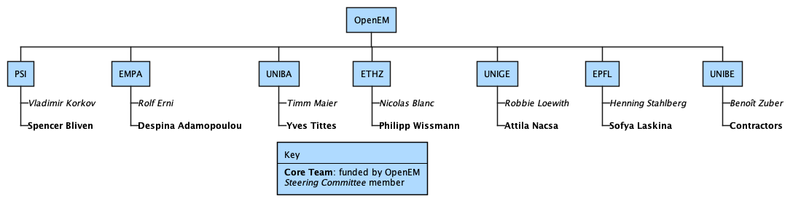
Open EM Data Network (OpenEM)
Open EM Data Network
Two funding instruments
  ETH ORD. PI: Henning Stahlberg. 1.5 MCHF
  Swissuniversities. PI: Robbie Loewith. 0.92 MCHF
6.5 new positions
Timeline: June 2023–Dec 2025
Started March 1

Slide 5
Project Management Tools
Confluence for documents, meeting notes, and planning
Github projects for tasks/Kanban
Agile development
Slack, sympa email lists
https://swissopenem.github.io

Slide 6
Architecture
EM Standard
Website & Training
Metadata
Collection
Web-based
Ingestor
Federated Authentication & Authorization
Deposition Tool
ETHZ Archiver System

Slide 7
Open Standards Community for EM (OSCEM)

Slide 8
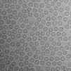
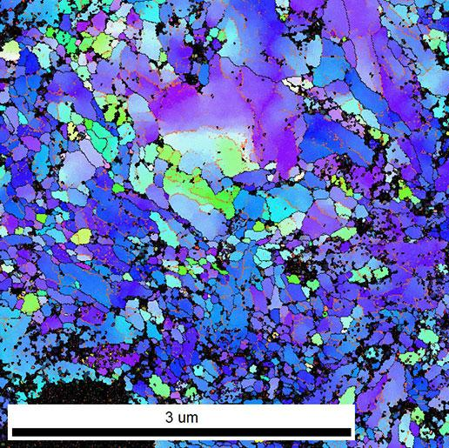
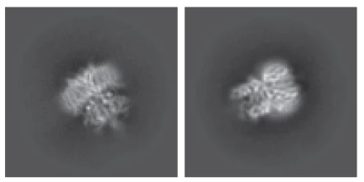
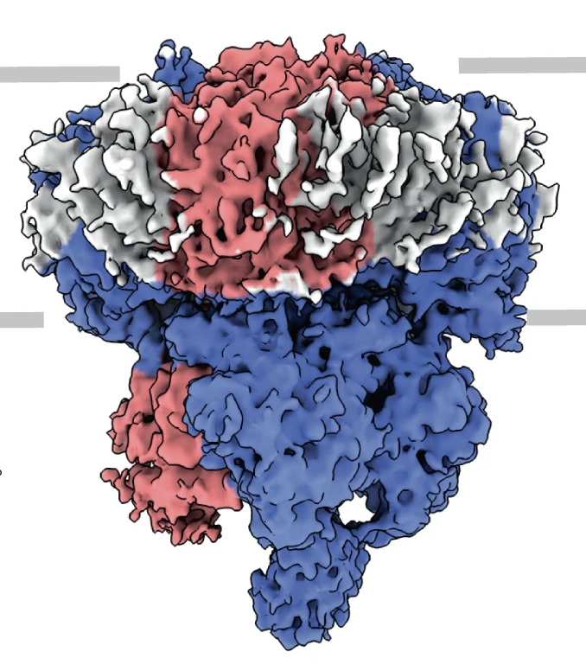
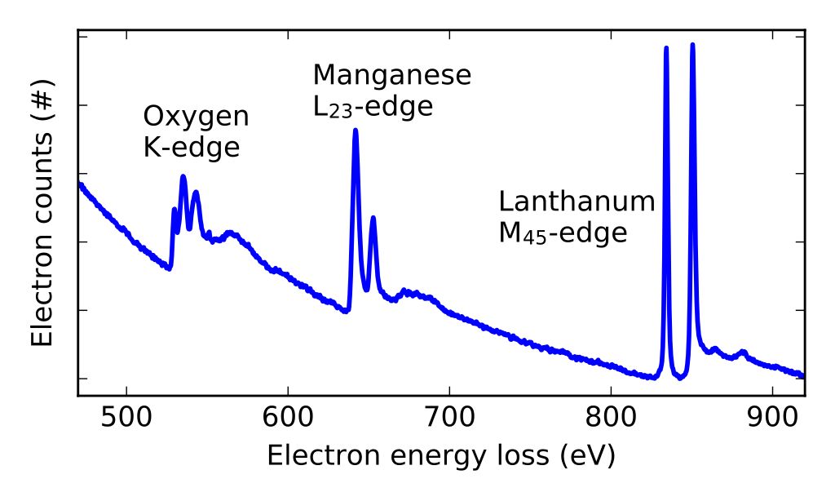
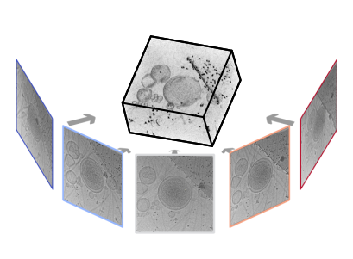
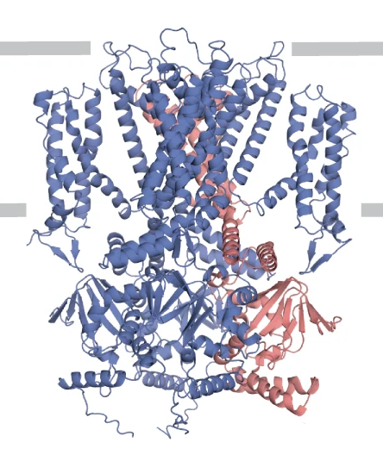
Diverse data types
Raw Data
Sample Description
Derived Data
Particles & classes
(Barret, PSI)
Instrument Settings
Electron Maps
(EMDB)
2D Micrographs
Annotated Images
(EMPIAR-11016, Harder, EPFL)
(EMD-12718, Barret, PSI)
(Kunze and Sologubenko,
ETHZ)
Workflows
Molecular Models
(Protein Databank)
Spectrograms
Magnunor, Wikimedia
3D tomograms
teamtomo.org
(7o4h, Barret, PSI)
Publications
More: ptychography, 4D STEM, …
More: Tomographic reconstructions, segmented models, …
Notes:
R

Slide 9
Diverse Formats
Raw Data
Sample Description
Proposal systems
Labbooks
Derived Data
Micrographs
MRC
TIFF
Zarr/OME
HDF5/EMD
PRZ/numpy
NXem
Metadata
XML (diverse formats)
SerialEM mdoc
Image metadata (eg TIFF headers)
Manufacturers
Thermo, Zeiss, Gatan, Jeol, ASI, …
CryoEM
PDBx/mmCIF
Map
Databases
EMPIAR/EMDB/PDB
Zenodo/Institutional repos
Instrument Settings
SerialEMSettings.txt
Configuration files
Workflows
Project directories
Workflow files (scipion, ccpem-pipeliner, etc)
Publications
DOI
DataCite records
Git repos
Notes:
R

Slide 10





Workshop February 22-23
Open Standards Community for EM (OSCEM)
Participants from facilities, software, and repositories
https://indico.psi.ch/e/em-standards-2024
Will draft an ontology and a schema for EM metadata
  Encompasses both the minimal metadata for processing a dataset and the metadata required for depositing a dataset
  Extensible to many techniques in EM (single particle, tomography, EELS
  Derived from existing standards (CryoEM Ontology, PDBx, NXem)
Scipion

Slide 11
Current baseline: repository requirements (+)
Parameter | Type | EMDB required | SerialEM | EPU | In emd
Instrument Name | str | x | Yes | Yes | Yes
Illumination mode | str | x | No | Yes | Yes
Imaging mode | str | x | No | Yes | No
Electron source | str | x | No | Yes | No
Acceleration Voltage | int | x | Yes | Yes | Yes
C2 Aperture | int |  | No | Yes | Yes
CS | float |  | ? | Yes | No
Nominal defocus (min/max) | float |  | Yes | Yes | ?
calibrated defocus (min/max) | float |  | Yes | Yes | ?
nominal magnification | float |  | Yes | Yes | No
calibrated magnification | float |  | No | No | No
speciman holder model | str |  | No | ? | Yes
cooling holder cryogen | str |  | No | No | No
Temperature (min/max) | float |  | No | No | No
alignment procedure | str |  | No | No | No
software list | str |  | Yes | Yes | ?
Detector / Camera | str | x | ? | Yes | Yes
average dose per image | float | x | Yes | Yes | No
Energy filter | bool |  | Yes | Yes | No
energy filter slit width | float |  | Yes | Yes | No
detector pixels | int x int |  | Yes | Yes | No
Date of experiment | str |  | Yes | Yes | Yes
average exposure time | float |  | Yes | Yes | ?
Tilt angle (min/max) | float |  | Yes | Yes | No
cryogen | str |  | No | No | No
Residual tilt | float |  | No | No | No
Details instrumet | str |  | No | No | No
specialist optics | str |  | Yes | Yes | ?
spherical aberration corrector | str |  | No | No | No
chromatic aberration corrector | str |  | No | No | No
Microscopy settings | str | x | No | Yes | ?
Detector mode | str |  | No | Yes | ?
sampling interval | float |  | No | No | No
Movie frames per image | int |  | Yes | Yes | No
range of frames used | int |  | No | No | ?
# of grids imaged | int |  | No | No | No
# of images | int |  | No | No | ?
details for camera | str |  | No | No | No
Available in files
(Facilities)
Required for deposition (EMDB)
Required for processing
(Software)
Notes:
Example: Instrument parameters in the EMDB schema and ease of access for automatic metadata collection from files generated during data acquisition
+ refers to extension in case the requirements are not sufficient for a given topic to process the data

Slide 12
Archiver System

Slide 13
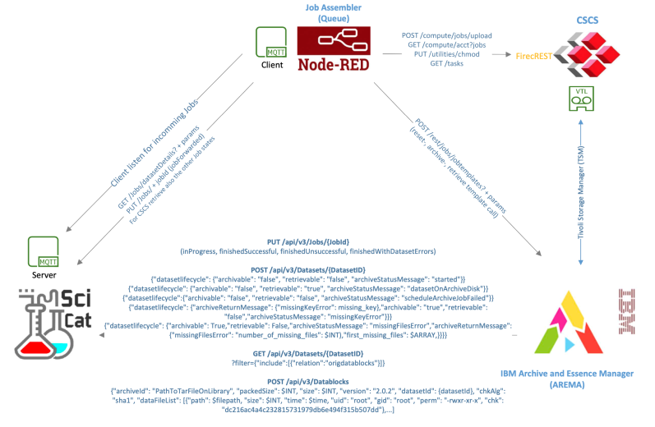
PSI Archiver System
RabbitMQ for job notifications from SciCat
Node-RED dispatch system
Arema scheduler
Tivoli Storage Manage for tape interface
FirecREST for CSCS operations
SciCat receives status updates via REST API

Slide 14
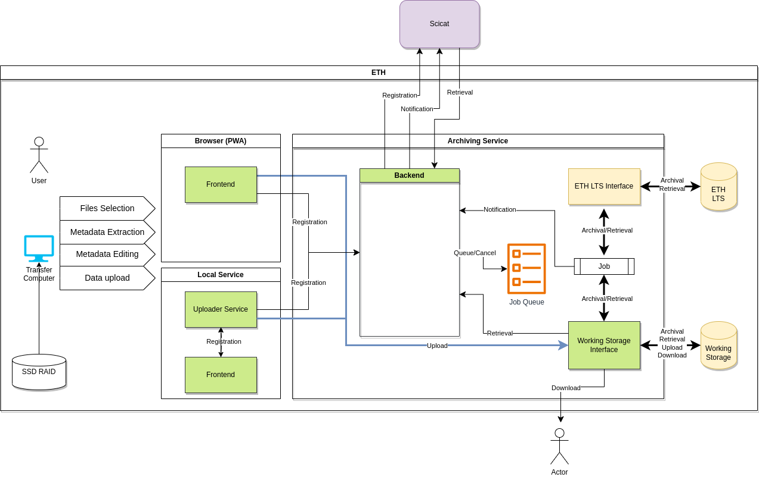
ETHZ Archiver System
Initial data transfer to S3 staging location
  Resumable uploads (tus)
Archive/retrieve from ETH Long-term storage via posix interface
Interact with Scicat Job API via REST
Deployment with Cellery/Kubernetes
Monitoring: grafana, prometheus

Slide 15
SciCat changes

Slide 16
Needed SciCat Features
Backend undergoing a major update to v4.0.0 (typescript, NestJs, better configuration, …)
Federated authorization via OIDC
User management system
  Independent of PSI-AD
  Fine-grained authorization
  More detailed accounting for billing
New data transfer mechanism
  Accessible from outside PSI
  Bandwidth for 3-4 PB/year
  Considering Globus or S3
Web-based upload for decentral data

Slide 17
Thanks!
Data Curation group (Leo, Carlo, Ali)
OpenEM team
SciCat team
Archiver team (Pedro, Michael, Bernard)
EM Facility staff

