Slide 1
Reconstruction in a Segmented Calorimeter
Omar Beesley

Slide 2
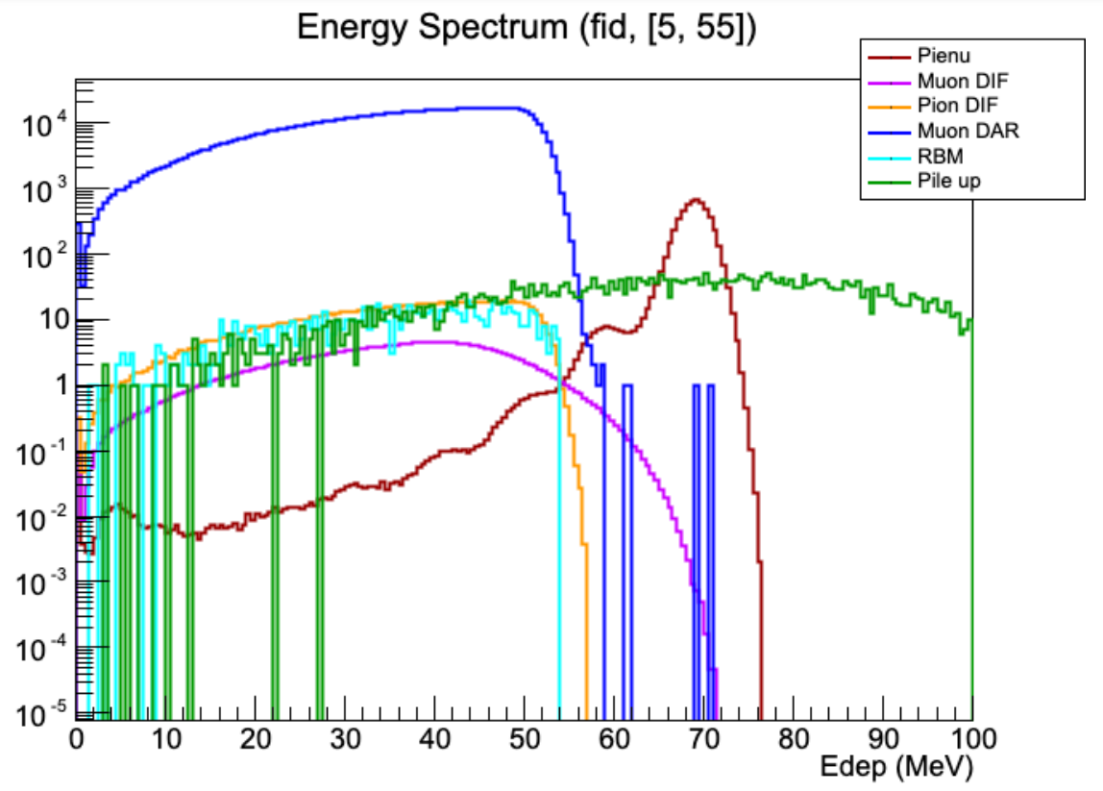
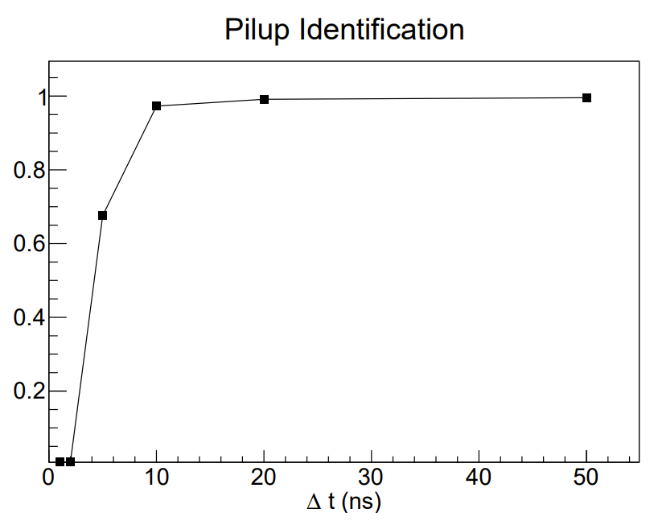
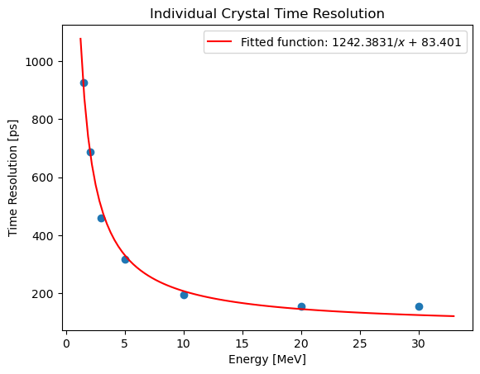
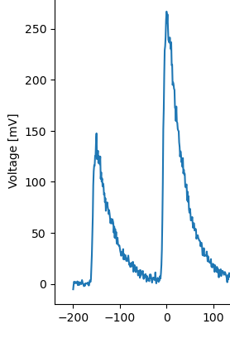
Current Calorimeter Reconstruction
Within 10 ns
Pileup
|t1-t2| < 10 ns → Pileup
|t1-t2| > 10 ns → Not Pileup
Move templates closer together until fitter can’t find two pulses
t1
LYSO measured to have <200 ps resolution
t2
Segmented should do much better!
P. Schwendimann (2022)

Slide 3
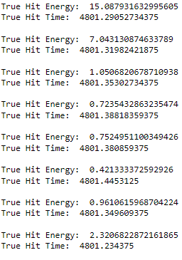
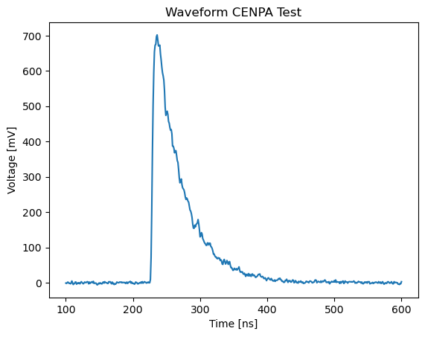
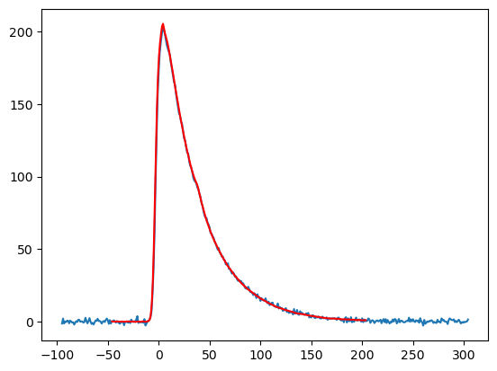
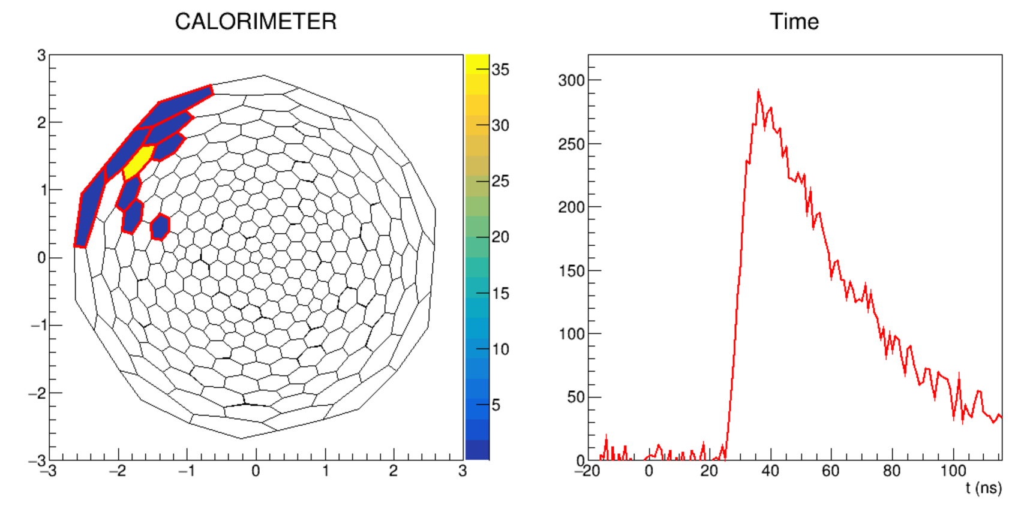
Implementation of LYSO Detector Response
Truth energies/times
Waveforms
Fitted waveforms (reconstructed energies/times)
Calorimeter clusters

Slide 4
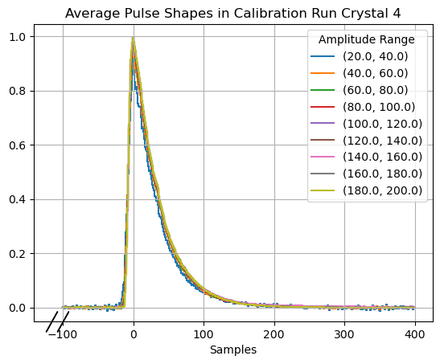
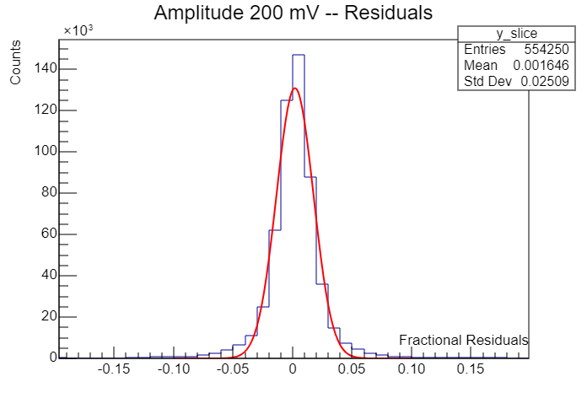
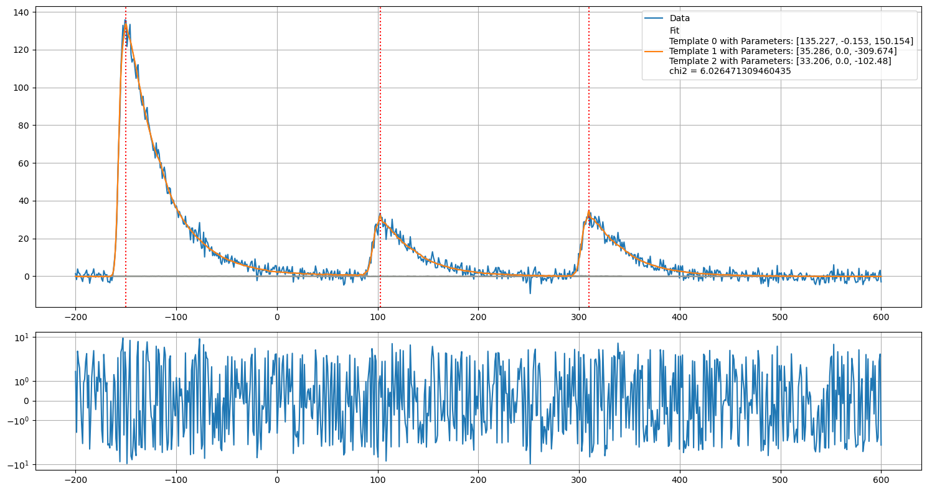
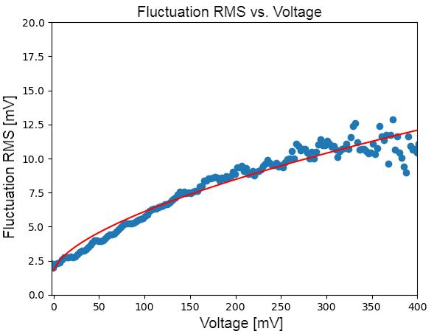
A Waveform Generator from LYSO Waveforms
3. Residual distributions at each voltage are fit to quantify voltage dependent fluctuations
Templates built from testbeam waveforms across PIONEER energy scale
2. Waveforms are fit with templates and residuals are recorded as a function of voltage
4. Fluctuation size is fit as a function of voltage to obtain a two parameter waveform model
Pedestal noise

Slide 5
Outline of LYSO Clustering Algorithm
Crystal hits within 2.5 R_{M} that are within 3.5 standard deviations of time resolution – combined to form “bunches”
Bunches within 5 R_{M} that are within 2 standard deviations of time – combined to form “proto clusters”

Slide 6
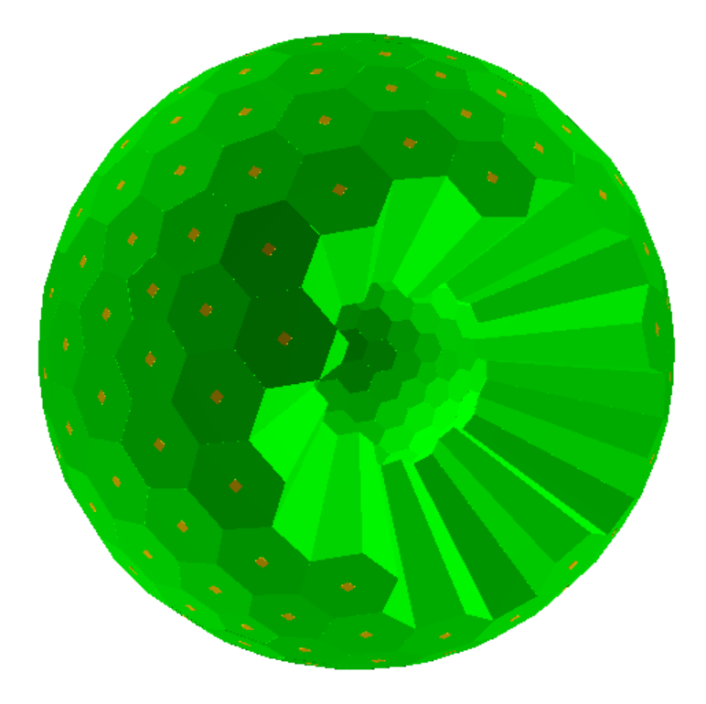
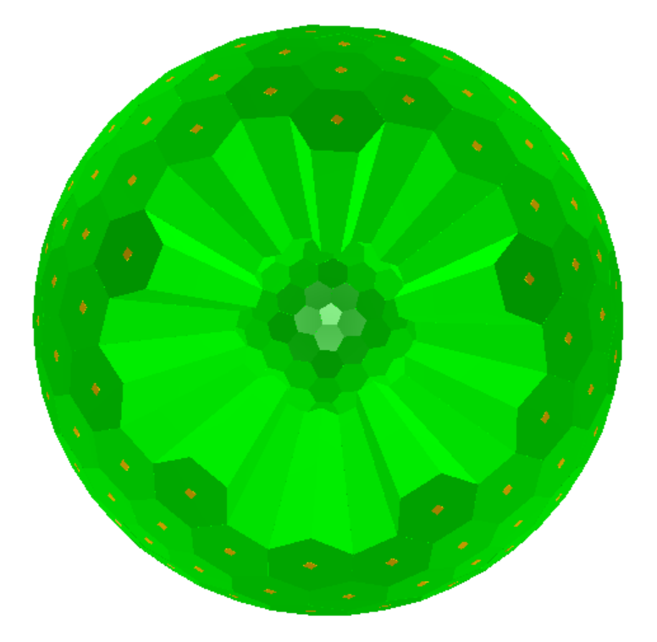
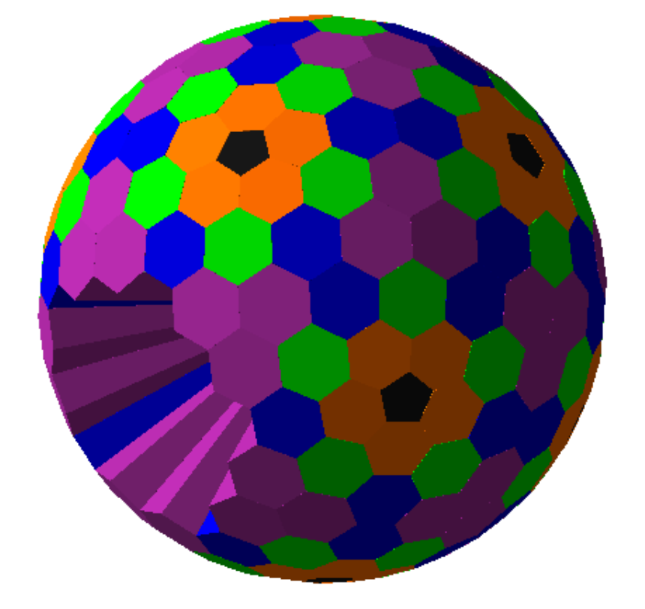
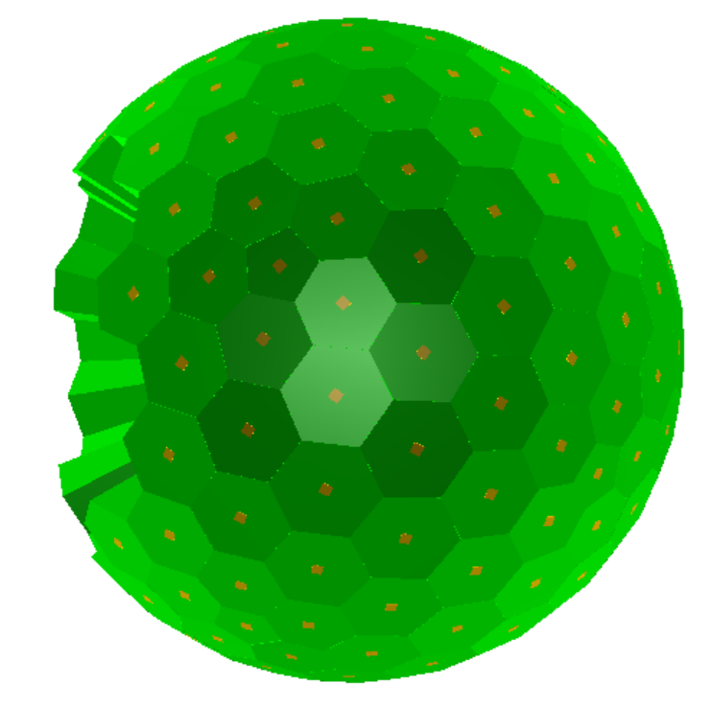
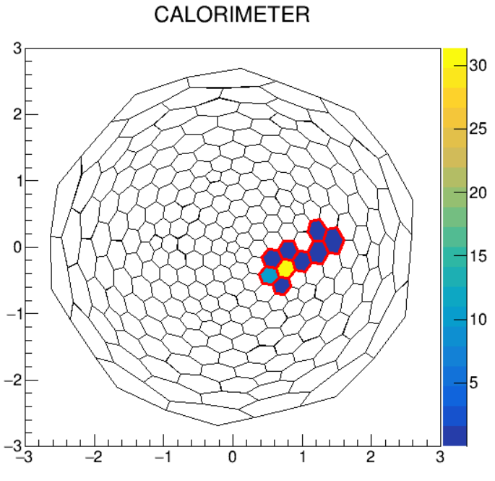
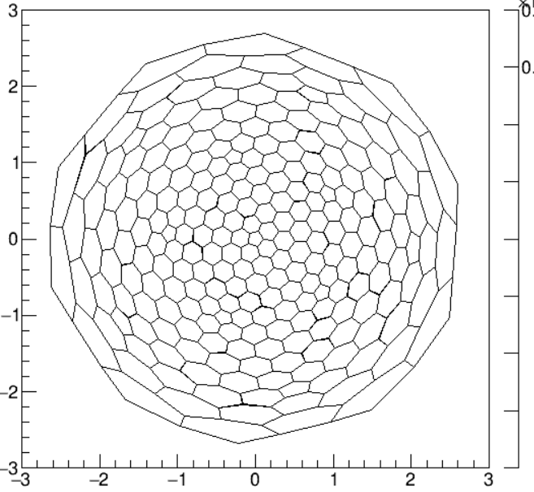
Calorimeter and Beam Setup
Nominal LYSO inner radius is now 15 cm
Beam of pions with 3e5 rate – forced to decay to muons

Slide 7
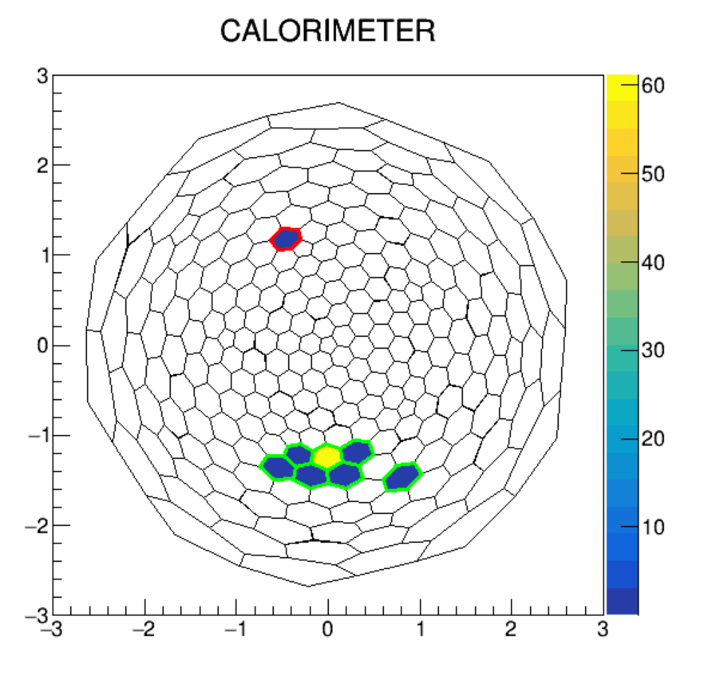
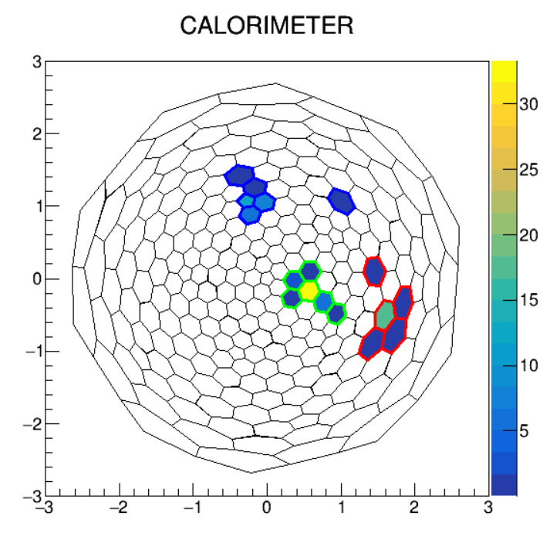
Event Displays
Look 5 R_{M} to capture 511s
511 keV gamma from albedo
3 separate e+ events in the calo

Slide 8
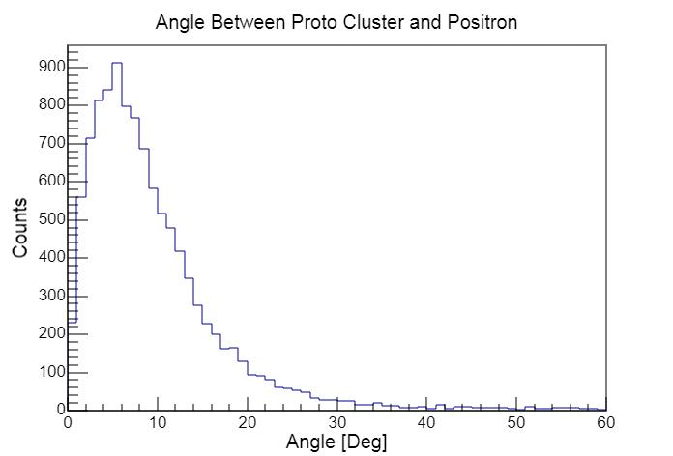
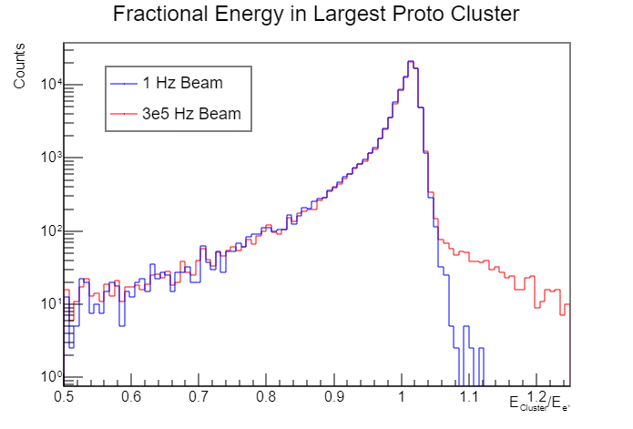
Proto cluster performance
Additional energy from a 2nd hit is misidentified as being part of the cluster
High energy proto cluster angles are typically within 5 degrees of the true position angles
Highest energy proto cluster misses energy
Uncertainty in reconstructed energy from fitter

Slide 9
Reconstruction from proto clusters to clusters
Time Difference | Overall Efficiency | More clusters than e+ | More e+ than clusters | Reasons for inaccuracy
0-2 ns | 86% | 0.3% | 13.7% | 1. Timing limitations 2. Fitter bug 3. Delayed energy deposits
2-10 ns | 98% | 0.5% | 1.5% | 1. Delayed energy deposits 2. Fitter bug 3. Timing limitations
Overall <10 ns | 95.4% | 0.5% | 4.1%
Simulation outputs proto clusters – user able to do additional reconstruction/merging
To classify events using only calo information, energy dependent criterion for timing difference used to combine proto clusters into clusters
  Proto clusters above 5 MeV need to be almost exactly time coincident to be merged – rarely merged
bunches → proto clusters → clusters

Slide 10
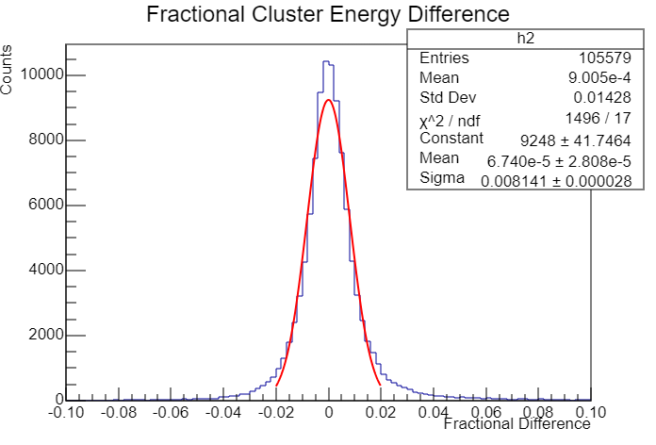
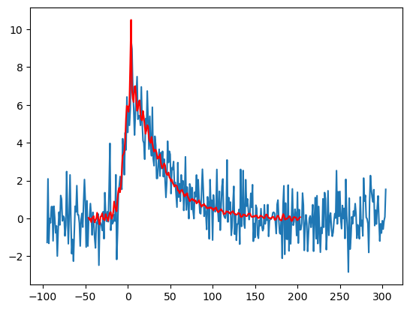
Effect of clustering on calorimeter energy resolution
Uncertainty of reconstructed energy from fit - especially at low energies
Inaccurate clustering of 511s
Add uncertainty in cluster energies to intrinsic calorimeter resolution via quadrature
Reconstruction smears 1.8% resolution to 2%

Slide 11
Next Steps
Improve fitter stability and introduce correlated waveform fits
Implement LYSO intrinsic radioactivity at a Geant4 level
Optimize clustering for PiBeta
Train a neural network to classify and cluster events in the calorimeter

