Slide 1
Role of a Tracker in the PIONEER Experiment
Josh LaBounty and Jaydeep Datta
PIONEER Collaboration Meeting
6/19/2024

Slide 2
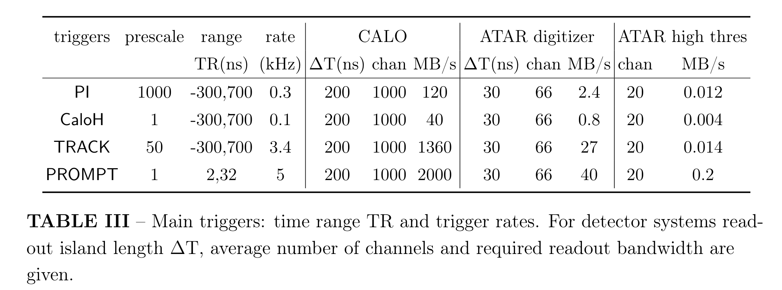
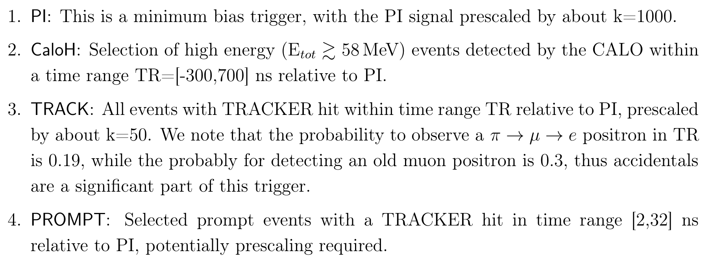
What is the purpose of the tracker?
Trigger
(see Peter’s talk)
Physics
Join ATAR information to CALO hits
Provide information about pileup in calorimeter
  Disambiguate multiple pulses when combined with ATAR information
Provide information about charged particle content in an event
  radiative decays
  appropriate dead material energy estimation for scattering events
https://arxiv.org/abs/2203.01981

Slide 3
What does the tracker need to fulfill that purpose?
Fast response (~ns)
Good position resolution
Good pileup resolution
High efficiency/layer
Minimal dead material

Slide 4
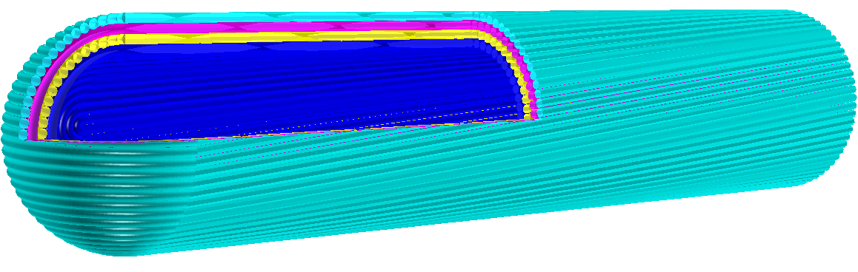
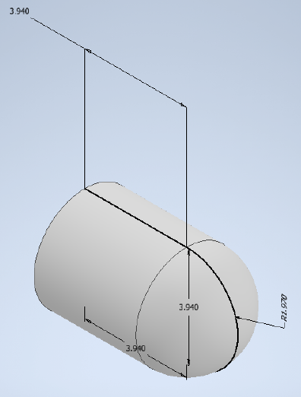
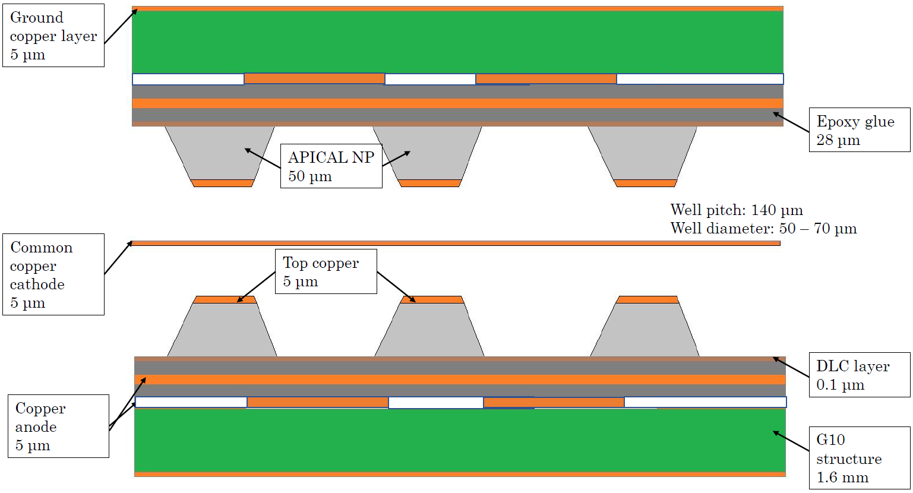
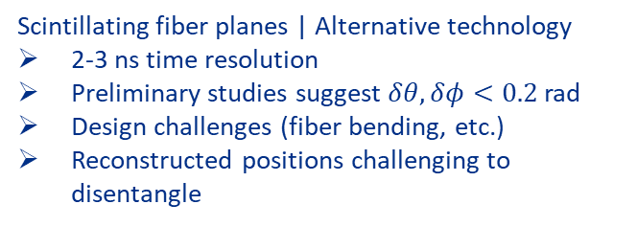
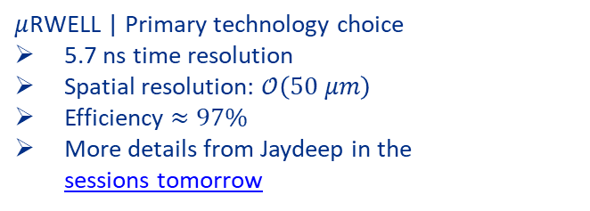
Tracker Designs
*fiber size increased by 10x for visibility
Common cathode Micro-RWELL Technology
CAD drawing
$μ$RWELL | Primary technology choice
5.7 ns time resolution
Spatial resolution: $𝒪\left(50 μm\right)$
Efficiency $≈97\%$
More details from Jaydeep in the
sessions tomorrow
Scintillating fiber planes | Alternative technology
2-3 ns time resolution
Preliminary studies suggest $δθ, δφ<0.2$rad
Design challenges (fiber bending, etc.)
Reconstructed positions challenging to disentangle

Slide 5
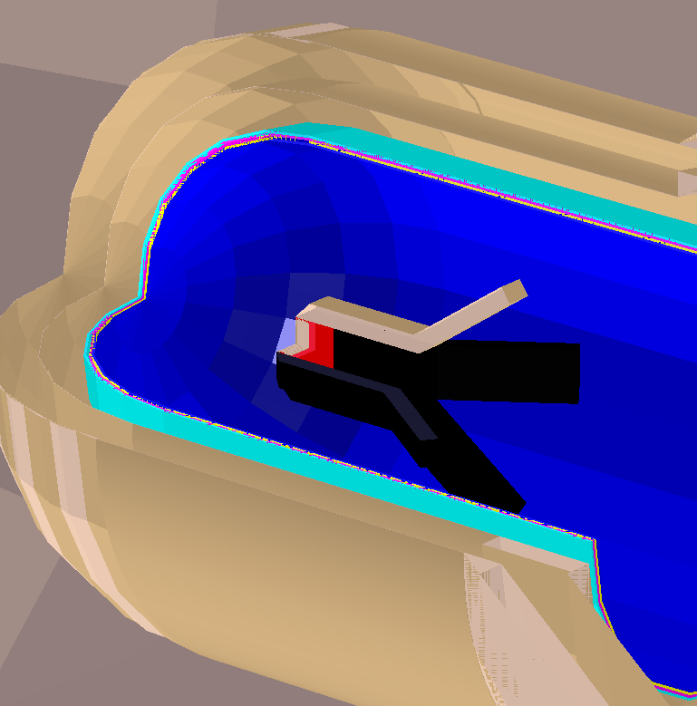
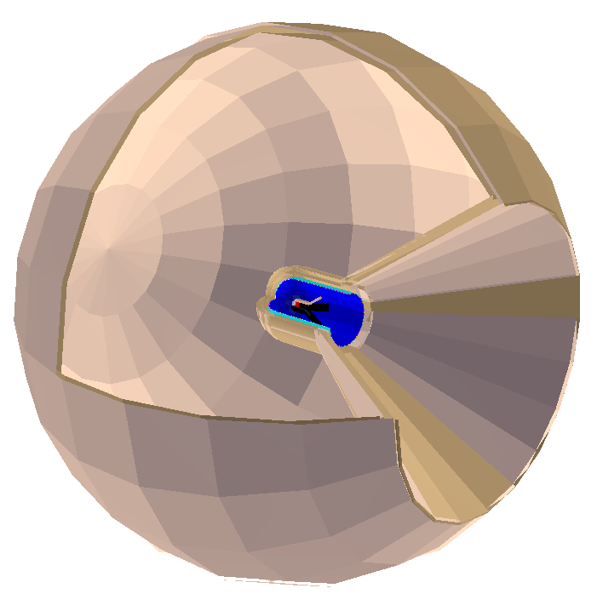
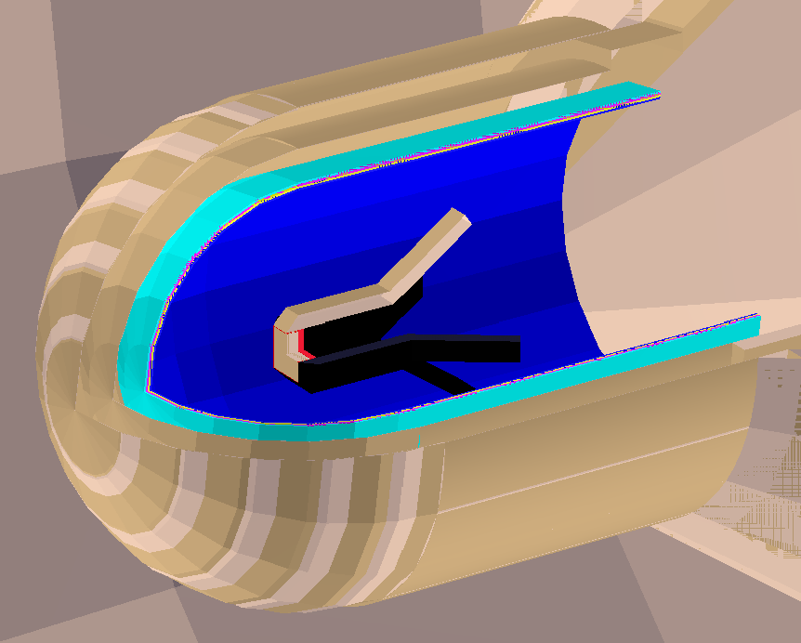
Generic Tracker Simulation

Slide 6
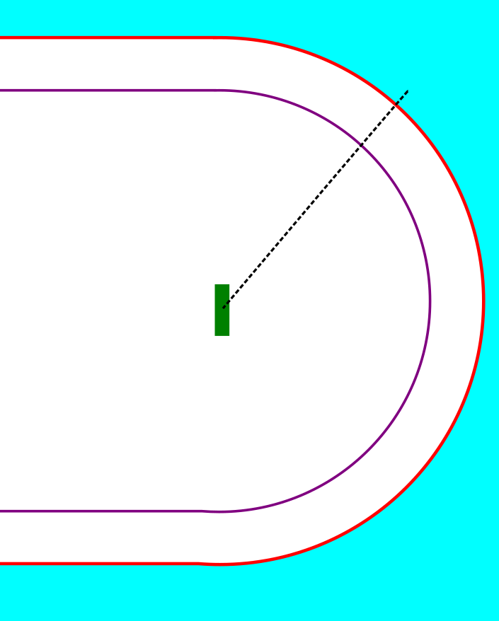
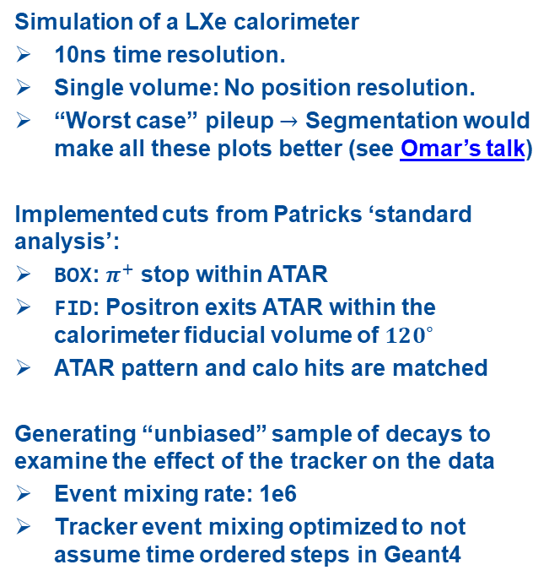

Some Specific Studies: Setup
Single LXe Volume
Simulation of a LXe calorimeter
10ns time resolution.
Single volume: No position resolution.
“Worst case” pileup $→$ Segmentation would make all these plots better (see Omar’s talk)
Implemented cuts from Patricks ‘standard analysis’:
BOX: $π^{+}$ stop within ATAR
FID: Positron exits ATAR within the calorimeter fiducial volume of $120^{∘}$
ATAR pattern and calo hits are matched
Generating “unbiased” sample of decays to examine the effect of the tracker on the data
Event mixing rate: 1e6
Tracker event mixing optimized to not assume time ordered steps in Geant4
0.1 mm Pencil $π^{+}$ beam
1-4 layers of 0.1 mm
generic tracker

Slide 7
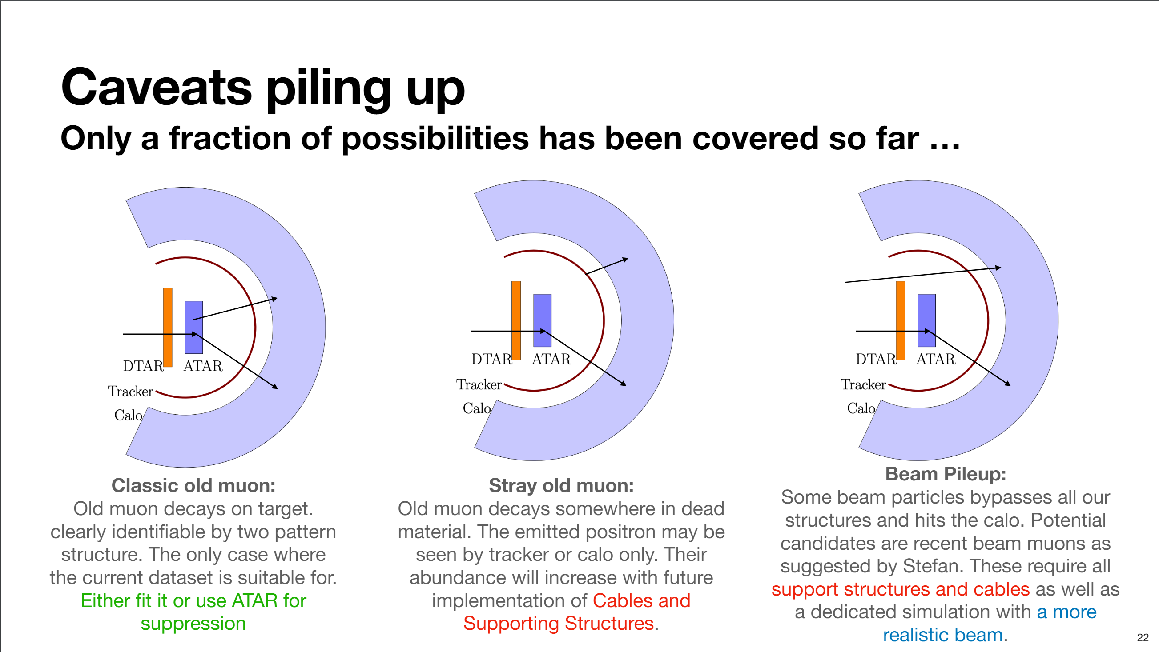
Types of Pileup
Patrick’s talk from last year

Slide 8
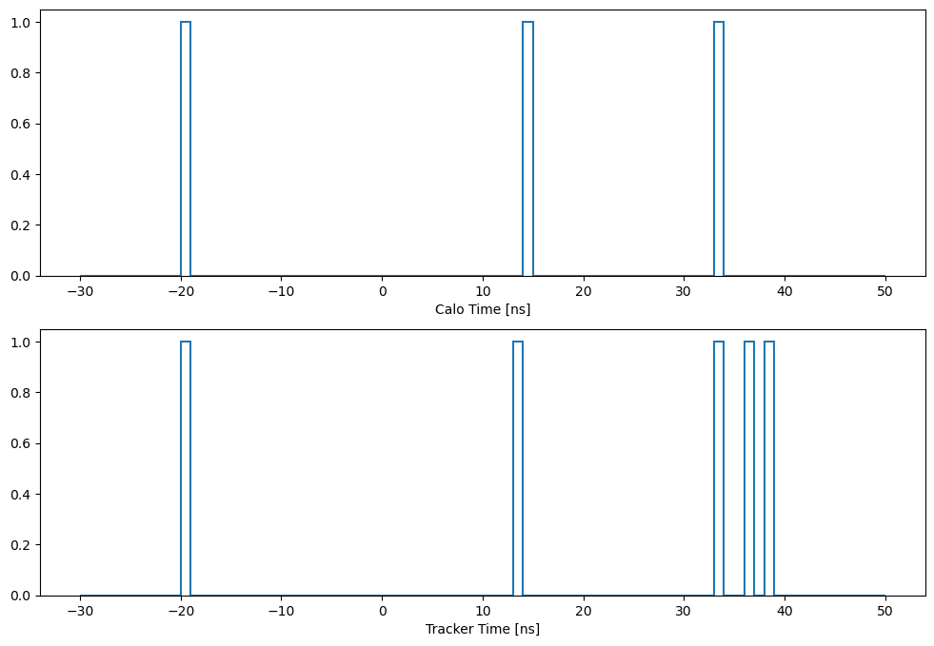

Basic Tracker Analysis
Score $=\frac{N_{hit}−1}{N_{layers}}$

Slide 9
Basic Tracker Analysis
Score $=\frac{N_{hit}−1}{N_{layers}}$
0
0
2

Slide 10
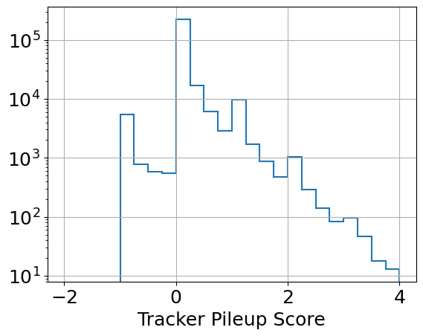
Basic Tracker Analysis
Score $=\frac{N_{hit}−1}{N_{layers}}$
< 1 charged particle / layer observed
No pileup seen
> 1 charged particle / layer observed in all layers

Slide 11
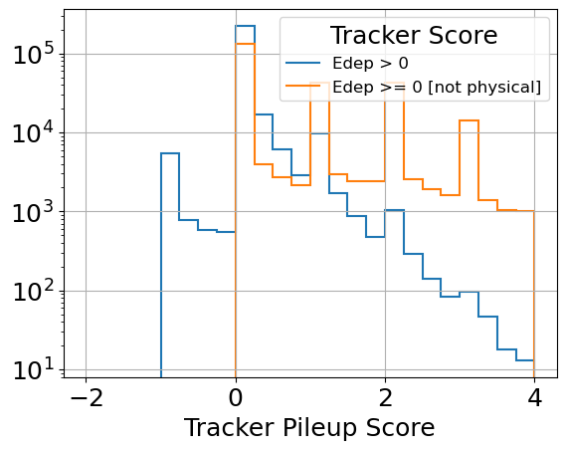

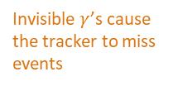
Basic Tracker Analysis
Score $=\frac{N_{hit}−1}{N_{layers}}$
Invisible $γ$’s cause the tracker to miss events
$$\frac{N_{−1}}{ΣN_{i}}=2.0\%$$

Slide 12
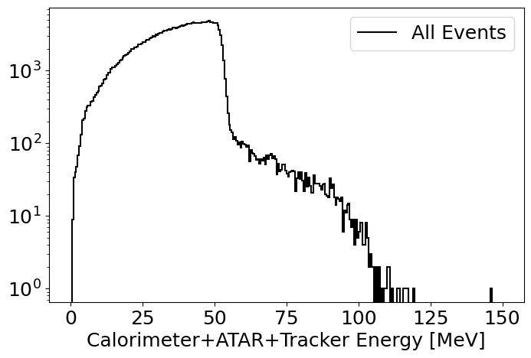
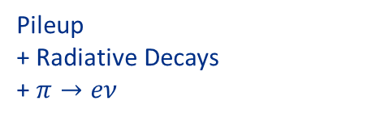
Tagging Event Types
Pileup
+ Radiative Decays
+ $π→eν$

Slide 13
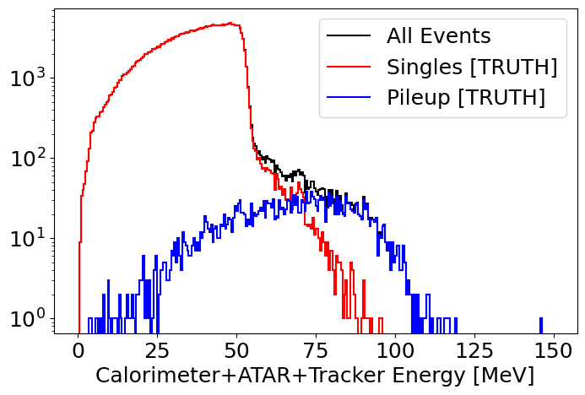
Tagging Event Types

Slide 14
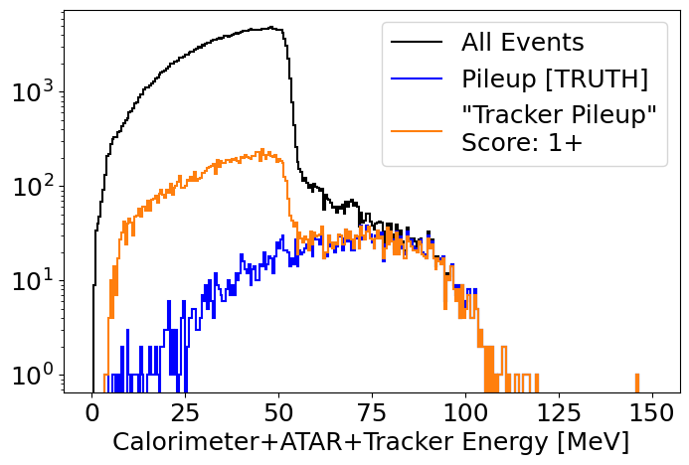

Tagging Event Types
$$δt=1 ns$$
$$δx=20 mm$$
High energy pileup can be tagged with good efficiency.
Low energy scattering in ATAR/cables appears in the tracker as pileup

Slide 15
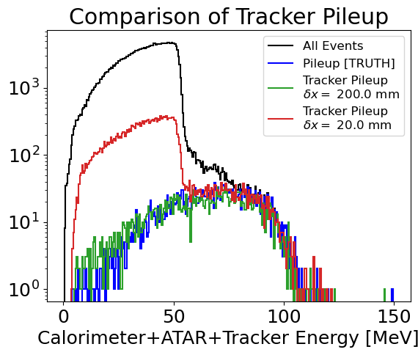
Tagging Event Types
$$δt=1 ns$$
$$δx=20 mm$$
High energy pileup can be tagged with good efficiency.
Low energy scattering in ATAR/cables appears in the tracker as pileup
Can be fixed with a smarter algorithm
Notes:
Can be recovered with smarter reconstruction, or lumped together with worse position resolution

Slide 16
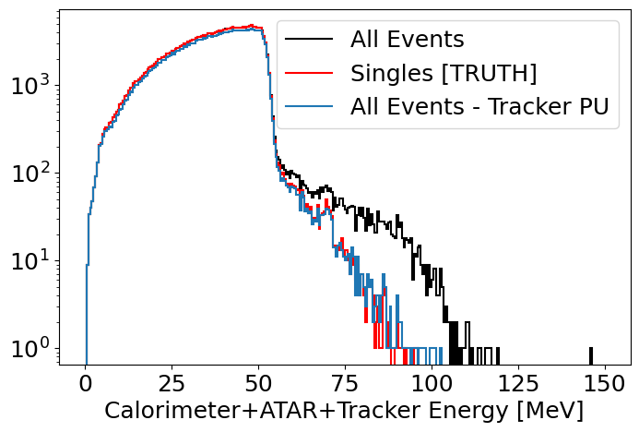
Tagging Event Types
$$δt=1 ns$$
$$δx=20 mm$$
High energy pileup can be tagged with good efficiency.
Low energy scattering in ATAR/cables appears in the tracker as pileup (but can be recovered)

Slide 17
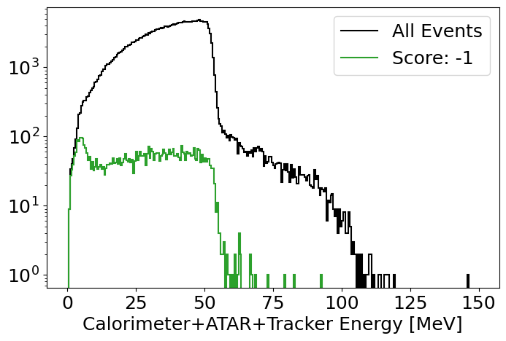
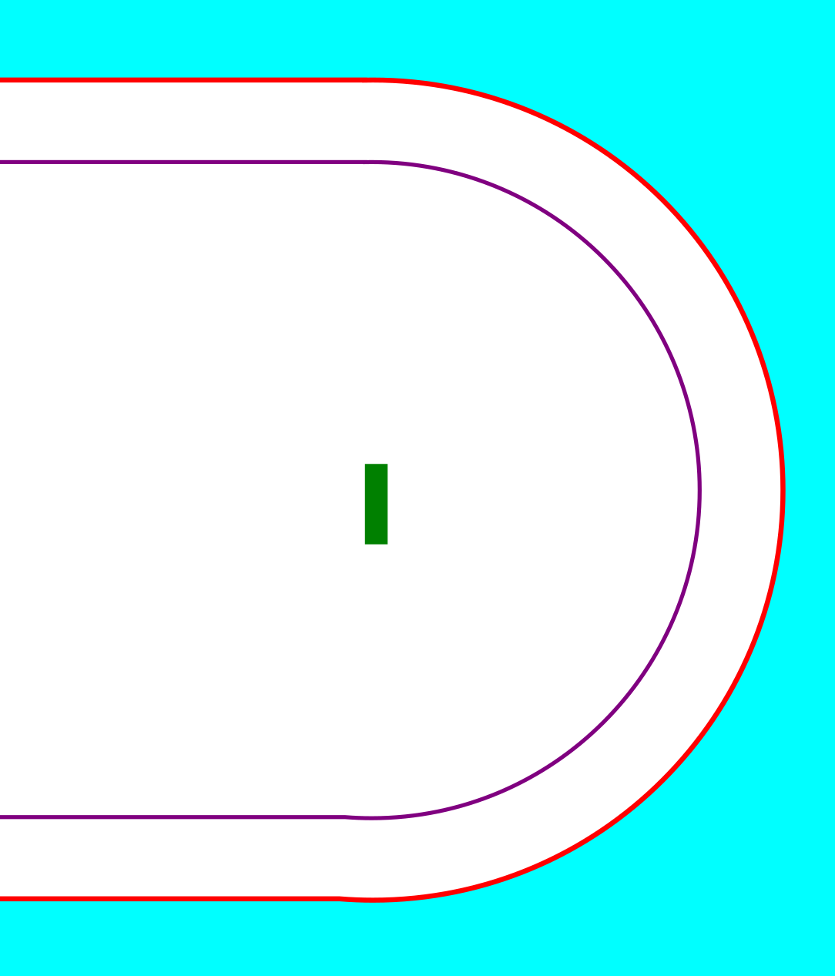
Tagging Event Types
$$δt=1 ns$$
$$δx=20 mm$$
Potential bias to the TRACK/PROMPT trigger
Notes:
emphasize that these ‘missed’ events will distort the michel spectrum, and thus a trigger based on a tracker may do so as well
trigger will need to be an or of calo and tracker?
what do we want to get out of the trigger?

Slide 18
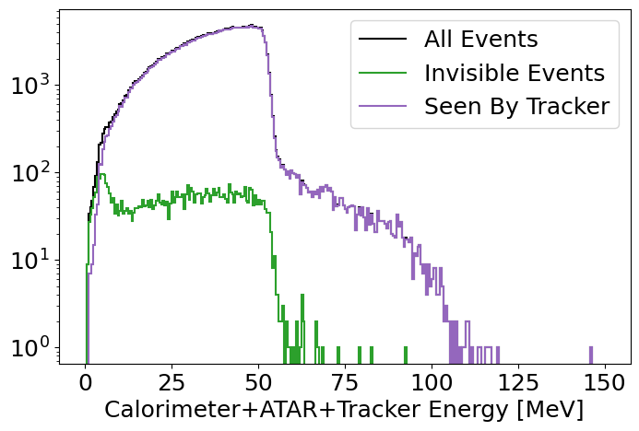
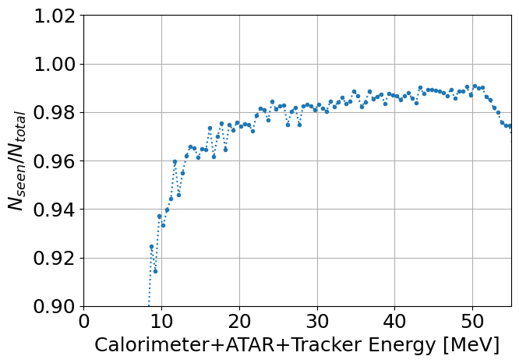
Tagging Event Types
$$δt=1 ns$$
$$δx=20 mm$$

Slide 19
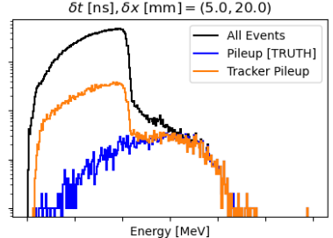
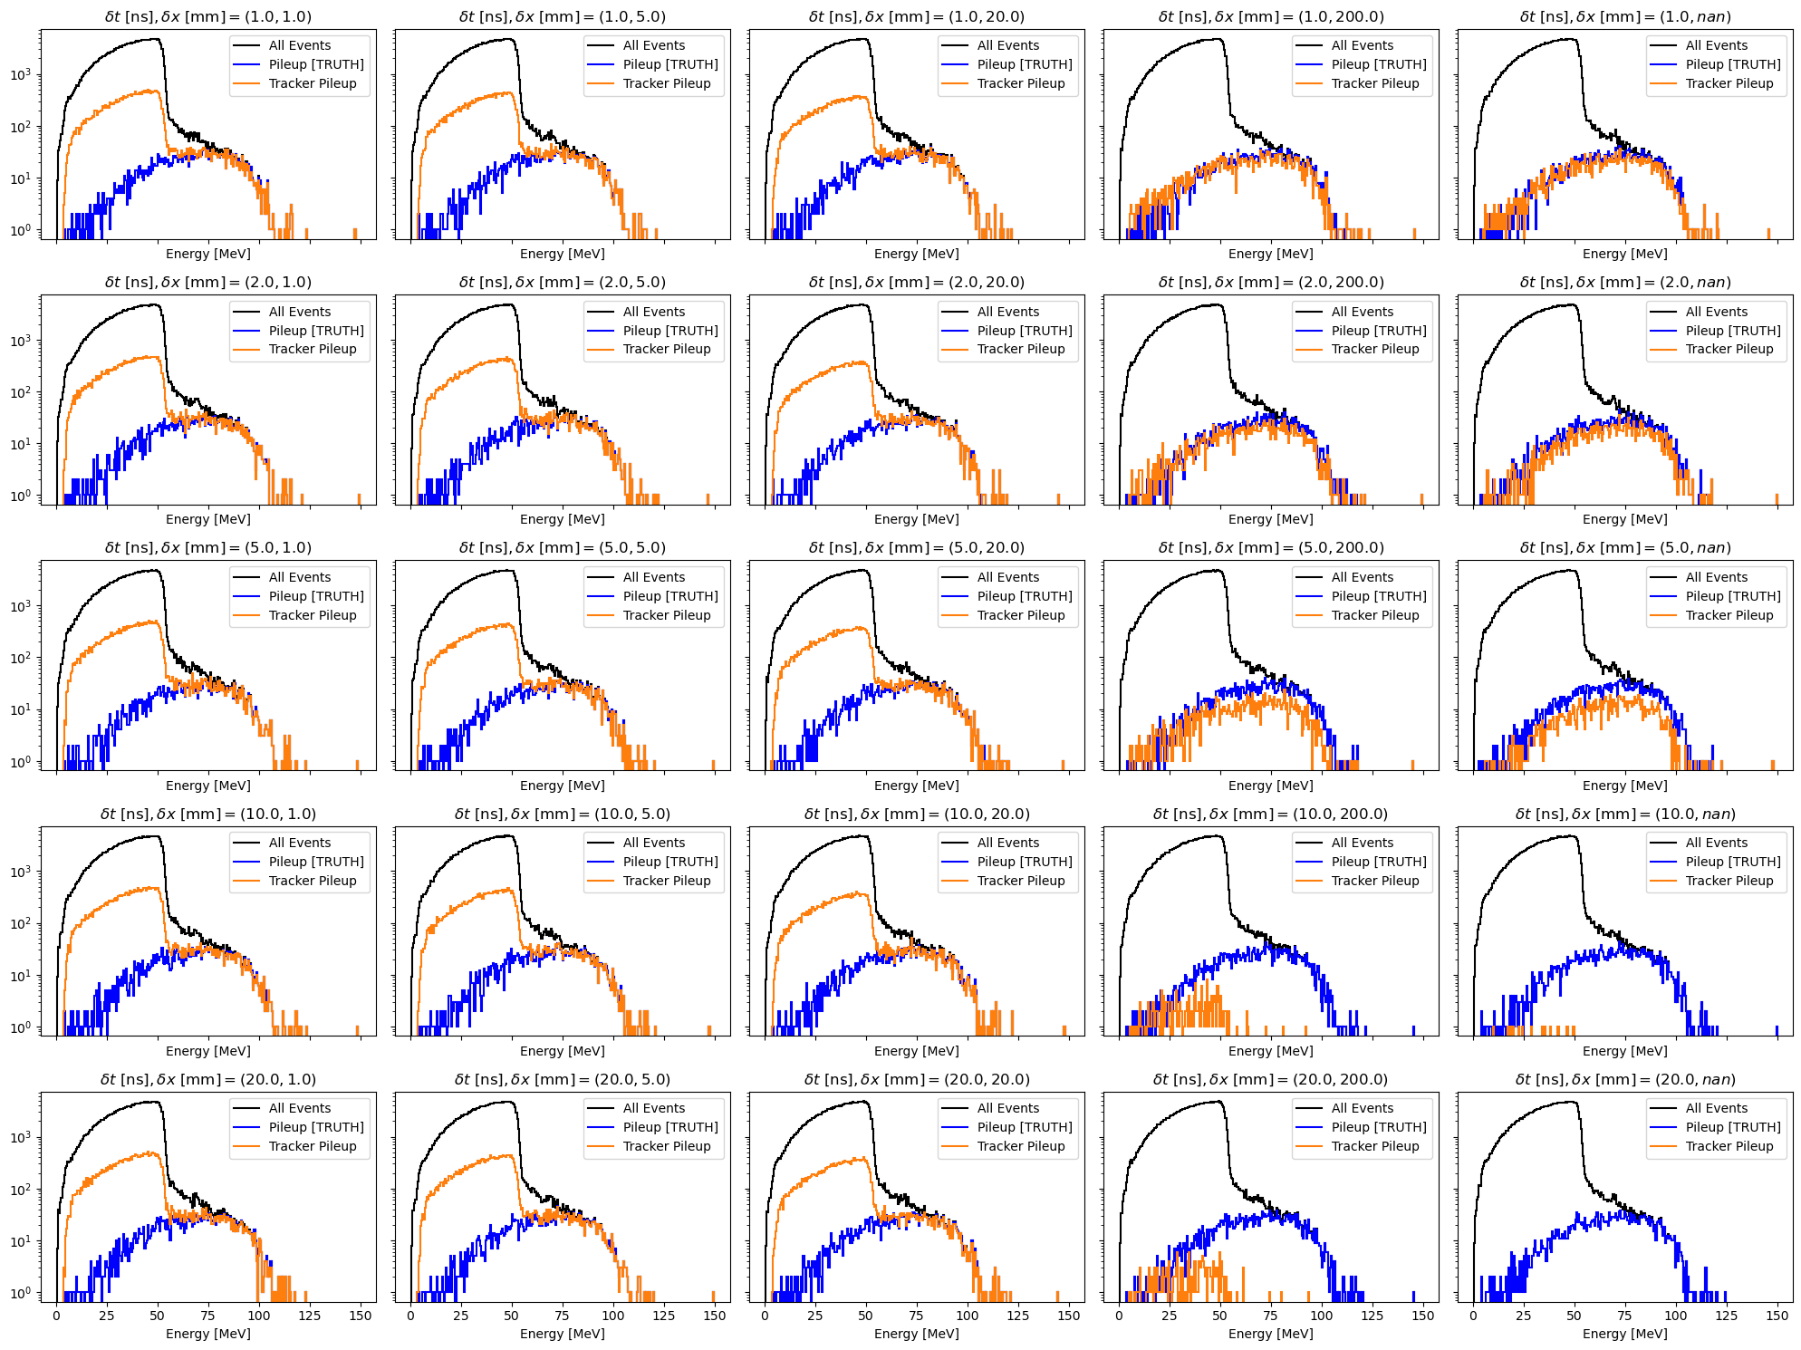
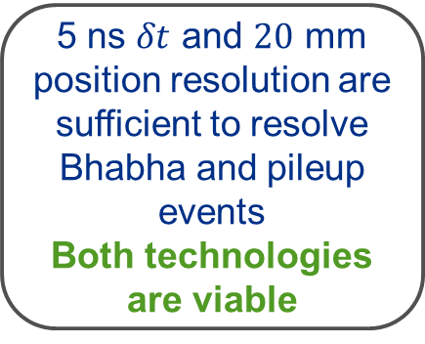
Pileup Tagging: Time vs. Spatial Resolution
Worse time resolution
5 ns $δt$ and $20$ mm position resolution are sufficient to resolve Bhabha and pileup events
Both technologies are viable
Worse position resolution

Slide 20
Tagging Scattering Outside Fiducial Region

Slide 21
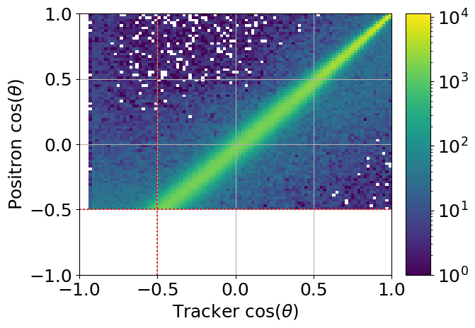
Tagging Scattering Outside Fiducial Volume

Slide 22
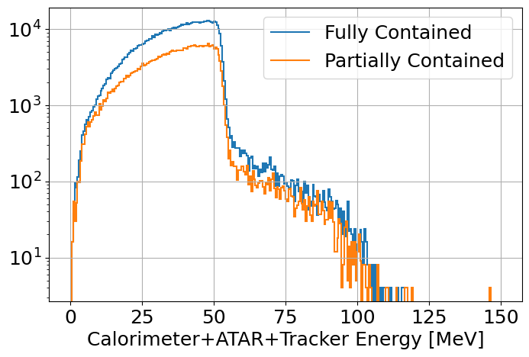
Tagging Scattering Outside Fiducial Volume

Slide 23
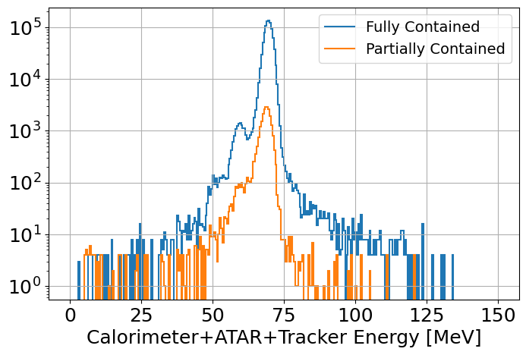
Tagging Scattering Outside Fiducial Volume

Slide 24
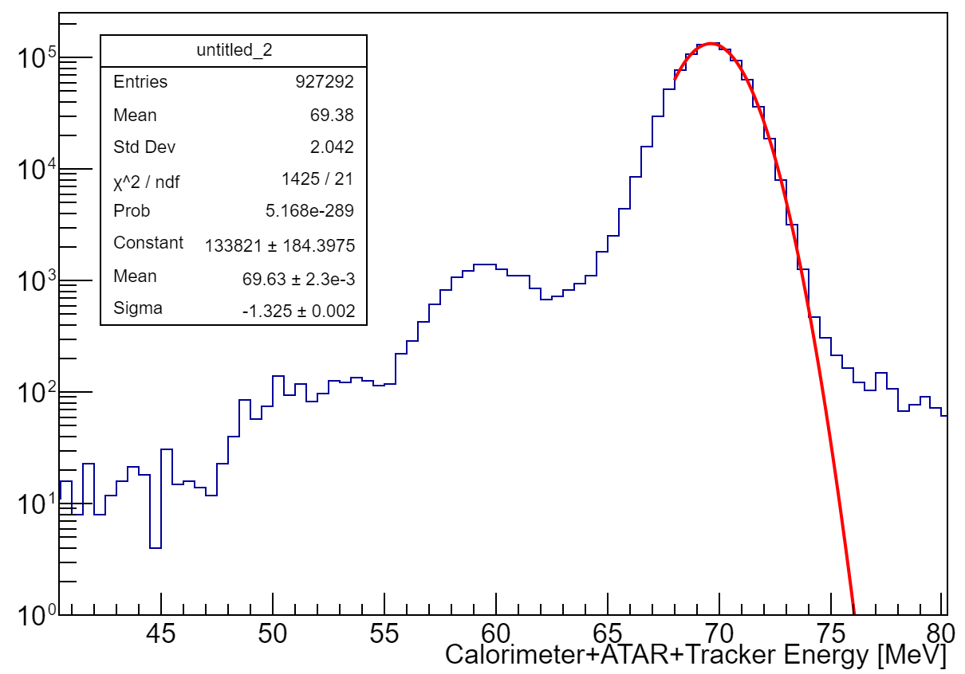
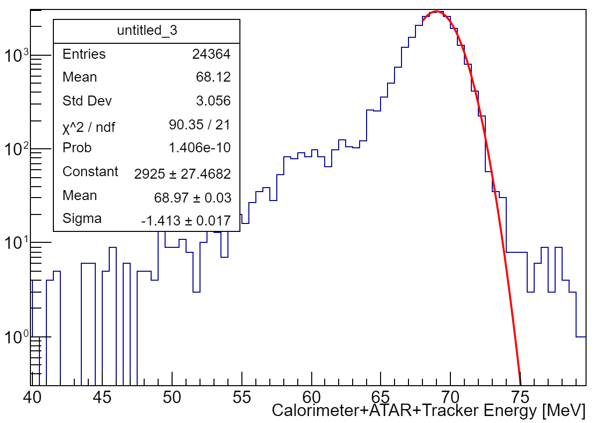
Tagging Scattering Outside Fiducial Volume
2.1%
1.9%
The tracker can help to provide information about energy leakage

Slide 25
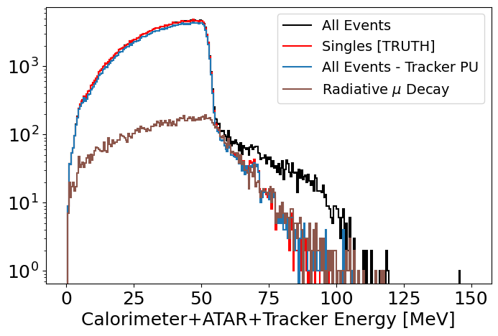
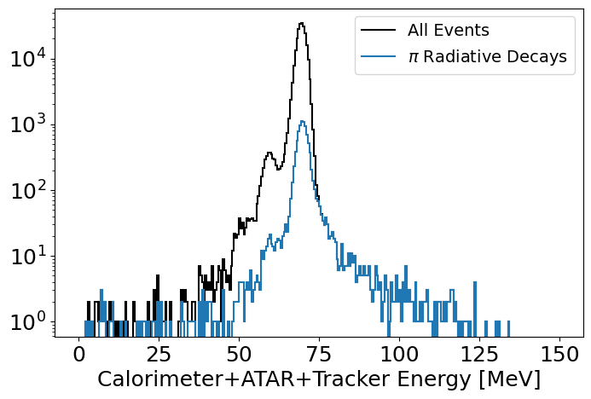

Additional Roles
Charged particle tagging for $πβ$
Radiative Decay Measurements
Dead material estimation for Bhabha events
Twice the energy loss, but recoverable by the tracker

Slide 26
Conclusions
The tracker has two important roles in the experiment:
  Trigger
    The bias to a potential trigger due to annihilation in flight (percent level contribution to all events) must be quantified and understood
  Physics Analysis
    A tracker with ‘reasonable’ timing and position resolution provides a great view into high energy pileup and scattering.
    Studies are underway to quantify the needs of the tracker for all phases experiment
      Timing resolution cuts may not be as stringent as imagined because of spatial resolution
Integrating tracker information into the SPA pipeline is in its infancy, but is crucial to understanding the entire picture of the experiment.
  Details of the hardware will be discussed in the sessions tomorrow
  Integration of this detector into the proto-analysis chain is a goal for the software workshop
    These studies can then be repeated with high statistics to get an understanding of higher order effects and bias to the final energy/timing spectrum

Slide 27
Questions?

Slide 28
Backup

Slide 29
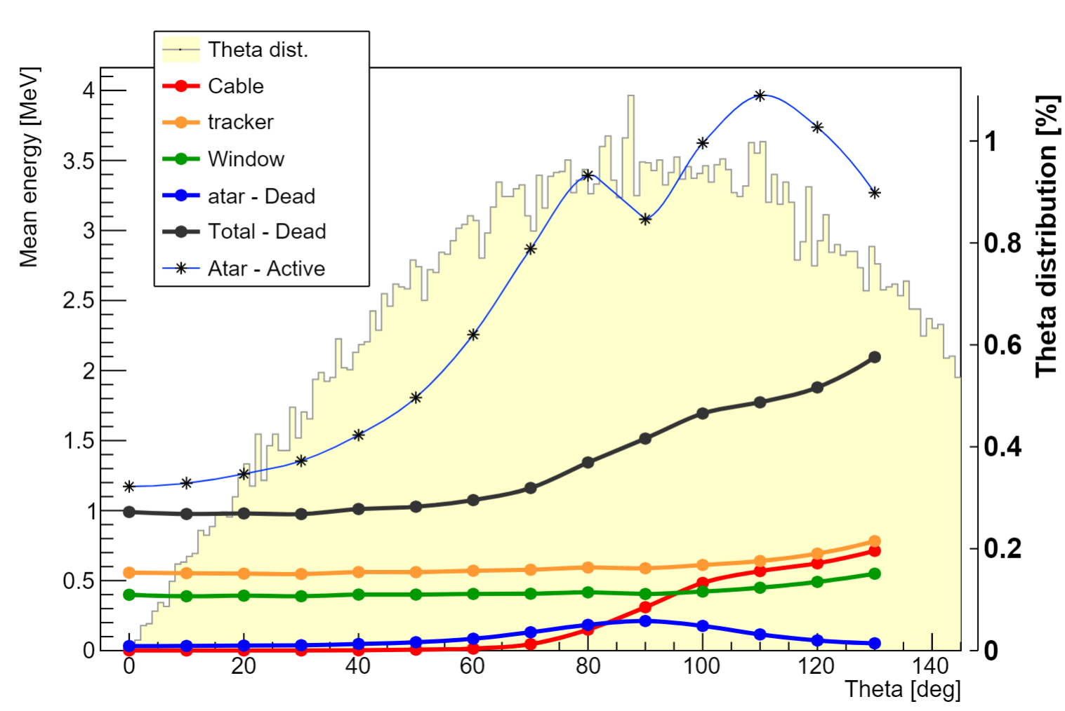
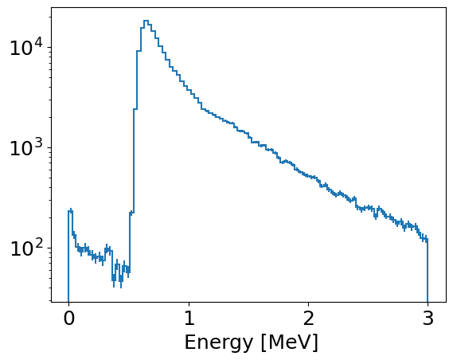

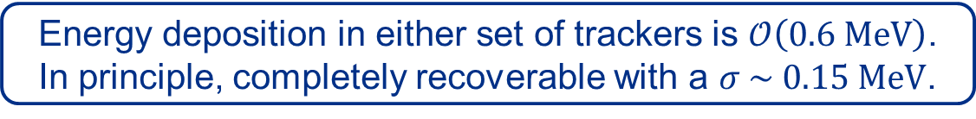

Tracker Cost: Dead Material
$μ$RWELL Geometry
Placeholder SciFi Geometry
PRELIMINARY
$≈0.2 MeV/$layer
Energy deposition in either set of trackers is $𝒪\left(0.6 MeV\right)$.
In principle, completely recoverable with a $σ \sim 0.15 MeV$.
Left: Jessie Yang | See more in her talk here

Slide 30
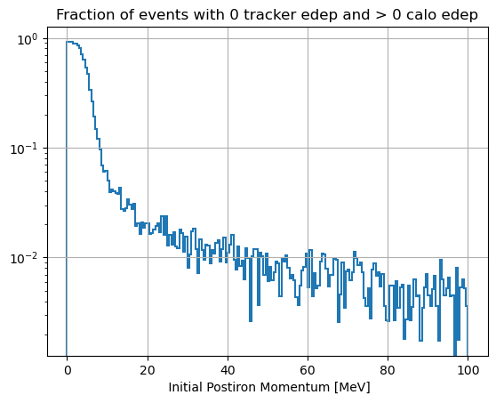
$e^{+}$ Annihilation in Flight vs. Energy
Fiducial cut
Positrons generated in center of ATAR

Slide 31
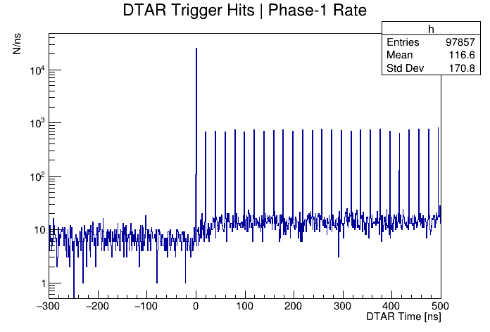
Role: Pileup from Particles Outside ATAR

Slide 32
Role: Trigger

Slide 33
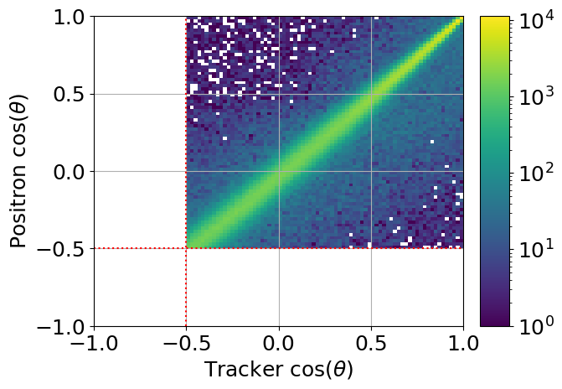
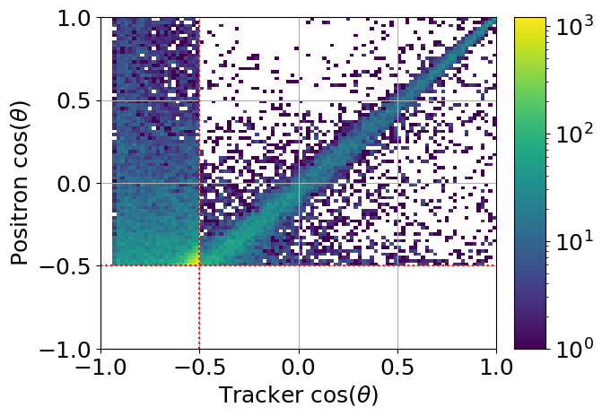
Tagging Scattering Outside Fiducial Volume
All Contained
Partially Contained

