Slide 1
ATAR Readout
Peter Kammel
Representing ATAR team: UCSC, UW, BNL
Simone, thanks for your slides !
UW: Theresa, David P., Tim van W., Marcel and Ryan

Slide 2
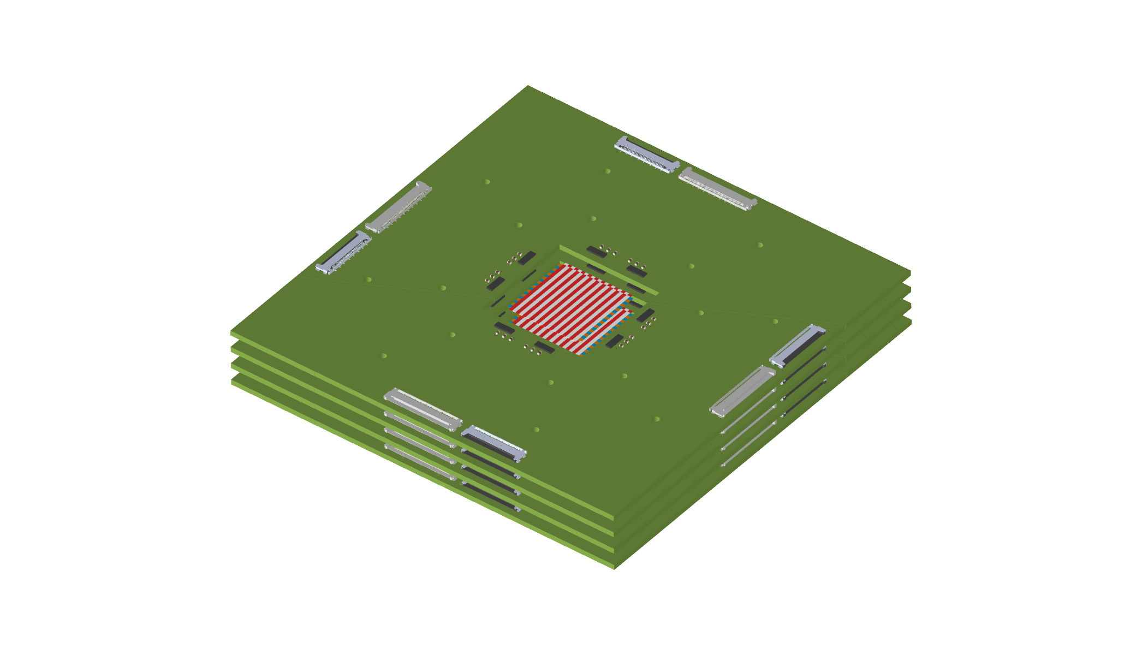
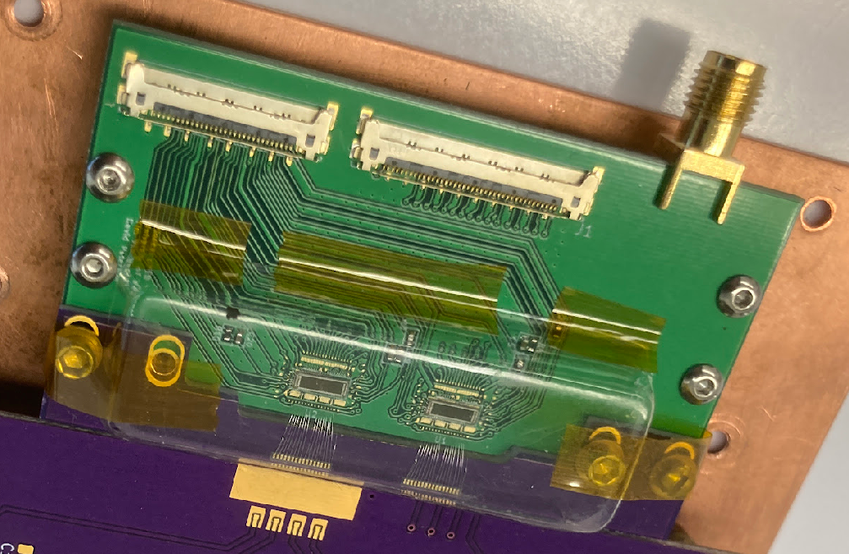
Strategy FEB Development
Front End Board
Reality check compared to Oct 23 Coll meeting
Start
UCSC board and FAST2 chip
Step1
proto frontend board pFEB, UW
Step2
pFEB with minimal board spacing. Few mm gaps between pFEBs and sensor modules. FAST3
Step3
Step4
FEB, Rigid-flex board with minimal thickness retracked behind ATAR.
pFEB with flex between sensor and amplifier. Sensor close packing.
First transmission LGAD board
Baseline goal before 2026 shutdown
Stretch goal before 2026 shutdown
Pre-production prototype
2025 board
2026 integration
2023
2024
2026 board
Including digitizer

Slide 3
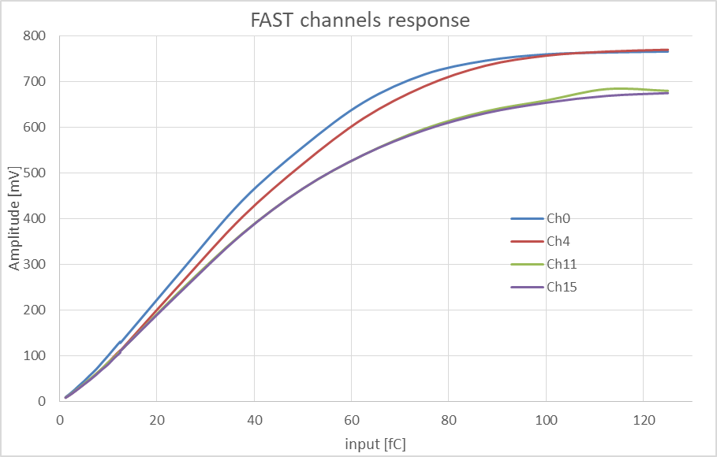
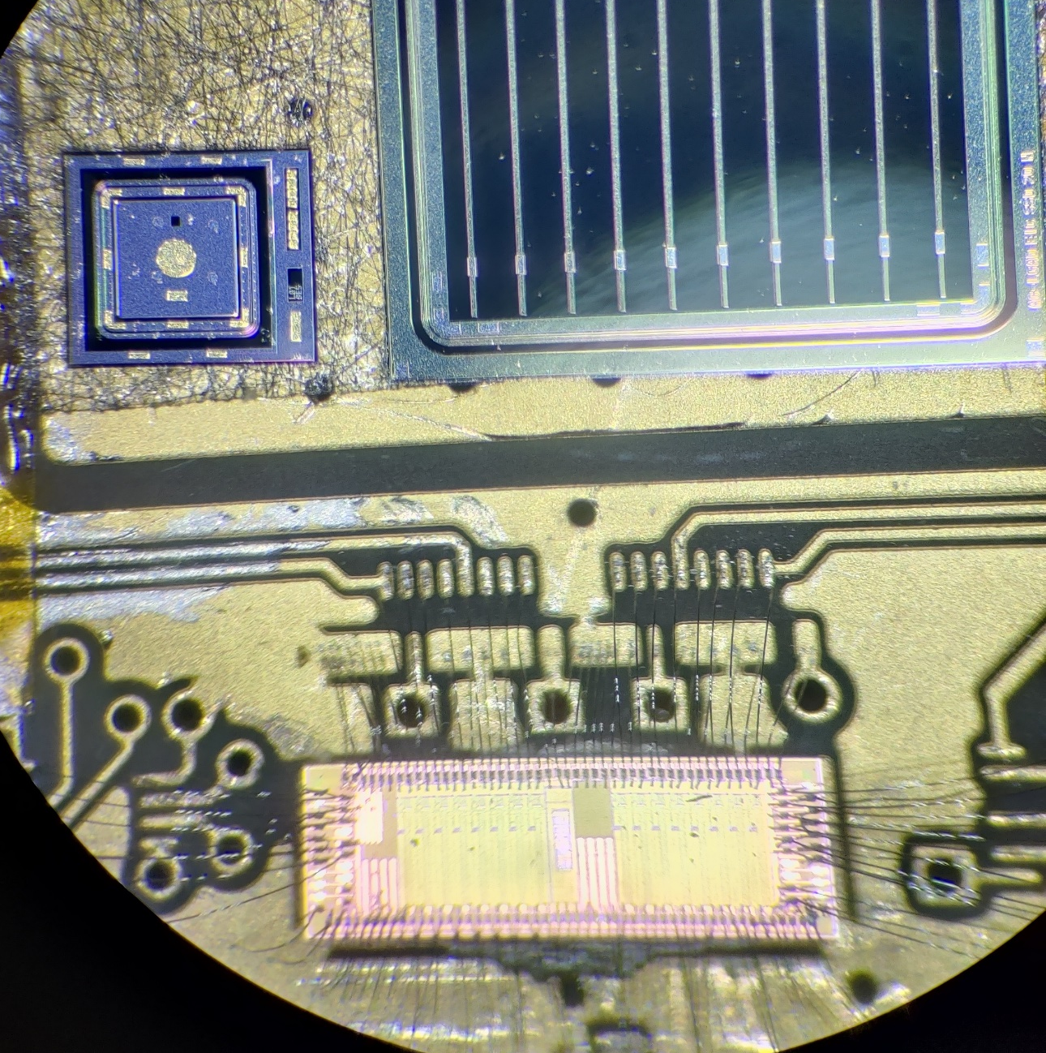
FAST3
Received FAST3 chip a few months ago
  Improved driver and dynamic range
  Noise ~1 mV, dynamic range up to ~800 mV
  8 different configurable gain settings
Tested with calibration system, LGADs, AC-LGADs and PIN sensors
Tested all 4 channels with calibration (0, 4, 11, 15), noticed difference in performance and baseline
  Highest value reachable
  is 100mV lower for 11/15
  If 11/15 are exposed to light,
  the gain is reduced
  BUT higher maximum voltage
  Mystery, discussion with designers
Channel 0/4 have higher response and range than 11/15
  At low input roughly the same, difference higher at large inputs. Up to 20% variation. Not sure why?
Noise roughly the same for all channels
But baseline is different! Mainly for 11, 15
Rise time between 1-1.5ns,
Full collection in 5-7 ns + undershoot
Simone, UCSC

Slide 4
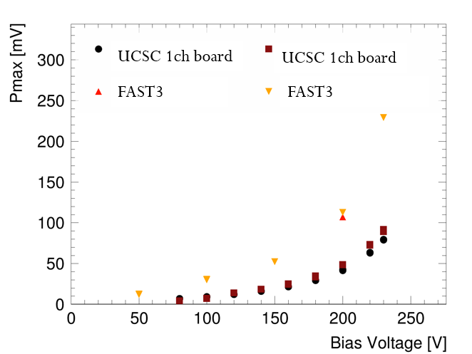
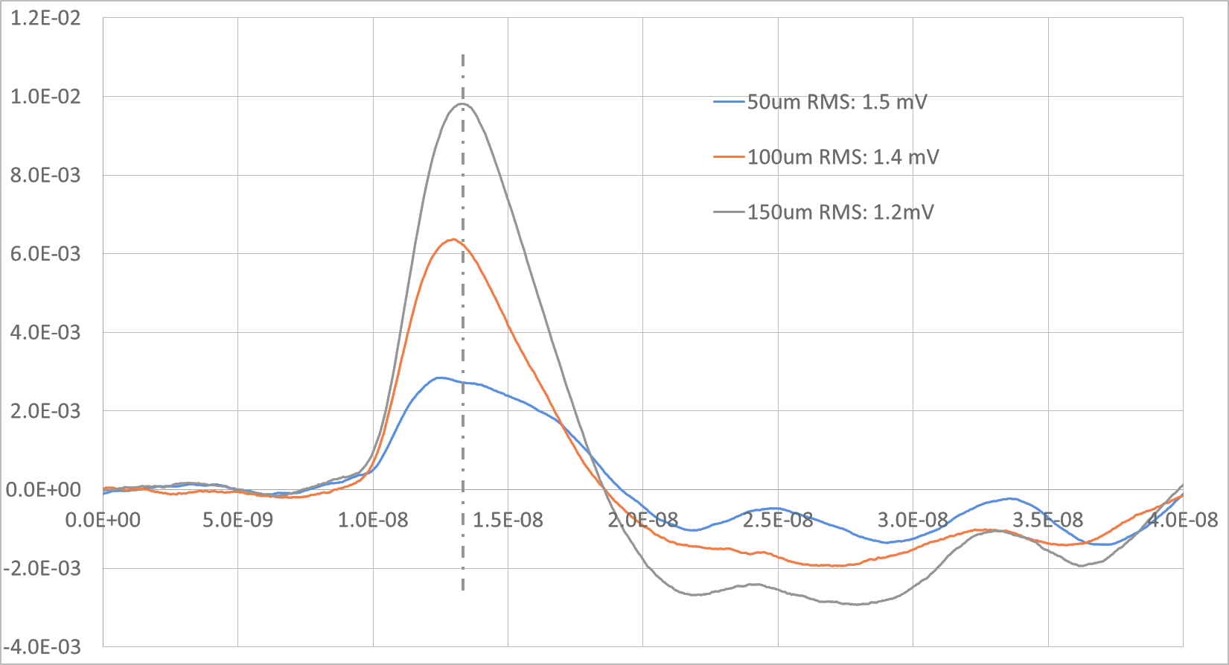
FAST3 dynamic testing
Tested FAST with HPK 3.1 50 um thick single pad LGAD sensors and same geometry PIN detector (4.2 pF input capacitance)
  RMS noise in both cases is around 1 mV
Response to LGAD better than expected
(~10-15 mV/fC, expected 10 mV/fC)
For 50 um PIN less than (naively) expected
  expect a signal >5mV (S/N > 5),
  observed S/N to 4
  probably ballistic deficit (PIN signal is too fast)
For a 150 um PIN device we get a S/N > 10!
  Possible option for PIN version using
  thicker ATAR layers?
  Pmax scales with thickness
Simone, UCSC

Slide 5
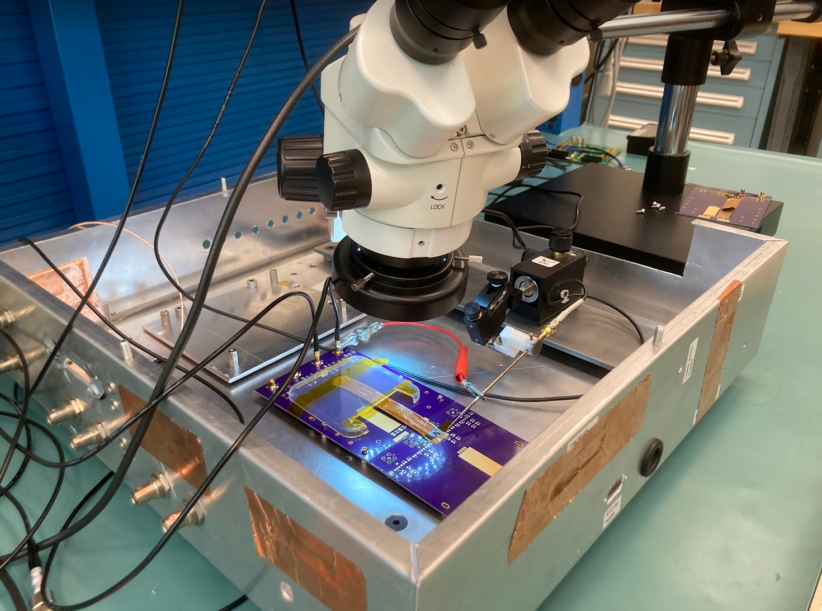
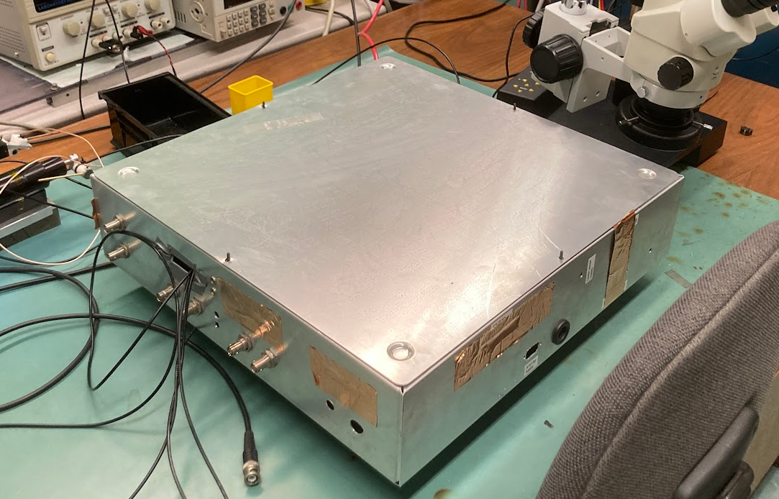
Infrastructure development @ UW
Mini Probe Station
  Shielded probe station
  3 probes on micro positioners, one “RF” probe
  Flexible and well-grounded mounting plate to
  test various LGAD-flex-electronics combination
Parylene coating
at Washington Nanofabrication Facility
Marcel
Powerful radio stations in Seattle

Slide 6
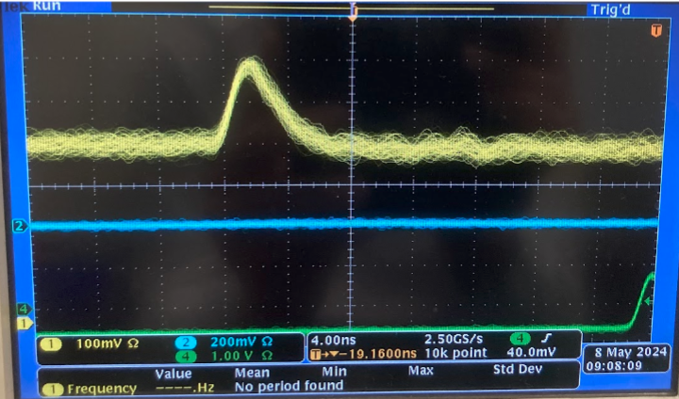
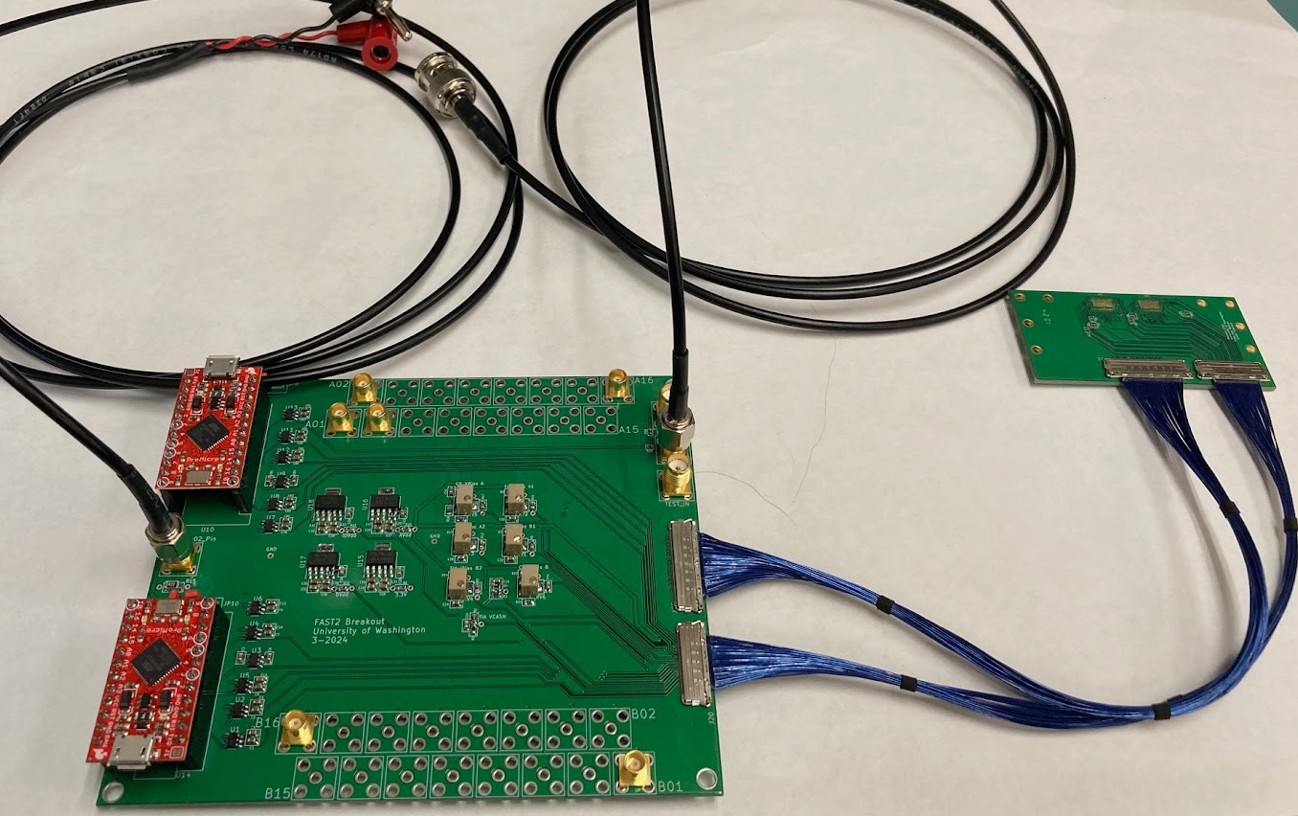
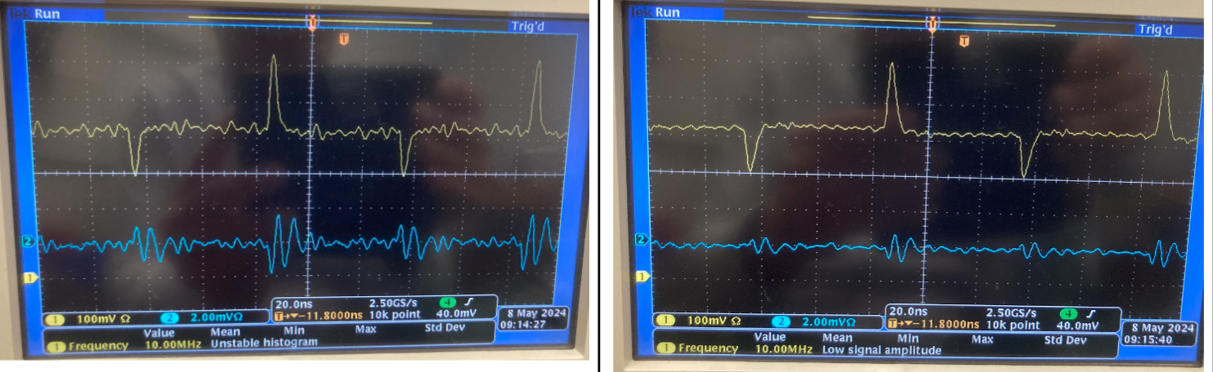
pFEB Status
Performance from initial tests
    basic functionality ok
    signal shape ok
    Cross talk sub percent
    noise 1.3-1.7 mV,
    somewhat better than UCSC board, lower bandwidth?
    dynamic range still problematic. Signal flattens out after 200 mV
    RF pickup with probe tricky
pFEB system
  Small front-end board for two FAST2 (32 channels)
  Low voltage periphery on mother board
  Connection analog and supply
    I-PEX CABLINE®-CA II
4ns
pFEB system
pFEB
Next channel
Far channel
100 mV scale
2 mV scale
Mother board

Slide 7
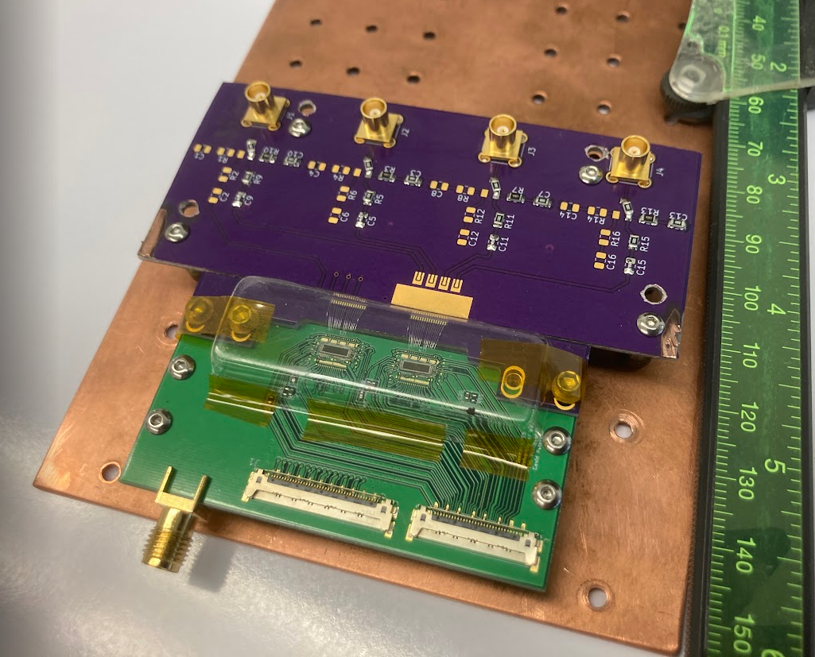
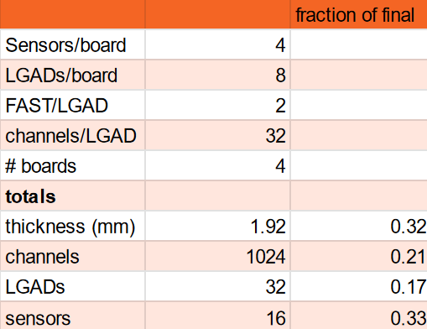
pFEB Plans
Testing
  Repeat basic tests with
  2nd board and SMA
  charge injection
  Advanced tests
    explore bit pattern gain control on Arduino, maybe hardware issue
    check all channels V vs charge, 4 SMA inputs
      measure cross talk as well
      measure FAST2 gain
      measure FAST input impedance (gain dependent)
    measure allowed range of V, I of low voltage supplies
      criteria
        pulse shape
        V vs charge
    establish DAQ with SAMPIC (11 bit, SCA cells, 1V, BW>1GHz)
    other commissioning tests ?
    strip LGAD - FEB, many channels
    strip LGAD - Flex - FEB
Recap 2026 configuration
test board
pFEB with test board
pFEB

Slide 8
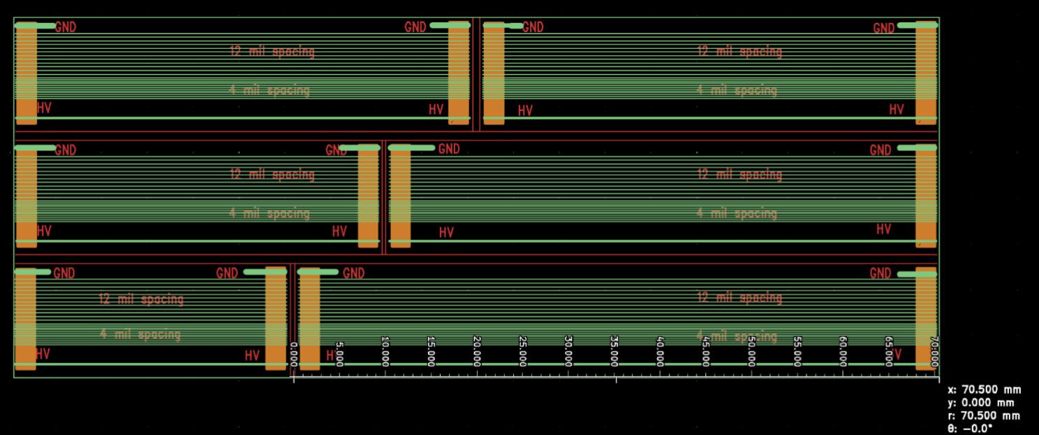
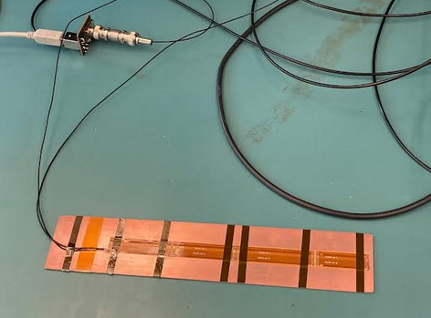
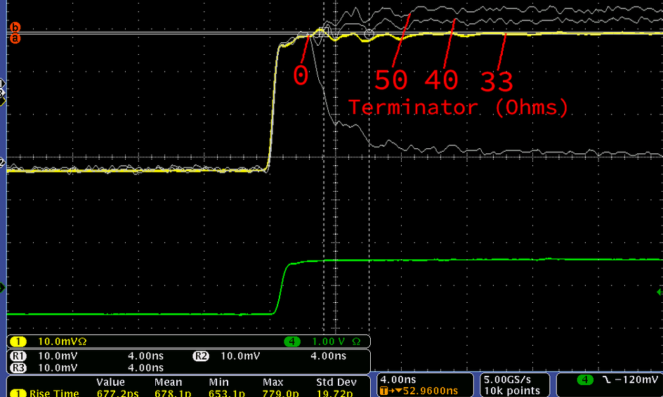
Flex
Flex between LGAD and electronics unusual,
but unavoidable for PIONEER
Independent studies at UCSC and UW
Issues
  Cross talk
    For a long time UCSC measured ~10% for 5cm cable,
    see discussion. Not expected from UW calculations
  Poor impedance matching of present flex design
    33 Ohm (Tim and David)
  Additional capacitance
    Calcs Peter and Tim: 1-2 pF/cm depending on design
  Noise pickup
Goal
  Understand and design optimal flex

Slide 9
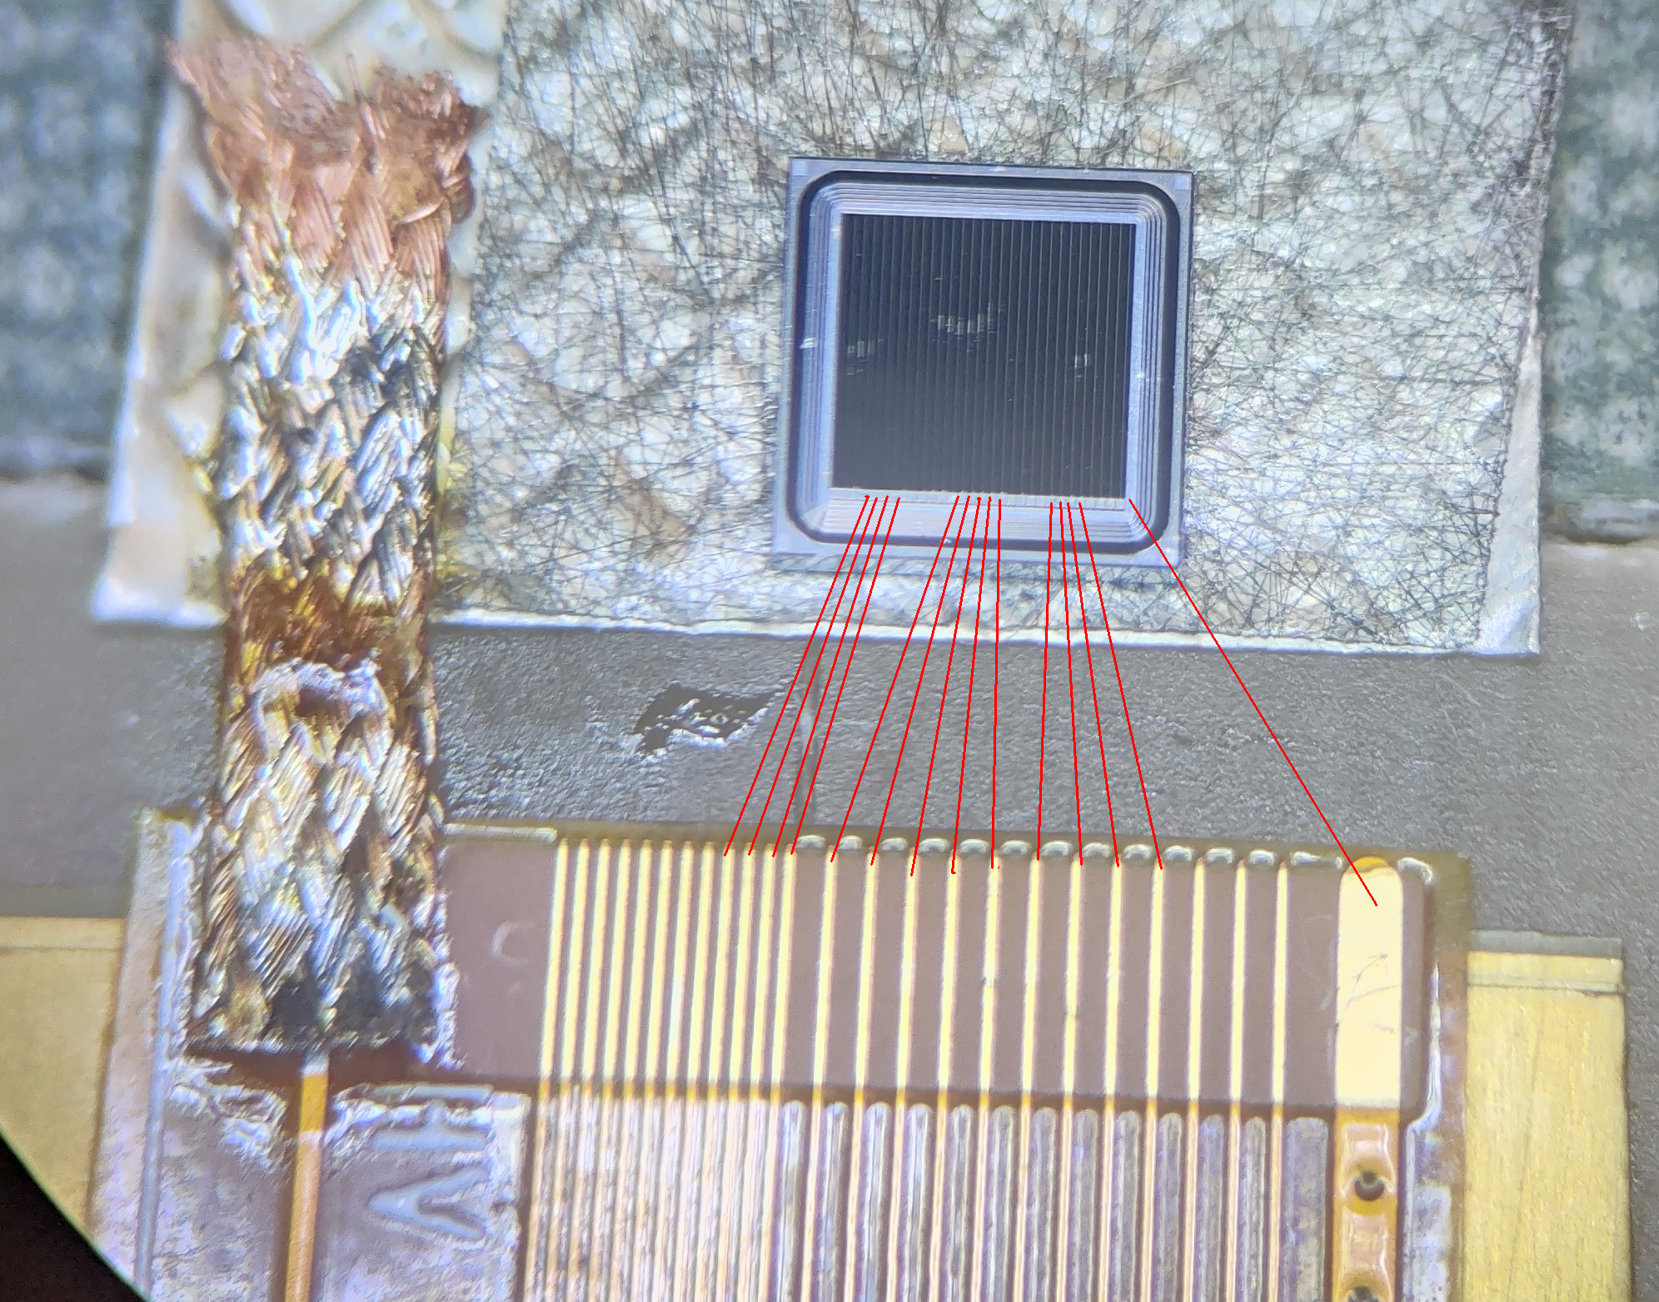
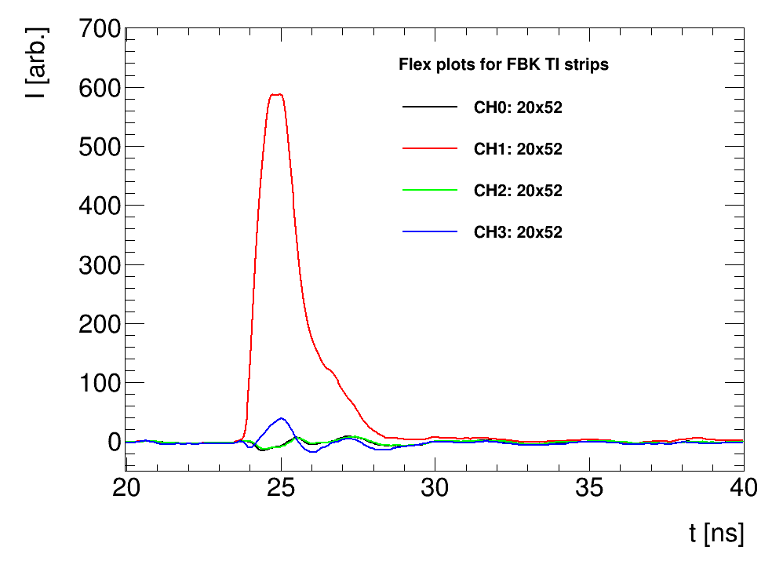
New Flex measurements UCSC
Issue of higher-than-expected cross talk in the flex over
long distance
Setup with injection probe had high external pickup and reflection issues
Tested again with mounted sensor to have cleaner (and more realistic) signal injection
  FBK TI-LGAD strip sensor
  Laser on top of CH1
  Ch3 neighbor, Ch1 and Ch2 far away strips
Results
  No cross talk from strips connected to the board (how it will be in PIONEER)
  Cross talk with first neighbor ~10%
  Long range cross talk is minimal
  Cross talk from the gold grounding pin that was also used for
  previous needle tests!
Long range crosstalk
Simone, UCSC

Slide 10
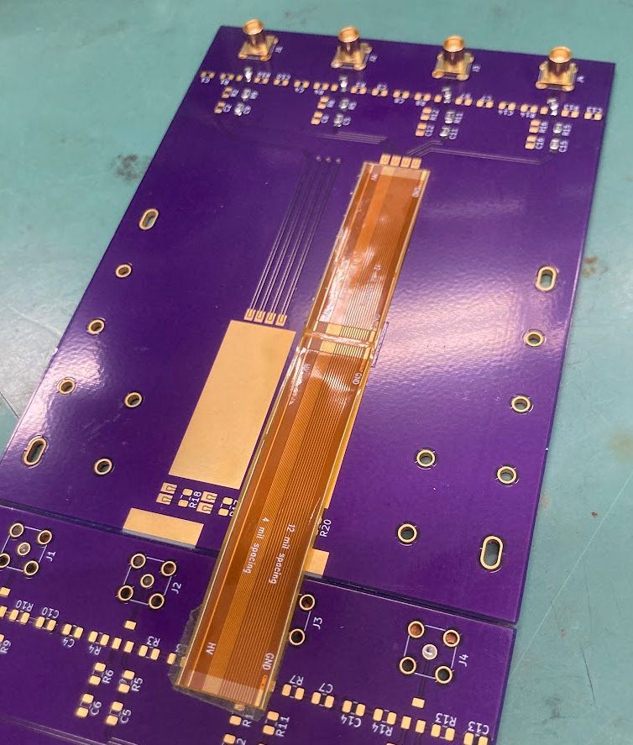
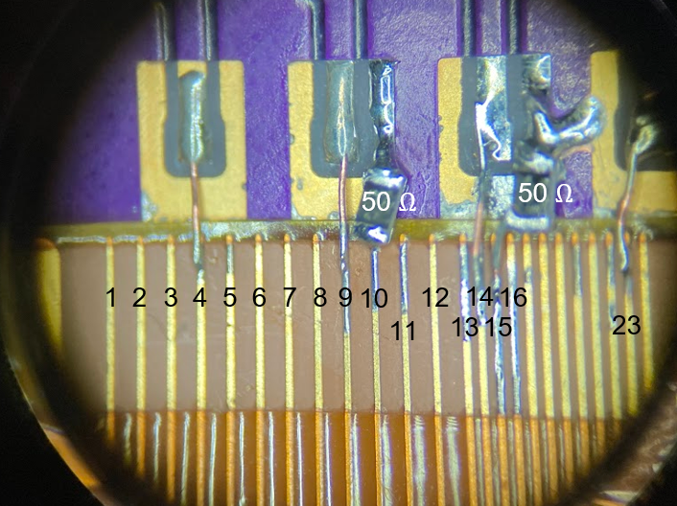
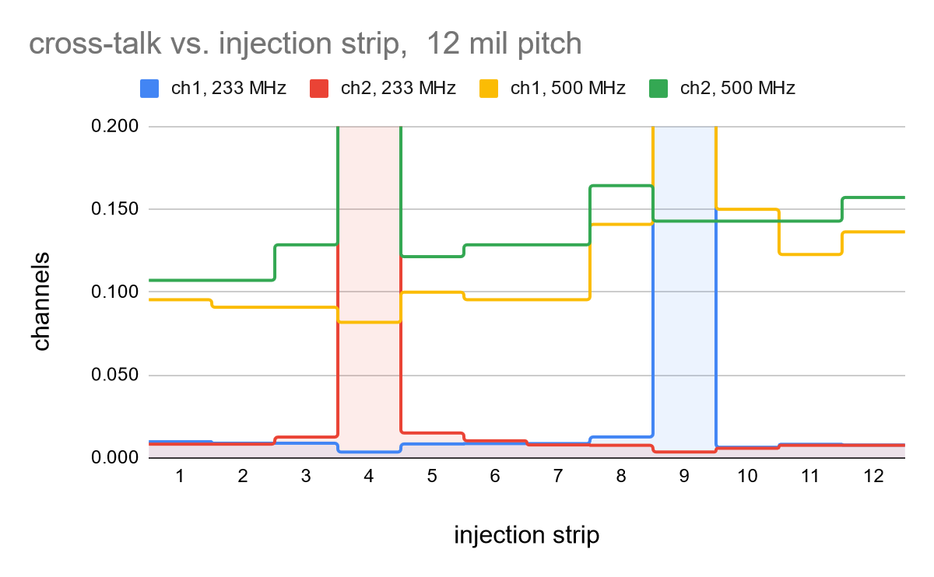
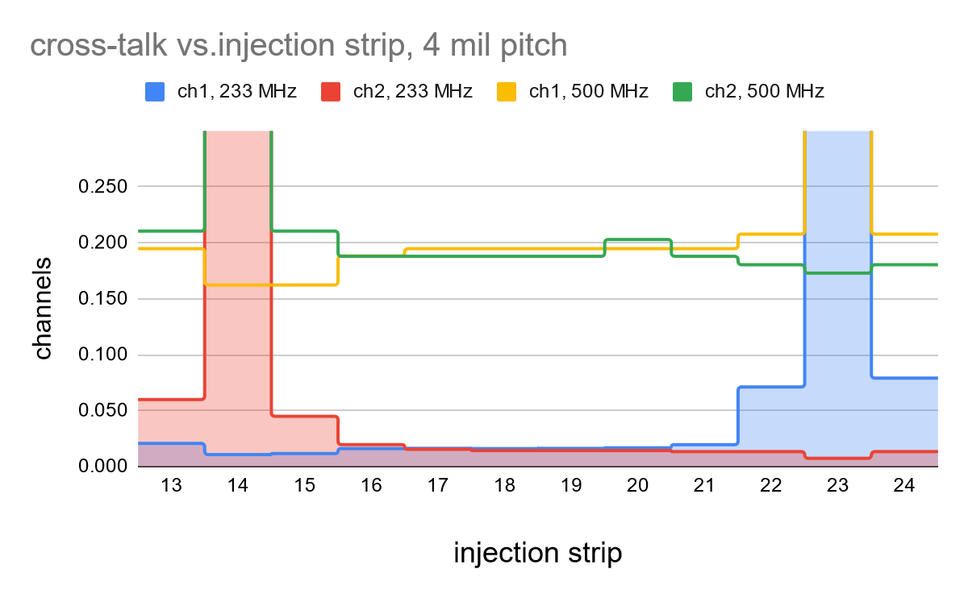
UW Flex Tests
Tests (clean set-up, 10 cm flex)
  Pulse injection
  RF generator
First prelim. Results
  233 MHz ~ 1.5 ns
    far cross talk and next neighbor <1%, 300µm pitch
    far cross talk < 1.6%, NN < 8%, 100µm pitch
  But strong frequency dependency
    We might get away, but better be careful
  syst. measurements with new setup starting
Further plans
  Match flex impedance
  Measure with pFEB and LGAD
  Design optimized flex
10 cm
Measurements 6/18/2024

Slide 11
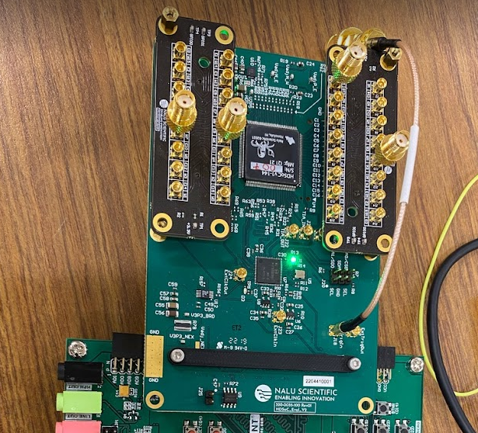
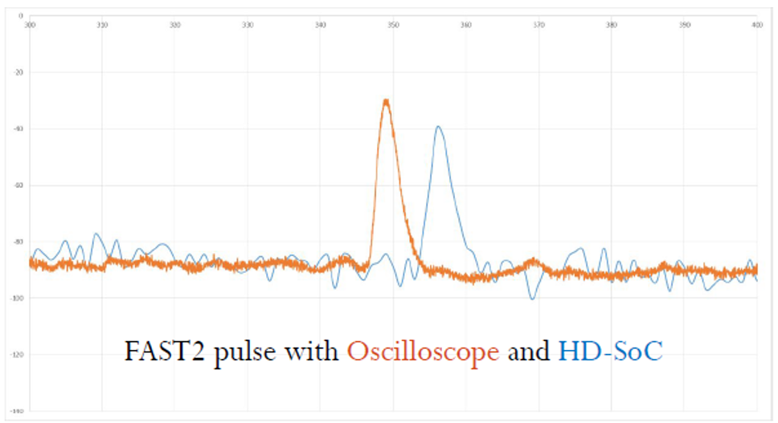
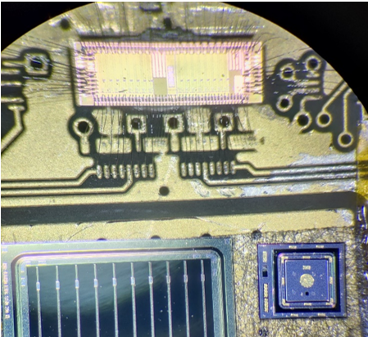
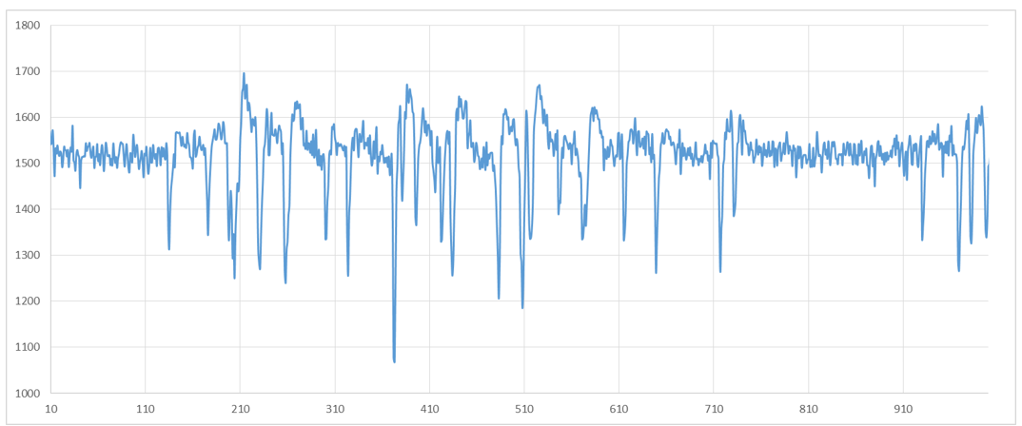
Digitizer HD-Soc from Nalu
HD-SoC from Nalu Scientific in evaluation at UCSC:
  32 channel (Next version: 64 channels)
  1Gs/s digitizer chip (might be up to 2Gs/s)
  Buffer length 1024: 1 us window
  2.5 Vpp, 12-bits
Collaboration with Nalu Scientific to understand the triggering capabilities of the chip
  Trying the right firmware/software recipe to get to 2Gs/s
FAST3 and HD-Soc tested at SSRL
  using oscilloscope and HD-SOC digitizer
    Test-beam two weeks ago, will analyze data in the next months
  Single pad HPK 3.1 and HPK AC-LGAD 2 cm strips
  Result of FAST3 and HD-SoC, 1us of time window
    Useful to test repetition rate capabilities of this setup
Simone, UCSC

Slide 12
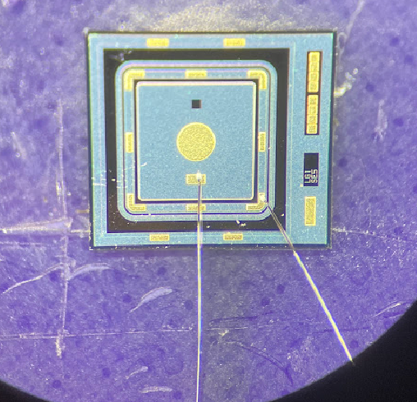
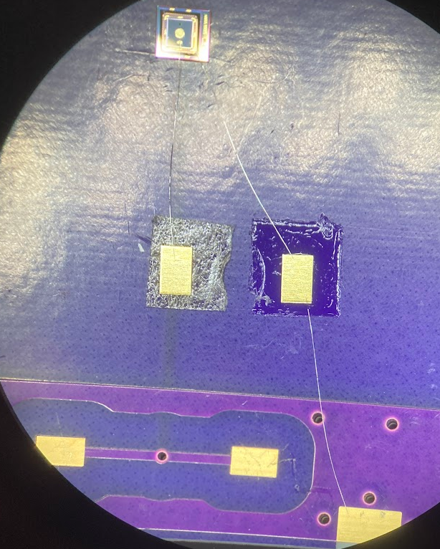
Parylene Coating
Marcel applied 5um parylene to copper plates at Washington Nanofabrication Facility
Peter’s tests
  First plate
  I placed the parylene covered plate on the bare plate and applied HV with a chamber power supply, with a fast trip. I could reach 500 V, then the HV tripped. Afterwards, it tripped at 400 and then at 350V.
  Second plate
  The 2nd plate was better (with the same bare copper plate). I left it on 500V for 30-40 min, and then ramped up to 800V, at which point it tripped. Afterwards it always tripped at 350V. Apparently the spark destroys the
  parylene cover, leading to lower dielectric strength.
  These are promising results and are reasonable relative to the quoted dielectric strength: 276 V/micron at
  25.4microns. Potential poorer performance can be due to our surface roughness. I suggest using 8 um in
  the future to play it safe.
Produced boards for parylene coating
  Example of Theresa’s board
  Will be coated after I-V test
Marcel will try photolithography on parylene
  That would allow selective coverage, no parylene over
  active LGAD region

Slide 13
Summary
Substantial progress since October 2023
  FAST3 significantly improved over FAST2
  pFEB from design to commissioning, several obstacles overcome
  Flex. Does not seem insurmountable issue, though still challenges by long cable
  and full demonstration required.
  Digitizer from Nalu. Promising, slow but steady progress.
  Infrastructure at UW established

Slide 14
Backup

Slide 15
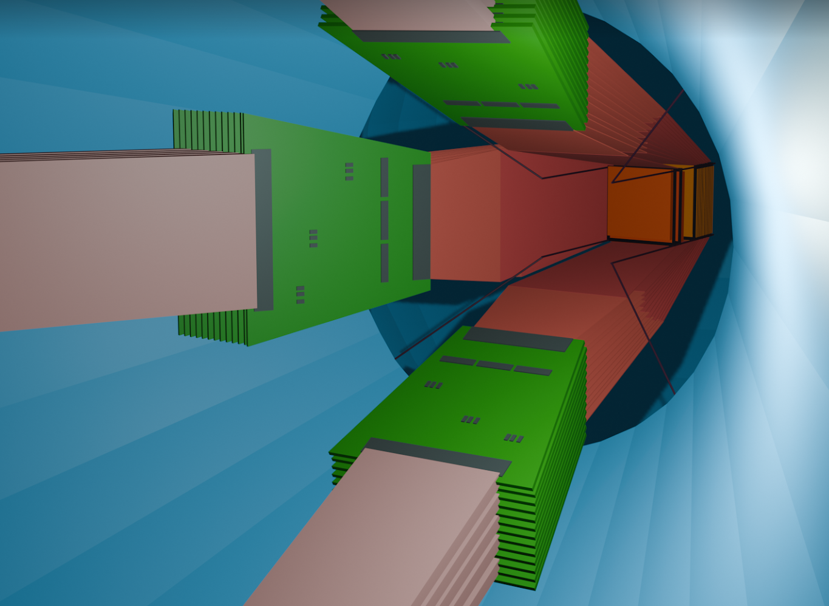
Read Out within Overall ATAR R&D
Update from my PSI BVR 2024 presentation
Development directions
  optimal customized PIONEER sensor
    fully depleted 120 µm sensor, minimal dead material
    minimal cross talk, small gain saturation, large dynamic range
  Interface and Electronics for 5000 channels
    frontend chips and board
    flex
    digitizer
  Integration into stack with minimal dead material
Goals 2024
  Sensors
    Characterization of
      new BNL sensors and
      TI-LGADs and thicker LGADs from FBK
    Acquisition of thin, double-sided Silicon sensors from Micron
    Study of new LGAD devices with test beams at SSRL and CENPA
    Conclude analysis of the PSI test beam data
  Electronics
    multi-sensor pFEB testing with sensors, towards sensor stack
    Testing readout chips for low-noise PIN readout ?
    Fabrication of improved flexes after tests and simulation
    Digitizer development based on Nalu HDSoc chip
  Integration
    Sensor thinning (good enough, alternatives?)
    Double LGAD
    Two sensors close packed and insulated by parylene

Slide 16
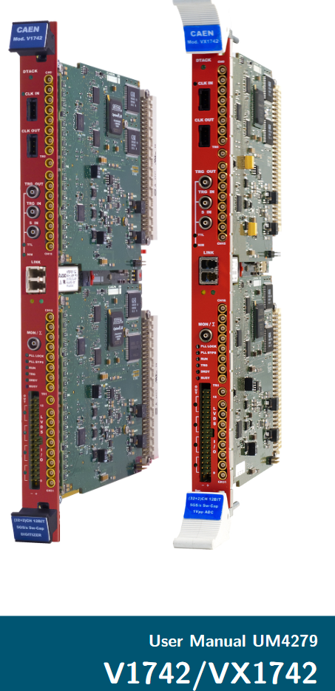
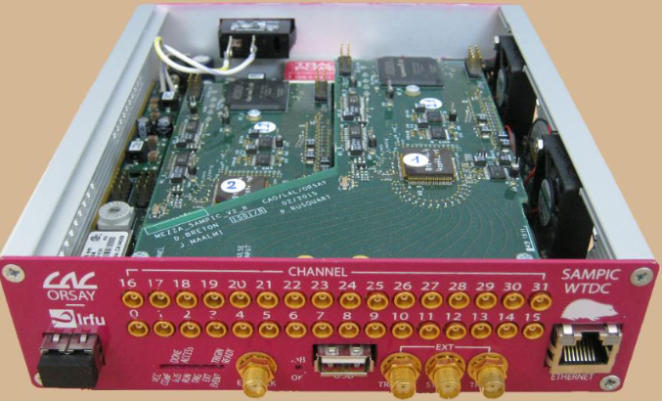
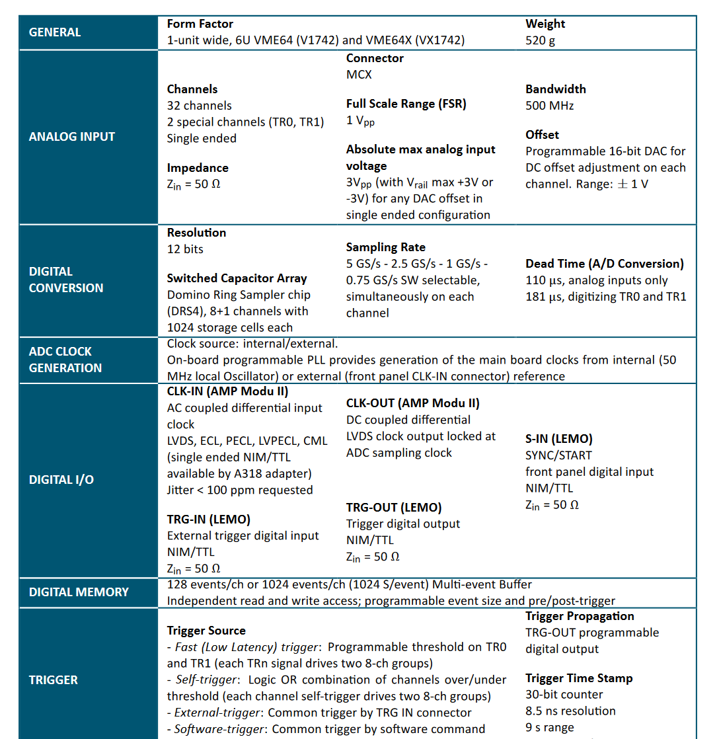
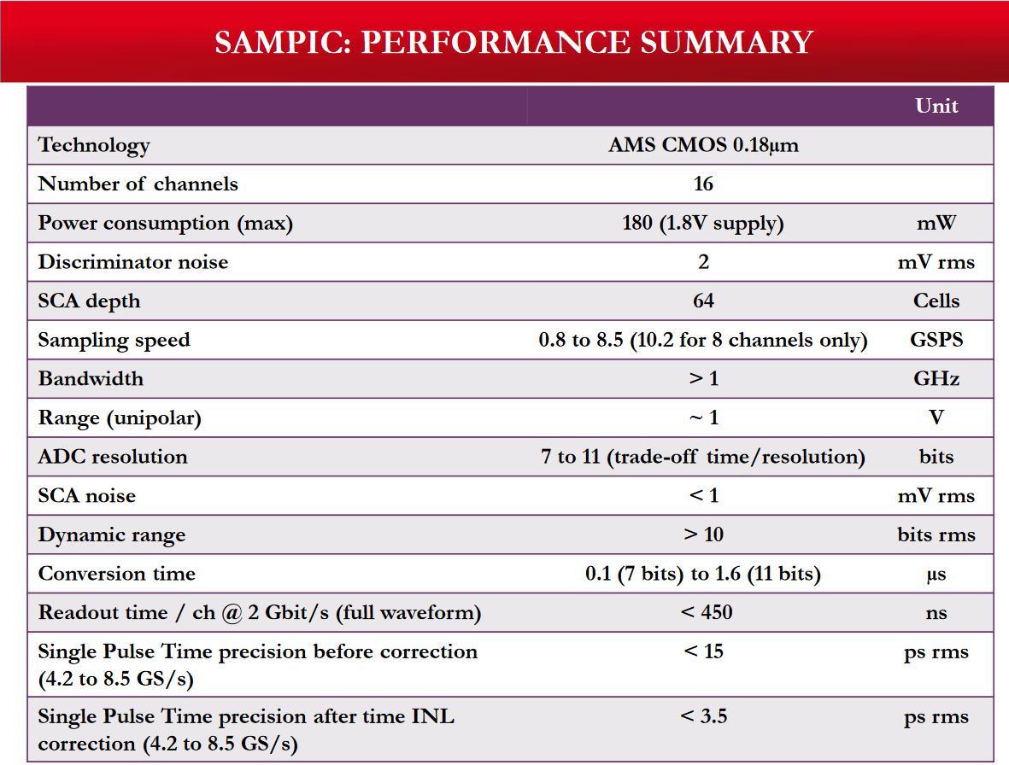
Digitizer
Sampic
V1742, domino chip

Slide 17
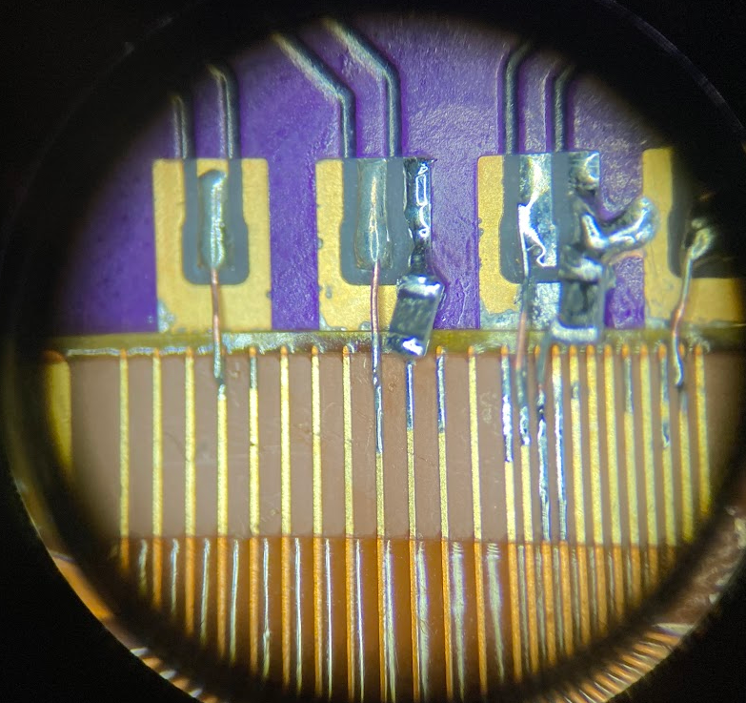
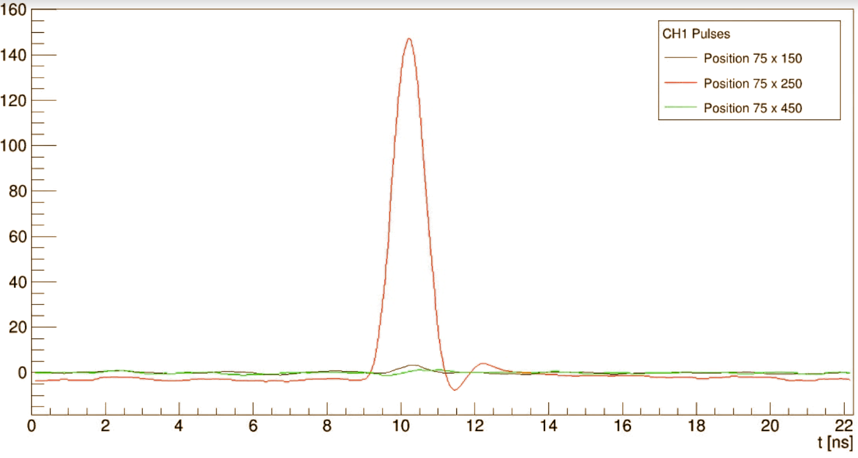
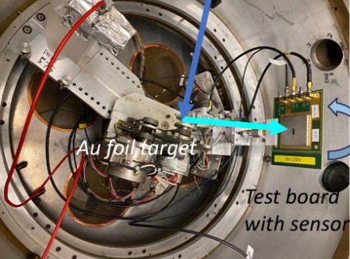
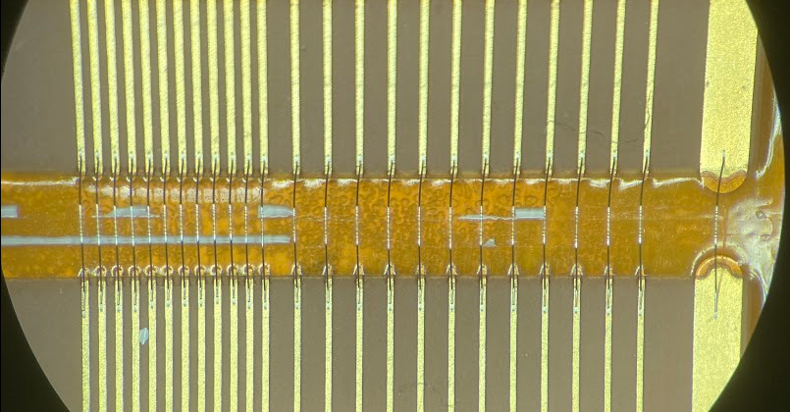


TI LGAD response
50 $Ω$
50 $Ω$
ATAR prototype
1/3 sensors
1/9 electronics
9
12
14
1
2
3
4
5
6
7
8
10
16
15
23
11
13
CENPA test
with protons

