Slide 1


PIONEER Tracker
Jaydeep Datta¹, Abhay Deshpande¹, Josh LaBounty²
1. CFNs, Stony Brook University
2. University of Washington

Slide 2
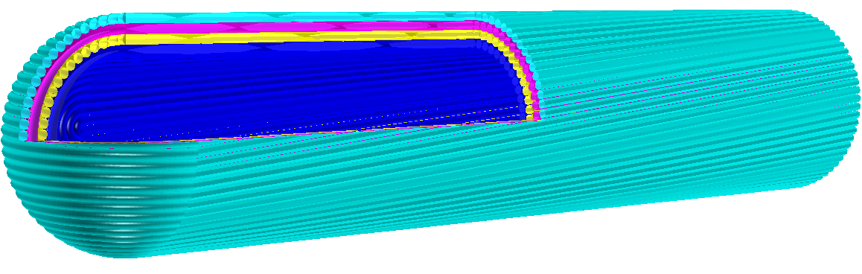
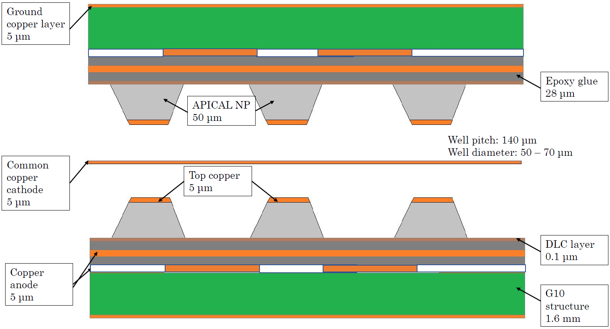
Motivation and Technology
The tracker hits will help to correlate the hits in ATAR with the Calorimeter
For this good spatial and time resolution required
Scintillation fiber and µRWELL are two possible choices
Preliminary idea two layers of µRWELL PCB with common cathode
µRWELL technology
SciFi pictures from Josh’s slides

Slide 3
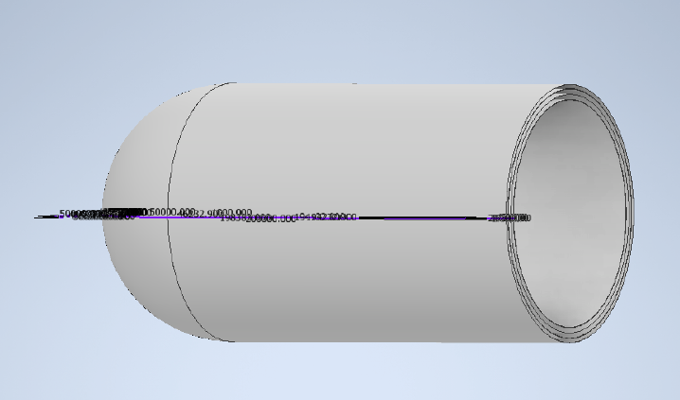
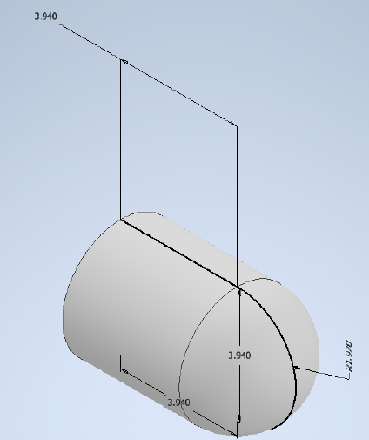
µRWELL Technology
Pros
Gas detector technology
Small amount of material
Spatial resolution ~ 50 µm
Time resolution ~ 5.7 ns
Cons
Need a single volume detector to reduce dead materials, making construction complicated
Readout scheme needs to be tested

Slide 4
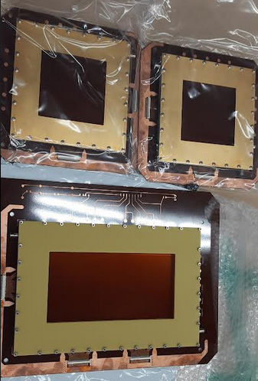
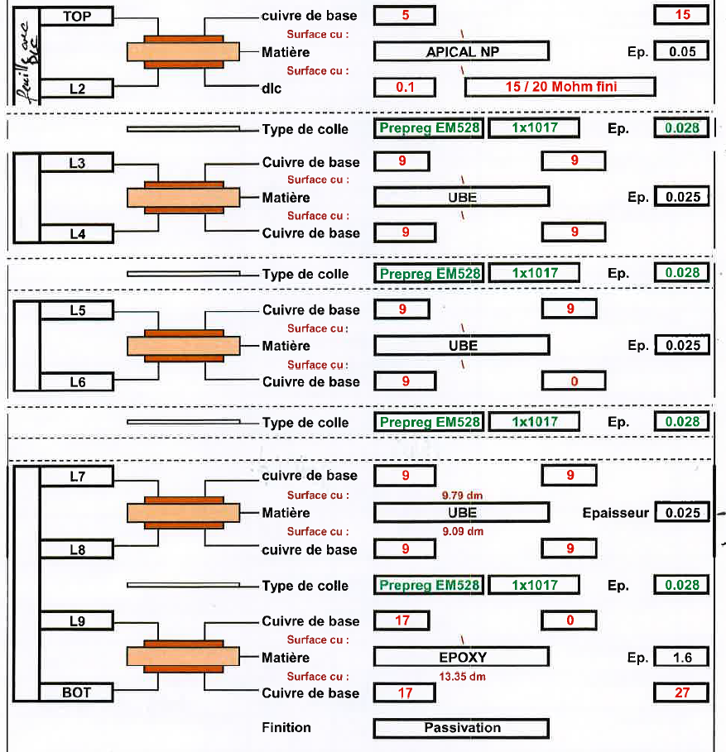
Material description
µRWELL stage
Capacitive sharing stage
Mostly copper, Kapton and insulating material
Readout stage
Micro-RWELLs

Slide 5
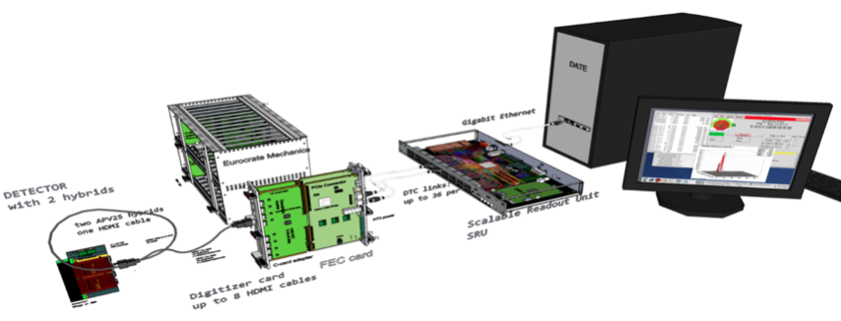
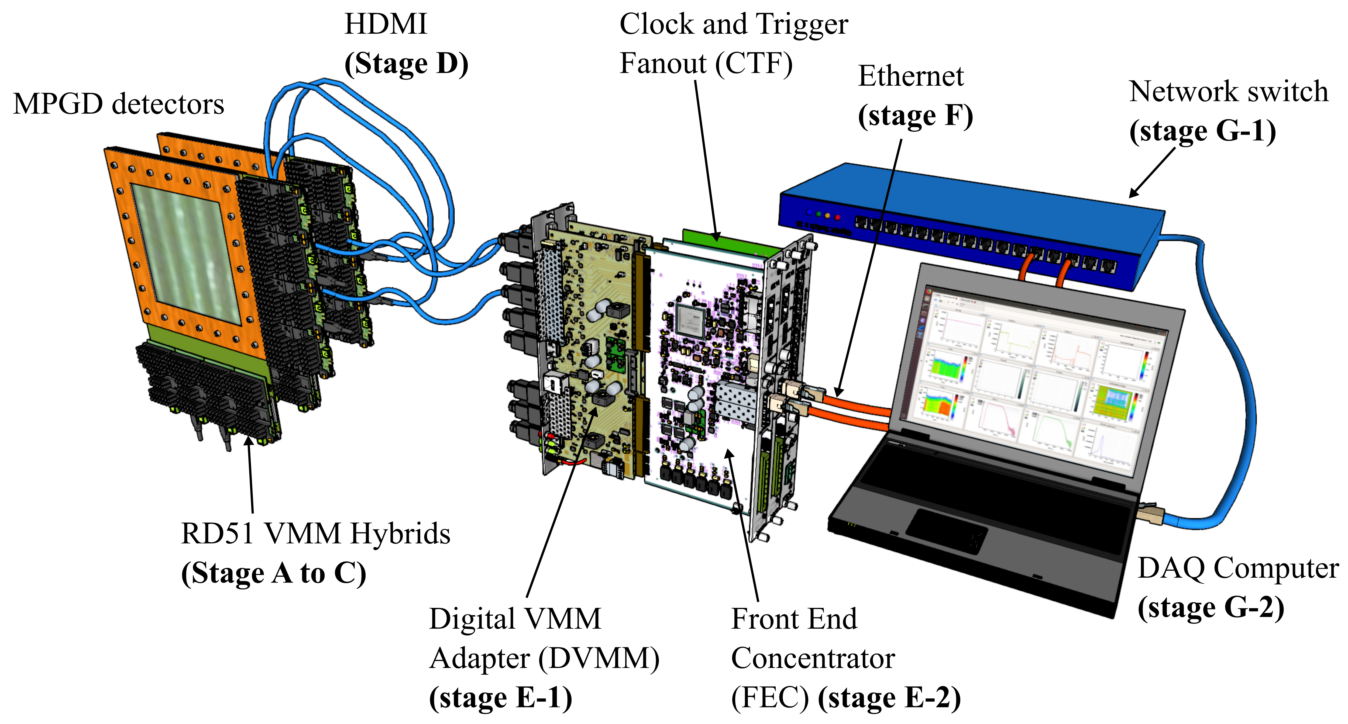
DAQ system
APV25 cards, SRS, and RCDAQ as DAQ software
APV25 is robust but slow, with huge dead time
New system VMM3A cards
Continuous data acquisition system
Needs a separate LV supply to operate and a dedicated cooling system
APV25 and SRS system
VMM and SRS system

Slide 6
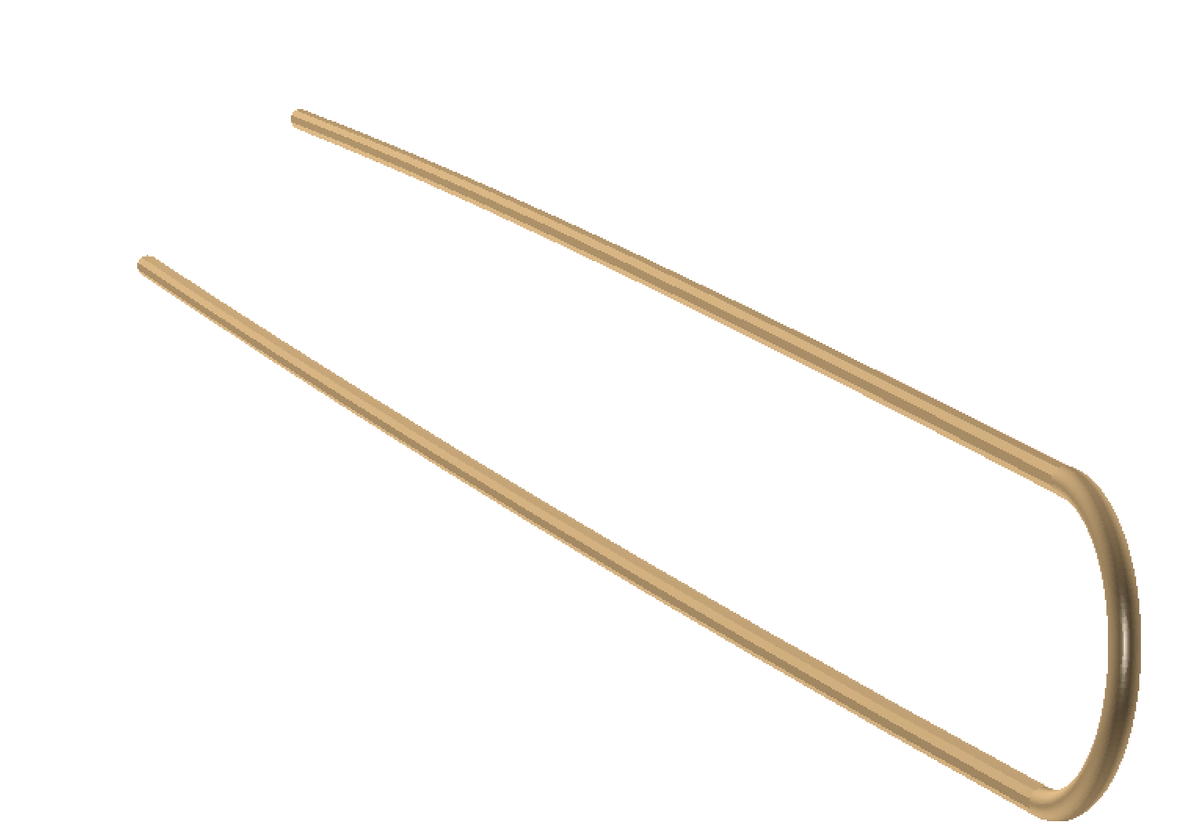
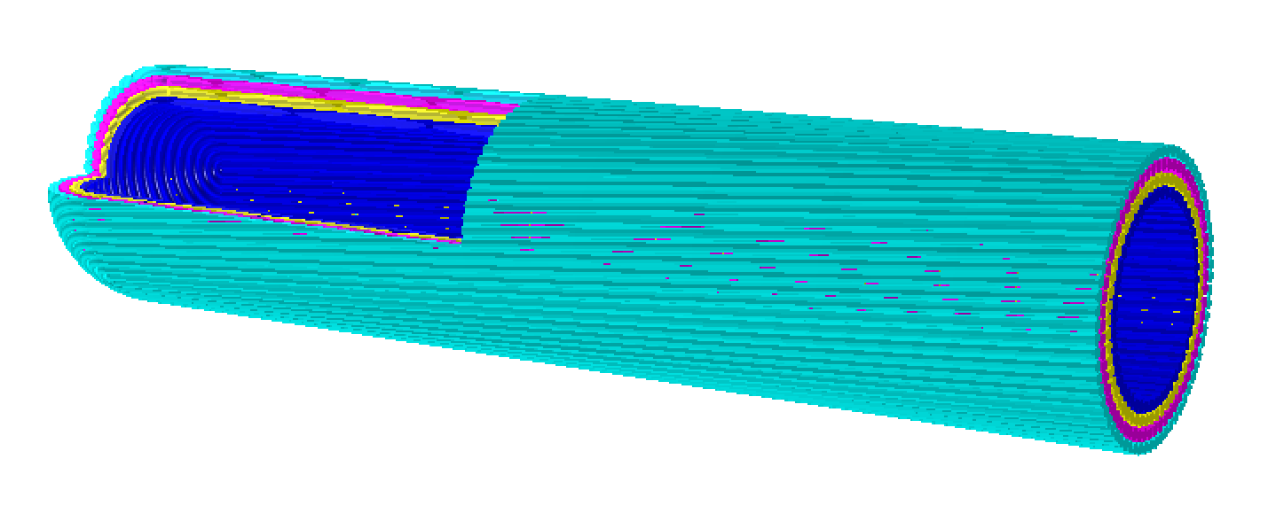
Scintillation Fiber
Established tracking technology
4 layers of 500 µm scintillating fibers. Approximately 1000 channels of readout.
2 - 3 ns of timing resolution [to be verified with simulation]
Preliminary studies suggest a theta/phi resolution for particles emerging from ATAR of < 0.2 rad
Design challenges (fiber bending, etc.)
Pileup could be challenging to disentangle
SiPM for detecting photons, needs dedicated cooling
Pictures from Josh’s slides

Slide 7
Future Plans
Need to fix the tracker shape and space constraints
Working on readout scheme for bullet-shaped, µRWELL based tracker
Figuring out the details to make one such detector
Planning to use µRWELL detectors as cosmic tracker
Need to figure out integration to DAQ
SciFi idea needs to be studied more

Slide 8
Acknowledgement
Thanks to Josh for the study on SciFi.
Thanks to the PIONEER collaboration

Slide 9
Thank you

