Slide 1
Energy/Time Resolution for an Array of LYSO Crystals
Omar Beesley

Slide 2
LYSO Testbeam Goals
Energy resolution measurement – scan energies around 70 MeV
Muon tomography – determine longitudinal uniformity of LYSO crystals using a high energy muon beam
Time resolution measurement - determine crystal-crystal timing differences as a function of hit energy
Fine position scans across front face of LYSO array – determine losses at the boundaries of the crystals
Position resolution measurements - characterize ability of crystals to reconstruct hit position

Slide 3
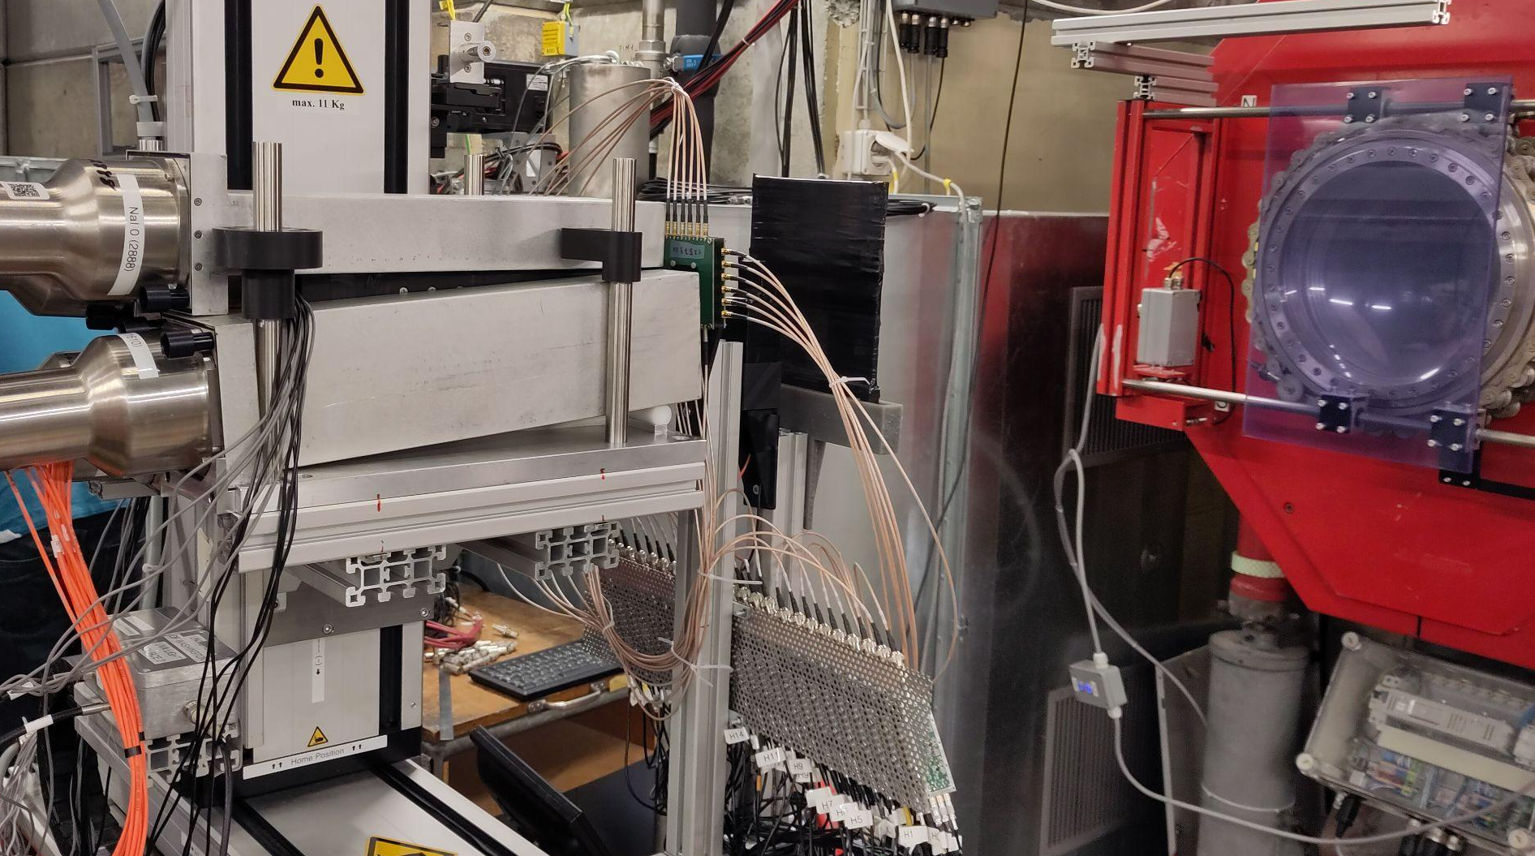
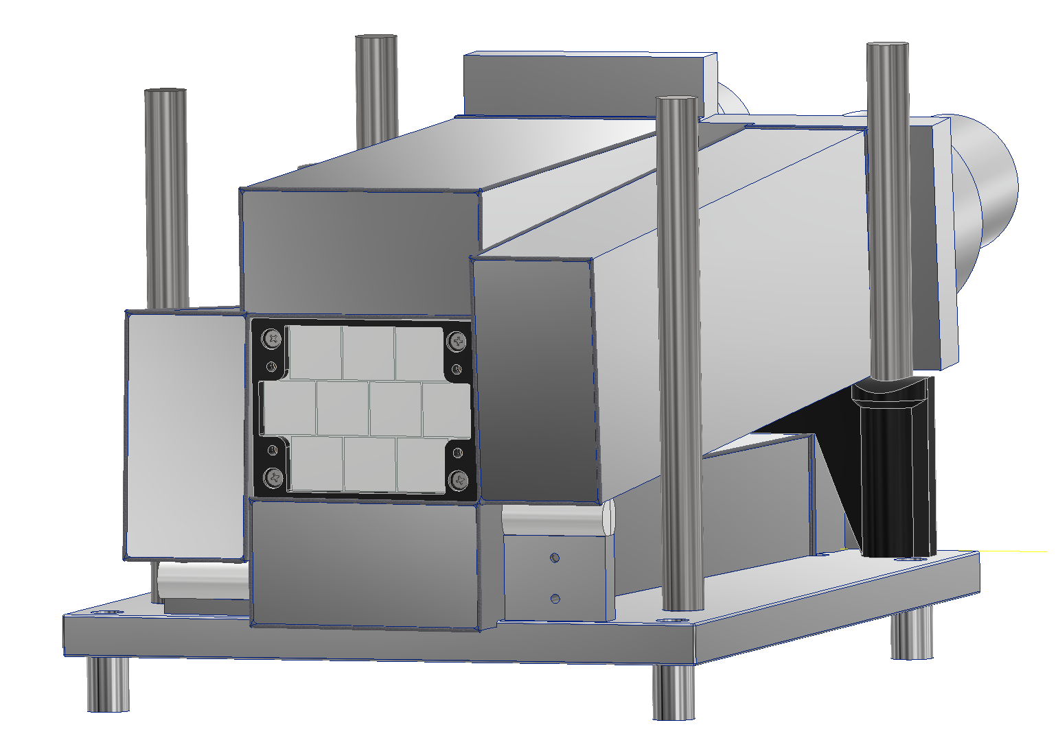
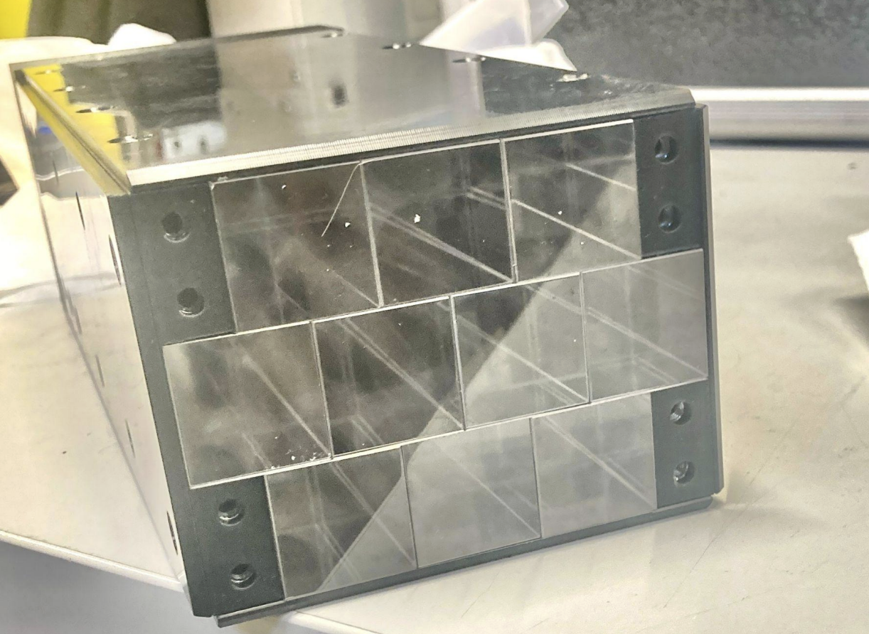
Detector setup at PSI
Detectors:
Positron beam exit
Veto detector
t0 detector
Beam hodoscope
LYSO array
NaI detectors
XY-table
⑦
④
②
①
⑤
③
⑥
⑤

Slide 4
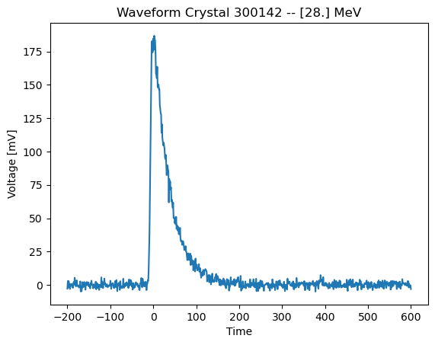
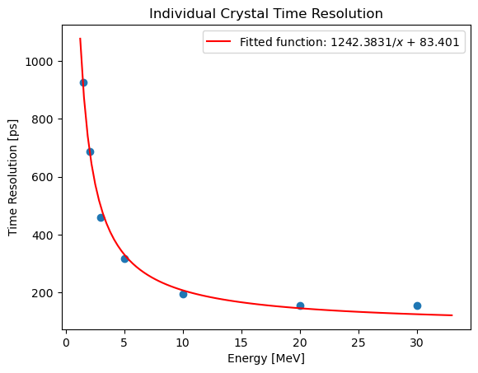
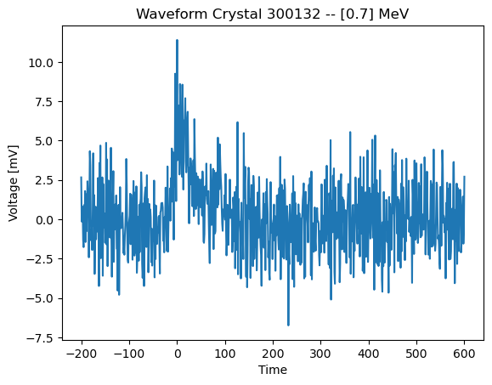
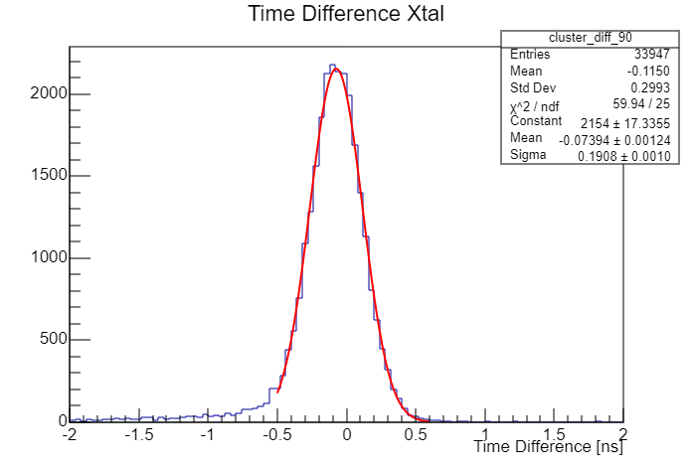
Time Resolution Results
E1 > 10 MeV
t1
t2
t1-t2
2.5 ns resolution at 0.511 MeV
<200 ps resolution above 10 MeV
E2 [MeV]
Notes:
Change x axis to E2 and state energy threshold cut

Slide 5
Nominal energy resolution configuration
FACING DOWNSTREAM
Veto is centered on crystal 4 (outlined in red) so that only particles entering the array through crystal 4 can trigger the DAQ
Crystal 4 used as the primary crystal due to a coupling issue with crystal 5
Any energy deposit in a NaI detector results in the event being vetoed
Non-linearity problem with 3 of the PMTs
Beam region allowed by veto
4
5
Beam center
Non-linear PMTs
Linear PMTs

Slide 6
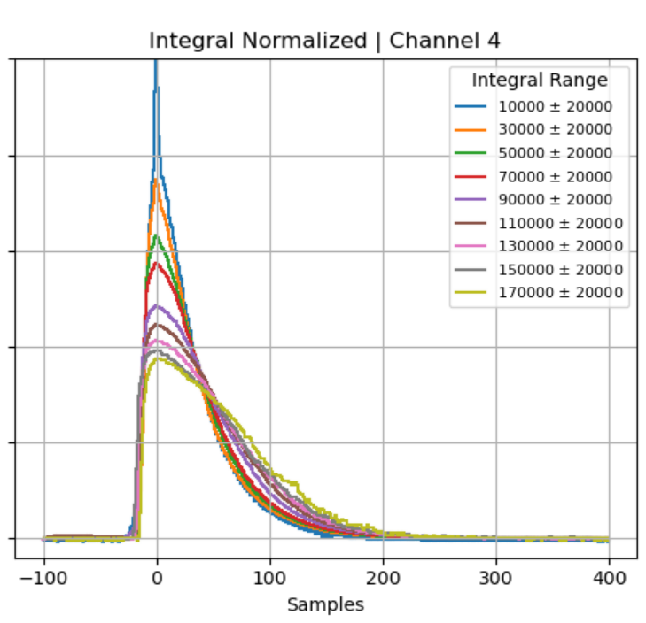
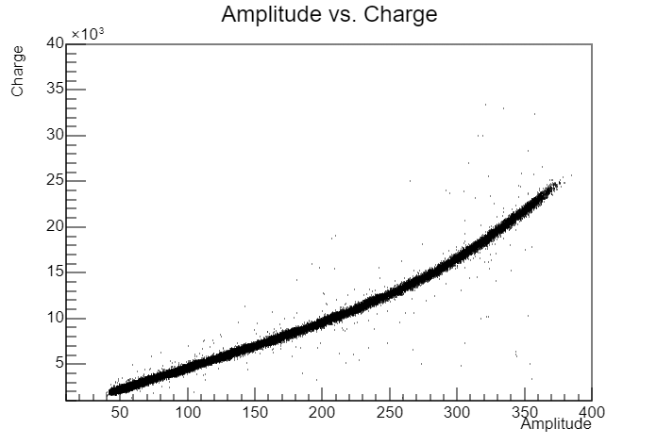
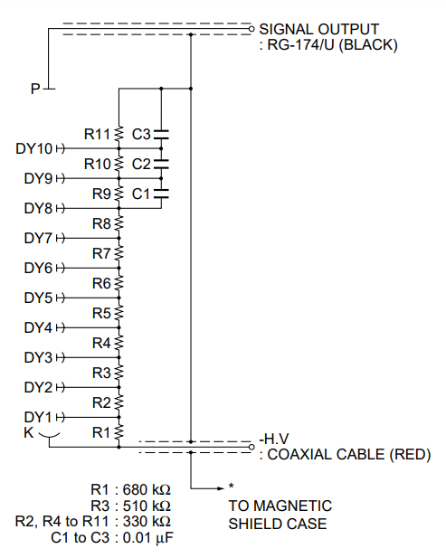
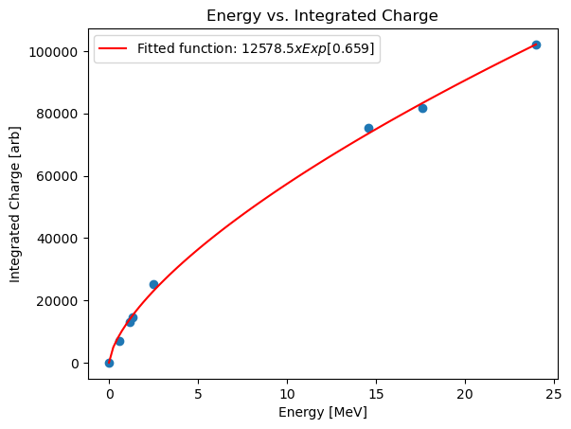
Hamamatsu R1450 and Non-Linearity Problems
Last 8 resistors all have the same resistance:
- Large currents generate electric fields that oppose dynode potential and result in smaller gains for larger signals
Waveform shapes are energy dependent
Energy is not proportional to charge
Run all PMTs at low voltages to minimize effects
Notes:
https://www.hamamatsu.com/content/dam/hamamatsu-photonics/sites/documents/99_SALES_LIBRARY/etd/R1450_TPMH1215E.pdf

Slide 7
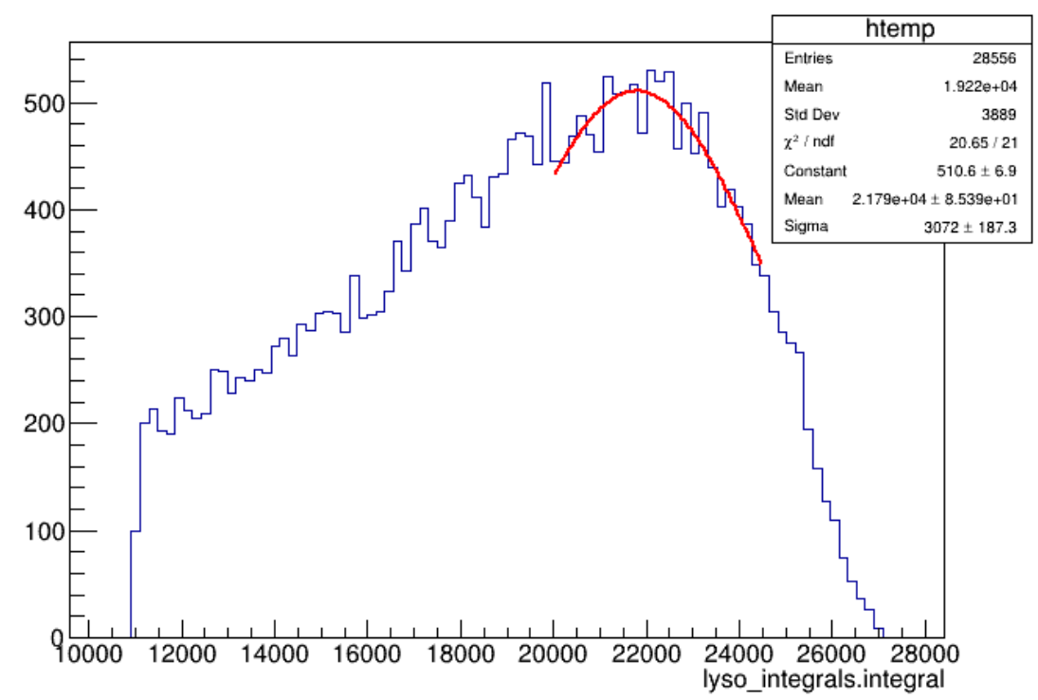
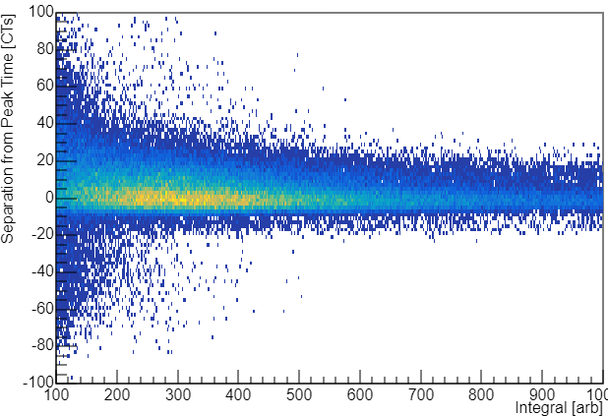
Crystal Calibrations and Timing Cuts
Before each data run at each energy, drive beam into the center of each LYSO xtal
Additional suppression of low energy signals in non-linear PMTs is made (~10%)
We overestimate low-energy signals by calibrating on high energy signals
Fit e+ energy distribution to obtain intra crystal calibration constant – verified with μ+ from beam
Only consider pulses with peak within gate [t-15,t+35] of seed time t

Slide 8
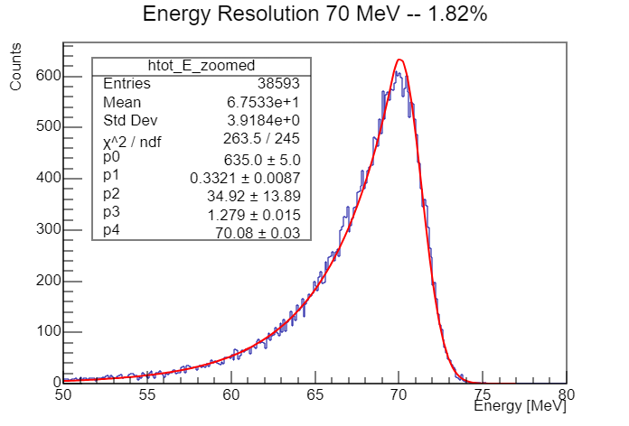
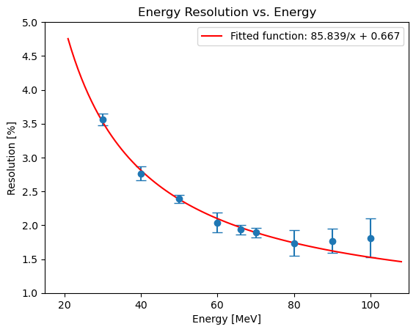
Energy resolution results
~1.8% energy resolution at 70 MeV
NaI crystals used as vetos
Momentum bite of beam (dp/p) < 0.6%
Energy resolution vs. energy fit:
𝛿E/E = a/√E + b/E + c
0
Noise
Constant
Only noise term and constant term are non-zero in fit:
Electronics noise (due to running the PMTs at low HV)
Leakage from the array not picked up by NaI veto detectors
Miscalibrations
Notes:
No arrow goes to 0, start with standard equation and then show cancellation

Slide 9
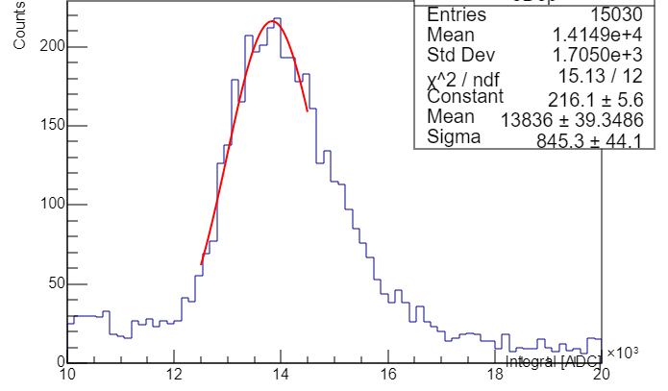
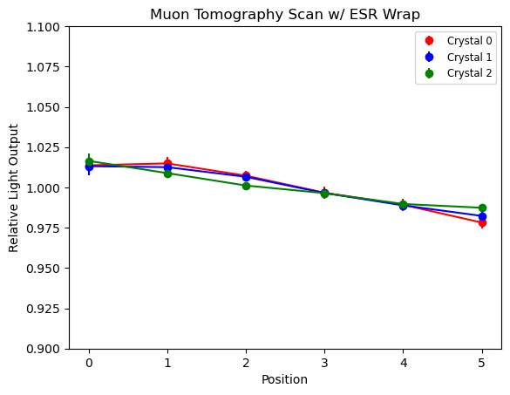
Muon Tomography Results
23 MeV deposit
Detector rotated 90 degrees and NaI removed
210 MeV/c 𝜇 ⁺
PMTs
LYSO
Track light output across 6 positions along the long side of the crystals
3%
Longitudinal uniformity would contribute < 0.2% to energy resolution
Notes:
Equates to x% distortion to energy res, talked too fast, shift more towards analysis and add more depth to slides

Slide 10
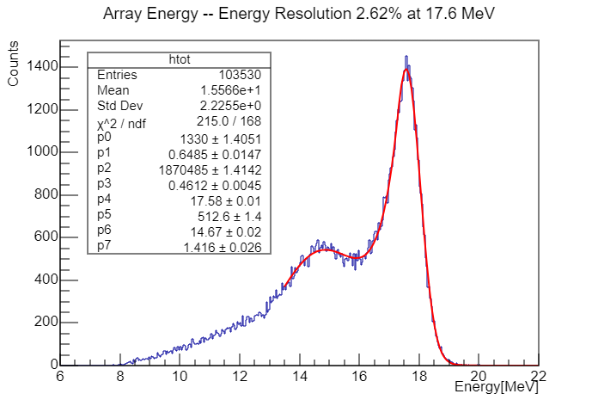

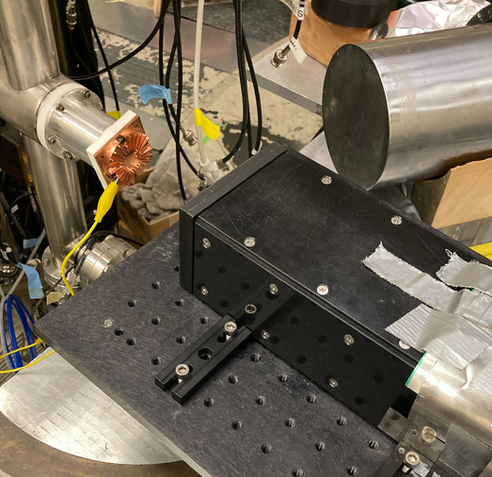
Energy Resolution of a LYSO Array at 17.6 MeV
Protons
LiF target
17.6 MeV 𝛾
2.62% energy resolution at 17.6 MeV – comparable to LXe detector
Exact p-Li reaction could be used as a calibration in PIONEER – used by MEG II (also get ~2.6%)
Notes:
Protons on Li produce 17.6 MeV gamma, match colors to Li7 reaction

Slide 11
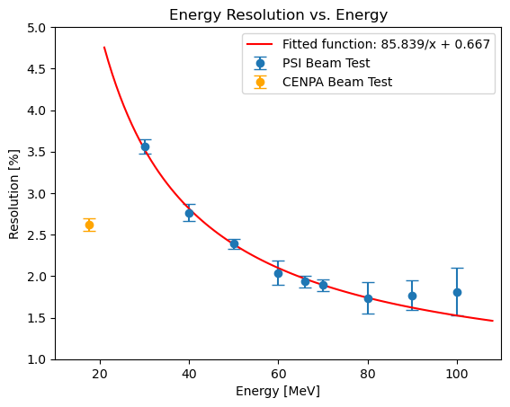
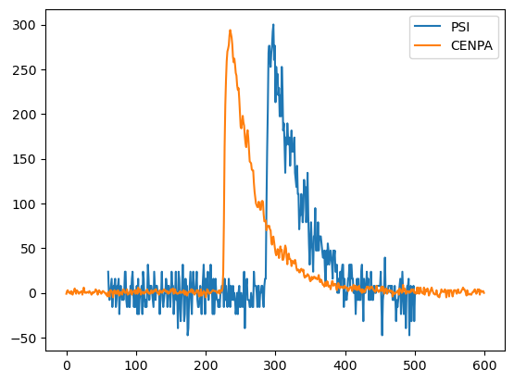
CENPA Beam Test Shows Significant Improvement
PMT bases were corrected to a tapered design
Voltages were increased by about 300V on each PMT

