Slide 1
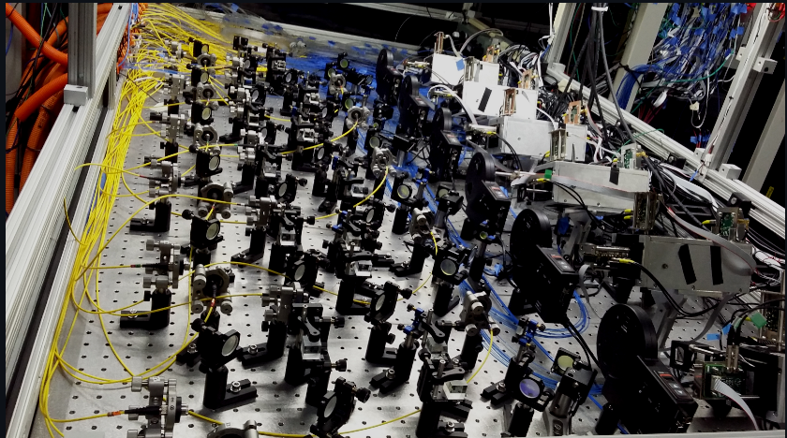
Calibration Concepts
Erik Swanson
PIONEER collaboration meeting

Slide 2
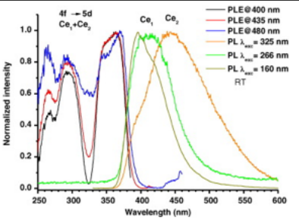
Monitoring our 10 LYSO crystal array
2 UV LEDs excite light production
Bundles of 7 fibers distribute UV
Fibers couple to back of crystal by PMs
Primarily monitors long term stability
  Useful for setting up DAQ without beam
Difficult to scale to full calorimeter
Next look to successful muon g-2 experiment for inspiration
A. Anastasi et al JINST 14 P1125
365 nm

Slide 3
Crucial design elements of this laser system
1) The light source wavelength is in the range of calorimeter photo-detector sensitivity
2) The light distribution system has adequate intensity and homogeneity
3) The system needs to monitor the stability of the light delivered
Now an overview of the hardware

Slide 4
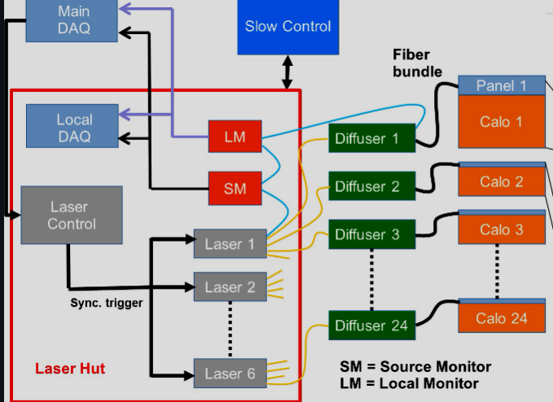
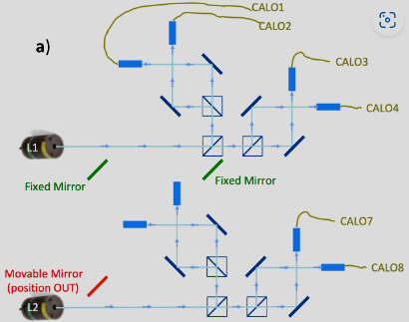
Muon g-2 laser-based gain monitoring system for the calorimeters
Muon g-2 has 24 Calorimeters – with a 6x9 array of PbF₂ crystals (54) in each viewed by SiPMs
6 Lasers Picoquant LDH-P-C-405M 600 ps duration
launched into 25 meter silica fibers
Each laser illuminates diffusers for 4 calorimeters,
about the number of crystals in our calorimeter
Diffusers distribute 405 nm light pulses to crystals

Slide 5
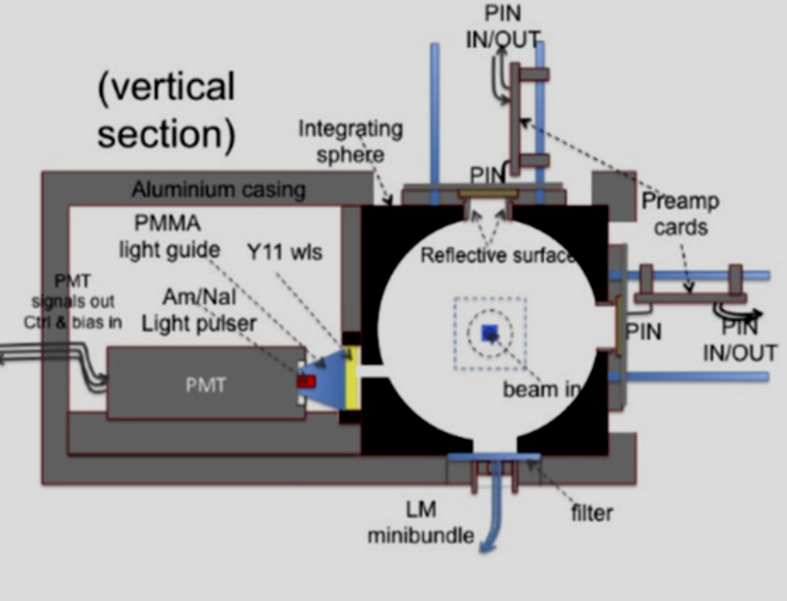
Light monitors
Each laser has one
Light split off from laser enters the integrating sphere at “beam in”
Light from each of 4 calorimeters enters at the bottom
Large area PIN diodes and PM receive the light
241Am / NaI provides 5 MeV reference alphas

Slide 6
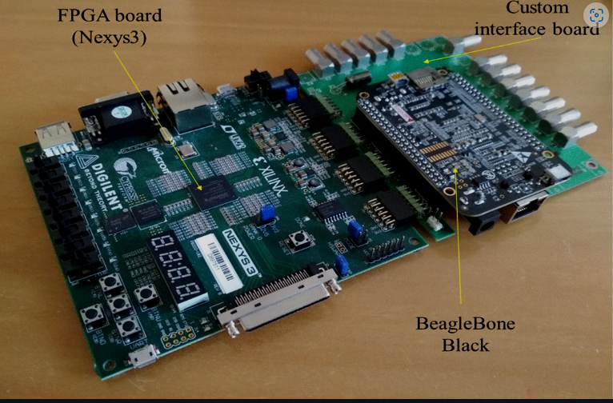
Laser pulse control board
Board contains a Spartan 6 FPGA and ARM CPU to program pulse sequences.
SIPM gains in g-2 calorimeters are rate dependent and different pulse sequences mapped this behavior
The board manages the light monitor system.

Slide 7
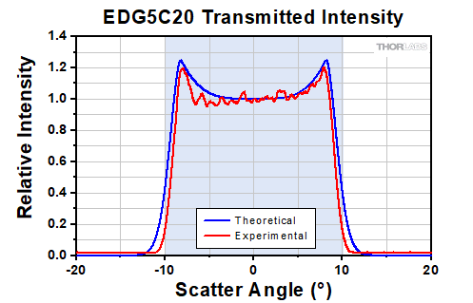
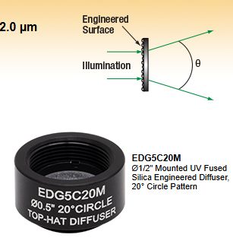
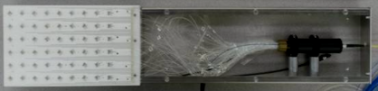
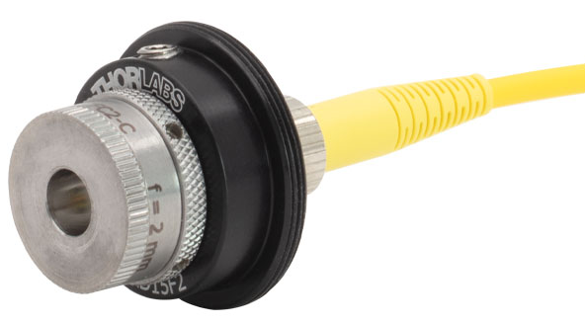
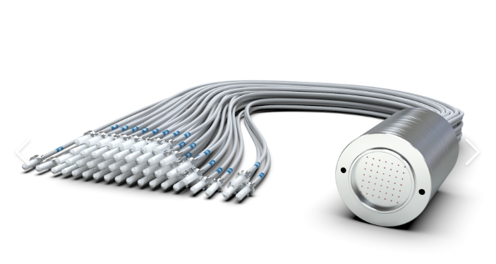
The Diffusing System
Light from launching fiber is transmitted through an engineered diffuser (Thorlabs EDI-S20)
Structured microlens array transforms gaussian beam to flat top beam
Fiber
bundle
Each fiber terminates in a prism
On the front face of a crystal in the array
Fiber bundle is positioned to intercept flat central part
Fiber launcher
We would do something like this

Slide 8
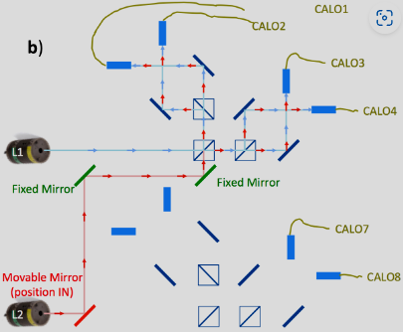
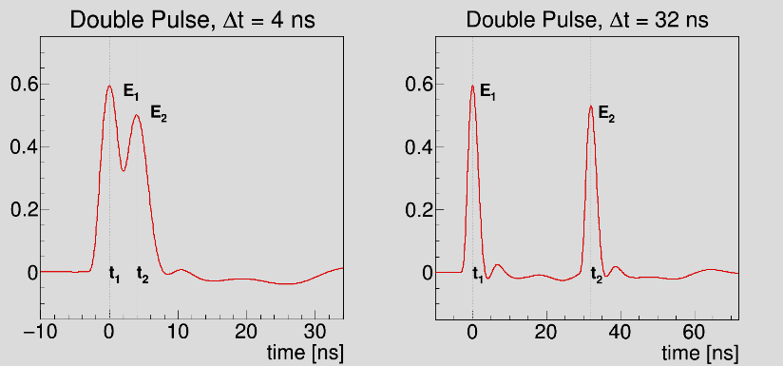
Double pulsing with two independent lasers.
Amplitudes of pulses can be varied independently.
Consecutive pulses from same laser limited to 40 MHz rep rate.
Pulse statistics from independent lasers are uncorrelated.
A movable mirror re-directs
the laser’s light along the same path as another laser.
Two pulses with different amplitudes and times are sent to the same calorimeter

Slide 9
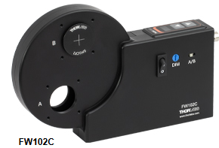
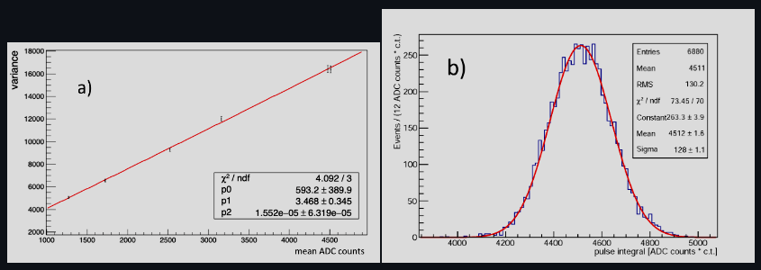
Vary the laser’s output with calibrated neutral density filters
Assume laser’s photon distribution is Poissonian
with measured mean proportional to photo-electrons
Variance is proportional to the mean.
The slope of the variance/mean plot is the proportionality constant or gain of the SIPM.

Slide 10
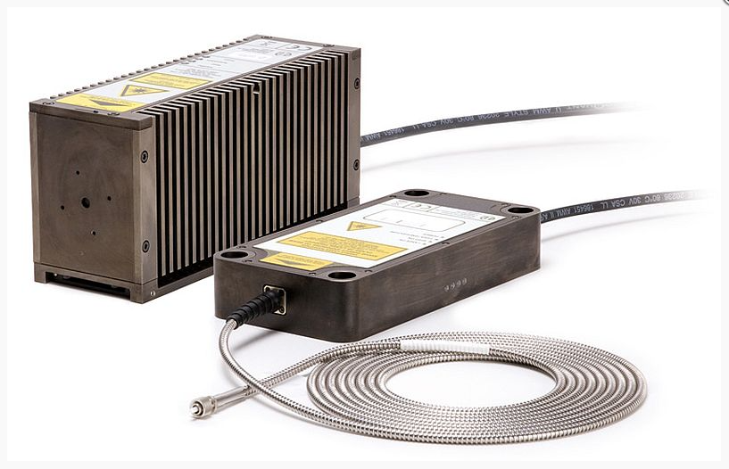

The LYSO version with a UV laser
Laser:
Picoquant LDH-FA=355
UV Optics:
Engineered diffuser
Fiber, Launcher
Laser control
Laser Monitor

Slide 11

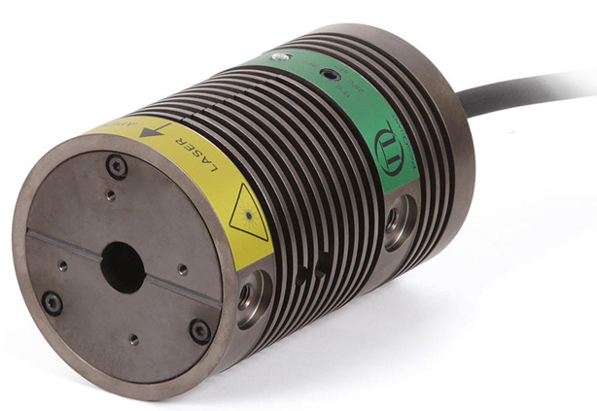
diffuser
LYSO laser-based
gain monitoring system
100+ Fiber bundle
To calorimeter
Fiber
launcher
Filter wheel
Fiber
launcher
UV Laser head
Non-polarizing beam splitter
diffuser
100+ Fiber bundle
To calorimeter

Slide 12
diffuser
PIONEER laser-based
gain monitoring system
100+ Fiber bundle
To calorimeter
Fiber
launcher
Filter wheel
Fiber
launcher
UV Laser head
Non-polarizing beam splitter
Filter wheel
diffuser
100+ Fiber bundle
To calorimeter
UV Laser head 2

Slide 13
With appropriate control of the lasers, we can have an equivalent laser calibration system that uses LYSO’s own light.

Slide 14
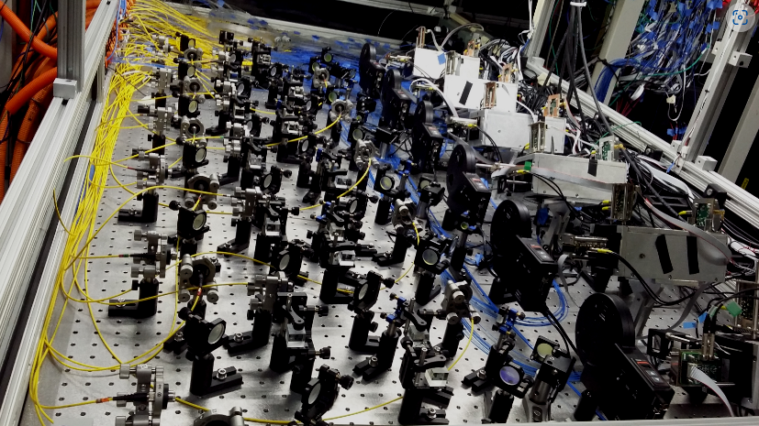
That’s All Folks

