Slide 1
Pion Beta Decay with the PIONEER Apparatus
PIONEER June 2024 Collaboration Meeting
Bradley Taylor

Slide 2
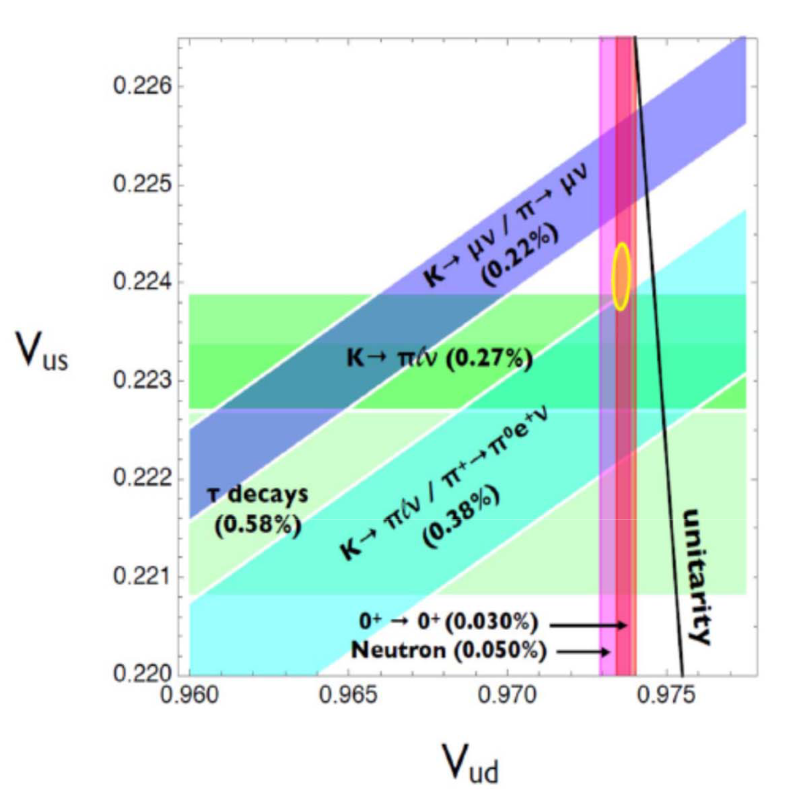
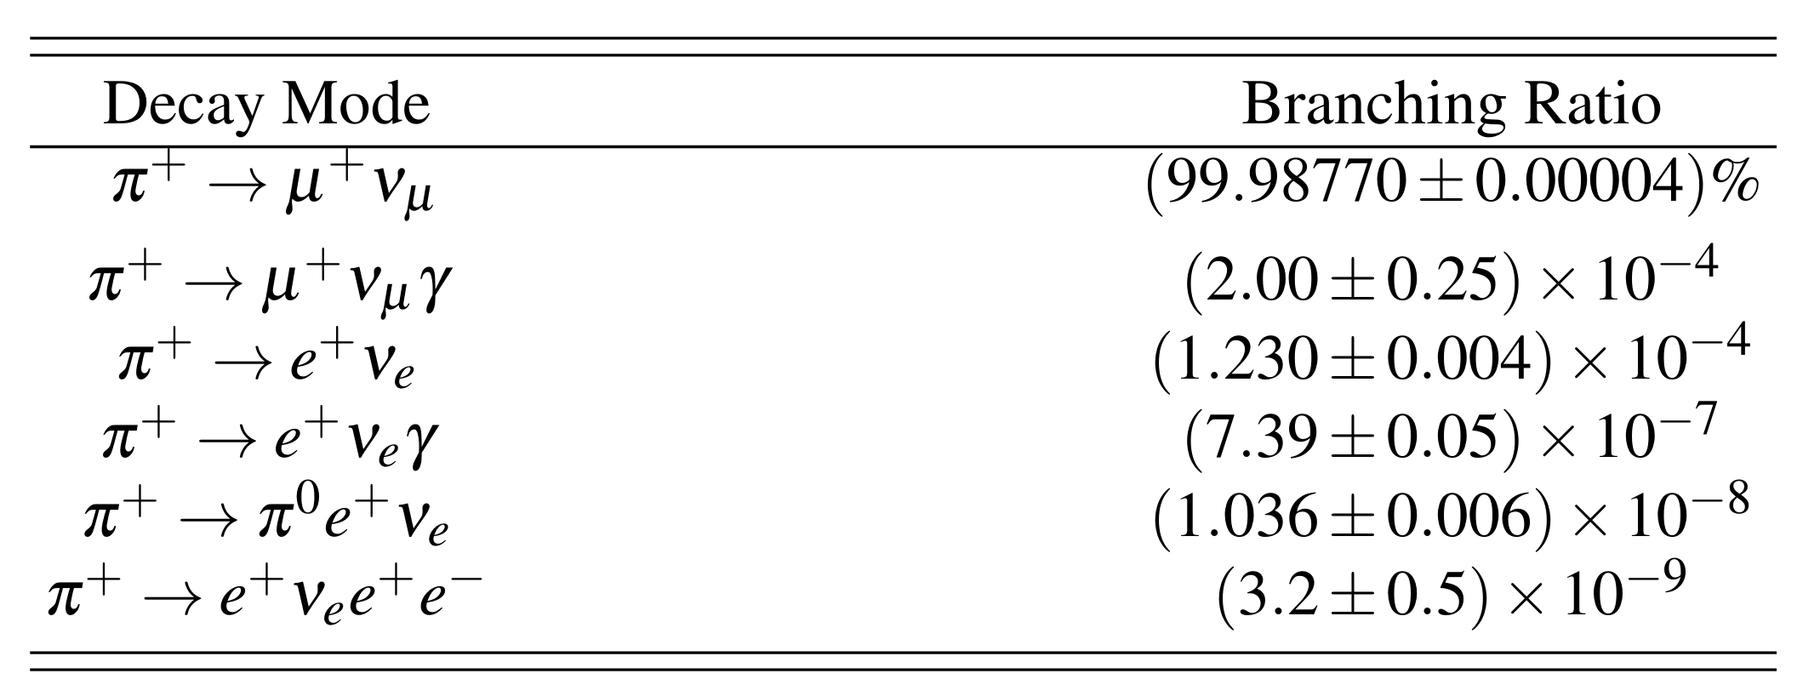

CKM Unitarity Tensions & Pion Beta Decay
The first row of the CKM quark-mixing matrix has a 3σ tension with unitarity
The pion beta decay branching ratio provides a theoretically clean determination of $|V_{ud}|$
The PiBeta experiment measured the branching ratio to ~0.6%

Slide 3
PIONEER Phase II aims for 3x
PIONEER Phase III aims for 10x improvement in the precision of the pion beta decay branching ratio

Slide 4
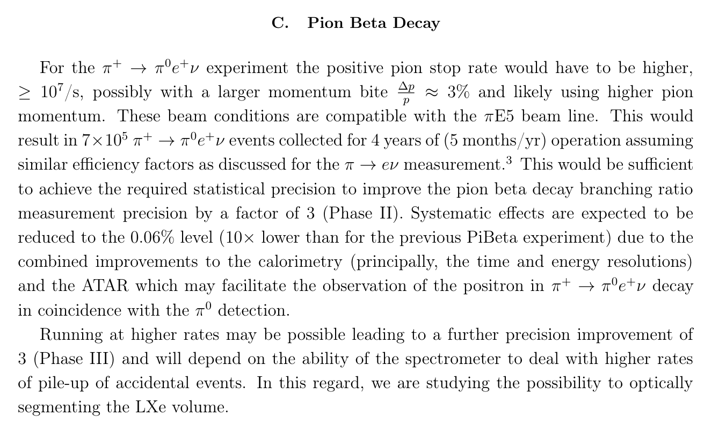

Slide 5
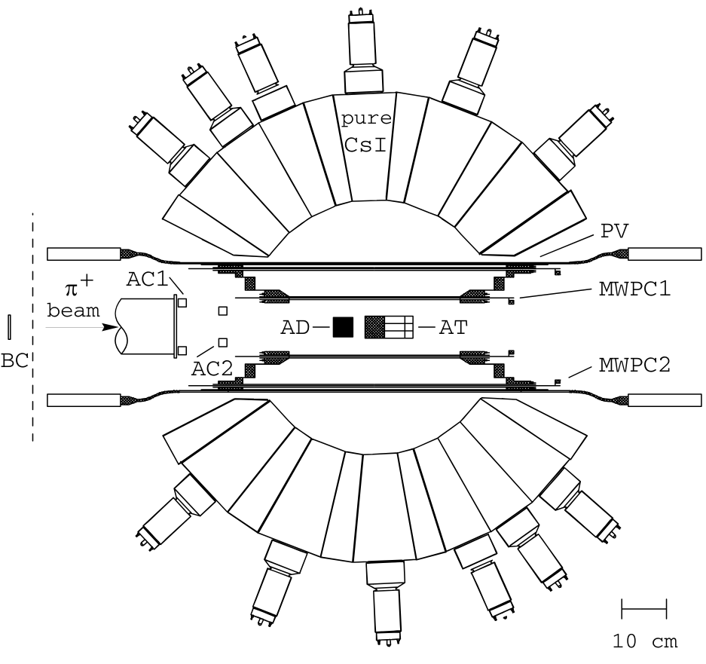
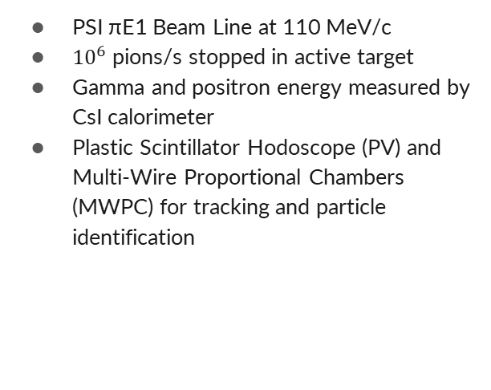
PiBeta Experiment - Design
PSI πE1 Beam Line at 110 MeV/c
${10}^{6}$ pions/s stopped in active target
Gamma and positron energy measured by CsI calorimeter
Plastic Scintillator Hodoscope (PV) and Multi-Wire Proportional Chambers (MWPC) for tracking and particle identification

Slide 6
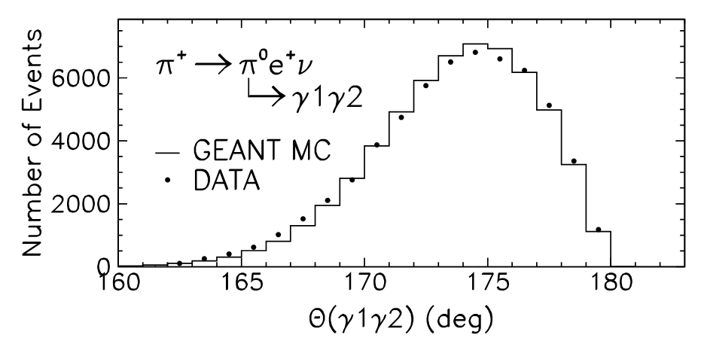
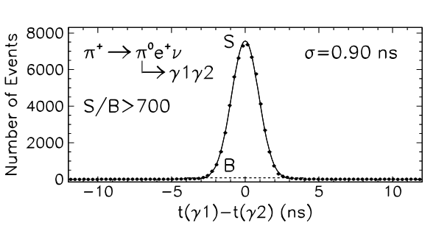


PiBeta Experiment - Method
π⁰ decays quickly (~0.085 fs) to 2 gammas, observed in the calorimeter, nearly colinear
Normalized to PIENU count (similar acceptance)
$$γ$$
$$π^{+}$$
$$γ$$
Notes:
Effective solid angle

Slide 7
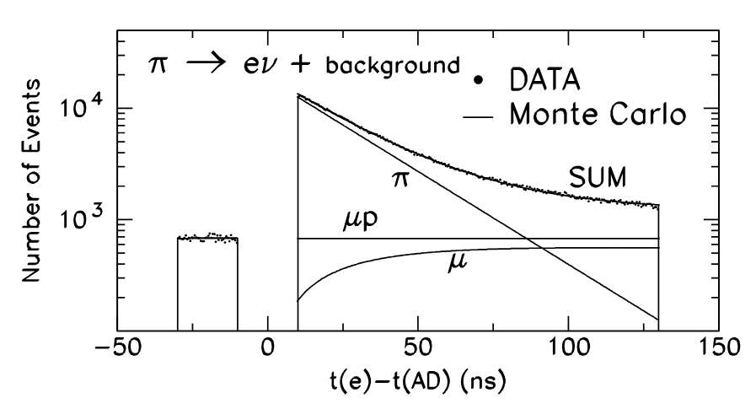
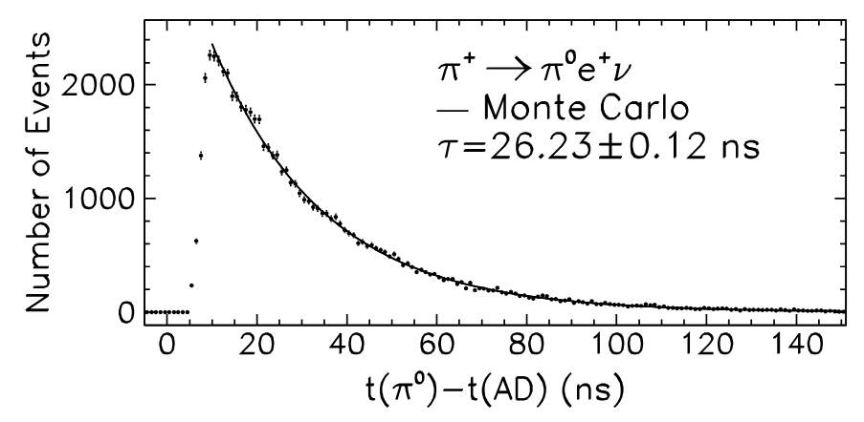
PiBeta Experiment - Timing
PIENU (π) and Michel (μ) timing histogram
Pion Beta Decay timing histogram
PIENU and Pion Beta decays have similar time distributions

Slide 8

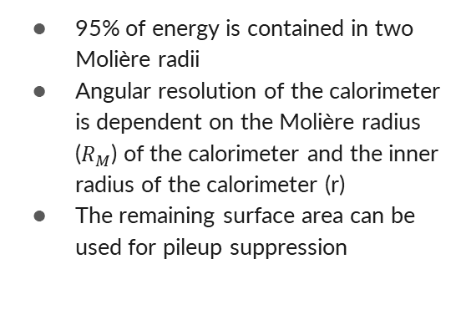



Angular Resolution & Pileup Suppression
$$2R_{M}$$
$$γ$$
95% of energy is contained in two Molière radii
Angular resolution of the calorimeter is dependent on the Molière radius ($R_{M}$) of the calorimeter and the inner radius of the calorimeter (r)
The remaining surface area can be used for pileup suppression
r
r
$$γ$$
$$2R_{M}$$

Slide 9



Calorimeter Comparison
PiBeta Calorimeter
PIONEER Calorimeter (LYSO)
PIONEER Calorimeter (Segmented LXe)
26 cm
15 cm
15 cm
20.896 cm
31.24°
14.0 cm
32.04°
8.28 cm
88.30°
26 cm
15 cm
15 cm
26 cm inner radius
3.5 cm Molière Radius (CsI)
15 cm inner radius
2.07 cm Molière Radius (LYSO)
15 cm inner radius
5.224 cm Molière Radius (LXe)
Energy of $2γ$ in 3.6% of the Calorimeter
Energy of $2γ$ in 3.8% of the Calorimeter
Energy of $2γ$ in 24.3% of the Calorimeter

Slide 10
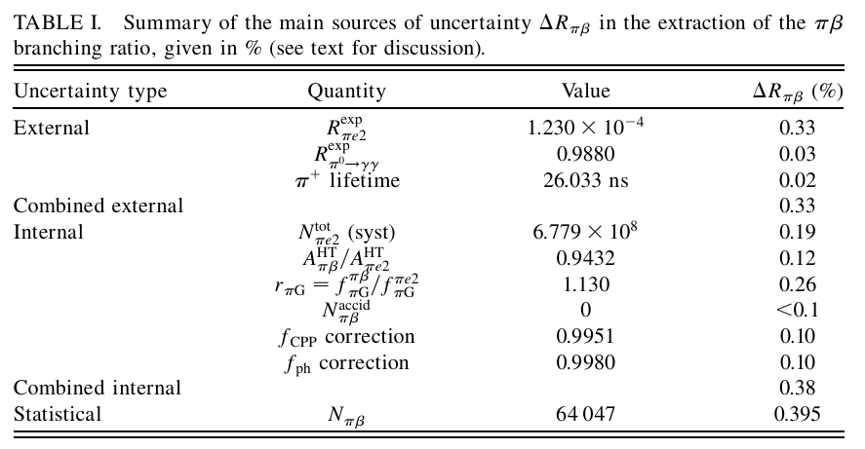
PiBeta Uncertainty Summary
Approximate Phase II Goals
0.01
0.02
0.01
0.02
0.05
0.05
0.10
0.08
0.05
0.03
0.16
0.13
0.21
Total: 0.63
Notes:
Systematic count of PiBeta events was not a significant uncertainty in the previous experiment. It seems our LYSO calorimeter would be able to count these similarly well. Additionally, we expect the PIONEER ATAR to be able to see the pibeta positron, increasing our confidence in this count. Simulations will be run this summer to confirm this.

Slide 11
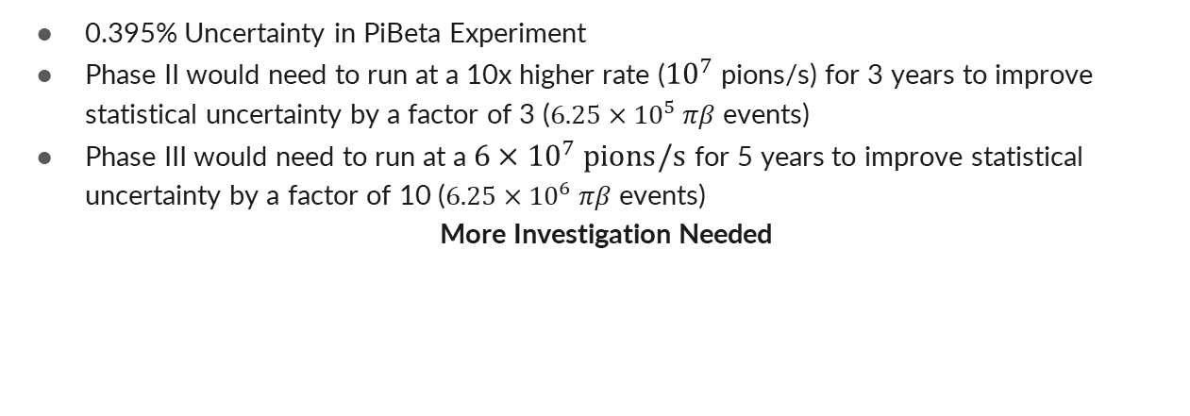
PiBeta Statistical Uncertainty ($N_{πβ}$)
0.395% Uncertainty in PiBeta Experiment
Phase II would need to run at a 10x higher rate (${10}^{7}$ pions/s) for 3 years to improve statistical uncertainty by a factor of 3 ($6.25×{10}^{5} πβ$ events)
Phase III would need to run at a ${6×10}^{7} pions/s$ for 5 years to improve statistical uncertainty by a factor of 10 ($6.25×{10}^{6} πβ$ events)
More Investigation Needed
II: $1.036×{10}^{−8} πβ events / pion ×0.2 \left[Acceptance \& Timing Cuts\right]×{10}^{7}\frac{pions}{sec}×{10}^{7} running sec/year=2.07×{10}^{5} πβ events / year$
$$\left(6.25×{10}^{5} πβ events\right)×{\left(2.07×{10}^{5} πβ events / year\right)}^{−1}=3 years$$
III: $\left(6.25×{10}^{6} πβ events\right)×{\left(1.036×{10}^{−8} πβ events / pion\right)}^{−1}×5 \left[Acceptance \& Timing Cuts\right]×{(5 years)}^{−1}×{({10}^{7} running sec/year)}^{−1}=6×{10}^{7} pions/sec$
Notes:
Current pienu measuremnt

Slide 12
$π^{+}→e^{+}ν$ Branching Ratio ($R_{πe2}^{exp}$)
0.33% Uncertainty in PiBeta Experiment
PIENU experiment improved to 0.24%
Phase I plans to improve to 0.01%

Slide 13
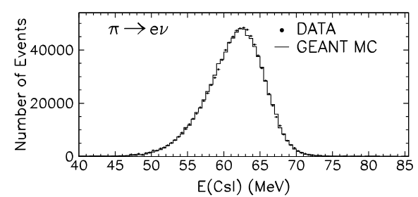
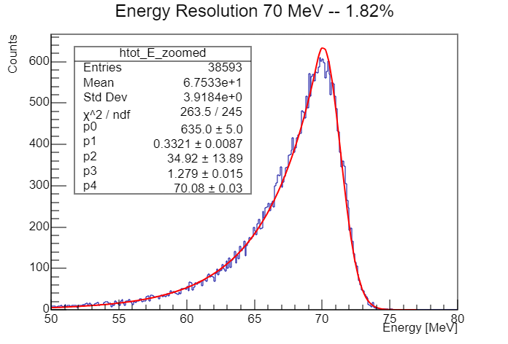
$π^{+}→e^{+}ν$ Count ($N_{πe2}^{tot}$) (Systematic)
0.19% Uncertainty in PiBeta Experiment
Uncertainty primarily from extracting the PIENU tail from Michel events - PiBeta used Monte Carlo estimates
PIONEER should have a better understanding of the tail fraction from Phase I – the fraction will change if the target is changed for phase II
The PIONEER ATAR will be able to distinguish PIENU events from Michel events
PIONEER’s increased calorimeter depth will greatly decrease the tail size compared to PiBeta (20 RL vs 12 RL)
The calorimeter’s improved energy resolution (~2% versus ~5%) should also improve this precision
More Investigation Needed
(LYSO)

Slide 14
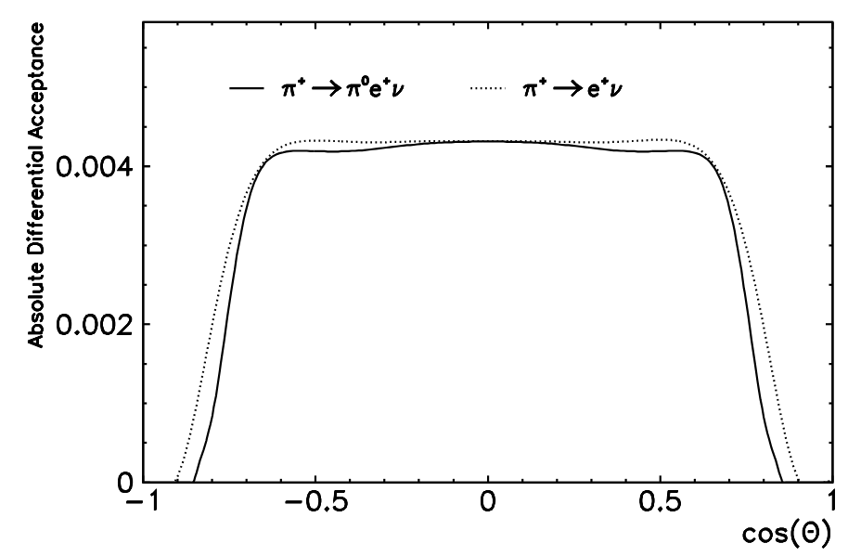
Acceptance Ratio ($A_{πβ}^{HT}/A_{πe2}^{HT}$)
0.12% Uncertainty in PiBeta Experiment
Acceptance uncertainty dominated by uncertainty in pion stop distribution
PiBeta backtracked charged particles from their trackers to the target to determine the pion stop distribution (50 micron uncertainty)
The PIONEER ATAR and tracker should be able to improve this precision
Also includes uncertainty from PiBeta track identification and radiative decay correction
More Investigation Needed

Slide 15
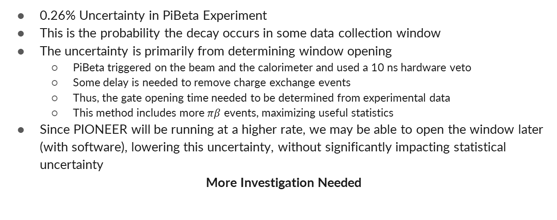
Gate Fraction Ratio ($r_{πG}=f_{πG}^{πβ}/f_{πG}^{πe2}$)
0.26% Uncertainty in PiBeta Experiment
This is the probability the decay occurs in some data collection window
The uncertainty is primarily from determining window opening
  PiBeta triggered on the beam and the calorimeter and used a 10 ns hardware veto
  Some delay is needed to remove charge exchange events
  Thus, the gate opening time needed to be determined from experimental data
  This method includes more $πβ$ events, maximizing useful statistics
Since PIONEER will be running at a higher rate, we may be able to open the window later (with software), lowering this uncertainty, without significantly impacting statistical uncertainty
More Investigation Needed

Slide 16


Other Uncertainties
Tracker Pileup Correction ($f_{CPP}$)
Photonuclear Correction ($f_{ph}$)
0.10% Uncertainty in PiBeta Experiment
Can we have a better tracker than PiBeta?
0.10% Uncertainty in PiBeta Experiment
Probability PiBeta photon converts to electron-positron pair
Calculated using GEANT3 and ‘conservatively assigned a 50% uncertainty’
More Investigation Needed

Slide 17
We will use our simulation this summer to better understand how to perform a Pion Beta Decay measurement using our apparatus and analyze if/how we can make significant improvements over the PiBeta experiment’s precision

Slide 18
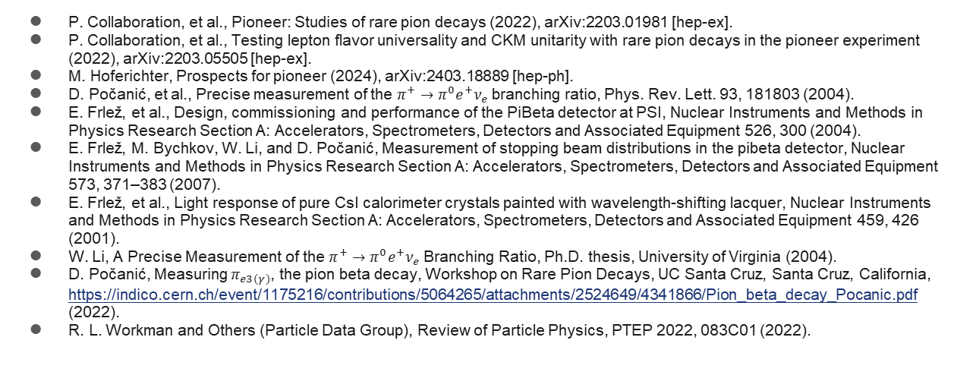
References
P. Collaboration, et al., Pioneer: Studies of rare pion decays (2022), arXiv:2203.01981 [hep-ex].
P. Collaboration, et al., Testing lepton flavor universality and CKM unitarity with rare pion decays in the pioneer experiment (2022), arXiv:2203.05505 [hep-ex].
M. Hoferichter, Prospects for pioneer (2024), arXiv:2403.18889 [hep-ph].
D. Počanić, et al., Precise measurement of the $π^{+}→π^{0}e^{+}ν_{e}$branching ratio, Phys. Rev. Lett. 93, 181803 (2004).
E. Frlež, et al., Design, commissioning and performance of the PiBeta detector at PSI, Nuclear Instruments and Methods in Physics Research Section A: Accelerators, Spectrometers, Detectors and Associated Equipment 526, 300 (2004).
E. Frlež, M. Bychkov, W. Li, and D. Počanić, Measurement of stopping beam distributions in the pibeta detector, Nuclear Instruments and Methods in Physics Research Section A: Accelerators, Spectrometers, Detectors and Associated Equipment 573, 371–383 (2007).
E. Frlež, et al., Light response of pure CsI calorimeter crystals painted with wavelength-shifting lacquer, Nuclear Instruments and Methods in Physics Research Section A: Accelerators, Spectrometers, Detectors and Associated Equipment 459, 426 (2001).
W. Li, A Precise Measurement of the $π^{+}→π^{0}e^{+}ν_{e}$Branching Ratio, Ph.D. thesis, University of Virginia (2004).
D. Počanić, Measuring $π_{e3(γ)}$, the pion beta decay, Workshop on Rare Pion Decays, UC Santa Cruz, Santa Cruz, California, https://indico.cern.ch/event/1175216/contributions/5064265/attachments/2524649/4341866/Pion_beta_decay_Pocanic.pdf (2022).
R. L. Workman and Others (Particle Data Group), Review of Particle Physics, PTEP 2022, 083C01 (2022).

