Slide 1
Technical Coordination, and Towards a CDR
Bruce Schumm
June 21 2024
PIONEER Collaboration Meeting
CENPA/UW

Slide 2
Next Collaboration Meeting
January 7-9, 2025
TRIUMF
Vancouver, BC, Canada
Host: Chloe Malbrunot

Slide 3
What Does PIONEER Need to Do
In the broadest possible terms
Convince agencies to provide seed funding
Do R&D with this funding to develop and optimize these approaches
Identify critical sector tests to establish performance
Convince agencies to provide construction funding
Fabricate, assemble and deploy the detector and beamline
Assume that operation/analysis funding will accompany construction funding
➔ CDR/TDR process

Slide 4
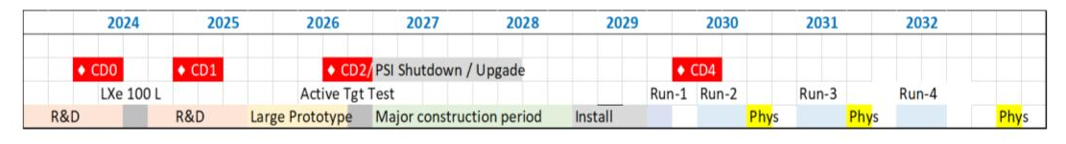
CDR/TDR Timeline
Conceptual Design Report (soon? Q1 2025?)
Physics case and experimental strategy
R&D roadmap, including sector tests
To inspire seed funding from regions
Technical Design Report (T minus 2-3 years? Q3-Q1 2026-27)
Engineering design
No or limited alternatives
To justify full funding of PIONEER 1.0
~1 year of R&D after CDR!

Slide 5
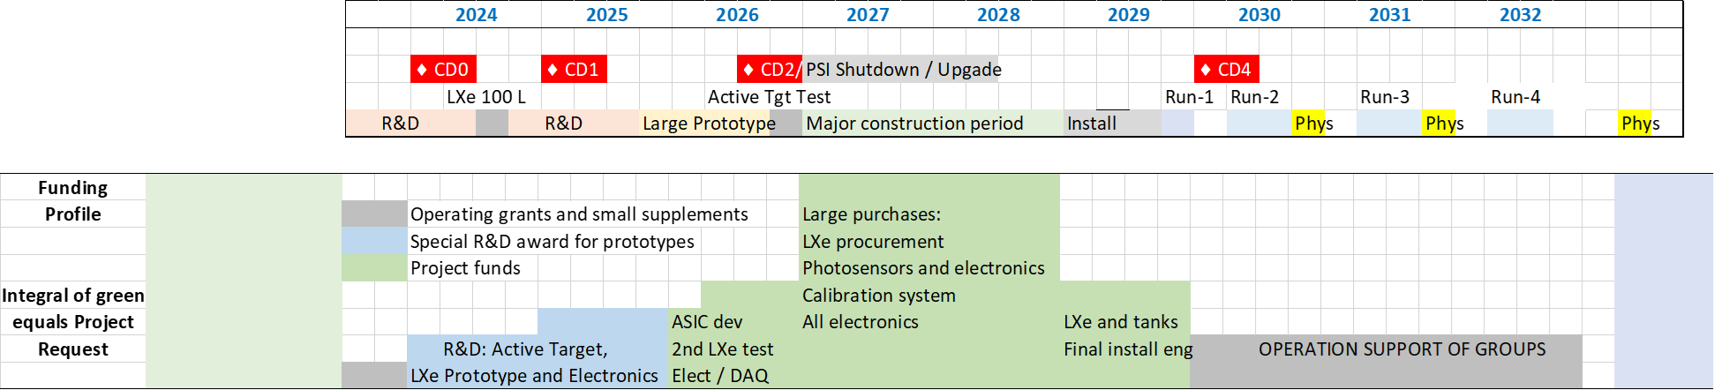
Timeline and budget: 2023 version; coarse view
~1 $M

Slide 6
Important dates impacting timeline
July 2024: Will learn about UBC prelim; will learn about UCSC/Cornell R&D grant; will learn about Cornell base grant (encouraging)
Early fall 2024: CENPA base grant submission. This is significant because g-2 will not “drive” the support of the Muon Group within the grant. The KY group will submit to NSF.
Dec 2024: CFI grant goes in as a full document if step 1 is successful.
Jan 2025: PSI report must be clear, with CDR level descriptions of how the experiment will perform and hardware choices made
July 2025: UCSC base grant submission

Slide 7
What is CDR all about?
Establish compelling Physics case
  eν_{e}
  π⁰eν_{e}
  aeν_{e}
  lν_{l}γ
  … ?
Lay out detection strategy, including alternatives
Establish plausibility, with clearly identified risks
Establish R&D path to address risks
Lay out performance demonstration milestones and timelines
Provide cost estimates

Slide 8
What is the Purpose of the CDR
No one has asked us for this document
PSI has asked for a Progress Report in January, but this would be much deeper and more comprehensive
The reasons for this are to
  Provide a document we can use to inspire funding and draw in new collaborators
  The exercise will force us to step back and identify risks, to focus our R&D, and identify and mend gaps in our thinking
Given the timeline and status of our effort, I believe this is a very important exercise for us

Slide 9
Straw CDR Outline
Physics Reach
Sensitivity studies
  eν_{e}
  π⁰eν_{e}
  aeν_{e}
  lν_{l} γ
Identified Risks
Summary of identified risks
Associated R&D plan
Plans and goals for PIONEER 0.5
Costs
R&D towards TDR
Envelope for full experiment (?)
  Engineering studies
  Construction
  Collaboration costs (travel etc.)
  Operation costs
  Personnel costs (students etc.)
Summary and Outlook
Introduction
Statement of Physics opportunities
  Rare pion spectrometer
  Universal technology (5D tracking)
Status of prior experimentation
Summary of main needs and outline of strategies
  PSI / beam
  Detector
Timelines
Content and structure of the collaboration
Basic Design Concept
Beam
ATAR
Calo
  LYSO
  LXe
DTAR/Tracker
Trigger strategies
DAQ

Slide 10
Personal Slide: Technical Coordinator Role
Can be significantly more active now. Possibilities include
Detector/Analysis “Whip”
  Push collaboration towards consensus paths when possible
  Oversee their implementation
Village Skeptic
  Step back and anticipate questions from agencies looking for an excuse not to fund us
  Invite and curate others’ skepticism
  “Show me” gadfly (e.g. have we thought hard enough about reducing the tail fraction?)
Regular meetings of Technical Board (how often?)
  Tentatively: Hertzog, Schumm, Mihara, Mazza, Gibbons, Buat, Kammel, Bryman, Soter
Individual meetings with sub-area leaders (depending on need)
  Help identify and strategize about risks
  Identify areas where support is needed
  Oversee work towards CDR

Slide 11
Other Thoughts
What can we work towards consensus on now?
  DAQ protocols (Apollo, PCE vs. Ethernet, …)
  Simulation baseline (maybe with alternatives for Calo, beam)
  ???
ATAR region getting very busy
  Could use engineering drawing of 2-3 alternatives
  Will almost certainly be needed for CDR
Need to discuss well-defined simulation goals for the CDR
  Feedback to detector groups best if by end of summer

Slide 12

Backup

Slide 13
Detailed Notional timeline & funding profile: 2023 version

Slide 14
U.S. and International approximate Scope division
  Active Target development and readout electronics (US)
  Calorimeter digital electronics (US)
  Trigger and DAQ (UK groups?)
  Calibration system for calorimeter (Italy?)
  Tracker system (US + TBD)
  Custom beamline elements (Switzerland)
  Calorimeter procurement (Canada, Japan, Switzerland, China?)
  Calorimeter photosensors, cabling, and power supplies (TBD)
  Beamline detectors and LH₂ charge-exchange calibration infrastructure (PSI, Italy)
  Local installation support at PSI
  Data storage at PSI

