Slide 1
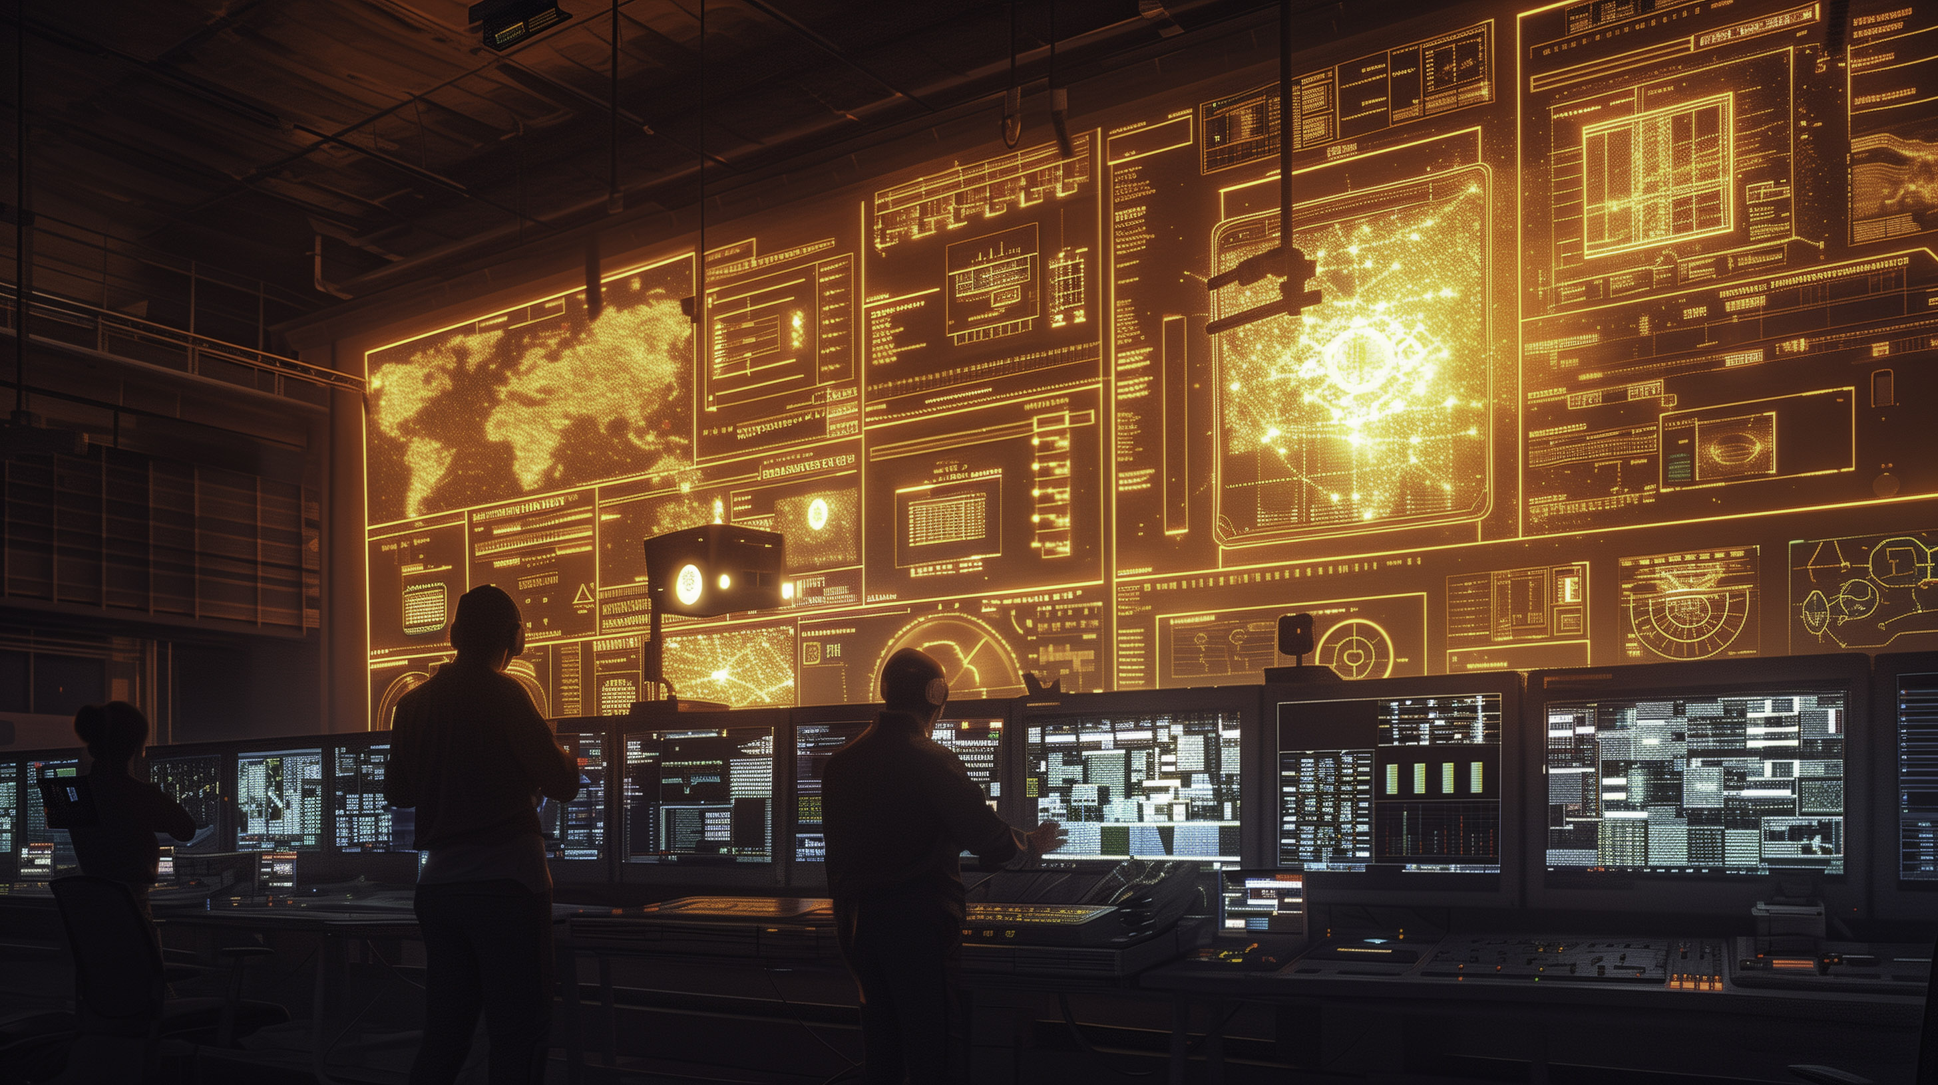
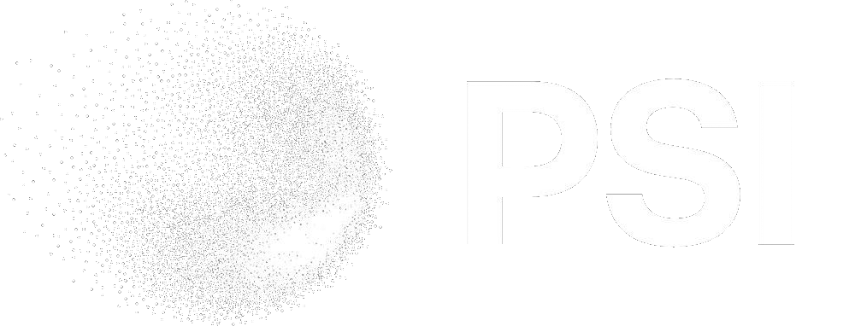
Rasmus Ischebeck
SwissFEL Run Coordinator Report
Rasmus Ischebeck
Rasmus ⊕ Midjourney

Slide 2
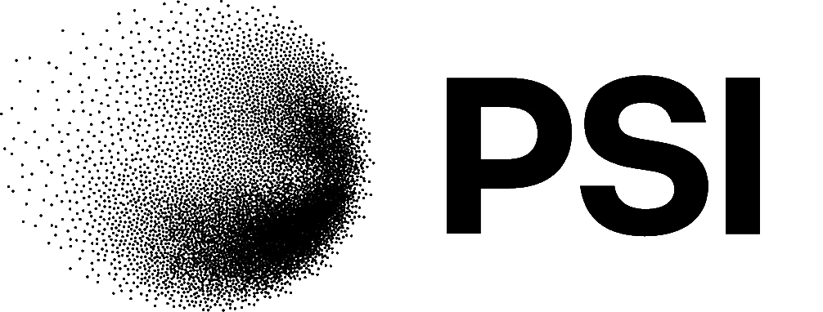
Week 19, 2024
Aramis:
  10 pC mode with single-spike operation for Cristallina
Athos:
  Machine development
  Maloia operation
Feedback on compression from monitor in the energy collimator chicane
Good stability during the week, some drifts during the weekend
Rasmus Ischebeck

Slide 3
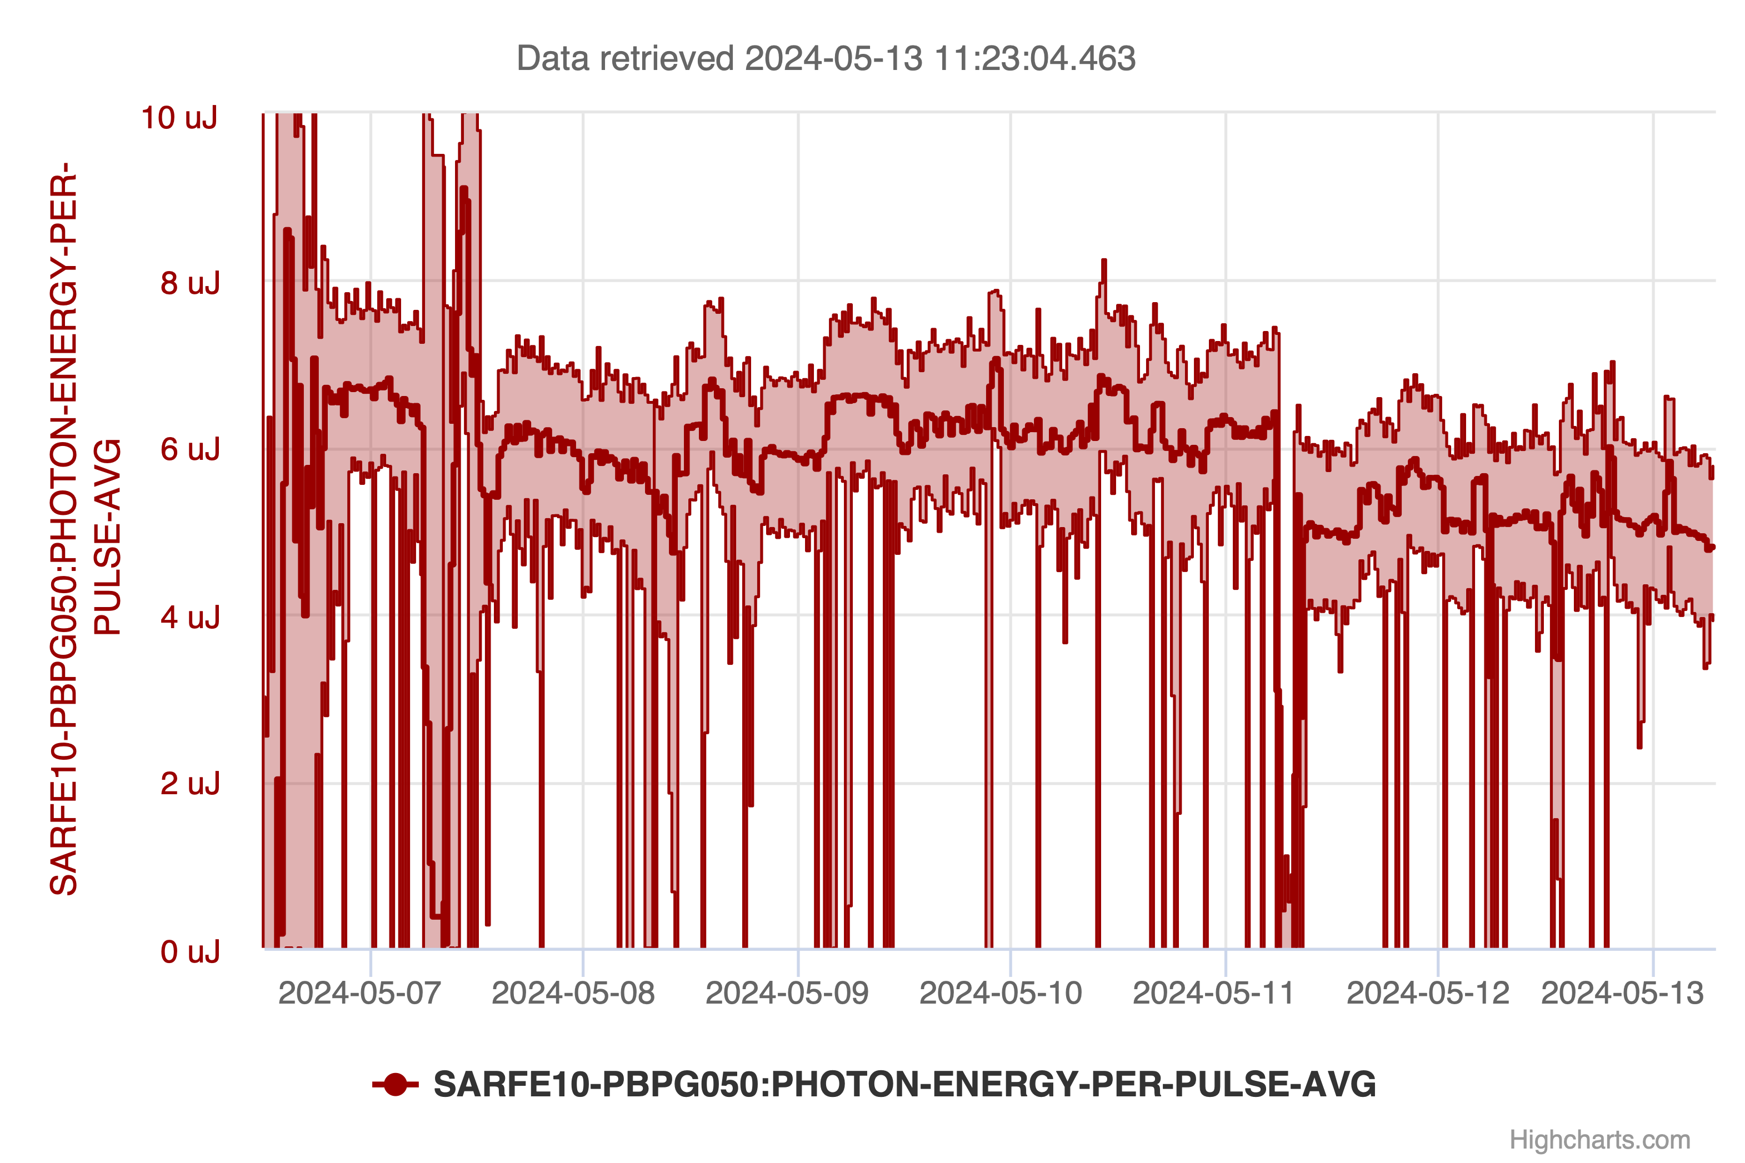
Aramis Performance
Rasmus Ischebeck

Slide 4
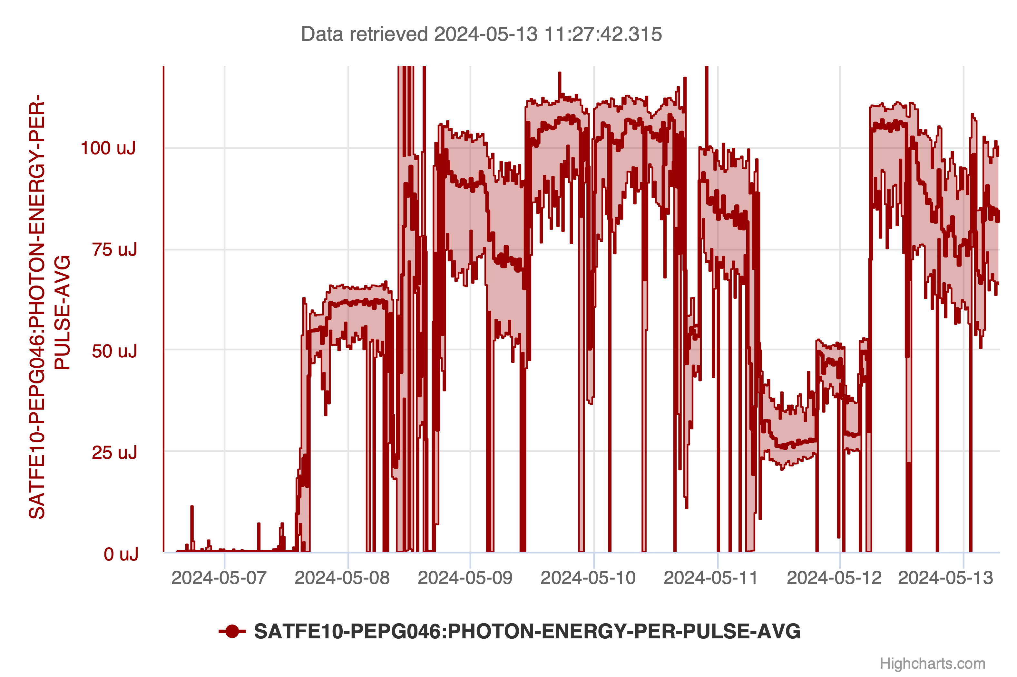
Athos Performance
Rasmus Ischebeck

Slide 5
Before Optimization
Rasmus Ischebeck
Eduard Prat

Slide 6
Single-Spike Operation
Rasmus Ischebeck
Eduard Prat

Slide 7
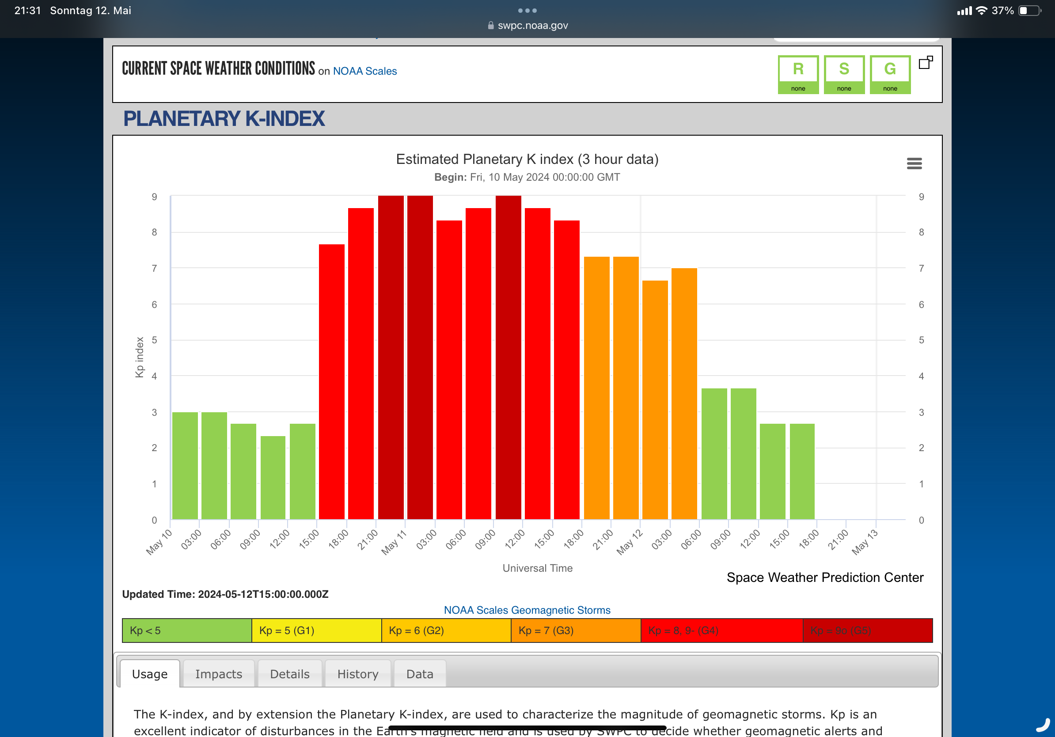
Stability Issues During the Weekend
Speculation: is there a correlation to the changes in Earth’s magnetic field in response to the solar storm?
Rasmus Ischebeck

Slide 8
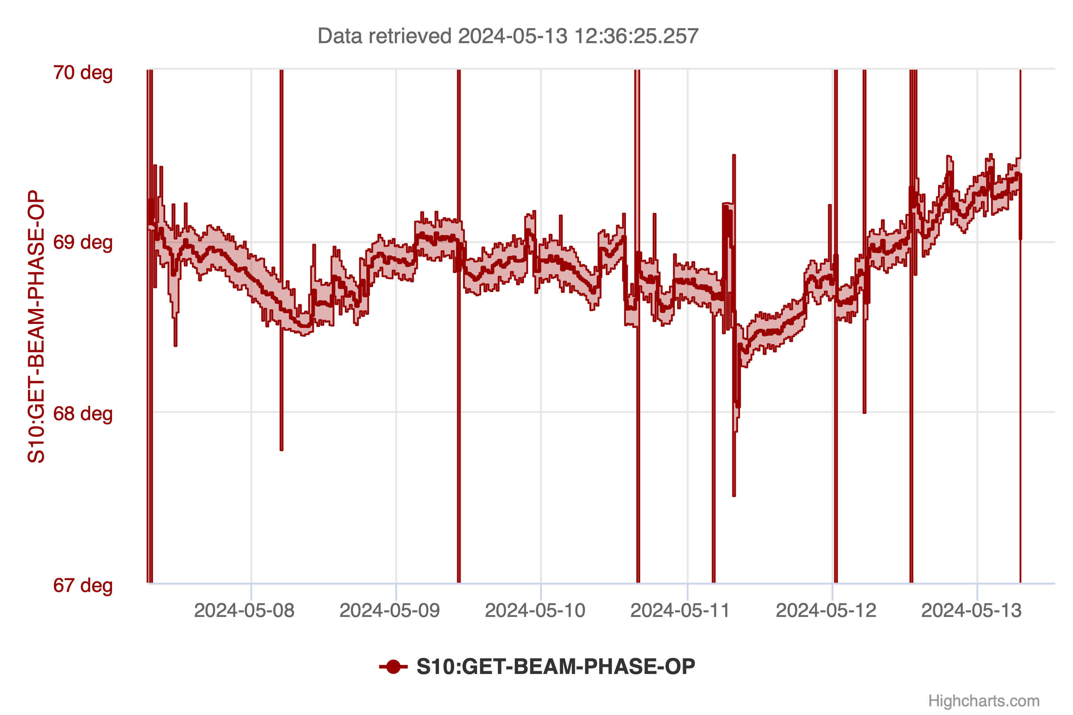
Linac 1 Phase
Rasmus Ischebeck

Slide 9
Northern Lights
Rasmus Ischebeck
Valeri B. / 20min.ch

