Slide 1
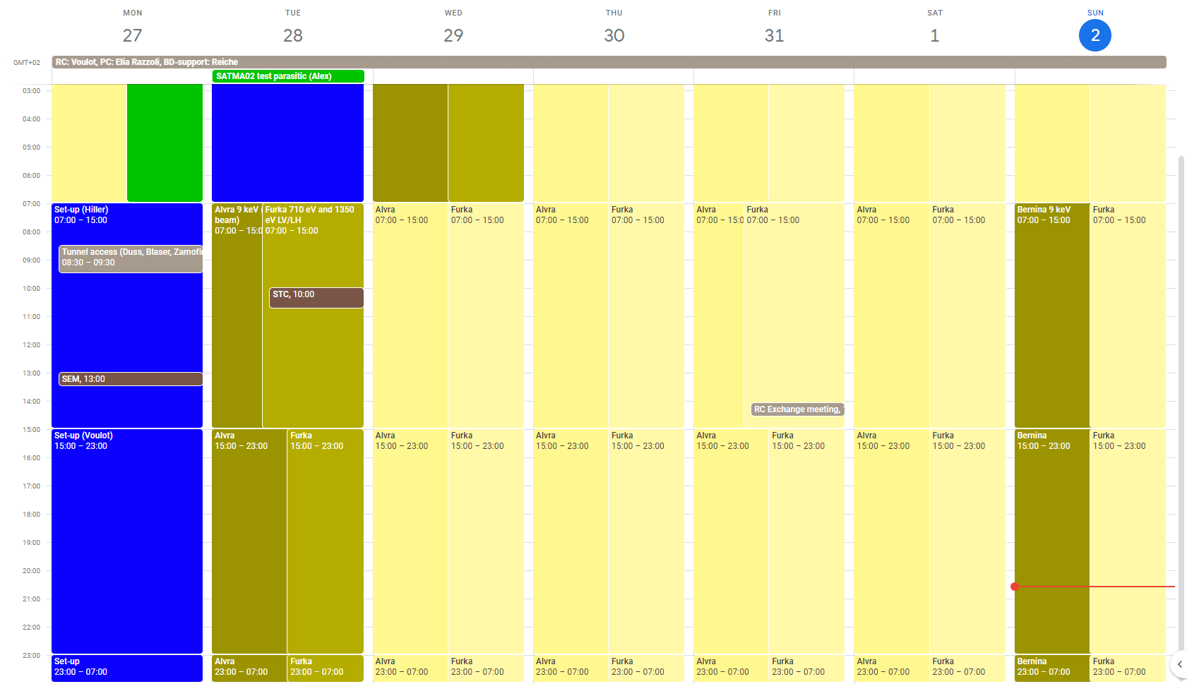
Aramis: Alvra 9 keV, Sunday Bernina
Athos: Furka 710 eV and 1350 eV LV/LH

Slide 2
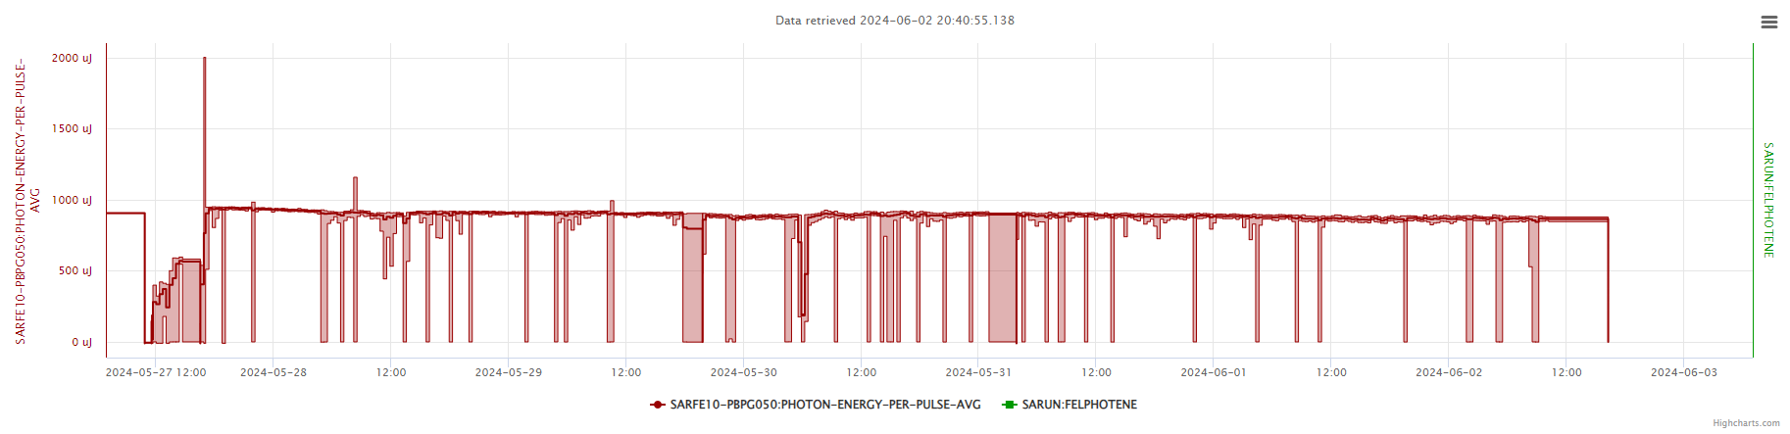
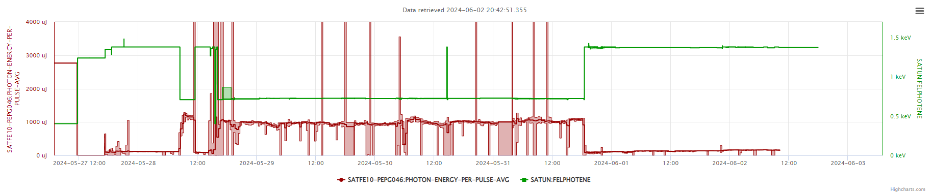
SARUN06 vacuum
SINSB02
Power cut

Slide 3
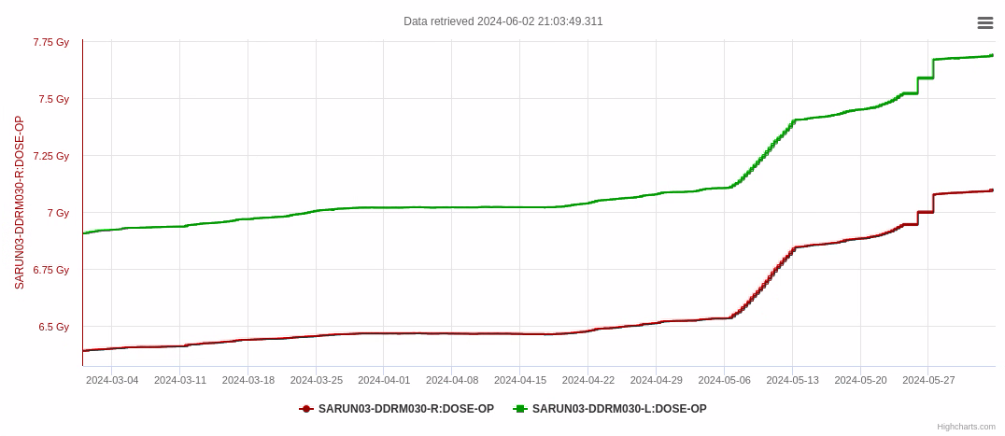
Losses
WSC moved
Increased losses
Spring shutdown
A wire-scanner was in the beam or very close to the beam (SARCL01-DWSC160) most likely since the spring shutdown. A new test WSC was installed in this position.
The losses increased strongly on May 6th. An inspection took place in the tunnel last Monday. Moving the WSC position cured the problem.
Action: check all WSC position calibration -> MD
Lesson learnt: take more precaution when installing new diagnostics in the machine…

Slide 4
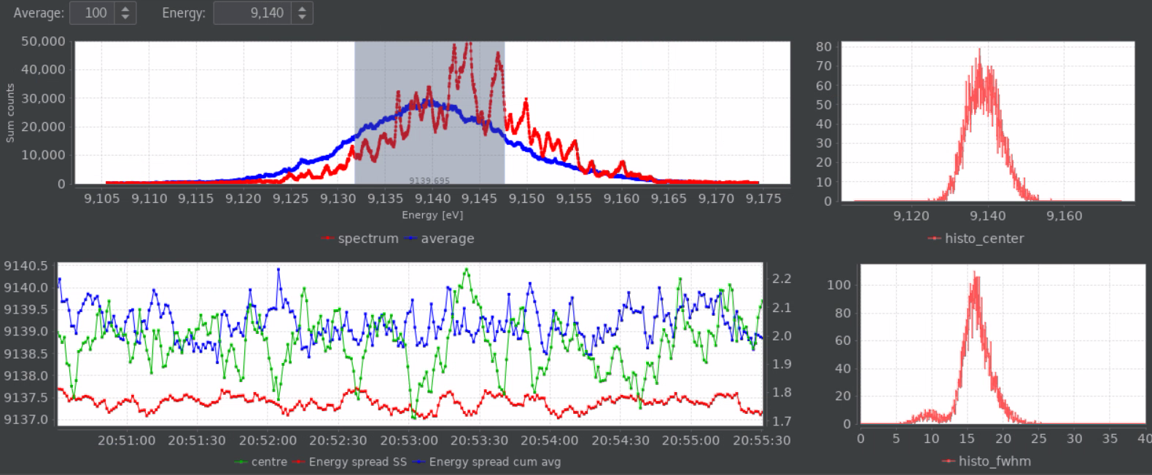
Set-up / problems
Aramis
9 keV 900 uJ (best perf. 1.15 mJ)
0.18% BW
Tried to run with PSSS energy feedback -> need to be improved the feedback does not handle correctly beam interruptions
Also attempted 2-point pointing feedback. More work needed on the PBPS channels.
Athos
1350 eV linear is challenging: modest performances 100-150 uJ (expect 500 uJ?)
710 eV LH/LV ~1 mJ -> we had much better performances in the past 2.5-2.7 mJ at this energy
Need to spend some time on high photon energy beams in Athos (and linear polarization)

Slide 5
Technical problems
Power cut on Sunday morning, could not restore the beam
Network problems affecting RF, PSYS, DRPS (could not connect to the server)
Vacuum could not be restarted, apparently some equipment (gauges?) was damaged
Problems with T&S
Other issues
Archiver down, too many channels archiving at high rates… (the new archiver is almost ready to go)
Periodic drops in Athos pulse energy correlated with BC2 compression feedback -> problem with the monitor (range limit) or changes in RF leading to different compression in the dogleg
Vacuum problem on SARUN06 on Wednesday (2h)
SINSB02 on Friday (3h)

