Slide 1
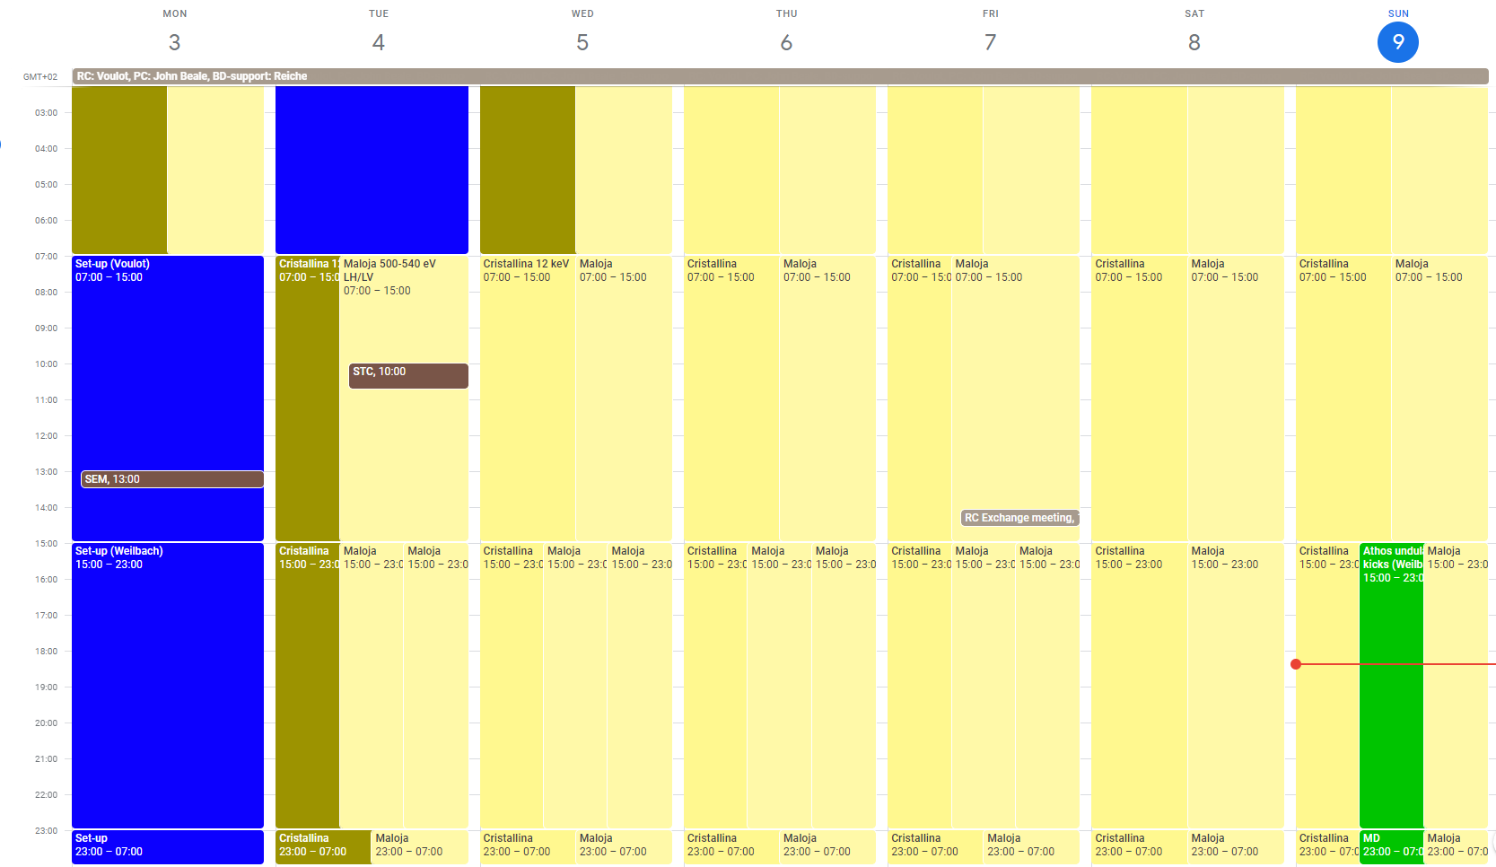
Aramis: Cristallina 12 keV (11 keV)
Athos: Maloja 500-540 eV LH/LV (5 Athos MD shifts converted to user operation)

Slide 2
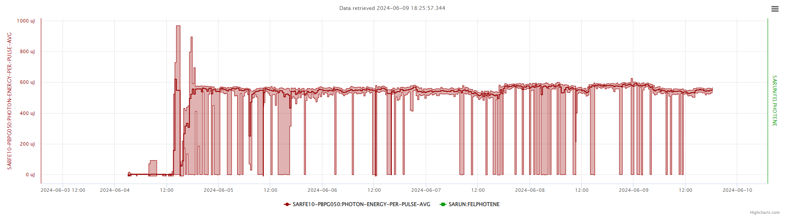
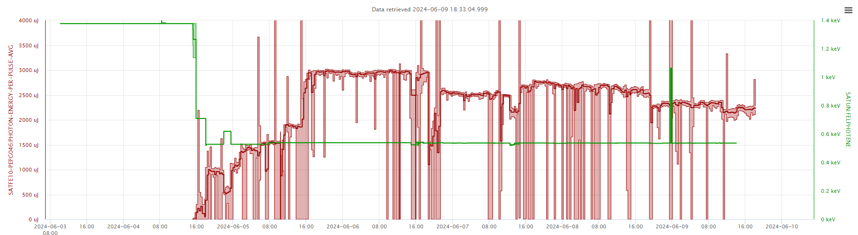
Recovery
Set-up
Recovery
Set-up
Tunnel access for DRPS

Slide 3
Power cut
Failure on the 50 kV line feeding PSI on Sunday 2.6 at 10h30
Full power cut: the control room was in the dark for about 20 min, only access to few consoles with UPS
Many system suffered hardware damages: Vacuum, Network, T&S, RF, laser, DRPS, PSYS, undulator motors…
Some failures were only discovered late in the recovery process, leading to more delays:
Undulator motor failure Monday (tunnel access on Tuesday)
DRPS detectors on Tuesday (tunnel access on Wednesday)
Difficult to assess the situation, the recovery could have been mor efficient e.g. RF and laser piquet could not really do anything until the network, vacuum and T&S was restored. Some diagnostics and procedure should be improved for such situations.
Aramis was back and set-up on Tuesday 18:30
Athos fully recovered on Wednesday 10:45 (fully optimized 16:30)
Almost all possible piquets have been called, many colleagues worked long hours between Sunday and Monday, priorities have been shifted to free some manpower for SwissFEL…
Many thanks for their support to all groups involved!

Slide 4
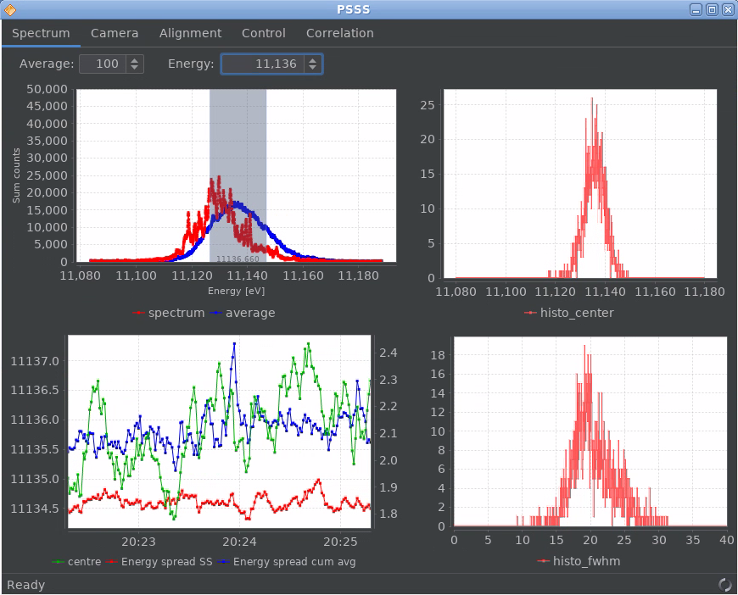
Set-up
Aramis
11 keV (12 keV was planned, Cristallina proposed to lower the energy to speed up the set-up)
550-600 uJ (peak perf.: 1.1 mJ (2022) -> not so bad given the circumstances)
BW 0.18% / 11.13 keV
Athos
3 mJ at 510 eV LH / 2.5 mJ LV+
Some difficulties with polarity switching, due to different undulator kicks
Difficult to restore full performance at each polarization change (down to 2.3 mJ LH during the weekend, also due to energy scanning)

Slide 5
Technical problems
Downtimes
SINSB03 several interruptions (2h in total)
S30CB12 (Friday night, 1h in total)
Vacuum problems in Linac1 (Saturday)
Other issues
None?

