Slide 1
SwissFEL RC report, week 24, G.L. Orlandi

Slide 2
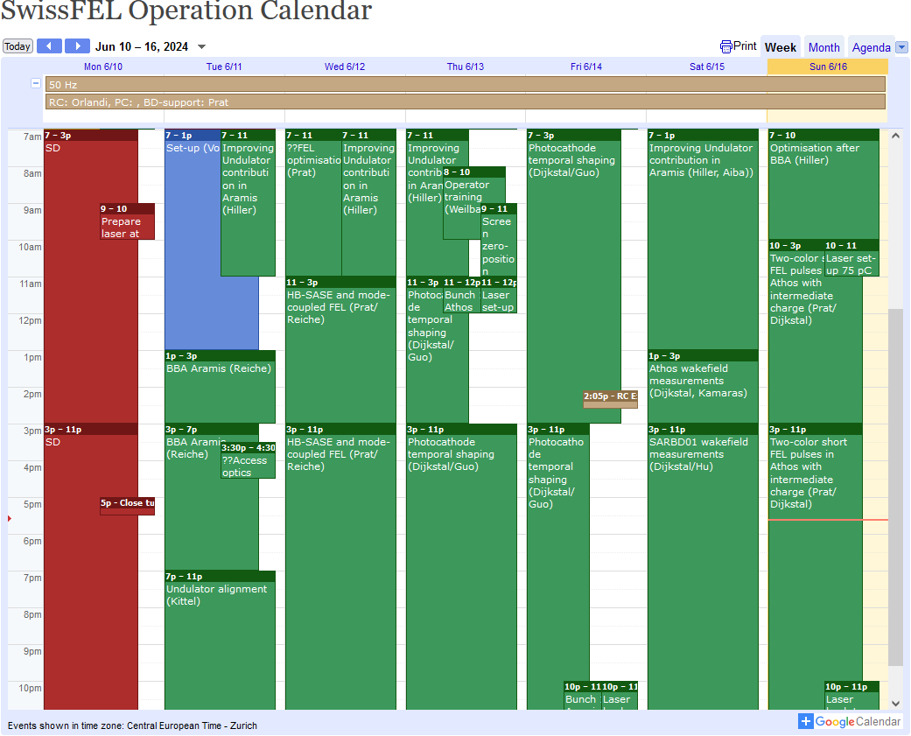

Slide 3
MD activities
Mo 10.06, service day
Tue 11.06, Morning, machine set-up:
            Aramis 11 keV 300 uJ (S30CB13 not on beam)
            Athos 2.8 mJ 540 eV C+
Tue 11.06, Late morning-Evening: BBA Aramis
Wed 12.06 Morning: Mode-Coupled (MC) and High-Brightness (HB) SASE studies in Athos:
  Measured MC-SASE at 570 eV and 1 keV for different delays.
  Measured HB-SASE vs SASE for 570 eV.
Thu 13.06, DSCR position calibration
Thu 13.06-Fri 14.06, Photocathode temporal shaping (2-bunches in Athos)
Sa 15.06 Morning, Aramis BBA
Sa 15.06 Afternoon, Wakefield measurements in Athos:
    Perform measurements with and without horn cutting, and for different pulse durations.
Sa 15.06 Evening, Wakefield measurements in Aramis:
    Wakefield measurements of corrugated structure after slotted foil insertion
    Horn cutting
    Wakefield measurements with and without foil
Su 16.06 Morning, Aramis: lasing optimization after BBA
Su 16.06 Morning, Athos: 10 pC set-up ➔ possibility to run Athos (10 pC,sub-fs pulses) in parallel with Aramis (200pC)
Su 16.06 Afternoon-Evening, Two-color short pulse set-up and measurements with various charges➔MC-SASE and HB-SASE studies in Athos, repeat measurements done on Wed 12.06 with a better signal-to-noise ratio of the spectrometer
Machine issues
Thu 13.06, DRPS alarm issue with SATMA01-DSCR030 at 1Hz (Eike Hohmann informed)
Fri 14.06, issue HERO modulator motors got stuck, power cycling needed with tunnel access (to be scheduled)

