Slide 1
High-Brightness, Mode-Coupled and Mode-Locked SASE in Athos
SwissFEL Progress Meeting
Eduard Prat and Wenxiang Hu
PSI, 2 July 2024

Slide 2
Agenda
The concept
The modes in Athos and setup
Experimental results
Conclusion

Slide 3
Agenda
The concept
The modes in Athos and setup
Experimental results
Conclusion

Slide 4
Time
The concept I
Needs laser
Frequency
Standard SASE
Enhanced SASE
Needs CHIC
Mode-Coupled SASE
(MC-SASE)
Mode-locked SASE
(ML-SASE)

Slide 5
The concept II
MC-SASE
All CHICs set at same delay
(many sidebands)
High-Brightness SASE
(HB-SASE)
CHICs set at different delays
(one sideband)

Slide 6
The concept III
simulations
HB-SASE, MC-SASE and ML_SASE require intra-undulator chicanes
MC and ML-SASE: frequency comb separation corresponds to chicane delay → it is tunable!
ML-SASE requires also an optical laser (with same period as chicane delays+slippage)
Because of optical klystron effect, these modes saturate earlier than standard SASE

Slide 7
Agenda
The concept
The modes in Athos and setup
Experimental results
Conclusion

Slide 8
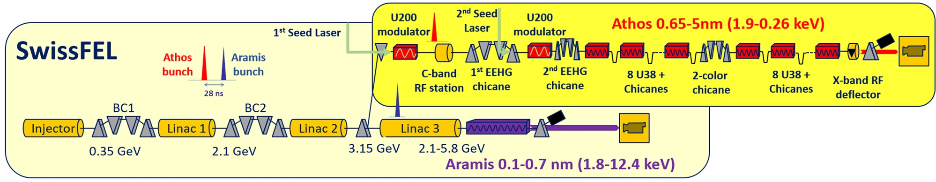
The modes in Athos
All modes require intra-undulator chicanes → unique in Athos!
Chicanes with tunable delays up to ~6 fs
Laser period is 2.67 and 0.89 fs (800 and 266 nm)
Main diagnostic: spectrometer (PMOS)

Slide 9
Setup
Requirements:
  Gain length ≥ module length
  Small slice energy spread
  Minimum energy chirp
Solution for proof-of-principle experiment → single stage compression to 500 A
  Energy spread reduced (from >1 MeV to ~0.3 MeV)
  Flexibility to compensate the chirp with linac 1 phase
  Gain reduced due to reduced current
Chicane delays set from high to low values to take advantage of optical klystron and avoid overbunching.
Tried many configurations
Phase matcher important for best results

Slide 10
Agenda
The concept
The modes in Athos and setup
Experimental results
Conclusion

Slide 11
Measurements overview
February 18 (500 eV): https://elog-gfa.psi.ch/SwissFEL+commissioning/32430
  Demonstration of MC-SASE: frequency combs with variable separation
  Demonstration of HB-SASE (BW improvement by a factor ~2)
  Results presented in previous SPM: https://indico.psi.ch/event/15946/
March 10 and May 8 (attempt at 10 pC operation, not very successful due to large energy spread): https://elog-gfa.psi.ch/SwissFEL+commissioning/32750 and https://elog-gfa.psi.ch/SwissFEL+commissioning/33496 .
March 17 (510 eV): https://elog-gfa.psi.ch/SwissFEL+commissioning/32866:
  HB-SASE: BW improvement by a factor of 2.5, much less sidebands than in Feb 18.
May 15 and 16 (500 eV): https://elog-gfa.psi.ch/SwissFEL+commissioning/33578 & https://elog-gfa.psi.ch/SwissFEL+commissioning/33597
  ML-SASE: some indications, but not a full proof
June 12 (580 and 1000 eV): https://elog-gfa.psi.ch/SwissFEL+commissioning/34129:
  MC-SASE for 570 and 1 keV
  HB-SASE at 570 eV. BW improvement by up to a factor of 3.
June 16 (580 eV): https://elog-gfa.psi.ch/SwissFEL+commissioning/34182
  Repetition of MC-SASE and HB-SASE, equivalent results as June 12 but better signal to noise ratio

Slide 12
PMOS resolution and calibration
Main diagnostics for these modes, a must!
Excellent PMOS resolution during most of the shifts → can resolve theoretical BW of ~ 0.2 eV.
Lesson learnt: resolution depends on source point → worse resolution when doing MC/HB-SASE with 1st part of the undulator
Still, resolution may limit obtained results and it is not sufficient for EEHG
According to expectations from MC/ML-SASE, calibration could be sometimes wrong up to 20-30%

Slide 13
MC-SASE and HB-SASE (June 16)
MC-SASE: spectrum gets broader and has combs
HB-SASE selects one of the combs
BW (rms):
  SASE: 0.913± 0.161eV
  HB-SASE: 0.306±0.062 eV
  Factor of 3 reduction
Expect about a factor of ~5 improvement. Reasons to not get this:
  Suboptimal chicane delays
  Residual energy chirp
  PMOS resolution

Slide 14
Shorter saturation length with HB-SASE
HB-SASE: saturation length reduced by 35-40% with respect to SASE.
Improvements larger than in standard operation thanks to reduced energy spread

Slide 15
MC-SASE for different delays (February 18)
Separation and number of combs can be tuned with the delay
  400 nm delay: 3 modes with 2.23 eV separation
  1400 nm delay: ~10 modes with 0.74 eV separation
Measured combs separation fits expectations within 10%.

Slide 16
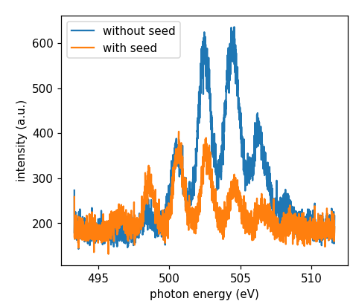
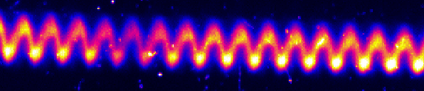
ML-SASE
Seed laser: 800 nm, 4.2 mJ, 425 fs (FWHM). Induced energy spread to the electron beam: 0.4 MeV -> 4 MeV.
Indications that we had ML-lasing:
  Photon energy changes consistently with laser power (restricted lasing part changes energy)
  With laser on, signal decreases when chic delay goes away from matching condition
  With laser on, photon energy separation between combs is more robust against delay changes
But no clear evidence that we had a train of short pulses in time domain … despite we could clearly see the beautiful energy modulation in time domain!
E
time

Slide 17
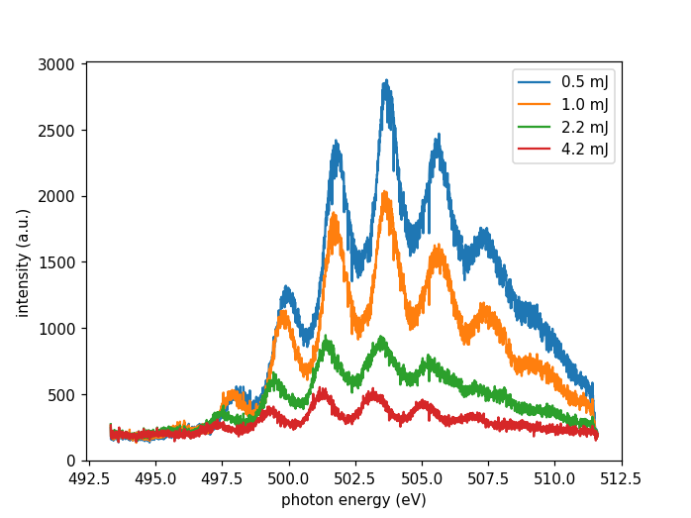
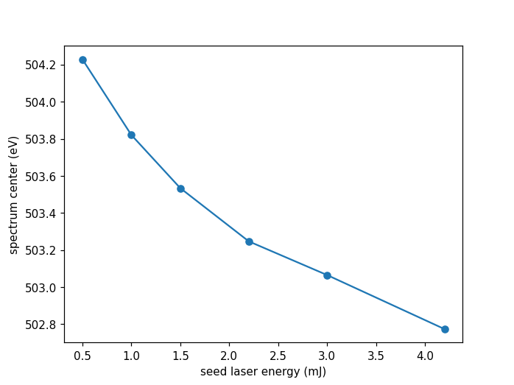
ML-SASE: seed laser energy scan
  Intensity reduction when increasing laser energy (A): seems to imply the lasing part gets more limited
  Change in photon energy (fig. B) matched with expected variation.
    4.2 mJ seed laser power corresponds to 4 MeV energy spread. 4 MeV / 3 GeV = 0.13%. This corresponds to ~0.26% change in photon energy.
    We observe a reduction of photon energy by equivalent amount → Implies a limitation of lasing part, towards the bottom of the sinusoidal modulation.
(A)
(B)

Slide 18
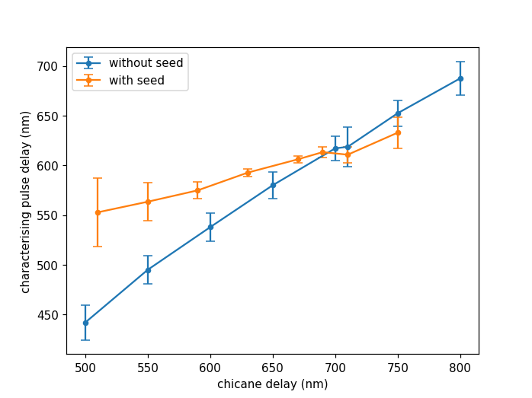
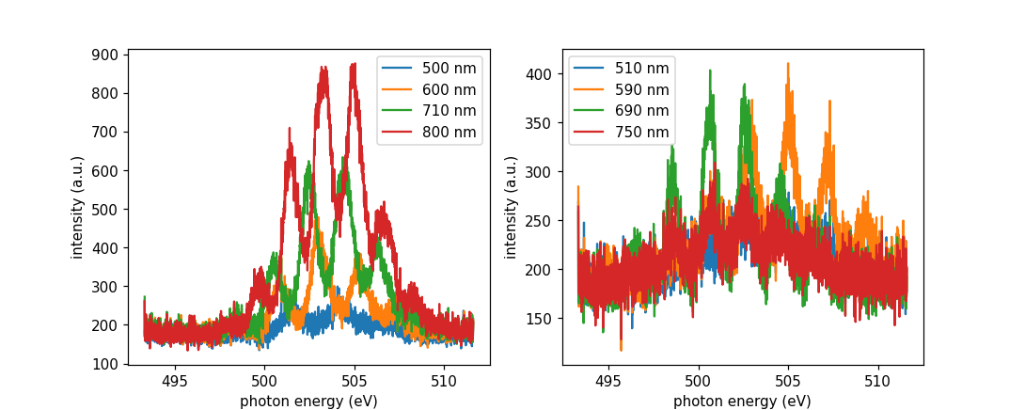
ML-SASE: chicane delay scan
The resonant condition for mode-locked lasing should correspond to 670 nm
Chicane delay = Seed laser wavelength (800 nm) - Slippage (52*2.48 nm)
Indications of mode-locked lasing when changing chicane delays:
  Intensity is more dependent on the delay, has maximum around expected value
  Photon energy separation between combs is more robust against delay variations
Without seed laser
With seed laser
Measured pulse delay is 30% off from PMOS calibration

Slide 19
Agenda
The concept
The modes in Athos and setup
Experimental results
Conclusion

Slide 20
Conclusion
Summary
HB/MC/ML-SASE improve the longitudinal coherence of SASE-FELs by producing frequency combs and narrow BW pulses
They use intra-undulator chicanes, unique in Athos
We have demonstrated MC-SASE and HB-SASE
Observed indications of ML-SASE but not a full proof yet
Outlook
Improve HB/MC-SASE performance (improve energy chirp and optimization procedures, have even better diagnostics)
Proof ML-SASE → phase sensitive diagnostics
Use these modes in experiments?
Thanks to everyone involved!

