Slide 1


Bruker Strand: $I_{C}$ vs. $ε_{B}$ Results - Update
J. Greenwood
25.06.2024

Slide 2
Overview
Summary of results from first set of measurements
Results for barrels re-measured last week
Next steps

Slide 3
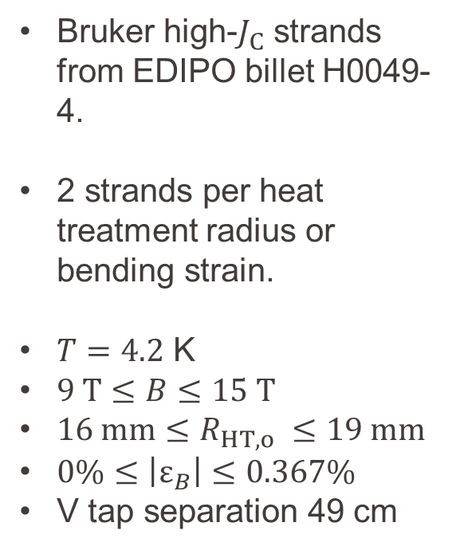
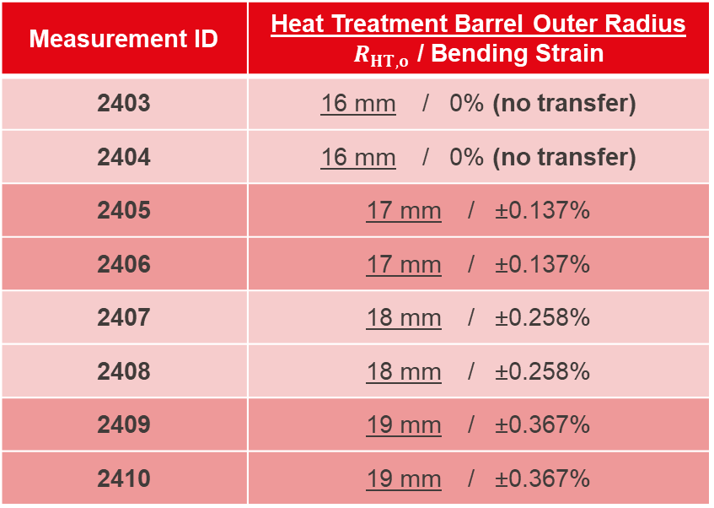
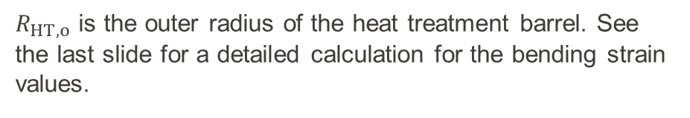
Summary of measurements performed
Measurement ID | Heat Treatment Barrel Outer Radius $R_{HT,o}$ / Bending Strain
2403 | 16 mm / 0% (no transfer)
2404 | 16 mm / 0% (no transfer)
2405 | 17 mm / ±0.137%
2406 | 17 mm / ±0.137%
2407 | 18 mm / ±0.258%
2408 | 18 mm / ±0.258%
2409 | 19 mm / ±0.367%
2410 | 19 mm / ±0.367%
Bruker high-$J_{C}$ strands from EDIPO billet H0049-4.
2 strands per heat treatment radius or bending strain.
$T=4.2$ K
$9 T≤B≤15 T$
${16 mm≤R}_{HT,o} ≤19 mm$
$0\%≤\left|ε_{B}\right|≤0.367\%$
V tap separation 49 cm
$R_{HT,o}$ is the outer radius of the heat treatment barrel. See the last slide for a detailed calculation for the bending strain values.

Slide 4
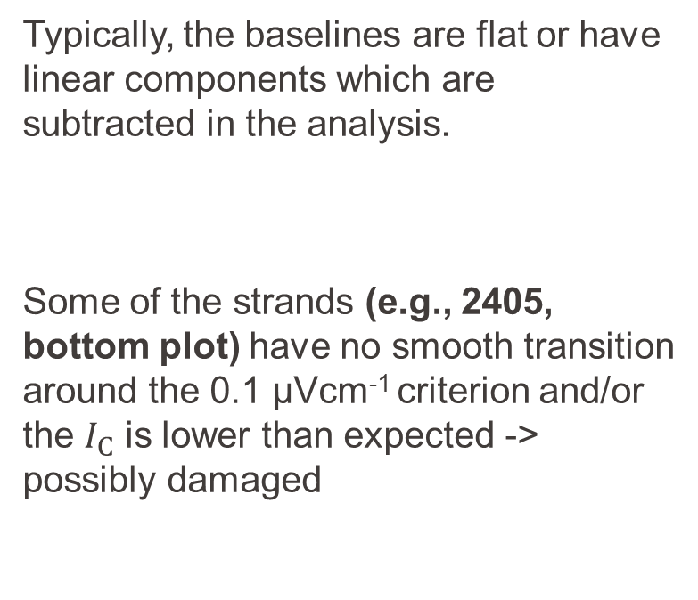
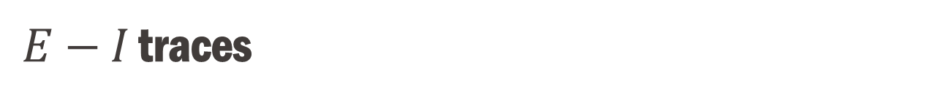
$E−I$ traces
Typically, the baselines are flat or have linear components which are subtracted in the analysis.
Some of the strands (e.g., 2405, bottom plot) have no smooth transition around the 0.1 μVcm⁻¹ criterion and/or the $I_{C}$ is lower than expected -> possibly damaged

Slide 5
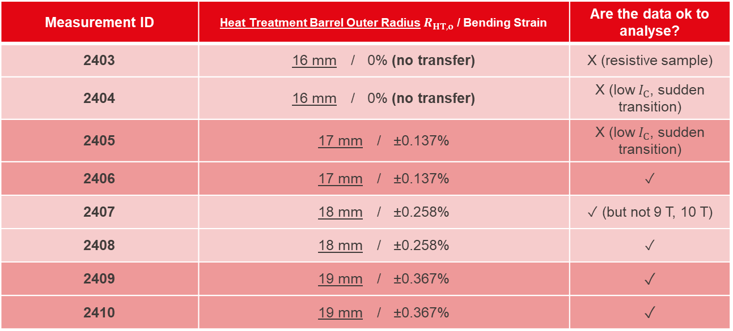
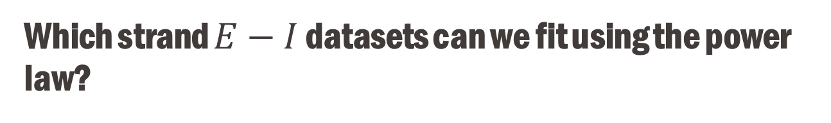
Which strand $E−I$ datasets can we fit using the power law?
Measurement ID | Heat Treatment Barrel Outer Radius $R_{HT,o}$ / Bending Strain | Are the data ok to analyse?
2403 | 16 mm / 0% (no transfer) | X (resistive sample)
2404 | 16 mm / 0% (no transfer) | X (low $I_{C}$, sudden transition)
2405 | 17 mm / ±0.137% | X (low $I_{C}$, sudden transition)
2406 | 17 mm / ±0.137% | ✓
2407 | 18 mm / ±0.258% | ✓ (but not 9 T, 10 T)
2408 | 18 mm / ±0.258% | ✓
2409 | 19 mm / ±0.367% | ✓
2410 | 19 mm / ±0.367% | ✓

Slide 6
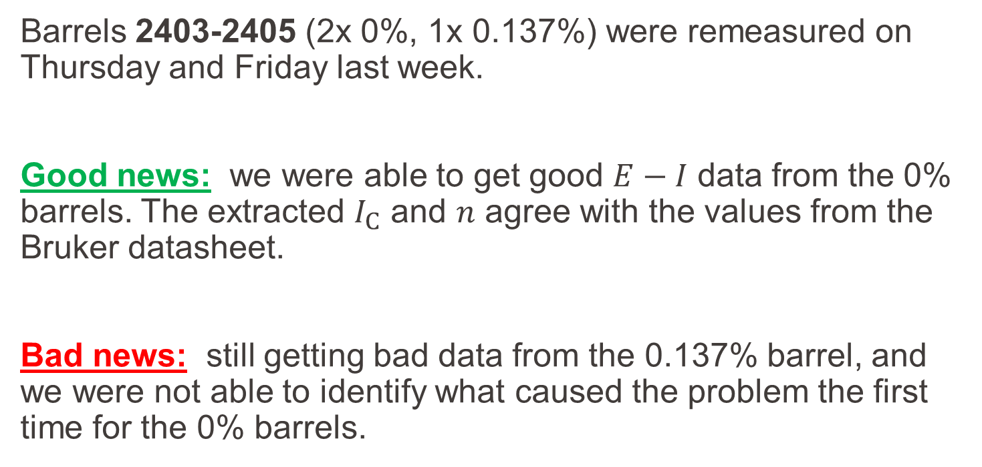
New results
Barrels 2403-2405 (2x 0%, 1x 0.137%) were remeasured on Thursday and Friday last week.
Good news: we were able to get good $E−I$ data from the 0% barrels. The extracted $I_{C}$ and $n$ agree with the values from the Bruker datasheet.
Bad news: still getting bad data from the 0.137% barrel, and we were not able to identify what caused the problem the first time for the 0% barrels.

Slide 7
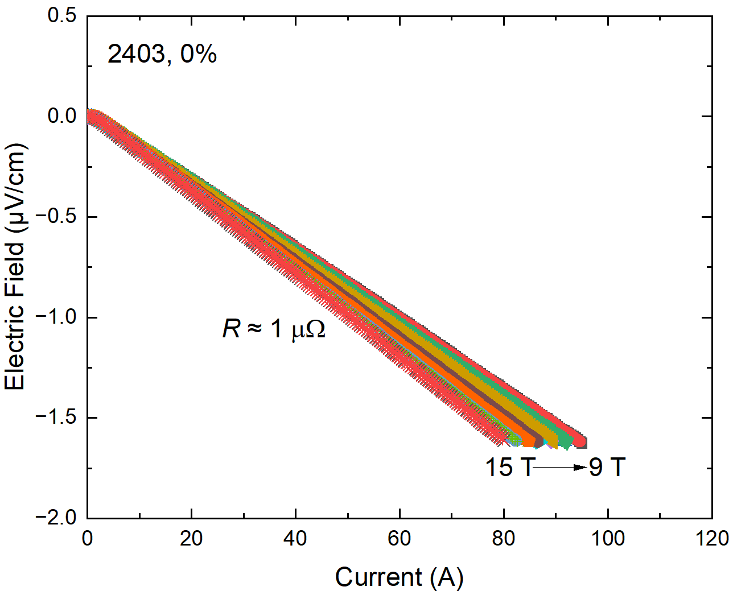
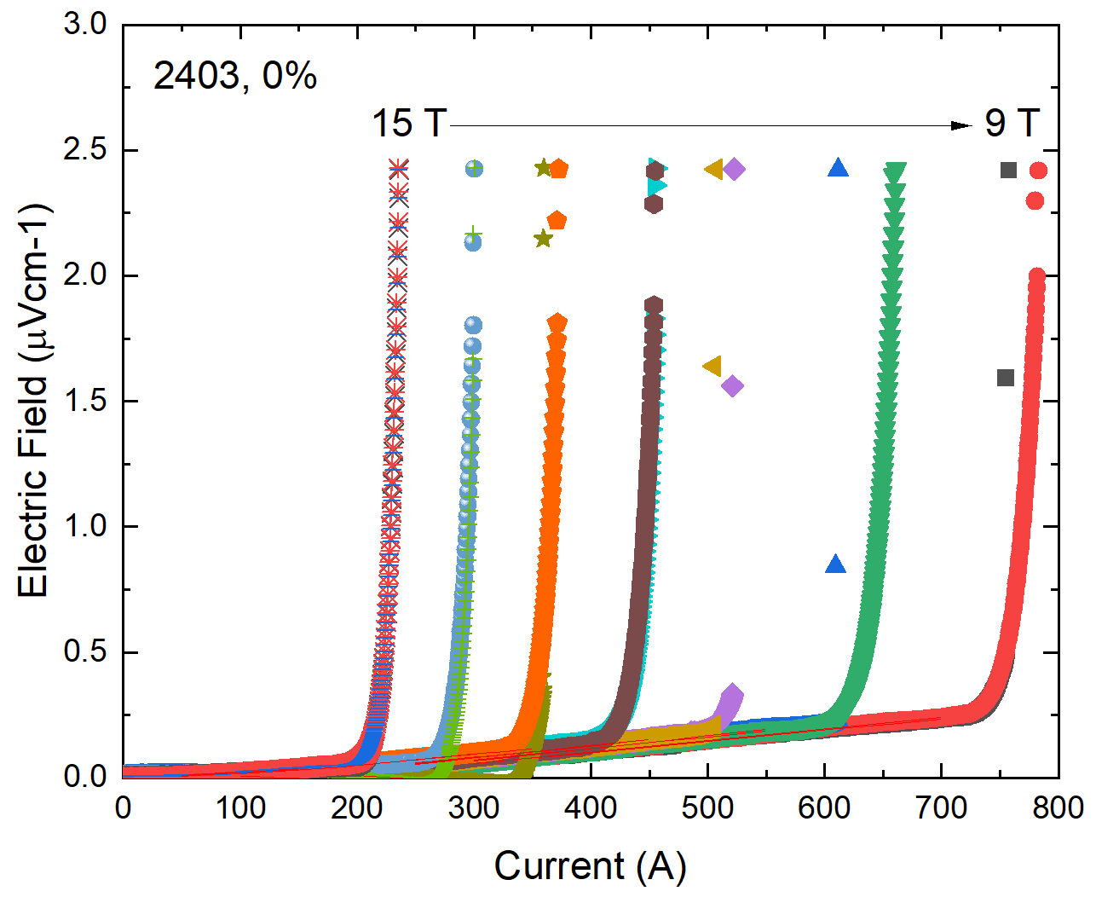
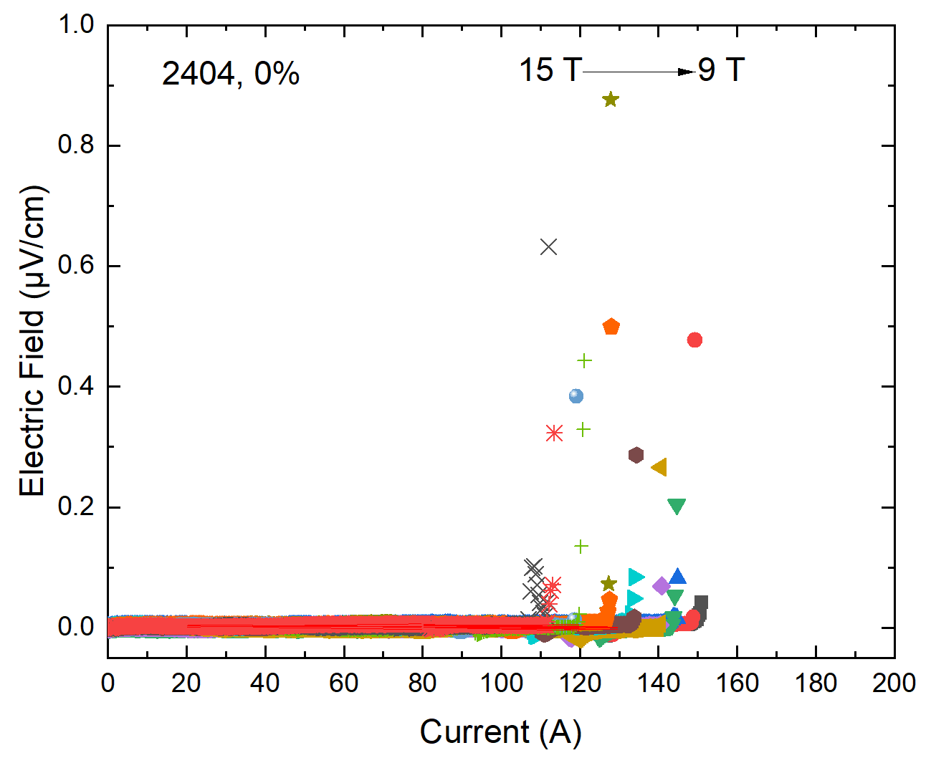
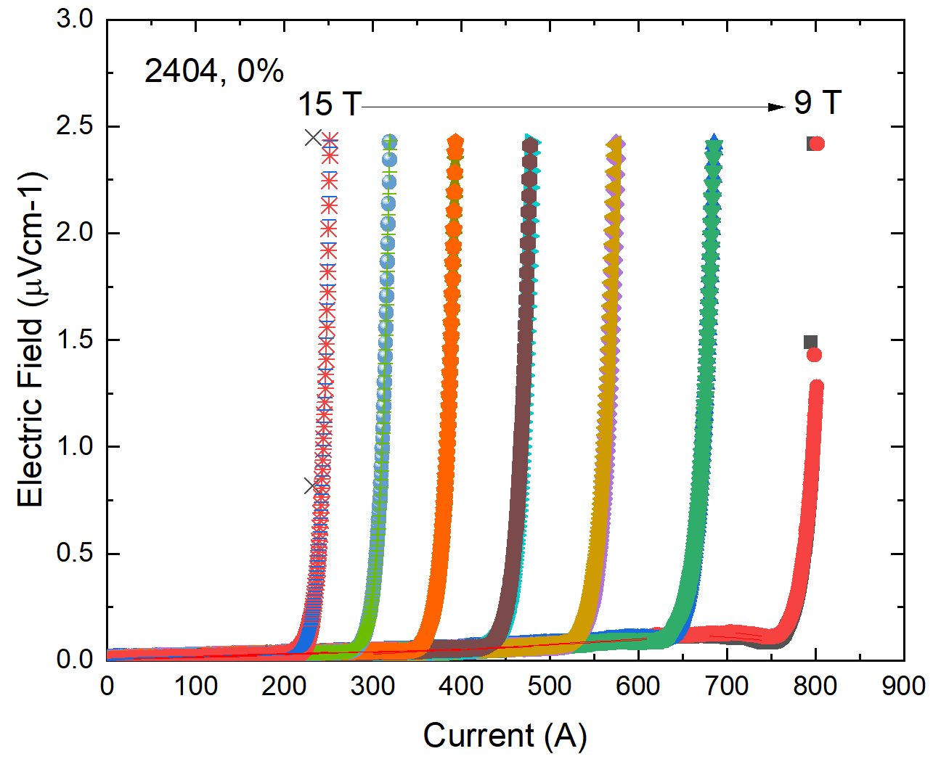
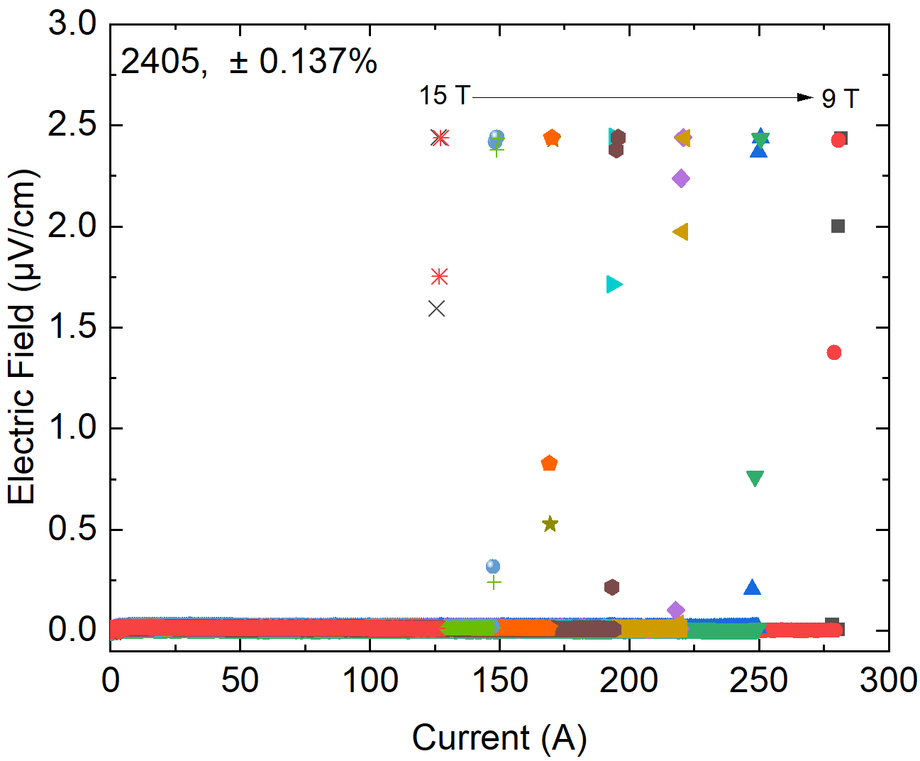
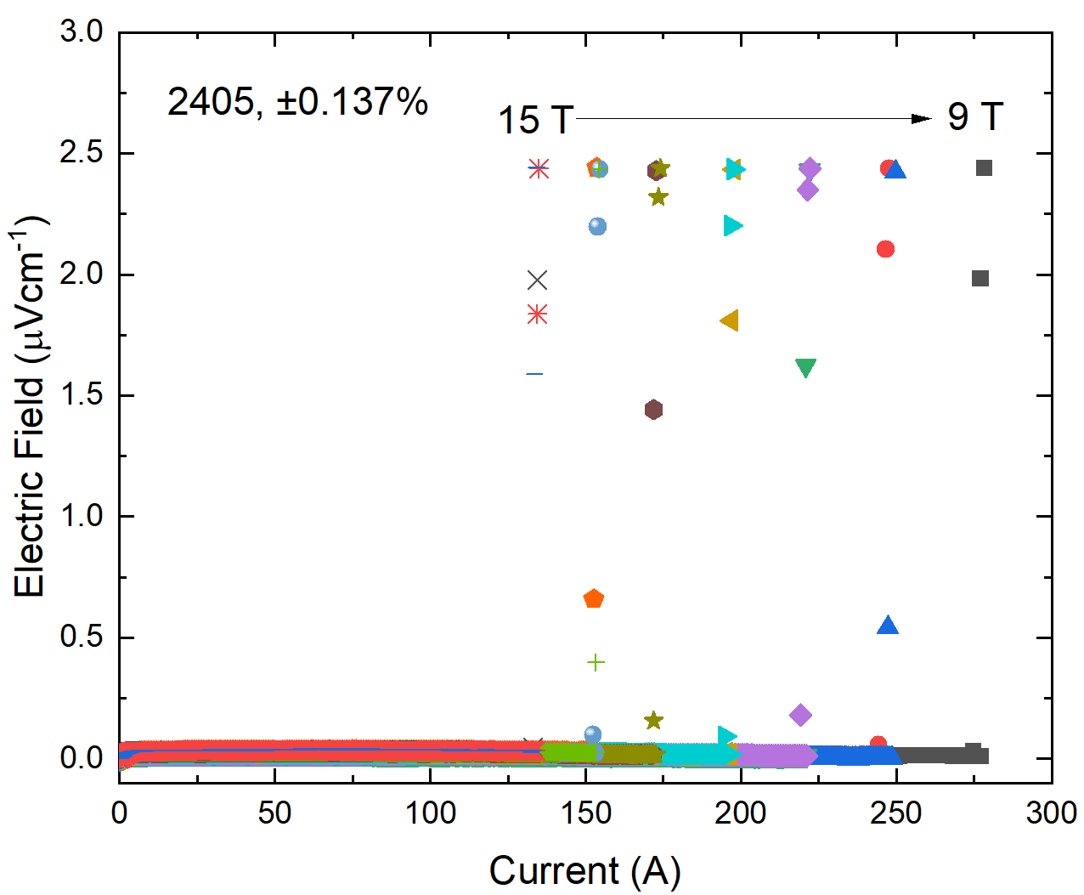

Comparison
Barrel ID and strain | First Measurement | Second Measurement
2403, 0%
2404, 0%
2405, ±0.137%
Resistive
Setup problem not present
Low $I_{C}$, sudden transition
Still transitioning early at the exact same currents, to within ~1%
Low $I_{C}$, sudden transition

Slide 8
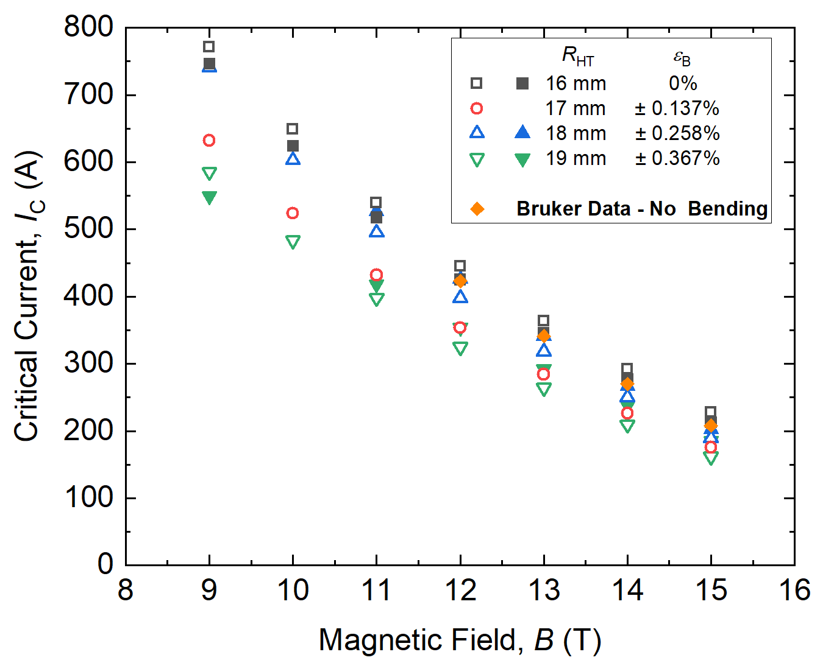

New $I_{C}(B)$

Slide 9
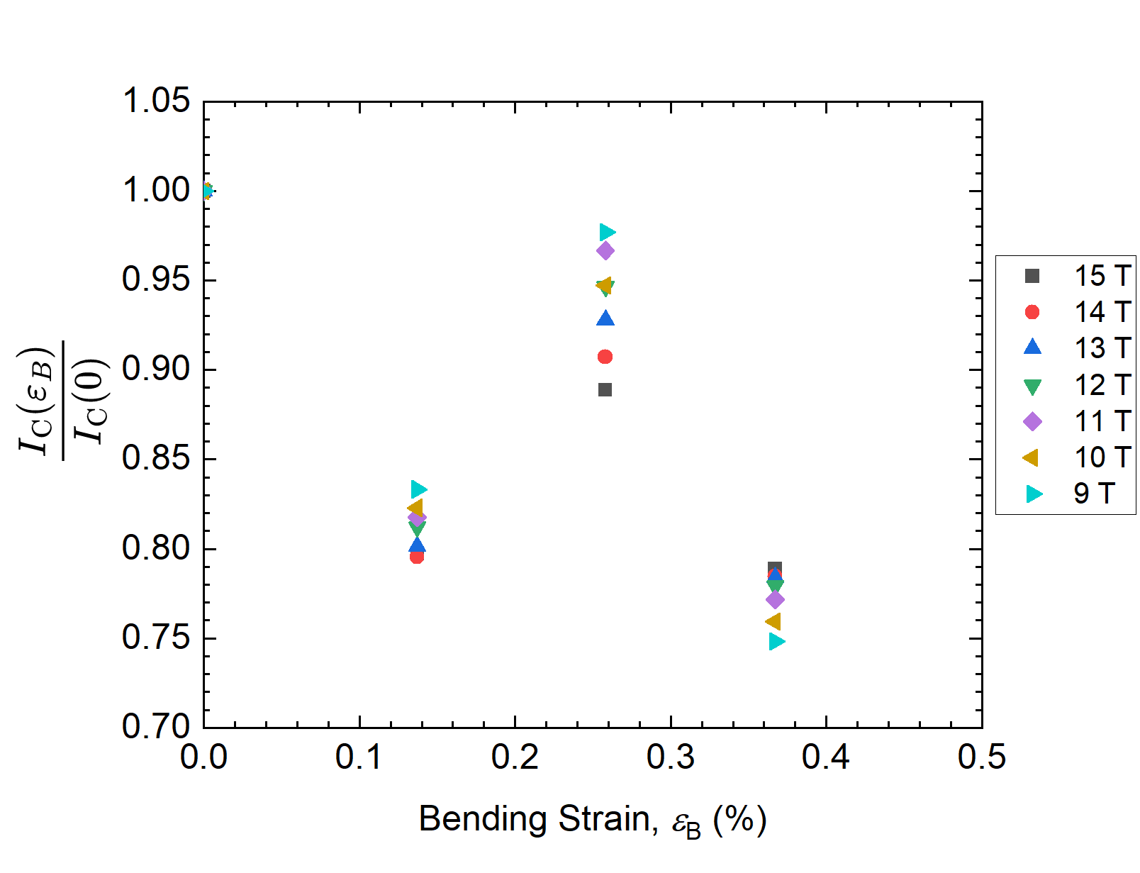
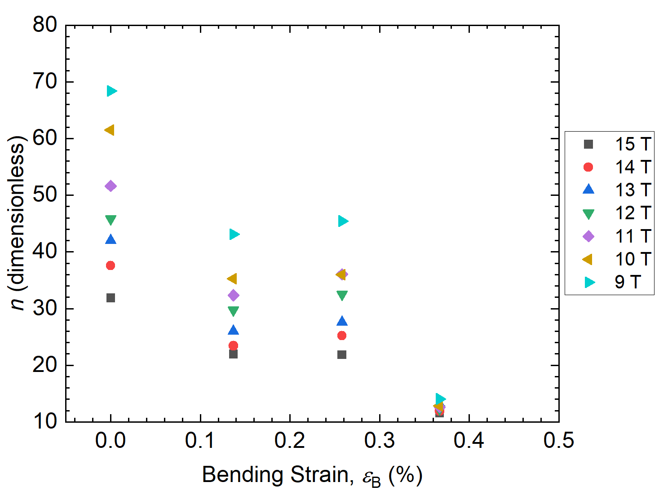

New $I_{C}(ε_{B})$ and $n(ε_{B})$

Slide 10
Next steps
We plan to react and measure more strands at the same bending strains and additional strains
This time, the strands will be reacted on smooth cylinders.
The heat treatment began last week and it will finish in approximately 2 weeks.
ASC starts in ~10 weeks.
Option | Bending strain | Smooth cylinder outer radius required | Quantity
1 | 0% | Use normal ITER barrels | 4
2 | 0.12% | 16 mm | 2
3 | 0.25% | 17 mm | 2
4 | 0.30% | 17.5 mm | 2
5 | 0.36% | 18 mm | 2
6 | 0.41% | 18.5 mm | 2
New strain
Priority is option 4 then option 6

Slide 11
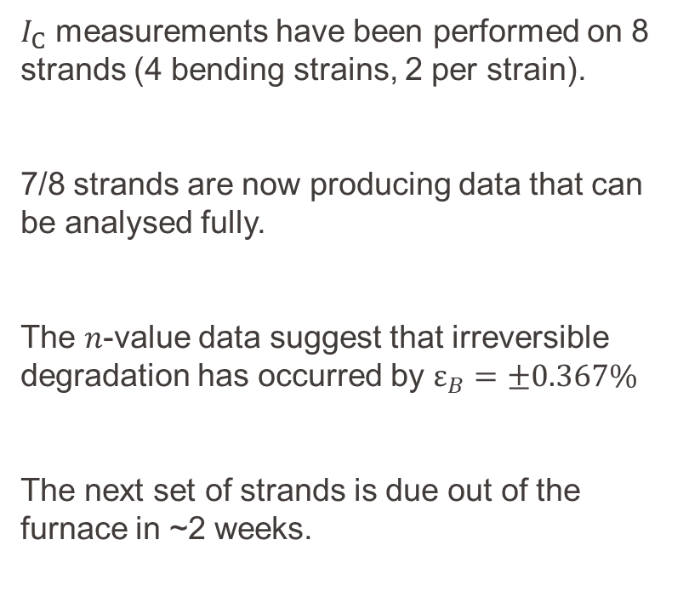
Summary
$I_{C}$ measurements have been performed on 8 strands (4 bending strains, 2 per strain).
7/8 strands are now producing data that can be analysed fully.
The $n$-value data suggest that irreversible degradation has occurred by $ε_{B}=±0.367\%$
The next set of strands is due out of the furnace in ~2 weeks.
Measurement ID | Heat Treatment Radius / Bending Strain | Are the data ok to analyse?
2403 | 16 mm / 0% (no transfer) | ✓
2404 | 16 mm / 0% (no transfer) | ✓
2405 | 17 mm / ±0.137% | X
2406 | 17 mm / ±0.137% | ✓
2407 | 18 mm / ±0.258% | ✓
2408 | 18 mm / ±0.258% | ✓
2409 | 19 mm / ±0.367% | ✓
2410 | 19 mm / ±0.367% | ✓

Slide 12
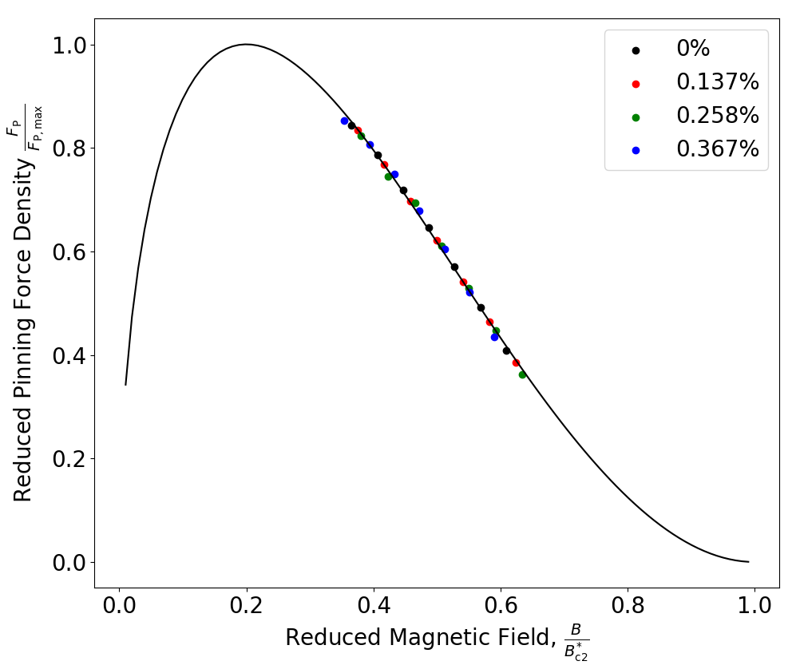
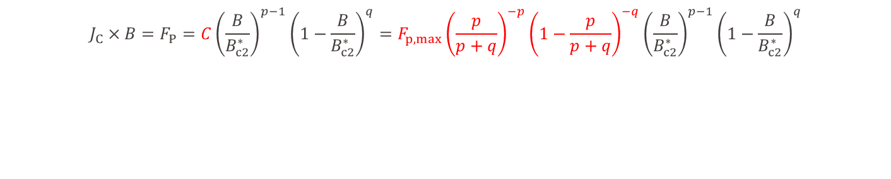


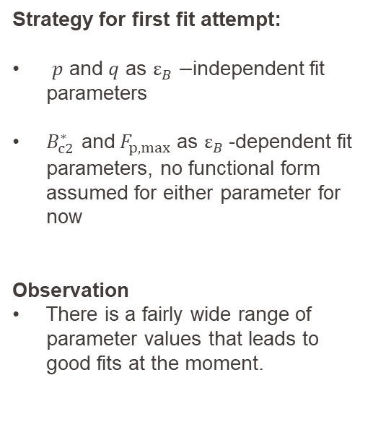
New $I_{C}\left(B\right)−$ fitting
$$J_{C}×B=F_{P}=C{\left(\frac{B}{B_{c2}^{∗}}\right)}^{p−1}{\left(1−\frac{B}{B_{c2}^{∗}}\right)}^{q}=F_{p,max}{\left(\frac{p}{p+q}\right)}^{−p}{\left(1−\frac{p}{p+q}\right)}^{−q}{\left(\frac{B}{B_{c2}^{∗}}\right)}^{p−1}{\left(1−\frac{B}{B_{c2}^{∗}}\right)}^{q}$$
Strategy for first fit attempt:
$p$ and $q$ as $ε_{B}−$independent fit parameters
$B_{c2}^{∗}$ and${ F}_{p,max}$ as $ε_{B}$-dependent fit parameters, no functional form assumed for either parameter for now
Observation
There is a fairly wide range of parameter values that leads to good fits at the moment.
$p=0.5, q=2$, $B_{c2}^{∗}≈24.5$ T

Slide 13
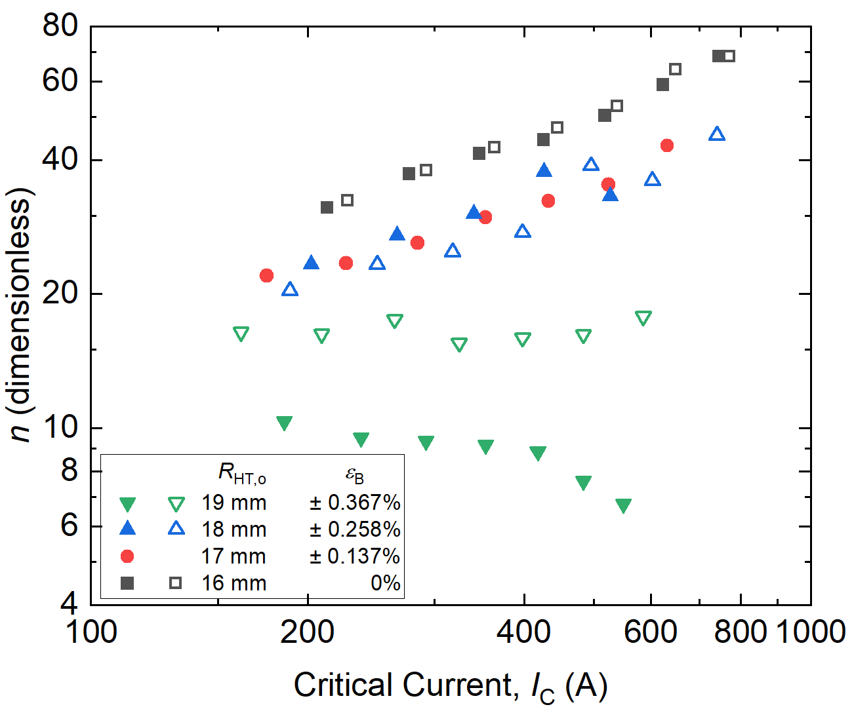

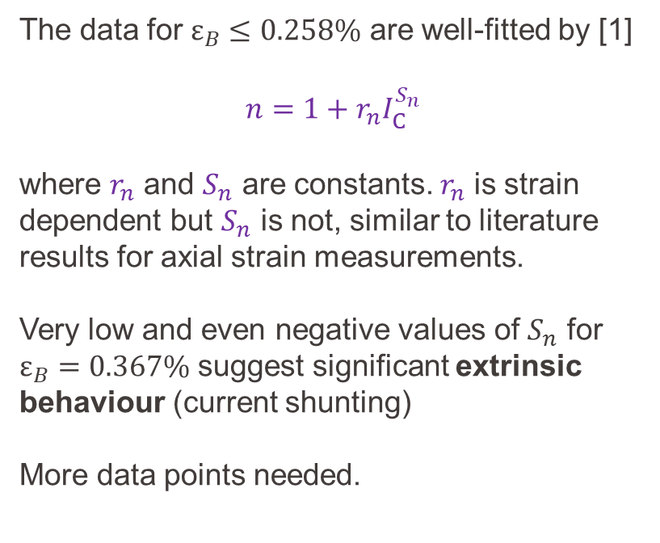
New $n$ vs. $I_{C}$
The data for $ε_{B}≤0.258\%$ are well-fitted by [1]
$n=1+r_{n}I_{C}^{S_{n}}$
where $r_{n}$ and $S_{n}$ are constants. $r_{n}$ is strain dependent but $S_{n}$ is not, similar to literature results for axial strain measurements.
Very low and even negative values of $S_{n}$ for $ε_{B}=0.367\%$ suggest significant extrinsic behaviour (current shunting)
More data points needed.
[1] e.g., https://iopscience.iop.org/article/10.1088/0953-2048/18/12/012,
https://iopscience.iop.org/article/10.1088/0953-2048/25/5/054008

Slide 14
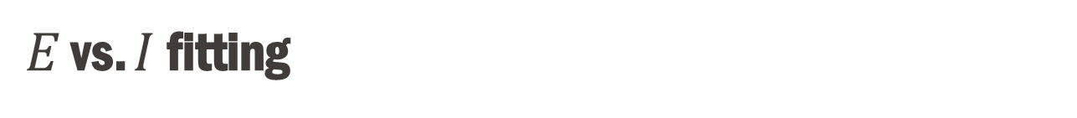
$E$ vs. $I$ fitting
The data were fitted using the power law:
$\frac{E}{E_{C}}={\left(\frac{I}{I_{C}}\right)}^{n}$
$I_{C}$ was extracted at 0.1 μVcm⁻¹.
The fitting was performed twice:
Over roughly $0.1 \text{μ}\text{Vcm}\text{−1}≤E≤1$ μVcm⁻¹
Over roughly $0.05 \text{μ}\text{Vcm}\text{−1}≤E≤0.5$ μVcm⁻¹
The fit around 0.1 μVcm⁻¹ is perhaps very slightly better with method 2, and data could not be collected up to $1$ μVcm⁻¹ in some measurements.
-> only results from method 2 are presented from now on, but the same conclusions for $I_{C}(B,ε_{B})$ and $n(B,ε_{B})$ can be reached using either method.
1
2

Slide 15



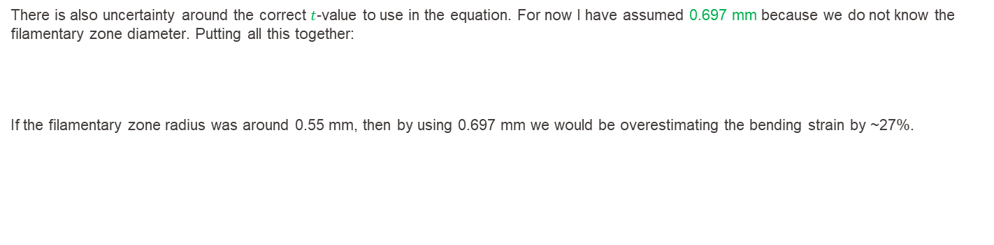
Appendix: Bending Strain Calculation & Uncertainty
$$ε_{B}=±\frac{t}{2}\left(\frac{1}{R_{m,n}}−\frac{1}{R_{HT,n}}\right)$$
$R_{HT,n}$ and $R_{m,n}$ are the neutral axes of the strands on the heat treatment barrels and measurement barrels, respectively. $t$ is the strand or (more accurately) the filamentary zone thickness.
After heat treatment, the strands are transferred to ‘ITER barrels’ with an outer radius of 16.00 mm and a ‘groove radius’ of 15.10 mm, i.e., the groove is ~0.90 mm deep. These values have been measured in the SPC-SG workshop using calipers. The diameter of each strand is 0.697 mm. For now I have assumed
$R_{m,n}=15.10 mm+\frac{0.697}{ 2} mm=15.45$ mm,
but it is not clear whether the strand touches the bottom of the groove.
There is a similar uncertainty for the heat treatment radii. The measured strands were heat treated on the barrels with grooves. For now I only have the outer radii $R_{HT,o}$’s of the heat treatment barrels (16 mm, 17 mm, 18 mm, 19 mm). Assuming a 0.9 mm groove depth and the strand touches the bottom of the groove,
$R_{HT,n}=R_{HT,o}−0.90 mm+\frac{0.697}{ 2} mm.$
There is also uncertainty around the correct $t$-value to use in the equation. For now I have assumed 0.697 mm because we do not know the filamentary zone diameter. Putting all this together:
If the filamentary zone radius was around 0.55 mm, then by using 0.697 mm we would be overestimating the bending strain by ~27%.
$$ε_{B}\left(R_{HT,o}\right)=±\frac{0.697 mm}{2}\left(\frac{1}{15.45 \text{mm}}−\frac{1}{R_{HT,o}−0.90 mm+\frac{0.697}{ 2} mm}\right)$$

