Slide 1

EDIPO2 Subsize Coil and Straight Sample - Updates
J. Greenwood
25.06.2024

Slide 2
Overview
EDIPO2 subsize coil update
  Implications for sample dimensions with a cable bending radius of 50 mm
  Coil current limits with a cable bending radius of 50 mm
  Coil displacement estimations
  Next steps
First look at EDIPO2 straight sample for SULTAN- 3D CAD

Slide 3
Bending radius of 50 mm
Bending trials on the most recent WST and GREMCO cable samples have led to the minimum bend radius for the cable being specified as 50 mm.
This has implications for the thickness of the coil, its support structure, and the ampere-turns that can be achieved in a SULTAN test.
Minimum Bend Radius | Number of Full Turns, per Layer | Support Plate Thickness, per Plate
50 mm | 2 | ~9.4 mm
 | 3 | ~5.5 mm

Slide 4
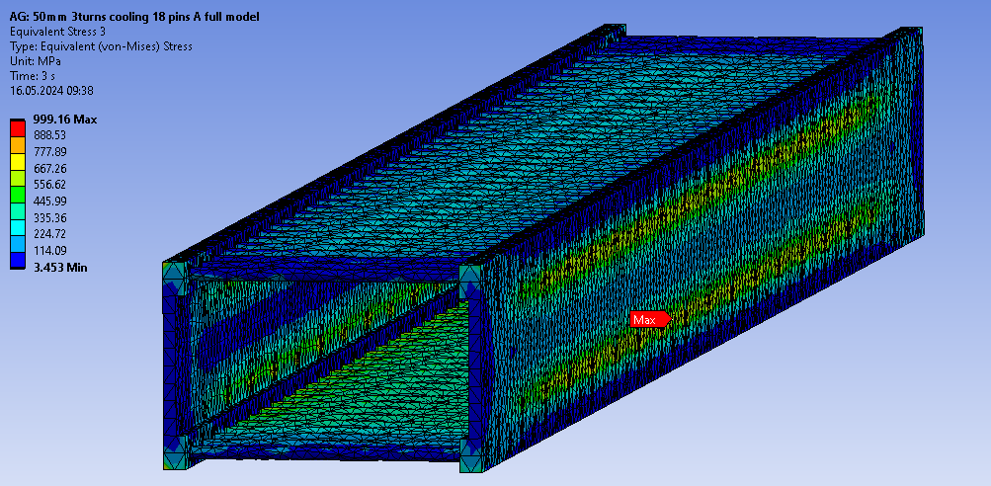
Implications for stresses
Example below: 8 kA, 3 full turns per layer
Peak coil stress here is ~110 MPa
Eq. Stress (MPa)
M6 screw preload = 2 kN per screw
The design is limited by the plates

Slide 5
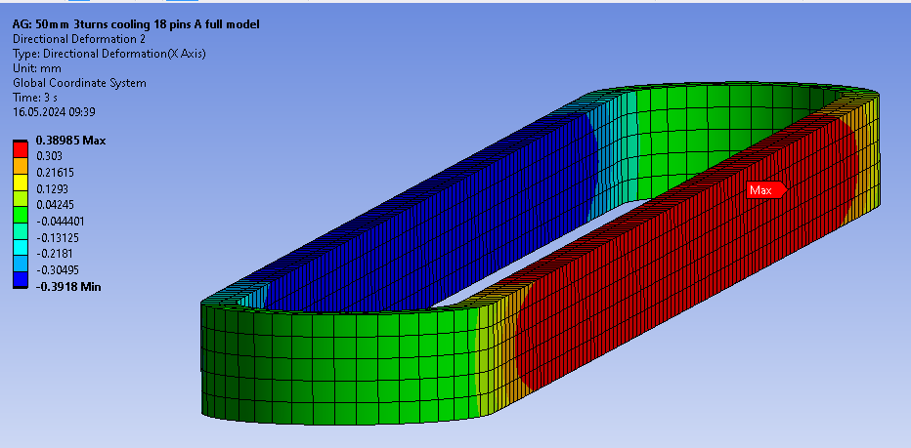
Coil movement, 3 Turns
Coil movement values during EM loading are similar to that suggested by ASG for their design in the recent Zoom meeting (~0.3 mm)

Slide 6
Next steps
Check effects of thermal contraction during cooldown, check cooling performance
Decision on contract structure for the supplier
If no further major design changes are anticipated, produce drawings for technical specification(?)

Slide 7
EDIPO2 Straight Sample for SULTAN - Update

Slide 8
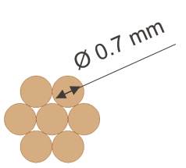
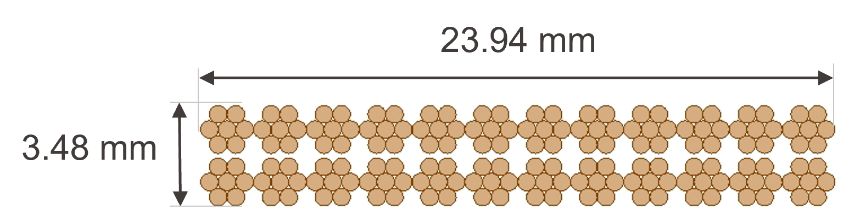
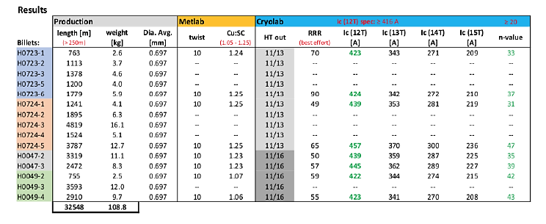
EDIPO2 straight sample - recap
We have acquired ~32.5 km of Bruker RRP strand for EDIPO2 cable prototyping.
A straight sample test is needed to confirm that the average strand performance is retained in the cable.

Slide 9
R&W u-bend vs. two straight sections?
For R&W, the HT is performed at an intermediate bending radius, between straight and the smallest radius in the winding (80 mm).
To adapt a R&W U-bend sample to SPC’s furnace and the SULTAN test well, i.e., Ф = 190 mm heat treatment and u-bend 60 mm radius, the strain would be:
Straight section: 1.8%
Bent section: 1%
Experiment loses relevance -> react 2 straight sections (+ 2 spares) and include a bottom joint in the sample.

Slide 10
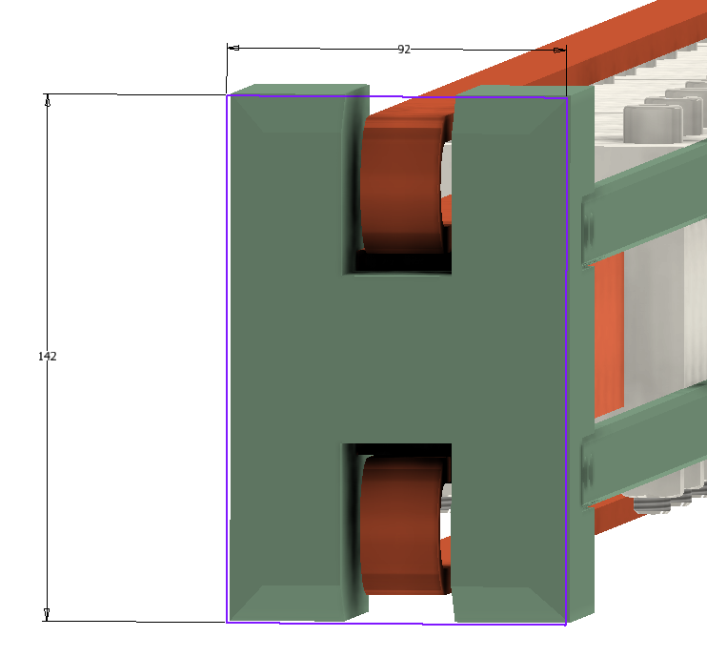
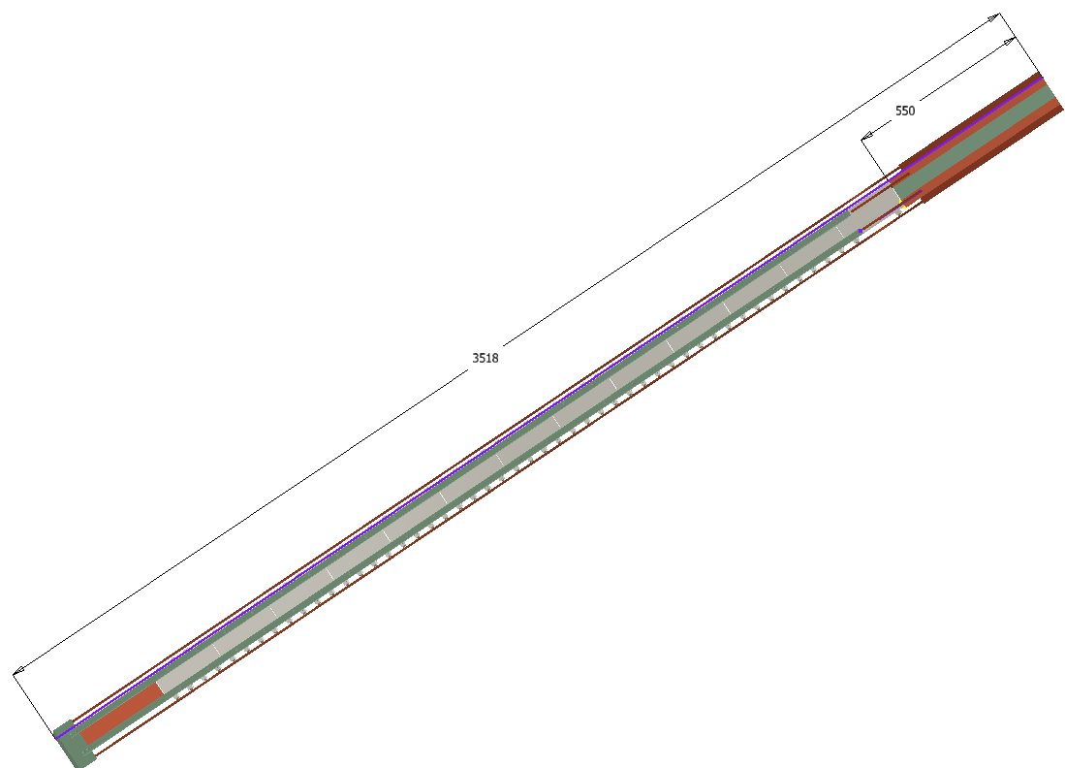
Straight sample design overview
Designed according to SULTAN User Spec
Cross section 92 mm x 142 mm to allow 1 mm insertion gap
The sample is currently 3518 mm long, from top of Cu terminal to bottom of G10 spacer attached to the bottom joint.
3518 mm
.stp CAD file is in 7007/Greenwood.

Slide 11
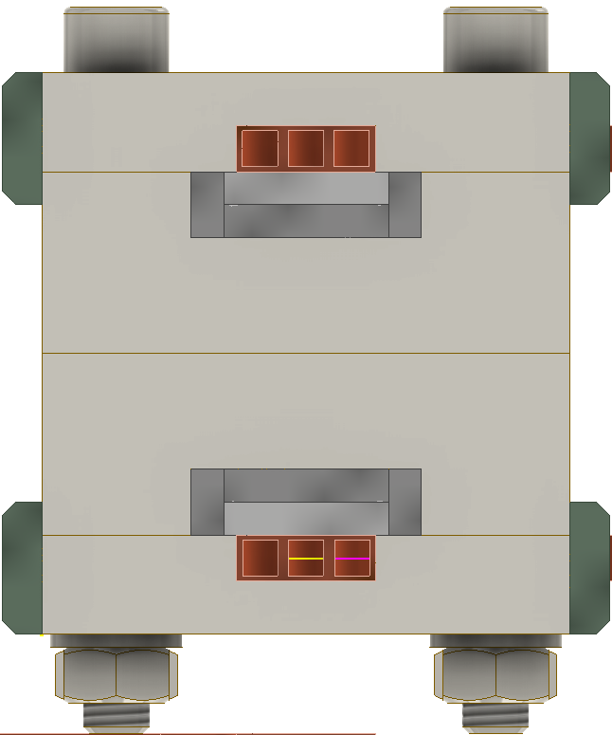
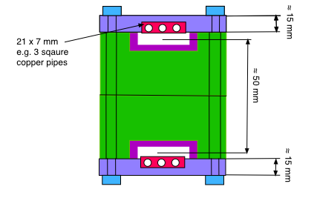
High field zone cross section
Teflon channel, single u-shaped piece or 3 pieces
Reproduced from PB’s memo, dimensions are the same
G10 sample support
Series of 200 mm long Ti support plates and M10 nuts & bolts

Slide 12
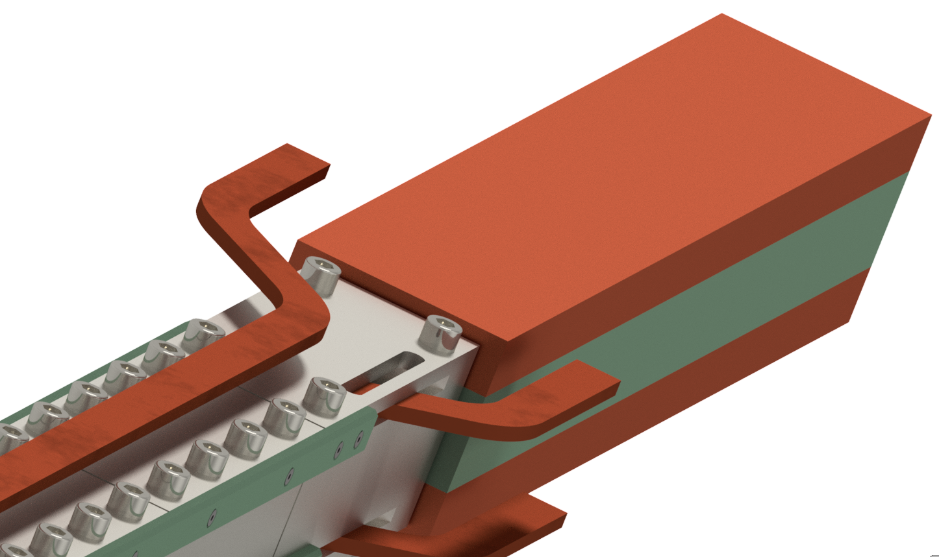
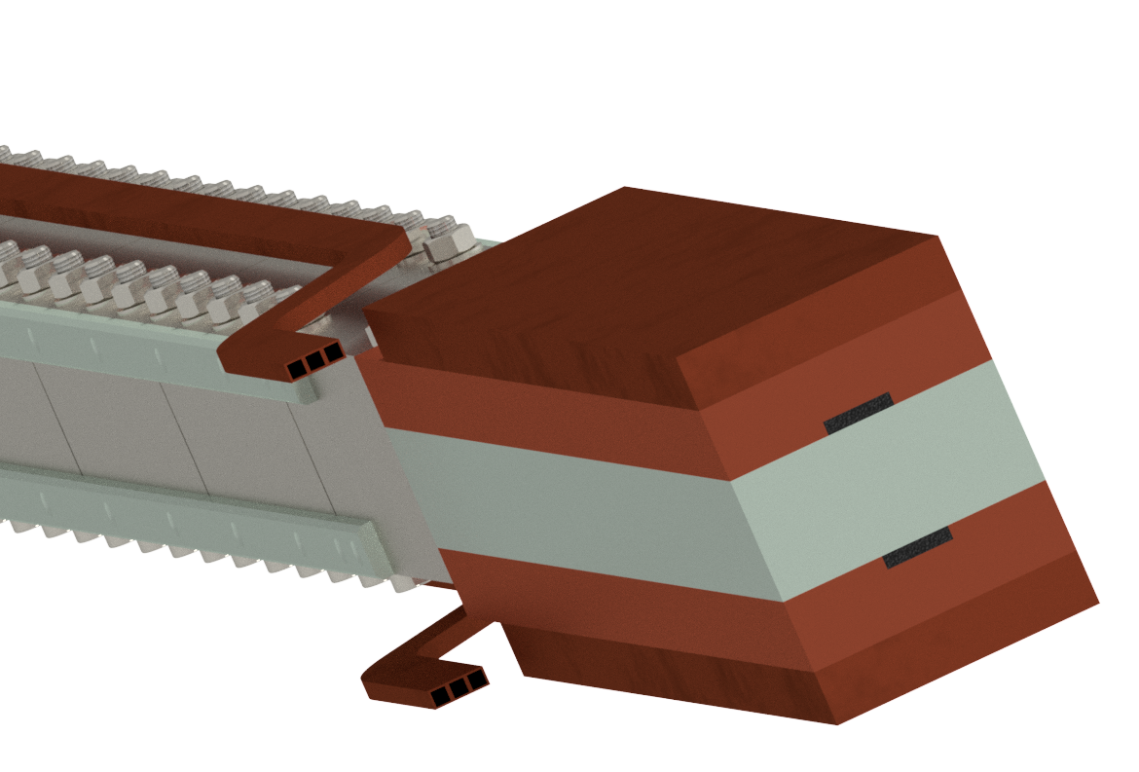
Upper terminal region
He out
He in
Cu pipes enter the sample just beyond the terminals, in the first 200 mm Ti section
100 mm
26.25 mm

Slide 13
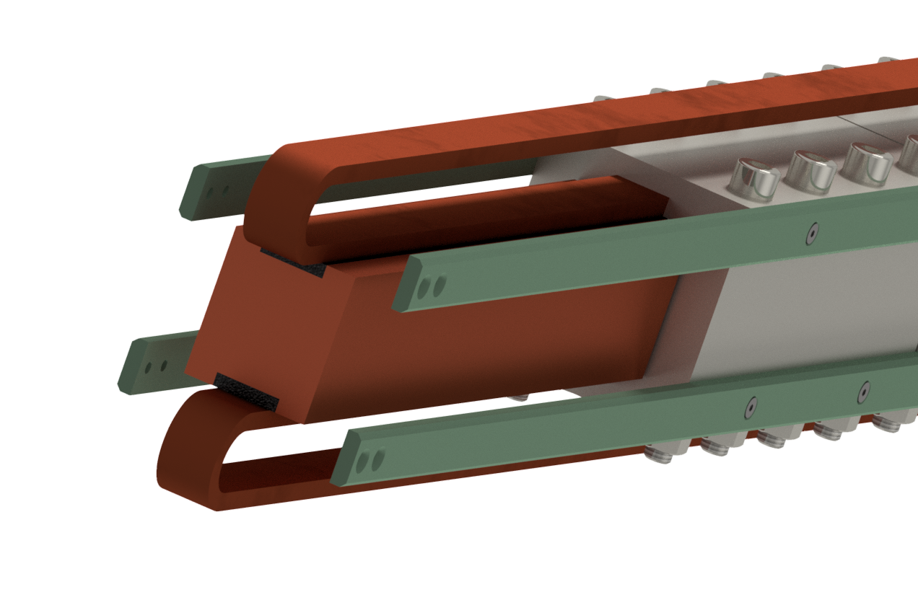
Bottom joint region
(with the G10 spacer at the bottom removed)
55 mm
45 mm
300 mm
25 mm
48 mm

Slide 14
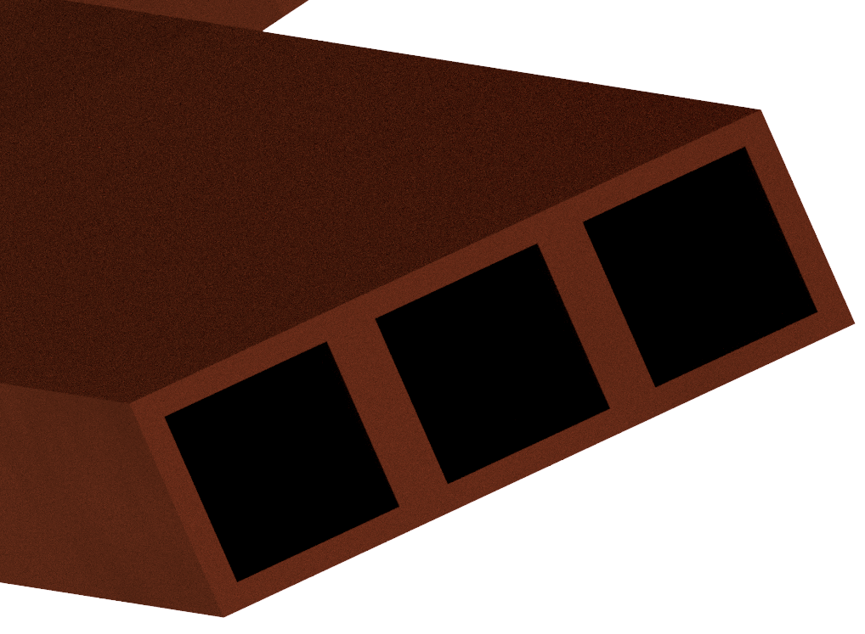
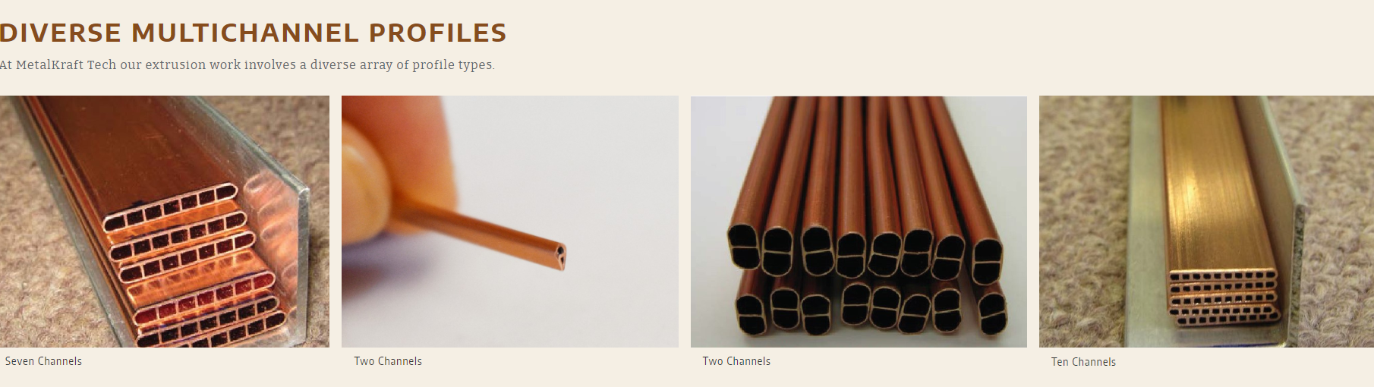
Cu cooling pipes
Very simple design in the CAD model for now, 3x 7 mm square Cu pipes, treated as single object
Possible alternative: Metalkraft Technologies, USA
https://metalkrafttechnologies.com/

Slide 15
Next steps
Manufacturing & assembly tooling/jigs
Performance predictions
Instrumentation
SPC workshop input

