Slide 1
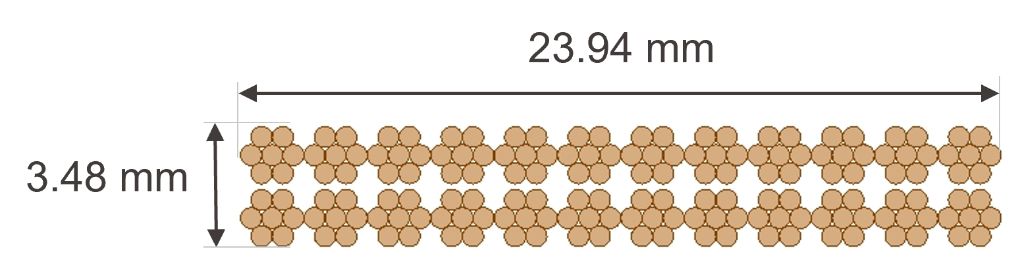
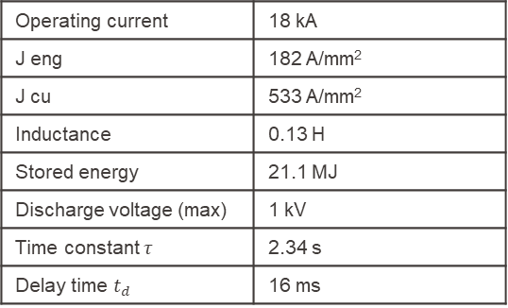
Quench analysis: 0D estimate
13 / 02 / 23
Conductor cross-section | 94.4 mm²
Cable | 64.7 mm² (68.5%)
Copper | 32.3 mm² (34.2%)
Noncopper | 32.3 mm² (34.2%)
Impregnation | 18.7 mm² (11.8%)
Insulation | 11.1 mm² (19.8%)
Conductor layout:
Strand diameter | 0.7 mm
Copper-noncopper ratio | 1
RRR | 150
Number of strands | 24*7 = 168
Total width | 24.34 mm
Total height | 3.88 mm
Insulation thickness | 0.2 mm
Operating current | 18 kA
J eng | 182 A/mm²
J cu | 533 A/mm²
Inductance | 0.13 H
Stored energy | 21.1 MJ
Discharge voltage (max) | 1 kV
Time constant $τ$ | 2.34 s
Delay time $t_{d}$ | 16 ms

Slide 2
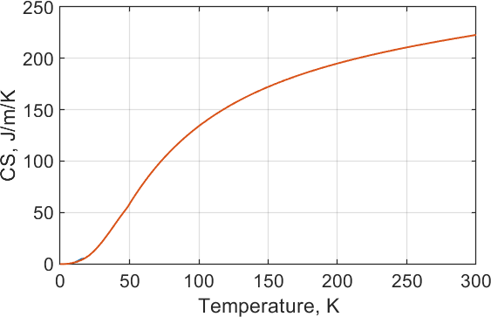
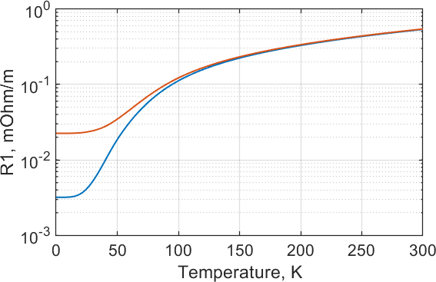
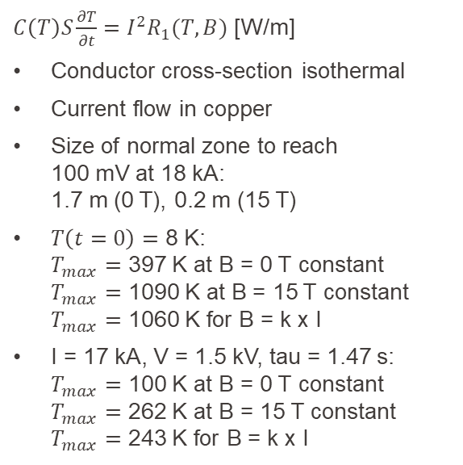
Quench analysis: 0D estimate
Adiabatic analysis:
$C\left(T\right)S\frac{∂T}{∂t}=I^{2}R_{1}(T,B)$ [W/m]
Conductor cross-section isothermal
Current flow in copper
Size of normal zone to reach
100 mV at 18 kA:
1.7 m (0 T), 0.2 m (15 T)
$T\left(t=0\right)=$ 8 K:
$T_{max}=$ 397 K at B = 0 T constant
$T_{max}=$ 1090 K at B = 15 T constant
$T_{max}=$ 1060 K for B = k x I
I = 17 kA, V = 1.5 kV, tau = 1.47 s:
$T_{max}=$ 100 K at B = 0 T constant
$T_{max}=$ 262 K at B = 15 T constant
$T_{max}=$ 243 K for B = k x I
Cable + insulation + impregnation
B = 15 T
B = 0 T

Slide 3
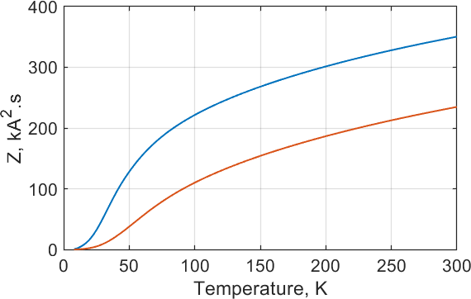
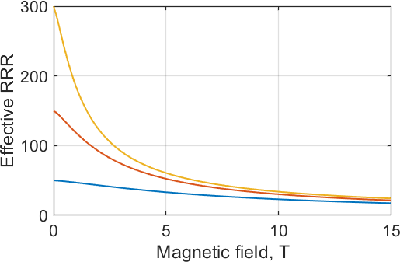
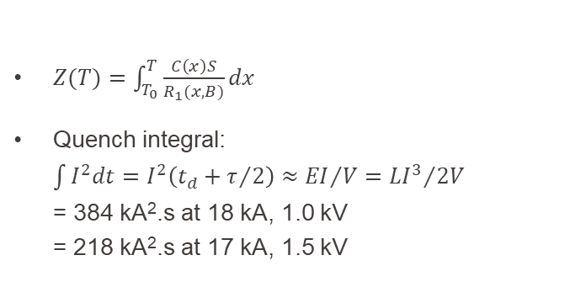

Quench analysis: 0D estimate
Constant B:
B = 0 T
B = 15 T
$Z(T)=\int_{T_{0}}^{T}{\frac{C\left(x\right)S}{R_{1}(x,B)}}dx$
Quench integral:
$\int{I^{2}dt}=I^{2}\left(t_{d}+τ/2\right)≈{EI}/V={LI^{3}}/{2V}$
= 384 kA².s at 18 kA, 1.0 kV
= 218 kA².s at 17 kA, 1.5 kV
$$RRR⋅ρ\left(B\right)=RRR\left(B=0\right)⋅ρ(B=0)$$
Cross-check the actual effect of magnetoresistance?
3-D model to be prepared to quantify impact of thermal conductivity in transverse and longitudinal directions, though strong impact on Tmax is not expected
RRR ~ 20

Slide 4
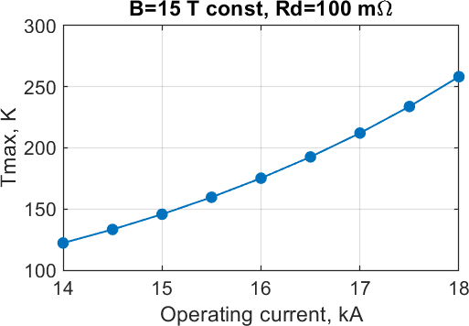
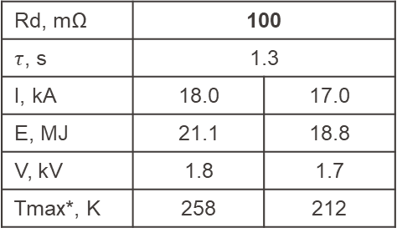
Quench analysis: 0D estimate
15 / 04 / 23
Rd, mΩ | 100 | 94
$τ$, s | 1.3 | 1.4
I, kA | 18.0 | 17.0
E, MJ | 21.1 | 18.8
V, kV | 1.8 | 1.7
Tmax*, K | 258 | 212
* @ B = 15 T constant

Slide 5
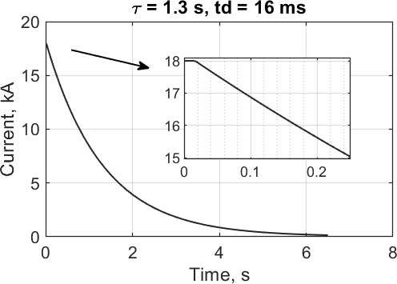
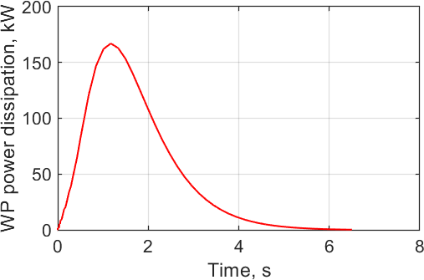
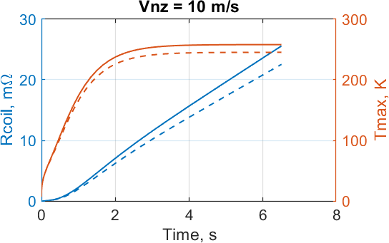
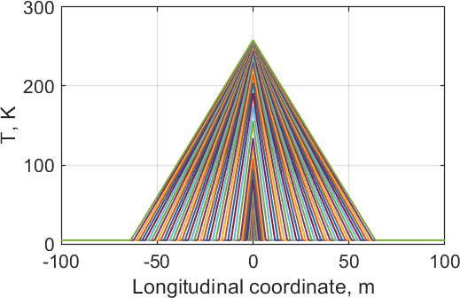
Quench analysis: 0D estimate
Q ~ 330 kJ
(~1.6% stored energy)
10 m/s
B=15 T: solid lines
B=k x I: dashed lines

Slide 6
Quench analysis: 0D estimate
Neglected terms so far:
Thermal conductivity in longitudinal and transverse direction → lower Tmax
AC loss heating due to Bdot, thus faster current decay → lower Tmax
Higher resistance due to Rcoil, thus faster current decay → lower Tmax
Impact of iron on coil inductance during quench? ~20% higher L at low B?

Slide 7

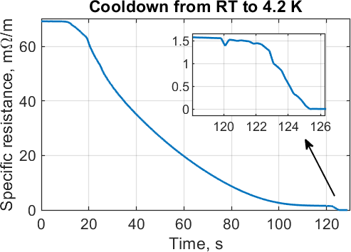
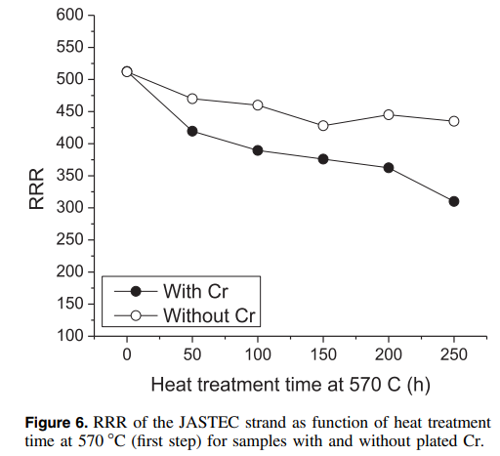
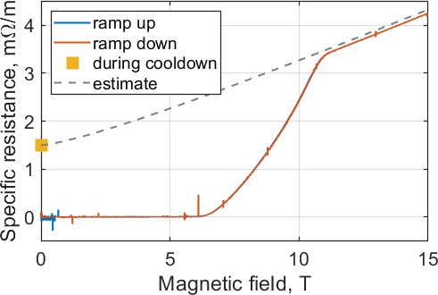
Quench analysis: Copper RRR
OD 0.7 mm, cnc ~1.2, Scu 0.21 mm², RRR
Resistance estimate for RRR = 50:
~80 mΩ/m at 293 K → ~1.5 mΩ/m at 4 – 20 K → ~4.3 mΩ/m at 4 K, 15 T
Measurements on non-reacted 0.5 m-long sample
Impact of heat-treatment…
https://iopscience.iop.org/article/10.1088/1361-6668/aa67ab

Slide 8
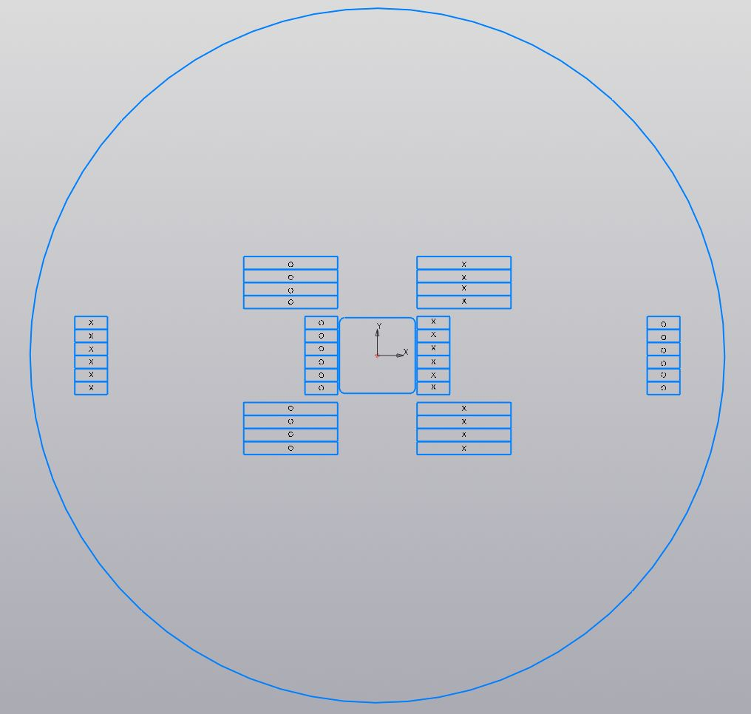
Quench analysis: towards 3D model
Coil splicing layout?
Cooling interface?

Slide 9
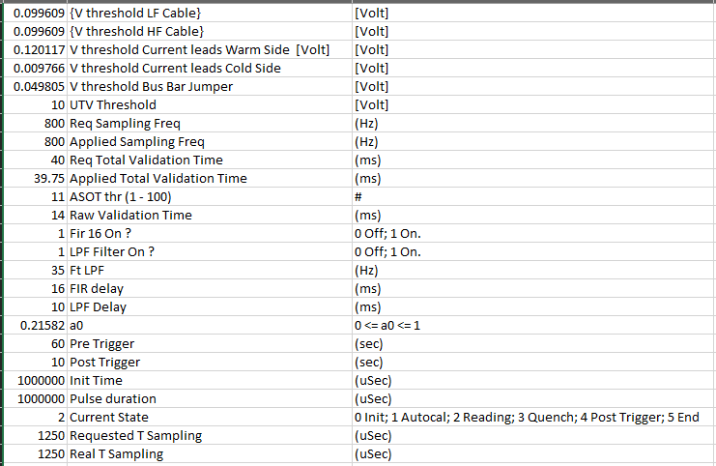
EDIPO1 QD parameters
25 / 06 /24
+ few ms to open circuit breakers

Slide 10
Setting up 3-D quench model:
Geometry import
Matrix of mutual inductances
Magnetic field incl. iron (by Xabier)
Current sharing, Tcs distribution
Heat equation

Slide 11
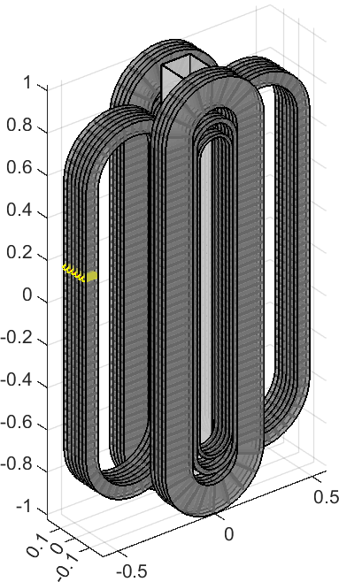
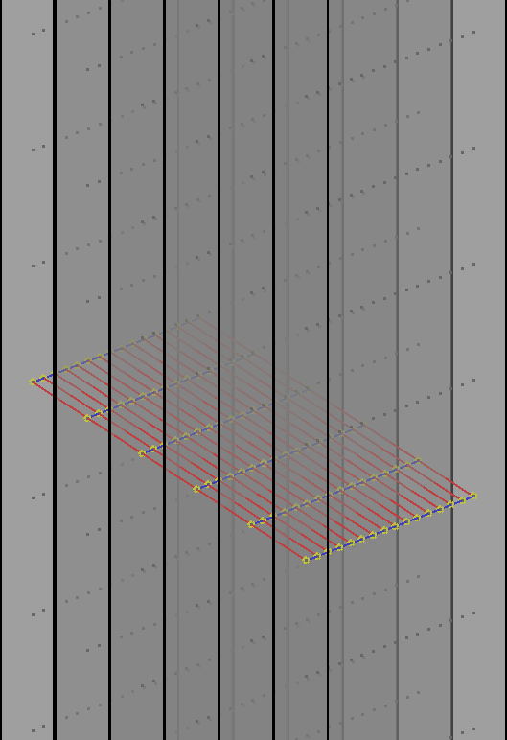
Geometry:
20 pancakes (4 per vertical, 6 per side coils)
560 turns (46 per vert. pancake, 16 per side pancake)
100 nodes per turn
→ 56’000 nodes to evaluate heat equation

Slide 12
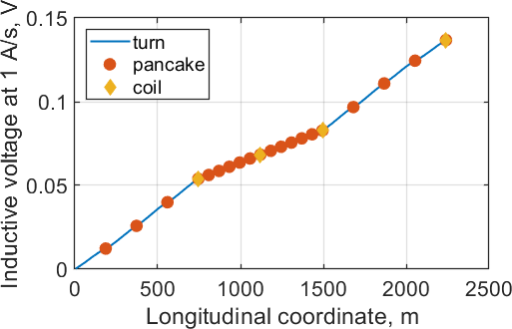
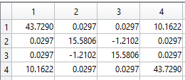
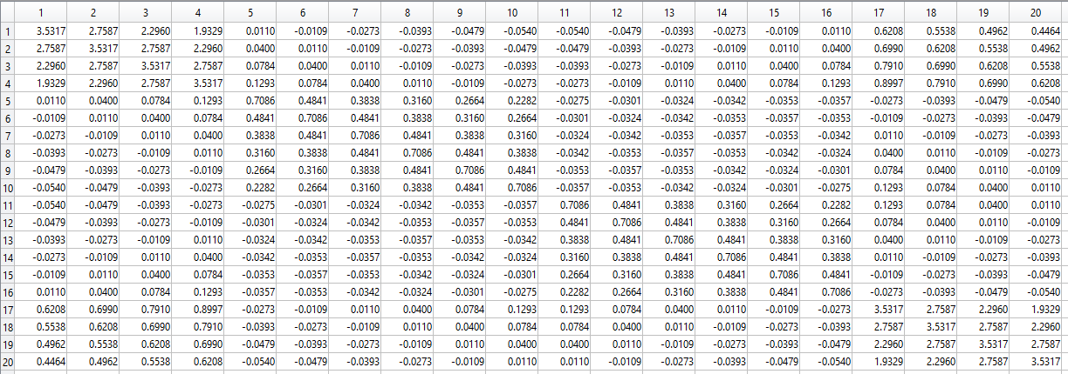
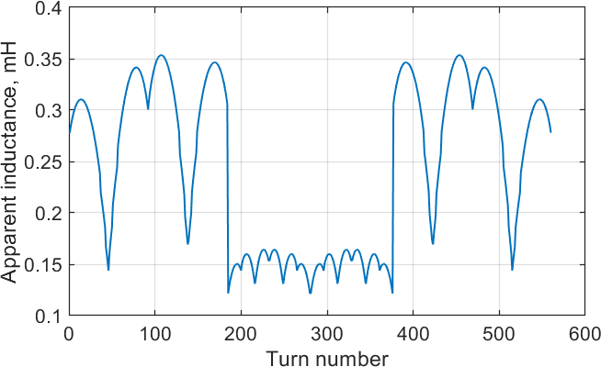
Inductance:
Magnet: 137 mH
Coil: 4 x 4 matrix
Pancake: 20 x 20 matrix
Turn: 560 x 560 matrix
(Average value = 0.44 µH, max value = 9.93 µH, min value = -0.21 µH)

Slide 13
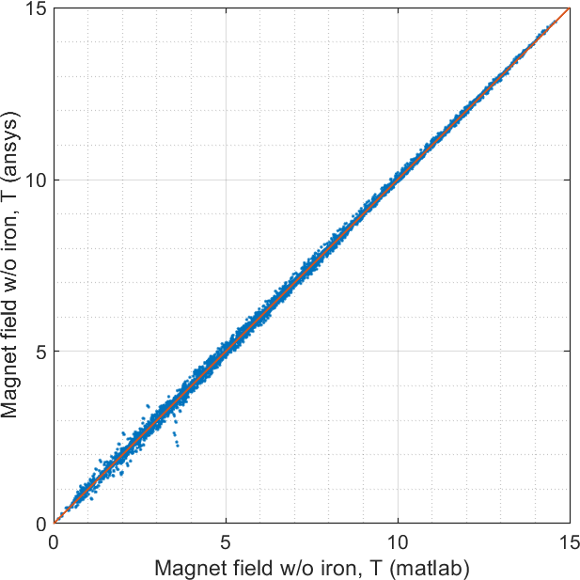
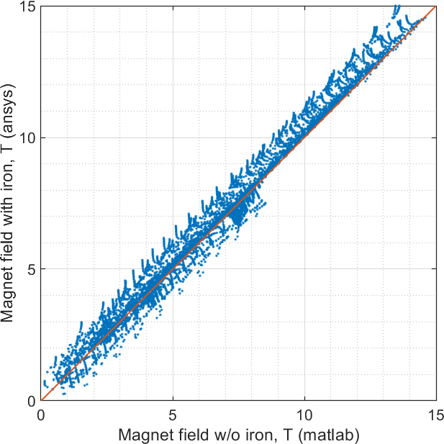
Magnetic field within the coil winding (over 56’000 nodes)

Slide 14
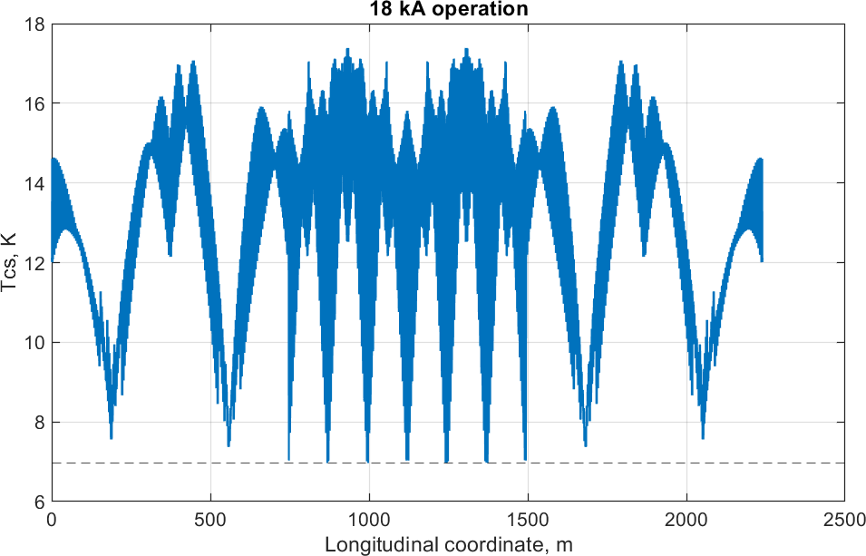
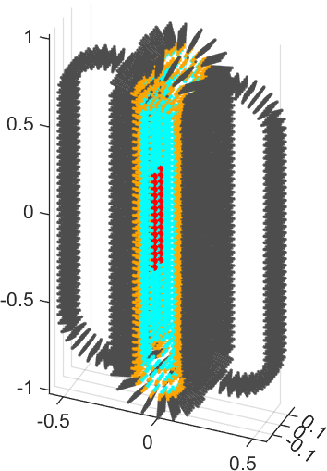
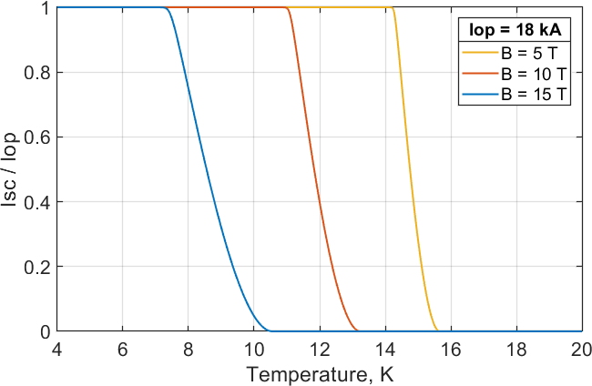
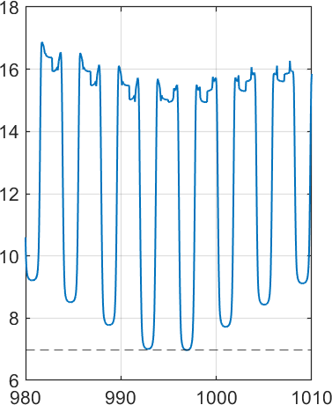
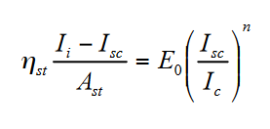

Current sharing at 18 kA operation
Tcs distribution along conductor length
Tcs<11 K
Tcs<9 K
Tcs<7 K
min Tcs = 6.97 K
Intra-strand resistance neglected

Slide 15
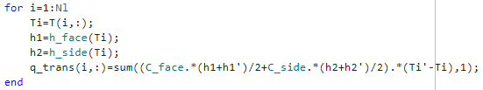
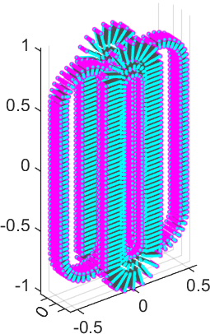


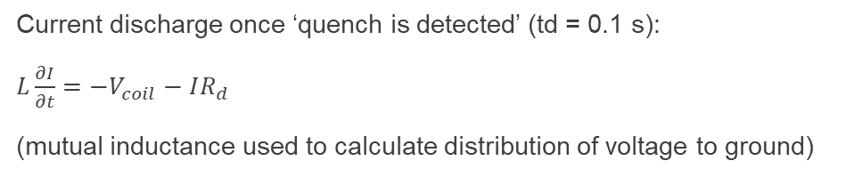
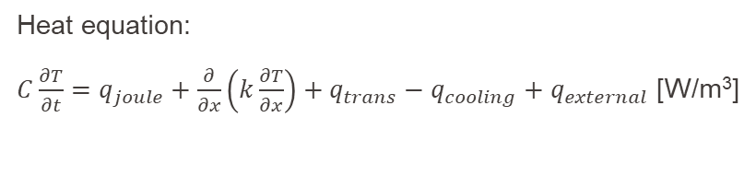
Heat equation:
$C\frac{∂T}{∂t}=q_{joule}+\frac{∂}{∂x}\left(k\frac{∂T}{∂x}\right)+q_{trans}−q_{cooling}+q_{external}$ [W/m³]
Conductor face and conductor side
cooled by helium
(through 0.2 mm G10)
Connectivity matrices for nodes in the same cross-section
Current discharge once ‘quench is detected’ (td = 0.1 s):
$L\frac{∂I}{∂t}=−V_{coil}−IR_{d}$
(mutual inductance used to calculate distribution of voltage to ground)

Slide 16
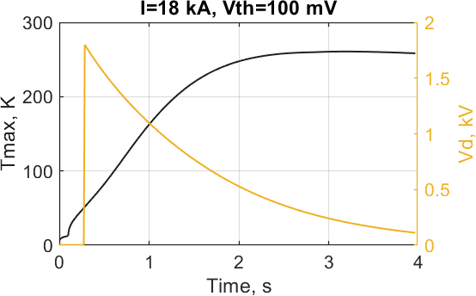
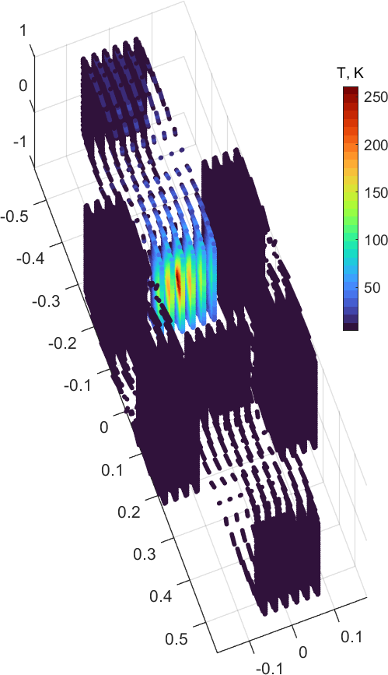
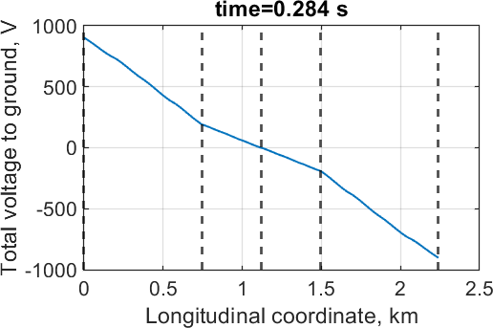
External energy of 1.7 J deposited over 12 cm (3 nodes) within 0.1 s (power ~140 W/m)

Slide 17
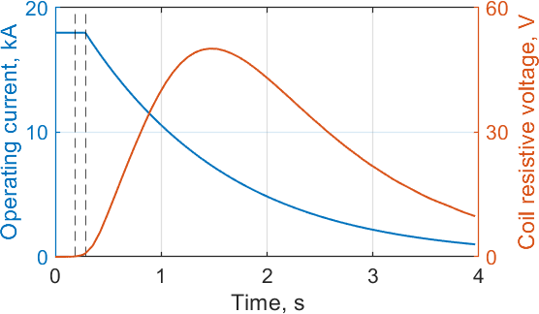
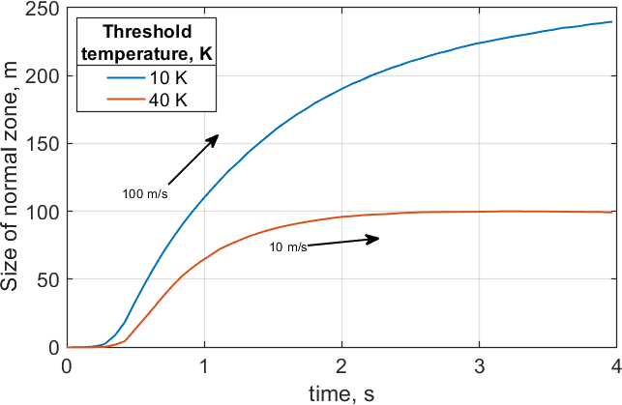
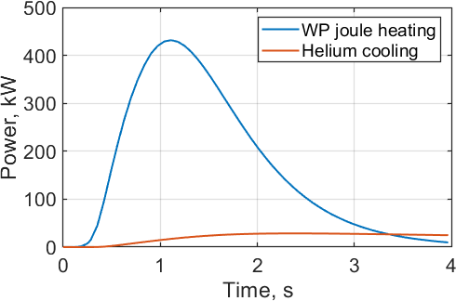
tdetect
tdetect+td
~98% stored energy released in Rdump,
~660 kJ in the coil winding, i.e. losing
~250 liters of helium (latent heat 2.6 kJ/liter)
Heat removal rate by helium up to ~30 kW
NZPV strongly depends on temperature threshold, up to ~100 m/s for the 10 K front

Slide 18
