Slide 1
Update muX meeting 12/07
Marie Deseyn

Slide 2
Update on my G4 simulations

Slide 3
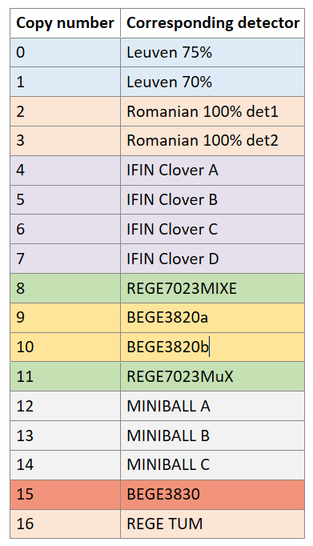
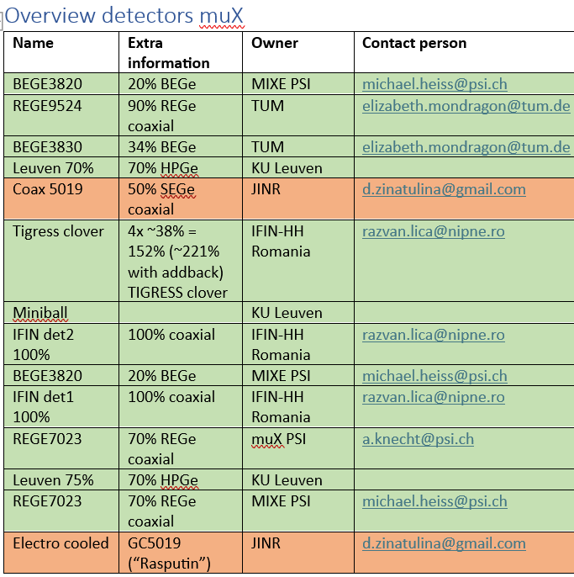
Overview of detectors I have simulated

Slide 4
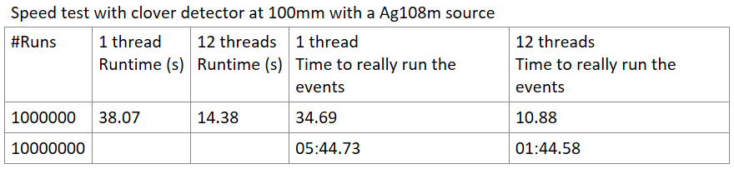
Multithreading

Slide 5
Lu preparation
Energies from muDirac
Intensities from Stella’s cascade code
PROBLEM:
  muDirac does not calculate L3-M2 (3p1/2 to 2p3/2) and I am not sure why or if this is a big problem

Slide 6
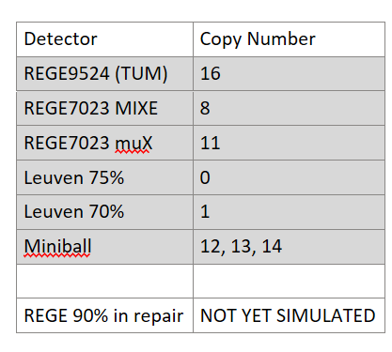
Lu preparation

Slide 7
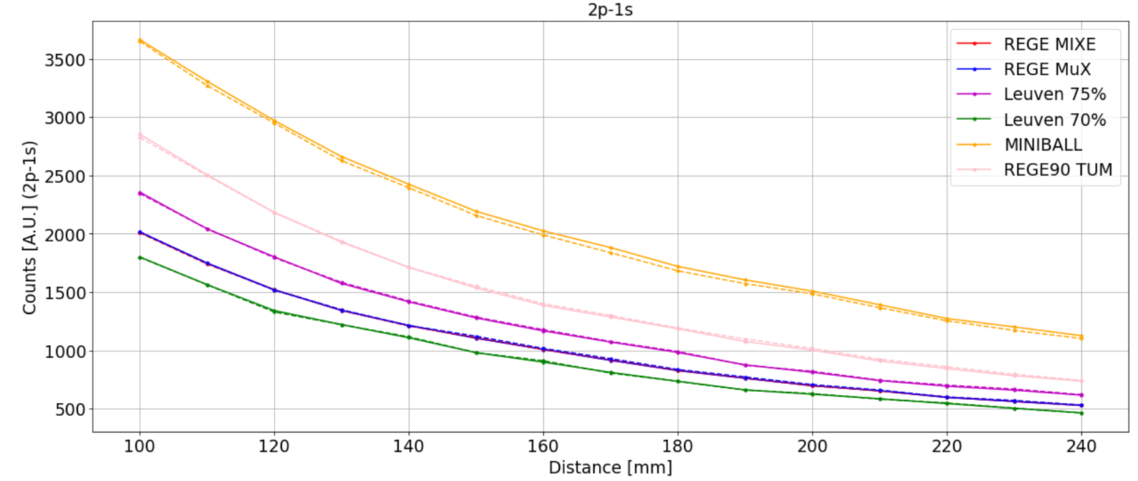
Distance dependence

Slide 8
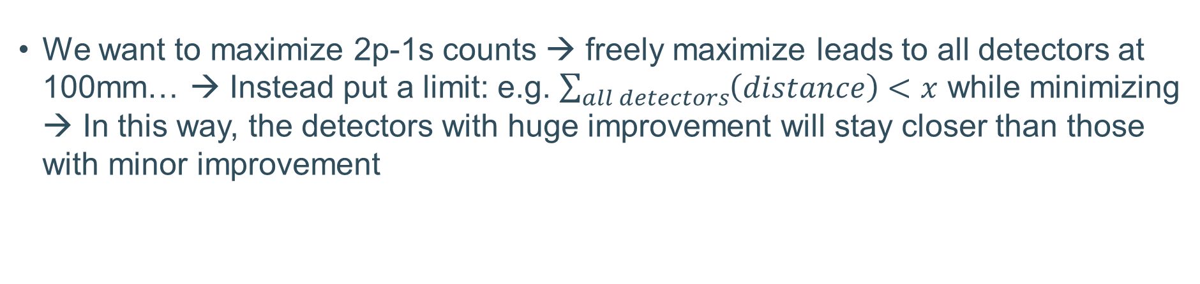
Distance dependence
We want to maximize 2p-1s counts → freely maximize leads to all detectors at 100mm… → Instead put a limit: e.g. $\sum_{all detectors}{\left(distance\right)<x}$ while minimizing → In this way, the detectors with huge improvement will stay closer than those with minor improvement

Slide 9
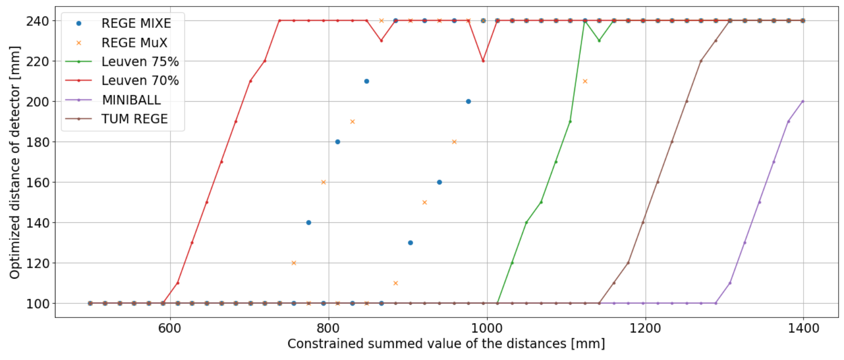
Distance dependence

Slide 10
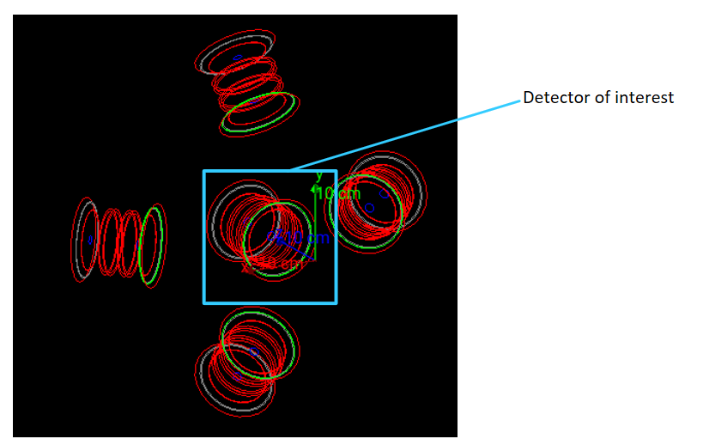
Effect of other nearby detectors

Slide 11
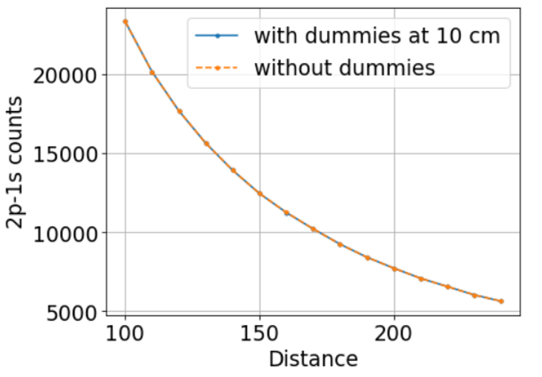
Effect of other nearby detectors

Slide 12
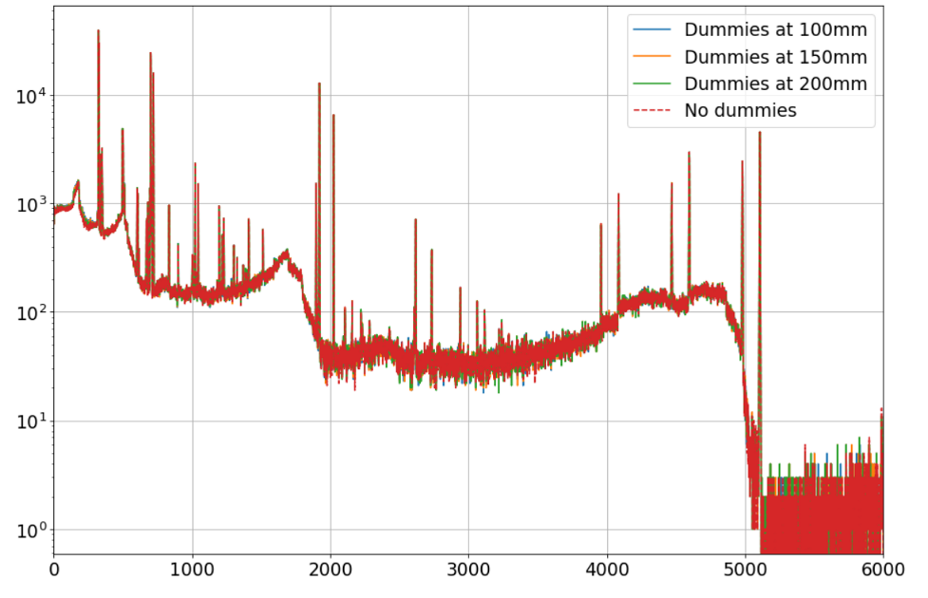
Effect of other nearby detectors

Slide 13
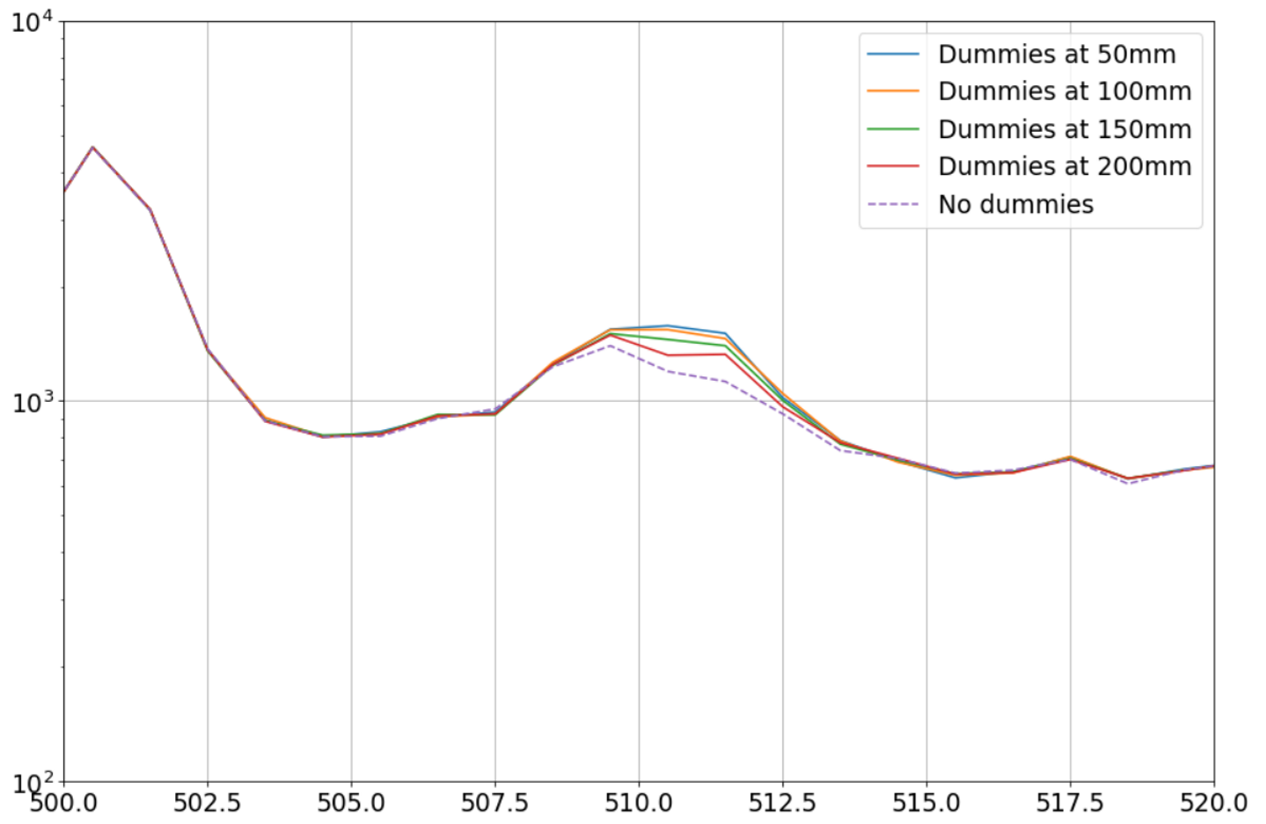
Effect of other nearby detectors
Will we ever do addback between different detectors with the 511keV peak? In that case, the change of this peak should be investigated more

Slide 14
Future of the G4 simulations
I am a bit puzzled on how to further optimize the positioning of the detectors:
  Changing position and rotation of detector in the simulation I have now should not change things beyond our intuition → Becomes more a geometrical problem rather than a simulation problem???
I am considering simulating the Michel electrons to see the effects of the scintillator coverage (electron-gamma coincidences) → would this be useful?
Compton of Pb in our regions of interest (e.g. how much of the background in Ra region is due to Compton of Pb peaks)

